Slide 1
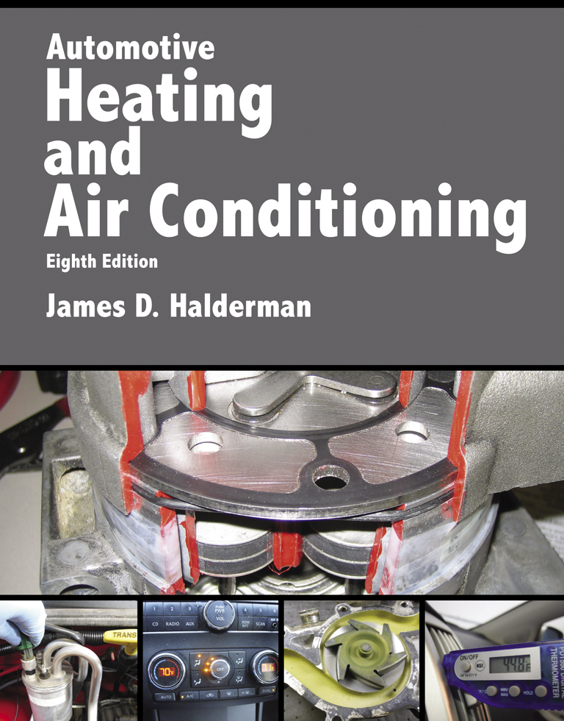
Automotive Heating And Air Conditioning
Eighth Edition
Chapter 10
HVAC Electricity and Electronics

Slide 2
Learning Objectives
10.1 Prepare for the Heating and Air Conditioning (A7) ASE certification test content area “D” (Operating Systems and Related Controls Diagnosis and Repair).
10.2 Explain the characteristics of electricity.
10.3 Differentiate between conductors, insulators, and semiconductors.

Slide 3
Learning Objectives
10.4 Explain the units of electrical measurement.
10.5 List the parts of a complete circuit.
10.6 Discuss the types of electrical circuit faults.
10.7 Explain how to detect and measure electrical voltage, current, and resistance using digital meters.

Slide 4
Learning Objectives
10.8 Discuss wire repair.
10.9 Discuss the purpose of terminals, connectors, relays, and switches.
10.10 Discuss networks and network classifications.

Slide 5
Introduction
Electricity may be difficult for some people to learn for the following reasons:
  It cannot be seen.
  Only the results of electricity can be seen.
  It has to be detected and measured

Slide 6
Electricity (1 of 2)
Electricity is the movement of electrons from one atom to another.
  Nucleus
    Protons, neutrons, and electrons
Automotive electricity uses the conventional theory that electricity flows from positive to negative.
Magnets and electrical charge
Electron orbits

Slide 7
Electricity (2 of 2)
Conductors
  Conductors are materials with fewer than four electrons in their atom’s outer orbit.
Insulators
  Insulators are materials with more than four electrons in their atom’s outer orbit.
Semiconductors
  Materials with exactly four electrons in their outer orbit are called semiconductors.

Slide 8
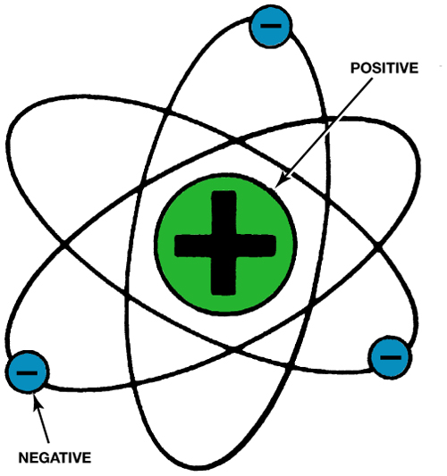
FIGURE 10–2 The nucleus of an atom has a positive (+) charge and the surrounding electrons have a negative (−) charge.

Slide 9
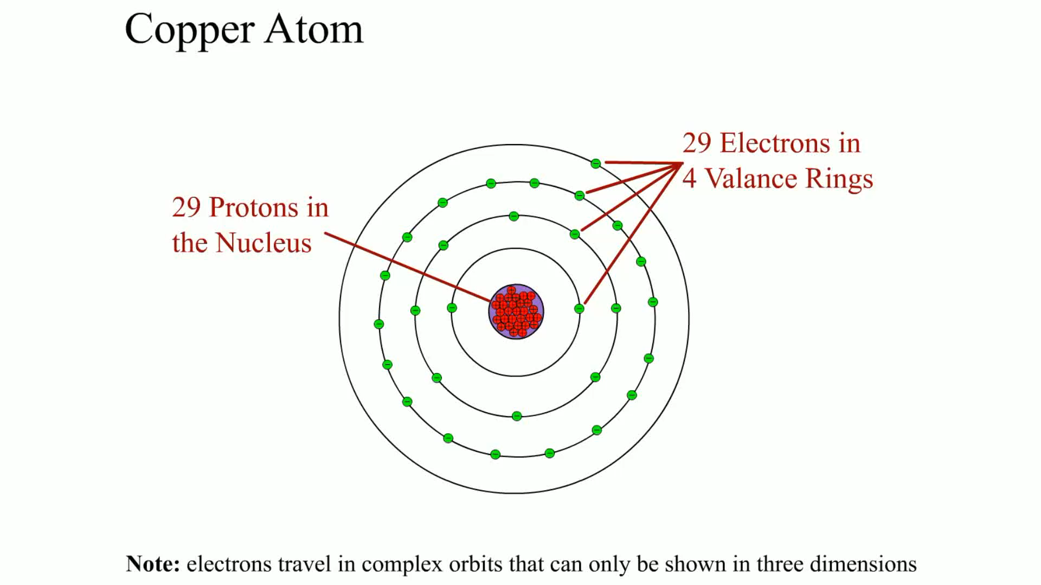
Animation: Copper Atom
(The animation will automatically start in a few seconds)

Slide 10
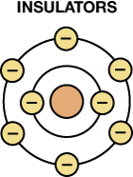
FIGURE 10–7 Insulators are elements with five to eight electrons in the outer orbit.

Slide 11
How Electrons Move Through a Conductor
Current flow
Conventional Theory versus Electron Theory
  What is the difference?

Slide 12
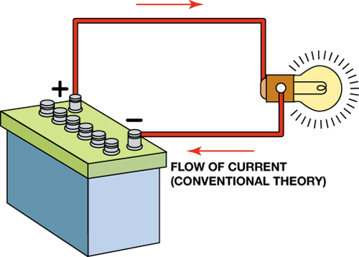
FIGURE 10–10 Conventional theory states that current flows through a circuit from positive (+) to negative (−). Automotive electricity uses the conventional theory in all electrical diagrams and schematics.

Slide 13
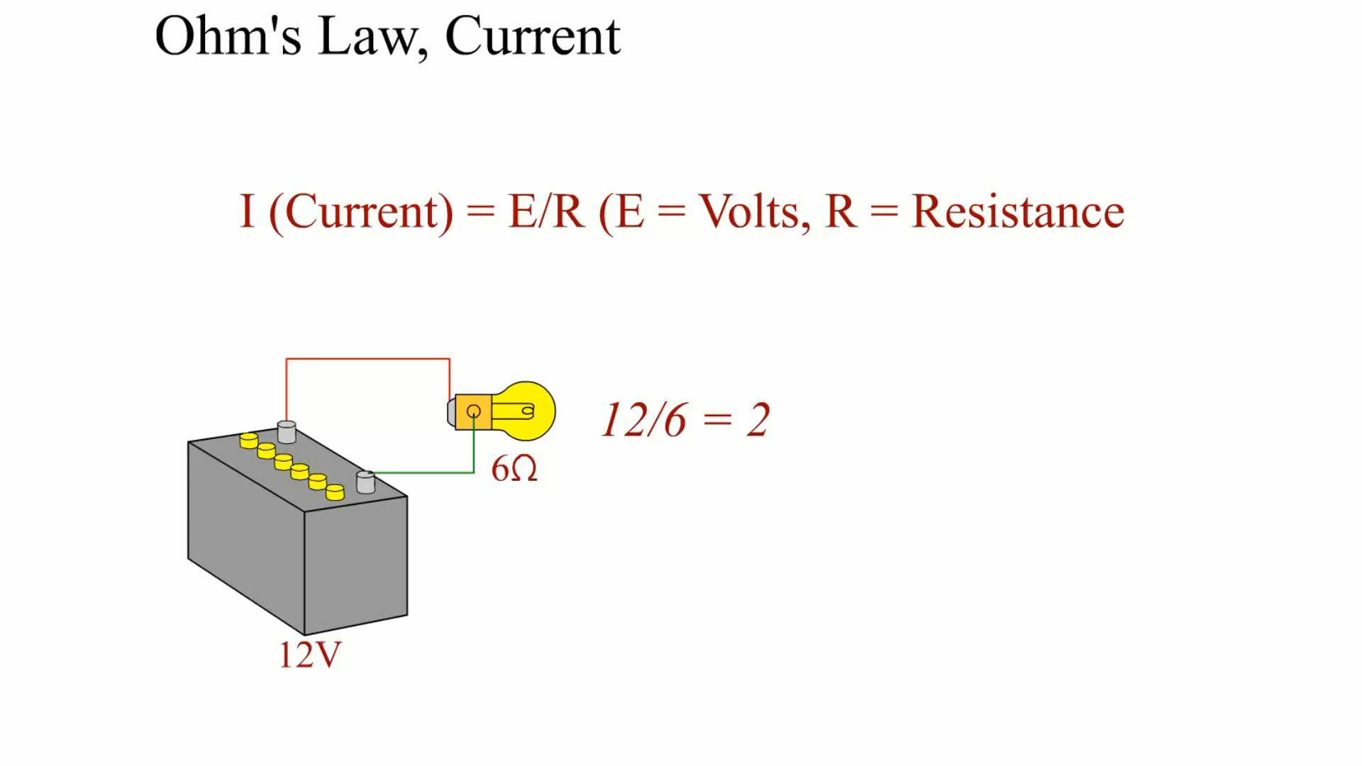
Animation: Ohm’s Law, Current
(The animation will automatically start in a few seconds)

Slide 14
Units of Electricity
The three fundamentals of electricity-related units include the ampere, volt, and ohm
  The ampere is the measure of the amount of current flow.
  Voltage is the unit of electrical pressure.
  The ohm is the unit of electrical resistance.

Slide 15
Electrical Circuits
All complete electrical circuits have:
  A power source, a circuit protection device, a power-side wire or path, an electrical load, a ground return path, and a switch or a control device.
Circuit testers include test lights and fused jumper leads.

Slide 16
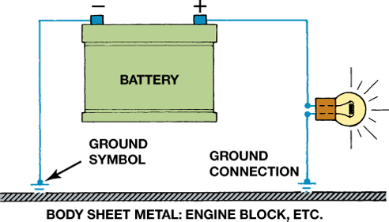
FIGURE 10–16 The return path back to the battery can be any electrical conductor, such as a copper wire or the metal frame or body of the vehicle.

Slide 17
Electrical Schematics (1 of 2)
All circuit schematics or diagrams include:
  Power-side wiring of the circuit
  All splices
  Connectors
  Wire size
  Wire color
  Trace color (if any)
  Circuit number
  Electrical components

Slide 18
Electrical Schematics (2 of 2)
  Ground return paths
  Fuses and switches
Circuit information
Wire size
Open circuits
Short-to-voltage
Short-to-ground
High resistance

Slide 19
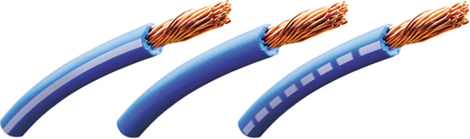
FIGURE 10–18 The center wire is a solid color wire, meaning that the wire has no other identifying tracer or stripe color. The two end wires could be labeled “BLU/WHT,” indicating a blue wire with a white tracer or stripe.

Slide 20
Types of Circuit Faults (1 of 2)
An open circuit is any circuit that is not complete, or that lacks continuity, such as a broken wire.
A short-to-voltage occurs when the power side of one circuit is electrically connected to the power side of another circuit.

Slide 21
Types of Circuit Faults (2 of 2)
A short-to-ground is a type of short circuit that occurs when the current bypasses part of the normal circuit and flows directly to ground.
High resistance is resistance higher than normal circuit resistance.

Slide 22
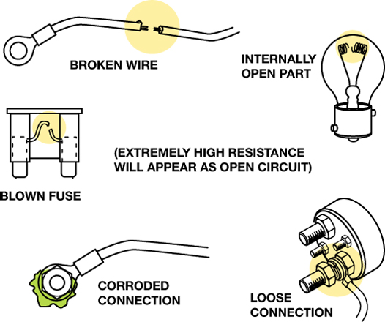
FIGURE 10–21 Examples of common causes of open circuits. Some of these causes are often difficult to find.

Slide 23
Fused Jumper Wire
Purpose and function
  Fuse
  Alligator clip ends
  Good-quality insulated wire

Slide 24
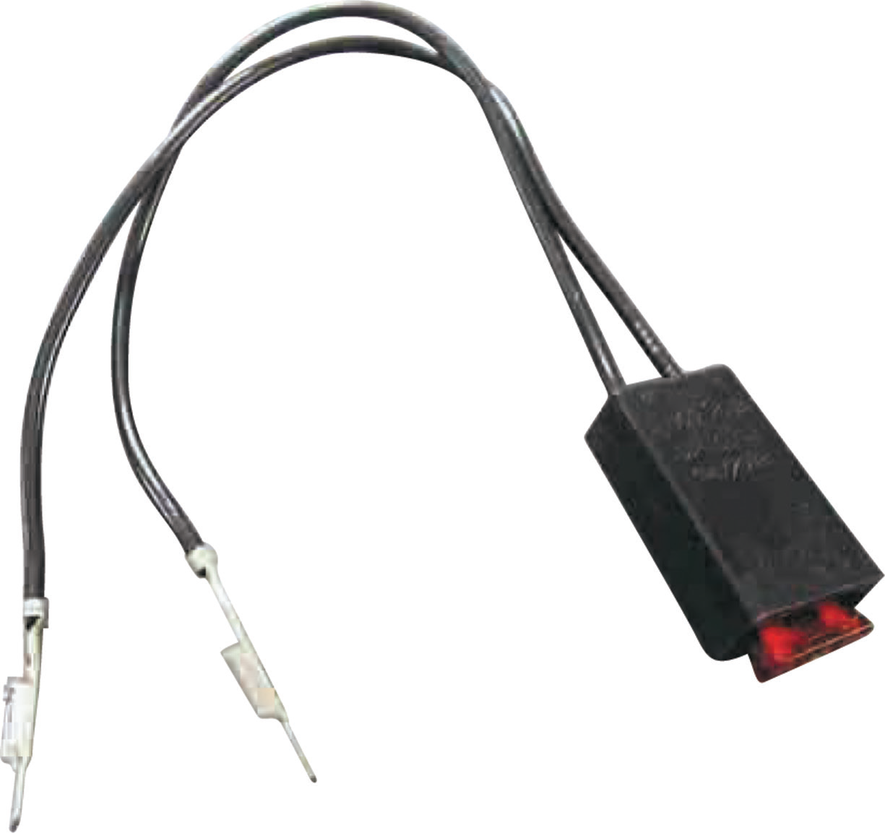
FIGURE 10–25 A technician-made fused jumper lead, which is equipped with a red 10-ampere fuse. This fused jumper wire uses terminals for testing circuits at a connector instead of alligator clips.

Slide 25
Test Light
Non-powered test light
Use of a 12-volt test light
  Electrical power
  Grounds

Slide 26
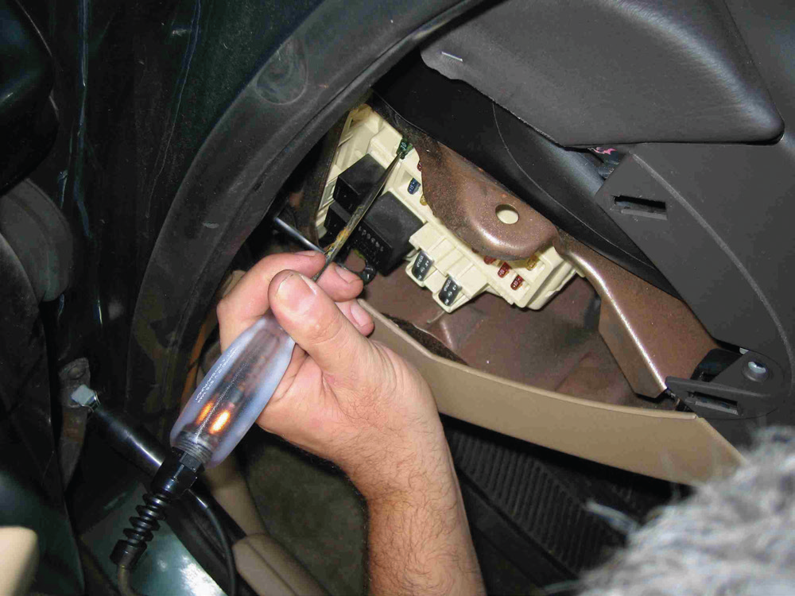
FIGURE 10–26 Testing a fuse with a test light. If the fuse is good, the test light should light on both sides (power side and load side) of the fuse.

Slide 27
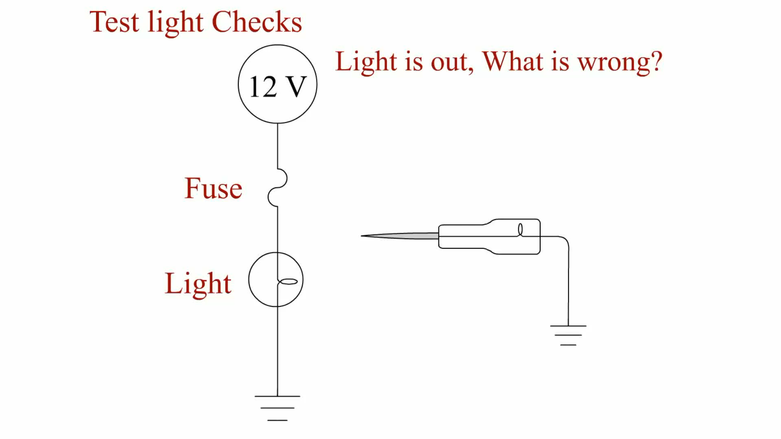
Animation: Test Light Checks
(The animation will automatically start in a few seconds)

Slide 28
Digital Meters
A voltmeter measures the pressure or potential of electricity in units of volts
An ohmmeter measures the resistance in ohms of a component or circuit section when no current is flowing through the circuit
An ammeter measures the flow of current through a complete circuit in units of amperes or milliamperes

Slide 29
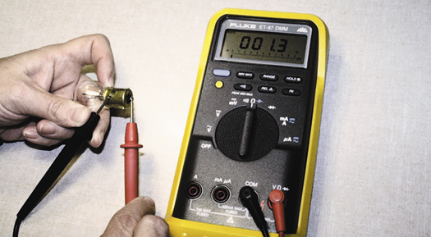
FIGURE 10–31 Using a digital multimeter set to read ohms (Ω) to test this light bulb. The meter reads the resistance of the filament.

Slide 30
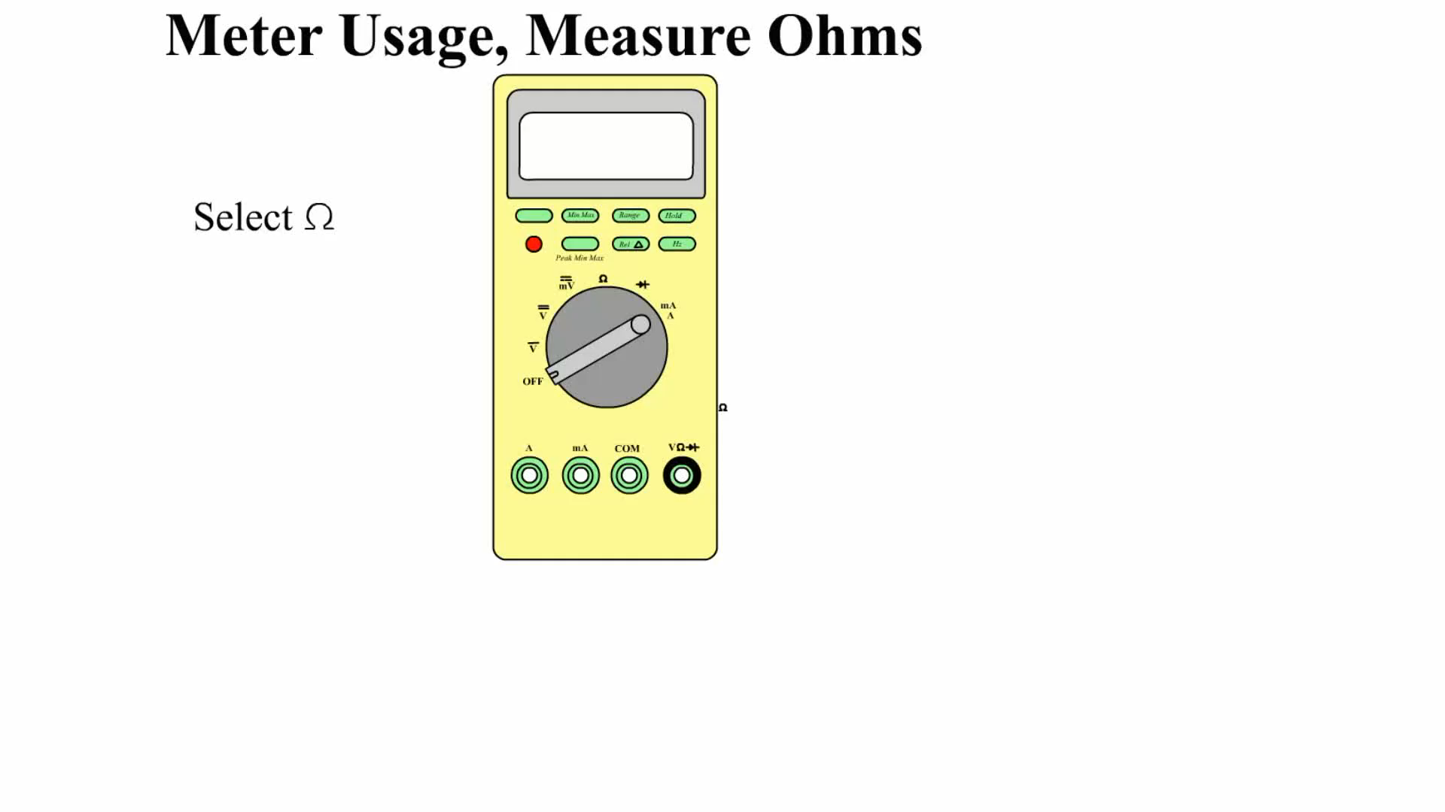
Animation: Meter Usage, Measure Ohms
(The animation will automatically start in a few seconds)

Slide 31
Inductive Ammeters
What is the operation of inductive ammeters?
AC/DC clamp-on digital multimeters
Think of money
  The display for a battery measured as 12 1/2 volts would be 12.50 V, just as $12.50 is 12 dollars and 50 cents.

Slide 32
Terminals and Connectors
A terminal is the metal end of a wire, whereas a connector is the plastic housing for the terminal.
Servicing terminals

Slide 33
Figure 10–37 Some terminals have seals attached to help seal the electrical connections

Slide 34
FIGURE 10–39 The secondary locks help retain the terminals in the connector.

Slide 35
Wire Repair (1 of 2)
Many manufacturers recommend that all wiring repairs be soldered.
  Solder is an alloy of tin and lead used to make a good electrical contact between two wires or connections in an electrical circuit.
Terminals can be crimped to create a good electrical connection if the proper type of crimping tool is used.

Slide 36
Wire Repair (2 of 2)
Heat shrink tubing is usually made from polyvinyl chloride (PVC) or polyolefin and shrinks to about half of its original diameter when heated; this is usually called a 2:1 shrink ratio.
  Heat shrink by itself does not provide protection against corrosion.

Slide 37
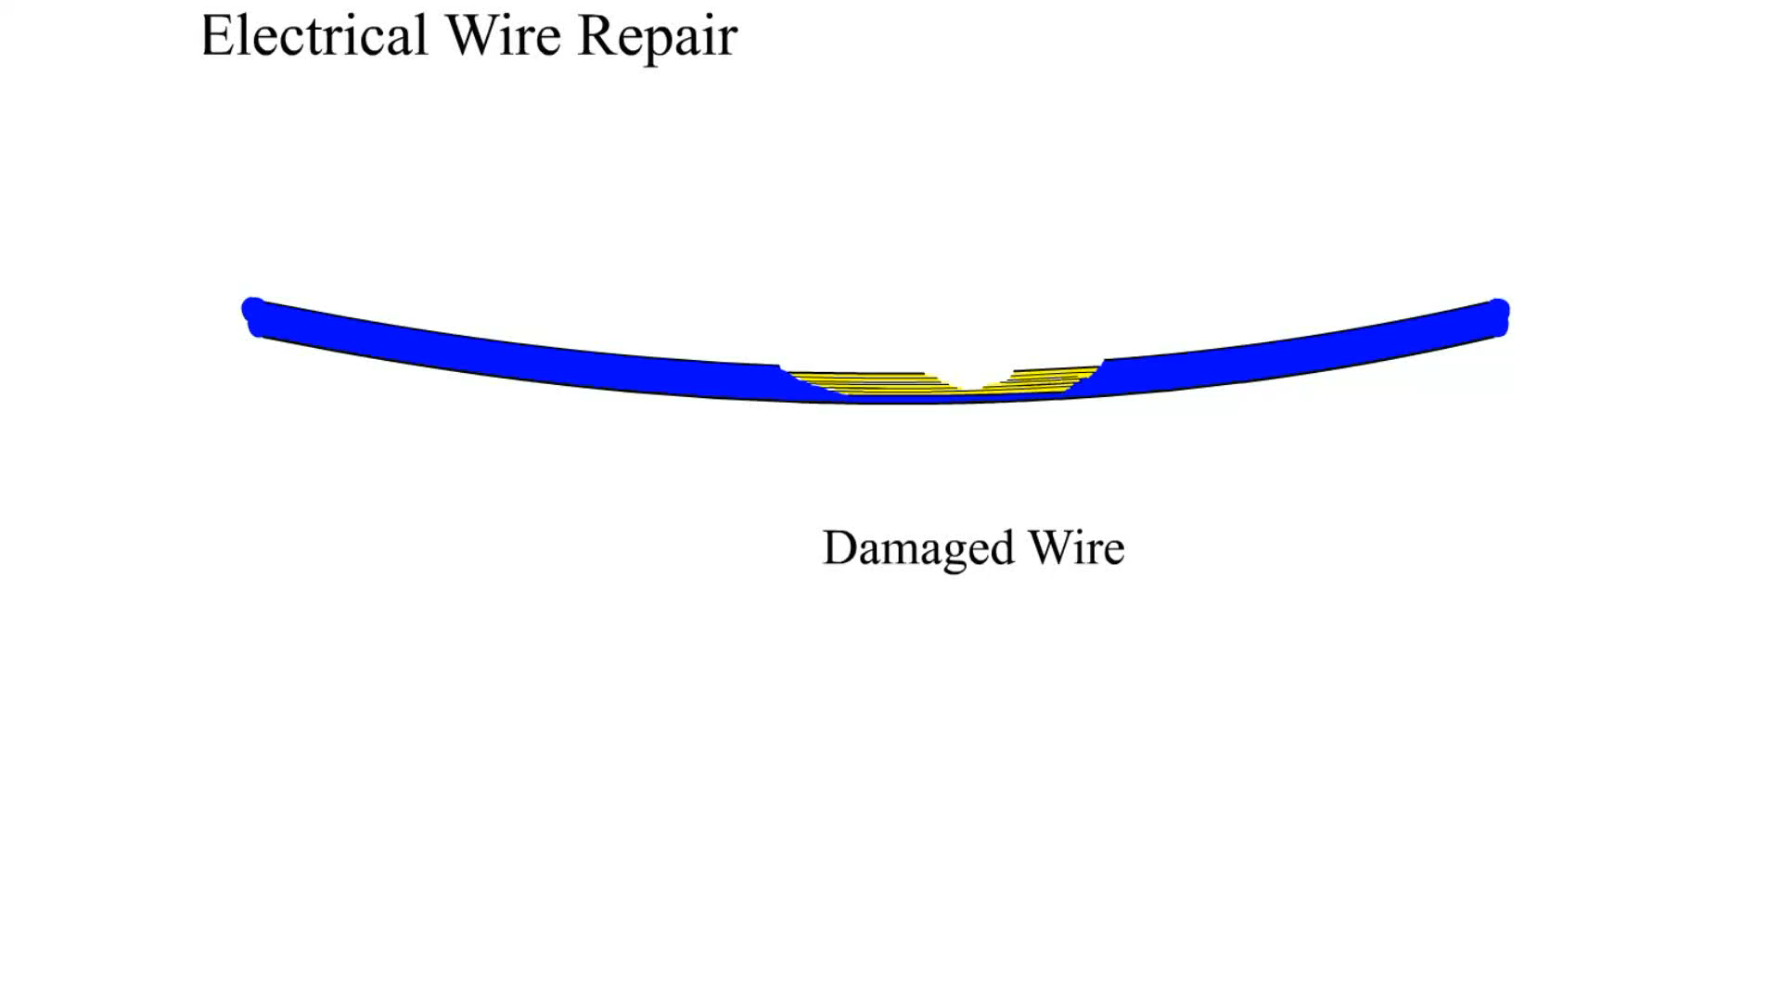
Animation: Electrical Wire Repair
(The animation will automatically start in a few seconds)

Slide 38
Relays
A relay is a magnetic switch that uses a movable armature to control a high-amperage circuit by using a low-amperage electrical switch.
Terminal identification
  Coil
  Other terminals used to control the load current

Slide 39
FIGURE 1–47 A relay uses a movable arm to complete a circuit whenever there is a power at terminal 86 and a ground at terminal 85. A typical relay only requires about 1/10 ampere through the relay coil. The movable arm then closes the contacts (#30 to #87) and can often handle 30 amperes or more.

Slide 40
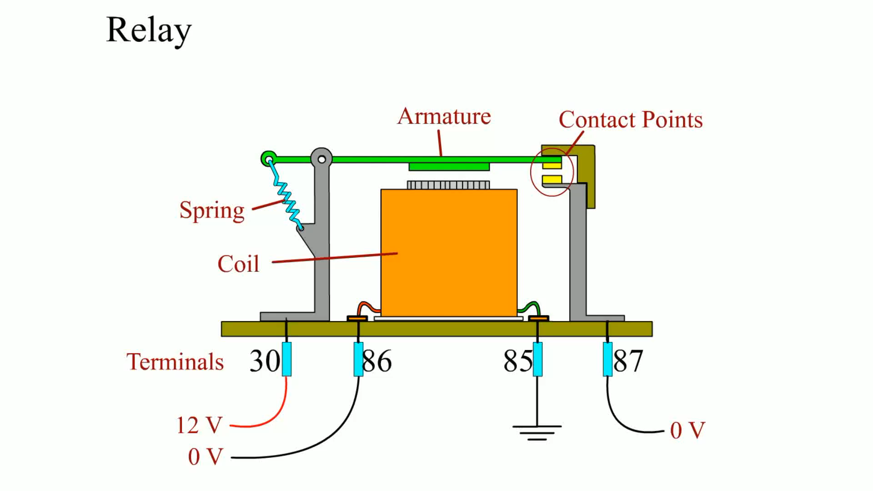
Animation: Relay
(The animation will automatically start in a few seconds)

Slide 41
Networks
Need for network
Modules communicate with each other over data lines or hard wiring.
  The use of a network for module communications reduces the number of wires and connections needed.
Types of communication
  Differential
  Parallel
  Serial data
  Multiplexing

Slide 42
FIGURE 10–53 A network allows all modules to communicate with other modules.

Slide 43
Network Classifications
The SAE communication classifications for vehicle communications system.
  Class A
  Class B
  Class C

Slide 44
Controller Area Network
Robert Bosch Corporation developed the CAN protocol, which was called CAN 1.2, in 1993.
What is the CAN?

Slide 45
FIGURE 10–55 A schematic of a Chevrolet Equinox shows that the vehicle uses a GMLAN BUS (DLC pins 6 and 14), plus a Class 2 (pin 2). A scan tool can therefore communicate to the transmission control module (TCM) through the high-speed network. Pin 1 connects to the low-speed GMLAN network.

Slide 46
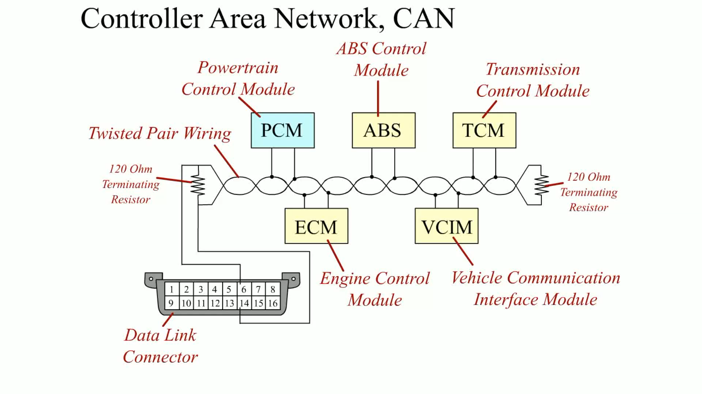
Animation: Controller Area Network, CAN
(The animation will automatically start in a few seconds)

Slide 47
Summary (1 of 3)
Electricity is the movement of electrons from one atom to another.
Automotive electricity uses the conventional theory that electricity flows from positive to negative.
The ampere is the measure of the amount of current flow.
Voltage is the unit of electrical pressure.

Slide 48
Summary (2 of 3)
The ohm is the unit of electrical resistance.
All complete electrical circuits have a power source, a circuit protection device, a power-side wire or path, an electrical load, a ground return path, and a switch or a control device.
Circuit testers include test lights and fused jumper leads.

Slide 49
Summary (3 of 3)
A terminal is the metal end of a wire, whereas a connector is the plastic housing for the terminal.
The use of a network for module communications reduces the number of wires and connections needed.
The SAE communication classifications for vehicle communications system.

Slide 50
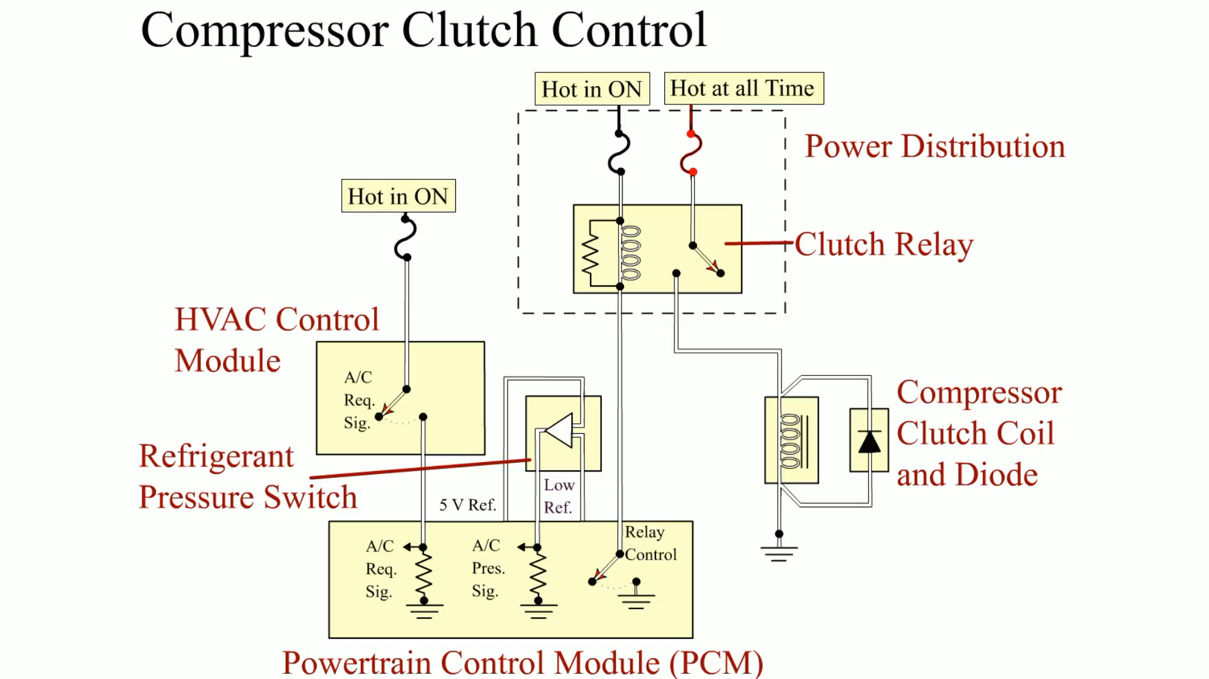
Animation: Compressor Clutch Control
(The animation will automatically start in a few seconds)

Slide 51
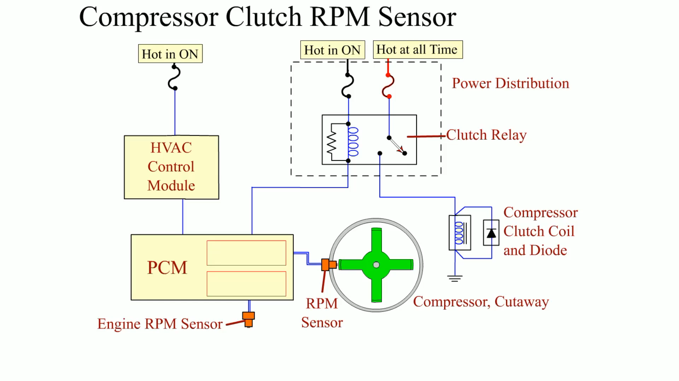
Animation: Compressor Clutch RPM Sensor
(The animation will automatically start in a few seconds)

Slide 52
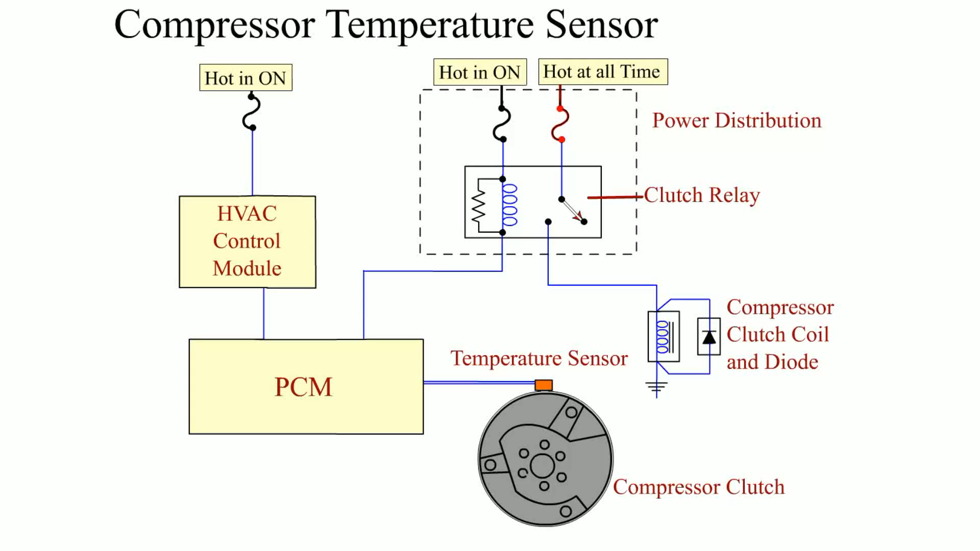
Animation: Compressor Temperature Sensor
(The animation will automatically start in a few seconds)

Slide 53
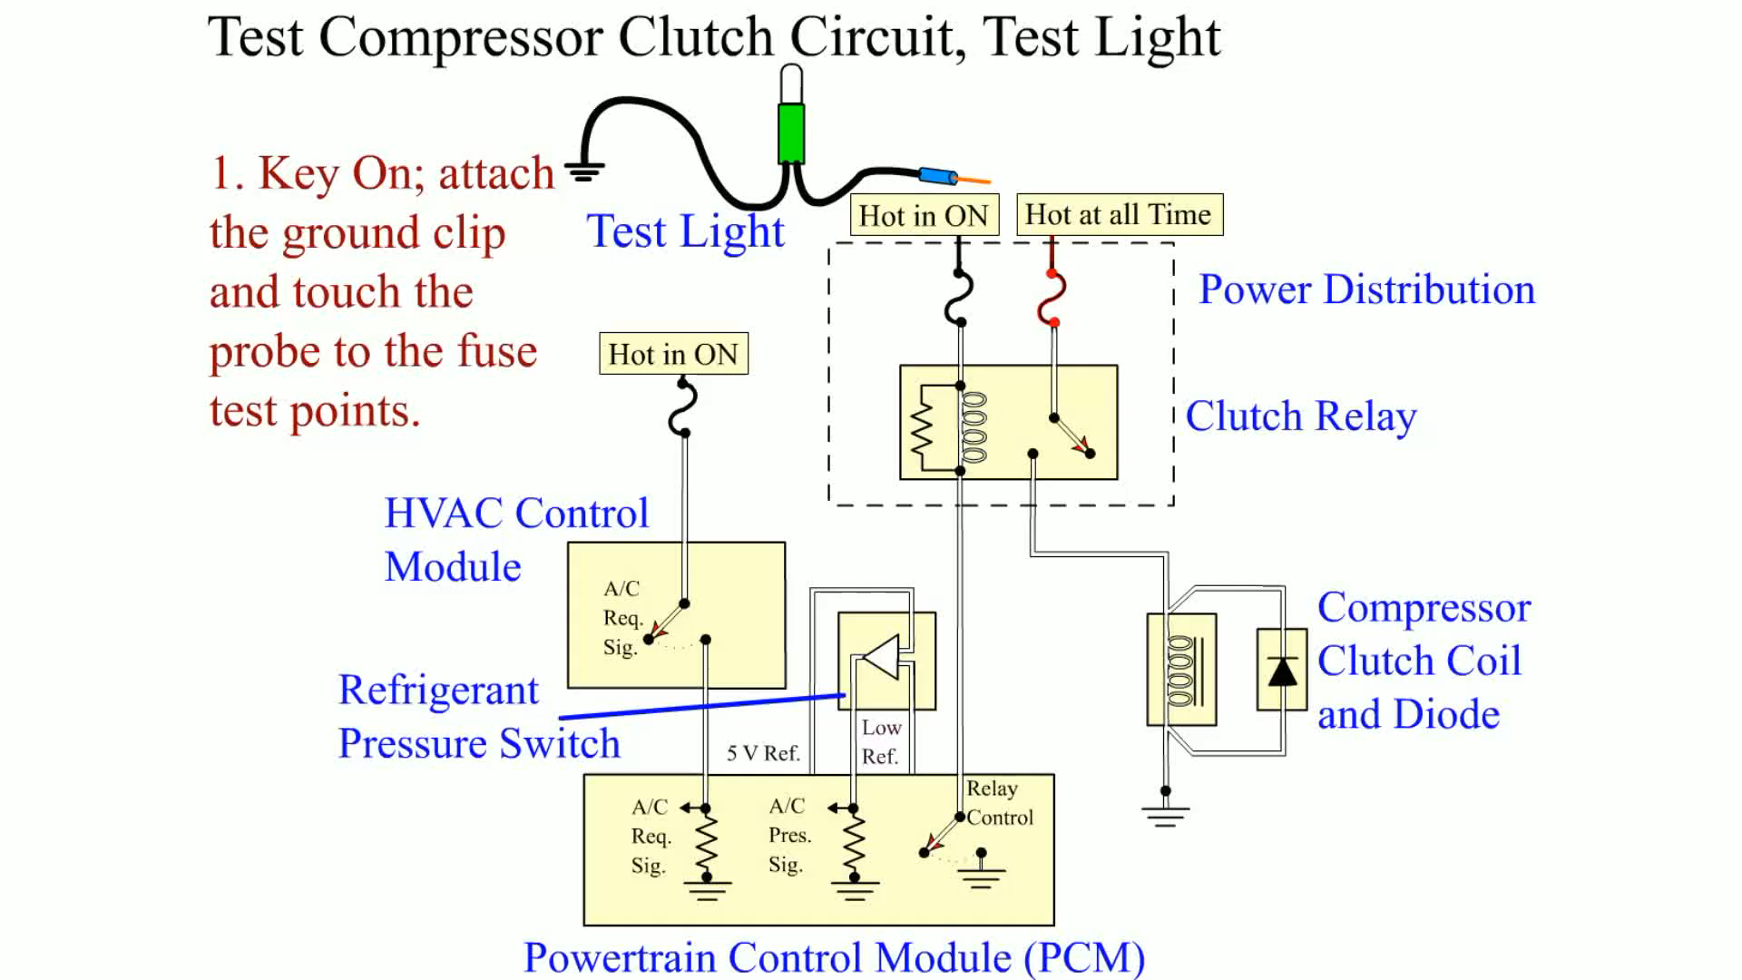
Animation: Test Compressor Clutch Circuit, Test Light
(The animation will automatically start in a few seconds)

Slide 54
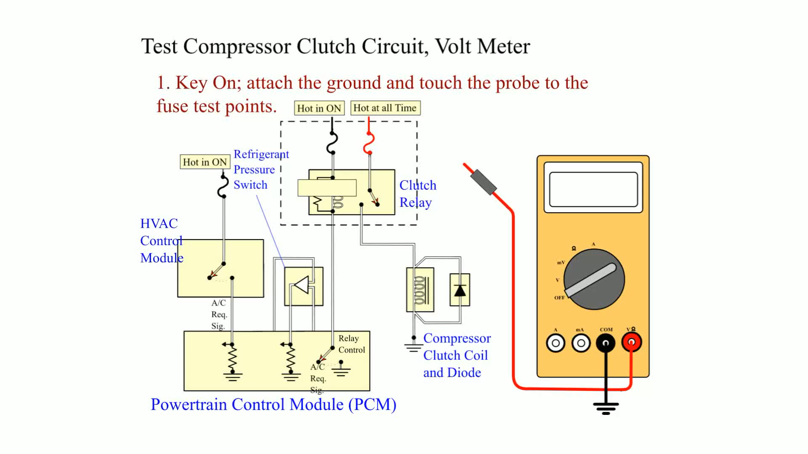
Animation: Test Compressor Clutch Circuit, Volt Meter
(The animation will automatically start in a few seconds)

Slide 55
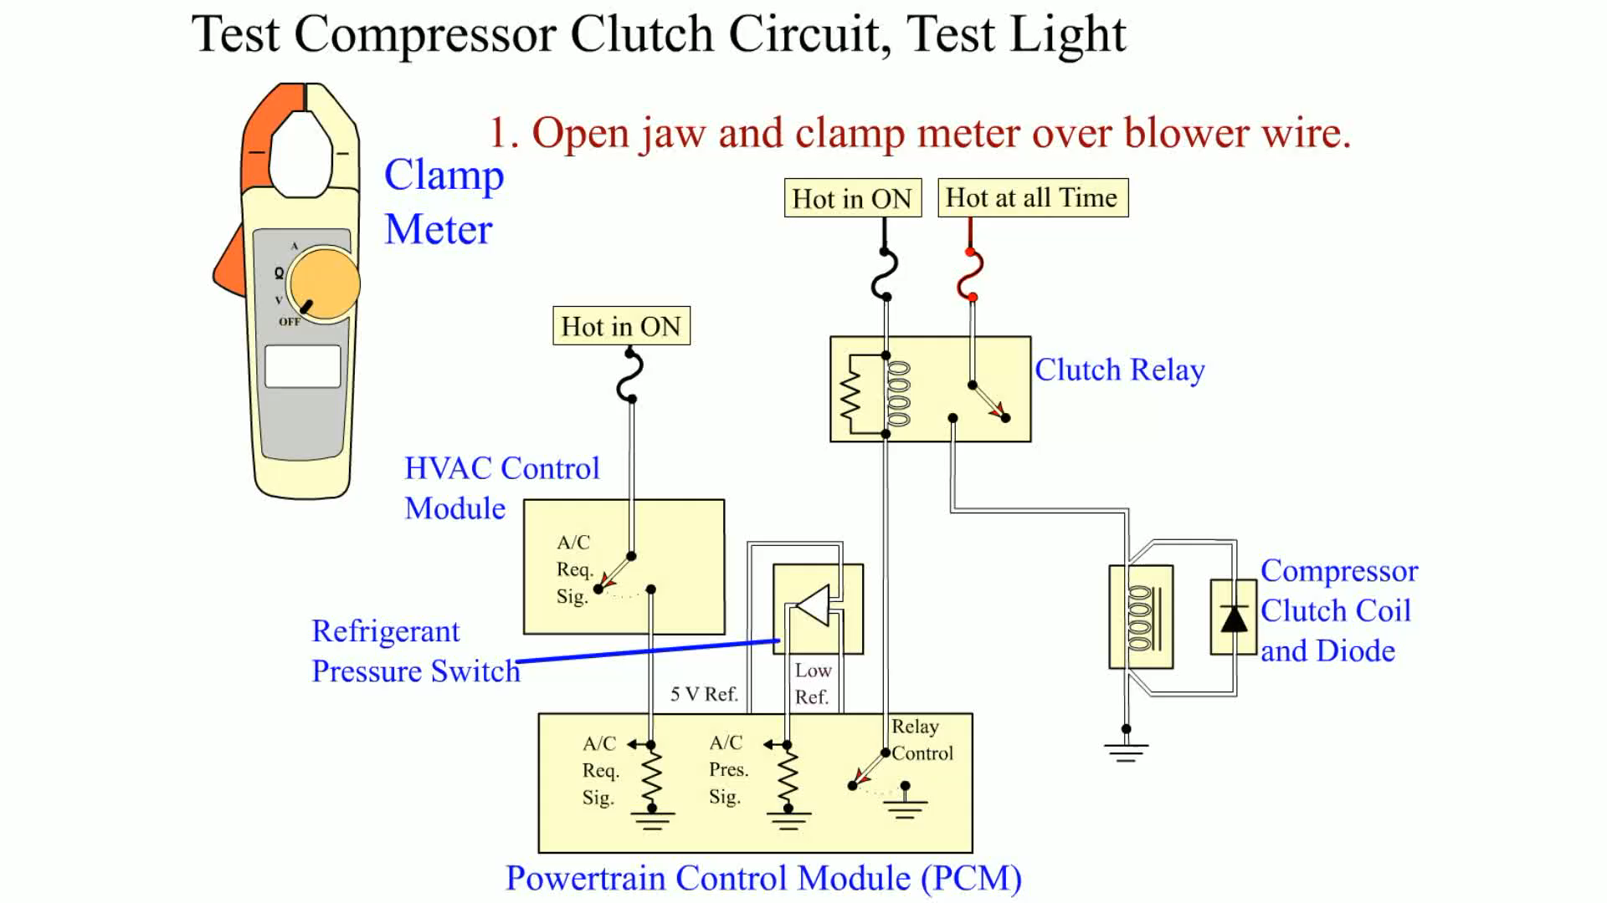
Animation: Test Compressor Clutch Circuit, Clamp Meter
(The animation will automatically start in a few seconds)
Test Compressor Clutch Circuit, Clamp Meter

Slide 56
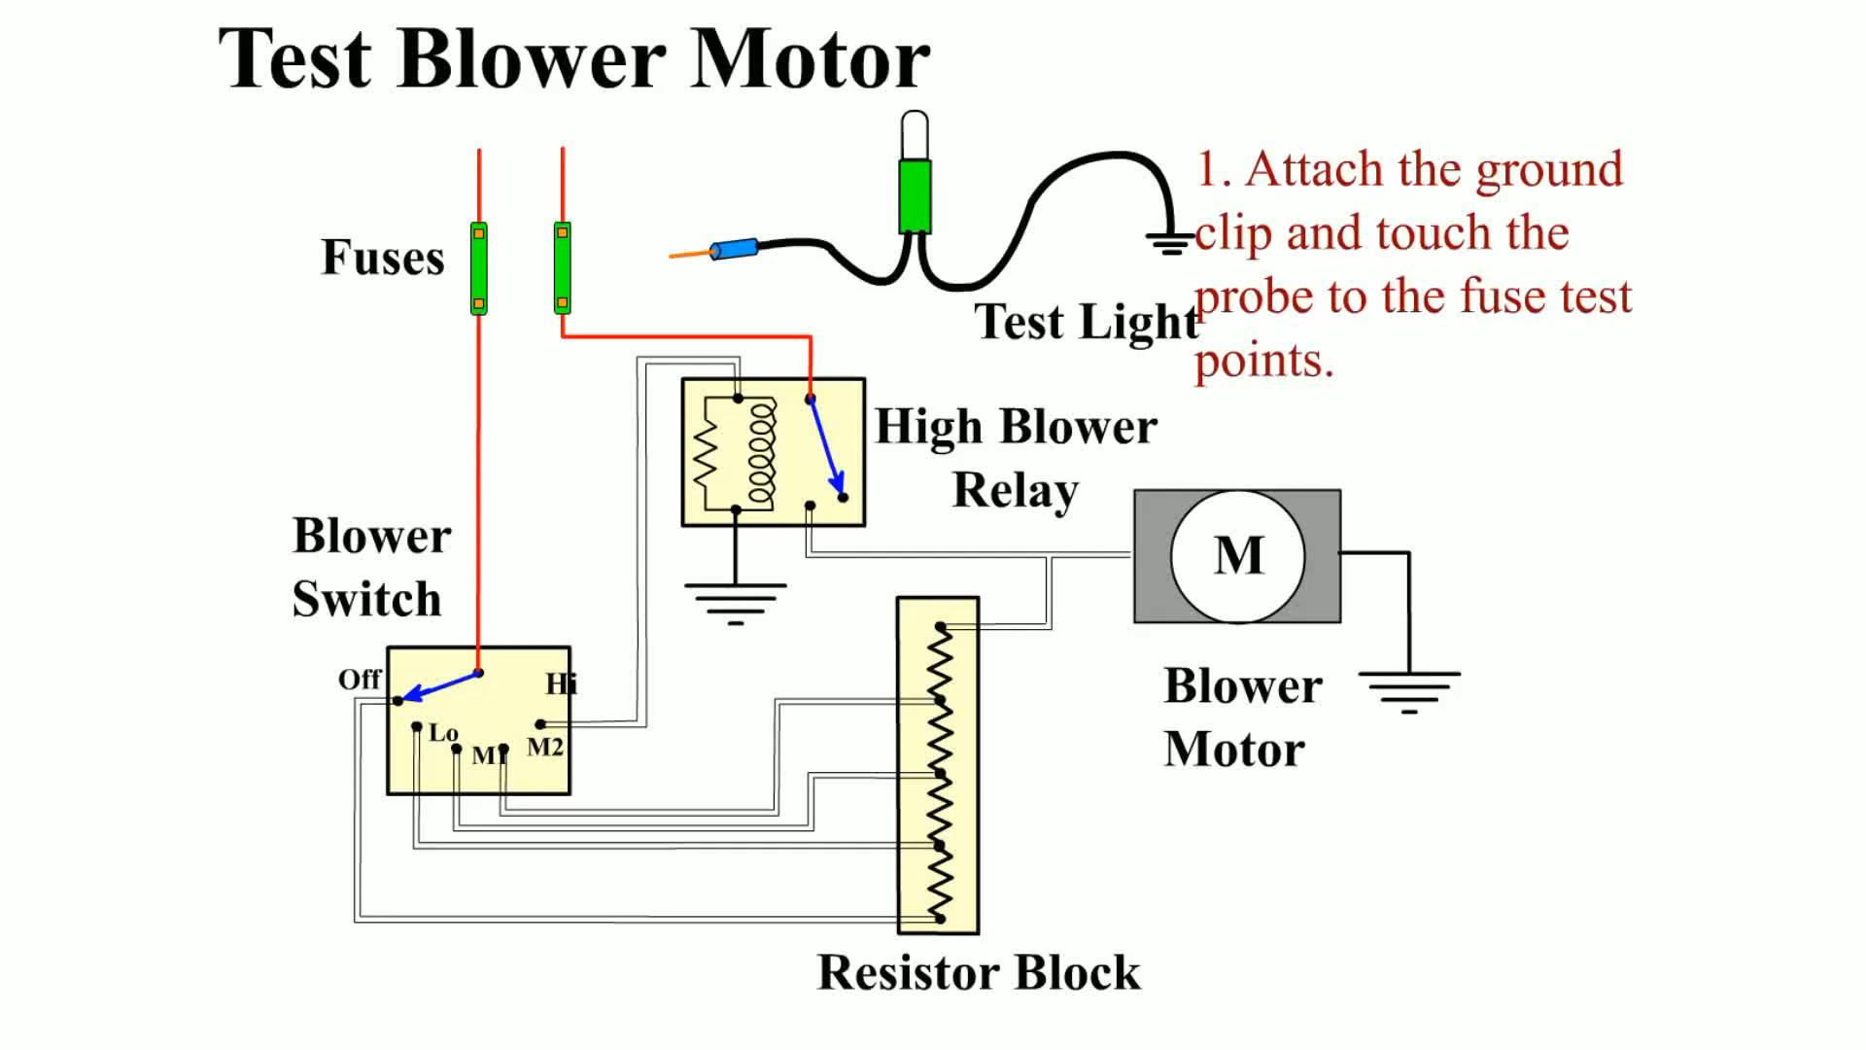
Animation: Test Blower Motor
(The animation will automatically start in a few seconds)

Slide 57
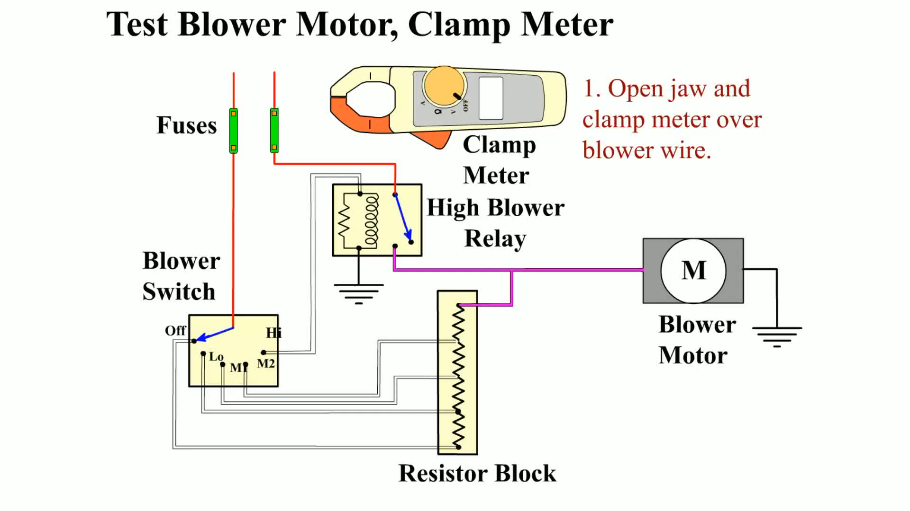
Animation: Test Blower Motor, Clamp Meter
(The animation will automatically start in a few seconds)

Slide 58
Video Links (Internet Access Required)
Heater box removal (time 6:44)
Flushing a heater core (time 9:49)
Plugged heater core (time 9:33)
F150 heater core part 1 (time 7:15)
F150 heater core part 2 (time 15:28 )
Heater core removal (time 9:16)
Dodge heater core (time 6:41)
Audi heater core (time 6:09)
S 10 heater core (time 3:52)
Thunderbird heater core (time 5:35)

Slide 59
Video Links (Internet Access Required)
Chevy 1500 heater core (time 11:59)
Lincoln heater core (time 21:46)
Kia Sportage heater core (time 7:14)
Cooling system pressure test (time 9:02)
Cooling system animation (time 0:22)
Thermostat (time 0:05)
Water pump replacement (time 8:36)
Coolant bypass pipe (time 9:14)
Thermostat (time 6:20)
Thermostat (time 8:27)

Slide 60
Video Links (Internet Access Required)
Radiator replacement (time 11:32)
Water pump and timing belt (time 12:22)
Coolant testing (time 2:11)
Coolant temp sensor (time 5:18)
Draining the radiator (time 2:33)
Cooling system (time 4:02)
Replace freeze plugs (time 3:43)
Engine overheat (time 26:09)
Water pump failure (time 6:00)
Does stop leak work (time 8:29)

Slide 61
Video Links (Internet Access Required)
Cooling system check (time 4:12)
Cooling fan (time 5:15)
Water pump (time 2:31)
Thermostat (time 1:07)
Thermostat (time 1:40)
Radiator (time 3:52)
Coolant tube (time 14:54)
Radiator (time 4:05)
Water pump replacement (time 2:19)
Radiator replacement (time 3:02)

Slide 62
Video Links (Internet Access Required)
Belt tensioner (time 3:59)
Belt and pulley basics (time 10:58)
Idler pulley (time 2:50)
Cooling fan diagnosis (time 2:21)

