Slide 1
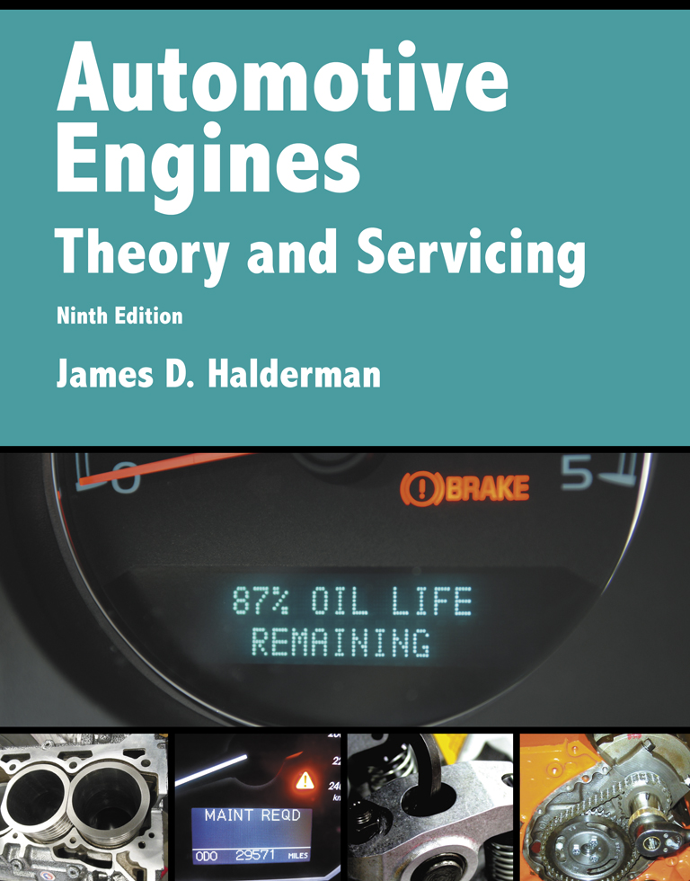
Automotive Engines Theory and Servicing
Ninth Edition
Chapter 7
Measuring Systems and Tools

Slide 2
OBJECTIVES
7.1 Compare the English customary measuring system and the metric system of measure.
7.2 Discuss the purpose of tape measures, micrometers, and depth micrometers.
7.3 Discuss the purpose of telescopic gauges, small-hole gauges, and vernier dial calipers.
7.4 Discuss the purpose of the straightedges, dial indicators, feeler gauges, and dial bore gauges.

Slide 3
ENGLISH CUSTOMARY MEASURING SYSTEM (1 OF 3)
The English customary measuring system was established about A.D. 1100 in England during the reign of Henry I.
The foot was determined to be 12 inches and was taken from the length of a typical foot.
The yard was determined to be the length from King Henry's nose to the end of his outstretched hand.

Slide 4
ENGLISH CUSTOMARY MEASURING SYSTEM (2 OF 3)
The mile came from Roman days and was originally defined as the distance traveled by a soldier in 1,000 paces or steps.
Other English units, such as the pound (weight) and volume (gallon), evolved over the years from Roman and English measurements.

Slide 5
ENGLISH CUSTOMARY MEASURING SYSTEM (3 OF 3)
The Fahrenheit temperature scale was created by Gabriel Fahrenheit (1686–1736) and he used 100°F as the temperature of the human body, which he missed by 1.4 degrees.
On the Fahrenheit scale, water freezes at 32°F and water boils at 212°F.

Slide 6
METRIC SYSTEM OF MEASURE
Linear Metric Measurements
Volume Measurement
Weight Measurement
Pressure Measurements
Derived Units

Slide 7
LINEAR MEASUREMENTS (TAPE MEASURE/RULE) (1 OF 2)
A tape measure or machinist rule divides inches into smaller units.
Each smaller unit is drawn with a line shorter than the longer unit.

Slide 8
LINEAR MEASUREMENTS (TAPE MEASURE/RULE) (2 OF 2)
The units of measure include:
1 inch
1/2 inch
1/4 inch
1/8 inch
1/16 inch

Slide 9
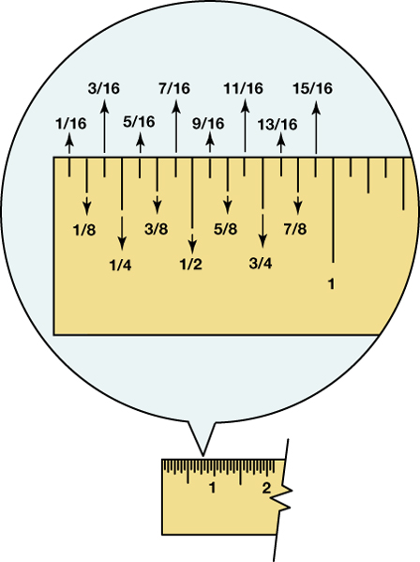
FIGURE 7–1 A rule showing that the larger the division, the longer the line.

Slide 10
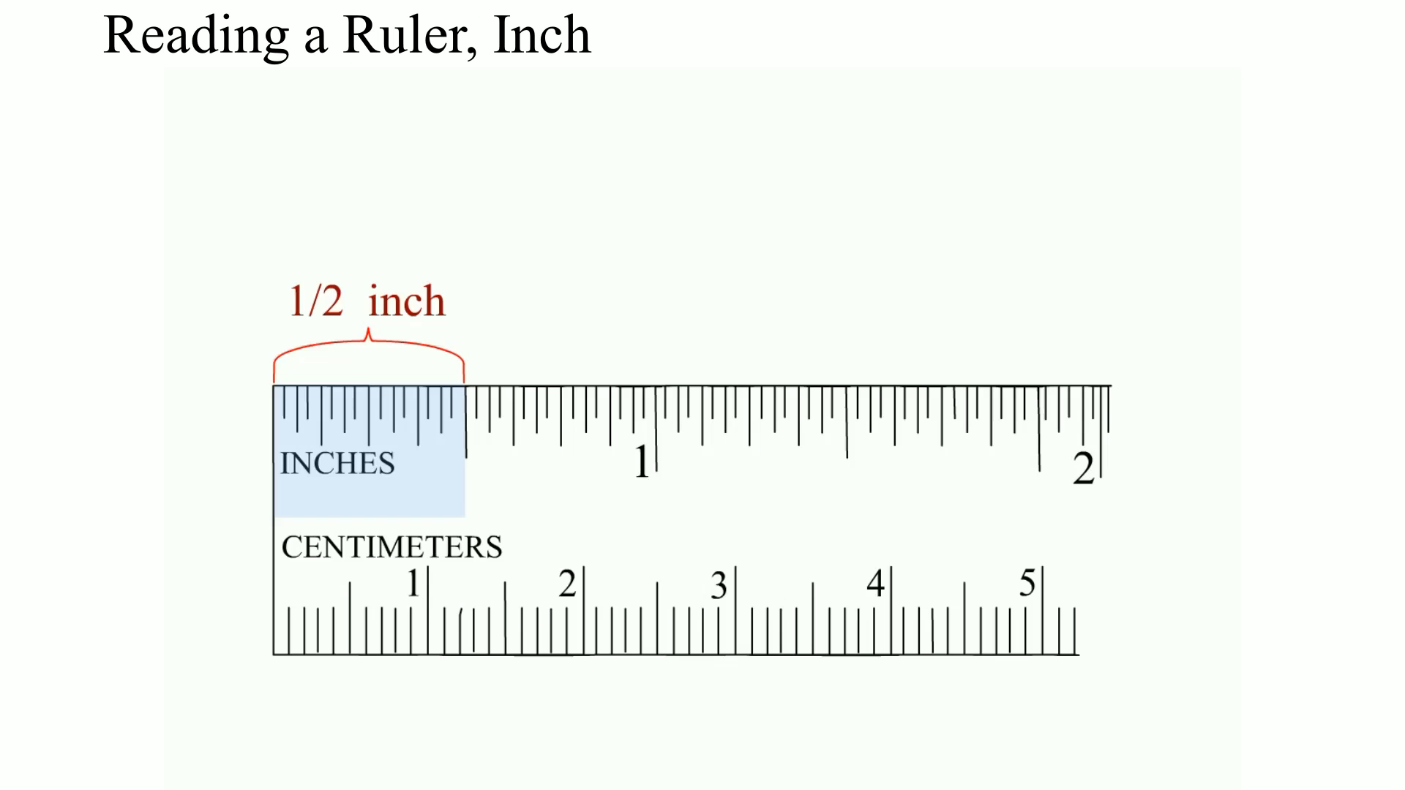
Animation: Reading a Ruler, Inch (The animation will automatically start in a few seconds)

Slide 11
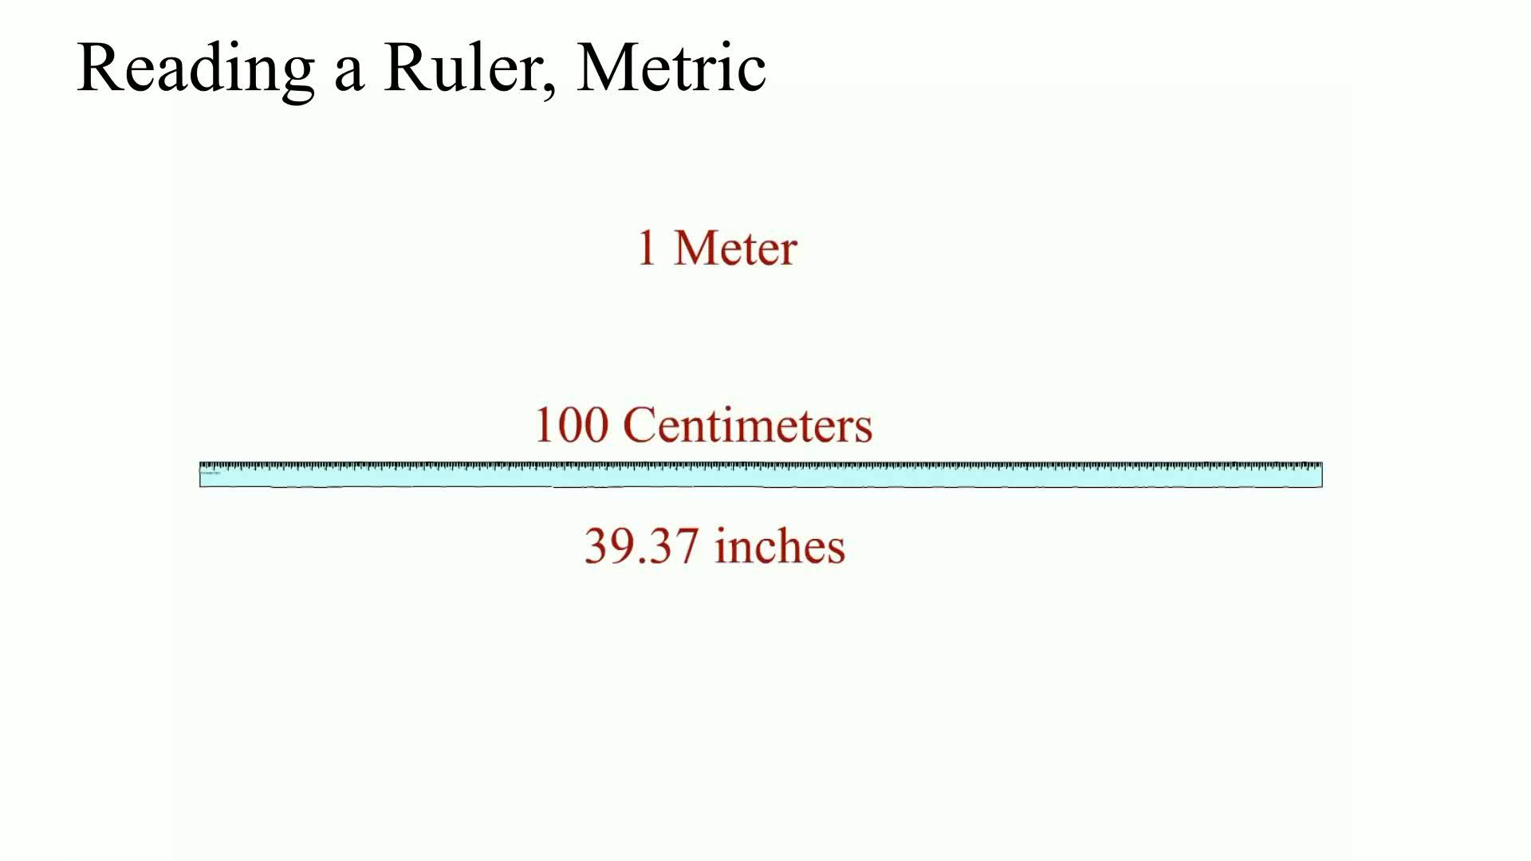
Animation: Reading a Ruler, Metric (The animation will automatically start in a few seconds)

Slide 12
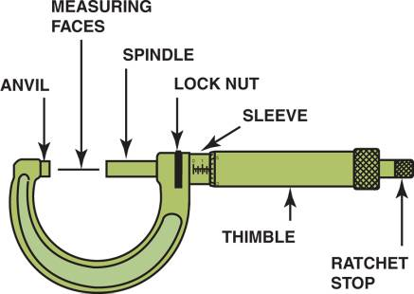
MICROMETER (1 OF 2)
A micrometer is the most used measuring instrument in engine service and repair.
FIGURE 7–3 A typical micrometer showing the names of the parts. The sleeve may also be called the barrel or stock.

Slide 13
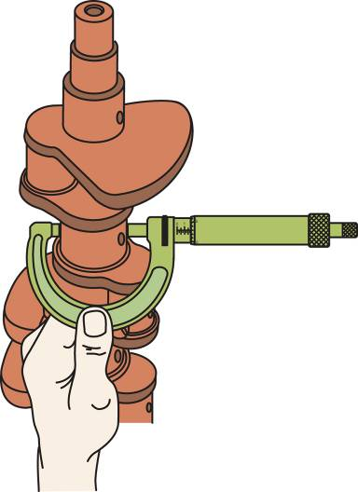
MICROMETER (2 OF 2)
Crankshaft Measurement
Out-of-round
Taper
Camshaft Measurement
FIGURE 7–7 Using a micrometer to measure the connecting rod journal for out-of-round and taper.

Slide 14
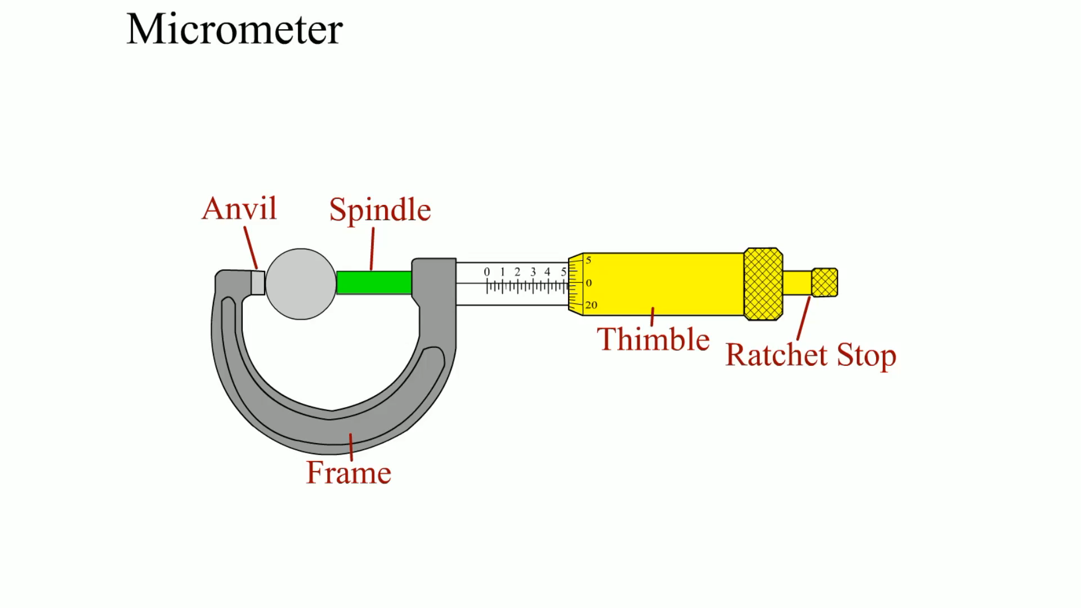
Animation: Micrometer (The animation will automatically start in a few seconds)

Slide 15
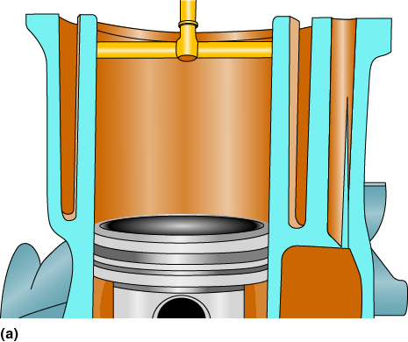
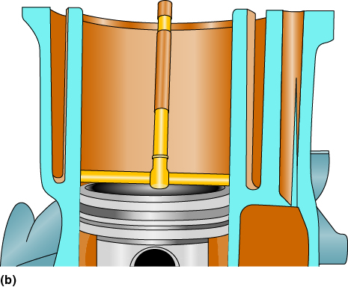
TELESCOPIC GAUGE
A telescopic gauge is used with a micrometer to measure the inside diameter of a hole or bore.
FIGURE 7–11 When the head is first removed, the cylinder taper and out-of-round should be checked below the ridge (a) and above the piston when it is at the bottom of the stroke (b).

Slide 16
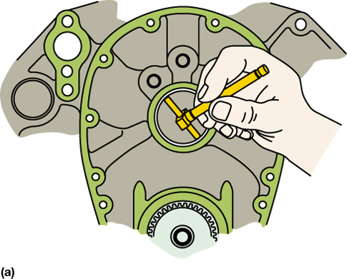
FIGURE 7–12 (a) A telescopic gauge being used to measure the inside diameter (ID) of a camshaft bearing. (b) An outside micrometer used to measure the telescopic gauge.

Slide 17
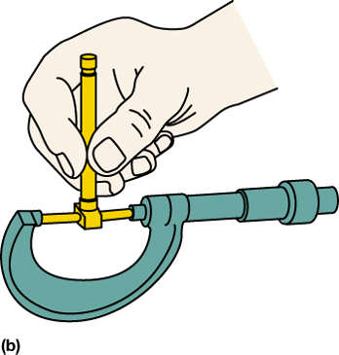
FIGURE 7–12 (a) A telescopic gauge being used to measure the inside diameter (ID) of a camshaft bearing. (b) An outside micrometer used to measure the telescopic gauge.

Slide 18
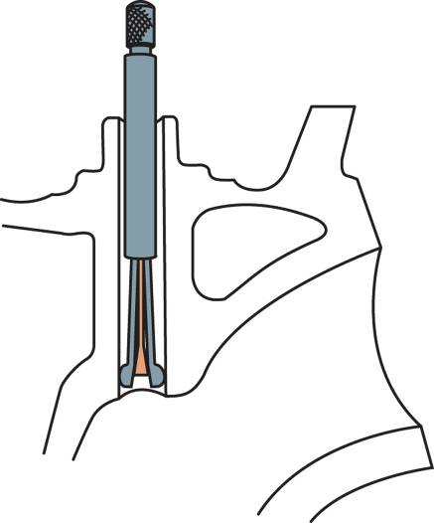
SMALL-HOLE GAUGE
A small-hole gauge (also called a split-ball gauge) is used with a micrometer to measure the inside diameter of small holes such as a valve guide in a cylinder head.
FIGURE 7–13 Cutaway of a valve guide with a hole gauge adjusted to the hole diameter.

Slide 19
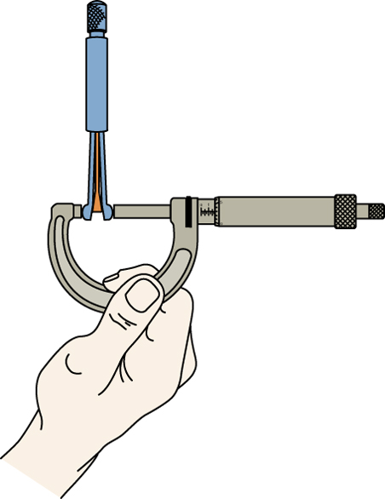
FIGURE 7–14 The outside of a small hole gauge being measured with a micrometer.

Slide 20
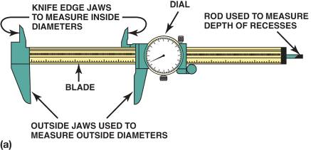
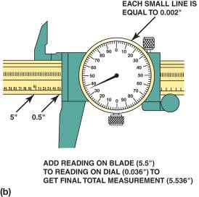
DIAL CALIPER
A dial caliper is normally used to measure length, inside and outside diameters, and depth.
FIGURE 7–15 (a) A typical vernier dial caliper. This is a very useful measuring tool for automotive engine work because it is capable of measuring inside, outside, and depth measurements. (b) To read a vernier dial caliper, simply add the reading on the blade to the reading on the dial.

Slide 21
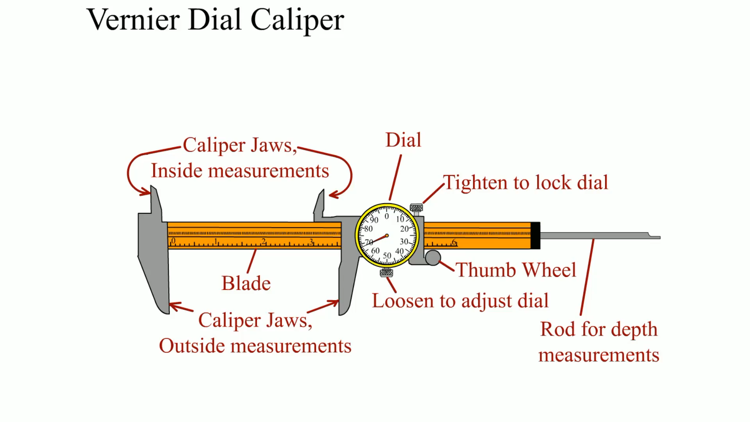
Animation: Vernier Dial Caliper (The animation will automatically start in a few seconds)

Slide 22
FEELER GAUGE
A feeler gauge is an accurately manufactured strip of metal that is used to determine the gap or clearance between two components.
A feeler gauge can be used to check the following:
Piston ring gap
Piston ring side clearance
Connecting rod side clearance
Piston-to-wall clearance

Slide 23
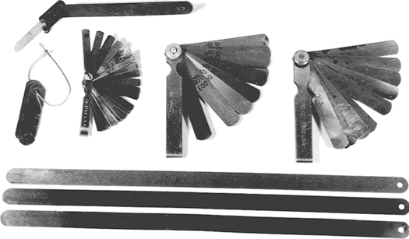
FIGURE 7–16 A group of feeler gauges (also known as thickness gauges), used to measure between two parts. The long gauges on the bottom are used to measure the piston-to-cylinder wall clearance.

Slide 24
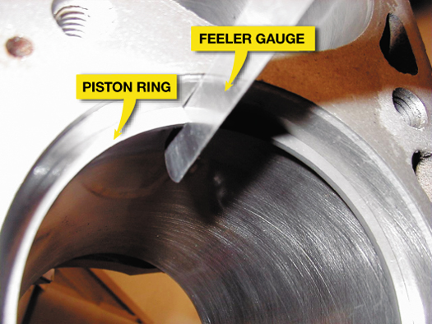
FIGURE 7–17 A feeler gauge, also called a thickness gauge, is used to measure the small clearances such as the end gap of a piston ring.

Slide 25
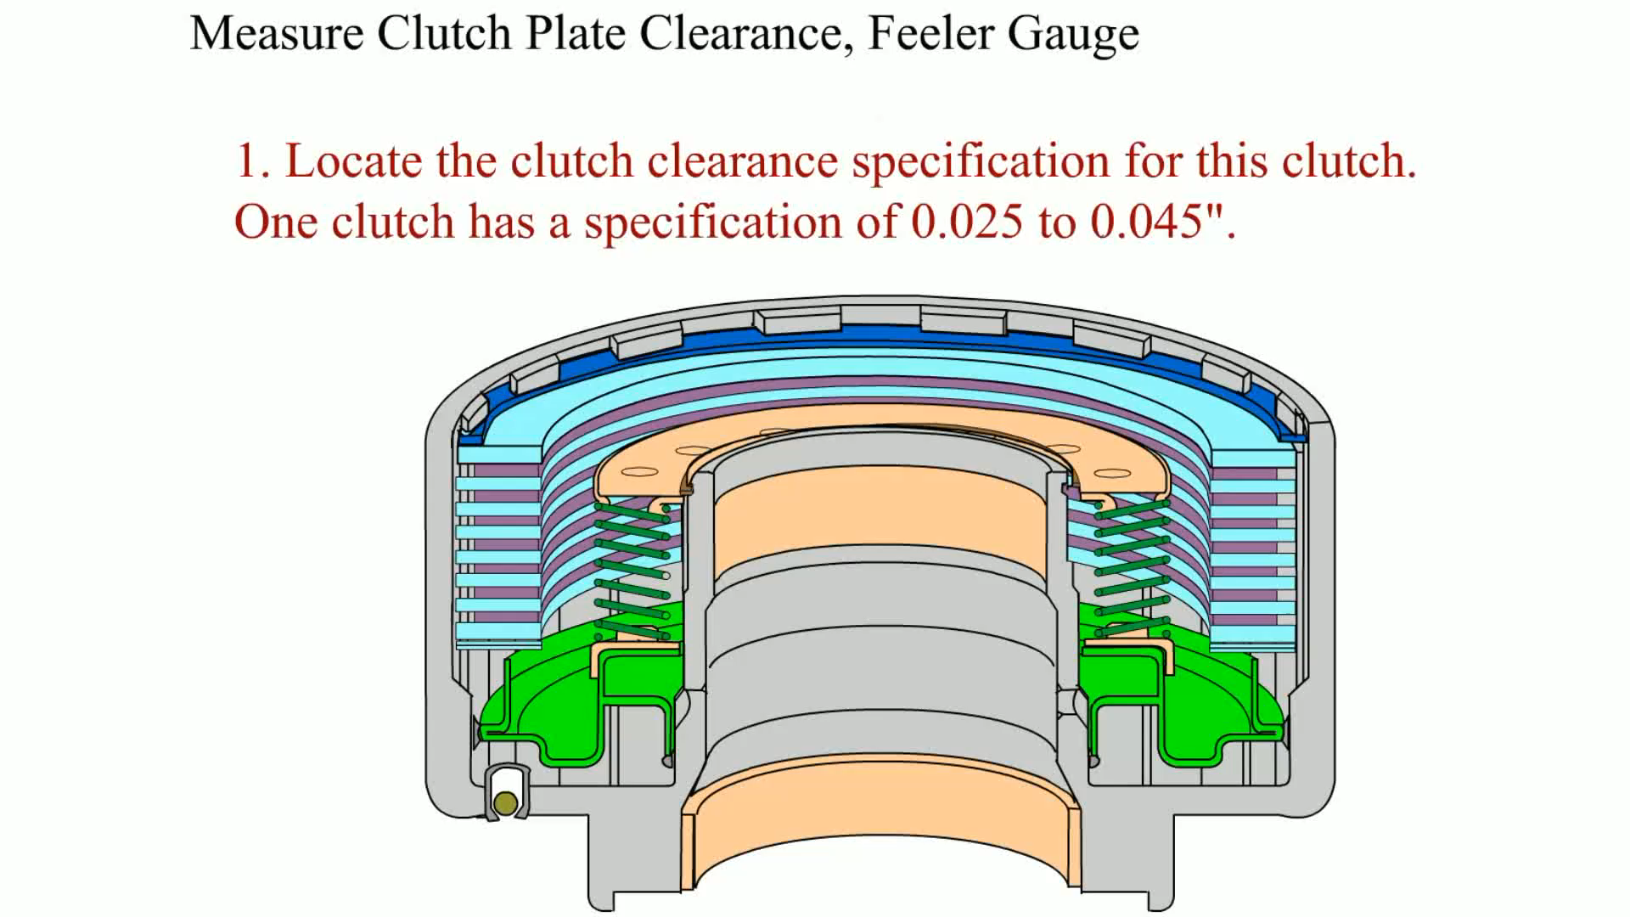
Animation: Measure Clutch Plate Clearance, Feeler Gauge (The animation will automatically start in a few seconds)

Slide 26
STRAIGHTEDGE (1 OF 2)
A straightedge is a precision ground metal measuring gauge that is used to check the flatness of engine components when used with a feeler gauge.

Slide 27
STRAIGHTEDGE (2 OF 2)
A straightedge is used to check the flatness of the following:
Cylinder heads
Cylinder block deck
Straightness of the main bearing bores (saddles)

Slide 28
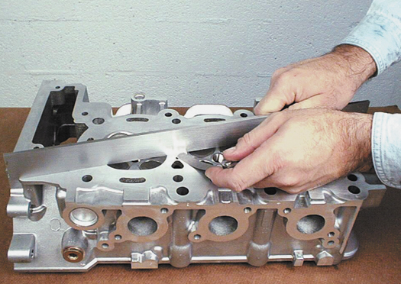
FIGURE 7–18 A straightedge is used with a feeler gauge to determine if a cylinder head is warped or twisted.

Slide 29
DIAL INDICATOR
A dial indicator is a precision measuring instrument used to measure crankshaft end play, crankshaft runout, and valve guide wear.
A dial indicator can be mounted three ways, including:
Magnetic mount
Clamp mount
Threaded rod

Slide 30
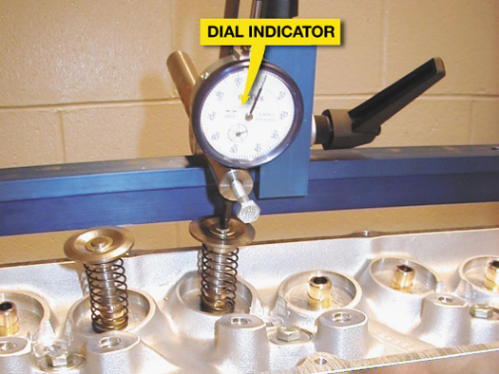
FIGURE 7–19 A dial indicator is used to measure valve lift during flow testing of a high-performance cylinder head.

Slide 31
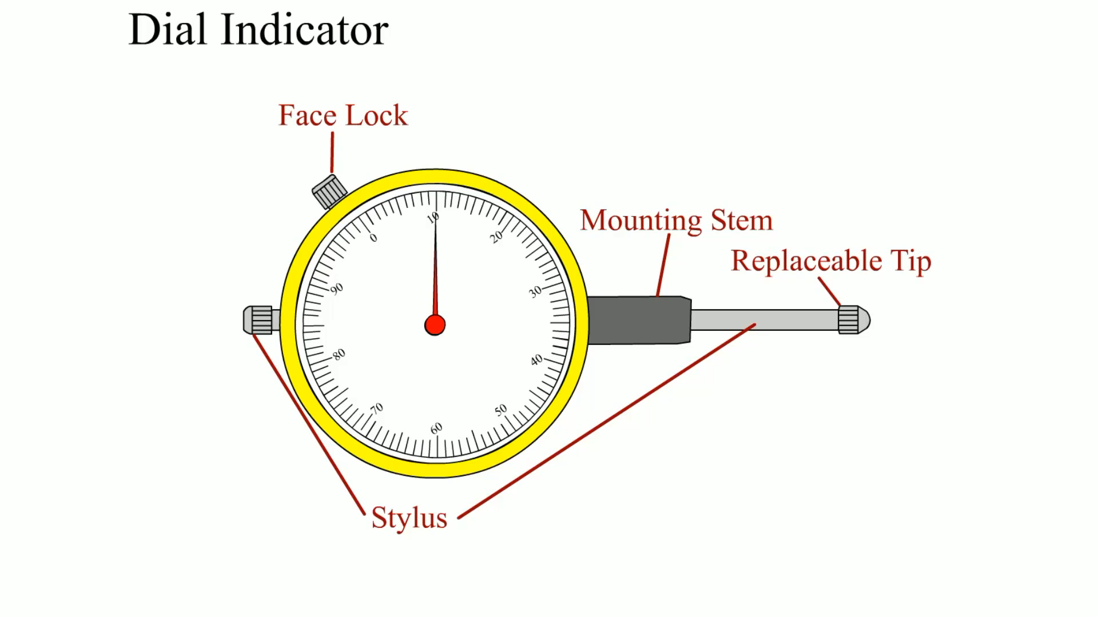
Animation: Dial Indicator (The animation will automatically start in a few seconds)

Slide 32
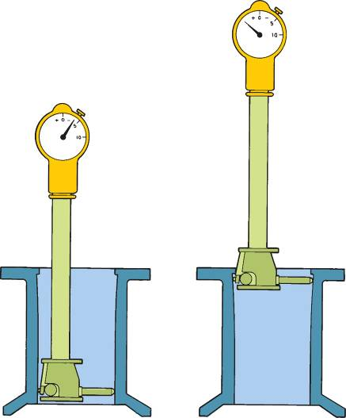
DIAL BORE GAUGE
A dial bore gauge is an expensive, but important, gauge used to measure cylinder taper and out-of-round as well as main bearing (block housing) bore for taper and out-of-round.
FIGURE 7–20 A dial bore gauge is used to measure cylinders and other engine parts for out-of-round and taper conditions.

Slide 33
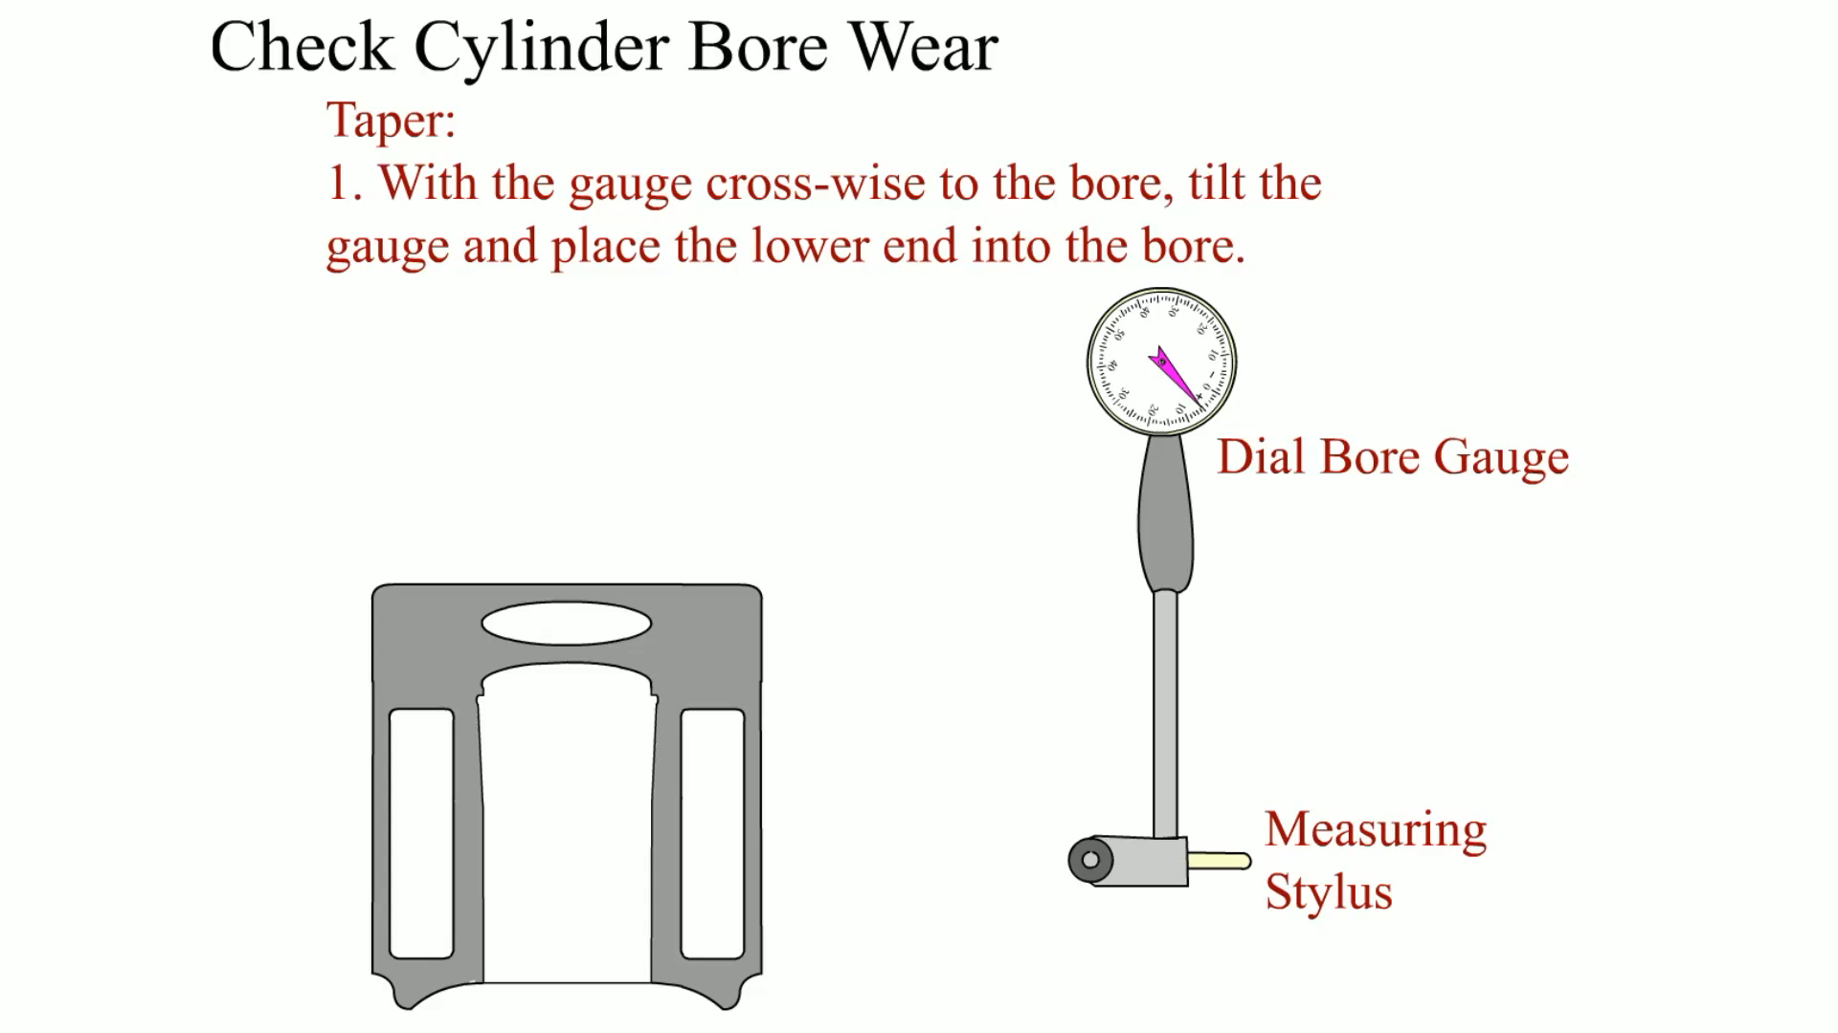
Animation: Check Cylinder Bore Wear (The animation will automatically start in a few seconds)

Slide 34
DEPTH MICROMETER
A depth micrometer is similar to a conventional micrometer except that it is designed to measure the depth from a flat surface.

Slide 35
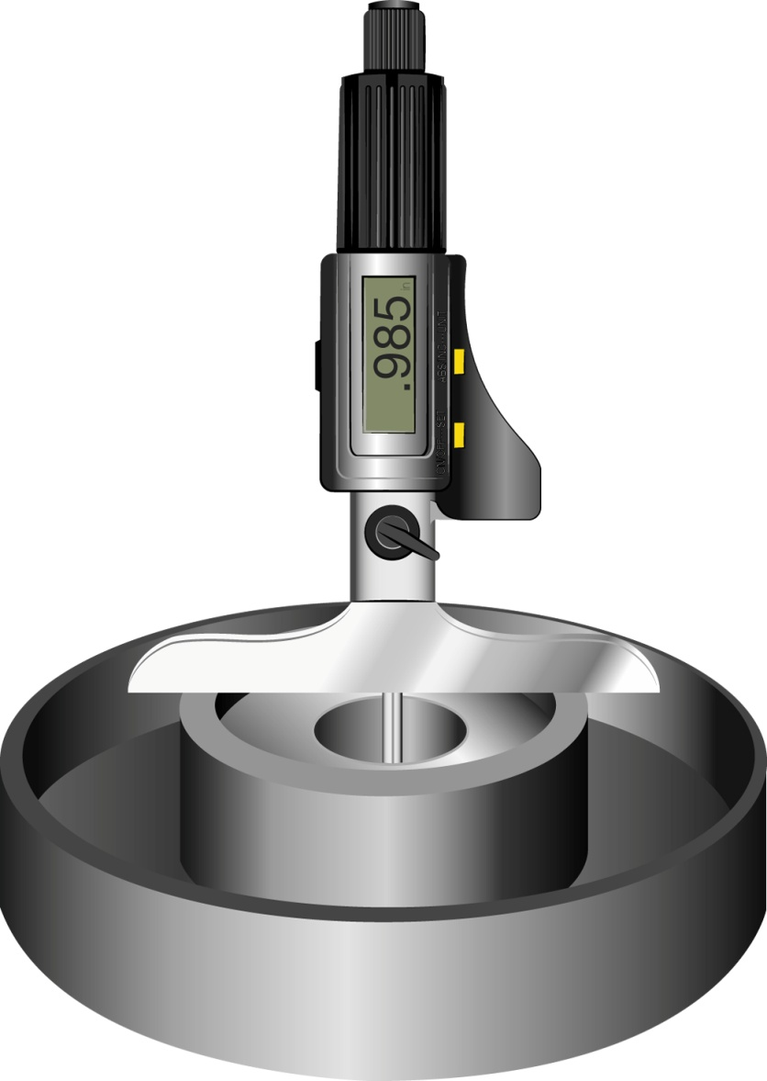
FIGURE 7–21 A digital readout depth micrometer.

Slide 36
SUMMARY (1 OF 3)
A tape measure or machinist rule can be used to measure linear distances.
A micrometer can measure 0.001 in. by using a thimble that has 40 threads per in.
A micrometer is used to check the diameter of a crankshaft journal as well as the taper and out-of-round.

Slide 37
SUMMARY (2 OF 3)
A camshaft bearing and lobe can be measured using a micrometer.
A telescopic gauge is used with a micrometer to measure the inside of a hole or bore.
A small-hole gauge is used with a micrometer to measure small holes such as the inside diameter of a valve guide in a cylinder head.

Slide 38
SUMMARY (3 OF 3)
A vernier dial caliper is used to measure the outside diameter of components.
A feeler gauge is used to measure the gap or clearance between two components.
A dial indicator and dial bore gauge are used to measure differences in a component.

