Slide 1

Automotive Engines Theory and Servicing
Ninth Edition
Chapter 4
Hand Tools

Slide 2
OBJECTIVES (1 OF 2)
4.1 Compare the different types of wrenches.
4.2 Discuss the purpose of ratchets, sockets, and extensions, and screwdrivers.
4.3 Discuss the purpose of hammers, mallets, and pliers.

Slide 3
OBJECTIVES (2 OF 2)
4.4 Explain the characteristics of cutters, punches, chisels, removers, and hacksaws.
4.5 Identify the different types of electrical hand tools.
4.6 Discuss the safety tips for using hand tools and hand tool maintenance.

Slide 4
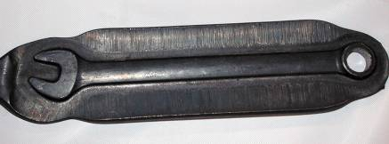
WRENCHES (1 OF 3)
Wrenches are the most used hand tool by service technicians.
Most wrenches are constructed of forged alloy steel, usually chrome-vanadium steel.
FIGURE 4–1 A forged wrench after it has been forged but before the flashing, extra material around the wrench, has been removed.

Slide 5
WRENCHES (2 OF 3)
Open-end Wrench: used to loosen or tighten bolts or nuts that do not require a lot of torque
Box-end Wrench: placed on top of the fastener and grips the points of the fastener
Combination Wrench: allows technicians to loosen or tighten a fastener, with the open end to increase the speed of rotating the fastener

Slide 6
WRENCHES (3 OF 3)
Adjustable Wrench: used when the exact size wrench is not available or when a large nut needs to be rotated
Line Wrenches: used to grip all the way around a nut for a fuel or refrigerant line

Slide 7
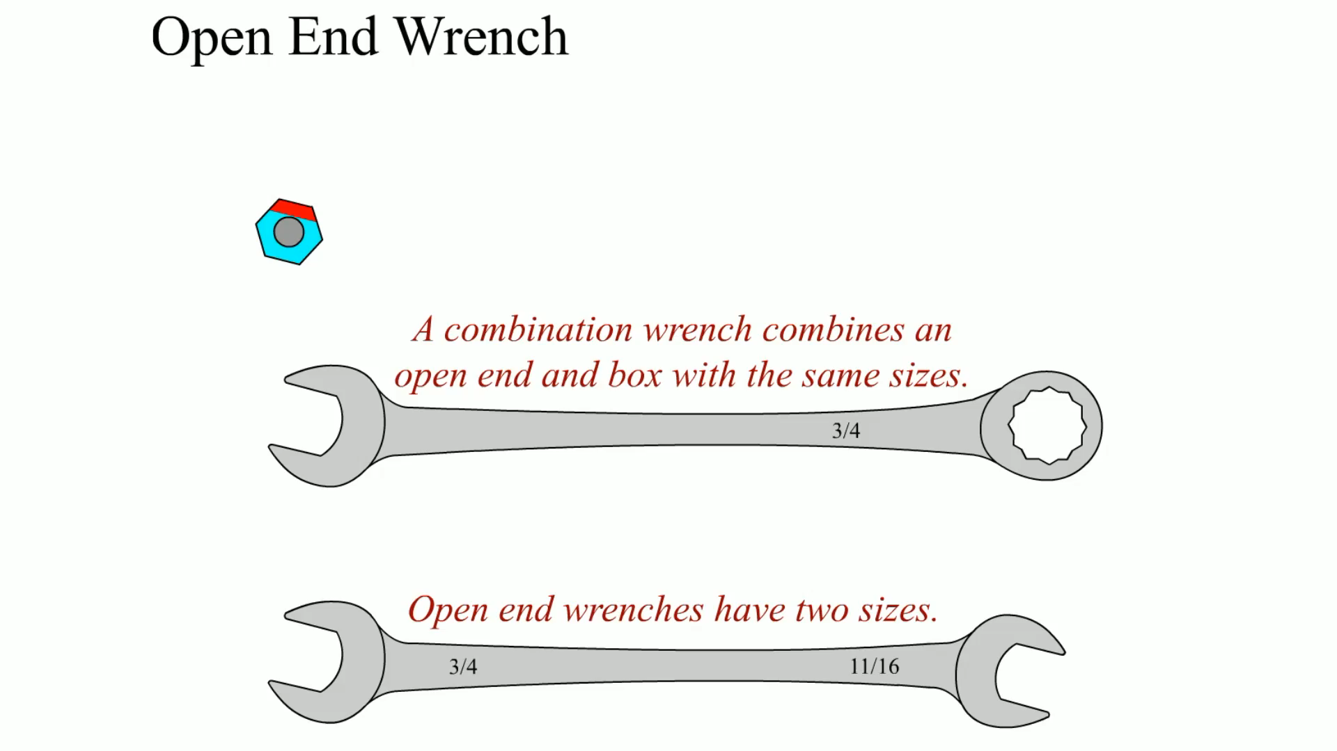
Animation: Open End Wrenches (The animation will automatically start in a few seconds)

Slide 8
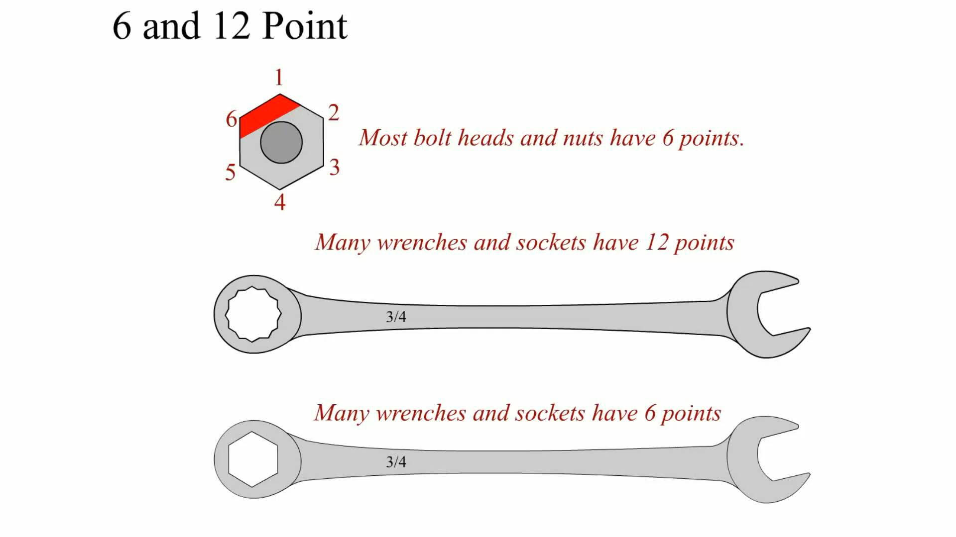
Animation: 6 and 12 Point (The animation will automatically start in a few seconds)

Slide 9
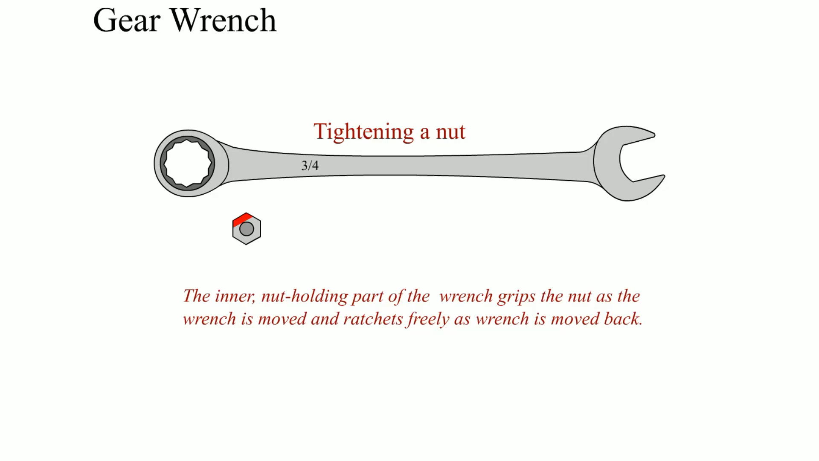
Animation: Gear Wrench (The animation will automatically start in a few seconds)

Slide 10
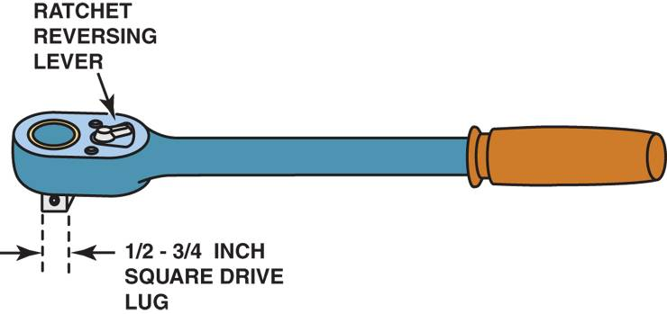
RATCHETS, SOCKETS, AND EXTENSIONS (1 OF 2)
A socket fits over the fastener and grips the points and/or flats of the bolt or nut.
The socket is rotated (driven) using either a long bar called a breaker bar (flex handle) or a ratchet.
FIGURE 4–8 A typical ratchet used to rotate a socket. A ratchet makes a ratcheting noise when it is being rotated in the opposite direction from loosening or tightening. A knob or lever on the ratchet allows the user to switch directions.

Slide 11
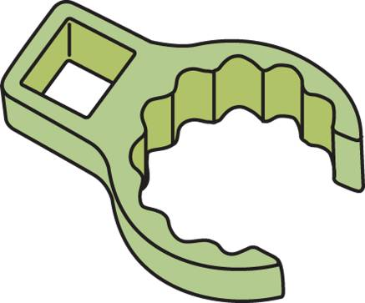
RATCHETS, SOCKETS, AND EXTENSIONS (2 OF 2)
Crowfoot Sockets
Torque Wrenches
A clicker-type torque wrench
A beam- or dial-type torque wrench
FIGURE 4–12 A crowfoot socket is designed to reach fasteners using a ratchet or breaker bar with an extension.

Slide 12
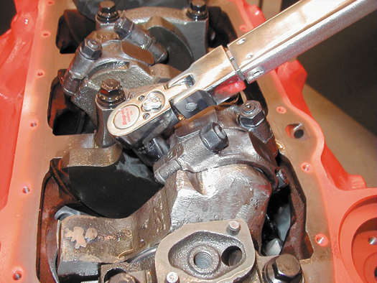
FIGURE 4–13 Using a torque wench to tighten connecting rod nuts on an engine.

Slide 13
SCREWDRIVERS (1 OF 2)
Many smaller fasteners are removed and installed by using a screwdriver.
Screwdrivers are available in many sizes and tip shapes.
The most commonly used screwdriver is called a flat tip or straight blade.

Slide 14
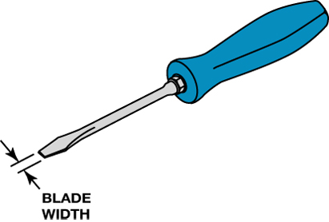
FIGURE 4–17 A flat-tip (straight blade) screwdriver. The width of the blade should match the width of the slot in the fastener being loosened or tightened.

Slide 15
SCREWDRIVERS (2 OF 2)
Flat-tip screwdrivers are sized by the width of the blade and this width should match the width of the slot in the screw.
Offset Screwdrivers
Impact Screwdriver

Slide 16
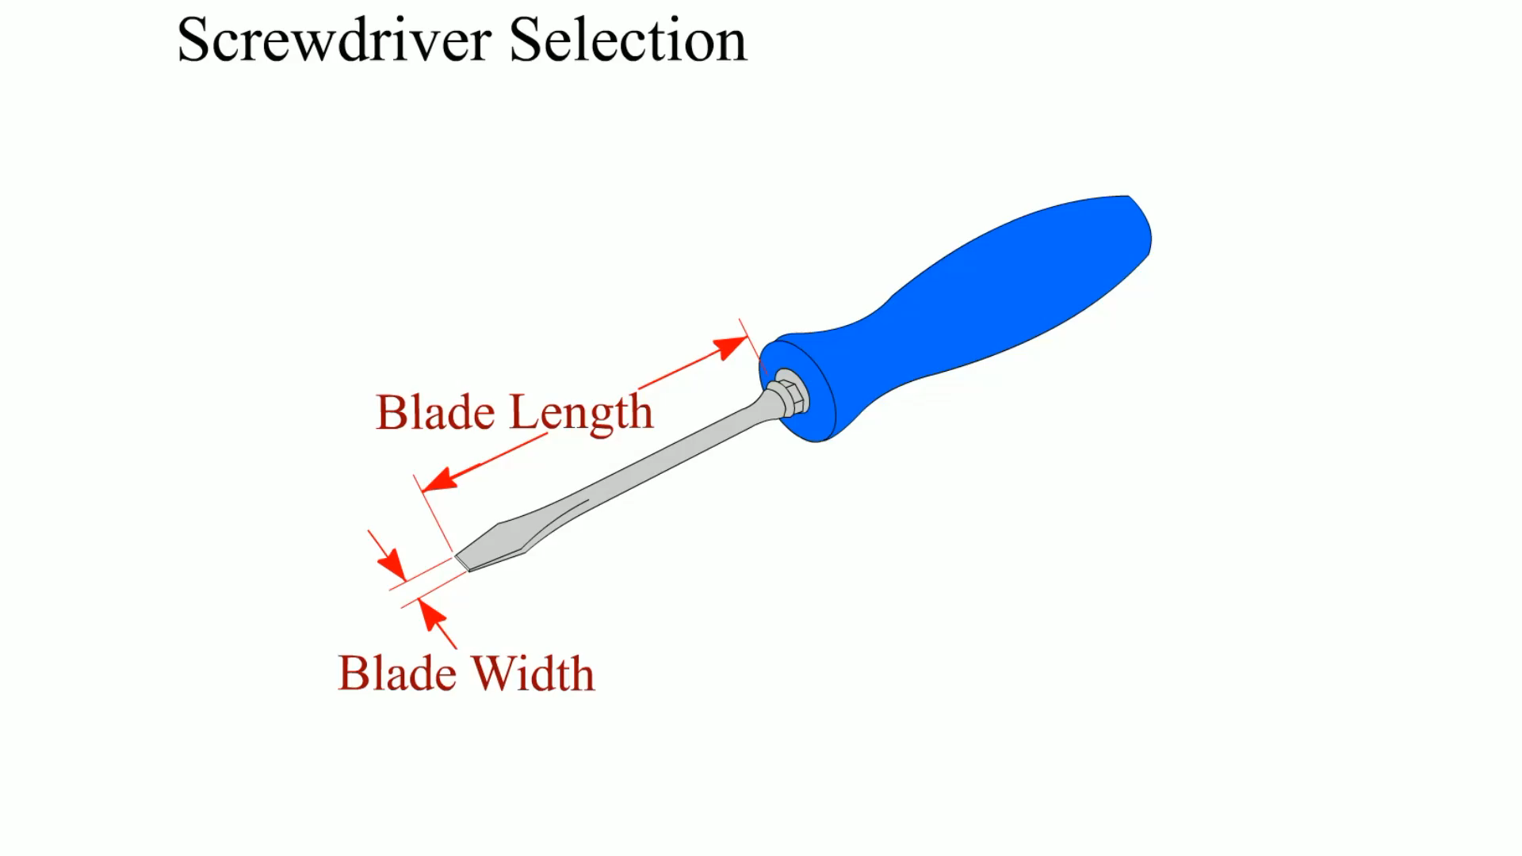
Animation: Screwdriver Selection (The animation will automatically start in a few seconds)

Slide 17
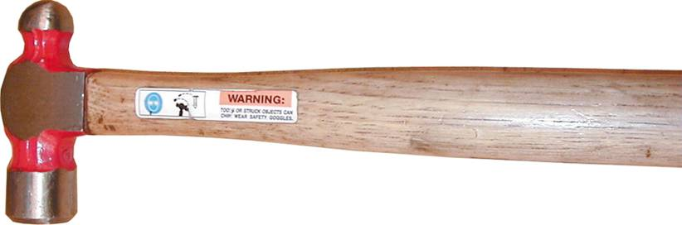
HAMMERS AND MALLETS
Hammers and mallets are used to force objects together or apart
FIGURE 4–21 A typical ball-peen hammer.

Slide 18
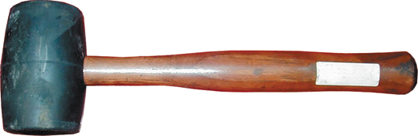
FIGURE 4–22 A rubber mallet used to deliver a force to an object without harming the surface.

Slide 19
PLIERS (1 OF 2)
Pliers are used to hold, twist, bend, and cut objects
Slip-joint Pliers
Multigroove Adjustable Pliers
Linesman's Pliers
Diagonal Pliers

Slide 20
PLIERS (2 OF 2)
Needle-nose Pliers
Locking Pliers
Snap-ring Pliers
Files

Slide 21
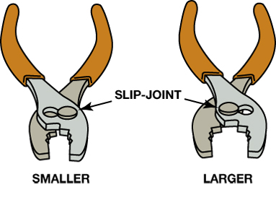
FIGURE 4–24 Typical slip-joint pliers, which are also common household pliers. The slip joint allows the jaws to be opened to two different settings.

Slide 22
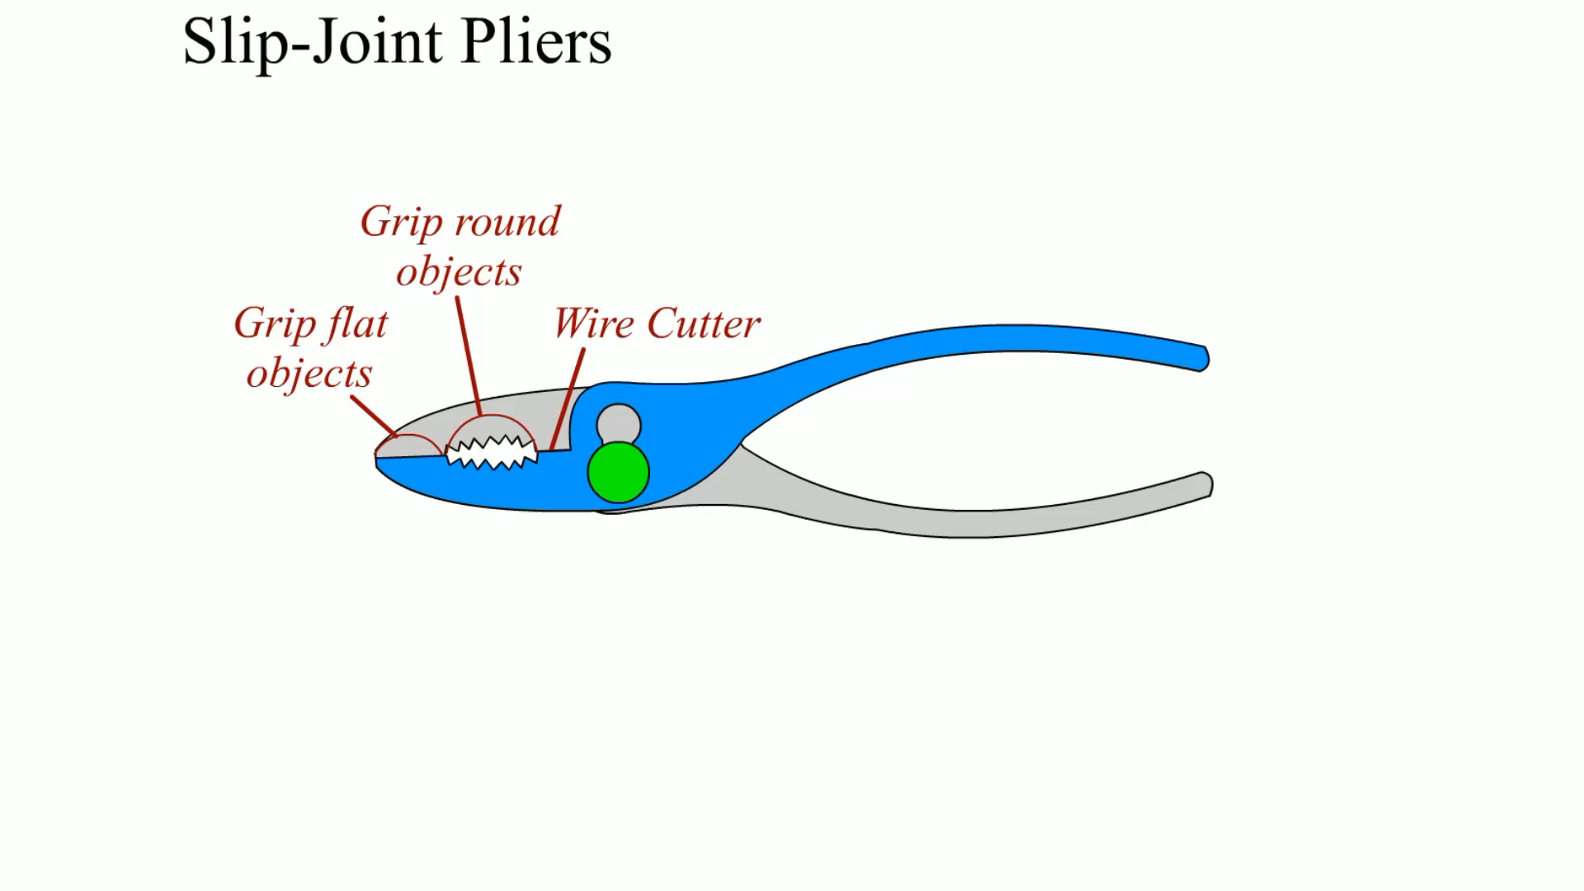
Animation: Slip-Joint Pliers (The animation will automatically start in a few seconds)

Slide 23
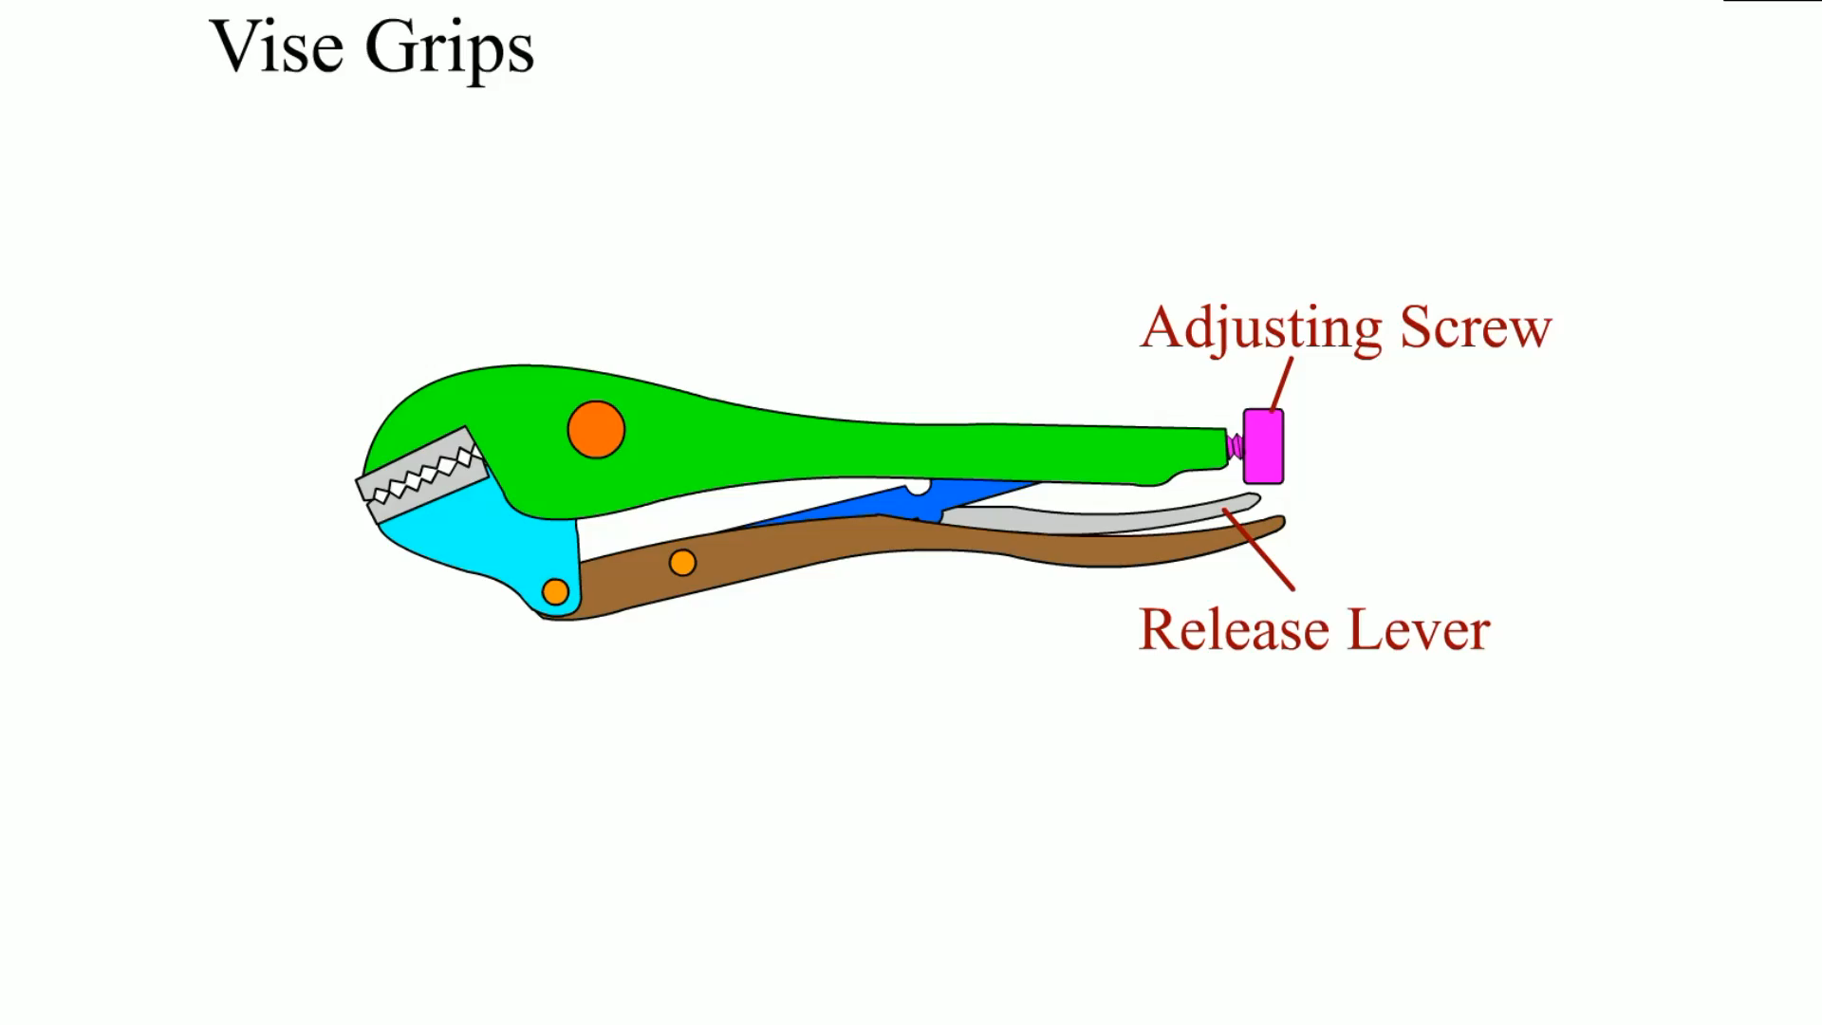
Animation: Vise Grips (The animation will automatically start in a few seconds)

Slide 24
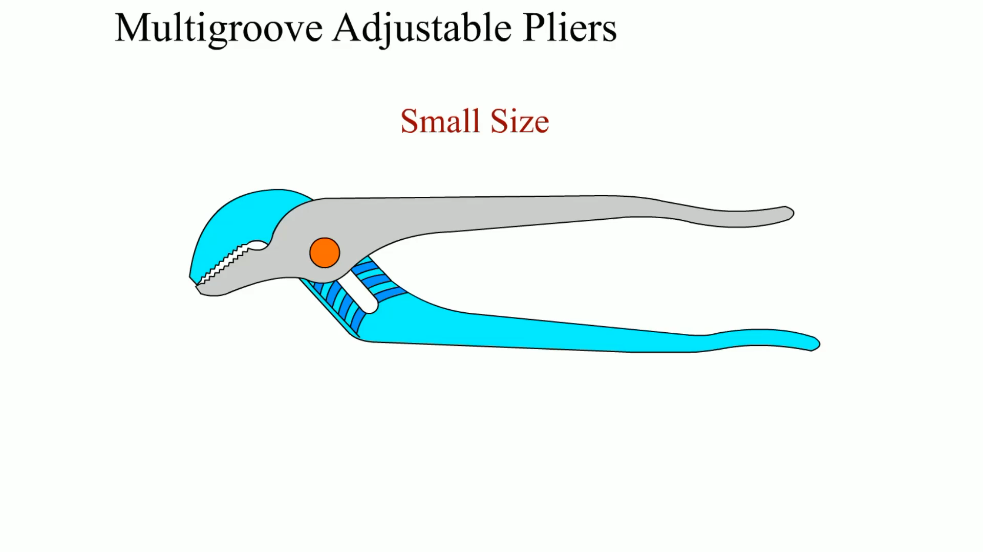
Animation: Multigroove Adjustable Pliers (The animation will automatically start in a few seconds)

Slide 25
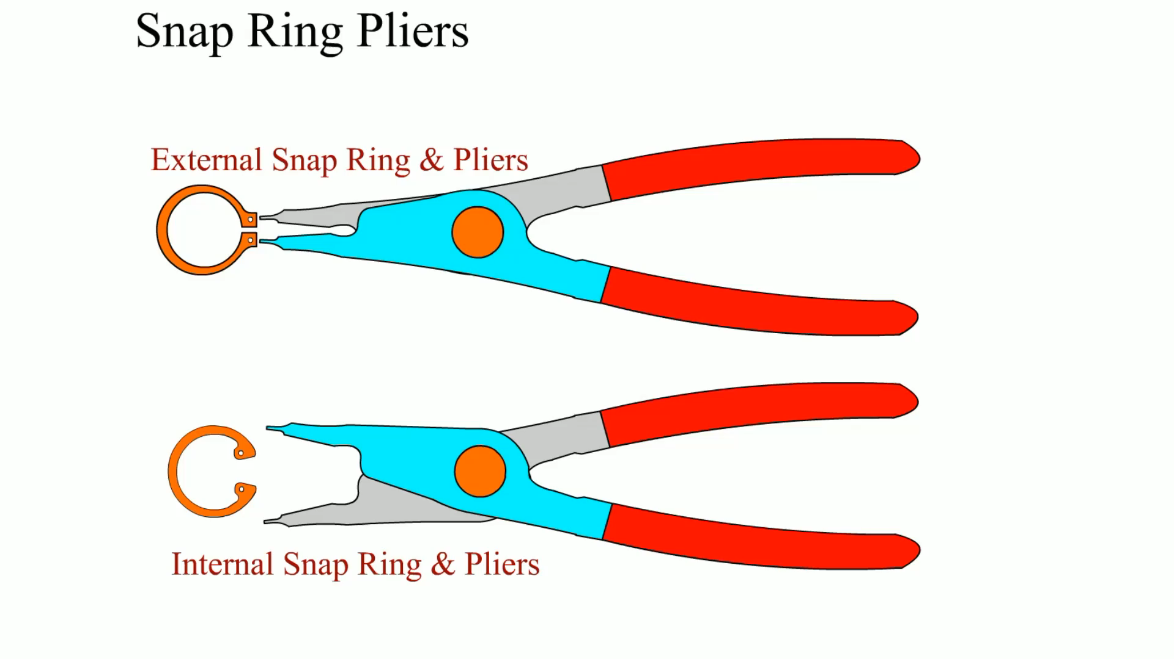
Animation: Snap Ring Pliers (The animation will automatically start in a few seconds)

Slide 26
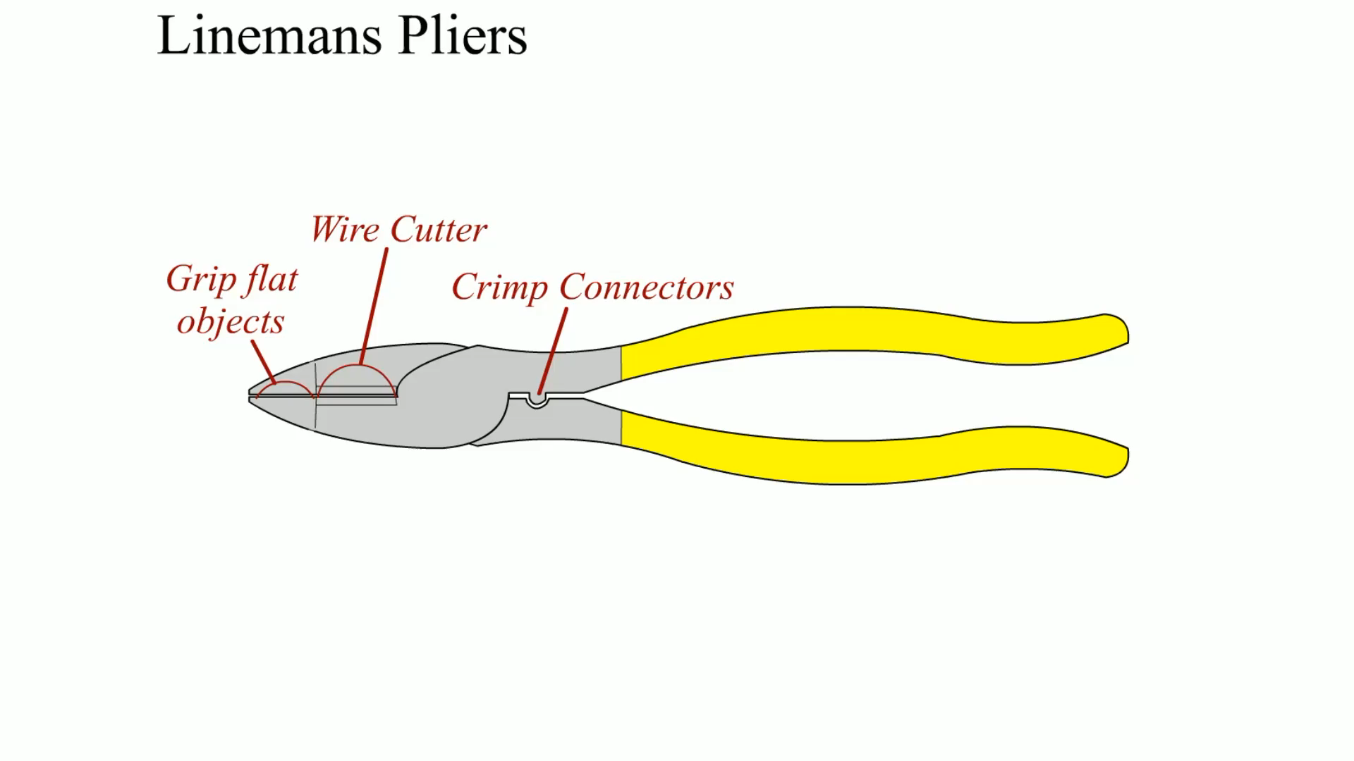
Animation: Lineman’s Pliers (The animation will automatically start in a few seconds)

Slide 27
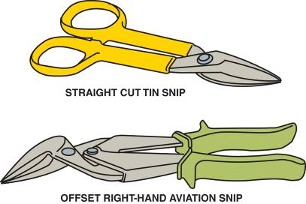
CUTTERS
Snips
Utility Knife
Safe Use of Cutters
FIGURE 4–32 Tin snips are used to cut thin sheets of metal or carpet.

Slide 28
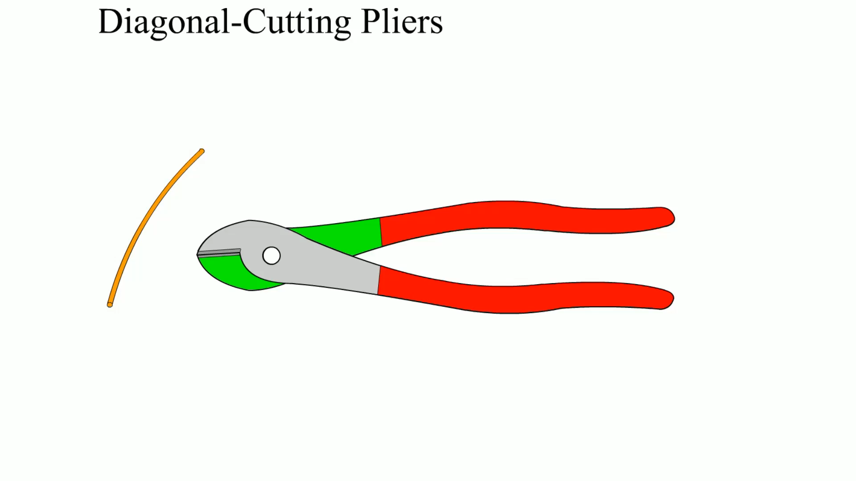
Animation: Diagonal-Cutting Pliers (The animation will automatically start in a few seconds)

Slide 29
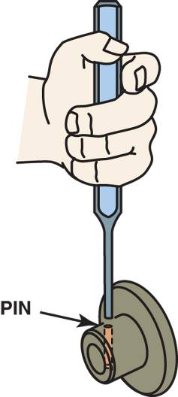
PUNCHES AND CHISELS
Punches
Chisels
FIGURE 4–34 A punch used to drive pins from assembled components. This type of punch is also called a pin punch.

Slide 30
REMOVERS (1 OF 2)
Removers are tools used to remove damaged fasteners.
A remover tool is not normally needed during routine service unless the fastener is corroded or has been broken or damaged by a previous attempt to remove the bolt or nut.

Slide 31
REMOVERS (2 OF 2)
Damaged Heads
Broken Bolts, Studs, or Screws

Slide 32
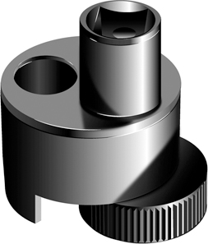
FIGURE 4–37 A stud remover uses an offset serrated wheel to grasp the stud so it will be rotated when a ratchet or breaker bar is used to rotate the assembly.

Slide 33
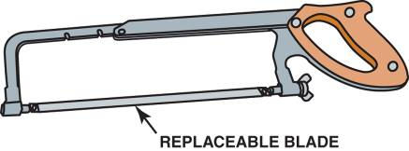
HACKSAWS
A hacksaw is used to cut metals, such as steel, aluminum, brass, or copper.
FIGURE 4–41 A typical hacksaw that is used to cut metal. If cutting sheet metal or thin objects, a blade with more teeth should be used.

Slide 34
BASIC HAND TOOL LIST
How many items can you name from the list?

Slide 35
TOOL SETS AND ACCESSORIES
A beginning service technician may wish to start with a small set of tools before spending a lot of money on an expensive, extensive tool box.

Slide 36
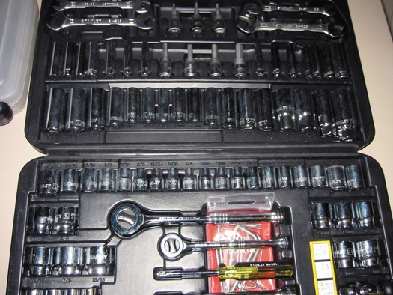
FIGURE 4–42 A typical beginning technician tool set that includes the basic tools to get started.

Slide 37
SEAL PULLERS AND DRIVERS
What is the difference between seal pullers and seal drivers?

Slide 38
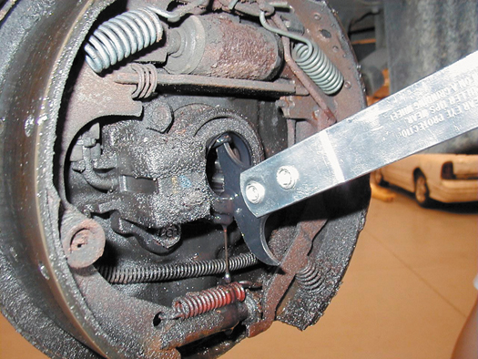
FIGURE 4–44 A seal puller being used to remove a seal from a rear axle.

Slide 39
ELECTRICAL HAND TOOLS
Test Lights
Soldering Guns
Electric soldering gun
Electric soldering pencil
Butane-powered soldering iron

Slide 40
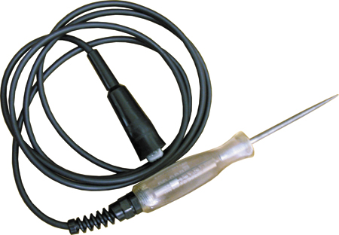
FIGURE 4–46 A typical 12 volt test light.

Slide 41
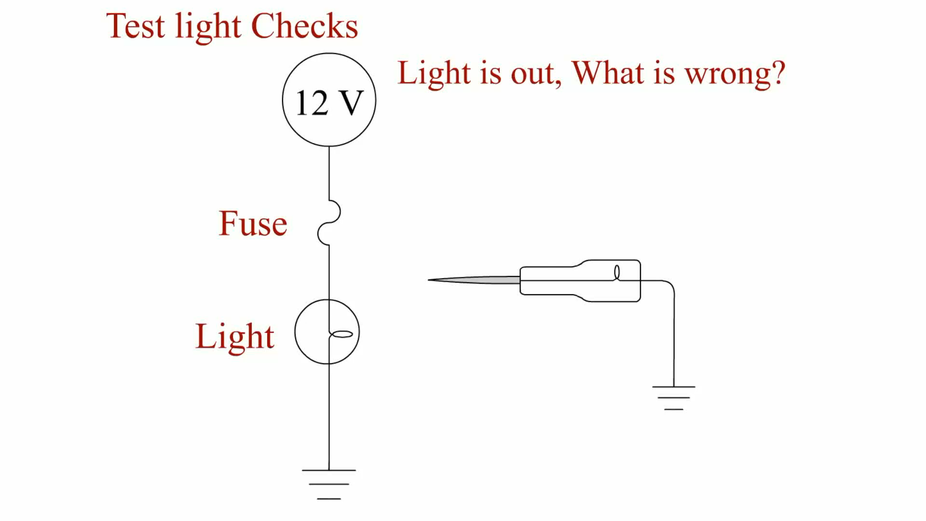
Animation: Test Light Checks (The animation will automatically start in a few seconds)

Slide 42
SAFETY TIPS FOR USING HAND TOOLS (1 OF 3)
Always pull a wrench toward you for best control and safety. Never push a wrench.
Keep wrenches and all hand tools clean to help prevent rust and to allow for a better, firmer grip.
Always use a 6-point socket or a box-end wrench to break loose a tight bolt or nut.

Slide 43
SAFETY TIPS FOR USING HAND TOOLS (2 OF 3)
Use a box-end wrench for torque and an open-end wrench for speed.
Never use a pipe extension or other type of "cheater bar" on a wrench or ratchet handle.
Always use the proper tool for the job. If a specialized tool is required, use the proper tool and do not try to use another tool improperly.

Slide 44
SAFETY TIPS FOR USING HAND TOOLS (3 OF 3)
Never expose any tool to excessive heat.
Never use a hammer on any wrench or socket handle unless you are using a special "staking face" wrench designed to be used with a hammer.
Replace any tools that are damaged or worn.

Slide 45
HAND TOOL MAINTENANCE (1 OF 2)
Clean each tool before placing it back into the tool box.
Keep tools separated.
Line the drawers of the tool box with a material that will prevent the tools from moving as the drawers are opened and closed.

Slide 46
HAND TOOL MAINTENANCE (2 OF 2)
Release the tension on all "clicker-type" torque wrenches after use.
Keep the tool box secure.

Slide 47
SUMMARY (1 OF 3)
Wrenches are available in open end, box end, and combination open and box end.
An adjustable wrench should only be used where the proper size is not available.
Line wrenches are used to remove fuel or refrigerant lines.

Slide 48
SUMMARY (2 OF 3)
Sockets are rotated by a ratchet or breaker bar, also called a flex handle.
Torque wrenches measure the amount of torque applied to a fastener.
Screwdriver types include straight blade (flat tip) Torx, and Phillips.
Hammers and mallets come in a variety of sizes and weights.

Slide 49
SUMMARY (3 OF 3)
Pliers are a useful tool and are available in many different types, including slip-joint, multigroove, linesman's, diagonal, needle-nose, and locking pliers.
Other common hand tools include snap-ring pliers, files, cutters, punches, chisels, and hacksaws.

Slide 50
Video Links (Internet Access Required)
Essential Tools (time 13:24)

