Slide 1

Automotive Engines Theory and Servicing
Ninth Edition
Chapter 35
Engine Installation and Break-In

Slide 2
OBJECTIVES
35.1 Discuss the preinstallation checklist.
35.2 Explain the procedure for transmission installation.
35.3 Explain the process of dressing the engine and engine installation.
35.4 Explain engine start and discuss the break-in precautions of an overhauled engine.

Slide 3
PREINSTALLATION CHECKLIST (1 OF 4)
Engine installation must be thoroughly checked to ensure that it is in proper condition to give the customer dependable operation for a long time.
Using a checklist guarantees that all accessories are correctly reinstalled on the engine.

Slide 4
PREINSTALLATION CHECKLIST (2 OF 4)
Before installing or starting a new or rebuilt engine in a vehicle, be sure all of the following items have been checked.
Be sure the battery is fully charged.
Prelube the engine and check for proper oil pressure.
Check that all electrical wiring connecters and harnesses are properly installed.
Check that all of the vacuum lines are correctly installed and routed.

Slide 5
PREINSTALLATION CHECKLIST (3 OF 4)
Before installing or starting a new or rebuilt engine in a vehicle, be sure all of the following items have been checked.
Check that all fuel lines are properly connected and free from leaks.
Make sure all engine fluids are at the proper operating level such as coolant, engine oil, and power steering fluid.
Know the ignition timing specification and procedure.

Slide 6
PREINSTALLATION CHECKLIST (4 OF 4)
Before installing or starting a new or rebuilt engine in a vehicle, be sure all of the following items have been checked.
Check that fresh fuel is in the fuel tank.
Be sure that the radiator has been tested, is free from leaks, and flows correctly.
Check that all accessory drive belts are routed and tensioned correctly.

Slide 7
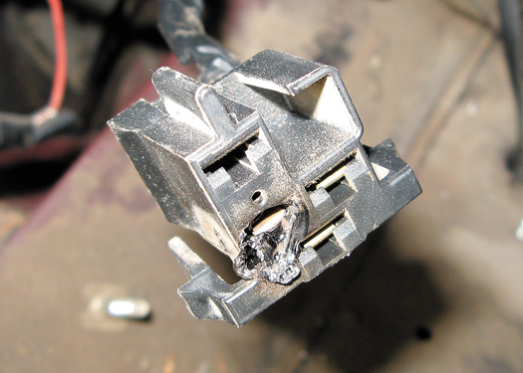
Figure 35–1 A partially melted electrical connector indicates that excessive current flow was present. The cause of the excessive current should be located and corrected before the engine is started.

Slide 8
TRANSMISSION INSTALLATION (1 OF 5)
Manual
STEP 1 A new clutch assembly or, at the least, a new clutch friction disc should be installed.
STEP 2 The clutch friction disc must be held in position using an alignment tool that is secured in the pilot bearing.

Slide 9
TRANSMISSION INSTALLATION (2 OF 5)
STEP 3 The engine bell housing is put on the engine, if it was not installed before. The alignment of this type of bell housing is then checked.
STEP 4 The clutch release yoke should be checked for free movement.

Slide 10
TRANSMISSION INSTALLATION (3 OF 5)
STEP 5 The transmission is installed by carefully guiding the transmission input (clutch) shaft straight into the clutch disc and pilot bearing.
Rotate the transmission output shaft as needed to engage the splines of the clutch disc.

Slide 11
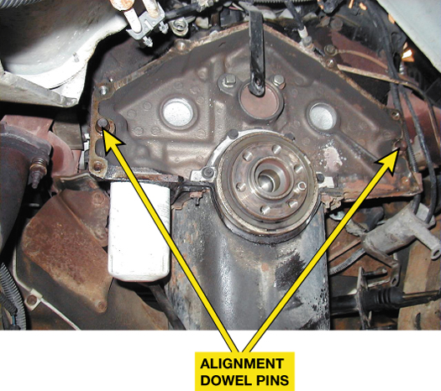
Figure 35–2 Bell housing alignment dowel pins are used to ensure proper alignment between the engine block and the transmission.

Slide 12
TRANSMISSION INSTALLATION (4 OF 5)
Automatic
STEP 1 The torque converter should be installed on the transmission before the transmission is put on the engine.
STEP 2 Rotate the torque converter while it is pushed onto the transmission shafts until the splines of all shafts are engaged in the torque converter.

Slide 13
TRANSMISSION INSTALLATION (5 OF 5)
STEP 3 The torque converter is held against the transmission as the transmission is fitted on the back of the engine. The transmission mounting bolts are attached finger tight.
STEP 4 The torque converter should be rotated to make sure that there is no binding.
The bell housing is secured to the block and then the torque converter is fastened to the drive plate.

Slide 14
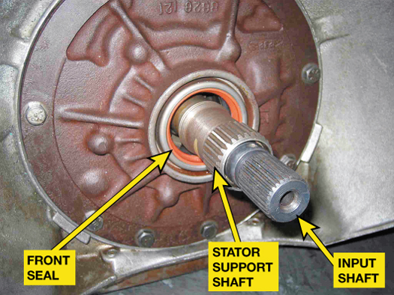
FIGURE 35–4 The internal splines inside the torque converter must be properly aligned with all of the splines of the automatic transmission.

Slide 15
DRESSING THE ENGINE (1 OF 2)
"Dressing the engine" is a term used to describe the process of attaching all of the auxiliary items to the engine. The items include:
Starter motor
Fuel rail and related fuel system components
New oxygen sensor(s), to ensure that the engine will be operating at the correct air-fuel ratio

Slide 16
DRESSING THE ENGINE (2 OF 2)
Engine/transmission wiring harness
Ignition components, such the ignition coil(s) and spark plug wires, if equipped
All belt-driven engine accessories, mounted on the front of the engine
Front accessories, such as the power steering pump, alternator, and air-conditioning compressor.

Slide 17
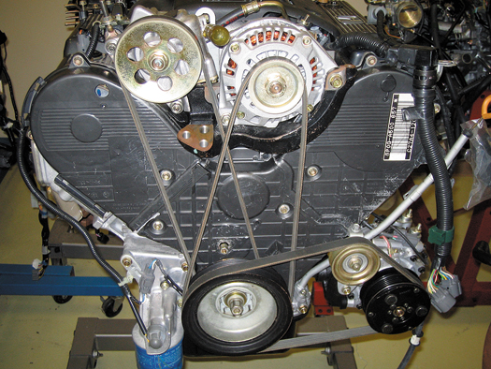
Figure 35–5 It is often easier to install all of the accessory drive belts before the engine is installed in the vehicle.

Slide 18
ENGINE INSTALLATION
Securing the Engine
Installing the Engine
Rear-wheel Drive
Front-wheel Drive
Reconnecting Components and Connectors
Cooling System
Electrical System

Slide 19
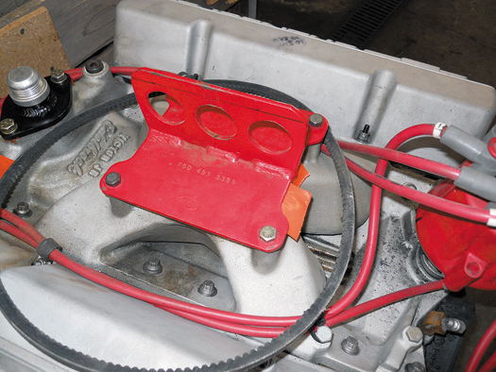
Figure 35–6 A fixture installed that is used as a place to attach the hosting chains.

Slide 20
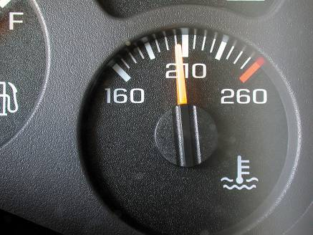
ENGINE START
Precautions
Normal Operating Temperature
How To Warm Up a Cold Engine
FIGURE 35–7 Even though the dash gauge may show normal operating temperature, a scan tool or an infrared pyrometer can also be used to verify proper coolant temperature.

Slide 21
BREAK-IN PRECAUTIONS
Any engine overhaul represents many hours of work and a large financial investment.
Precautions should be taken to protect the investment, including the following:
Never add cold water to the cooling system while the engine is running.
Never lug any engine. Lugging means increasing the throttle opening without increasing engine speed.

Slide 22
SUMMARY (1 OF 3)
Precautions should be taken to protect the investment, including the following:
Applying loads to an engine for short periods of time creates higher piston ring pressure against the cylinder walls and assists the breaking-in process by helping to seat the rings.
Change the oil and filter at 500 miles (800 km) or after 20 hours of operation.

Slide 23
SUMMARY (2 OF 3)
Check for leaks after the engine has gone through several warm-up and cooling down periods.
Carefully install all accessories.
When installing the transmission and other components on the engine block, be sure to use a torque wrench and tighten all fasteners to factory specifications.

Slide 24
SUMMARY (3 OF 3)
Always adjust the clutch free play before starting the engine.
Change the engine oil after 500 miles (800 km) or sooner, and use specified engine oil.

Slide 25
Video Links (Internet Access Required)
Trailblazer engine remove and reinstall (time 9:44)
Camshaft break in (time 1:56)
How to break in a new engine (time 9:57)

