Slide 1

Automotive Engines Theory and Servicing
Ninth Edition
Chapter 34
Engine Assembly and Dynamometer Testing

Slide 2
OBJECTIVES (1 OF 2)
34.1 Explain short block preparation and cylinder head preparation.
34.2 Discuss trial assembly and final short block assembly.
34.3 Describe camshaft installation and piston/rod installation.

Slide 3
OBJECTIVES (2 OF 2)
34.4 Explain the cylinder head installation procedure.
34.5 Discuss torque-to-yield head bolts.
34.6 Explain valve train assembly and final assembly of an engine.
34.7 Explain dynamometer testing.

Slide 4
DETAILS, DETAILS, DETAILS
Read
Understand
Follow

Slide 5
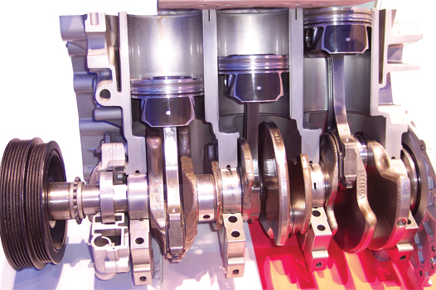
Figure 34–1 A Ford 1.0 liter 3-cylinder engine is different than many small engines and may require detailed service information to be sure that all of the steps are taken for proper assembly.

Slide 6
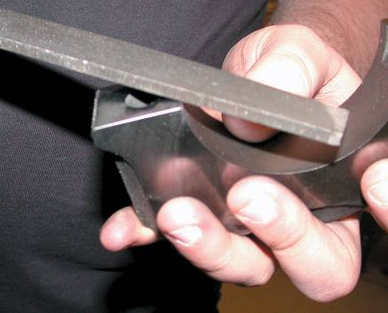
SHORT BLOCK PREPARATION
Items to Check
Surface Finish
Checking Surfaces Before Assembly
Preparing the Block For Studs
Preparing Threaded Holes
FIGURE 34–2 Deburring all sharp edges is an important step to achieve proper engine assembly.

Slide 7
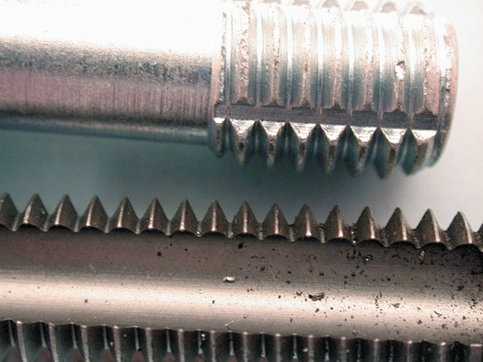
FIGURE 34–6 A thread chaser (top) is the preferred tool to clean threaded holes because it cleans without removing metal compared to a tap (bottom).

Slide 8
CYLINDER HEAD PREPARATION (1 OF 2)
Check the following details on the cylinder head(s).
  The surface finish of the fire deck is as specified for the head gasket type to be used.
  All valves should be checked for leakage by pouring mineral spirits into the intake and exhaust parts and look for leakage past the valves.

Slide 9
CYLINDER HEAD PREPARATION (2 OF 2)
  All valve springs should be checked for even spring pressure and installed height.
  Check for proper pushrod length.
  If replacement rocker arms are used, be sure that the geometry and total lift will be okay.

Slide 10
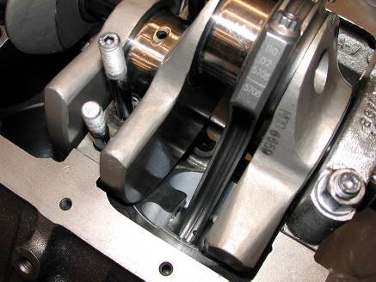
TRIAL ASSEMBLY
Short Block
Valve Train
Check the Angle Between Heads
FIGURE 34–8 A trial assembly showed that some grinding of the block will be needed to provide clearance for the counterweight of the crankshaft. Also, notice that the engine has been equipped with studs for the four-bolt main bearing caps.

Slide 11
FINAL SHORT BLOCK ASSEMBLY (1 OF 2)
Block Preparation
Installing Cups and Plugs
Cam Bearings
Measuring Main Bearing Clearance
Correcting Bearing Clearance
Lip Seal Installation

Slide 12
FINAL SHORT BLOCK ASSEMBLY (2 OF 2)
Rope Seal Installation
Crankshaft Installation
Thrust Bearing Clearance
Main Bearing Tightening Procedure
Crankshaft Rotating Torque

Slide 13
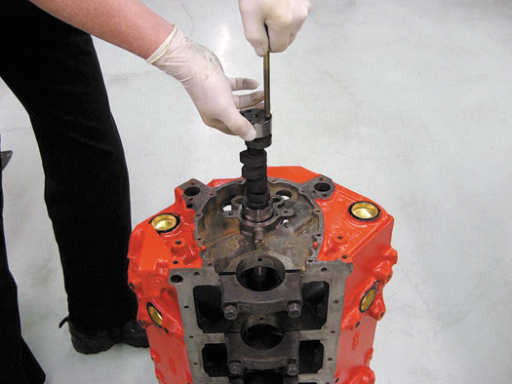
Figure 34–26 Installing a camshaft is easier if the engine is vertical so gravity can help, and this method reduces the possibility of damaging the cam bearings.

Slide 14
INSTALLING THE CAMSHAFT
Prelubrication
Camshaft Precautions
  New valve lifters
  Reuse camshaft if possible
  Never use:
    A hydraulic lifter camshaft with solid lifters
    OR hydraulic lifters with a solid lifter camshaft.

Slide 15
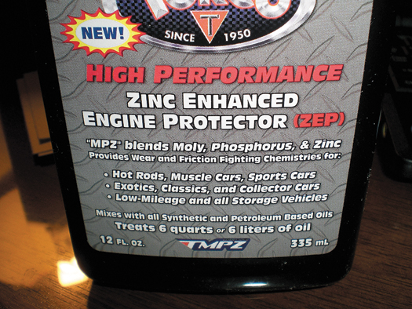
FIGURE 34–27 A commercial additive designed to protect a flat-bottom lifter camshaft used in older vehicles when using newer oils that do not have enough ZDDP to protect the camshaft and lifters.

Slide 16
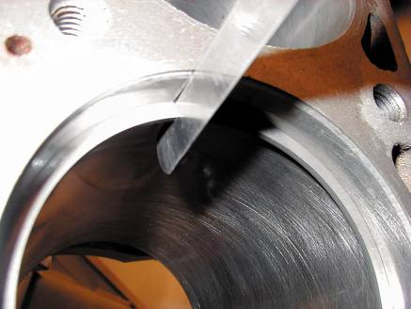
PISTON/ROD INSTALLATION
Checking Piston Rings
Piston Markings
Connecting Rod Bearing Clearance
Piston Installation
Connecting Rod Side Clearance
FIGURE 34–28 A feeler gauge is used to check piston ring gap.

Slide 17
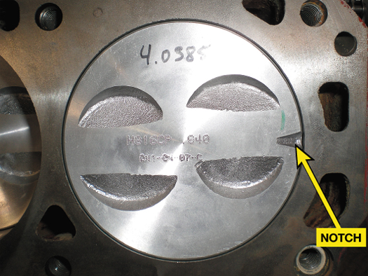
Figure 34–29 The notch on a piston should always face toward the front of the engine.

Slide 18
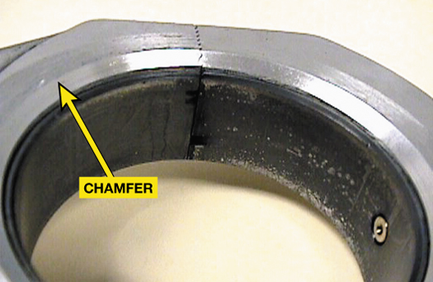
Figure 34–30 On V-type engines that use paired rod journals, the side of the rod with the large chamfer should face toward the crank throw (outward).

Slide 19
CYLINDER HEAD INSTALLATION
Installing the Camshaft For OHC Engines
Head Bolt Torque Sequence
Clamping Force
Fastener Consideration
Thread Lubricant

Slide 20
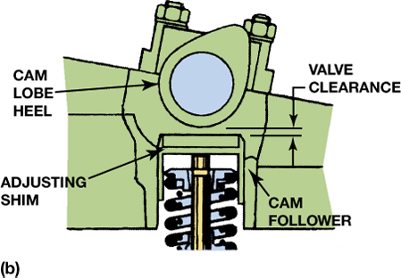
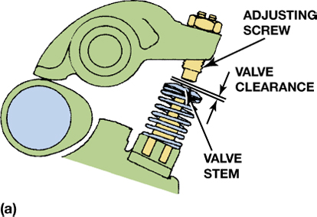
Figure 34–39 Valve clearance allows the metal parts to expand and maintain proper operation, both when the engine is cold and at normal operating temperature. (a) Adjustment is achieved by turning the adjusting screw. (b) Adjustment is achieved by changing the thickness of the adjusting shim.

Slide 21
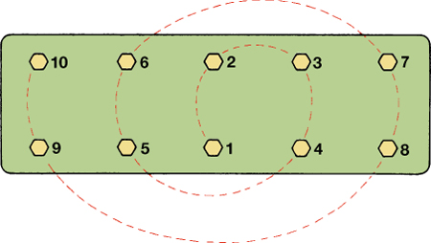
Figure 34–41 Typical cylinder head tightening sequence.

Slide 22
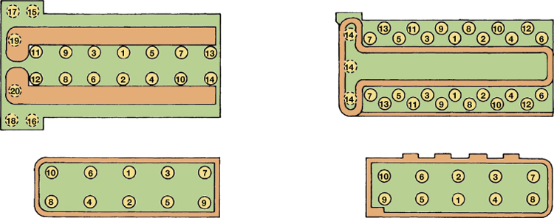
Figure 34–42 Examples of cylinder head bolt torquing sequences.

Slide 23
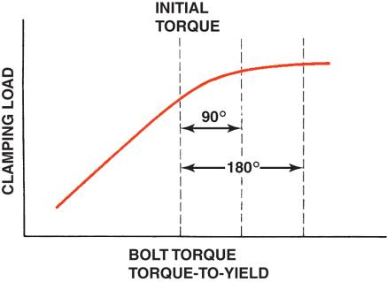
TORQUE-TO-YIELD HEAD BOLTS
Definition and Terminology
Bolt Construction
Torque-to-yield Procedure
Torque Angle Method
FIGURE 34–44 Due to variations in clamping force with turning force (torque) of head bolts, some engines are specifying the torque-to-yield procedure. The first step is to torque the bolts by an even amount called the initial torque. Final clamping load is achieved by turning the bolt a specified number of degrees. Bolt stretch provides the proper clamping force.

Slide 24
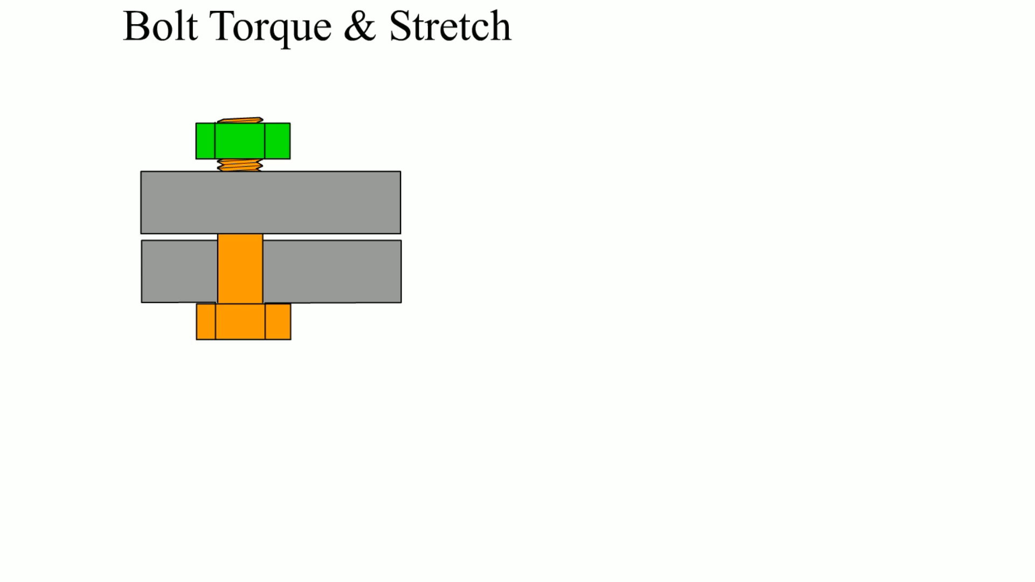
Animation: Bolt Torque & Stretch
(The animation will automatically start in a few seconds)

Slide 25
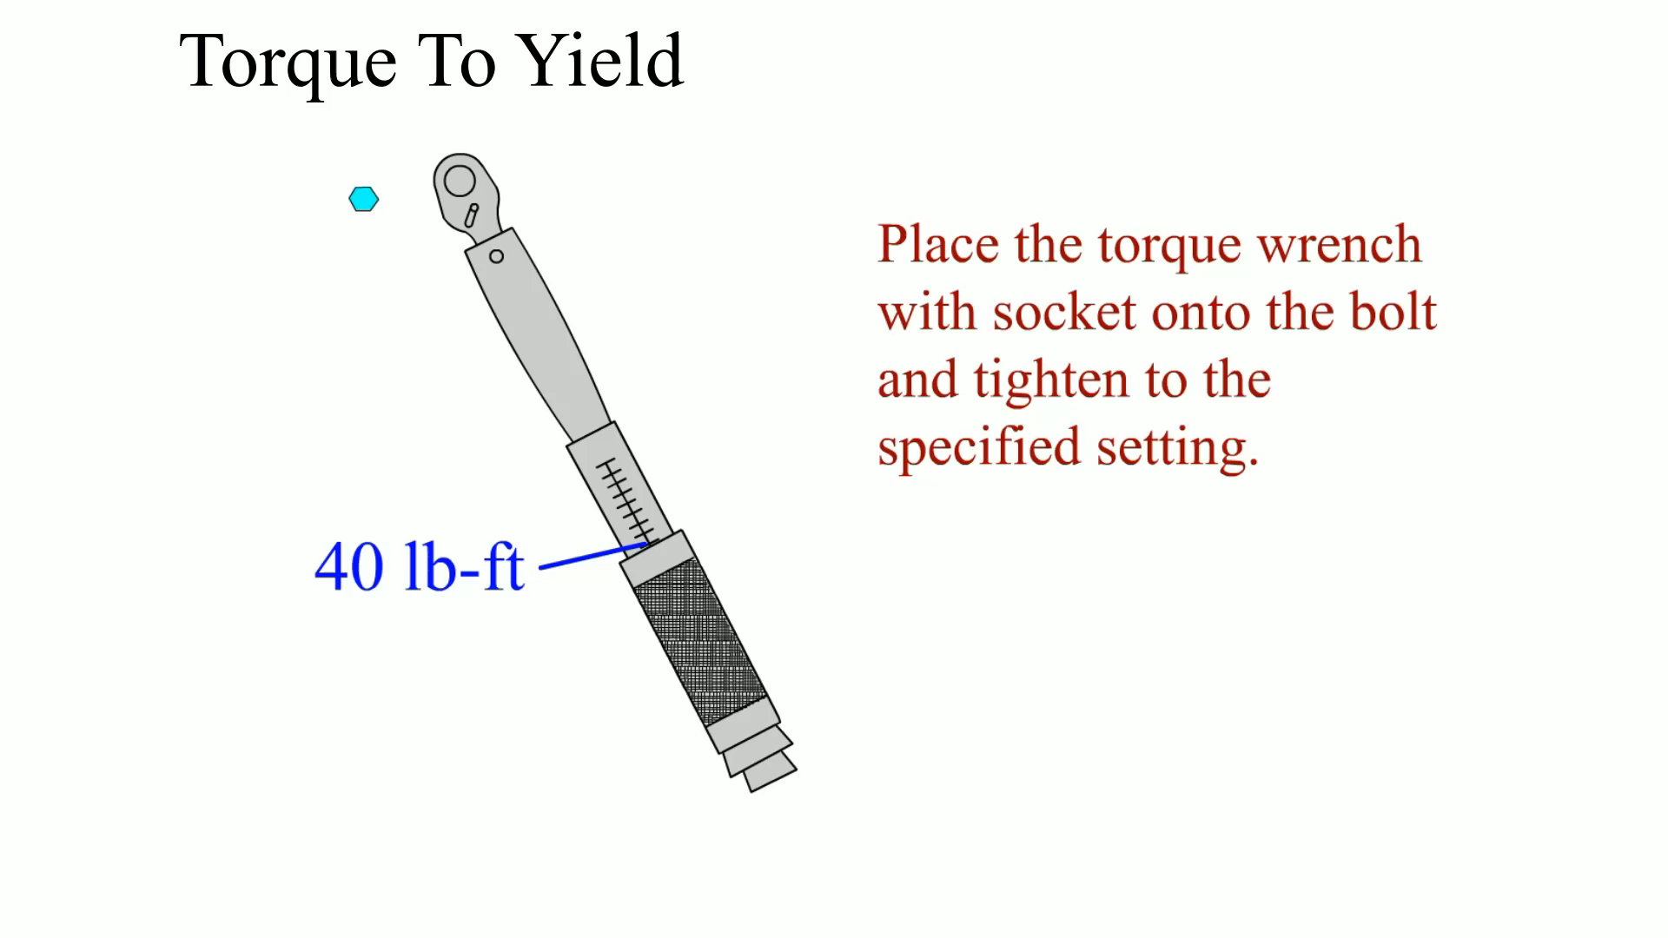
Animation: Torque To Yield
(The animation will automatically start in a few seconds)

Slide 26
VALVE TRAIN ASSEMBLY
Timing Drives for OHC Engines
Hydraulic Valve Lifter Installation
Bleeding Hydraulic Lifters
Timing Chains and Gears Installation
OHV Engine Lifter And Pushrod Installation
Hydraulic Lifter Adjustment
Solid Lifter Adjustment

Slide 27
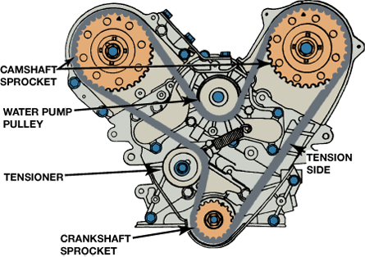
Figure 34–48 Both camshafts have to be timed on this engine and the timing belt also drives the water pump.

Slide 28
FINAL ASSEMBLY (1 OF 2)
Manifold Installation
Timing Cover Installation
Vibration Damper Installation
Oil Pump Installation
Oil Pan Installation

Slide 29
FINAL ASSEMBLY (2 OF 2)
Water Pump Installation
Engine Painting
Prelubricating the Engine
Setting Ignition Timing

Slide 30
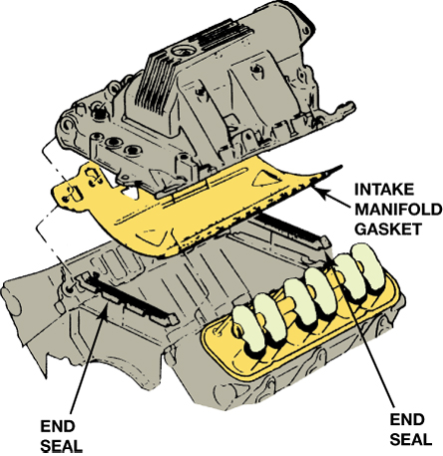
Figure 34–54 This intake manifold gasket includes end seals and a full shield cover for the valley to keep hot engine oil from heating the intake manifold.

Slide 31
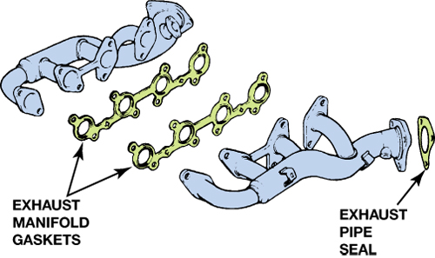
Figure 34–55 An exhaust manifold gasket is used on some engines. It seals the exhaust manifold to the cylinder head.

Slide 32
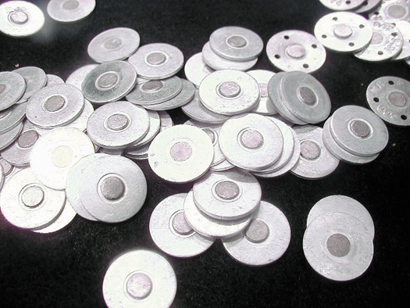
Figure 34–62 Heat tabs can be purchased from engine supply companies.

Slide 33
DYNAMOMETER TESTING
Purposes
Types of Dynamometers
Terminology
Measured Values
Calculated Numbers
Standards
Final Notes

Slide 34
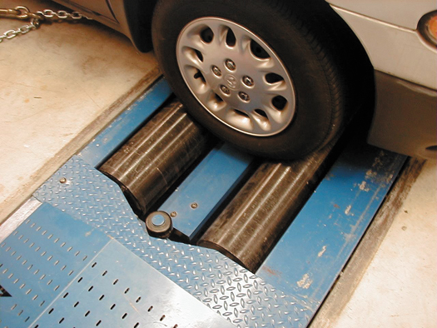
Figure 34–64 A chassis dynamometer is used to measure torque at the drive wheels. There is a power loss through the drive train so the measured values are about 20% less than when measuring engine output at the flywheel using an engine dynamometer.

Slide 35
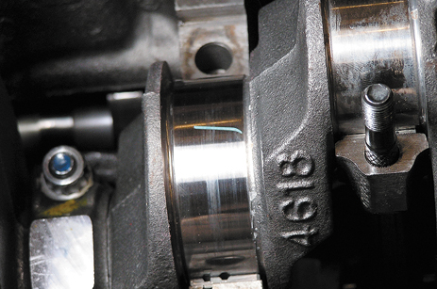
1 Clean the main bearing journal and then place a strip of Plastigage material across the entire width of the journal.

Slide 36
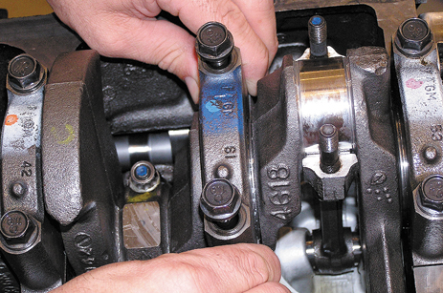
2 Carefully install the main bearing cap with the bearing installed.

Slide 37
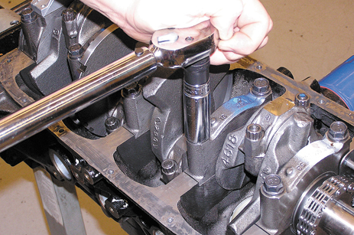
3 Torque main bearing cap bolts to factory specifications.

Slide 38
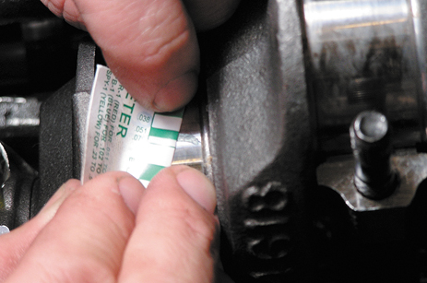
4 Carefully remove the bearing cap and, using the package that contained the Plastigage strips, measure the width of the compressed material. The gauge is calibrated in thousandths of the inch. Repeat for each main bearing.

Slide 39
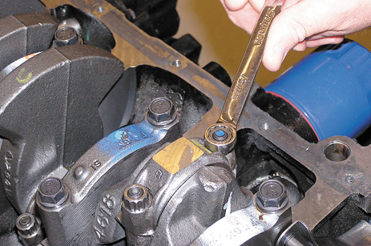
5 To measure rod bearing oil clearance, start by removing the rod cap.

Slide 40
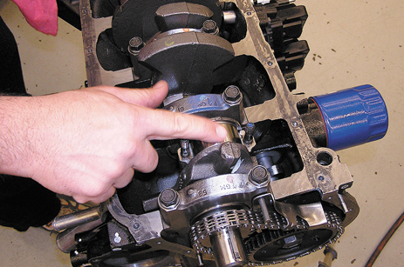
6 Clean the rod bearing journal and then place a strip of Plastigage across the entire width of the journal.

Slide 41
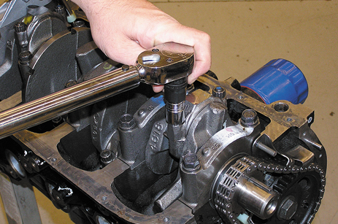
7 Torque the rod bearing cap nuts to factory specifications.

Slide 42
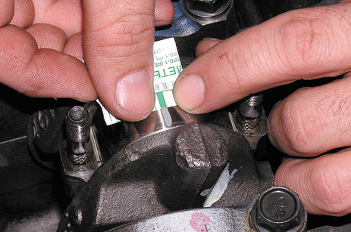
8 Remove the rod cap and measure the oil clearance using the markings on the Plastigage package. The wider the compressed gauge material, the narrower the bearing oil clearance. Repeat for all rod bearings.

Slide 43
SUMMARY (1 OF 3)
The technician should read, understand, and follow all instructions that came with the parts and gaskets to ensure proper assembly.
Assembling the short block includes preparing the block and installing the crankshaft and the piston/rod assemblies.
A trial assembly should be performed before the final assembly.

Slide 44
SUMMARY (2 OF 3)
Cylinder head assembly includes checking valve spring tension as well as proper rocker arm and pushrod measurements.
A trial assembly should be performed before the final assembly.
All bearing oil clearances should be checked using a micrometer and telescoping gauges or Plastigage.

Slide 45
SUMMARY (3 OF 3)
Piston ring end gap should be checked before the pistons are installed.
Cylinder head bolts should be properly tightened and in the specified sequence.
Testing an engine on a dynamometer allows the engine to be tested before being installed in a vehicle.

Slide 46
Video Links (Internet Access Required)
Timing gears (time 4:46)
Timing gears (time 6:39)
Timing gears (time 9:14)
Using plastigauge (time 3:49)
Piston ring end gap (time 6:50)
How to find TDC (time 1:14)
Rear main seal (time 7:38)
Motor mount (time 6:22)
SBC top end (time 23:45)
SBC lower end (time 23:41)

Slide 47
Video Links (Internet Access Required)
Crankshaft balancing (time 1:37)
Plasti gauge (time 10:18)
Rod bearing install (time 1:52)
Thrust bearing (time 6:04)
Radius and fillet (time 2:32)
End play check (time 4:23)
Motor mount (time 4:38)
Checking valve to piston clearance part 1 (time 2:53)
Checking valve to piston clearance part 2 (time 4:01)
Rear main seal check (time 1:53)

Slide 48
Video Links (Internet Access Required)
Motor mounts (time 10:54)
Motor mount (time 1:21)
King Engine Bearing & Crankshaft Installation Guide (time 10:20)
Robert Dana teaches you how to install a Harmonic Balancer (time 5:10)
Honda Crank Bolt & Harmonic Balancer Removal DIY (time 4:03)
Install piston rings (time 2:14)
Front seal replacement (time 6:27)
How To Remove / Install Freeze Plugs (time 12:49)
Valve adjustment (time 2:09)
Valve adjustment (time 1:39)

Slide 49
Video Links (Internet Access Required)
Camshaft installation (time 1:37)
Torque a cylinder head (time 25:08)
Install cam bearings (time 2:24)
Replace freeze plugs (time 3:43)

