Slide 1

Automotive Engines Theory and Servicing
Ninth Edition
Chapter 32
Gaskets and Sealants

Slide 2
OBJECTIVES
32.1 Discuss the need for gaskets and sealants.
32.2 Describe head gaskets and the types of head gaskets.
32.3 Discuss cover gasket materials and gasket failures.
32.4 Discuss the purpose and function of oil seals.
32.5 Discuss the purpose and function of assembly sealants.

Slide 3
INTRODUCTION (1 OF 2)
Gaskets and sealants are used in engines to seal gaps and potential gaps between two or more parts.
Gaskets and sealants must be able to withstand:
Temperatures to which the engine part may be exposed during normal operation

Slide 4
INTRODUCTION (2 OF 2)
Vibrations produced in the engine and the accessories that are attached to the engine
Acids and other chemicals that are found in and throughout an engine
Expanding and contracting at different rates

Slide 5
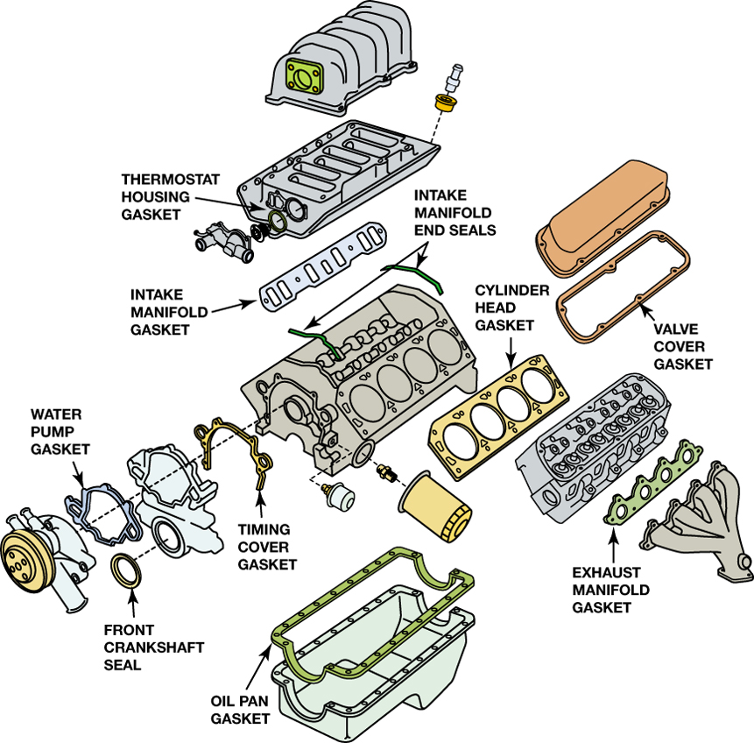
FIGURE 32–1 Gaskets are used in many locations in the engine.

Slide 6
HEAD GASKETS (1 OF 2)
The head gasket is under the highest clamping loads.
It must seal passages that carry coolant and often is required to seal a passage that carries hot engine oil.
The most demanding job of the head gasket is to seal the combustion chamber.

Slide 7
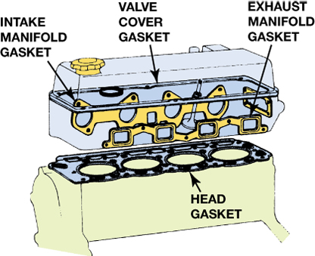
FIGURE 32–2 Gaskets help prevent leaks between two surfaces.

Slide 8
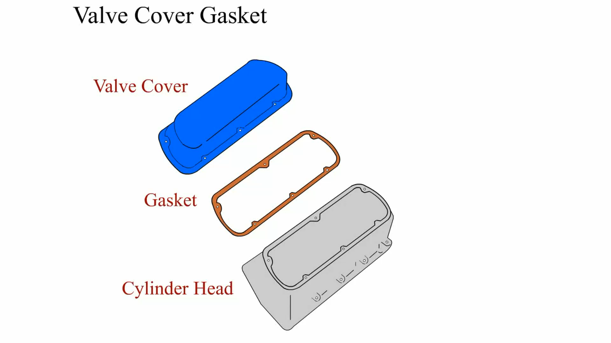
Animation: Valve Cover Gasket (The animation will automatically start in a few seconds)

Slide 9
HEAD GASKETS (2 OF 2)
As a rule of thumb, about 75% of the head bolt clamping force is used to seal the combustion chamber.
The remaining 25% seals the coolant and oil passages.
Perforated steel core gaskets
Multilayered steel gaskets

Slide 10
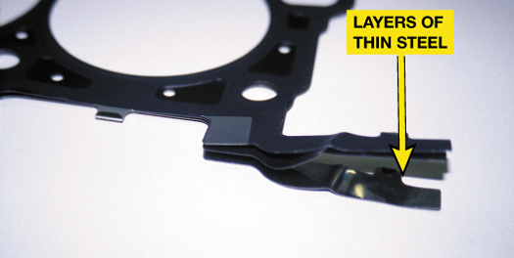
FIGURE 32–6 Multilayer steel (MLS) gaskets are used on many newer all-aluminum engines as well as on engines that use a cast block with aluminum cylinder heads. This type of gasket allows the aluminum to expand without losing the sealing ability of the gasket.

Slide 11
COVER GASKET MATERIALS
Cover Gasket Requirements
Cork Gaskets
Fiber Gaskets
Synthetic Rubber Gaskets
Rubber-coated Metal Gaskets
Formed In Place Gaskets
Plastic/Rubber Gaskets

Slide 12
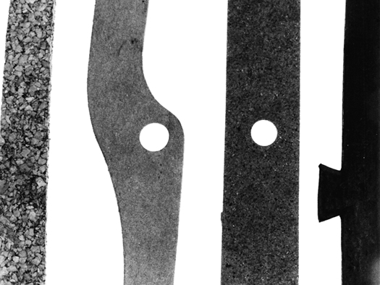
FIGURE 32–7 Left to right: Cork-rubber, paper, composite, and synthetic rubber (elastomer) gaskets.

Slide 13
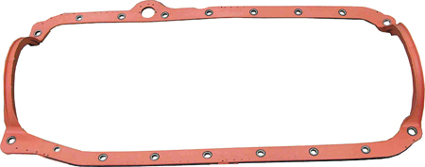
FIGURE 32–8 Rubber-coated steel gaskets have replaced many oil pan gaskets that once had separate side rail gaskets and end seals.

Slide 14
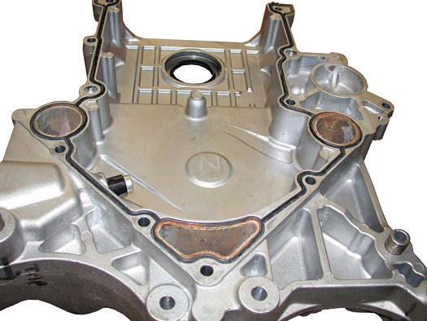
FIGURE 32–9 Formed in place gaskets often use silicone rubber and are applied at the factory using a robot. Check gasket manufacturers for the correct gasket replacement.

Slide 15
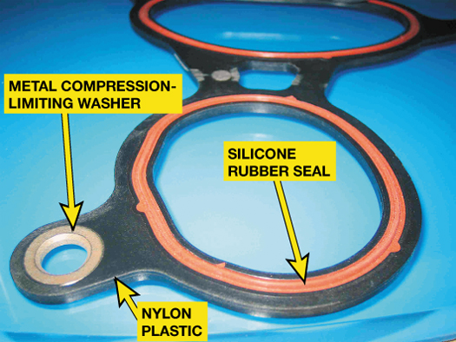
FIGURE 32–10 A typical intake manifold gasket showing the metal washer at each fastener location which keeps the gasket from being compressed too much.

Slide 16
GASKET FAILURES (1 OF 2)
Detonation may cause extreme pressure to be exerted on the armor of the head gasket, causing it to deform.
A plugged PCV system can increase crankcase pressure resulting in engine gasket failures such as oil pan, valve cover, timing cover, and main oil seals.

Slide 17
GASKET FAILURES (2 OF 2)
Improper installation such as incorrect torquing sequence can cause gasket failure.
Fretting is a condition that can destroy intake manifold gaskets, caused by the unequal expansion and contraction of two different engine materials.

Slide 18
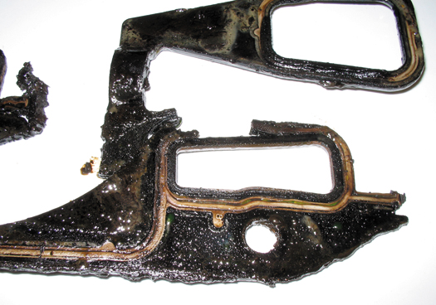
FIGURE 32–11 This intake manifold gasket was damaged due to fretting. Newer designs allow for more movement between the intake manifold and the cylinder head.

Slide 19
OIL SEALS (1 OF 2)
Oil seals allow the shaft to rotate and seal the area around the shaft to prevent oil or coolant from leaking.
Seals come in varied sizes and styles.

Slide 20
OIL SEALS (2 OF 2)
Most seals use a steel backing for strength and a variety of sealing materials, including:
Buna-N
Viton® (fluorocarbon)
Teflon® (polytetrafluorethylene, also called PTFE)

Slide 21
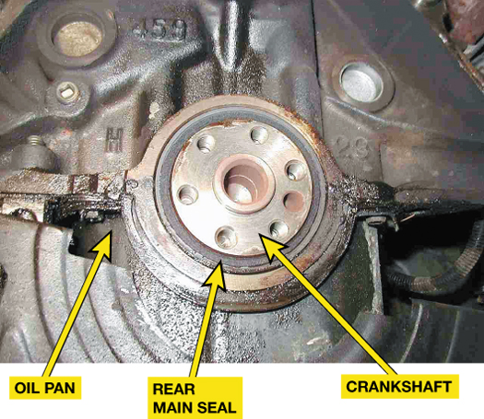
FIGURE 32–12 A rear main seal has to be designed to seal oil from leaking around the crankshaft under all temperature conditions.

Slide 22
ASSEMBLY SEALANTS
RTV Silicone
Anaerobic Sealers
Nonhardening Sealers
Antiseize Compounds
Sealant Summary

Slide 23
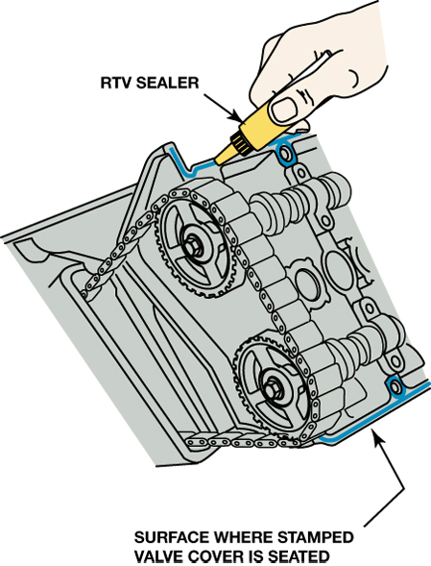
FIGURE 32–13 Room-temperature vulcanization (RTV) is designed to be a gasket substitute on nonmachined surfaces. Be sure to follow the instructions as printed on the tube for best results.

Slide 24
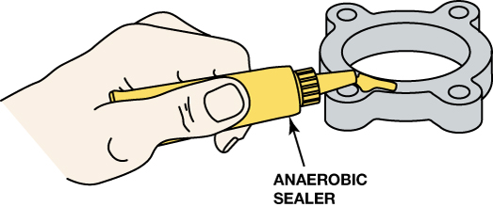
FIGURE 32–14 Anaerobic sealer is used to seal machined surfaces. Always follow the instructions on the tube for best results.

Slide 25
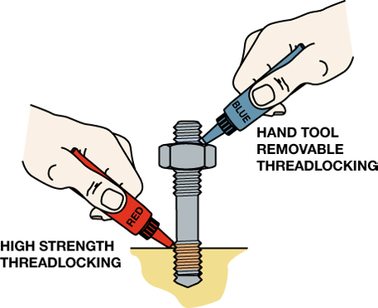
FIGURE 32–15 The strength of the thread locker depends on whether the fastener is to be removed by hand (blue). High-strength thread locker (red) can only be removed if heated.

Slide 26
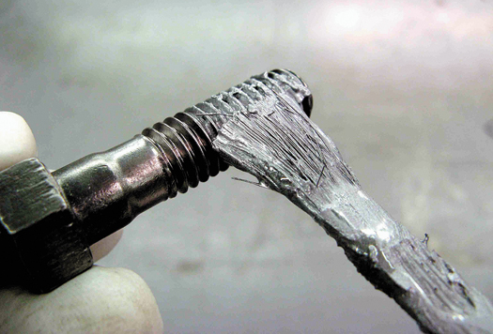
FIGURE 32–16 Applying antiseize compound to the threads of a bolt helps prevent the threads from galling or rusting.

Slide 27
SUMMARY (1 OF 2)
Gaskets are used to fill a space or gap between two objects to prevent leakage from occurring.
There are many types of gaskets including cylinder head gaskets, valve cover gaskets, and timing cover gaskets.
Rubber or contact cement is used to hold a gasket in place.

Slide 28
SUMMARY (2 OF 2)
RTV and anaerobic sealers are commonly used to seal engines.
Sealers are used to help gaskets seal.

Slide 29
Video Links (Internet Access Required)
Blown head gasket (time 6:23)
Head gasket leak test (time 1:06)
Head gasket check (time 0:54)
Signs of head gasket failure (time 1:11)
Head gasket leak (time 2:25)
Head gasket (time 14:57)
Surface preparation (time 10:28)
Rear main seal (time 7:38)
Front seal replacement (time 6:27)
Rear main seal check (time 1:53)

