Slide 1

Automotive Engines Theory and Servicing
Ninth Edition
Chapter 30
Engine Blocks

Slide 2
OBJECTIVES
30.1 Explain the construction of engine blocks.
30.2 Explain the procedure for engine block service.
30.3 Explain block preparation for assembly.

Slide 3
ENGINE BLOCKS (1 OF 2)
The engine block, which is the supporting structure for the entire engine, is made from one of the following:
Gray cast iron
Cast aluminum
Die-cast aluminum alloy
Block Manufacturing

Slide 4
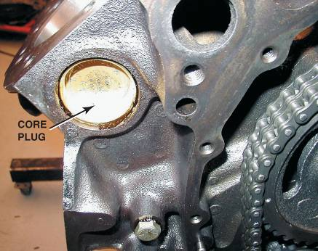
ENGINE BLOCKS (2 OF 2)
Aluminum Blocks
Bedplate Design Blocks
Casting Numbers
Block Deck
Cooling Passages
Lubricating Passages
Main Bearing Caps
FIGURE 30–2 An expansion (core) plug is used to block the opening in the cylinder head or block the holes where the core sand was removed after the part was cast.

Slide 5
ENGINE BLOCK SERVICE (1 OF 3)
Procedures
All parts of the block must be of the correct size and they must be aligned
The parts must also have the proper finishes if the engine is to function dependably for a normal service life.

Slide 6
ENGINE BLOCK SERVICE (2 OF 3)
Engine blueprinting is the reconditioning of all the critical surfaces and dimensions so that the block is actually like new.
After a thorough cleaning, the block should be inspected for cracks or other flaws before machine work begins.

Slide 7
ENGINE BLOCK SERVICE (3 OF 3)
After the block has been cleaned and cracked checked, the block should be prepared in the following sequence.
Operation 1 Main bearing housing bore alignment, often called "align boring" (or honing)
Operation 2 Machining of the block deck surface parallel to the crankshaft
Operation 3 Cylinder boring and honing

Slide 8
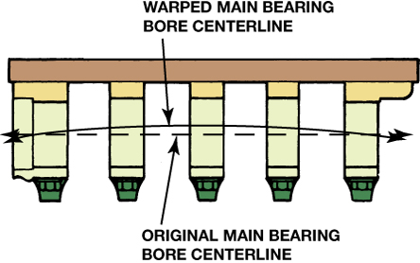
Figure 30–16 The main bearing bores of a warped block usually bend into a bowed shape. The greatest distortion is in the center bores.

Slide 9
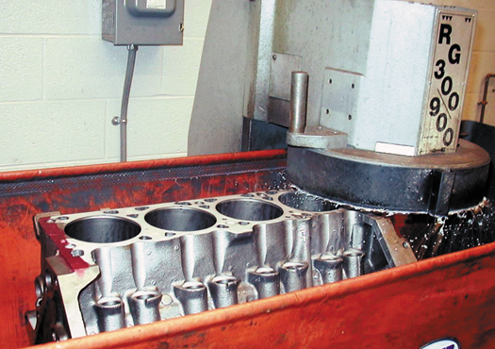
Figure 30–21 Grinding the deck surface of the block.

Slide 10
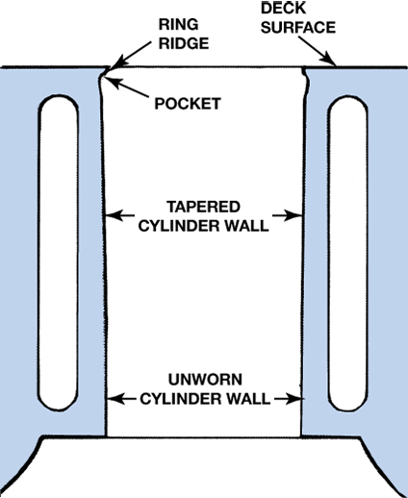
Figure 30–22 Cylinders wear in a taper, with most of the wear occurring at the top of the cylinder where the greatest amount of heat and pressure are created. The ridge is formed because the very top part of the cylinder is not contacted by the rings.

Slide 11
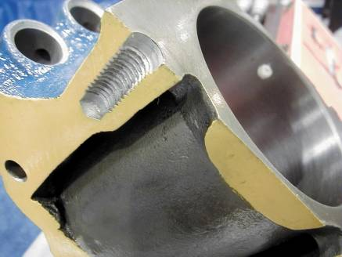
BLOCK PREPARATION FOR ASSEMBLY (1 OF 2)
Block Cleaning
Use a sandpaper cone to chamfer the top edge of the cylinder.
FIGURE 30–34 Notice on this cutaway engine block that some of the head bolt holes do not extend too far into the block and dead end. Debris can accumulate at the bottom of these holes and it must be cleaned out before final assembly.

Slide 12
BLOCK PREPARATION FOR ASSEMBLY (2 OF 2)
Block Detailing
All oil passages (galleries) should be cleaned
All tapped holes should have the sharp edges at the top of the holes removed
Coat the newly cleaned block with fogging oil

Slide 13
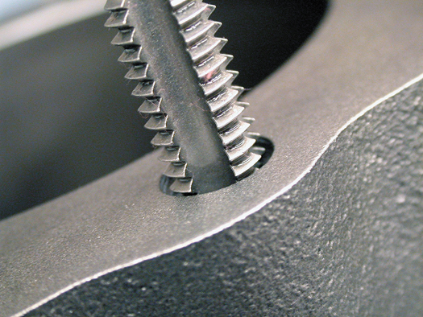
Figure 30–35 A tread chaser or bottoming tap should be used in all threaded holes before assembling the engine.

Slide 14
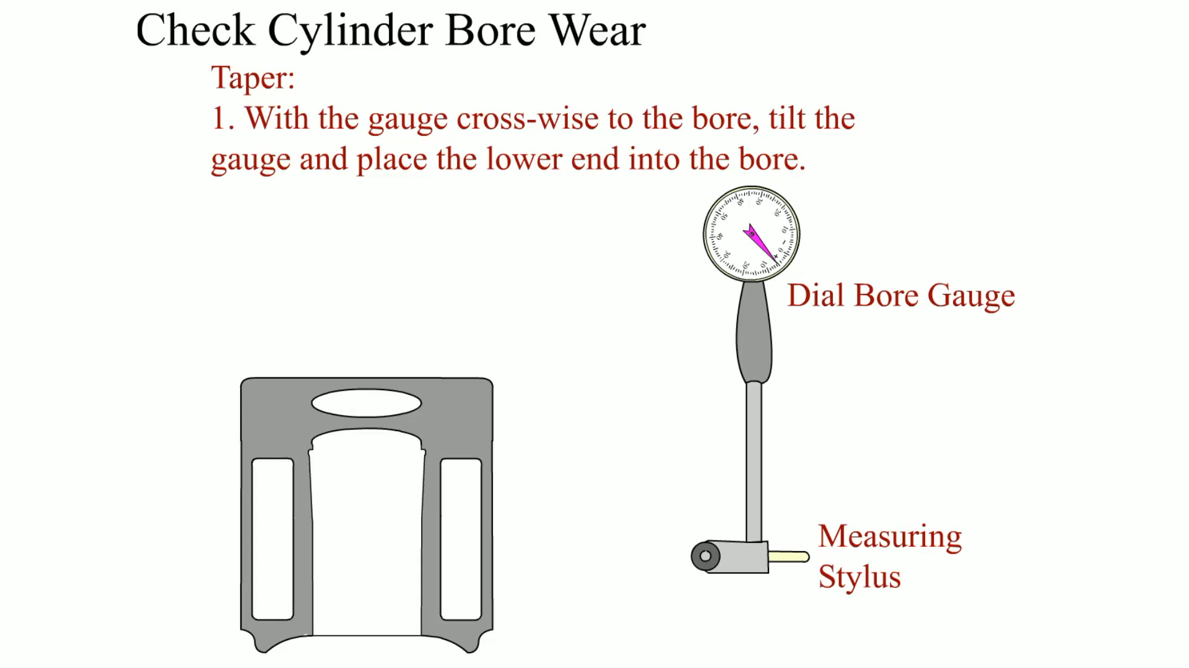
Animation: Check Cylinder Bore Wear (The animation will automatically start in a few seconds)

Slide 15
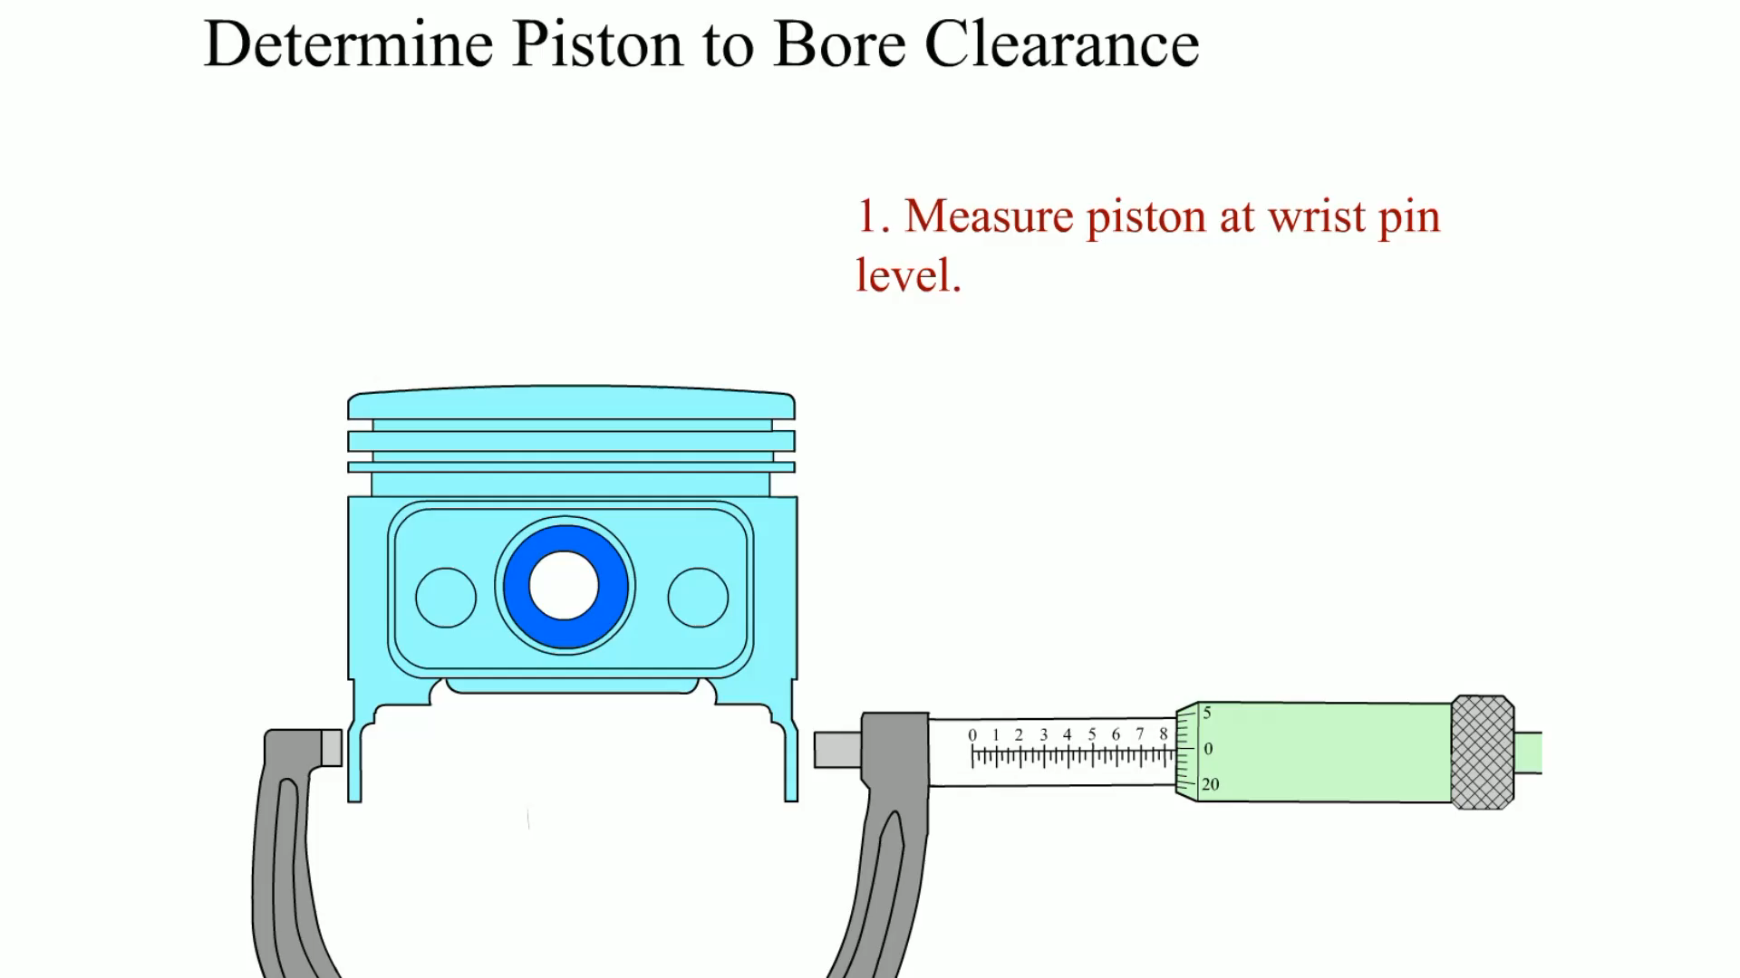
Animation: Determine Piston to Bore Clearance (The animation will automatically start in a few seconds)

Slide 16
SUMMARY (1 OF 2)
Engine blocks are either cast iron or aluminum.
Cores are used inside a mold to form water jackets and cylinder bores.
The block deck is the surface to which the cylinder head attaches.

Slide 17
SUMMARY (2 OF 2)
The cylinder should be bored and/or honed to match the size of the pistons to be used.
All bolt holes should be chamfered and cleaned with a thread chaser before assembly.

Slide 18
Video Links (Internet Access Required)
Engine assembly animation (time 3:12)
V-8 engine (time 1:21)
Ford Ecoboost Animation (time 2:41)
Ford Ecoboost Animation (time 1:32)
16 cylinder engine (time 0:44)
Rotary engine failures (time 2:42)
Rotary engine (time 5:17)
Rotary engine construction (time 4:17)
Rotary engine basics (time 3:07)
How a Hybrid Engine Works (time 1:24)
Car Engine Assembly and Operation (time 5:43)

Slide 19
Video Links (Internet Access Required)
Block honing (time 0:22)
Ridge reaming (time 0:40)
Cylinder hone (time 5:11)
Using a bore scope (time 1:36)
SBC machine work (time 23:46)
Cylinder bore (time 1:56)
Piston to deck clearance (time 6:25)
Piston animation (time 0:56)
V-8 animation (time 1:21)
Rotary engine animation (time 3:25)

