Slide 1

Automotive Engines Theory and Servicing
Ninth Edition
Chapter 3
Fasteners and Thread Repair

Slide 2
OBJECTIVES
3.1 Identify bolts and and explain the strength ratings of threaded fasteners.
3.2 Discuss the purpose of nuts, taps, dies, and washers.
3.3 Discuss how snap rings and clips are used.
3.4 Explain how to avoid broken fasteners.
3.5 Compare the different types of thread repair inserts.

Slide 3
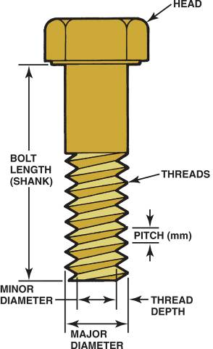
THREADED FASTENERS
The fastener threads must match the threads in the casting or nut.
The threads may be measured either in fractions of an inch or in metric units.
The size is measured across the outside of the threads.
FIGURE 3–1 The dimensions of a typical bolt showing where sizes are measured. The major diameter is called the crest.

Slide 4
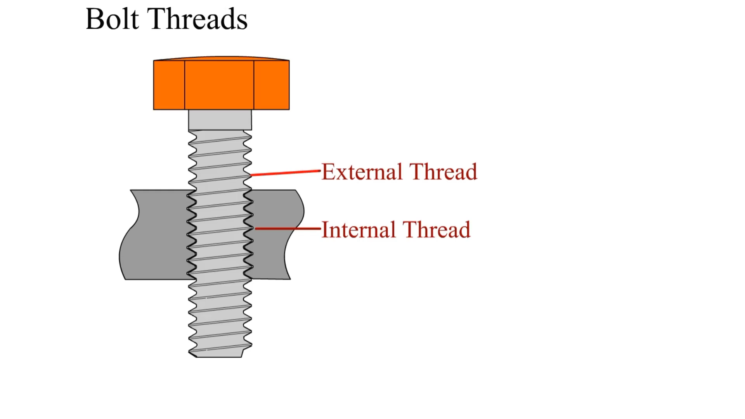
Animation: Bolt Threads
(The animation will automatically start in a few seconds)

Slide 5
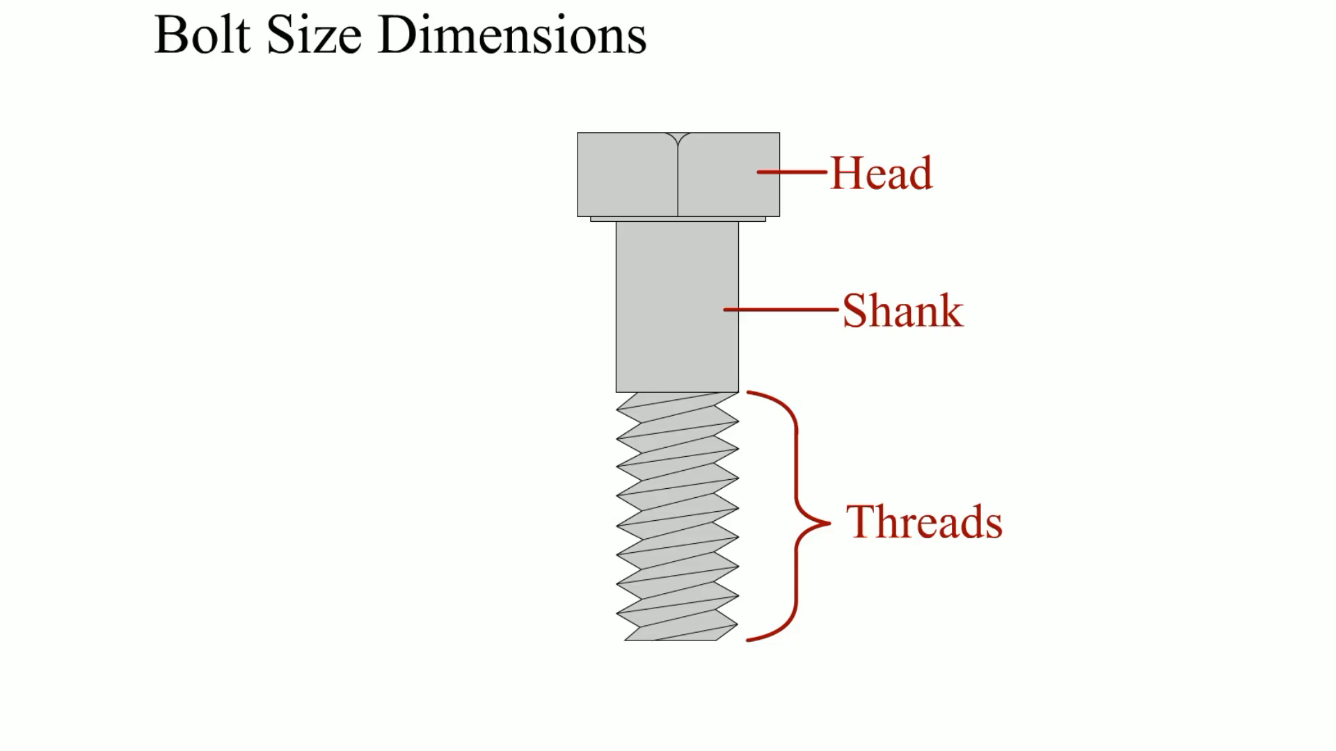
Animation: Bolt Size Dimension
(The animation will automatically start in a few seconds)

Slide 6
METRIC BOLTS
The size of a metric bolt is specified by the letter M followed by the diameter in millimeters (mm) across the outside (crest) of the threads.
Typical metric sizes would be M8 and M12.
Fine metric threads are specified by the thread diameter followed by X and the distance between the threads measured in millimeters (M8 X 1.5).

Slide 7
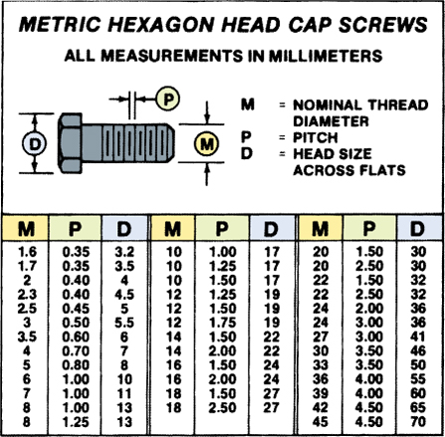
Figure 3–4 The metric system specifies fasteners by diameter, length, and pitch.

Slide 8
GRADES OF BOLTS (1 OF 2)
Bolts are made from many different types of steel, and for this reason some are stronger than others.
The strength or classification of a bolt is called the grade.
The bolt heads are marked to indicate their grade strength.

Slide 9
GRADES OF BOLTS (2 OF 2)
Graded bolts are commonly used in the suspension parts of the vehicle but can be used almost anywhere in the vehicle.

Slide 10
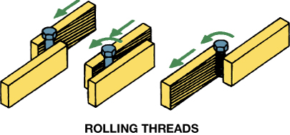
Figure 3–5 Stronger threads are created by cold-rolling a heat-treated bolt blank instead of cutting the threads using a die.

Slide 11
TENSILE STRENGTH
What is tensile strength?
Metric bolt tensile strength property class is shown on the head of the bolt as a number, such as 4.6, 8.8, 9.8, and 10.9
  The higher the number, the stronger the bolt

Slide 12
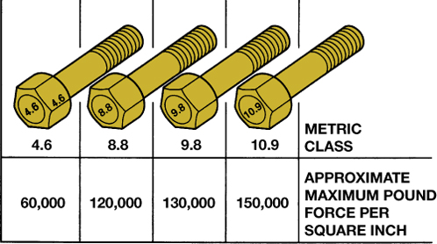
Figure 3–6 Metric bolt (cap screw) grade markings and approximate tensile strength.

Slide 13
NUTS (1 OF 2)
Most nuts used on cap screws have the same hex size as the cap screw head.
Metric nuts are often marked with dimples to show their strength.
  More dimples indicate stronger nuts.

Slide 14
NUTS (2 OF 2)
Some nuts and cap screws use interference fit threads to keep them from accidentally loosening.
Nuts can also be kept from loosening with a nylon washer fastened in the nut or with a nylon patch or strip on the threads.

Slide 15
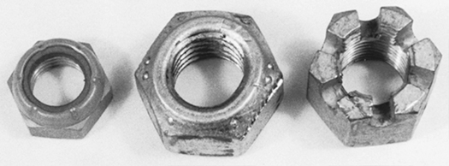
Figure 3–7 Types of lock nuts. On the left, a nylon ring; in the center, a distorted shape; and on the right, a castle for use with a cotter key.

Slide 16
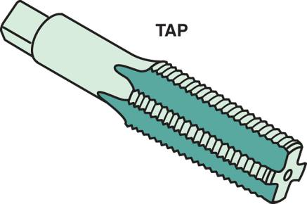
TAPS AND DIES (1 OF 3)
Taps and dies are used to cut threads.
  Taps are used to cut threads in holes drilled to an exact size depending on the size of the tap.
  A die is used to cut threads on round rods or studs.
FIGURE 3–8 A typical bottoming tap used to create threads in holes that are not open, but stop in a casting, such as an engine block.

Slide 17
TAPS AND DIES (2 OF 3)
Most taps and dies come as a complete set for the most commonly used fractional and metric threads.
  Taps
    Taper Tap
    Bottoming Tap

Slide 18
TAPS AND DIES (3 OF 3)
  Dies
  Proper Use of Taps and Dies
    Tap Usage
    Die Usage

Slide 19
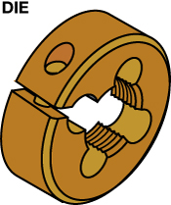
Figure 3–10 A die is used to cut threads on a metal rod.

Slide 20
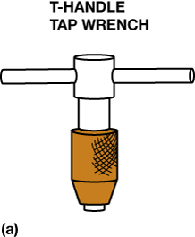
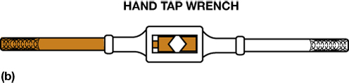
Figure 3–11 (a) A T-handle is used to hold and rotate small taps. (b) A tap wrench is used to hold and drive larger taps.

Slide 21
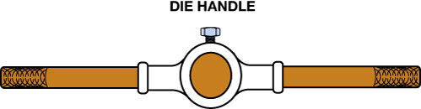
Figure 3–12 A die handle used to rotate a die while cutting threads on a metal rod.

Slide 22
THREAD PITCH GAUGE
What is a thread pitch gauge?
How does a technician determine the thread pitch size of a fastener?

Slide 23
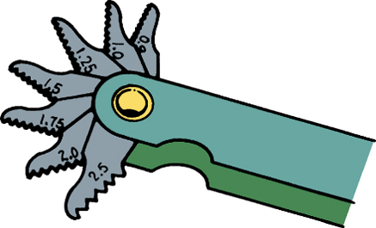
FIGURE 3–13 A typical metric thread pitch gauge.

Slide 24
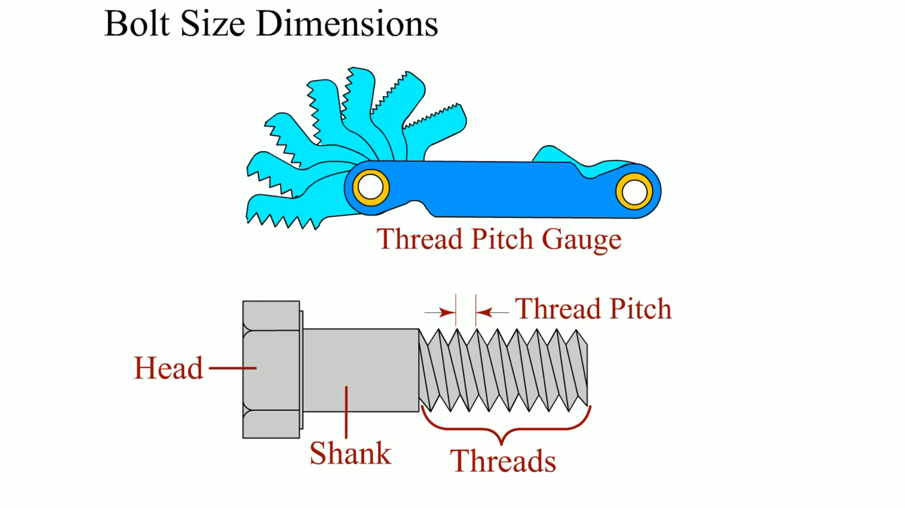
Animation: Bolt Size Dimensions
(The animation will automatically start in a few seconds)

Slide 25
SHEET METAL SCREWS
What are sheet metal screws?
How can you reinstall self-tapping screws?

Slide 26
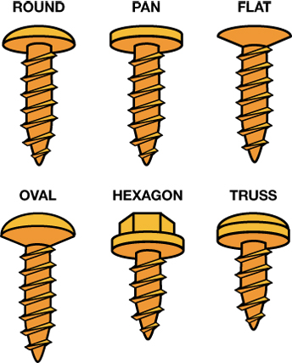
Figure 3–15 Sheet metal screws come with many head types.

Slide 27
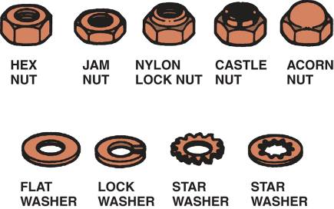
WASHERS
Washers are often used under cap screw heads and under nuts.
FIGURE 3–16 Various types of nuts (top) and washers (bottom) serve different purposes and all are used to secure bolts or cap screws.

Slide 28
SNAP RINGS AND CLIPS
Snap Rings
  Constructed of spring steel
  Used to attach parts without a threaded fastener
Door Panel Clips
Pins
Rivets
Locking Nuts

Slide 29
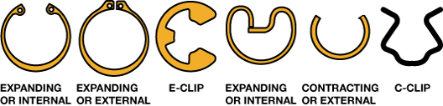
Figure 3–17 Some different types of snap rings. An internal snap ring fits inside of a housing or bore, into a groove. An external snap ring fits into a groove on the outside of a shaft or axle. An E-clip fits into a groove in the outside of a shaft. A C-clip shown is used to retain a window regulator handle on its shaft.

Slide 30
BROKEN FASTENER REMOVAL
Try not to break, strop, or round off fasteners
Don't force fasteners loose
Left-handed threads
Penetrating oil
Proper tightening

Slide 31
THREAD REPAIR INSERTS (1 OF 2)
Thread repair inserts are used to replace the original threaded hole when it has become damaged beyond use.
The original threaded hole is enlarged and tapped for threads and a threaded insert is installed to restore the threads to the original size.
  Helical Inserts

Slide 32
THREAD REPAIR INSERTS (2 OF 2)
  Threaded Inserts
  Self-tapping Inserts
  Solid-bushing Inserts
  Key-locking Inserts

Slide 33
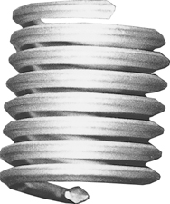
Figure 3–24 Helical inserts look like small, coiled springs. The outside is a thread to hold the coil in the hole, and the inside is threaded to fit the desired fastener.

Slide 34
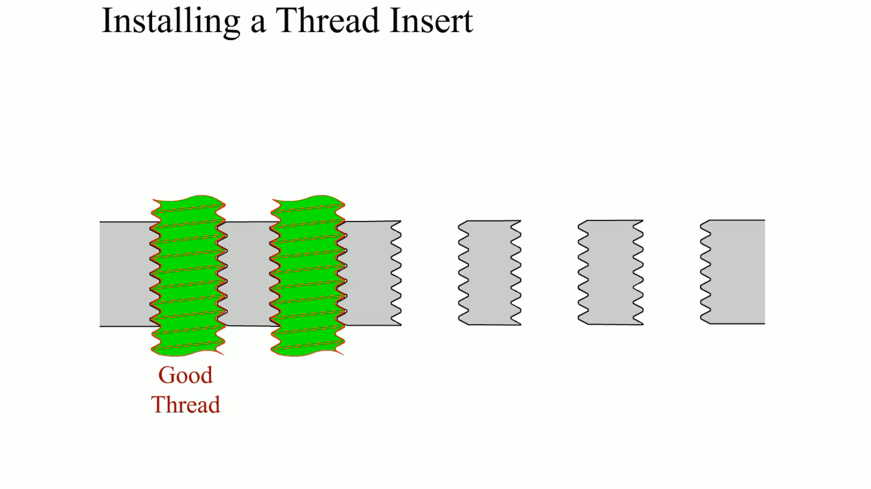
Animation: Installing a Thread Insert
(The animation will automatically start in a few seconds)

Slide 35
SUMMARY (1 OF 3)
The most common type of fastener is a threaded one often referred to as a bolt.
A nut or threaded hole is used at the end of a bolt to fasten two parts together.
The size of threaded fasteners includes the diameter, length, and pitch of the threads, as well as the shape of the head of the bolt.

Slide 36
SUMMARY (2 OF 3)
The diameter across the threads of metric bolts is in millimeters followed by the distance between the threads measured in millimeters.
Graded bolts are hardened and are capable of providing more holding force than nongraded bolts.

Slide 37
SUMMARY (3 OF 3)
Many nuts are capable of remaining attached to the bolt regardless of vibration. These types of nuts are often called prevailing torque nuts.
Threads can be repaired using a Heli-Coil® or threaded insert.

Slide 38
Video Links (Internet Access Required)
Removing Broken Fasteners (time 29:18)
Removing Plastic Auto Body Fasteners (time 2:03)

