Slide 1
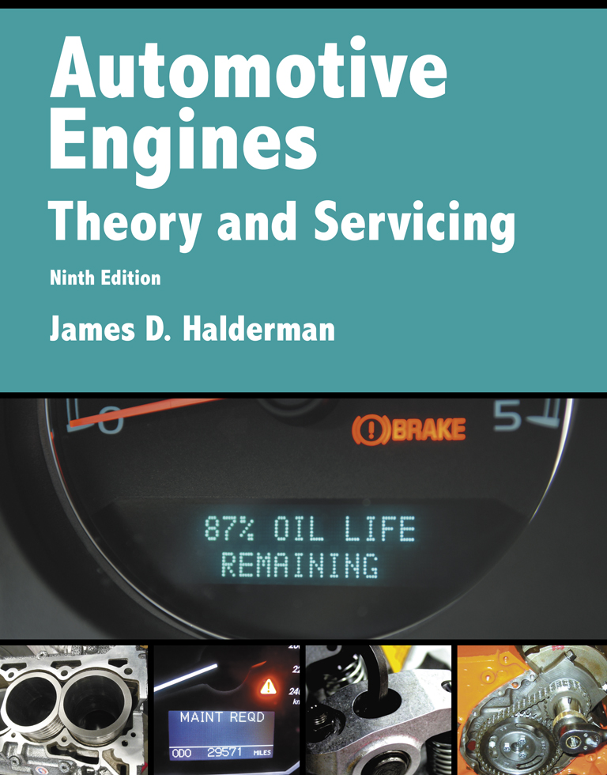
Automotive Engines Theory and Servicing
Ninth Edition
Chapter 28
Camshafts and Valve Trains

Slide 2
OBJECTIVES (1 OF 2)
28.1 Describe the purpose and function of camshaft and camshaft design.
28.2 Discuss camshaft drives and camshaft movement.
28.3 Discuss rocker arms, pushrods, and lifters or tappets.

Slide 3
OBJECTIVES (2 OF 2)
28.4 Explain overhead camshaft valve trains, valve train lubrication, and valve train problem diagnosis.
28.5 Explain camshaft specifications.
28.6 Explain the procedure for camshaft removal, measuring camshafts, and selecting a camshaft.
28.7 Explain variable valve timing, and variable lift and cylinder deactivation systems.

Slide 4
CAMSHAFT (1 OF 3)
The major function of a camshaft is to open the valves.
Camshafts have eccentric shapes called lobes that open the valve against the force of the valve springs.
The valve spring closes the valve when the camshaft rotates off of the lobe.
The camshaft lobe changes rotary motion (camshaft) to linear motion (valves).

Slide 5
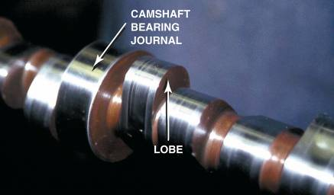
CAMSHAFT (2 OF 3)
Cam shape or contour is the major factor in determining the operating characteristics of the engine.
The camshaft is driven by:
Timing gears
Timing chains
Timing belts
FIGURE 28–1 This high-performance camshaft has a lobe that opens the valve quickly and keeps it open for a long time.

Slide 6
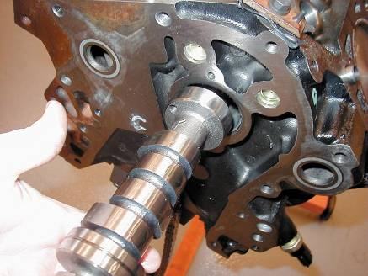
CAMSHAFT (3 OF 3)
There are two basic areas where the camshaft can be located in an engine.
In the engine block
Overhead
FIGURE 28–3 The camshaft rides on bearings inside the engine block above the crankshaft on a typical cam-in-block engine.

Slide 7
CAMSHAFT DESIGN
Construction
Camshaft Bearing Journals
Hardness
Camshaft Lubrication
Fuel Pump Eccentrics

Slide 8
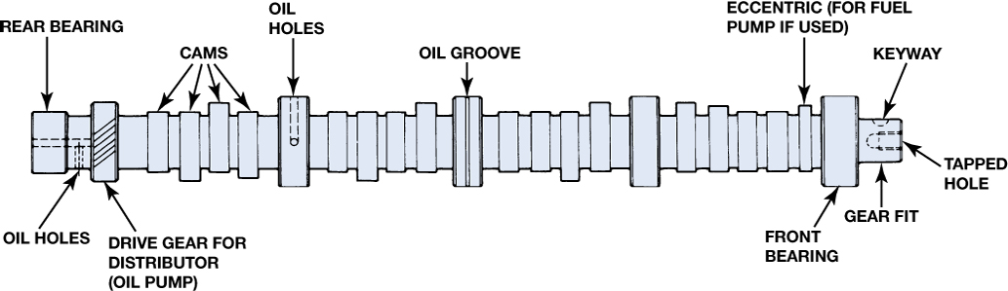
Figure 28–4 Parts of a cam and camshaft terms (nomenclature).

Slide 9
CAMSHAFT DRIVES (1 OF 2)
The crankshaft drives the camshaft with one of the following:
Timing gears
Sprockets and chains
Sprockets and timing belts

Slide 10
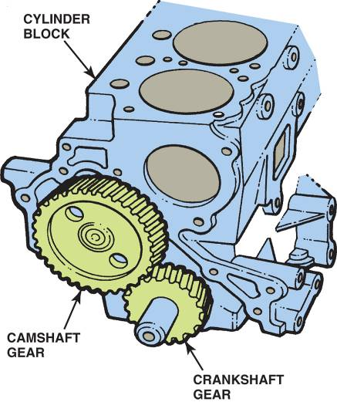
CAMSHAFT DRIVES (2 OF 2)
Camshaft Chain Drives
Camshaft Belt Drives
FIGURE 28–9 The larger camshaft gear is usually made from fiber and given a helical cut to help reduce noise. By making the camshaft gear twice as large as the crankshaft gear, the camshaft rotates one revolution for every two of the crankshaft.

Slide 11
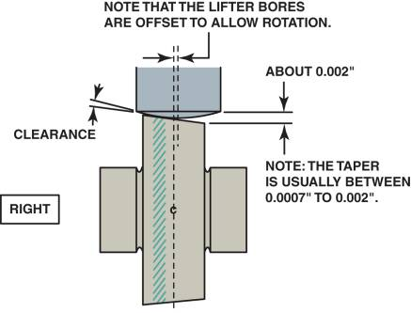
CAMSHAFT MOVEMENT
Reasons Camshafts Move
Why Flat-bottom Lifters Rotate
Camshaft Lobe Lift
FIGURE 28–18 The slight angle and the curve on the bottom of a flat bottom lifter cause the lifter and the pushrod to rotate during normal operation.

Slide 12
ROCKER ARMS (1 OF 2)
A rocker arm reverses the upward movement of the pushrod to produce a downward movement on the tip of the valve.
Engine designers make good use of the rocker arm.
It is designed to reduce the travel of the cam follower or lifter and pushrod while maintaining the required valve lift.
This is done by using a rocker arm ratio usually of 1.5:1.

Slide 13
ROCKER ARMS (2 OF 2)
Shaft-mounted Rocker Arms
Stud-mounted Rocker Arms
Pedestal-mounted Rocker Arms

Slide 14
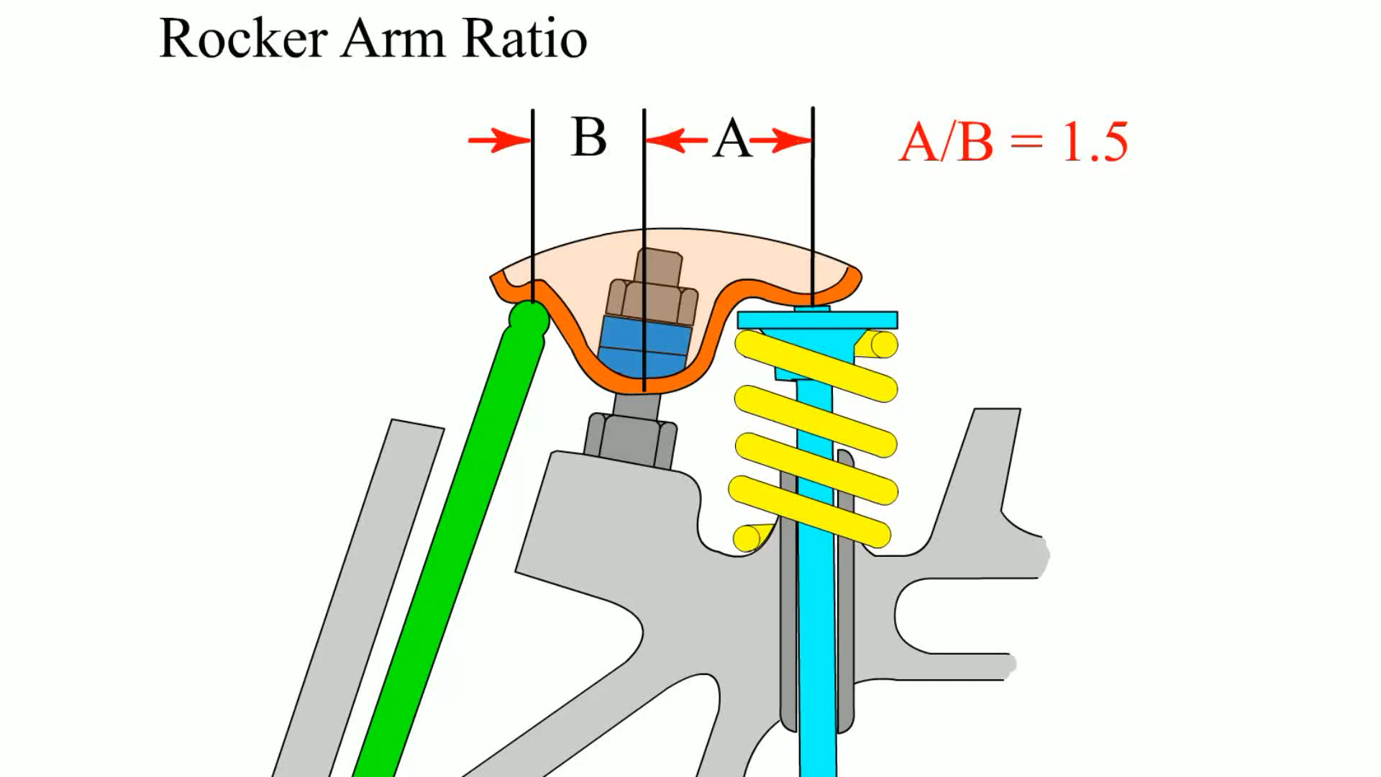
Animation: Rocker Arm Ratio (The animation will automatically start in a few seconds)

Slide 15
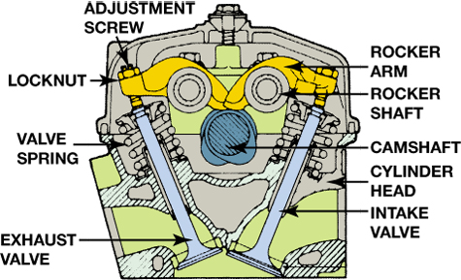
Figure 28–23 Some engines today use rocker shafts to support rocker arms such as the V-6 engine with a single overhead camshaft located in the center of the cylinder head.

Slide 16
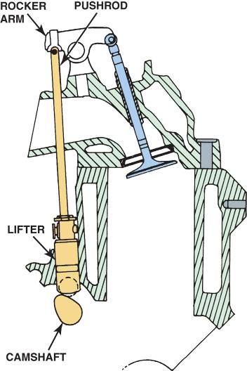
PUSHRODS
Pushrods transfer the lifting motion of the valve train from the cam lobe and lifters to the rocker arms.
FIGURE 28–27 Overhead valve engines are also known as pushrod engines because of the long pushrod that extends from the lifter to the rocker arm.

Slide 17
OVERHEAD CAMSHAFT VALVE TRAINS (1 OF 2)
Overhead camshaft engines use several different types of valve opening designs.
One type opens the valves directly with a bucket.
The second type uses a cam follower, also called a finger follower, that provides an opening ratio similar to that of a rocker arm.

Slide 18
OVERHEAD CAMSHAFT VALVE TRAINS (2 OF 2)
A third type moves the rocker arm directly through a hydraulic lifter.
In the fourth design, some newer engines have the hydraulic adjustment in the rocker arm and are commonly called hydraulic lash adjusters (HLA).

Slide 19
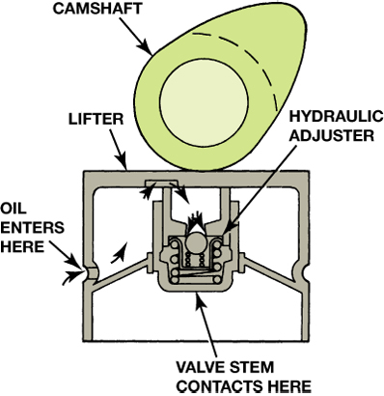
Figure 28–30 Hydraulic lifters may be built into bucket type lifters on some overhead camshaft engines.

Slide 20
CAMSHAFT SPECIFICATIONS
Duration
Valve Overlap
Calculating Valve Overlap
Lobe Centers
Effects of Lobe Separation on Valve Operation
Cam Timing Specifications
Cam Timing Chart

Slide 21
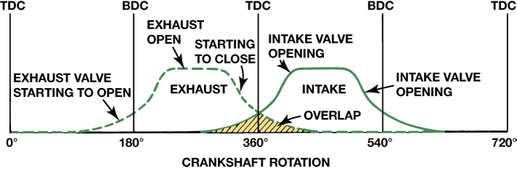
Figure 28–33 Graphic representation of a typical camshaft showing the relationship between the intake and exhaust valves. The shaded area represents the overlap period of 100 degrees.

Slide 22
LIFTERS OR TAPPETS (1 OF 2)
Valve lifters or tappets follow the contour or shape of the camshaft lobe.
This arrangement changes the rotary cam motion to a reciprocating motion in the valve train.
Older-style lifters have a relatively flat surface that slides on the cam.

Slide 23
LIFTERS OR TAPPETS (2 OF 2)
Valve Lash
Solid Lifters
Hydraulic Lifters

Slide 24
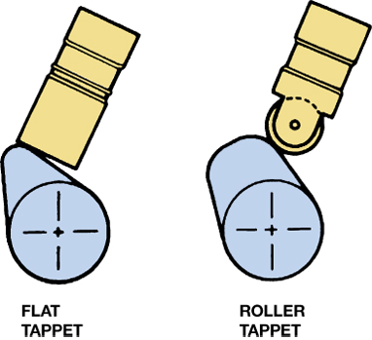
Figure 28–38 Older engines used flat-bottom lifters, whereas all engines since the 1990s use roller lifters.

Slide 25
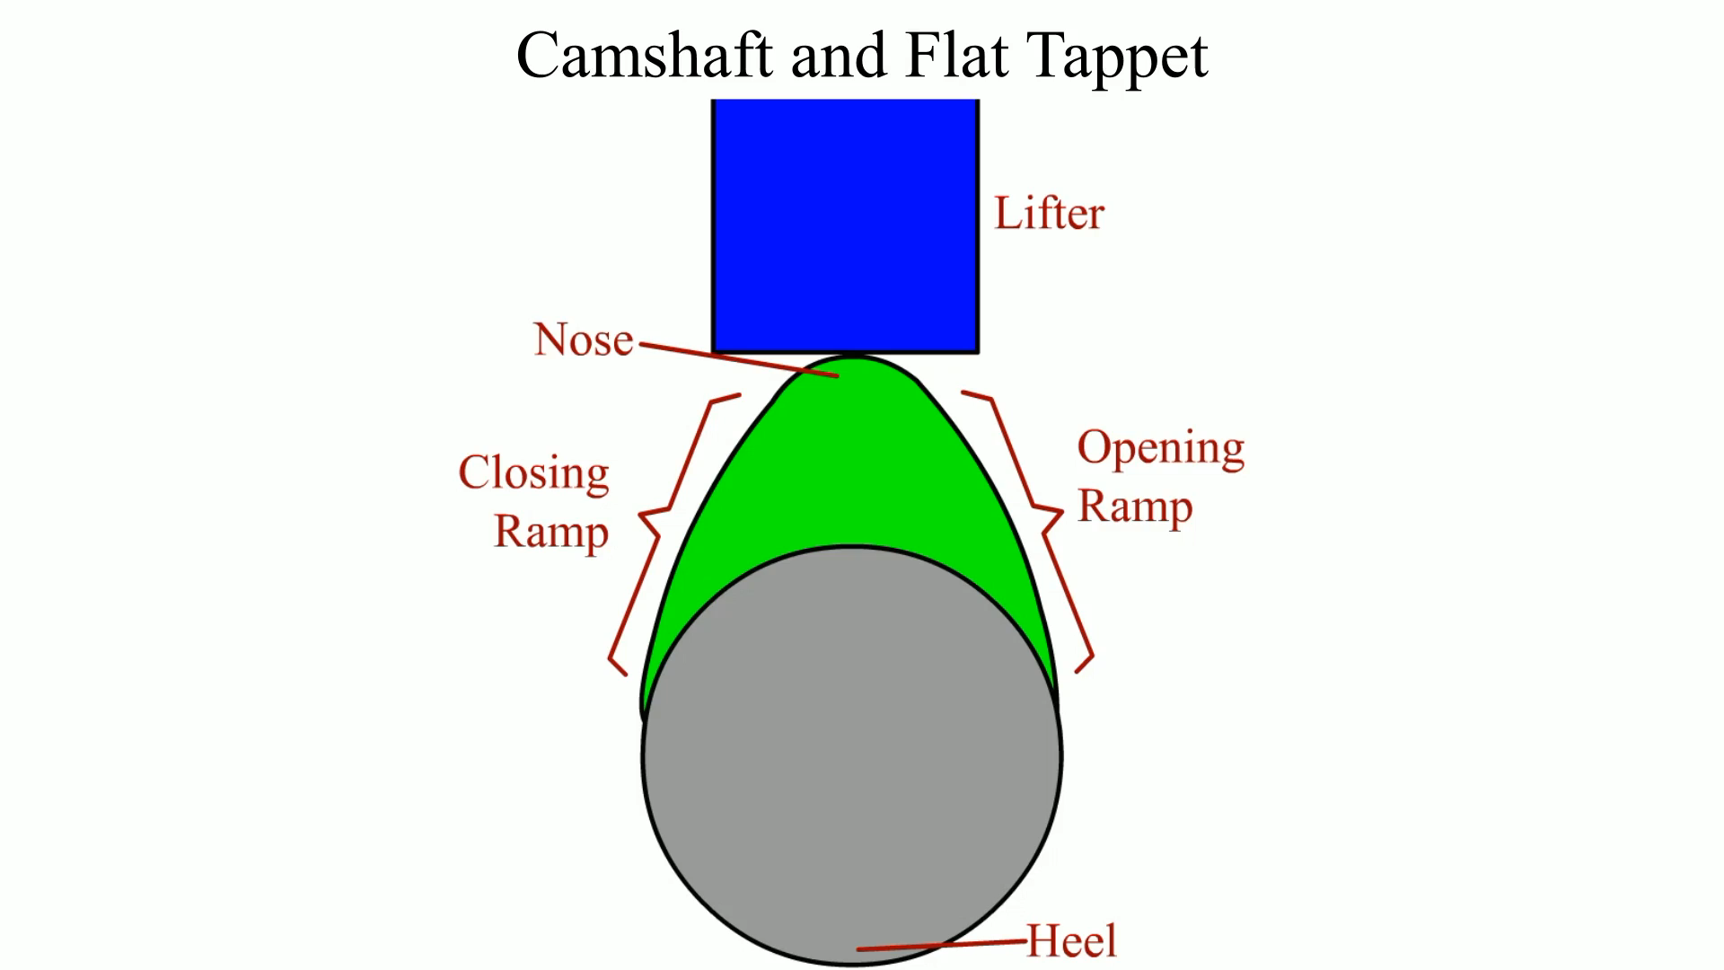
Animation: Camshaft and Flat Tappet (The animation will automatically start in a few seconds)

Slide 26
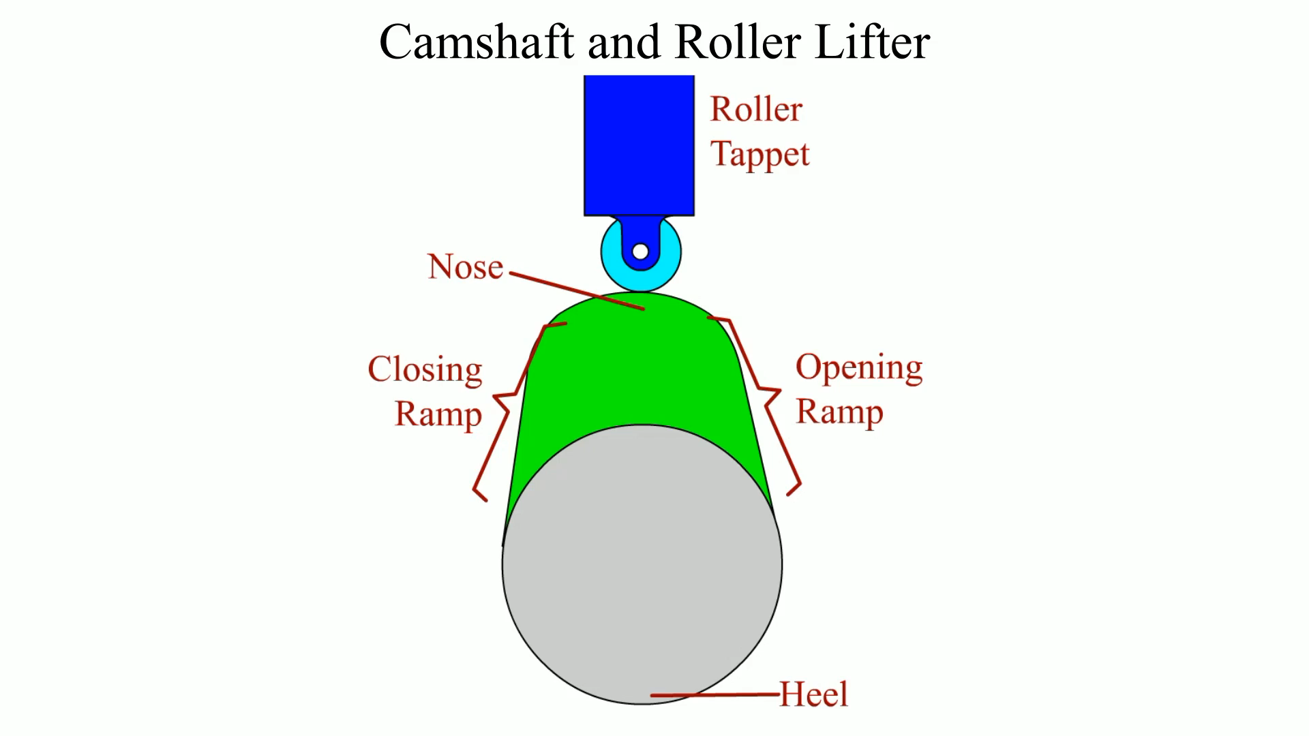
Animation: Camshaft and Roller Lifter (The animation will automatically start in a few seconds)

Slide 27
VALVE TRAIN LUBRICATION
The lifters in an overhead valve (OHV) engine are lubricated through oil passages drilled through the block.
The engine oil then flows through the lifter, and up through the hollow pushrod where the oil flows to lubricate and cool the rocker arm, valve and valve spring.
Camshaft Lubrication

Slide 28
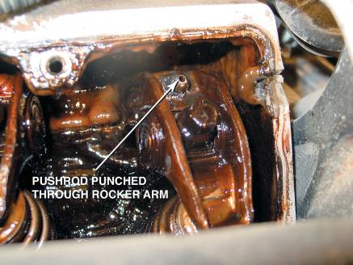
VALVE TRAIN PROBLEM DIAGNOSIS
Symptoms
Valve Noise Diagnosis
FIGURE 28–42 The cause of a misfire diagnostic trouble code was discovered to be a pushrod that had worn through the rocker arm on a General Motors 3.1 liter V-6 engine.

Slide 29
CAMSHAFT REMOVAL (1 OF 2)
If the engine is of an overhead valve (OHV) design, the camshaft is usually located in the block above the crankshaft.
The timing chain and gears (if the vehicle is so equipped) should be removed after the timing chain (gear) cover is removed.

Slide 30
CAMSHAFT REMOVAL (2 OF 2)
Loosen the rocker arms (or rocker arm shaft) and remove the pushrods.
Then remove the valve lifters before removing the camshaft from the block.

Slide 31
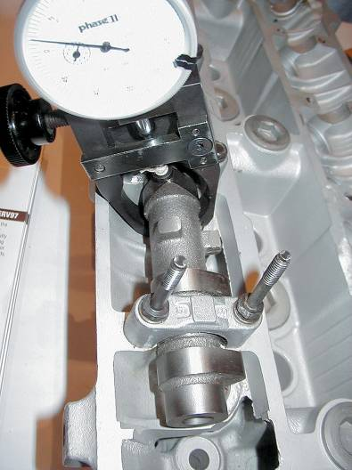
MEASURING AND SELECTING CAMSHAFTS
Total Indicator Runout
Cam Lobe Height
Determining engine usage
FIGURE 28–44 A dial indicator being used to measure cam lobe height.

Slide 32
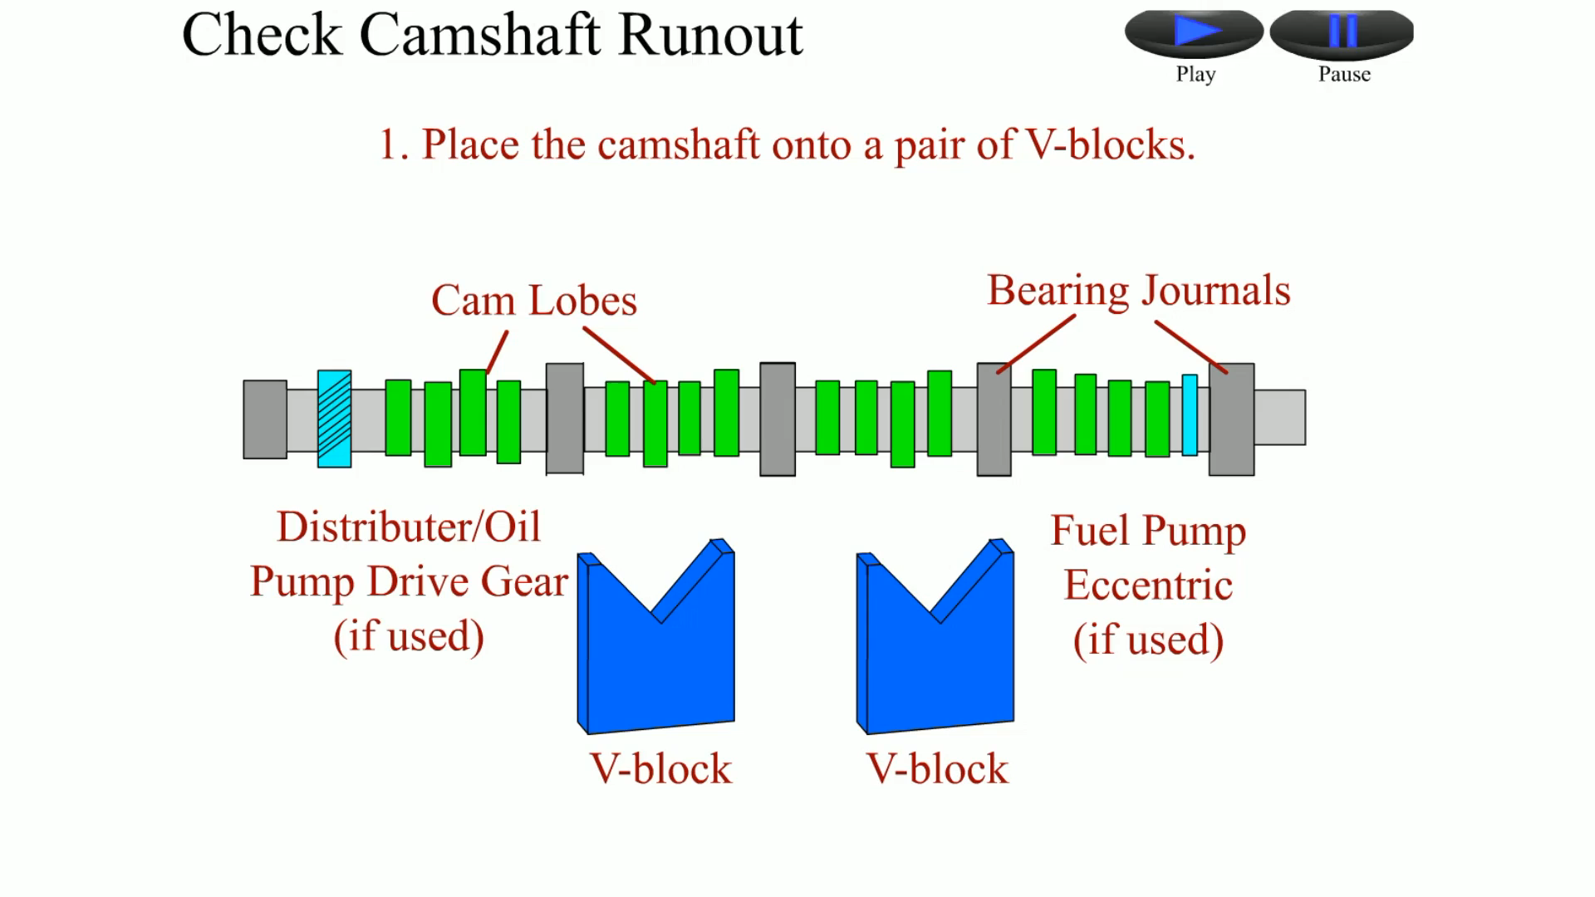
Animation: Check Camshaft Runout (The animation will automatically start in a few seconds)

Slide 33
VARIABLE VALVE TIMING (1 OF 2)
Purpose and Function
Operation
OHV Variable Timing
Spline Phaser System
Spline Phaser System Operation

Slide 34
VARIABLE VALVE TIMING (2 OF 2)
Vane Phaser System on an Overhead Camshaft Engine
Magnetically Controlled Vane Phaser
Cam-in-block Engine Cam Phaser

Slide 35
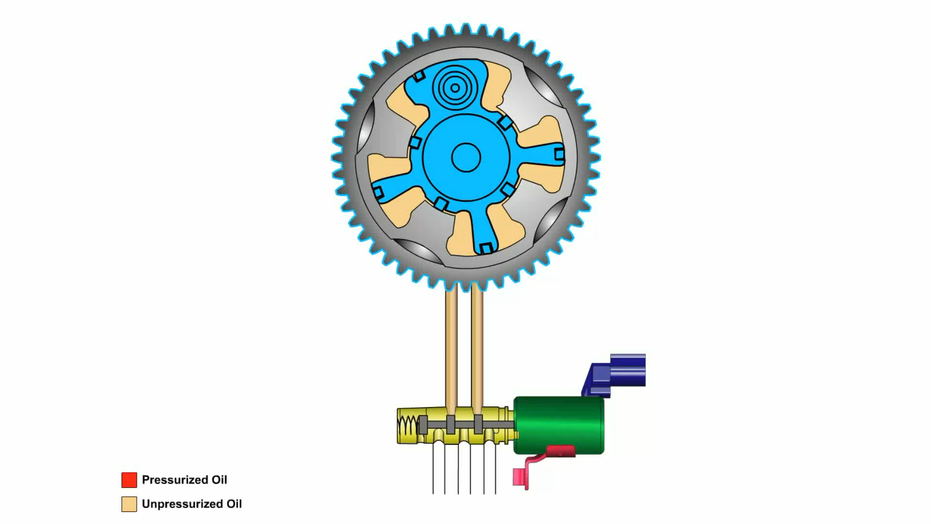
Animation: VVT Operation (The animation will automatically start in a few seconds)

Slide 36
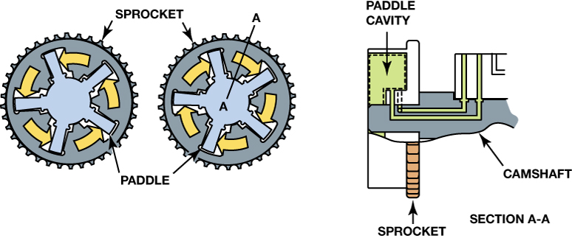
Figure 28–45 Camshaft rotation during advance and retard.

Slide 37
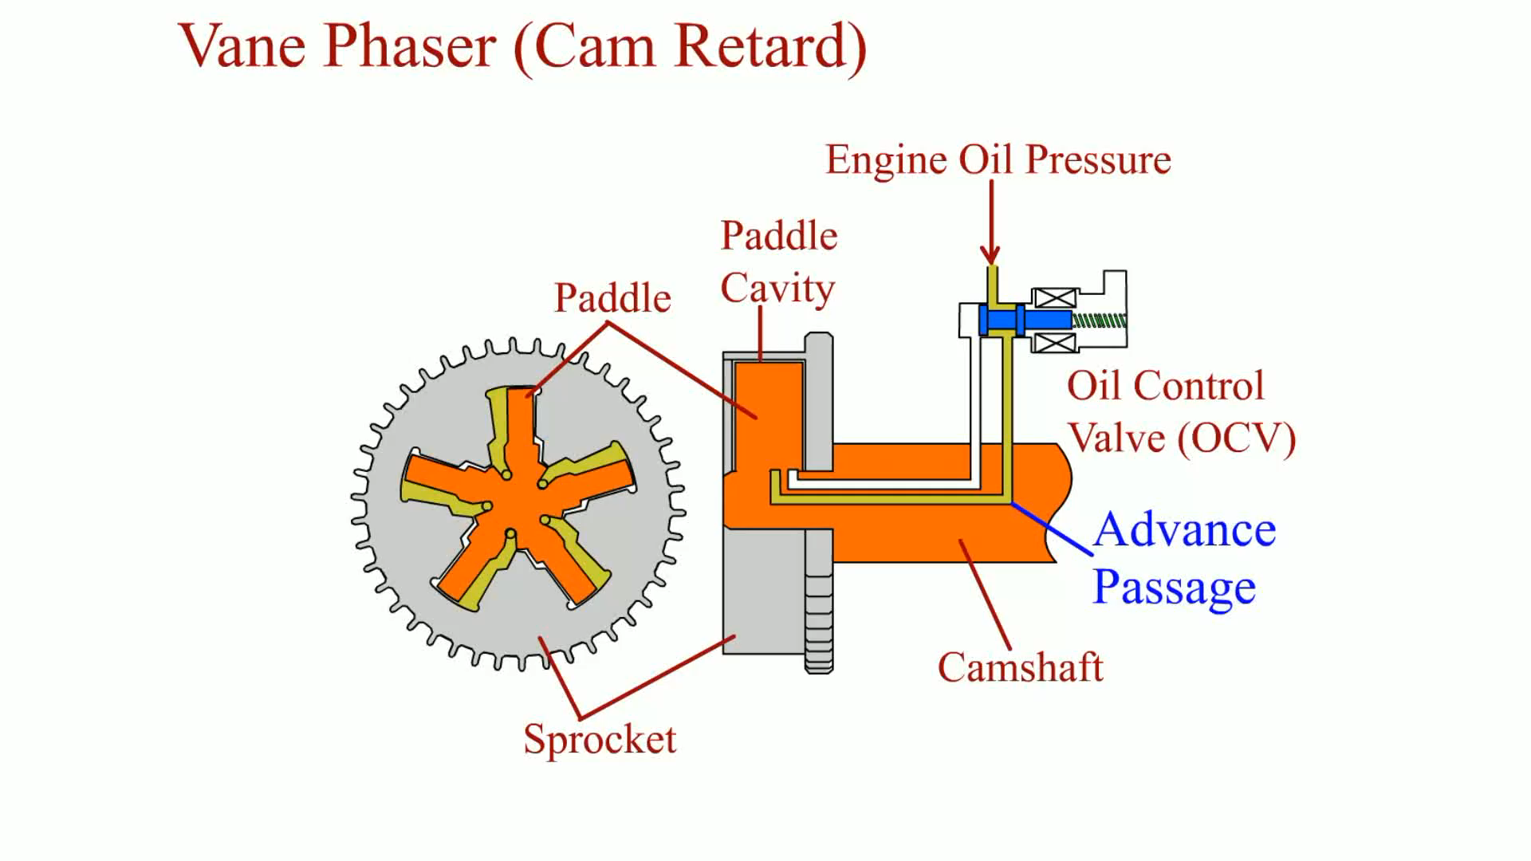
Animation: Vane Phaser (Cam Retard) (The animation will automatically start in a few seconds)

Slide 38
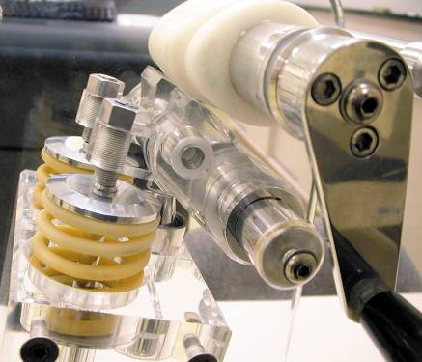
VARIABLE LIFT AND CYLINDER DEACTIVATION SYSTEMS
Variable Valve Lift Systems
Cylinder Deactivation Systems
FIGURE 28–53 A plastic mockup of a Honda VTEC system that uses two different camshaft profiles—one for low-speed engine operation and the other for high speed.

Slide 39
SUMMARY (1 OF 4)
The camshaft rotates at one-half the crankshaft speed.
The pushrods should be rotating while the engine is running if the camshaft and lifters are okay.
On overhead valve engines, the camshaft is usually placed in the block above the crankshaft.
The lobes of the camshaft are usually lubricated by splash lubrication.

Slide 40
SUMMARY (2 OF 4)
Silent chains are quieter than roller chains but tend to stretch with use.
Valve lift is usually expressed in decimal inches and represents the distance that the valve is lifted off the valve seat.
In many engines, camshaft lobe lift is transferred to the tip of the valve stem to open the valve by the use of a rocker arm or follower.

Slide 41
SUMMARY (3 OF 4)
Pushrods transfer camshaft lobe movement upward from the camshaft to the rocker arm.
Camshaft duration is the number of degrees of crankshaft rotation for which the valve is lifted off the seat.
Valve overlap is the number of crankshaft degrees for which both intake and exhaust valves are open at the same time.

Slide 42
SUMMARY (4 OF 4)
Camshafts should be installed according to the manufacturer's recommended procedures.
Flat lifter camshafts should be thoroughly lubricated with extreme pressure lubricant.
Variable valve timing on the exhaust camshaft helps improve exhaust emissions.
Variable valve timing of the intake camshaft helps improve engine power output.

Slide 43
Video Links (Internet Access Required)
Timing belt removal (time 7:50)
Timing belt inspection (time 7:53)
Timing belts explained (time 6:29)
Valve spring replacement (time 7:36)
Valve spring height measurement (time 15:49)
Valve adjustment (time 1:39)
Checking valve to piston clearance part 1 (time 2:53)
Checking valve to piston clearance part 2 (time 4:01)
Variable valve timing (time 0:41)
Variable valve timing (time 2:06)

Slide 44
Video Links (Internet Access Required)
Variable valve timing (time 3:38)
Degree a camshaft (time 1:30)
Degree a camshaft (time 3:19)
Valve adjustment (time 8:04)
Toyota VVTiE (time 3:02)
Variable cam timing (time 4:32)
Timing gears (time 4:46)
Timing gears (time 6:39)
Timing gears (time 9:14)
Camshaft break in (time 1:56)

Slide 45
Video Links (Internet Access Required)
Lifter operation (time 1:28)
Camshaft sensor indexing (time 2:26)
Variable valve timing explained (time 3:52)
How to check and notice bad camshaft (time 6:24)
Cylinder deactivation (time 2:35)
Camshaft bearing wear inspection (time 0:43)

