Slide 1

Automotive Engines Theory and Servicing
Ninth Edition
Chapter 27
Valve and Seat Service

Slide 2
OBJECTIVES (1 OF 2)
27.1 Discuss intake and exhaust valves.
27.2 Describe valve seats and the valve fault diagnosis procedure.
27.3 Explain valve springs, and valve keepers and rotators.
27.4 Discuss the procedure for valve reconditioning, valve face grinding, and valve seat reconditioning.

Slide 3
OBJECTIVES (2 OF 2)
27.5 Discuss valve guide pilots, valve seat grinding stones, and valve seat cutters.
27.6 Explain valve seat testing and valve seat replacement.
27.7 Discuss valve stem height and installed height.
27.8 Describe the procedure of installing the valves and explain valve stem seals.

Slide 4
INTAKE AND EXHAUST VALVES (1 OF 2)
Intake valves control the inlet of cool, low-pressure induction charges.
Exhaust valves handle hot, high-pressure exhaust gases.
Parts Involved
Valve Size Relationships

Slide 5
INTAKE AND EXHAUST VALVES (2 OF 2)
Valve Materials
Two-material Valves
Sodium-filled Valves

Slide 6
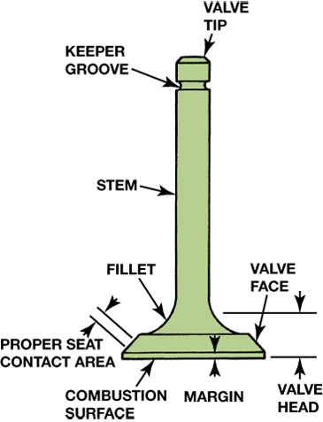
FIGURE 27–1 Identification of the parts of a valve.

Slide 7
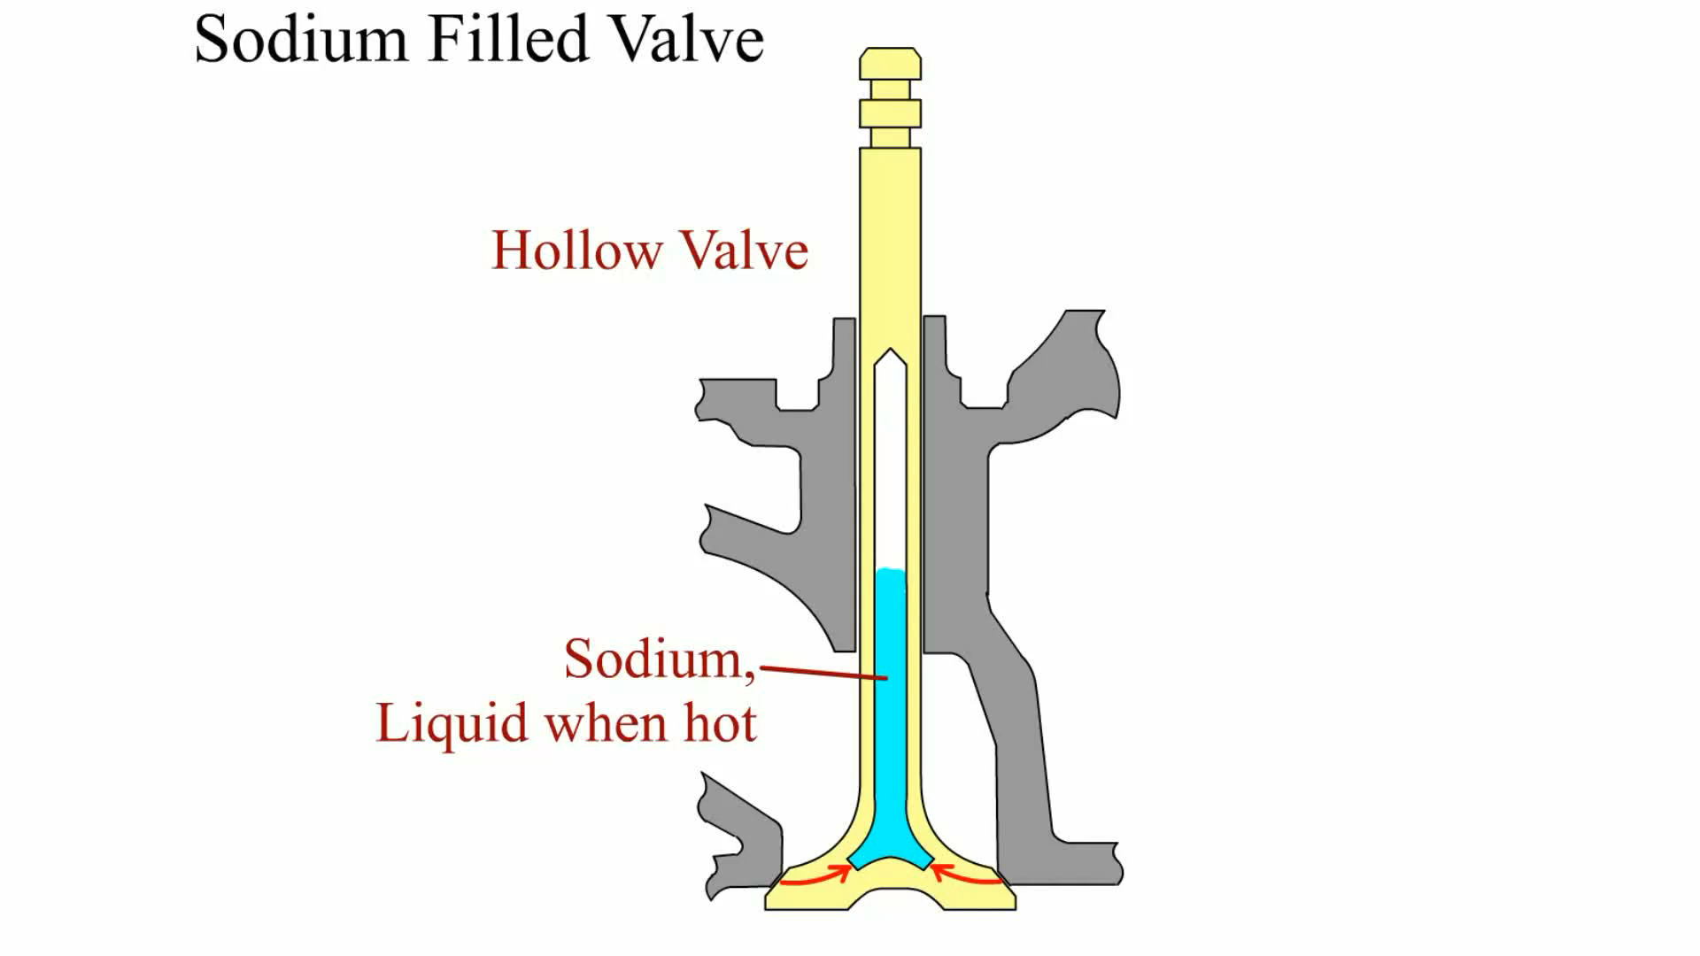
Animation: Sodium Filled Valve
(The animation will automatically start in a few seconds)

Slide 8
VALVE SEATS (1 OF 2)
The valve face closes against a valve seat to seal the combustion chamber.
The seat is generally formed as part of the cast-iron head of automotive engines, called an integral seat.

Slide 9
VALVE SEATS (2 OF 2)
An insert seat fits into a machined recess in the steel or aluminum cylinder head.
  Insert seats are used in all aluminum head engines and in applications for which corrosion and wear resistance are critical.

Slide 10
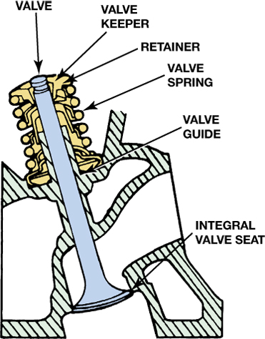
FIGURE 27–6 Integral valve seats are machined directly into the cast-iron cylinder head and are induction hardened to prevent wear.

Slide 11
VALVE FAULT DIAGNOSIS
Careful inspection of the cylinder head and valves can often reveal the root cause of failure.
  Poor Valve Seating
  Carbon Deposits
  Excessive Temperatures
  Valve Seat Erosion
  High-velocity Seating

Slide 12
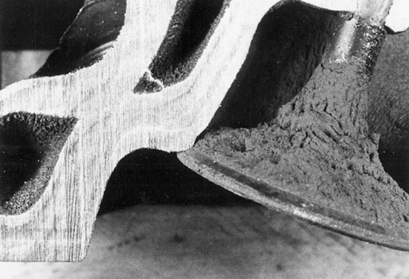
FIGURE 27–8 Typical intake valve seat wear.

Slide 13
VALVE SPRINGS (1 OF 2)
A valve spring holds the valve against the seat when the valve is not being opened.
One end of the valve spring is seated against the head.
The other end of the spring is attached under compression to the valve stem through a valve spring retainer and a valve spring keeper (lock).

Slide 14
VALVE SPRINGS (2 OF 2)
Spring Materials and Design
Variable Rate Springs
Valve Spring Inspection

Slide 15
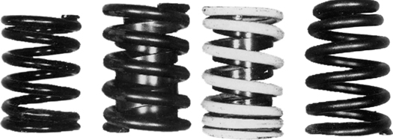
FIGURE 27–14 Valve spring types (left to right): coil spring with equally spaced coils; spring with damper inside spring coil; closely spaced spring with a damper; taper wound coil spring.

Slide 16
VALVE KEEPERS AND ROTATORS (1 OF 2)
Valve keepers (locks) are used on the end of the valve stem to retain the spring.
  The inside surfaces of the keeper use a variety of grooves or beads.
  The design depends on the holding requirements.
  The outside of the keeper fits into a cone-shaped seat in the center of the valve spring retainer.

Slide 17
VALVE KEEPERS AND ROTATORS (2 OF 2)
Some valve spring retainers have built-in devices called valve rotators.
  They cause the valve to rotate in a controlled manner as it is opened.

Slide 18
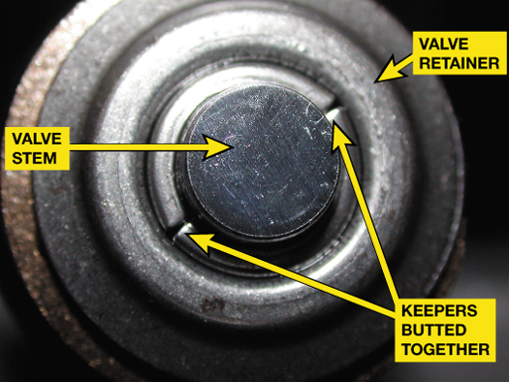
FIGURE 27–19 Notice that there is no gap between the two keepers (ends butted together). As a result, the valve is free to rotate because the retainer applies a force, holding the keepers in place but not tight against the stem of the valve. Most engines, however, do not use free rotators and, therefore, have a gap between the keepers.

Slide 19
VALVE RECONDITIONING PROCEDURE (1 OF 2)
After proper cleaning, inspection, and measurement procedures have been completed, valve reconditioning, usually called a "valve job," can be performed using the following sequence.
  STEP 1 The valve stem is lightly ground and chamfered.
  STEP 2 The face of the valve is ground to the proper angle using a valve grinder.

Slide 20
VALVE RECONDITIONING PROCEDURE (2 OF 2)
  STEP 3 The valve seat is ground in the head. (The seat must be matched to the valve that will be used in that position.)
  STEP 4 Valve spring installed height and valve stem height are checked and corrected as necessary.
  STEP 5 After a thorough cleaning, the cylinder head should be assembled with new valve stem seals installed.

Slide 21
VALVE FACE GRINDING (1 OF 2)
For best results perform the following:
  The rotating grinding wheel is fed slowly to the rotating valve face.
  Light grinding is done as the valve is moved back and forth across the grinding wheel face.
  Do not feed the valve into the grinding stone more than 0.001 to 0.002 in. at one time

Slide 22
VALVE FACE GRINDING (2 OF 2)
  The valve is never moved off the edge of the grinding wheel. It is ground only enough to clean the face.
The margin is the distance between the head of the valve and the seat of the value.
This distance should be 0.03 in. (0.8 mm).

Slide 23
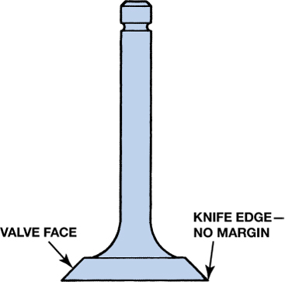
FIGURE 27–22 Never use a valve that has been ground to a sharp edge. This weakens the valve and increases the chance of valve face burning.

Slide 24
VALVE SEAT RECONDITIONING (1 OF 3)
The valve seats are reconditioned at the following times:
  After the cylinder head has been properly cleaned, resurfaced, and the valve guides have been resized or reconditioned
  When the valve guides have been replaced

Slide 25
VALVE SEAT RECONDITIONING (2 OF 3)
The final valve seat width and position are checked with the valve that is to be used on the seat being reconditioned.
Valve Seat Angles
  45 Degrees
  30 Degrees

Slide 26
VALVE SEAT RECONDITIONING (3 OF 3)
Interference Angle
Valve Seat Width
Three-angle Valve Job

Slide 27
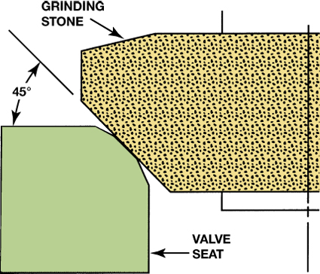
FIGURE 27–24 Grinding a 45 degree angle establishes the valve seat in the combustion chamber.

Slide 28
VALVE GUIDE PILOTS
Valve seat reconditioning equipment uses a pilot in the valve guide to align the stone holder or cutter in the exact same location as the valve stem.
This ensures accurate valve seat-to-valve face sealing.
Two types of pilots used include:
  Tapered pilots
  Expandable pilots

Slide 29
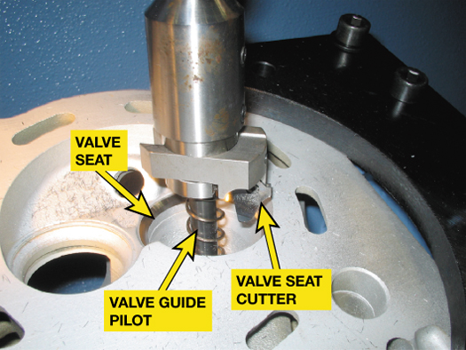
FIGURE 27–30 A valve guide pilot being used to support a valve seat cutter.

Slide 30
VALVE SEAT GRINDING STONES
Types of Stones
Dressing the Grinding Stone
Grinding the Valve Seat
Narrowing the Valve Seat

Slide 31
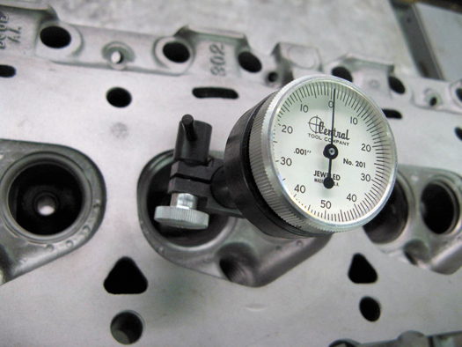
FIGURE 27–31 Checking valve seat concentricity using a dial indicator.

Slide 32
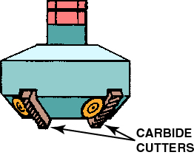
VALVE SEAT CUTTERS
Some vehicle manufacturer and automotive service technicians recommend the use of valve seat cutters rather than valve seat grinders.
FIGURE 27–34 A cutter is used to remove metal and form the valve seat angles.

Slide 33
VALVE SEAT TESTING
After the valves have been refaced and the guides and valve seats have been resurfaced, the valves should be inspected for proper sealing and to ensure that the valve seat is concentric with the valve face.

Slide 34
VALVE SEAT REPLACEMENT
Valve seats need to be replaced if they are cracked or if they are burned or eroded too much to be reground.
Insert Seat Removal Methods
Types of Valve Seats
Replacing an Integral Valve Seat

Slide 35
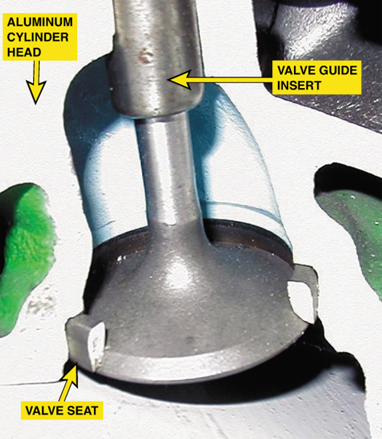
FIGURE 27–35 All aluminum cylinder heads use valve seat inserts. If an integral valve seat (cast-iron head) is worn, it can be replaced with a replacement valve seat by machining a pocket (counterbore) to make a place for the new insert seat.

Slide 36
VALVE STEM HEIGHT
Valve stem height is the distance the valve stem is above the spring seat.
Valve stem height is a different measurement from installed height.

Slide 37
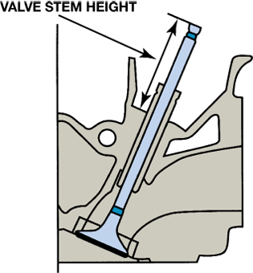
FIGURE 27–37 Valve stem height is measured from the spring seat to the tip of the valve after the valve seat and valve face have been refinished. If the valve stem height is too high, up to 0.02 inch can be ground from the tips of most valves.

Slide 38
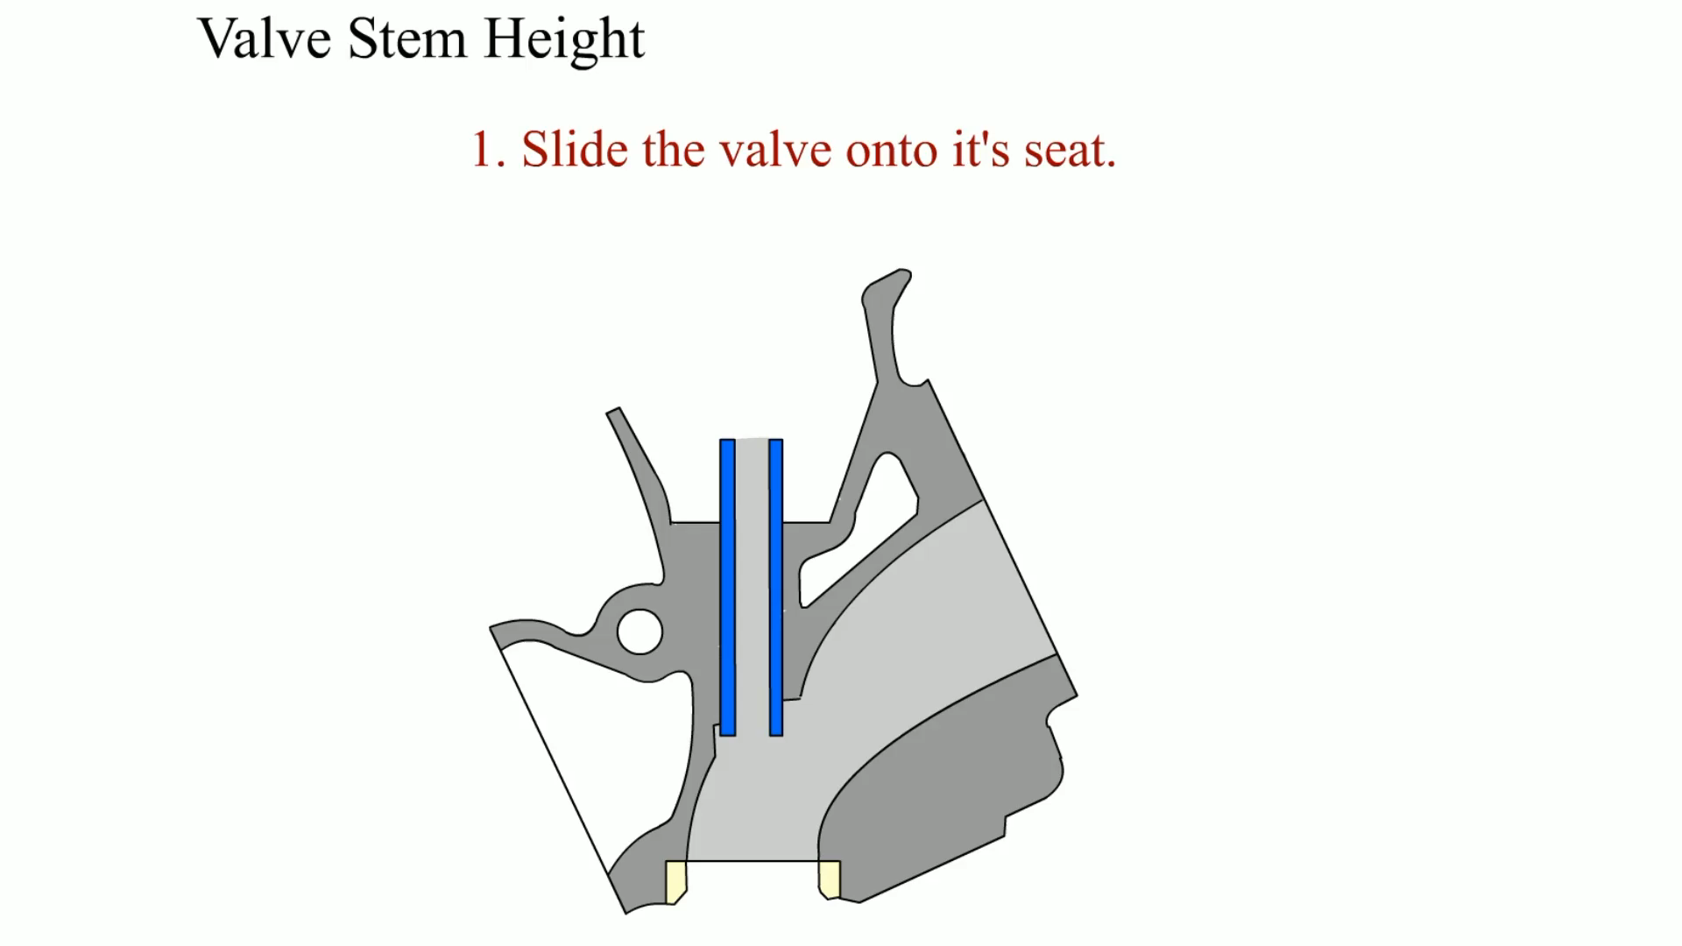
Animation: Valve Stem Height
(The animation will automatically start in a few seconds)

Slide 39
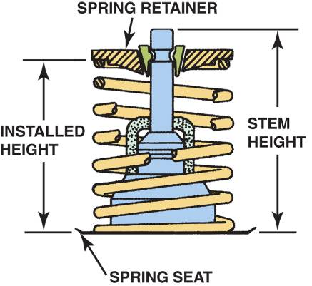
INSTALLED HEIGHT
Installed height is the distance between the valve spring seat and the underside of the valve spring retainer.
  Correcting Installed Height
FIGURE 27–38 Installed height is determined by measuring the distance from the spring seat to the bottom of the valve spring retainer.

Slide 40
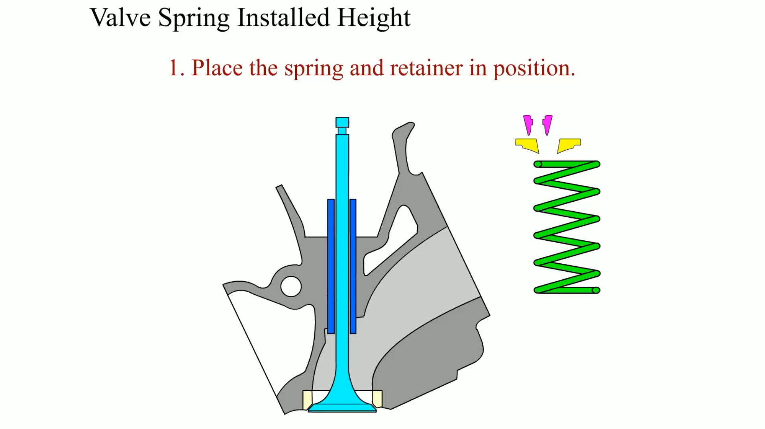
Animation: Valve Spring Installed Height
(The animation will automatically start in a few seconds)

Slide 41
VALVE STEM SEALS
Leakage past the valve guides is a major oil consumption problem in any overhead valve or overhead cam engine.
  A high vacuum exists in the intake port.
Types of Valve Stem Seals
Valve Seal Materials

Slide 42
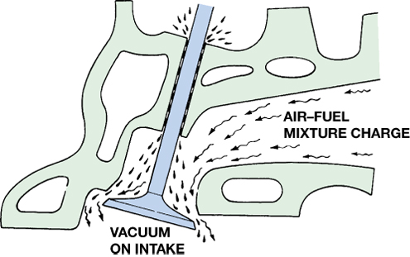
FIGURE 27–40 Engine vacuum can draw oil past the valve guides and into the combustion chamber. The use of valve stem seals limits the amount of oil that is drawn into the engine. If the seals are defective, excessive blue (oil) smoke is most often observed during engine start-up.

Slide 43
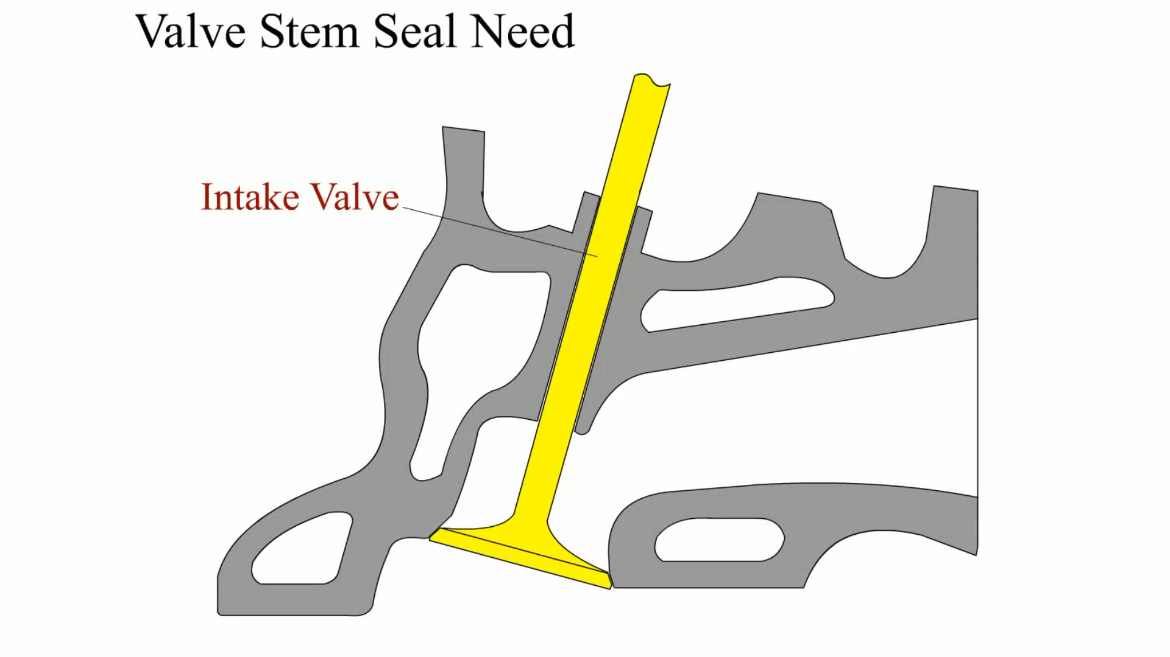
Animation: Valve Stem Seal
(The animation will automatically start in a few seconds)

Slide 44
INSTALLING THE VALVES (1 OF 2)
STEP 1 Clean the reconditioned cylinder head with soap and water.
STEP 2 Valves are assembled in the head, one at a time.
STEP 3 Umbrella and positive valve stem seals are installed.

Slide 45
INSTALLING THE VALVES (2 OF 2)
STEP 4 Hold the valve against the seat as the valve spring seat or insert, valve spring, valve seal, and retainer are placed over the valve stem.
STEP 5 The O-ring type of valve stem seal, if used, is installed in the lower groove.
STEP 6 Release the valve spring compressor.

Slide 46
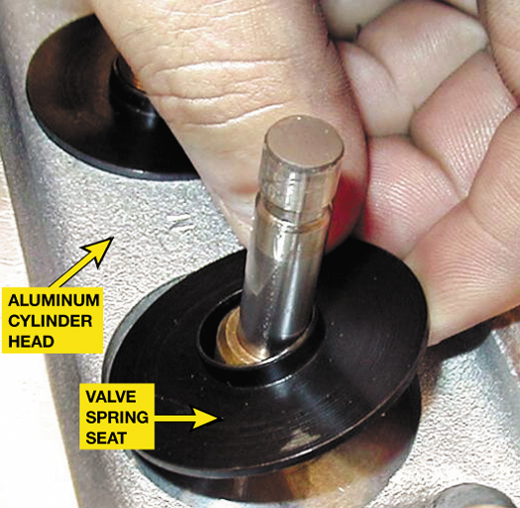
FIGURE 27–47 A metal valve spring seat must be used between the valve spring and the aluminum cylinder head. Many Chrysler aluminum cylinder heads use a combination valve spring seat and valve stem seal.

Slide 47
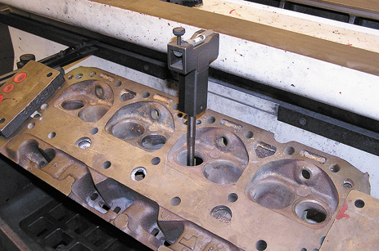
1 After the valve guide has been replaced or checked for being within specification, insert a pilot into the valve guide.

Slide 48
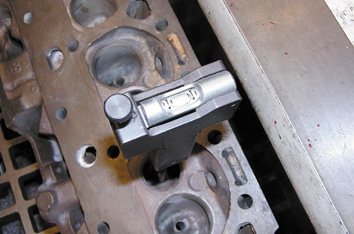
2 Level the bubble on the pilot by moving the cylinder head, which is clamped to a seat/guide machine.

Slide 49
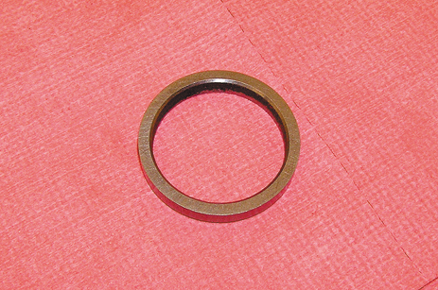
3 Select the proper valve seat for the application. Consult the manufacturer’s literature for recommendations.

Slide 50
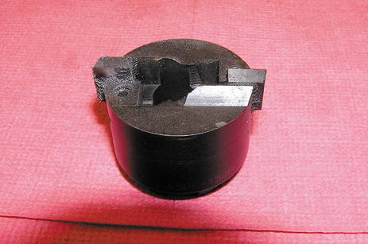
4 Select the correct cutter and check that the cutting bits are sharp.

Slide 51
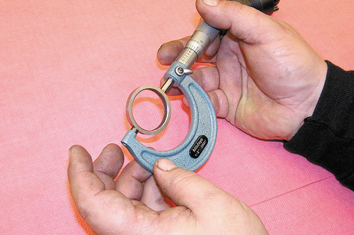
5 Carefully measure the exact outside diameter (O.D.) of the valve seat.

Slide 52
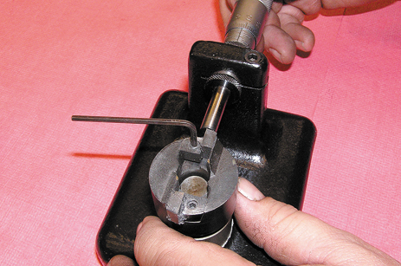
6 Adjust the diameter of the cutter bit to achieve the specified interference fit for the valve seat.

Slide 53
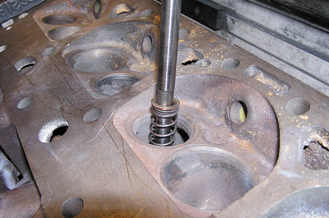
7 Install the pilot into the valve guide to support the seat cutter.

Slide 54
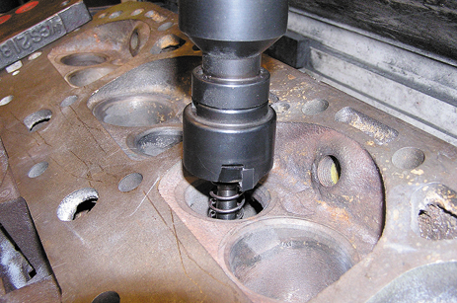
8 Install the seat cutter onto the pilot.

Slide 55
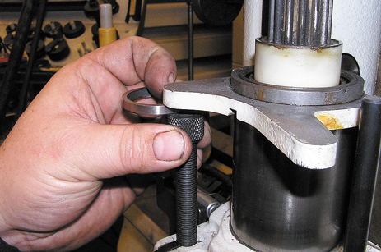
9 Adjust the depth of cut, using the new valve seat to set it to the same depth as the thickness of the seat.

Slide 56
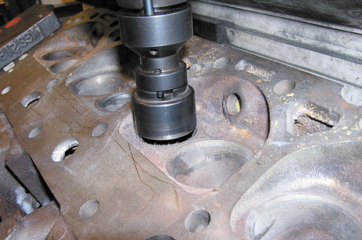
10 With the cylinder head still firmly attached to the seat and guide machine, start the cutter motor and cut the head until it reaches the stop.

Slide 57
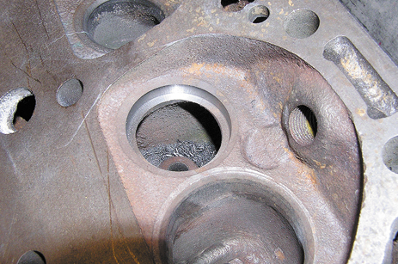
11 The finish cut valve seat pocket. Be sure to use a vacuum to remove all of the metal shavings from the cutting operation.

Slide 58
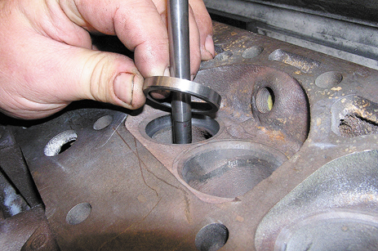
12 Place the chilled valve seat over the pilot being sure that the chamfer is facing toward the head as shown.

Slide 59
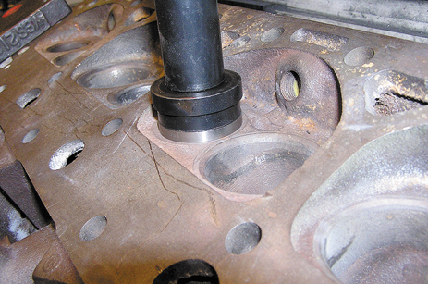
13 Install the correct size driver onto the valve seat.

Slide 60
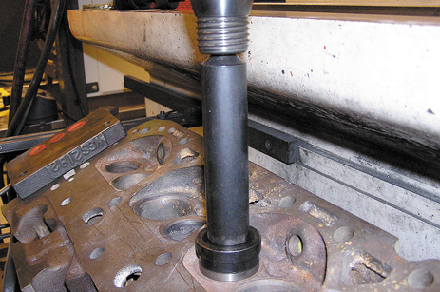
14 Using the air hammer or press, press the valve seat into the valve pocket.

Slide 61
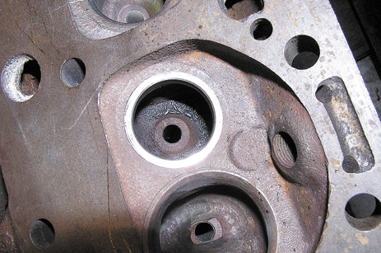
15 A new valve seat is now ready to be machined or cut.

Slide 62
SUMMARY (1 OF 2)
The exhaust valve is about 85% of the size of the intake valve.
Valve springs should be tested for squareness and proper spring force.
Two designs of valve rotators are free and positive.
Valve grinding should start with truing the valve tip; then the face should be refinished.

Slide 63
SUMMARY (2 OF 2)
The installed height should be checked and corrected with valve spring inserts, if needed.
Valve stem height should be checked and the top of the valve ground, if necessary.
After a thorough cleaning, the cylinder head should be assembled using new valve stem seals.

Slide 64
Video Links (Internet Access Required)
Removing valves (time 5:09)
Valve train teardown (time 2:36)
Checking cylinder head warpage (time 1:39)
Valve leak test (time 0:58)
Valve spring replacement (time 7:36)
Replacing valve seals (time 12:11)
Cylinder head repair (time 2:41)
Cracked cylinder head (time 2:41)
Checking cylinder head warpage (time 2:51)
Valve guide inspection (time 3:30)
Valve spring height measurement (time 15:49)

