Slide 1

Automotive Engines Theory and Servicing
Ninth Edition
Chapter 25
Engine Cleaning and Crack Detection

Slide 2
OBJECTIVES
25.1 Explain the mechanical cleaning procedure of engines.
25.2 Discuss chemical cleaners.
25.3 Compare spray and steam washing, thermal cleaning, tank and vapor cleaning, and ultrasonic and vibratory cleaning.
25.4 Explain crack detection and crack repair.

Slide 3
MECHANICAL CLEANING (1 OF 3)
Heavy deposits should be removed by mechanical cleaning before using other cleaning methods.
Mechanical cleaning involves:
  Scraping
  Abrasive brushing
  Abrasive blasting
Scraping

Slide 4
MECHANICAL CLEANING (2 OF 3)
Abrasive Pads or Discs
  White
  Yellow
  Green

Slide 5
MECHANICAL CLEANING (3 OF 3)
Media Blasting
  Nontoxic
  Nonflammable
  Nonhazardous
  Environmentally Safe

Slide 6
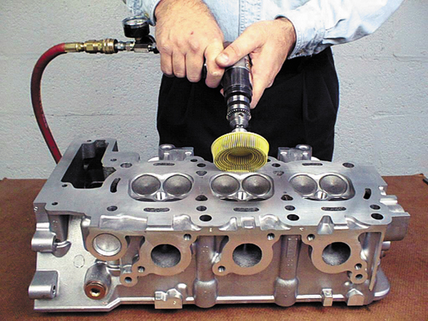
Figure 25–1 An air-powered grinder attached to a bristle pad being used to clean the gasket surface of a cylinder head. This type of cleaning pad should not be used on the engine block where the grit could get into the engine oil and cause harm when the engine is started and run after the repair.

Slide 7
CHEMICAL CLEANERS
pH
Solvent-based Cleaning
Water-based Chemical Cleaning

Slide 8
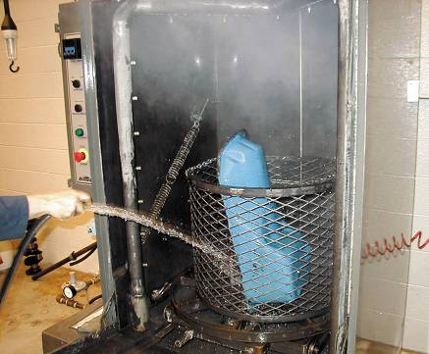
SPRAY AND STEAM WASHING
Spray Washing
  Spray washing is faster than soaking
Steam Cleaning
  Steam vapor is mixed with high-pressure water and sprayed on the parts
FIGURE 25–5 A pressure jet washer is similar to a large industrial-sized dishwasher. Each part is then rinsed with water to remove chemicals or debris that may remain there while it is still in the tank.

Slide 9
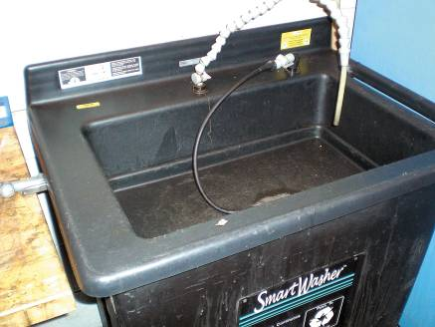
THERMAL CLEANING
Temperatures Involved
Advantages
Microbial Cleaning
Pyrolytic Oven
FIGURE 25–6 A microbial cleaning tank uses microbes to clean grease and oil from parts.

Slide 10
TANK AND VAPOR CLEANING
Cold Tank Cleaning
Hot Tank Cleaning
Vapor Cleaning

Slide 11
ULTRASONIC AND VIBRATORY CLEANING
Ultrasonic Cleaning
  To clean small parts that must be absolutely clean
Vibratory Cleaning
  Best on small parts
  The movement of the vibrating solution and the scrubbing action of the media do an excellent job of cleaning metal.

Slide 12
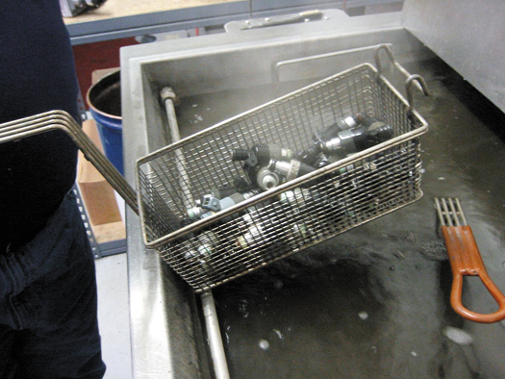
Figure 25–8 An ultrasonic cleaner is used to clean fuel injectors.

Slide 13
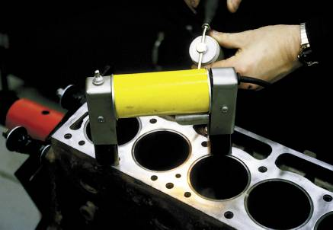
CRACK DETECTION
Visual Inspection
Magnetic Crack Detection
Dye-penetrant Testing
Fluorescent-penetrant Testing
Pressure Testing
FIGURE 25–9 The top deck surface of a block is being tested using magnetic crack inspection equipment.

Slide 14
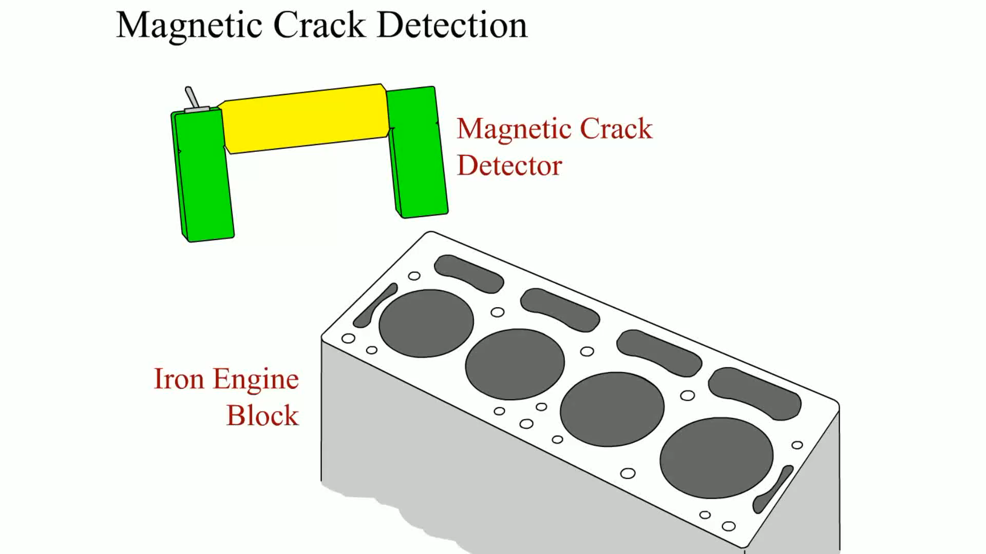
Animation: Magnetic Crack Detection
(The animation will automatically start in a few seconds)

Slide 15
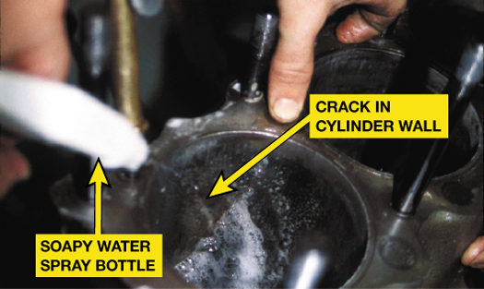
Figure 25–12 To make sure that the mark observed in the cylinder wall was a crack, compressed air was forced into the water jacket while soapy water was sprayed on the cylinder wall. Bubbles confirmed that the mark was indeed a crack.

Slide 16
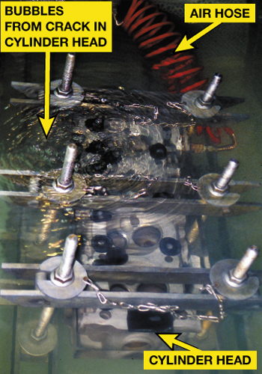
Figure 25–13 A cylinder head is under water and being pressure tested using compressed air. Note that the air bubbles indicate a crack.

Slide 17
CRACK REPAIR
Crack Concerns
Stop Drilling
Crack-welding Cast Iron
Crack-welding Aluminum
Crack Plugging

Slide 18
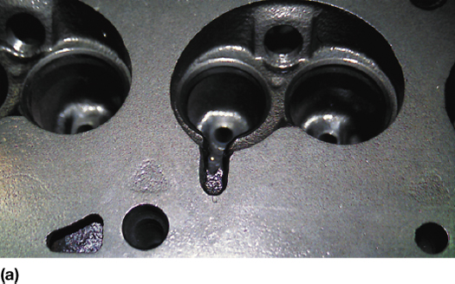
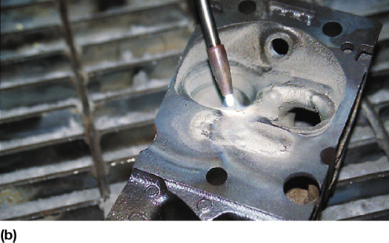
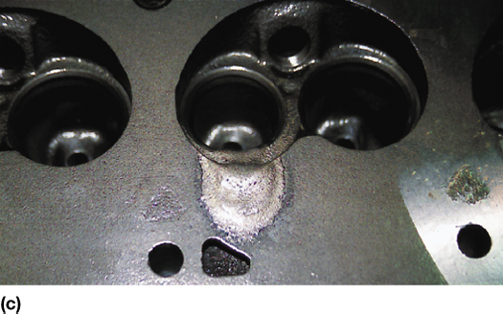
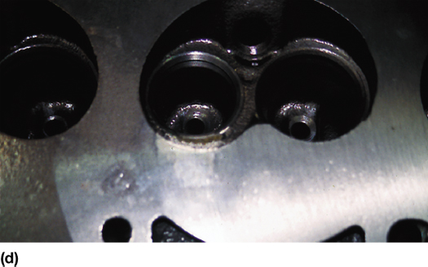
Figure 25–14 (a) Before welding, the crack is ground out using a carbide grinder. (b) Here the technician is practicing using the special cast-iron welding torch before welding the cracked cylinder head. (c) This is the finished welded crack before final machining. (d) Note the finished cylinder head after the crack has been repaired using welding.

Slide 19
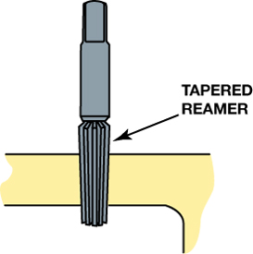
Figure 25–15 Reaming a hole for a tapered plug.

Slide 20
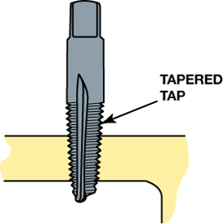
Figure 25–16 Tapping a tapered hole for a plug.

Slide 21
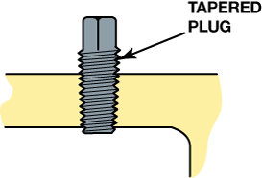
Figure 25–17 Screwing a tapered plug in the hole.

Slide 22
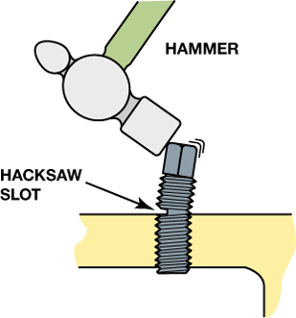
Figure 25–18 Cutting the plug with a hacksaw.

Slide 23
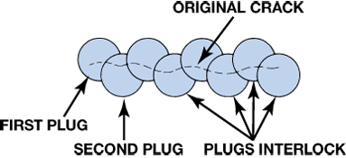
Figure 25–19 Interlocking plugs.

Slide 24
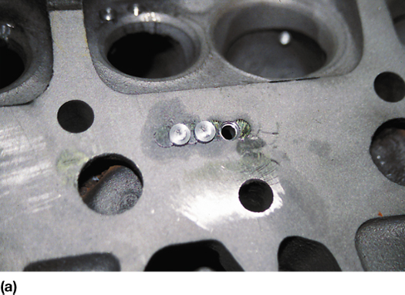
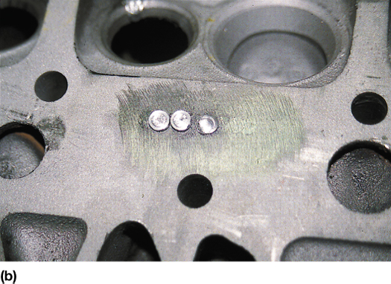
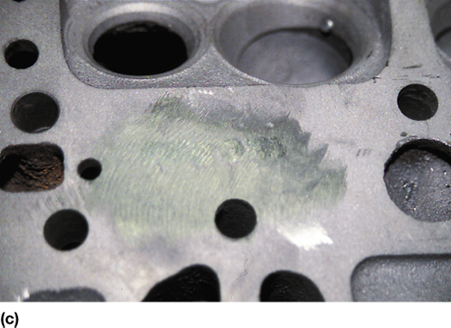
Figure 25–20 (a) A hole is drilled and tapped for the plugs. (b) The plugs are installed. (c) After final machining, the cylinder head can be returned to useful service.

Slide 25
SUMMARY (1 OF 3)
Mechanical cleaning with scrapers or wire brushes is used to remove deposits.
Steel wire brushes should never be used to clean aluminum parts.
Most chemical cleaners are strong soaps called caustic materials.

Slide 26
SUMMARY (2 OF 3)
Always use aluminum-safe chemicals when cleaning aluminum parts or components.
Thermal cleaning is done in a pyrolytic oven in temperatures as high as 800°F (425°C) to turn grease and dirt into harmless ash deposits.

Slide 27
SUMMARY (3 OF 3)
Blasters use metal shot or glass beads to clean parts.
All parts should be checked for cracks using magnetic, dye-penetrant, fluorescent-penetrant, or pressure testing methods.
Cracks can be repaired by welding or by plugging.

Slide 28
Video Links (Internet Access Required)
Cracked cylinder head (time 2:41)
Aluminum Block Crack Detection (time 1:31)

