Slide 1

Automotive Engines Theory and Servicing
Ninth Edition
Chapter 23
In-Vehicle Engine Service

Slide 2
OBJECTIVES
23.1 Explain thermostat replacement and water pump replacement in engines.
23.2 Discuss intake manifold gasket inspection and replacement.
23.3 Describe the steps involved in timing belt replacement.
23.4 Discuss hybrid engine precautions.

Slide 3
THERMOSTAT REPLACEMENT (1 OF 4)
All thermostat valves move during operation to maintain the desired coolant temperature.
Thermostats can fail in the following ways.
  Stuck open
  Stuck closed
  Stuck partially open
  Skewed

Slide 4
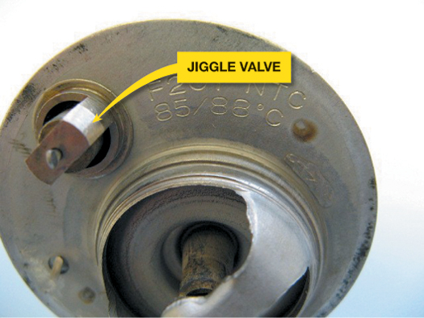
Figure 23–1 If the thermostat has a jiggle valve, it should be placed toward the top to allow air to escape. If a thermostat were to become stuck open or open too soon, this can set a diagnostic trouble code P0128 (coolant temperature below thermostat regulating temperature).

Slide 5
THERMOSTAT REPLACEMENT (2 OF 4)
STEP 1 Allow the engine to cool for several hours so the engine and the coolant should be at room temperature.
STEP 2 Drain the coolant into a suitable container.
STEP 3 Remove any necessary components to get access to the thermostat.
STEP 4 Remove the thermostat housing and thermostat.

Slide 6
THERMOSTAT REPLACEMENT (3 OF 4)
STEP 5 Replace the thermostat housing gasket and thermostat. Torque all fasteners to specifications.
STEP 6 Refill the cooling system with the specified coolant and bleed any trapped air from the system.

Slide 7
THERMOSTAT REPLACEMENT (4 OF 4)
STEP 7 Pressurize the cooling system to verify that there are no leaks around the thermostat housing.
STEP 8 Run the engine until it reaches normal operating temperature and check for leaks.
STEP 9 Verify that the engine is reaching correct operating temperature.

Slide 8
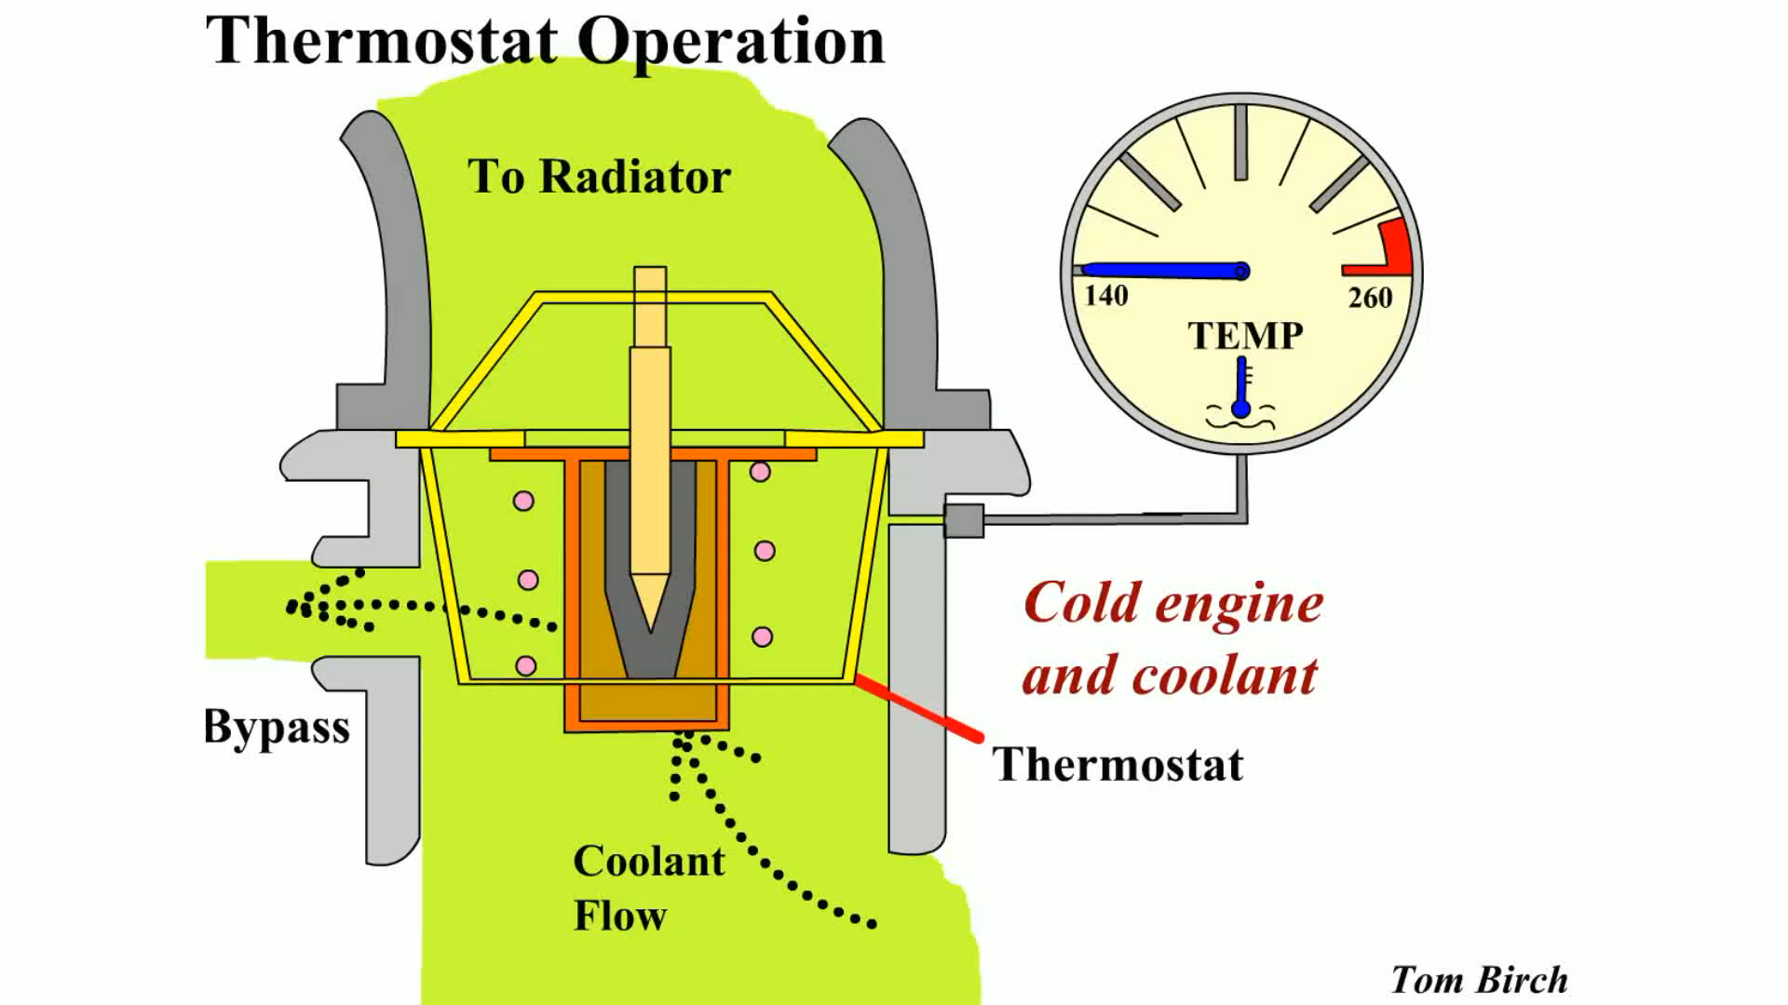
Animation: Thermostat Operation
(The animation will automatically start in a few seconds)

Slide 9
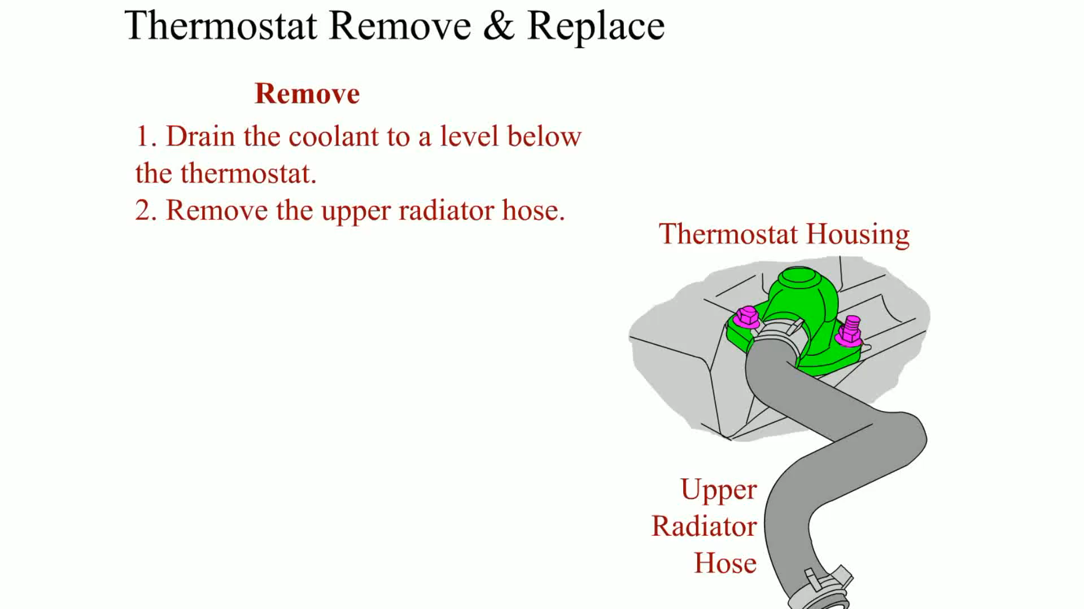
Animation: Thermostat Remove & Replace
(The animation will automatically start in a few seconds)

Slide 10
WATER PUMP REPLACEMENT (1 OF 4)
A water pump will require replacement if any of the following conditions are present.
  Leaking coolant from the weep hole
  Bearing noisy or loose
  Lack of proper coolant flow caused by worn or slipping impeller blades

Slide 11
WATER PUMP REPLACEMENT (2 OF 4)
STEP 1 Allow the engine to cool to room temperature.
STEP 2 Drain the coolant and dispose of properly or recycle.
STEP 3 Remove engine components to gain access to the water pump as specified in service information.

Slide 12
WATER PUMP REPLACEMENT (3 OF 4)
STEP 4 Remove the water pump assembly.
STEP 5 Clean the gasket surfaces and install the new water pump using a new gasket or seal as needed. Torque all fasteners to factory specifications.
STEP 6 Install removed engine components.

Slide 13
WATER PUMP REPLACEMENT (4 OF 4)
STEP 7 Fill the cooling system with the specified coolant.
STEP 8 Run the engine, check for leaks, and verify proper operation.

Slide 14
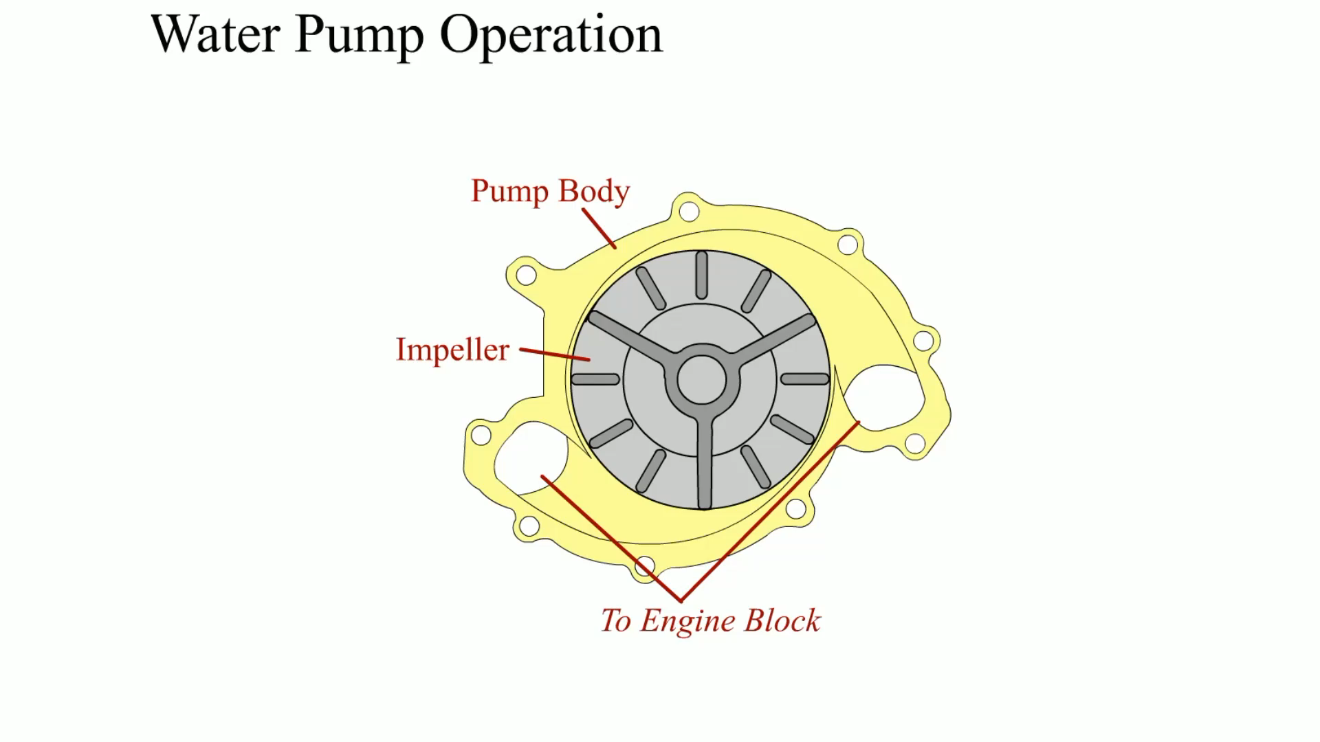
Animation: Water Pump Operation
(The animation will automatically start in a few seconds)

Slide 15
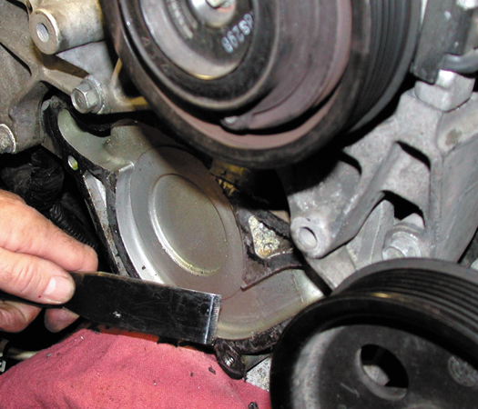
Figure 23–2 Use caution if using a steel scraper to remove a gasket from aluminum parts. It is best to use a wood or plastic scraper.

Slide 16
INTAKE MANIFOLD GASKET INSPECTION (1 OF 4)
Many V-type engines leak oil, coolant, or experience an air (vacuum) leak caused by a leaking intake manifold gasket.

Slide 17
INTAKE MANIFOLD GASKET INSPECTION (2 OF 4)
This failure can be contributed to one or more of the following:
  Expansion/contraction rate difference between the cast-iron head and the aluminum intake manifold. This type of failure is called fretting.
  Plastic (Nylon 6.6) gasket deterioration caused by the coolant

Slide 18
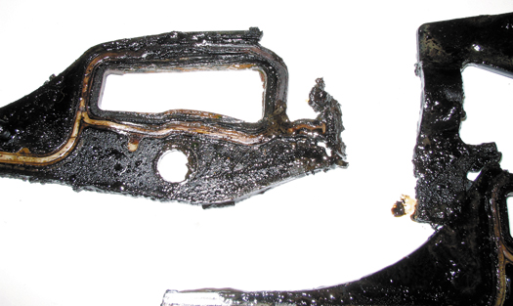
Figure 23–3 An intake manifold gasket that failed and allowed coolant to be drawn into the cylinder(s).

Slide 19
INTAKE MANIFOLD GASKET INSPECTION (3 OF 4)
Because intake manifold gaskets are used to seal oil, air, and coolant in most causes, determining that the intake manifold gasket is the root cause can be a challenge.

Slide 20
INTAKE MANIFOLD GASKET INSPECTION (4 OF 4)
To diagnose a possible leaking intake manifold gasket, perform the following tests.
  Visual inspection
  Coolant level
  Air (vacuum) leak

Slide 21
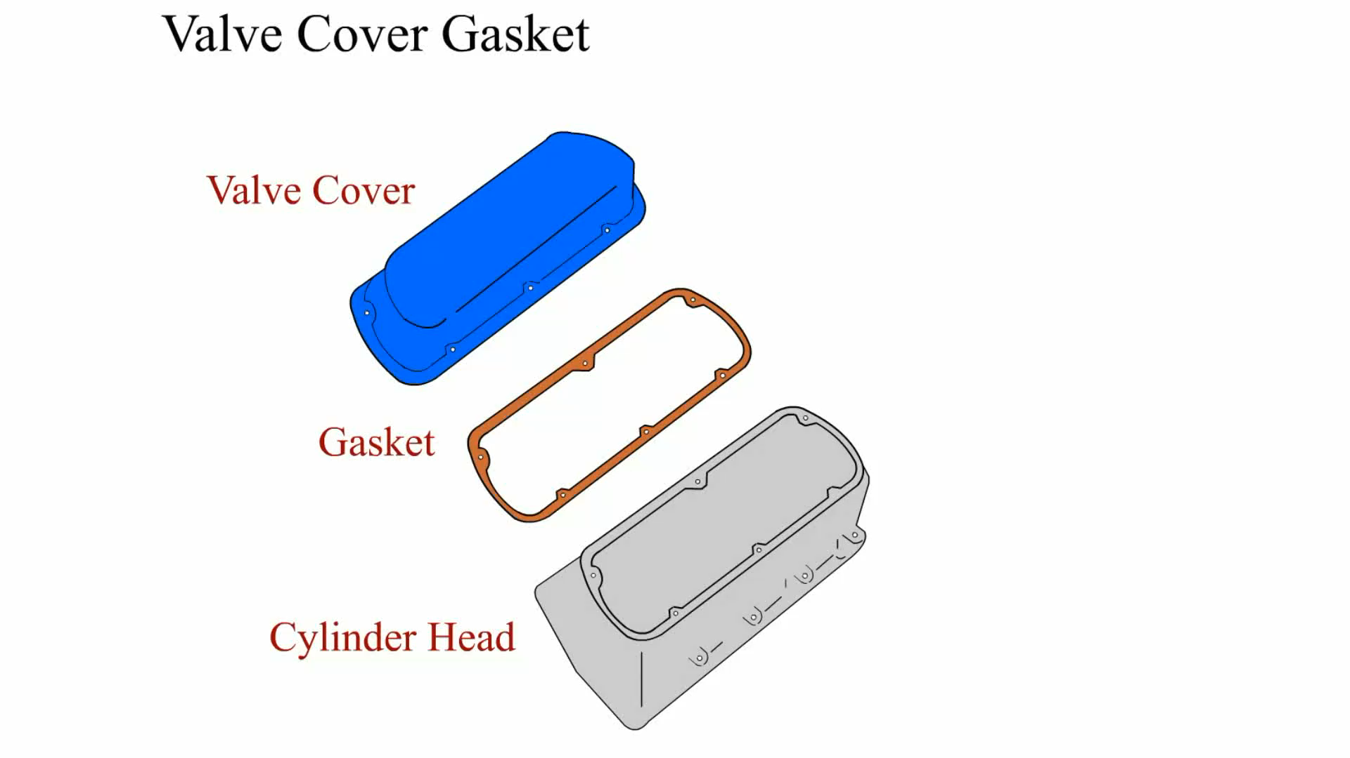
Animation: Valve Cover Gasket
(The animation will automatically start in a few seconds)

Slide 22
INTAKE MANIFOLD GASKET REPLACEMENT (1 OF 6)
STEP 1 Be sure the engine has been off for about an hour and then drain the coolant into a suitable container.
STEP 2 Remove covers and other specified parts needed to get access to the retaining bolts.
STEP 3 To help ensure that the manifold does not warp when removed, loosen all fasteners in the reverse order of the tightening sequence.

Slide 23
INTAKE MANIFOLD GASKET REPLACEMENT (2 OF 6)
STEP 4 Remove the upper intake manifold (plenum), if equipped, and inspect for faults.
STEP 5 Remove the lower intake manifold, using the same bolt removal procedure of starting at the ends and working toward the center.

Slide 24
INTAKE MANIFOLD GASKET REPLACEMENT (3 OF 6)
STEP 6 Thoroughly clean the area and replace the intake manifold if needed. Check that the correct replacement manifold is being used, and even the current part could look different from the original.
STEP 7 Install the intake manifold using new gaskets as specified.

Slide 25
INTAKE MANIFOLD GASKET REPLACEMENT (4 OF 6)
STEP 8 Torque all fasteners to factory specifications and in the proper sequences.
STEP 9 Reinstall all parts needed to allow the engine to start and run, including refilling the coolant if needed.
STEP 10 Start the engine and check for leaks and proper engine operation.

Slide 26
INTAKE MANIFOLD GASKET REPLACEMENT (5 OF 6)
STEP 11 Reset or relearn the idle if specified, using a scan tool.
STEP 12 Install all of the remaining parts and perform a test drive to verify proper operation and no leaks.
STEP 13 Check and replace the air filter if needed.

Slide 27
INTAKE MANIFOLD GASKET REPLACEMENT (6 OF 6)
STEP 14 Change the engine oil if the intake manifold leak could have caused coolant to leak into the engine, which would contaminate the oil.

Slide 28
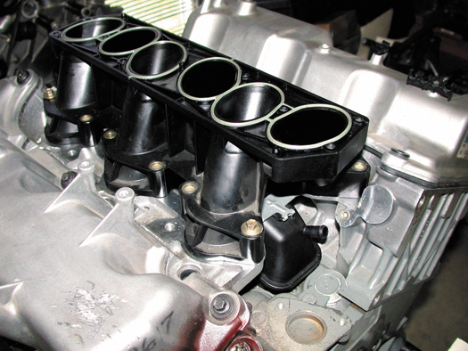
Figure 23–4 The lower intake manifold attaches to the cylinder heads.

Slide 29
TIMING BELT REPLACEMENT (1 OF 7)
Timing belts have a limited service and a specified replacement interval ranging from 60,000 miles (97,000 km) to about 100,000 miles (161,000 km).
Timing belts are required to be replaced if any of the following conditions occur.
  Meets or exceeds the vehicle manufacturer’s recommended timing belt replacement interval.

Slide 30
TIMING BELT REPLACEMENT (2 OF 7)
  The timing belt has been contaminated with coolant or engine oil.
  The timing belt has failed (missing belt teeth or broken).

Slide 31
TIMING BELT REPLACEMENT (3 OF 7)
STEP 1 Allow the engine to cool before removing components to help eliminate the possibility of personal injury or warpage of the parts.
STEP 2 Remove all necessary components to gain access to the timing belt and timing marks.

Slide 32
TIMING BELT REPLACEMENT (4 OF 7)
STEP 3 If the timing belt is not broken, rotate the engine until the camshaft and crankshaft timing marks are aligned according to the specified marks.
STEP 4 Loosen or remove the tensioner as needed to remove the timing belt.

Slide 33
TIMING BELT REPLACEMENT (5 OF 7)
STEP 5 Replace the timing belt and any other recommended items.
  Components that some vehicle manufacturers recommend replacing in addition to the timing belt include:
    Tensioner assembly
    Water pump

Slide 34
TIMING BELT REPLACEMENT (6 OF 7)
    Camshaft oil seal(s)
    Front crankshaft seal
STEP 6 Check (verify) that the camshaft timing is correct by rotating the engine several revolutions.
STEP 7 Install enough components to allow the engine to start to verify proper operation. Check for any leaks, especially if seals have been replaced.

Slide 35
TIMING BELT REPLACEMENT (7 OF 7)
STEP 8 Complete the reassembly of the engine and perform a test drive before returning the vehicle to the customer.

Slide 36
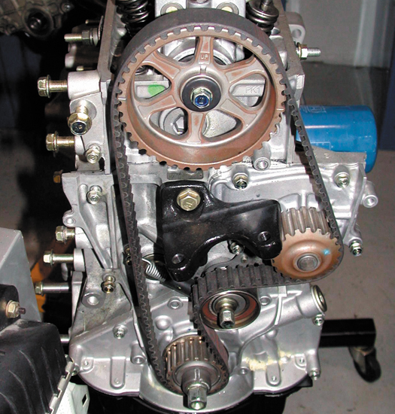
Figure 23–7 A single overhead camshaft engine with a timing belt that also rotates the water pump.

Slide 37
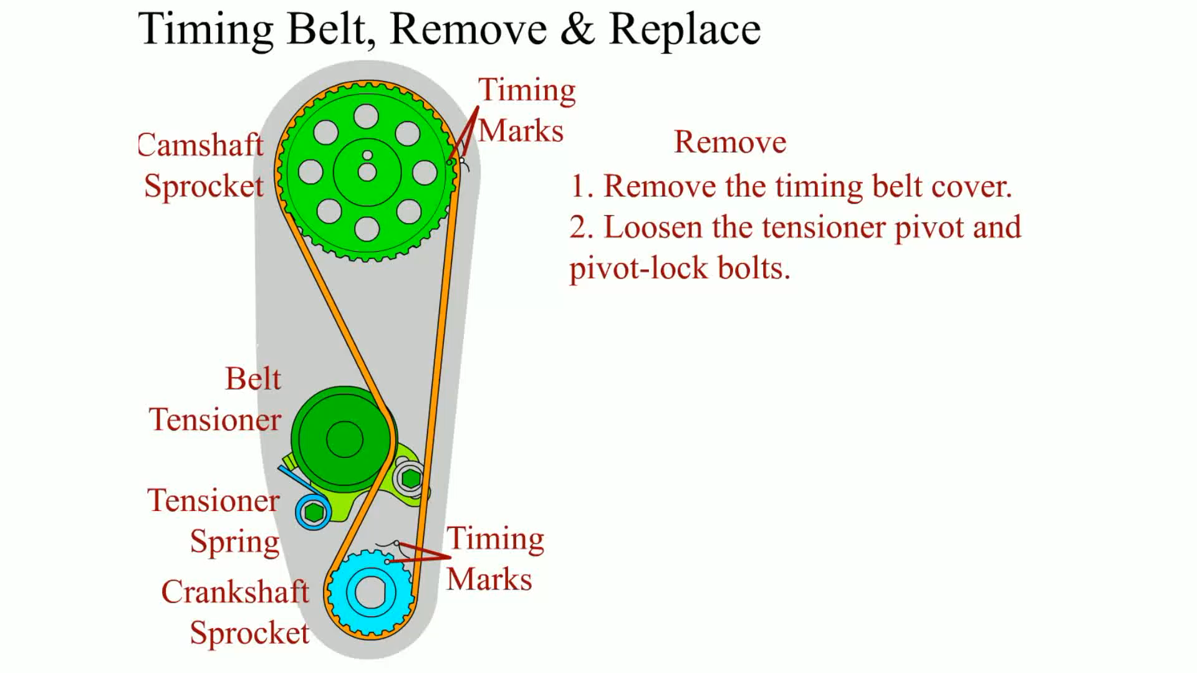
Animation: Timing Belt, Remove & Replace
(The animation will automatically start in a few seconds)

Slide 38
HYBRID ENGINE PRECAUTIONS (1 OF 4)
Gasoline engines used in hybrid electric vehicles and in extended range electric vehicles can be a hazard to be around under some conditions.
  These vehicles are designed to stop the gasoline engines unless needed.

Slide 39
HYBRID ENGINE PRECAUTIONS (2 OF 4)
    This feature is called idle stop.
    This means that the engine is not running, but could start at any time if the computer detects the need to charge the hybrid batteries or other issue that requires the gasoline engine to start and run.

Slide 40
HYBRID ENGINE PRECAUTIONS (3 OF 4)
Always check service information for the exact procedures to follow when working around or under the hood of a hybrid electric vehicle.
These precautions could include:
  Before working under the hood or around the engine, be sure that the ignition is off and the key is out of the ignition.
  Check that the “Ready” light is off.

Slide 41
HYBRID ENGINE PRECAUTIONS (4 OF 4)
  Do not touch any circuits that have orange electrical wires or conduit. The orange color indicates dangerous high-voltage wires, which could cause serious injury or death if touched.
  Always use high-voltage linesman’s gloves whenever depowering the high-voltage system.

Slide 42
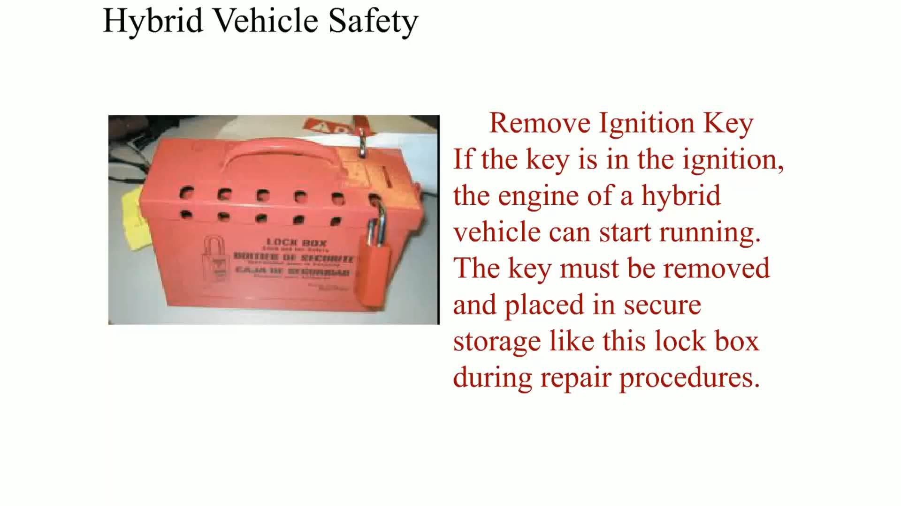
Animation: Hybrid Vehicle Safety
(The animation will automatically start in a few seconds)

Slide 43
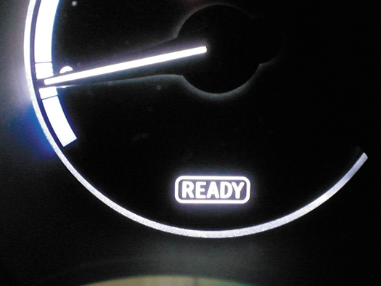
Figure 23–8 A Toyota/Lexus hybrid electric vehicle has a ready light. If the ready light is on, the engine can start at anytime without warning.

Slide 44
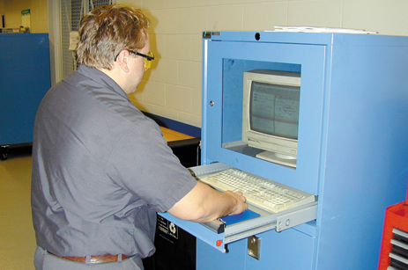
1 Before starting the process of adjusting the valves, look up the specifications and exact procedures. The technician is checking this information from a computer CD-ROM-based information system.

Slide 45
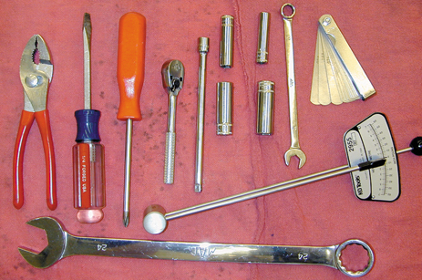
2 The tools necessary to adjust the valves on an engine with adjustable rocker arms include basic hand tools, feeler gauge, and a torque wrench.

Slide 46
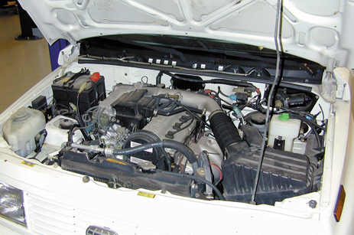
3 An overall view of the 4-cylinder engine that is due for a scheduled valve adjustment according to the vehicle manufacturer’s recommendations.

Slide 47
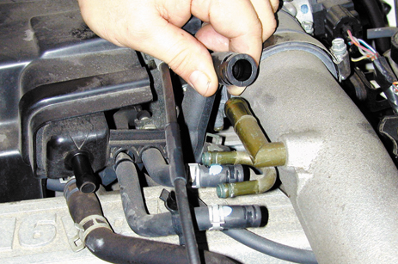
4 Start the valve adjustment procedure by first disconnecting and labeling, if necessary, all vacuum lines that need to be removed to gain access to the valve cover.

Slide 48
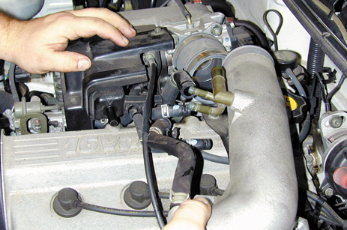
5 The air intake tube is being removed from the throttle body.

Slide 49
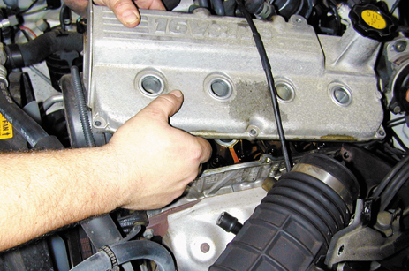
6 With all vacuum lines and the intake tube removed, the valve cover can be removed after removing all retaining bolts.

Slide 50
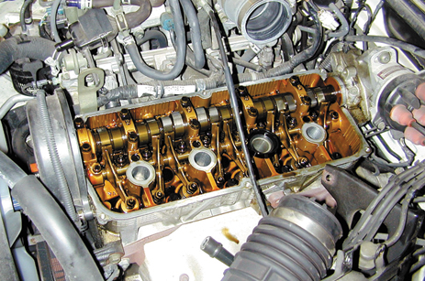
7 Notice how clean the engine appears. This is a testament of proper maintenance and regular oil changes by the owner.

Slide 51
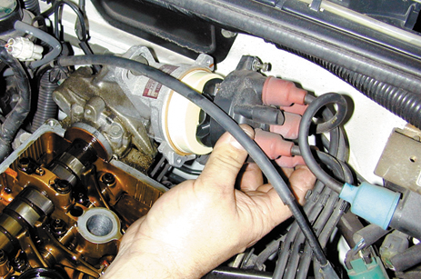
8 To help locate how far the engine is being rotated, the technician is removing the distributor cap to be able to observe the position of the rotor.

Slide 52
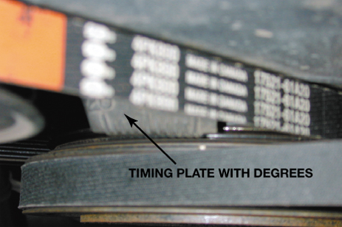
9 The engine is rotated until the timing marks on the front of the crankshaft line up with zero degrees—top dead center (TDC)—with both valves closed on #1 cylinder.

Slide 53
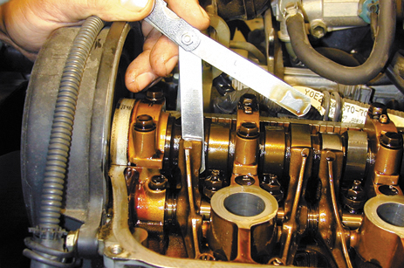
10 With the rocker arms contacting the base circle of the cam, insert a feeler gauge of the specified thickness between the camshaft and the rocker arm. There should be a slight drag on the feeler gauge.

Slide 54
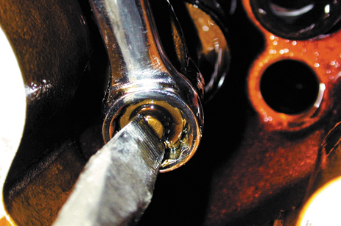
11 If the valve clearance (lash) is not correct, loosen the retaining nut and turn the valve adjusting screw with a screwdriver to achieve the proper clearance.

Slide 55
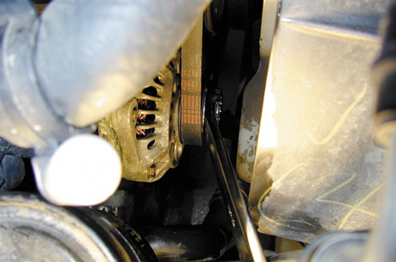
12 After adjusting the valves that are closed, rotate the engine one full rotation until the engine timing marks again align.

Slide 56
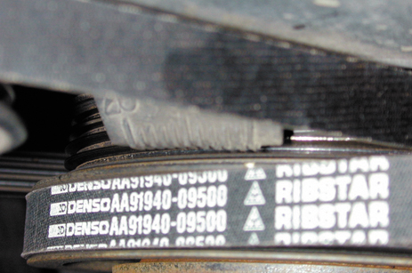
13 The engine is rotated until the timing marks again align indicating that the companion cylinder will now be in position for valve clearance measurement.

Slide 57
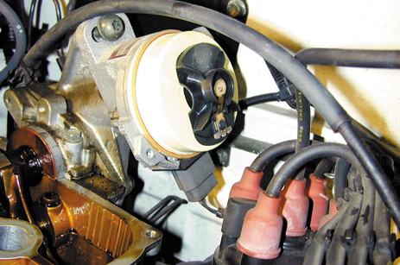
14 On some engines, it is necessary to watch the direction the rotor is pointing to help determine how far to rotate the engine. Always follow the vehicle manufacturer’s recommended procedure.

Slide 58
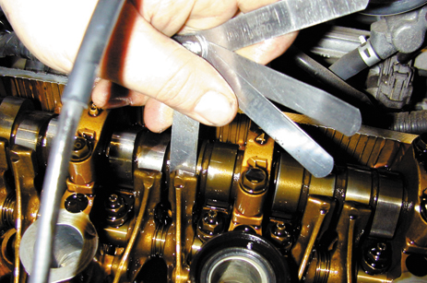
15 The technician is using a feeler gauge that is one-thousandth of an inch thinner and another one thousandth of an inch thicker than the specified clearance as a double-check that the clearance is correct.

Slide 59
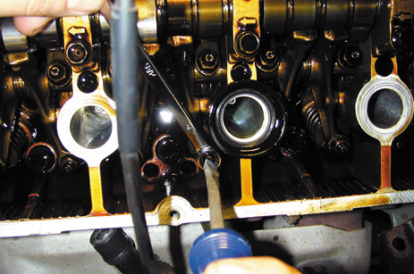
16 Adjusting a valve takes both hands—one to hold the wrench to loosen and tighten the lock nut and one to turn the adjusting screw. Always double check the clearance after an adjustment is made.

Slide 60
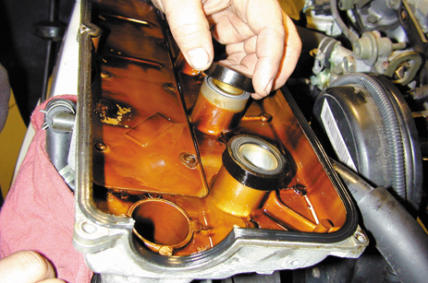
17 After all valves have been properly measured and adjusted as necessary, start the reassembly process by replacing all gaskets and seals as specified by the vehicle manufacturer.

Slide 61
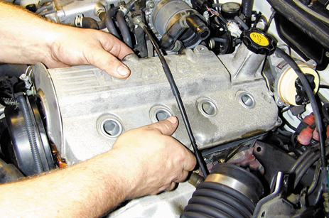
18 Reinstall the valve cover being careful to not pinch a wire or vacuum hose between the cover and the cylinder head.

Slide 62
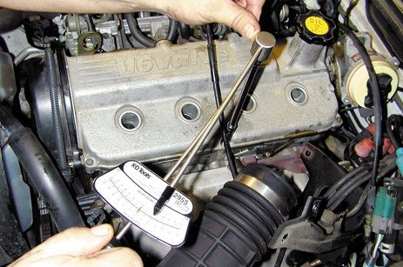
19 Use a torque wrench and torque the valve cover retaining bolts to factory specifications.

Slide 63
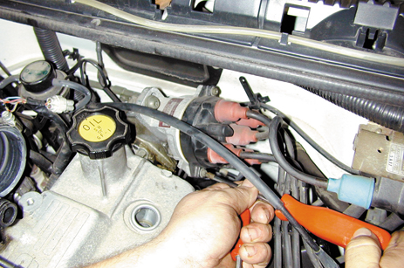
20 Reinstall the distributor cap.

Slide 64
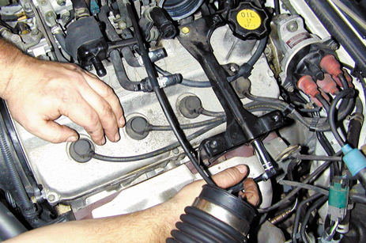
21 Reinstall the spark plug wires and all brackets that were removed to gain access to the valve cover.

Slide 65
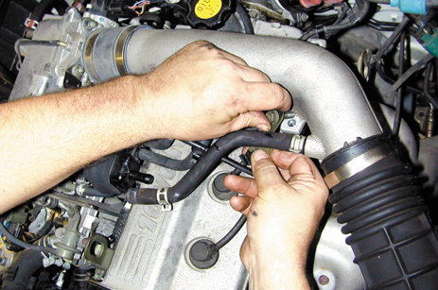
22 Reconnect all vacuum and air hoses and tubes. Replace any vacuum hoses that are brittle or swollen with new ones.

Slide 66
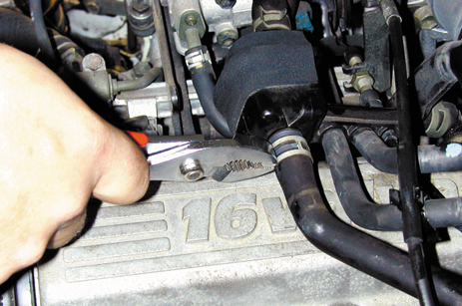
23 Be sure that the clips are properly installed. Start the engine and check for proper operation.

Slide 67
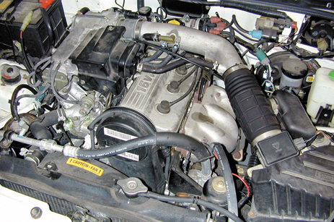
24 Double-check for any oil or vacuum leaks after starting the engine.

Slide 68
SUMMARY (1 OF 3)
Thermostats can fail in the following ways.
  Stuck open
  Stuck closed
  Stuck partially open
  Skewed
A water pump should be replaced if any of the following conditions are present.

Slide 69
SUMMARY (2 OF 3)
  Leaking from the weep hole
  Noisy bearing
  Loose bearing
  Lack of normal circulation from worn impeller blades
A leaking intake manifold gasket can cause coolant to get into the oil or oil into the coolant, as well as other faults, such as a poor running engine.

Slide 70
SUMMARY (3 OF 3)
When a timing belt is replaced, most vehicle manufacturers also recommend that the following items be replaced.
  Tensioner assembly; Water pump; Camshaft seal(s); Front crankshaft seal
When working on a Toyota/Lexus hybrid electric vehicle (HEV), be sure that the key is off and out of the ignition and the READY light is off.

Slide 71
Video Links (Internet Access Required)
Timing belt (time 1:18)
Timing belt (time 7:10)
Motor mount (time 1:21)
Honda civic timing belt (time 8:52)
Timing belt replacement (time 3:18)
Serpentine belt replacement (time 8:05)
Motor mount (time 6:22)
Engine mount (time 2:39)
Motor mount (time 4:38)
Motor mounts (time 10:54)

Slide 72
Video Links (Internet Access Required)
Belt replacement (time 2:23)
Timing belt removal (time 7:50)
Timing belt inspection (time 7:53)
VW timing belt (time 2:35)
Daewoo timing belt (time 5:11)
Focus timing belt part 1 (time 4:09)
Focus timing belt part 2 (time 5:21)
Focus timing belt part 3 (time 2:48)
Timing belt replacement (time 4:00)
Valve adjustment (time 8:04)

Slide 73
Video Links (Internet Access Required)
Timing belt (time 14:10)
Timing belt (time 9:28)
Timing belt (time 7:31)
Mitsubishi timing belt part 1 (time 8:11)
Mitsubishi timing belt part 2 (time 9:07)
Timing belt (time 5:00)
Hybrid vehicle precautions (time 1:29)

