Slide 1
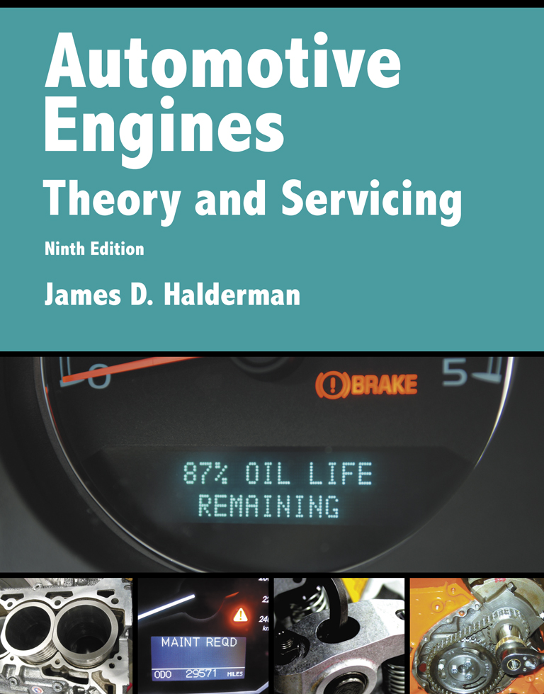
Automotive Engines Theory and Servicing
Ninth Edition
Chapter 22
Engine Condition Diagnosis

Slide 2
OBJECTIVES (1 OF 2)
22.1 Discuss typical engine-related complaints and engine smoke diagnosis.
22.2 Discuss the importance of visual checks.
22.3 Discuss engine noise diagnosis.
22.4 Explain oil pressure testing and the purpose of oil pressure warning lamps.
22.5 Explain compression test, and compare wet compression test and running compression test.

Slide 3
OBJECTIVES (2 OF 2)
22.6 Describe cylinder leakage test and cylinder power balance test.
22.7 Explain the vacuum test and exhaust restriction test.
22.8 Explain how to test back pressure with a vacuum gauge and a pressure gauge, and how to diagnose head gasket failure.
2.9 Discuss the operation of warning lights.

Slide 4
TYPICAL ENGINE-RELATED COMPLAINTS (1 OF 2)
Many driveability problems are not caused by engine mechanical problems.
  A thorough inspection and testing of the ignition and fuel systems should be performed before testing for mechanical engine problems.

Slide 5
TYPICAL ENGINE-RELATED COMPLAINTS (2 OF 2)
Typical engine mechanical-related complaints include the following:
  Excessive oil consumption
  Engine misfiring
  Loss of power
  Smoke from the engine or exhaust
  Engine noise

Slide 6
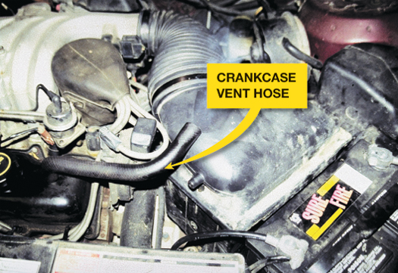
FIGURE 22–1 Blowby gases coming out of the crankcase vent hose. Excessive amounts of combustion gases flow past the piston rings and into the crankcase.

Slide 7
ENGINE SMOKE DIAGNOSIS
The color of engine exhaust smoke can indicate what engine problem might exist.
  Blue
  Black
  White (steam)

Slide 8
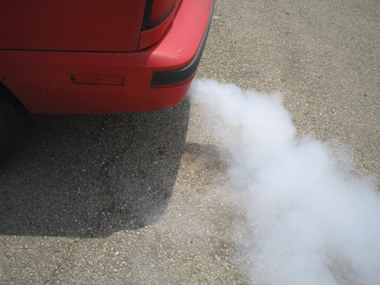
FIGURE 22–2 White steam is usually an indication of a blown (defective) cylinder head gasket that allows engine coolant to flow into the combustion chamber where it is turned to steam.

Slide 9
THE DRIVER IS YOUR BEST RESOURCE
When did the problem first occur?
Under what conditions does it occur?
  1. Cold or hot?
  2. Acceleration, cruise, or deceleration?
  3. How far was it driven?
  4. What recent repairs have been performed?

Slide 10
VISUAL CHECKS
The first and most important "test" that can be performed is a careful visual inspection.
  Oil Level and Condition
  Coolant Level and Condition
  Oil Leaks

Slide 11
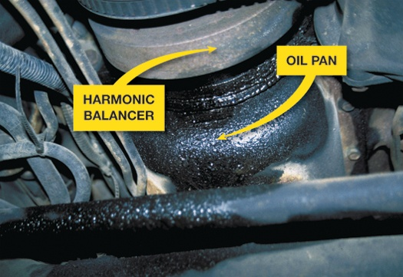
FIGURE 22–3 What looks like an oil pan gasket leak can be a rocker cover gasket leak. Always look up and look for the highest place you see oil leaking; that should be repaired first.

Slide 12
ENGINE NOISE DIAGNOSIS (1 OF 2)
An engine knocking noise is often difficult to diagnose. Several items that can cause it include:
  Valves clicking
  Torque converter
  Cracked flex plate
  Loose or defective drive belts or tensioners
  Piston pin knock

Slide 13
ENGINE NOISE DIAGNOSIS (2 OF 2)
  Piston slap
  Timing chain noise
  Rod-bearing noise
  Main-bearing knock

Slide 14
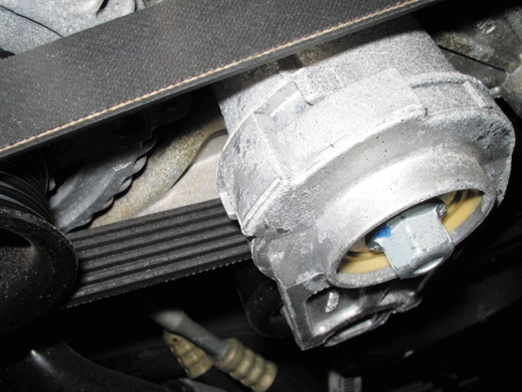
FIGURE 22–6 An accessory belt tensioner. Most tensioners have a mark that indicates normal operating location. If the belt has stretched, this indicator mark will be outside of the normal range. Anything wrong with the belt or tensioner can cause noise.

Slide 15
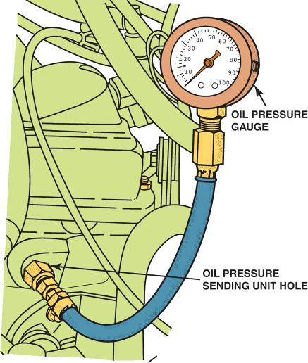
OIL PRESSURE TESTING
Proper oil pressure is very important for the operation of any engine.
  Low oil pressure can cause engine wear, and engine wear can cause low oil pressure.
FIGURE 22–8 To measure engine oil pressure, remove the oil pressure sending (sender) unit usually located near the oil filter. Screw the pressure gauge into the oil pressure sending unit hole.

Slide 16
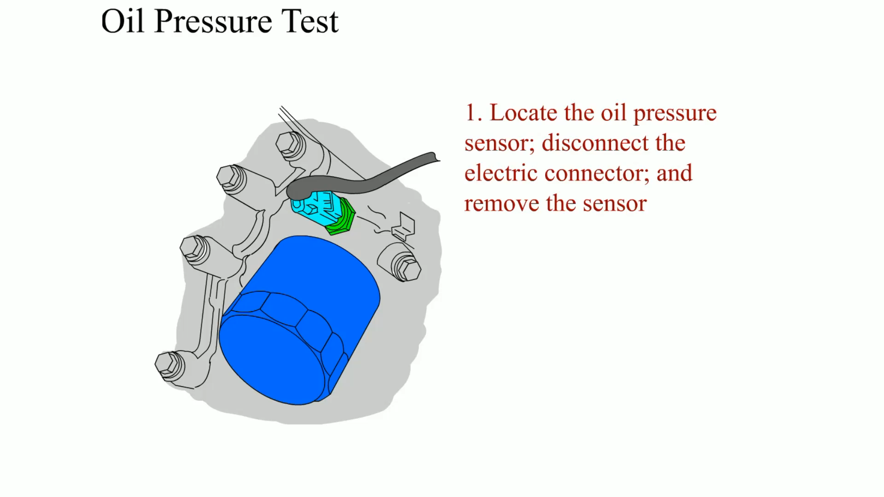
Animation: Oil Pressure Test
(The animation will automatically start in a few seconds)

Slide 17
OIL PRESSURE WARNING LAMP (1 OF 2)
The red oil pressure warning lamp in the dash usually lights when the oil pressure is less than 4 to 7 PSI, depending on vehicle and engine.
  The oil light should not be on during driving.
  If the oil warning lamp is on, stop the engine immediately.

Slide 18
OIL PRESSURE WARNING LAMP (2 OF 2)
Always confirm oil pressure with a reliable mechanical gauge before performing engine repairs.
  The sending unit or circuit may be defective.

Slide 19
COMPRESSION TEST (1 OF 2)
An engine compression test is one of the fundamental engine diagnostic tests that can be performed.
For smooth engine operation, all cylinders must have equal compression.

Slide 20
COMPRESSION TEST (2 OF 2)
An engine can lose compression by leakage of air through one or more of only three routes.
  Intake or exhaust valve
  Piston rings (or piston, if there is a hole)
  Cylinder head gasket

Slide 21
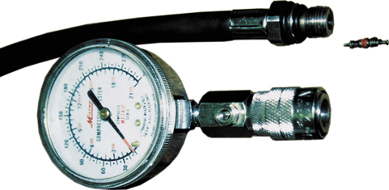
FIGURE 22–11 A two-piece compression gauge set. The threaded hose is screwed into the spark plug hole after removing the spark plug. The gauge part is then snapped onto the end of the hose.

Slide 22
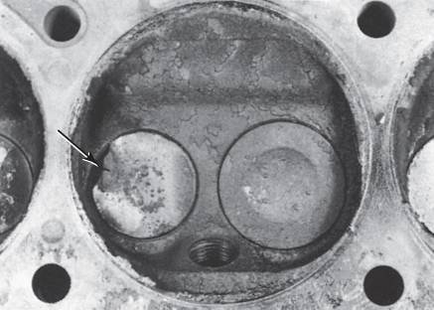
WET COMPRESSION TEST
If the compression test reading indicates low compression on one or more cylinders, add three squirts of oil to the cylinder and retest.
This is called a wet compression test, when oil is used to help seal around the piston rings.
FIGURE 22–13 Badly burned exhaust valve. A compression test could have detected a problem, and a cylinder leakage test (leak-down test) could have been used to determine the exact problem.

Slide 23
RUNNING (DYNAMIC) COMPRESSION TEST
A compression test is commonly used to help determine engine condition and is usually performed with the engine cranking.
  Performing a Running Compression Test

Slide 24
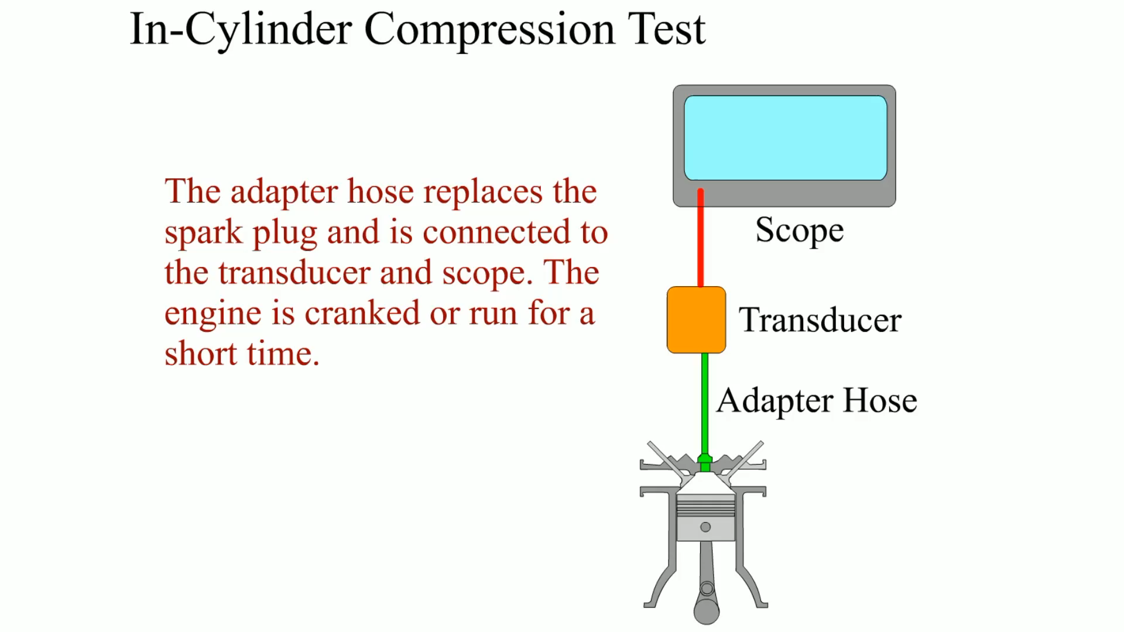
Animation: In-Cylinder Compression Test
(The animation will automatically start in a few seconds)

Slide 25
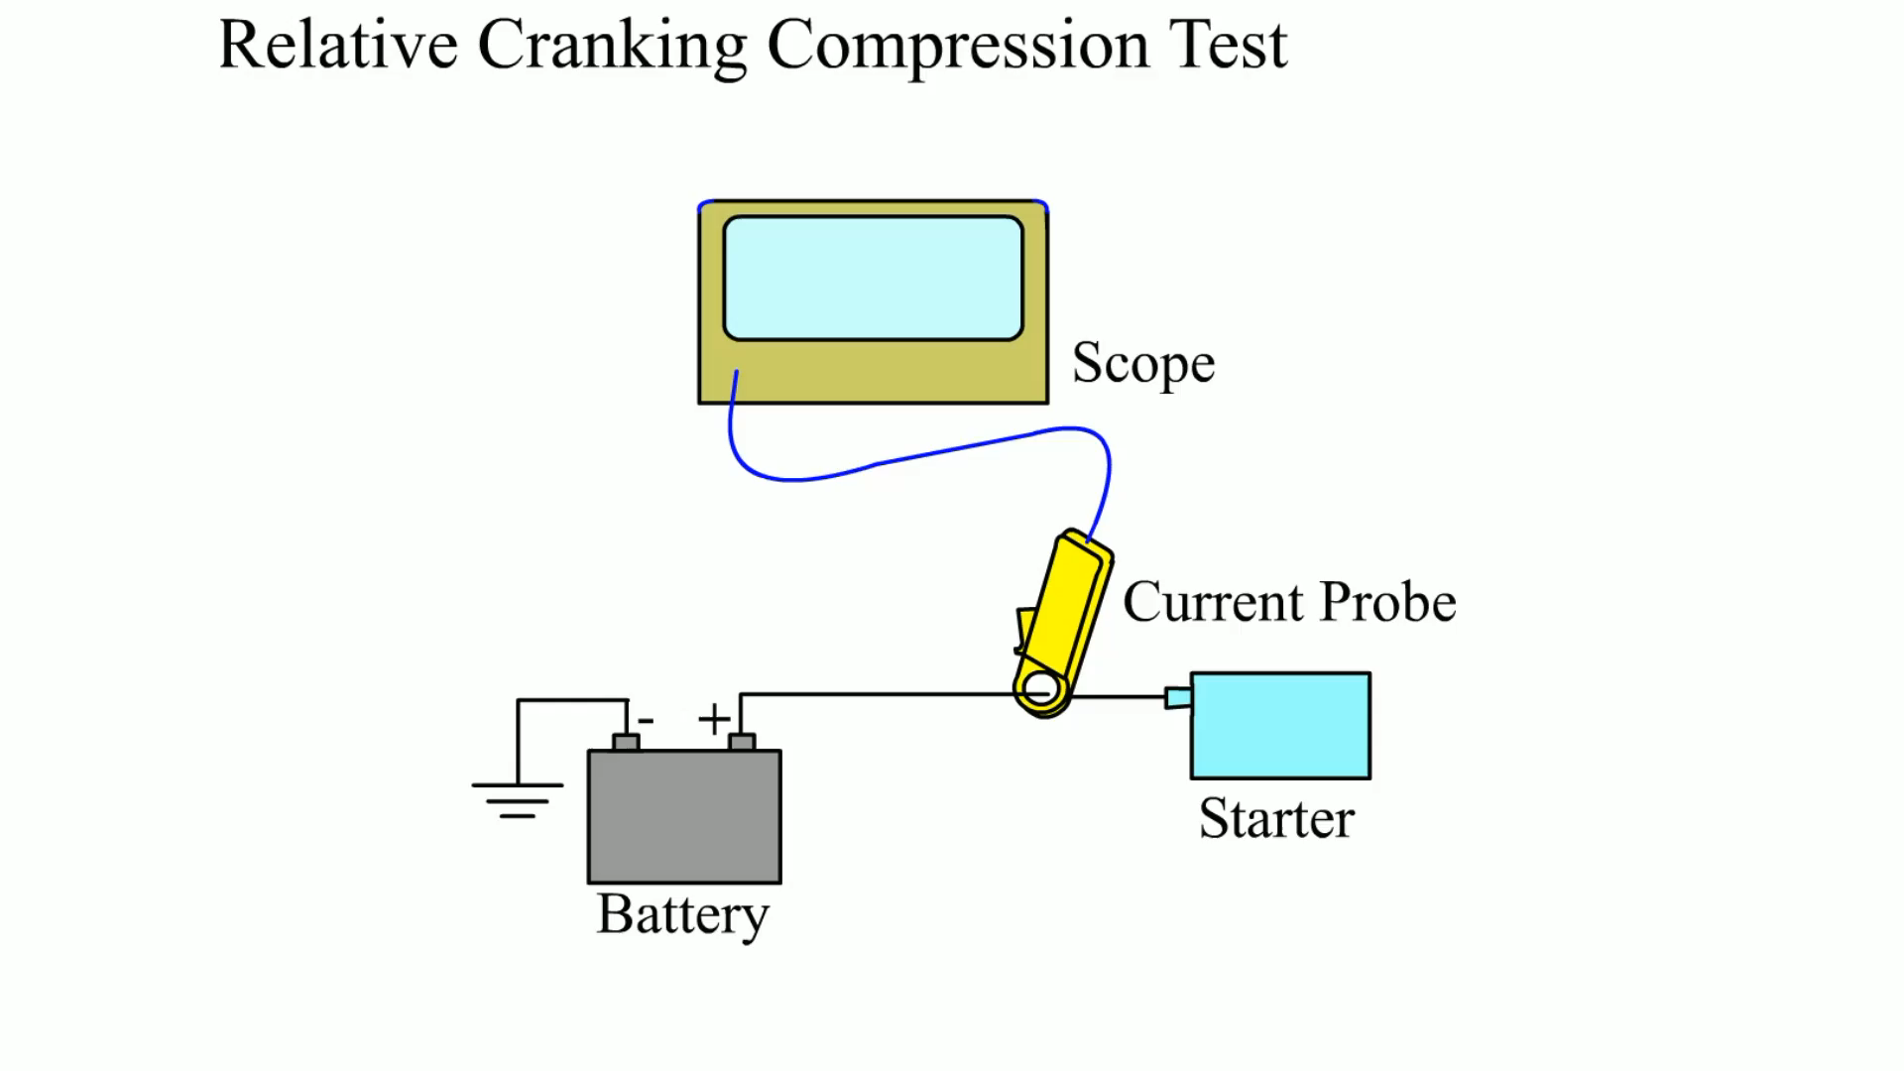
Animation: Relative Cranking Compression Test
(The animation will automatically start in a few seconds)

Slide 26
Animation: Relative Cranking Compression Test
(The animation will automatically start in a few seconds)

Slide 27
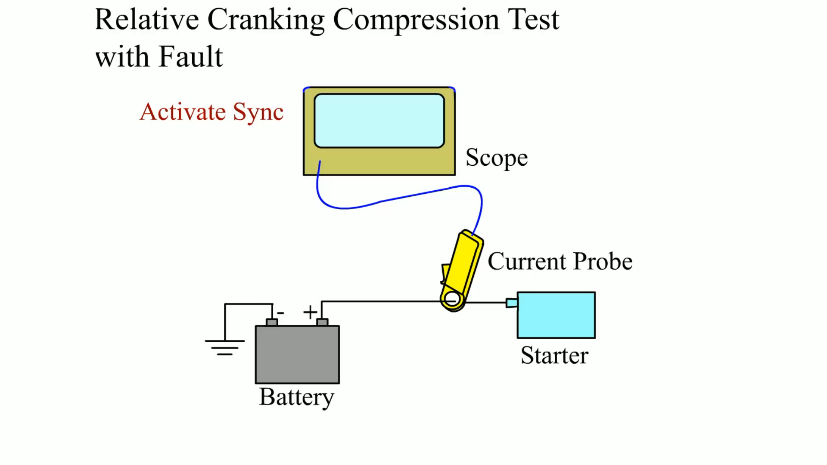
Animation: Relative Cranking Compression Test with Fault
(The animation will automatically start in a few seconds)

Slide 28
CYLINDER LEAKAGE TEST
One of the best tests that can be used to determine engine condition is the cylinder leakage test.
  This test involves injecting air under pressure into the cylinders one at a time.
  The amount and location of any escaping air helps the technician determine the condition of the engine.
  The air is injected into the cylinder through a cylinder leakage gauge into the spark plug hole.

Slide 29
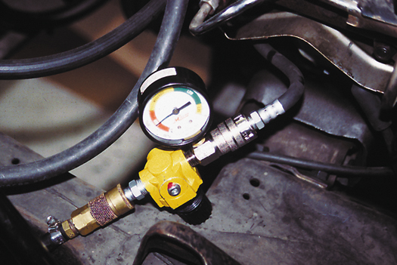
FIGURE 22–14 A typical handheld cylinder leakage tester.

Slide 30
CYLINDER POWER BALANCE TEST (1 OF 2)
Most large engine analyzers and scan tools have a cylinder power balance feature.
  The purpose of a cylinder power balance test is to determine if all cylinders are contributing power equally.
  It determines this by shorting out one cylinder at a time.

Slide 31
CYLINDER POWER BALANCE TEST (2 OF 2)
  If the engine speed (RPM) does not drop as much for one cylinder as for other cylinders of the same engine, then the shorted cylinder must be weaker than the other cylinders.

Slide 32
POWER BALANCE TEST PROCEDURE
The acceptable method of canceling cylinders, which will work on all types of ignition systems, including distributorless, is to ground the secondary current for each cylinder.
The cylinder with the least RPM drop is the cylinder not producing its share of power.

Slide 33
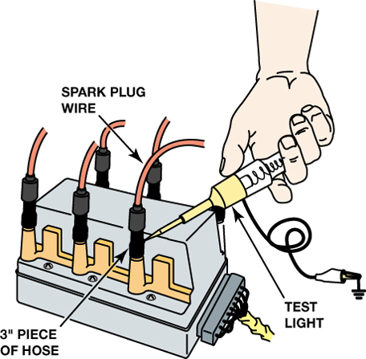
FIGURE 22–16 Using a vacuum hose and a test light to ground one cylinder at a time on a distributorless ignition system. This works on all types of ignition systems and provides a method for grounding out one cylinder at a time without fear of damaging any component. To avoid possible damage to the catalytic converter, do not short out a cylinder for longer than five seconds.

Slide 34
VACUUM TESTS
Cranking Vacuum Test
Idle Vacuum Test
Low and Steady Vacuum
Fluctuating Vacuum

Slide 35
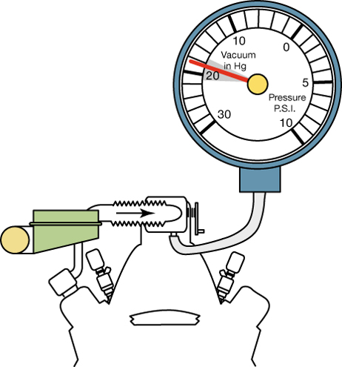
FIGURE 22–17 An engine in good mechanical condition should produce 17 to 21 inch Hg of vacuum at idle at sea level.

Slide 36
EXHAUST RESTRICTION TEST
If the exhaust system is restricted, the engine will be low on power, yet smooth.
Common causes of restricted exhaust include the following:
  Clogged catalytic converter
  Clogged or restricted muffler
  Damaged or defective piping

Slide 37
TESTING BACK PRESSURE WITH A VACUUM GAUGE
A vacuum gauge can be used to measure manifold vacuum at a high idle (2000 to 2500 RPM).
  If the exhaust system is restricted, pressure increases in the exhaust system.
  This pressure is called back pressure.
  Manifold vacuum will drop gradually if the engine is kept at a constant speed if the exhaust is restricted.

Slide 38
TESTING BACK PRESSURE WITH A PRESSURE GAUGE
Exhaust system back pressure can be measured directly by installing a pressure gauge into an exhaust opening.
This can be accomplished in one of the following ways.
  With an oxygen sensor
  With the exhaust gas recirculation (EGR) valve
  With the air-injection reaction (AIR) check valve

Slide 39
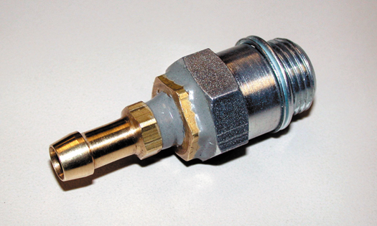
FIGURE 22–28 A technician-made adapter used to test exhaust system back pressure.

Slide 40
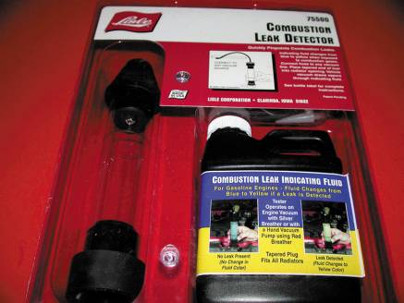
DIAGNOSING HEAD GASKET FAILURE
Several items can be used to help diagnose a head gasket failure.
  Exhaust gas analyzer
  Chemical test
  Bubbles in the coolant
  Excessive exhaust steam
FIGURE 22–29 A tester that uses a blue liquid to check for exhaust gases in the exhaust, which would indicate a head gasket leak problem.

Slide 41
DASH WARNING LIGHTS
Most vehicles are equipped with several dash warning lights often called "telltale" or "idiot" lights.
  These lights are often the only warning a driver receives that there may be engine problems.
  Oil (Engine) Light
  Coolant Temperature Light

Slide 42
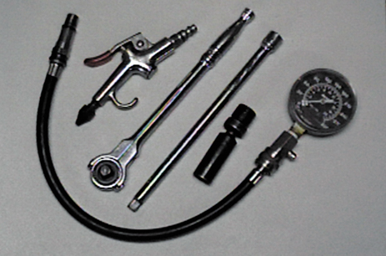
1 The tools and equipment needed to perform a compression test include a compression gauge, an air nozzle, and the socket ratchets and extensions that may be necessary to remove the spark plugs from the engine.

Slide 43
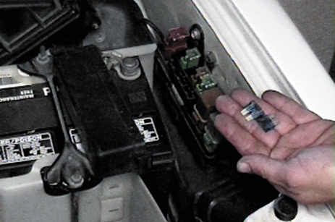
2 To prevent ignition and fuel-injection operation while the engine is being cranked, remove both the fuel injection fuse and the ignition fuse. If the fuses cannot be removed, disconnect the wiring connectors for the injectors and the ignition system.

Slide 44
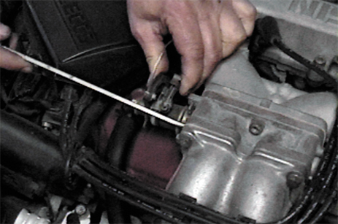
3 Block open the throttle (and choke, if the engine is equipped with a carburetor). Here a screwdriver is being used to wedge the throttle linkage open. Keeping the throttle open ensures that enough air will be drawn into the engine so that the compression test results will be accurate.

Slide 45
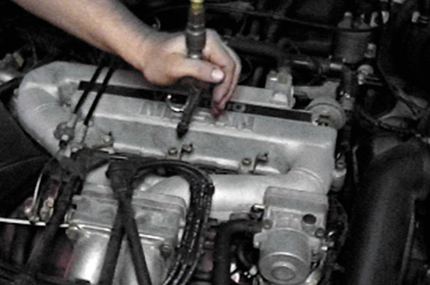
4 Before removing the spark plugs, use an air nozzle to blow away any dirt that may be around the spark plug. This step helps prevent debris from getting into the engine when the spark plugs are removed.

Slide 46
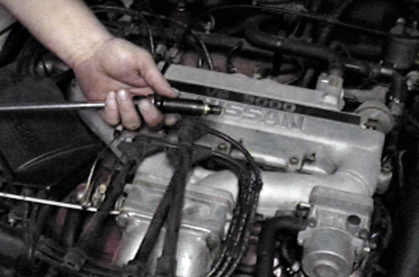
5 Remove all of the spark plugs. Be sure to mark the spark plug wires so that they can be reinstalled onto the correct spark plugs after the compression test has been performed.

Slide 47
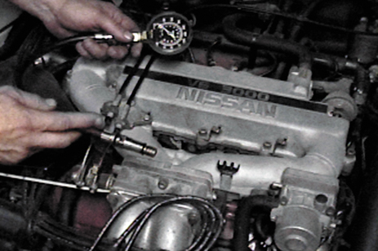
6 Select the proper adapter for the compression gauge. The threads on the adapter should match those on the spark plug.

Slide 48
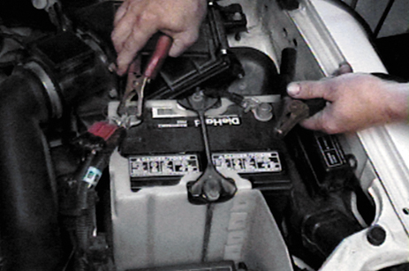
7 If necessary, connect a battery charger to the battery before starting the compression test. It is important that consistent cranking speed be available for each cylinder being tested.

Slide 49
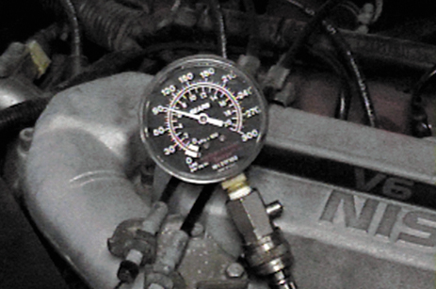
8 Make a note of the reading on the gauge after the first “puff,” which indicates the first compression stroke that occurred on that cylinder as the engine was being rotated. If the first puff reading is low and the reading gradually increases with each puff, weak or worn piston rings may be indicated.

Slide 50
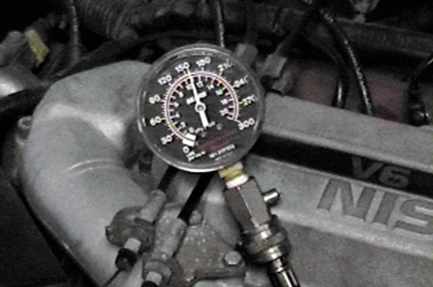
9 After the engine has been cranked for four “puffs,” stop cranking the engine and observe the compression gauge.

Slide 51
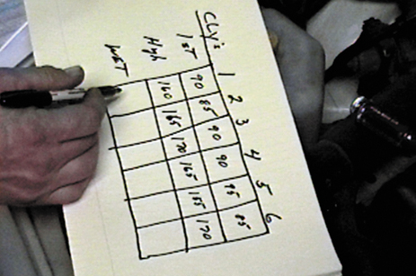
10 Record the first puff and this final reading for each cylinder. The final readings should all be within 20% of each other.

Slide 52
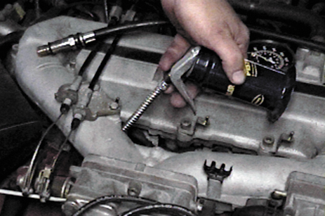
11 If a cylinder(s) is lower than most of the others, use an oil can and squirt two squirts of engine oil into the cylinder and repeat the compression test. This is called performing a wet compression test.

Slide 53
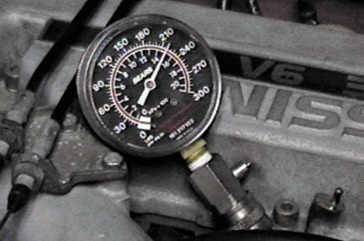
12 If the gauge reading is now much higher than the first test results, then the cause of the low compression is due to worn or defective piston rings. The oil in the cylinder temporarily seals the rings which causes the higher reading.

Slide 54
SUMMARY (1 OF 3)
The first step in diagnosing engine condition is to perform a thorough visual inspection, including a check of oil and coolant levels and condition.
Oil leaks can be found by using a white powder or a fluorescent dye and a black light.
Many engine-related problems make a characteristic noise.

Slide 55
SUMMARY (2 OF 3)
Oil analysis by an engineering laboratory can reveal engine problems by measuring the amount of dissolved metals in the oil.
A compression test can be used to test the condition of valves and piston rings.
A cylinder leakage test fills the cylinder with compressed air, and the gauge indicates the percentage of leakage.

Slide 56
SUMMARY (3 OF 3)
A cylinder balance test indicates whether all cylinders are working okay.
Testing engine vacuum is another procedure that can help the service technician determine engine condition.

Slide 57
Video Links (Internet Access Required)
Cylinder leak check (time 9:19)
Leak down test (time 2:12)
Belt noise (time 3:19)
Engine noise location (time 3:59)
Leak down tester (time 6:36)
Power balance test (time 7:47)
Leak down test (time 27:34)
How to find a vacuum leak (time 5:56)
Valve leak test (time 0:58)
Head gasket check (time 2:25)

Slide 58
Video Links (Internet Access Required)
Engine noise diagnosis (time 22:42)
Engine noise diagnosis (time 3:16)
Check for head gasket leak (time 1:45)
Compression testing (time 3:33)
Relative compression test (time 12:58)
Power balance test (time 1:37)
Cranking vacuum test (time 0:49)
Engine vacuum test (time 1:50)
Cylinder leak down test (time 1:12)
Compression testing (time 10:00)

Slide 59
Video Links (Internet Access Required)
Leak down testing (time 27:34)
Vacuum testing (time 2:21)
Vacuum testing (time 10:24)
Fuel system diagnosis (time 9:36)
Drivability diagnosis (time 12:05)
Finding engine leaks (time 12:49)
Engine cluster test (time 1:38)
Back pressure test (time 5:35)
Van engine repair (time 4:18)
Using a bore scope (time 1:36)

Slide 60
Video Links (Internet Access Required)
Head gasket leak test (time 1:06)
Cylinder leak down test (time 1:12)
Labscope Relative Compression Testing (time 7:29)
Low oil pressure (time 3:26)
Oil pressure (time 9:00)

