Slide 1

Automotive Engines Theory and Servicing
Ninth Edition
Chapter 21
Turbocharging and Supercharging

Slide 2
OBJECTIVES (1 OF 2)
21.1 Discuss airflow requirements and volumetric efficiency of engines.
21.2 Explain forced induction principles.
21.3 Discuss superchargers.
21.4 Discuss turbochargers and turbocharger failures.

Slide 3
OBJECTIVES (2 OF 2)
21.5 Explain boost control.
21.6 Describe the purpose of a nitrous oxide system.

Slide 4
INTRODUCTION (1 OF 2)
A four-stroke engine can take in only so much air
  How much fuel it needs for proper combustion depends on how much air it takes in.
Engineers calculate engine airflow requirements using three factors.
  Engine displacement
  Engine revolutions per minute (RPM)
  Volumetric efficiency

Slide 5
INTRODUCTION (2 OF 2)
Volumetric efficiency is a measure of how well an engine breathes.
  It is a comparison of the actual volume of air-fuel mixture drawn into an engine to the theoretical maximum volume that could be drawn in.
  Volumetric efficiency is expressed as a percentage.

Slide 6
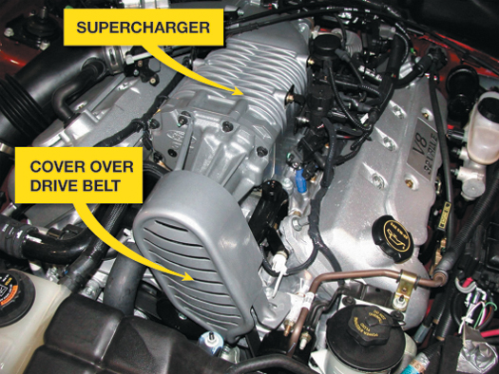
FIGURE 21–1 A supercharger on a Ford V-8.

Slide 7
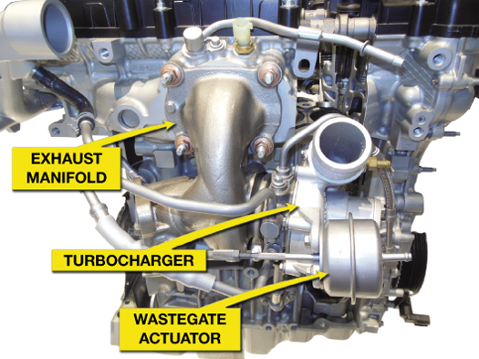
FIGURE 21–2 A turbocharged Ford three-cylinder 1.0 liter Eco Boost engine.

Slide 8
FORCED INDUCTION PRINCIPLES (1 OF 2)
The amount of force an air-fuel charge produces when it is ignited is largely a function of the charge density.
  Charge density is a term used to define the amount of the air-fuel charge introduced into the cylinders.
  Density is the mass of a substance in a given amount of space.

Slide 9
FORCED INDUCTION PRINCIPLES (2 OF 2)
Forced induction systems use an air pump to pack a denser air-fuel charge into the cylinders.
Because the density of the air-fuel charge is greater, the following occurs.
  The weight of the air-fuel charge is higher.
  Power is increased because it is directly related to the weight of an air-fuel charge consumed within a given time period.

Slide 10
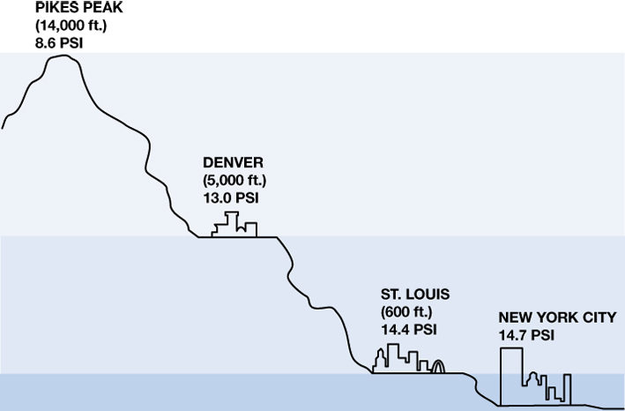
FIGURE 21–4 Atmospheric pressure decreases with increases in altitude.

Slide 11
SUPERCHARGERS (1 OF 2)
A supercharger is an engine-driven air pump that supplies more than the normal amount of air into the intake manifold and boosts engine torque and power.
  A supercharger provides an instantaneous increase in power without any delay.
  A supercharger, because it is driven by the engine, requires horsepower to operate and is not as efficient as a turbocharger.

Slide 12
SUPERCHARGERS (2 OF 2)
Types of Superchargers
  Roots type
  Centrifugal supercharger
Supercharger Boost Control
Supercharger Service

Slide 13
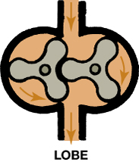
FIGURE 21–5 A roots-type supercharger uses two lobes to force the air around the outside of the housing and into the intake manifold.

Slide 14
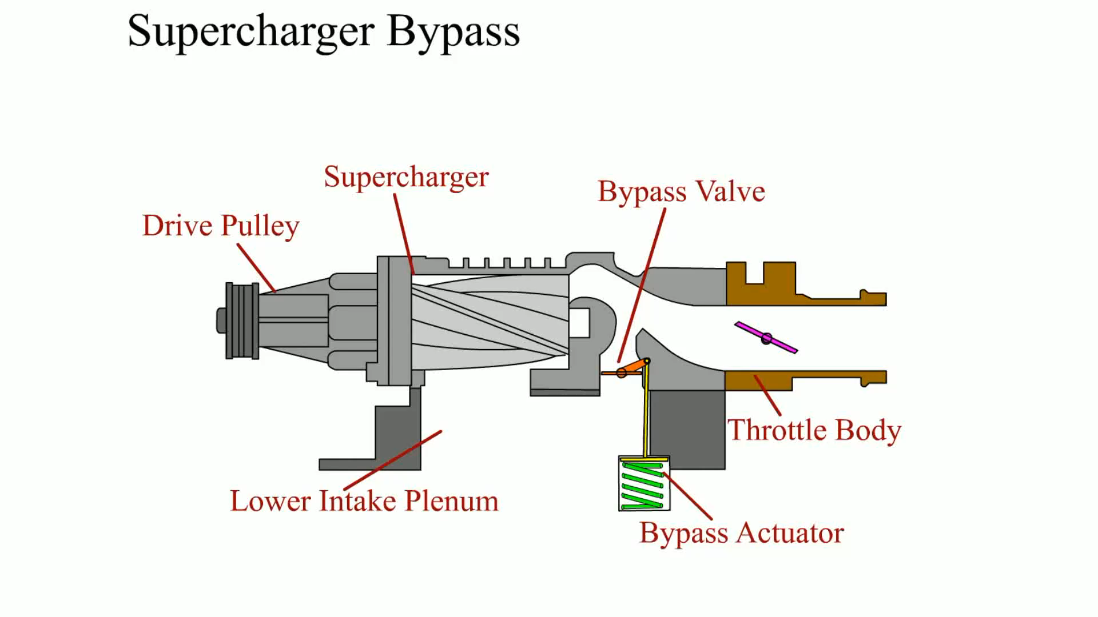
Animation: Supercharger Bypass
(The animation will automatically start in a few seconds)

Slide 15
TURBOCHARGERS (1 OF 2)
A turbocharger uses the heat of the exhaust to power a turbine wheel and therefore does not directly reduce engine power.
  In a naturally aspirated engine, about half of the heat energy contained in the fuel goes out the exhaust system.

Slide 16
TURBOCHARGERS (2 OF 2)
Operation
Turbocharger Operation
Turbocharger Size and Response Time

Slide 17
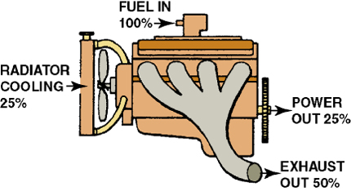
FIGURE 21–8 A turbocharger uses some of the heat energy that would normally be wasted.

Slide 18
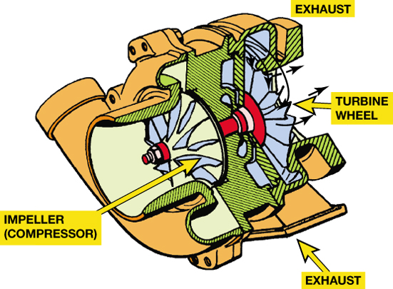
FIGURE 21–9 A turbine wheel is turned by the expanding exhaust gases.

Slide 19
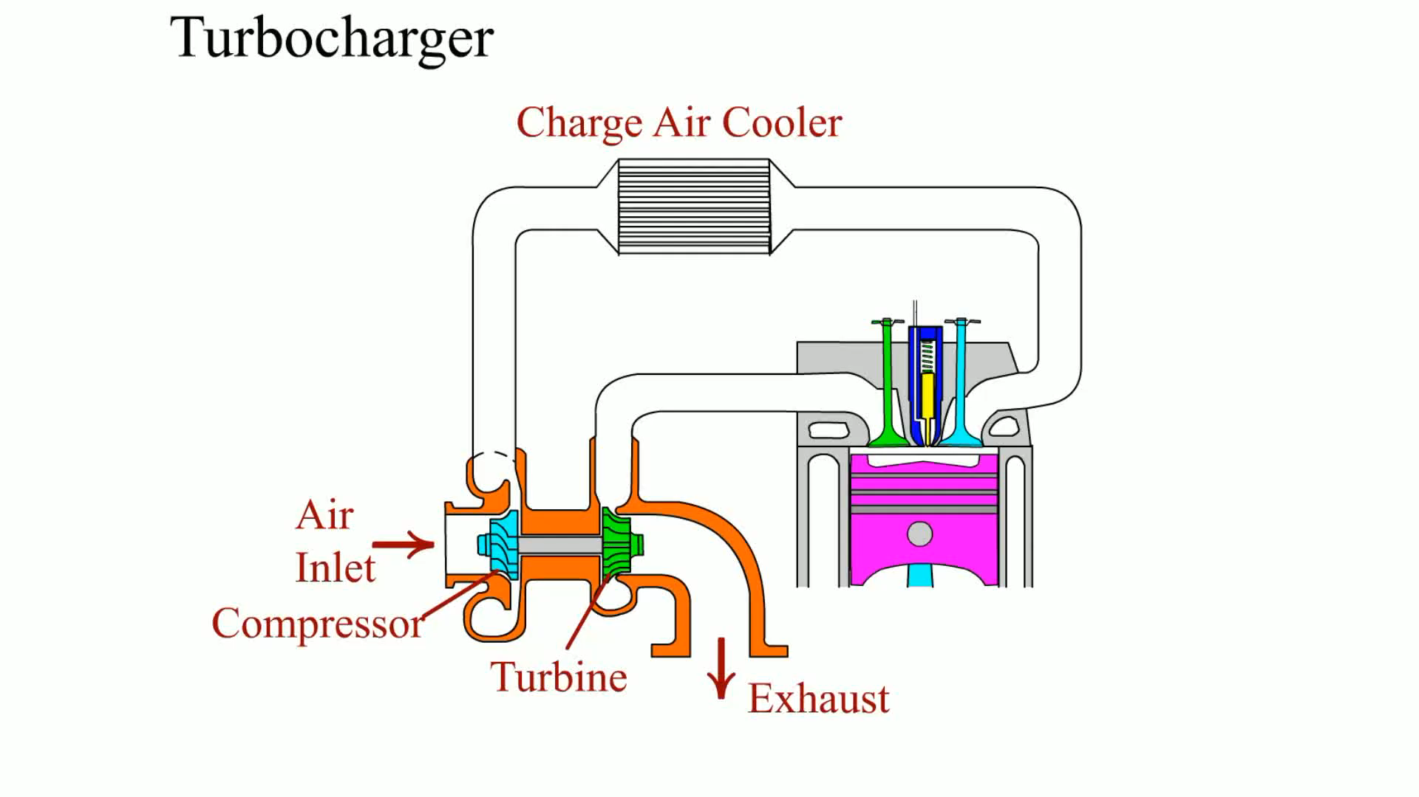
Animation: Turbocharger
(The animation will automatically start in a few seconds)

Slide 20
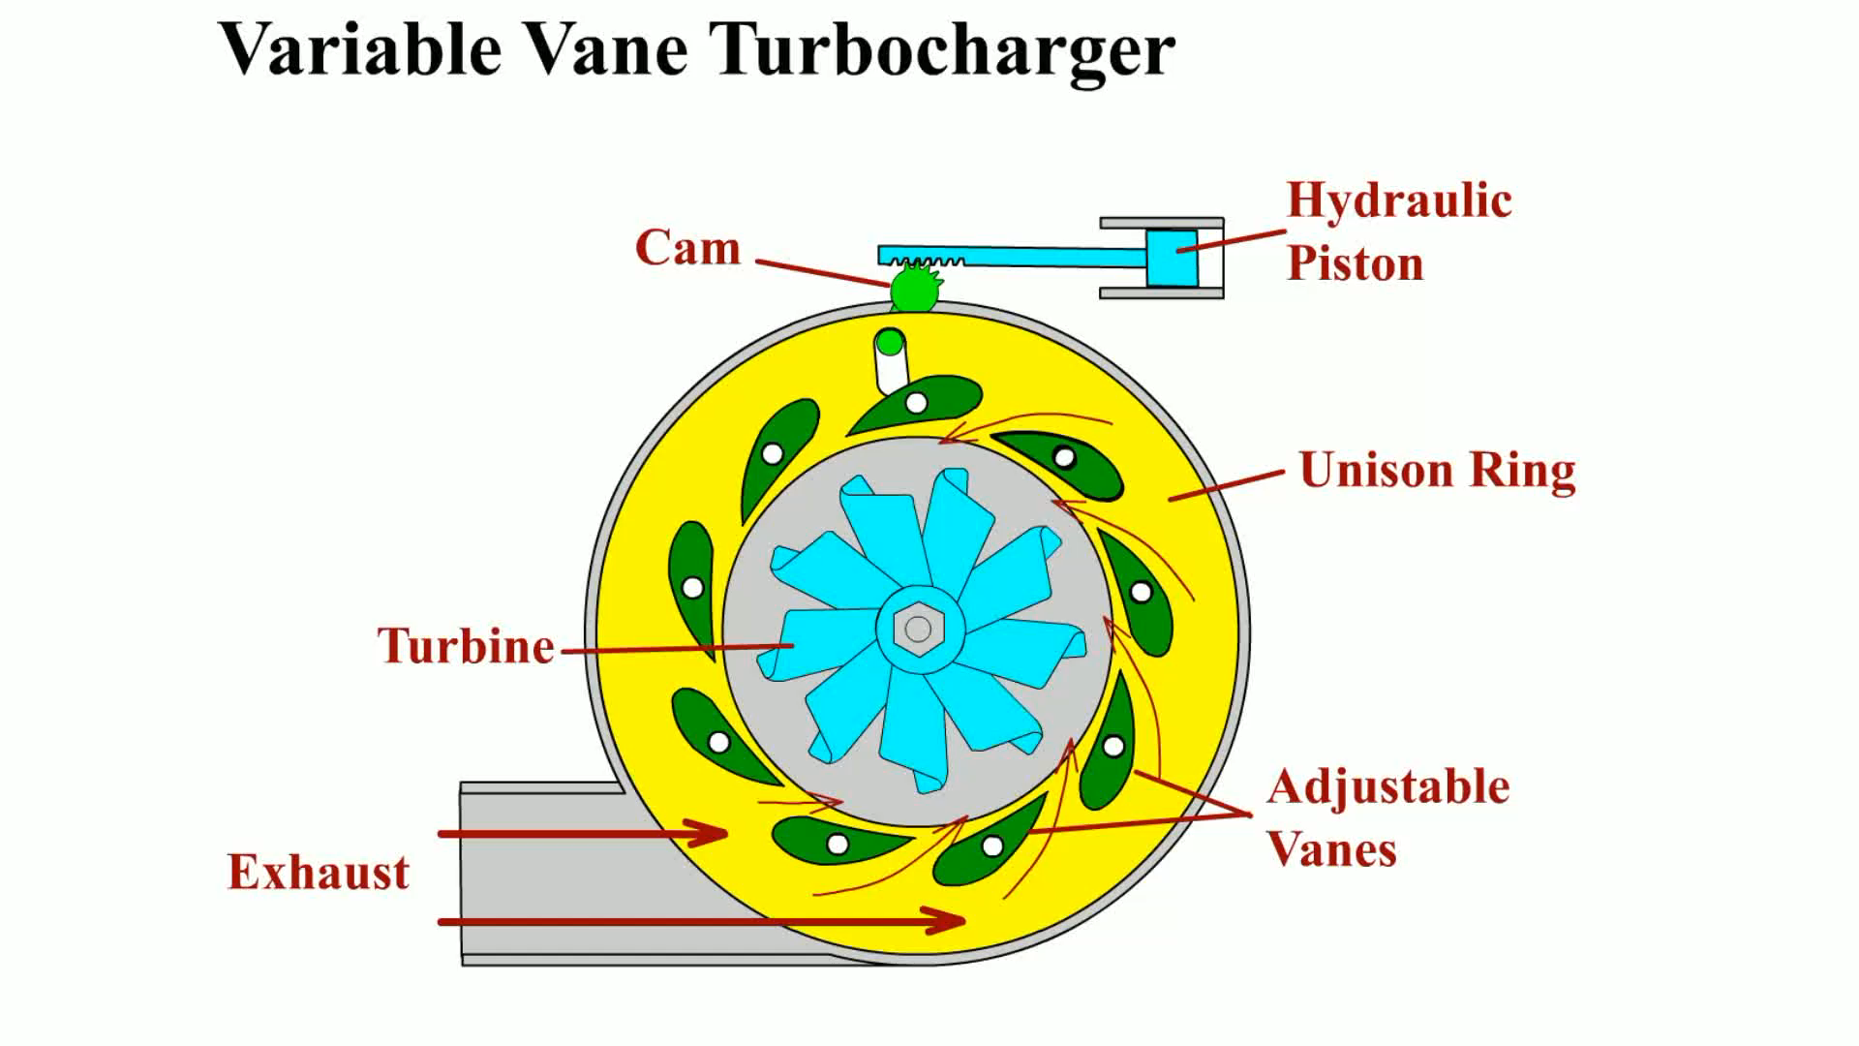
Animation: Variable Vane Turbocharger
(The animation will automatically start in a few seconds)

Slide 21
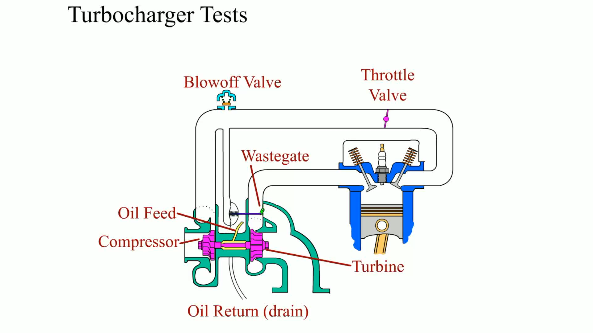
Animation: Turbocharger Tests
(The animation will automatically start in a few seconds)

Slide 22
BOOST CONTROL
Boost Control Factors
Wastegate
Relief Valves
  Compressor bypass valve (CBV)
  Blow-off valve (BOV)

Slide 23
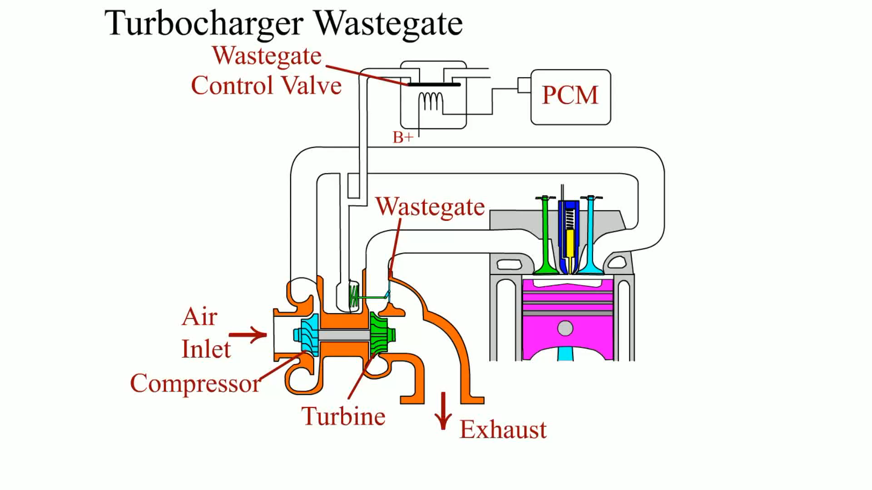
Animation: Turbocharger Wastegate
(The animation will automatically start in a few seconds)

Slide 24
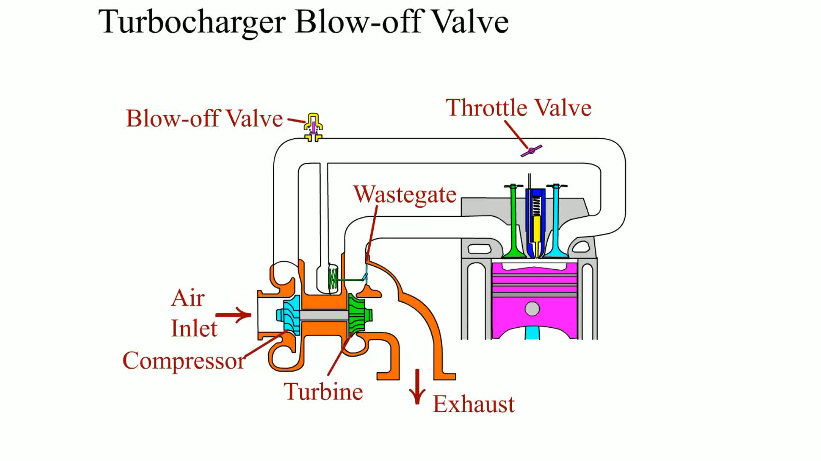
Animation: Turbocharger Blow-off Valve
(The animation will automatically start in a few seconds)

Slide 25
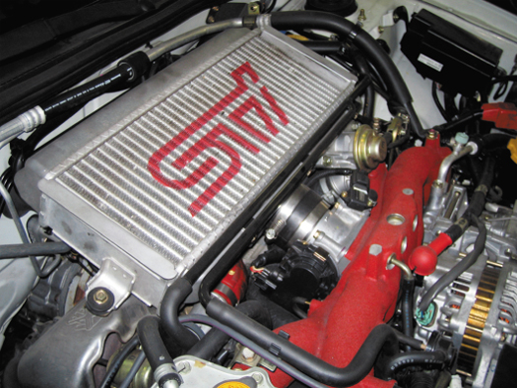
FIGURE 21–12 The unit on top of this Subaru that looks like a radiator is the intercooler, which cools the air after it has been compressed by the turbocharger.

Slide 26
TURBOCHARGER FAILURES
Symptoms of Failure
  When turbochargers fail to function correctly, a noticeable drop in power occurs
Preventing Turbocharger Failures

Slide 27
NITROUS OXIDE (1 OF 2)
Nitrous oxide is used for racing or high-performance only, and is not used from the factory on any vehicle.
This is a relatively inexpensive way to get additional power from an engine.
  But can cause serious engine damage if not used correctly or in excess amounts, or without proper precautions.

Slide 28
NITROUS OXIDE (2 OF 2)
Principles
Engine Power Adder
Pressure and Temperature
Wet And Dry System
Engine Changes Needed For N2O
System Installation And Calibration

Slide 29
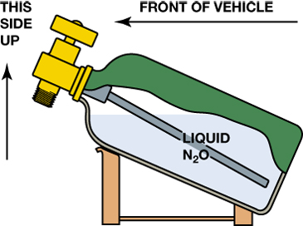
FIGURE 21–16 Nitrous bottles have to be mounted at an angle to ensure that the pickup tube is in the liquid N₂O.

Slide 30
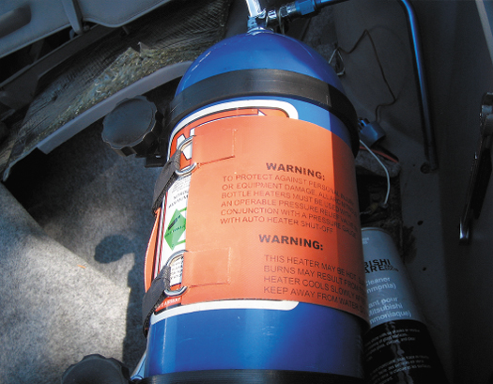
FIGURE 21–17 An electrical heating mat is installed on the bottle of nitrous oxide to increase the pressure of the gas inside.

Slide 31
SUMMARY (1 OF 4)
Volumetric efficiency is a comparison of the actual volume of air-fuel mixture drawn into the engine to the theoretical maximum volume that can be drawn into the cylinder.
A supercharger operates from the engine by a drive belt and it forces a greater amount of air into the cylinders for even more power.

Slide 32
SUMMARY (2 OF 4)
There are two types of superchargers: roots-type and centrifugal.
A turbocharger uses the normally wasted heat energy of the exhaust to turn an impeller at high speed.
A bypass valve is used to control the boost pressure on most factory installed superchargers.

Slide 33
SUMMARY (3 OF 4)
An intercooler is used on many turbocharged and some supercharged engines to reduce the temperature of air entering the engine for increased power.
Nitrous oxide injection can be used as a power adder, but only with extreme caution.

Slide 34
SUMMARY (4 OF 4)
A wastegate is used on most turbocharger systems to limit and control boost pressures, as well as a relief valve, to keep the speed of the turbine wheel from slowing down during engine deceleration.

Slide 35
Video Links (Internet Access Required)
Turbocharger (time 8:36)
Turbocharger (time 5:42)
Turbocharger (time 4:23)
Purpose of a turbocharger (time 2:23)
How a turbo works (time 3:46)
Turbo lag (time 3:07)
Superchargers (time 4:53)
Centrifugal superchargers (time 2:44)
Twin screw superchargers (time 2:27)

