Slide 1

Automotive Engines Theory and Servicing
Ninth Edition
Chapter 20
Intake and Exhaust Systems

Slide 2
OBJECTIVES
20.1 Explain air intake filtration.
20.2 Discuss the throttle-body injection intake manifolds and port fuel-injection intake manifolds.
20.3 Discuss exhaust gas recirculation passages and exhaust manifolds.
20.4 Describe the purpose and function of mufflers.

Slide 3
AIR INTAKE FILTRATION
Need For Air Filtering
Air Filter Elements
Filter Replacement
Remotely Mounted Air Filters And Ducts
Air Filter Restriction Indicator

Slide 4
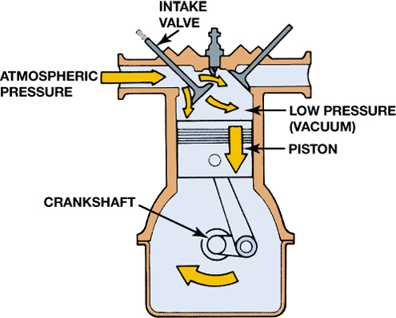
FIGURE 20–1 Downward movement of the piston lowers the air pressure inside the combustion chamber. The pressure differential between the atmosphere and the inside of the engine forces air into the engine.

Slide 5
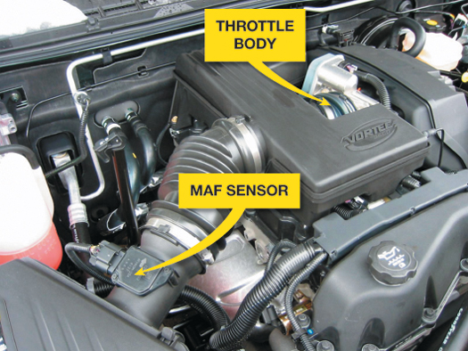
FIGURE 20–3 Most air filter housings are located on the side of the engine compartment and use flexible rubber hose to direct the airflow into the throttle body of the engine.

Slide 6
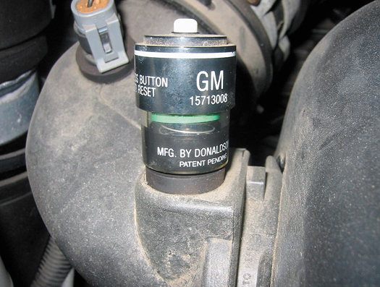
FIGURE 20–4 A typical air filter restriction indicator used on a General Motors truck engine. The indicator turns red when it detects enough restriction to require a filter replacement.

Slide 7
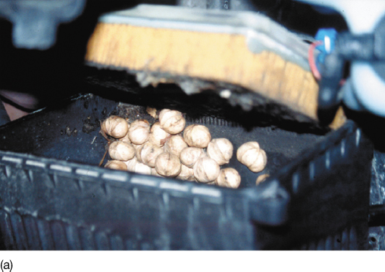
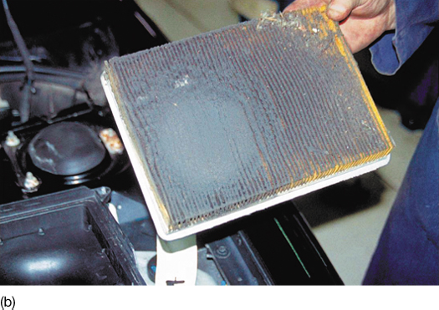
FIGURE 20–5 (a) Note the discovery as the air filter housing was opened during service on a Pontiac. The nuts were obviously deposited by squirrels (or some other animal). (b) Not only was the housing filled with nuts, but also this air filter was extremely dirty, indicating that this vehicle had not been serviced for a long time.

Slide 8
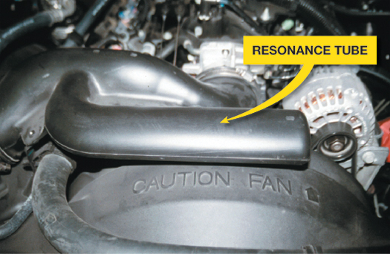
FIGURE 20–6 A resonance tube, called a Helmholtz resonator, is used on the intake duct between the air filter and the throttle body to reduce air intake noise during engine acceleration.

Slide 9
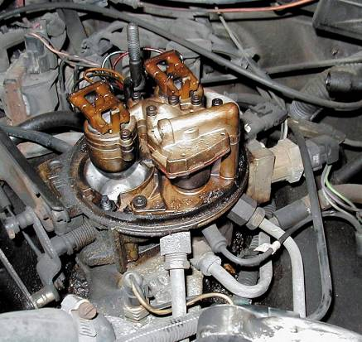
THROTTLE-BODY INJECTION INTAKE MANIFOLDS
Terminology
Intake Air Speeds
FIGURE 20–7 A throttle-body injection (TBI) unit used on a GM V-6 engine.

Slide 10
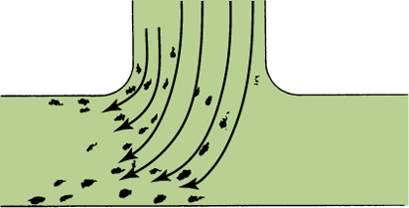
Figure 20–8 Heavy fuel droplets separate as they flow around an abrupt bend in an intake manifold.

Slide 11
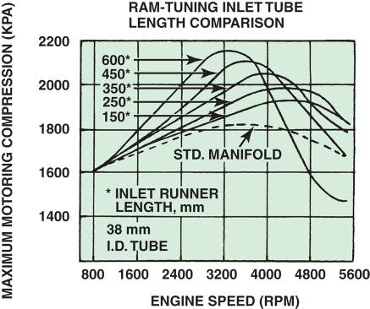
PORT FUEL-INJECTION INTAKE MANIFOLDS
Terminology
Variable Intakes
Plastic Intake Manifolds
Upper and Lower Intake Manifolds
FIGURE 20–9 The graph shows the effect of sonic tuning of the intake manifold runners. The longer runners increase the torque peak and move it to a lower RPM. The 600 mm intake runner is about 24 in. long.

Slide 12
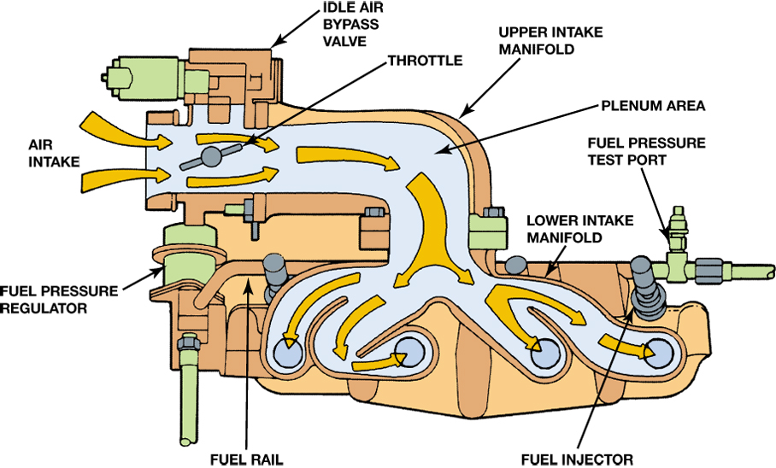
FIGURE 20–10 Airflow through the large diameter upper intake manifold is distributed to smaller diameter individual runners in the lower manifold in this two-piece manifold design.

Slide 13
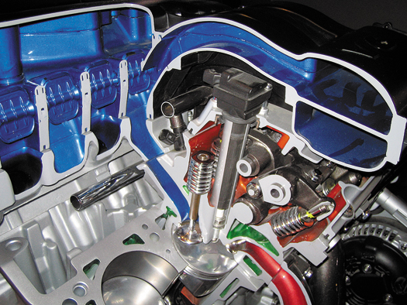
FIGURE 20–11 The air flowing into the engine can be directed through long or short runners for best performance and fuel economy.

Slide 14
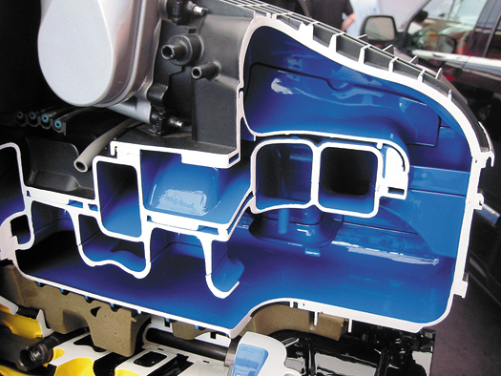
FIGURE 20–12 Many plastic intake manifolds are constructed using many parts glued together to form complex passages for airflow into the engine.

Slide 15
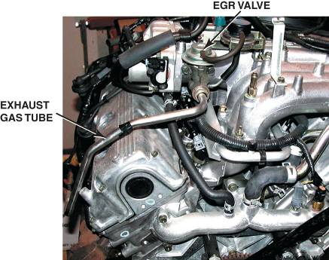
EXHAUST GAS RECIRCULATION PASSAGES
Purpose and Function
Exhaust Gas Coolers
FIGURE 20–13 A typical long exhaust gas line used to cool the exhaust gases before being recirculated back into the intake manifold.

Slide 16
EXHAUST MANIFOLDS
Purpose and Function
Construction
Exhaust Manifold Gaskets

Slide 17
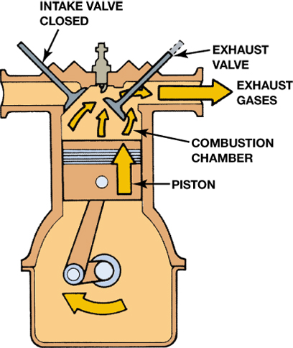
FIGURE 20–14 The exhaust gases are pushed out of the cylinder by the piston on the exhaust stroke.

Slide 18
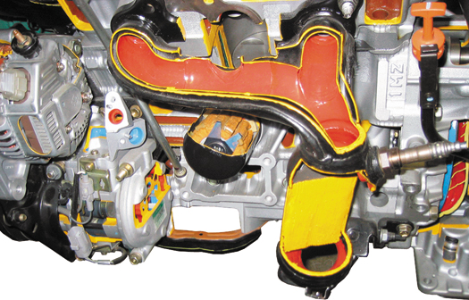
FIGURE 20–15 This exhaust manifold (red area) is equipped with a heat shield to help retain heat and reduce exhaust emissions.

Slide 19
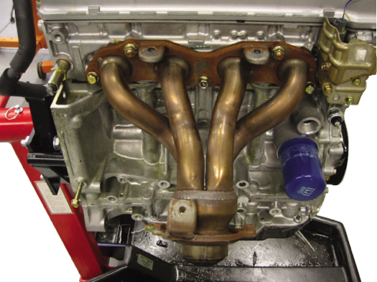
FIGURE 20–16 Many exhaust manifolds are constructed of steel tubing and are free flowing to improve engine performance.

Slide 20
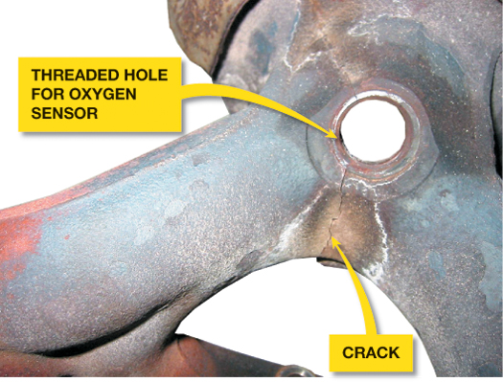
FIGURE 20–17 A crack in an exhaust manifold is often not visible because a heat shield usually covers the area. A crack in the exhaust manifold upstream of the oxygen sensor can fool the sensor and affect engine operation.

Slide 21
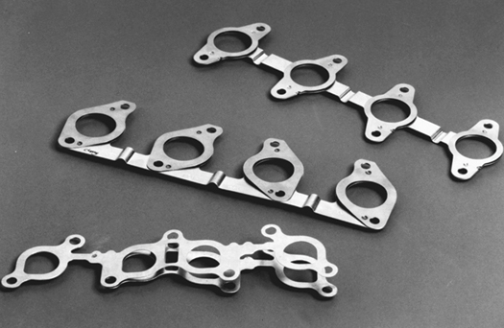
FIGURE 20–18 Typical exhaust manifold gaskets. Note how they are laminated to allow the exhaust manifold to expand and contract due to heating and cooling.

Slide 22
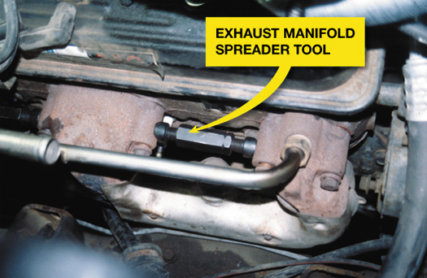
FIGURE 20–19 An exhaust manifold spreader tool is absolutely necessary when reinstalling exhaust manifolds. When they are removed from the engine, the manifolds tend to warp slightly even though the engine is allowed to cool before being removed. The spreader tool allows the technician to line up the bolt holes without harming the manifold.

Slide 23
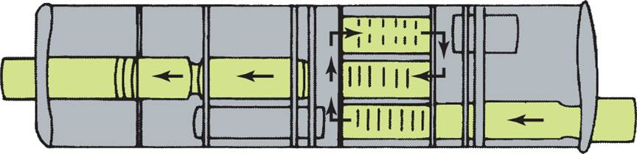
MUFFLERS
The muffler catches the large bursts of high-pressure exhaust gas from the cylinder
  Smoothing out the pressure pulses and allowing them to be released at an even and constant rate
FIGURE 20–20 Exhaust gases expand and cool as they travel through passages in the muffler.

Slide 24
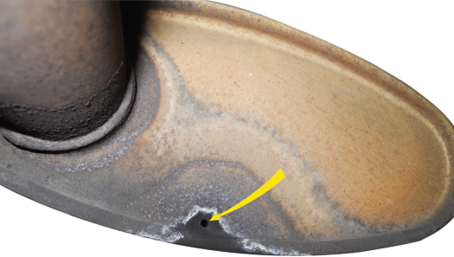
FIGURE 20–21 A hole in the muffler allows condensed water to escape.

Slide 25
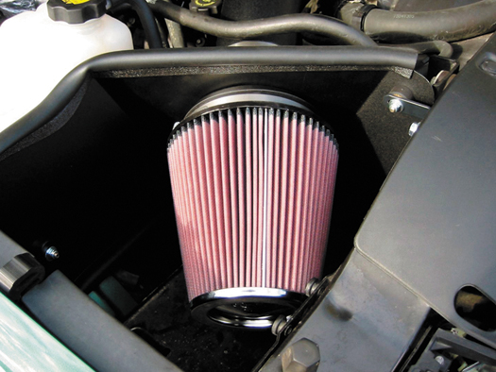
FIGURE 20–22 A high-performance aftermarket air filter often can increase airflow into the engine for more power.

Slide 26
SUMMARY (1 OF 2)
All air entering an engine must be filtered.
Engines that use throttle-body injection units are equipped with intake manifolds that keep the airflow speed through the manifold at 50 to 300 ft per second.
Most intake manifolds have an EGR valve that regulates the amount of recirculated exhaust that enters the engine to reduce NOx emissions.

Slide 27
SUMMARY (2 OF 2)
Exhaust manifolds can be made from cast iron or steel tubing.
The exhaust system also contains a catalytic converter, exhaust pipes, and muffler.
The entire exhaust system is supported by rubber hangers that isolate the noise and vibration of the exhaust from the rest of the vehicle.

Slide 28
Video Links (Internet Access Required)
Exhaust manifold (time 9:06)
Throttle body cleaning (time 3:38)
Throttle body cleaning (time 6:55)

