Slide 1

Automotive Engines Theory and Servicing
Ninth Edition
Chapter 19
Emission Control Devices Operation and Diagnosis

Slide 2
OBJECTIVES (1 OF 4)
19.1 Explain exhaust gas recirculation systems.
19.2 Discuss OBD-II EGR monitoring strategies, diagnosing a defective EGR system, and EGR trouble codes.
19.3 Discuss crankcase ventilation, PCV system diagnosis, and PCV-related trouble codes.

Slide 3
OBJECTIVES (2 OF 4)
19.4 Explain the secondary air-injection system and its diagnosis.
19.5 Explain the purpose and function of catalytic converters, their diagnosis, and guidelines to replace them.

Slide 4
OBJECTIVES (3 OF 4)
19.6 Explain evaporative emission control system, and compare enhanced evaporative control systems and nonenhanced evaporative control systems.
19.7 Discuss the leak detection pump system and onboard refueling vapor recovery.

Slide 5
OBJECTIVES (4 OF 4)
19.8 Discuss the diagnosis of the EVAP system and state inspection EVAP tests.
19.9 Describe evaporative system monitors and typical EVAP monitors.

Slide 6
SMOG
What is smog?
What are the emissions that are controlled?

Slide 7

FIGURE 19–1 Notice the red-brown haze which is often over many major cities. This haze is the result of oxides or nitrogen in the atmosphere.

Slide 8
EXHAUST GAS RECIRCULATION SYSTEMS (1 OF 2)
Exhaust gas recirculation (EGR) is an emission control system that lowers the amount of nitrogen oxides (NOx) formed during combustion.
  In the presence of sunlight, NOx reacts with hydrocarbons in the atmosphere to form ozone (O3) or photochemical smog, an air pollutant.
NOx Formation
Controlling NOx

Slide 9
EXHAUST GAS RECIRCULATION SYSTEMS (2 OF 2)
EGR System Operation
EGR Benefits
Positive and Negative Backpressure EGR Valves
Computer-controlled EGR Systems
EGR Valve Position Sensors
Digital EGR Valves
Linear EGR

Slide 10
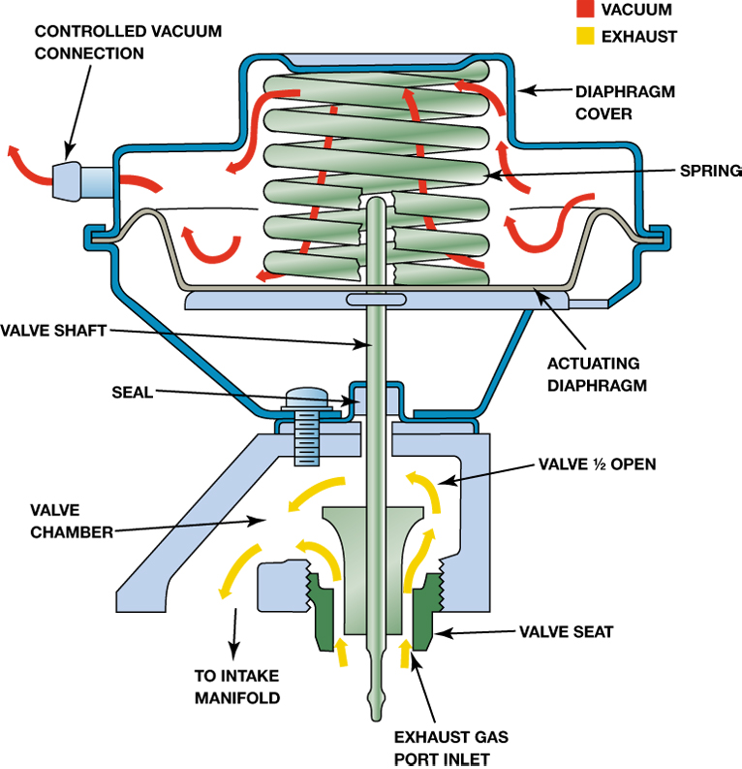
Figure 19–2 When the EGR valve opens, the exhaust gases flow through the valve and into passages in the intake manifold.

Slide 11
OBD-II EGR MONITORING STRATEGIES (1 OF 2)
U.S. EPA began requiring OBD-II systems in all passenger cars and most light duty trucks.
  These systems include emissions system monitors that alert the driver and the technician if an emissions system is malfunctioning.
  The OBD-II system performs this test by opening and closing the EGR valve.

Slide 12
OBD-II EGR MONITORING STRATEGIES (2 OF 2)
  The PCM monitors an EGR function sensor for a change in signal voltage.
  If the EGR system fails, a diagnostic trouble code (DTC) is set.
  If the system fails two consecutive times, the malfunction indicator light (MIL) is lit.

Slide 13
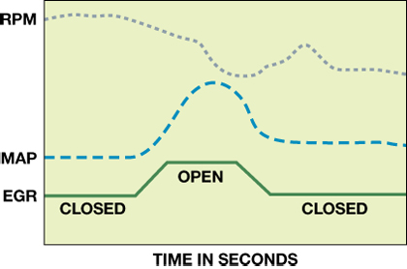
Figure 19–9 An OBD-II active test. The PCM opens the EGR valve and then monitors the MAP sensor and/or engine speed (RPM) to verify that it meets acceptable values.

Slide 14
DIAGNOSING A DEFECTIVE EGR (1 OF 3)
If the EGR valve is not opening or the flow of the exhaust gas is restricted, then the following symptoms are likely.
  Detonation (spark knock or ping) during acceleration or during cruise (steady-speed driving)
  Excessive oxides of nitrogen (NOx) exhaust emissions

Slide 15
DIAGNOSING A DEFECTIVE EGR (2 OF 3)
If the EGR valve is stuck open or partially open, then the following symptoms are likely.
  Rough idle or frequent stalling
  Poor performance/low power, especially at low engine speed
The first step in almost any diagnosis is to perform a thorough visual inspection.

Slide 16
DIAGNOSING A DEFECTIVE EGR (3 OF 3)
To check for proper operation of a vacuum-operated EGR valve, follow these steps.
  STEP 1 Check the vacuum diaphragm of the EGR valve to see if it can hold vacuum.
  STEP 2 Apply vacuum from a hand-operated vacuum pump and check for proper operation.
  STEP 3 Monitor engine vacuum drop.

Slide 17
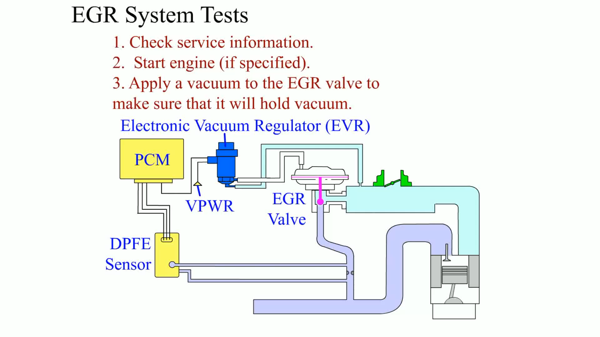
Animation: EGR System Tests
(The animation will automatically start in a few seconds)

Slide 18
EGR-RELATED OBD-II DIAGNOSTIC TROUBLE CODES
P0400
P0401
P0402
What are they and what are the possible causes?

Slide 19
CRANKCASE VENTILATION (1 OF 2)
The problem of crankcase ventilation has existed since the beginning of the automobile, because no piston ring, new or old, can provide a perfect seal between the piston and the cylinder wall.
  When an engine is running, the pressure of combustion forces the piston downward.

Slide 20
CRANKCASE VENTILATION (2 OF 2)
  This same pressure also forces gases and unburned fuel from the combustion chamber, past the piston rings, and into the crankcase.
Blowby is the term used to describe when combustion gases are forced past the piston rings and into the crankcase.

Slide 21
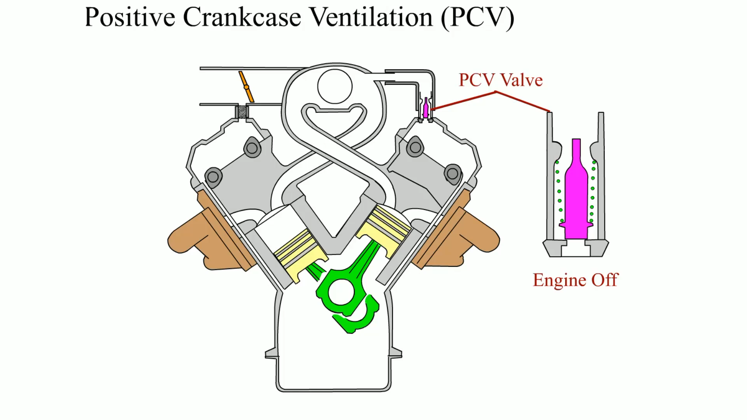
Animation: Positive Crankcase Ventilation (PCV)
(The animation will automatically start in a few seconds)

Slide 22
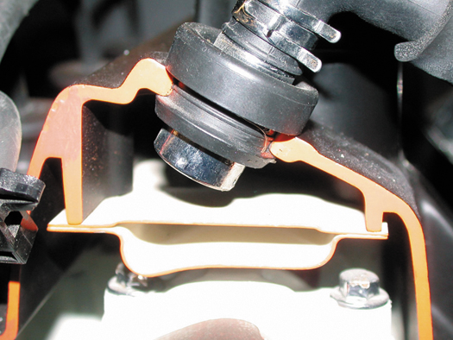
FIGURE 19–11 A PCV valve in a cutaway valve cover, showing the baffles that prevent liquid oil from being drawn into the intake manifold.

Slide 23
PCV SYSTEM DIAGNOSIS
Symptoms
PCV System Performance Check
Rattle Test
The 3 × 5 Card Test
Snap-back Test
Crankcase Vacuum Test
PCV Monitor

Slide 24
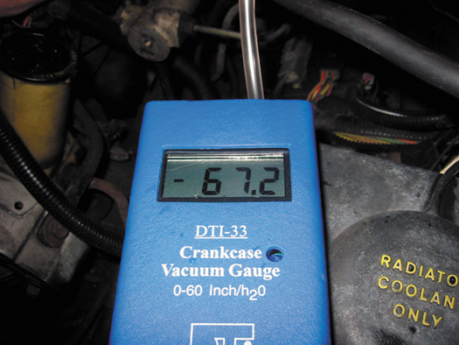
Figure 19–16 Using a gauge that measures vacuum in units of inches of water to test the vacuum at the dipstick tube, being sure that the PCV system is capable of drawing a vacuum on the crankcase. Note that 28 inch of water equals
1 PSI, or about 2 inch of mercury (inch Hg) of vacuum.

Slide 25
PCV-RELATED DIAGNOSTIC TROUBLE CODE
P0101
P0505
What are they and what are the possible causes?

Slide 26
SECONDARY AIR-INJECTION SYSTEM (1 OF 2)
The secondary air-injection (SAI) system provides the air necessary for the oxidizing process either at the exhaust manifold or inside the catalytic converter.
  Parts and Operation
  Air Distribution Manifolds and Nozzles
  Exhaust Check Valves

Slide 27
SECONDARY AIR-INJECTION SYSTEM (2 OF 2)
  Belt-driven Air Pumps
  Electric Motor-driven Air Pumps
Symptoms
Visual Inspection
Four-gas Exhaust Analysis

Slide 28
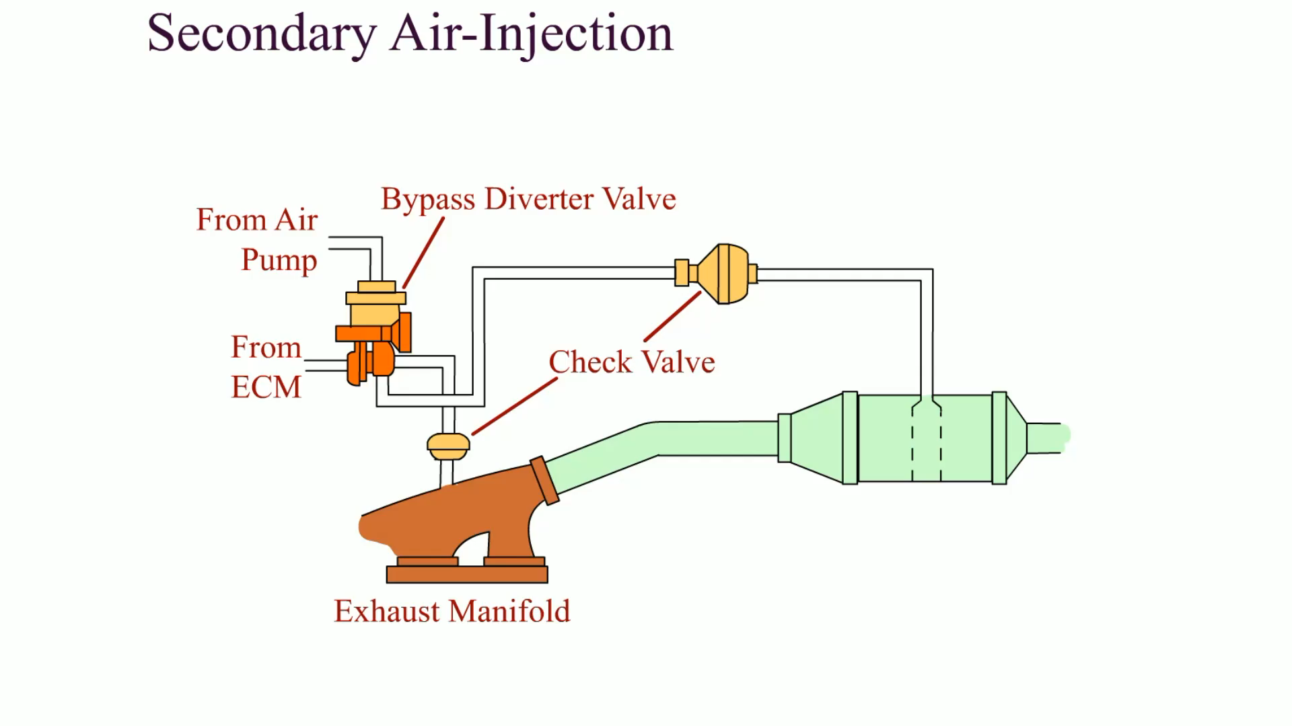
Animation: Secondary Air-Injection
(The animation will automatically start in a few seconds)

Slide 29
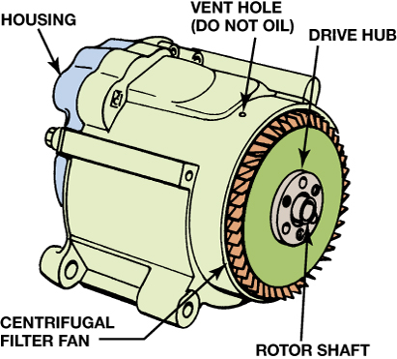
FIGURE 19–18 A typical belt-driven AIR pump. Air enters through the revolving fins behind the drive pulley. The fins act as an air filter because dirt is heavier than air and therefore the dirt is deflected off of the fins at the same time air is being drawn into the pump.

Slide 30
SECONDARY AIR-INJECTION SYSTEM DIAGNOSIS
Symptoms
Visual inspection
Four-gas exhaust analysis
  What are the four steps?

Slide 31
SAI-RELATED DIAGNOSTIC TROUBLE CODE
P0410
What is it and what are the possible causes?

Slide 32
CATALYTIC CONVERTERS (1 OF 3)
A catalytic converter is an aftertreatment device used to reduce exhaust emissions outside of the engine.
The catalytic converter uses a catalyst, which is a chemical that helps start a chemical reaction but does not enter into the chemical reaction.
  The catalyst materials on the surface of the material inside the converter help create a chemical reaction.

Slide 33
CATALYTIC CONVERTERS (2 OF 3)
  The chemical reaction changes harmful exhaust emissions into nonharmful exhaust emissions.
  The converter converts harmful exhaust gases into water vapor (H2O) and carbon dioxide (CO2).
Catalytic Converter Construction
Catalytic Converter Operation
Converter Light-off Temperature

Slide 34
CATALYTIC CONVERTERS (3 OF 3)
Converter Usage
OBD-II Catalytic Converter Performance
Converter-damaging Conditions
  Contamination
  Excessive temperatures
  Improper air-fuel mixtures

Slide 35
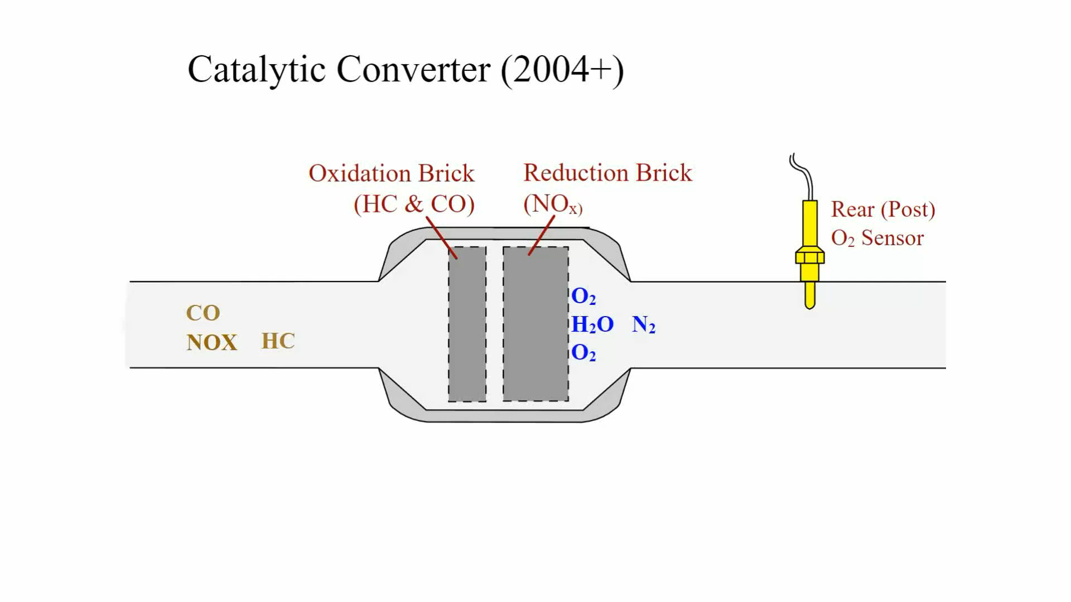
Animation: Catalytic Converter (2004+)
(The animation will automatically start in a few seconds)

Slide 36
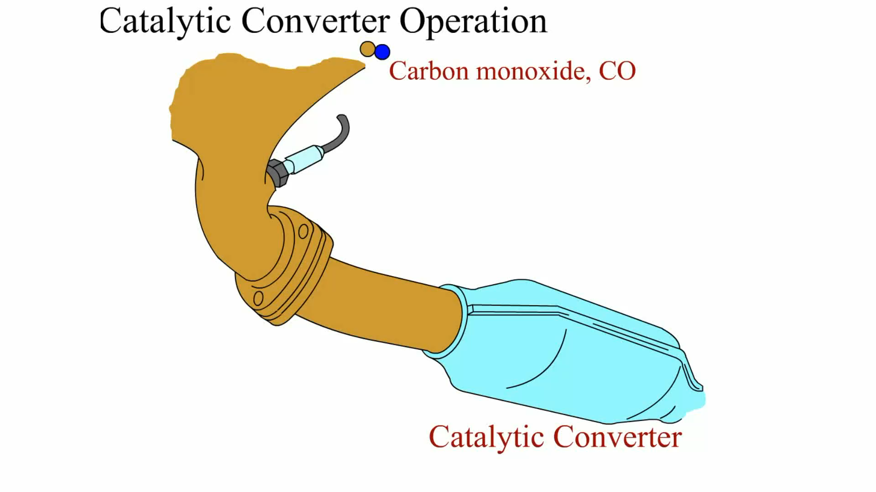
Animation: Catalytic Converter Operation
(The animation will automatically start in a few seconds)

Slide 37
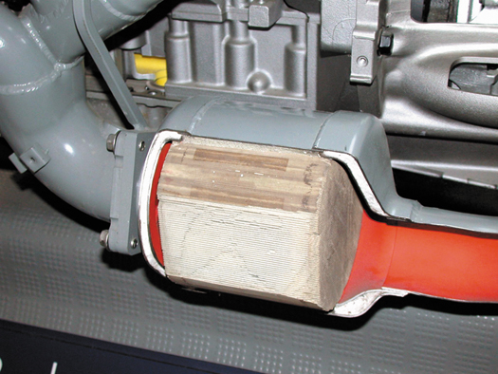
Figure 19–22 Most catalytic converters are located as close to the exhaust manifold as possible, as seen in this display of a Chevrolet Corvette.

Slide 38
DIAGNOSING CATALYTIC CONVERTERS
The Tap Test
Testing Backpressure With a Pressure Gauge
Testing For Backpressure Using a Vacuum Gauge
Testing a Catalytic Converter For Temperature Rise
Catalytic Converter Efficiency Tests

Slide 39
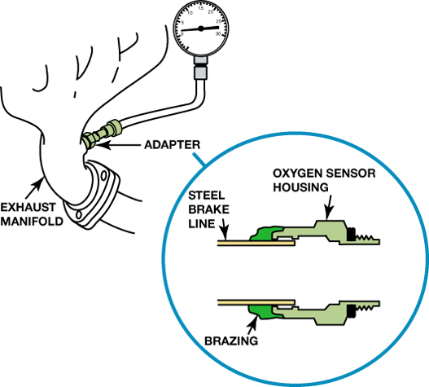
FIGURE 19–26 A back pressure tool can be made by using an oxygen sensor housing and epoxy or braze to hold the tube to the housing.

Slide 40
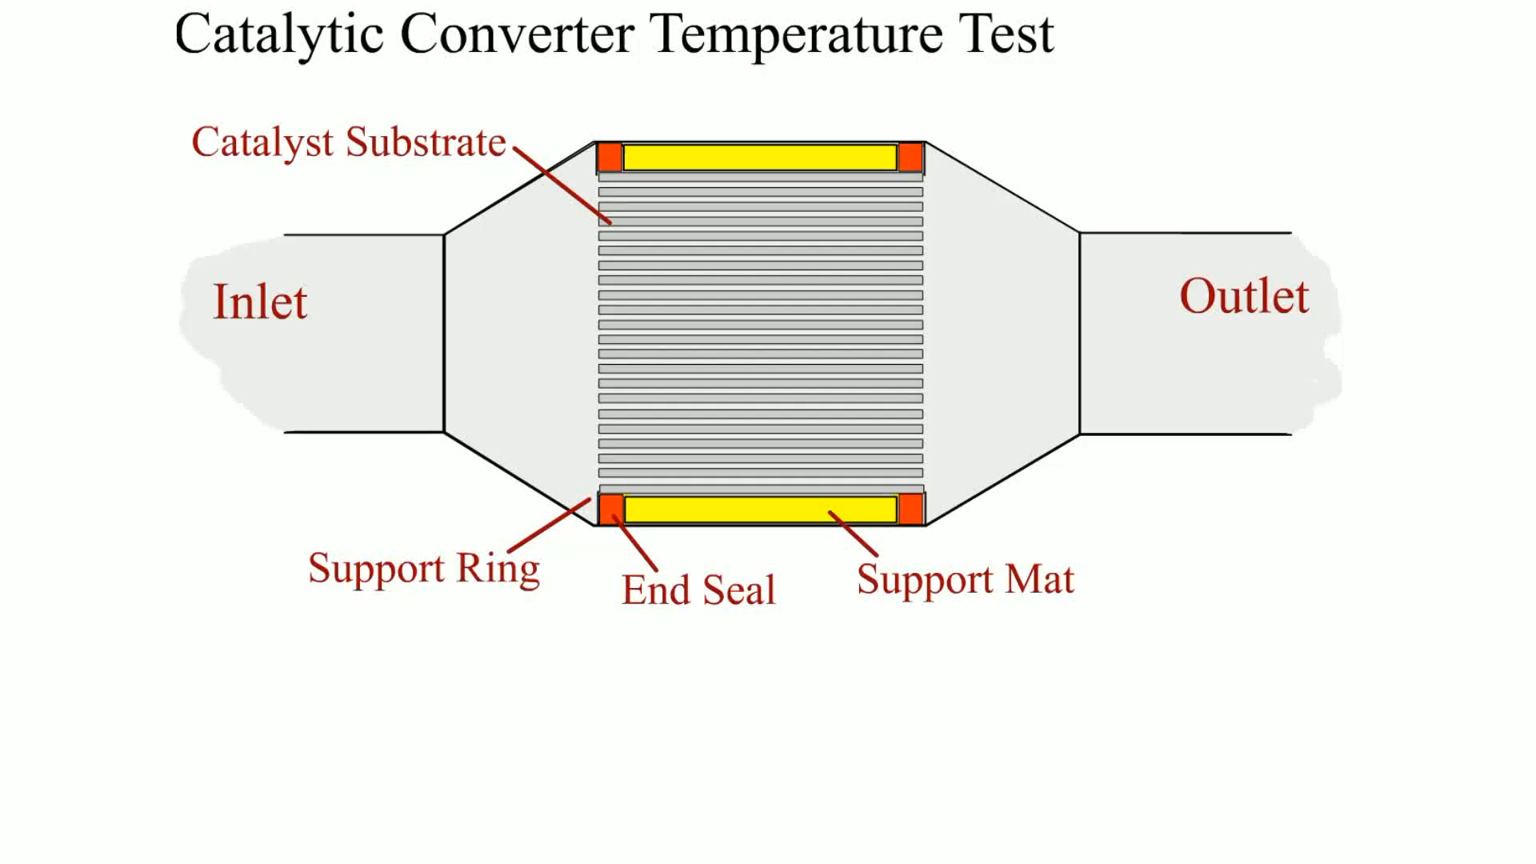
Animation: Catalytic Converter Temperature Test
(The animation will automatically start in a few seconds)

Slide 41
CATALYTIC CONVERTER REPLACEMENT GUIDELINES (1 OF 2)
Because a catalytic converter is a major exhaust gas emission control device, the Environmental Protection Agency (EPA) has strict guidelines for its replacement, including:
  If a converter is replaced on a vehicle with less than 80,000 miles or eight years, depending on the year of the vehicle, an original equipment catalytic converter must be used as a replacement.

Slide 42
CATALYTIC CONVERTER REPLACEMENT GUIDELINES (2 OF 2)
  The replacement converter must be of the same design as the original. If the original had an air pump fitting, so must the replacement.
  The old converter must be kept for possible inspection by the authorities for 60 days.
  A form must be completed and signed by both the vehicle owner and a representative from the service facility.

Slide 43
CATALYTIC CONVERTER-RELATED DIAGNOSTIC TROUBLE CODE
P0420
What is it and what are the possible causes?

Slide 44
EVAPORATIVE EMISSION CONTROL SYSTEM
The purpose of the evaporative (EVAP) emission control system is to trap and hold gasoline vapors, also called volatile organic compounds, or VOCs.
  The evaporative control system includes the charcoal canister, hoses, and valves.
  These vapors are routed into a charcoal canister, then into the intake airflow where they are burned in the engine instead of being released into the atmosphere.

Slide 45
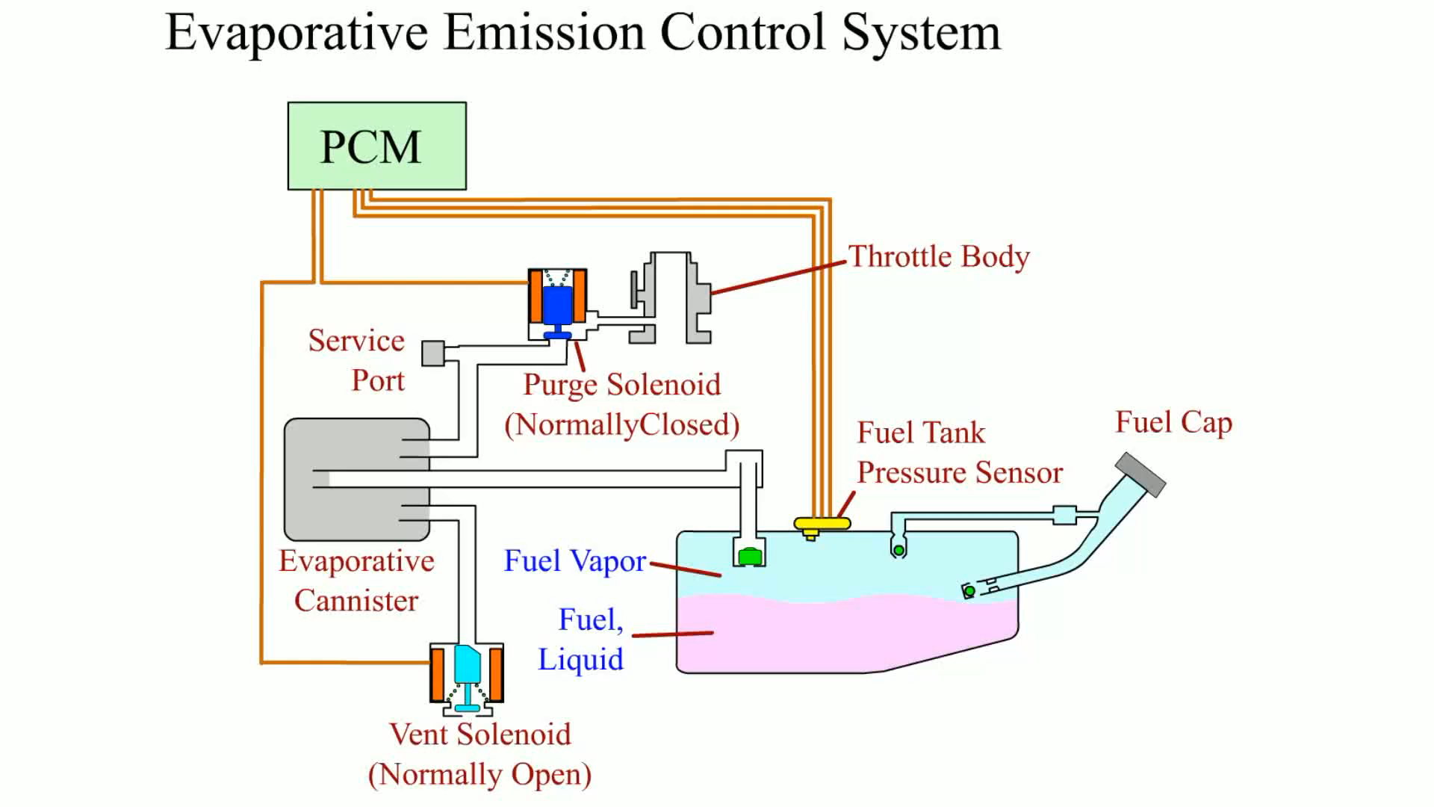
Animation: Evaporative Emission Control System
(The animation will automatically start in a few seconds)

Slide 46
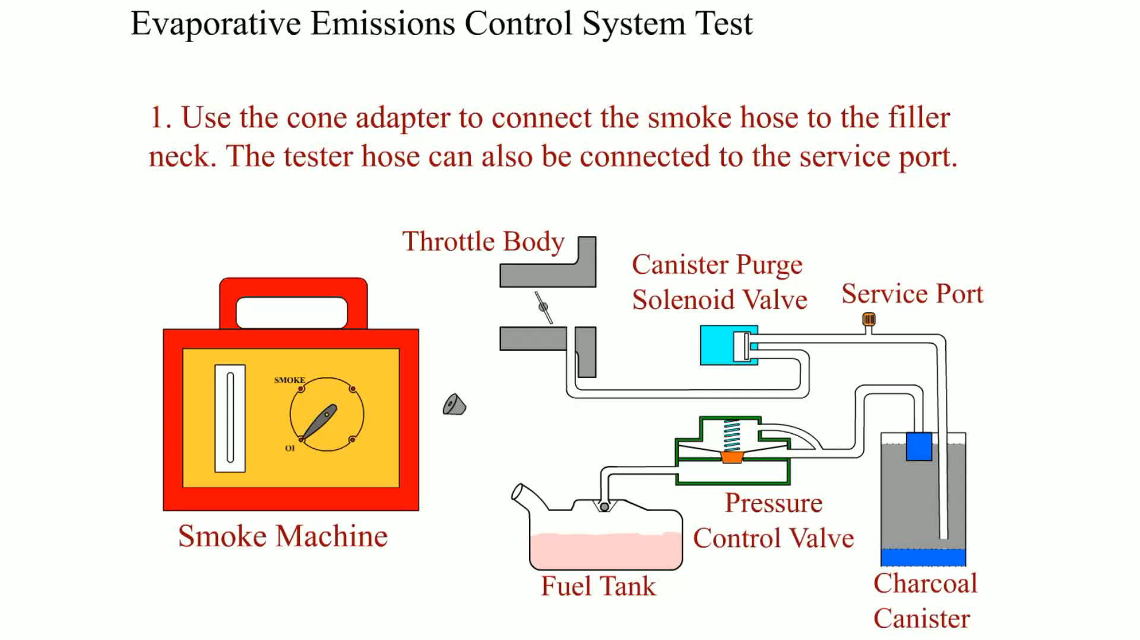
Animation: Evaporative Emissions Control System Test
(The animation will automatically start in a few seconds)

Slide 47
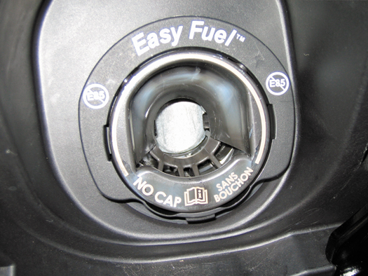
Figure 19–29 A capless system from a Ford Flex does not use a replaceable cap; instead, it has a spring-loaded closure.

Slide 48
NONENHANCED EVAPORATIVE CONTROL SSYTEMS
What is a nonenhanced evaporative control system?
Is it different than enhanced evaporative control systems?

Slide 49
ENHANCED AND NONENHANCED EVAPORATIVE CONTROL SYSTEM
Prior to 1996, evaporative systems were referred to as nonenhanced evaporative (EVAP) control systems
  Evaporative systems that had limited diagnostic capabilities
Background
Canister Vent Valve
Canister Purge Valve

Slide 50
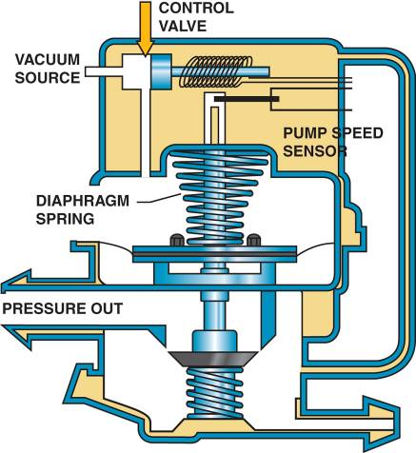
LEAK DETECTION PUMP SYSTEM
Many vehicles use a leak detection pump (LDP) as part of the evaporative control system diagnosis equipment.
  Operation
FIGURE 19–33 A leak detection pump (LDP) used on some Chrysler vehicles to pressurize (slightly) the fuel system to check for leaks.

Slide 51
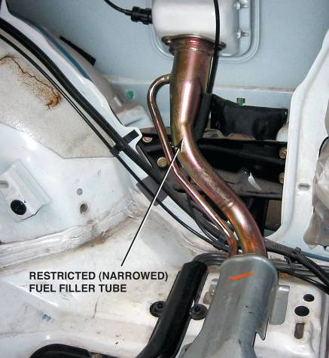
ONBOARD REFUELING VAPOR RECOVERY
Purpose and Function
Operation
  The fuel tank is vented to the charcoal canister with air flowing into the filler tube, no vapors can escape to the atmosphere
FIGURE 19–34 A restricted fuel fill pipe shown on a vehicle with the interior removed.

Slide 52
STATE INSPECTION EVAP TESTS
In some states, a periodic inspection and test of the fuel system are mandated along with a dynamometer test.
How can the fuel tank, cap, fuel lines, canister, and other fuel system components be tested?

Slide 53
DIAGNOSING THE EVAP SYSTEM
Symptoms
  Poor fuel economy
  Poor performance
Locating leaks in the system
  Smoke machine testing
  Nitrogen gas pressurization

Slide 54
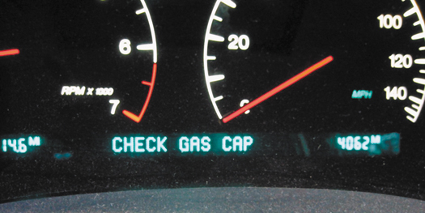
FIGURE 19–35 Some vehicles will display a message if an evaporative control system leak is detected that could be the result of a loose gas cap.

Slide 55
EVAPORATIVE SYSTEM MONITOR
OBD-II Requirements
  Serious faults cause a blinking malfunction indicator lamp (MIL) or even an engine shutdown.
  Less serious faults may simply store a code but not illuminate the MIL.
Engine-off natural vacuum

Slide 56
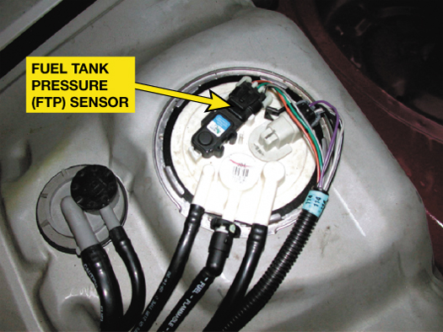
Figure 19–39 The fuel tank pressure sensor (black unit with three wires) looks like a MAP sensor and is usually located on top of the fuel pump module (white unit).

Slide 57
TYPICAL EVAP MONITOR (1 OF 3)
The PCM will run the EVAP monitor when the following enable criteria are met.
  Cold start
  Barometric pressure (BARO) greater than 70 kPa (20.7 in. Hg or 10.2 PSI)
  Intake air temperature (IAT) between 39°F and 86°F at engine start-up

Slide 58
TYPICAL EVAP MONITOR (2 OF 3)
  Engine coolant temperature (ECT) between 39°F and 86°F at engine start-up
  ECT and IAT within 39°F of each other at engine start-up
  Fuel level within 15% to 85%
  Throttle position (TP) sensor between 9% and 35%

Slide 59
TYPICAL EVAP MONITOR (3 OF 3)
Running the Evap Monitor
  Weak vacuum test (P0440—large leak)
  Small leak test (P0442—small leak)
  Excess vacuum test (P0446)

Slide 60
EVAP SYSTEM-RELATED DIAGNOSTIC TROUBLE CODES
P0440
P0442
P0446
What are they and what are the possible causes?

Slide 61
SUMMARY (1 OF 4)
Recirculating 6% to 10% inert exhaust gases back into the intake system by the EGR system reduces peak temperature inside the combustion chamber and reduces NOx exhaust emissions.
  OBD-II requires flow rate be tested and achieved by opening EGR valve and observing the reaction of the MAP sensor.

Slide 62
SUMMARY (2 OF 4)
Positive crankcase ventilation systems use a valve or a fixed orifice to control and direct the fumes from the crankcase back into the intake system.
The secondary air-injection (SAI) system forces air at low pressure into the exhaust to reduce CO and HC exhaust emissions.

Slide 63
SUMMARY (3 OF 4)
A catalytic converter is an after treatment device that reduces exhaust emissions outside of the engine.
The purpose of the evaporative emission control system is to reduce the release of volatile organic compounds into the atmosphere.

Slide 64
SUMMARY (4 OF 4)
A carbon canister is used to trap and hold gasoline vapors until they can be purged and run into the engine to be burned.
OBD-II regulation requires that the evaporative emission control system be checked for leakage and proper purge flow rates.
External leaks can best be located by pressurizing the fuel system with low-pressure smoke.

Slide 65
Video Links (Internet Access Required)
Bad catalytic converter (time 0:50)
Evap diagnostics (time 12:53)
EGR port cleaning (time 5:13)
EGR system (time 2:08)
Catalytic converters (time 3:04)
Understanding catalytic converters (time 4:39)
EVAP (time 6:06)
EVAP part 2 (time 9:34)
Purge control solenoid (time 1:28)
Charcoal canister (time 1:11)

Slide 66
Video Links (Internet Access Required)
Secondary air injection (time 4:23)
PCV valve (time 1:45)
VW EVAP system (time 32:15)
PCV valve (time 2:37)
GM EVAP vent solenoid testing (time 33:00)
Secondary Air Injection system (time 1:11)

