Slide 1
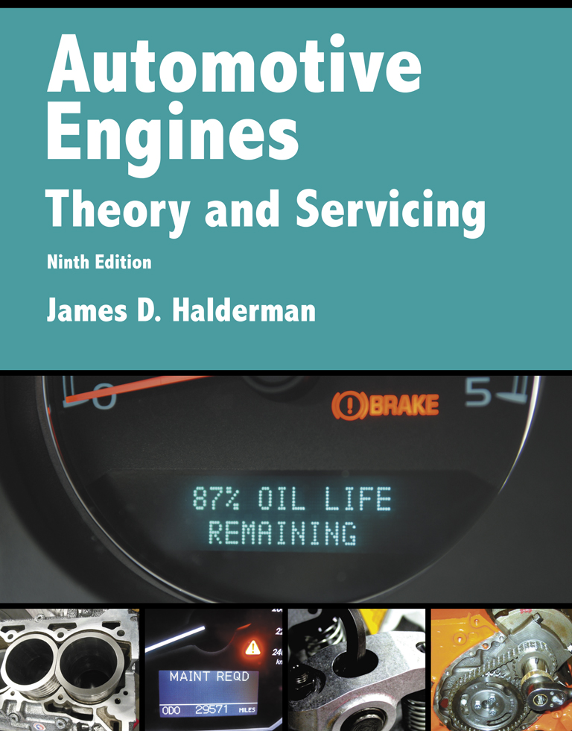
Automotive Engines Theory and Servicing
Ninth Edition
Chapter 18
Ignition System Operation and Diagnosis

Slide 2
OBJECTIVES (1 OF 2)
18.1 Describe the purpose and function of the ignition system.
18.2 Discuss ignition switching and triggering.
18.3 Explain the purpose and function of distributor ignition systems.
18.4 Discuss waste-spark ignition systems and coil-on-plug ignition systems.

Slide 3
OBJECTIVES (2 OF 2)
18.5 Discuss the purpose and function of knock sensors.
18.6 Explain ignition system diagnosis.
18.7 Explain spark plug construction, service, and how to conduct a spark plug wire inspection.
18.8 Explain ignition timing, and discuss the symptoms of a faulty ignition system.

Slide 4
IGNITION SYSTEM (1 OF 3)
The ignition system includes components and wiring necessary to create and distribute a high voltage and send to the spark plug.
A high-voltage arc occurs across the gap of a spark plug inside the combustion chamber.
The spark raises the temperature of the airfuel mixture and starts the combustion process inside the cylinder.

Slide 5
IGNITION SYSTEM (2 OF 3)
Background
Early ignition systems
Electronic ignition
Waste-spark system
Coil-on-plug (COP) system

Slide 6
IGNITION SYSTEM (3 OF 3)
Ignition Coil Construction
Secondary coil winding
Primary coil winding
Ignition Coil Operation

Slide 7
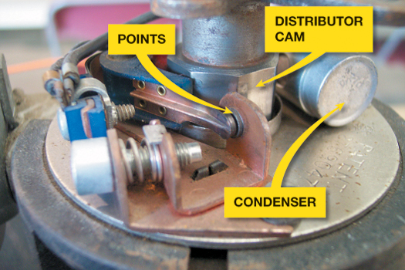
FIGURE 18–1 The points make and break electrical circuit of the coil primary winding in the ignition coil. The points are opened mechanically by the distributor cam. The condenser provides a path for the electrons to flow instead of arcing across the points when they open, preventing the points from burning.

Slide 8
IGNITION SWITCHING AND TRIGGERING
Switching
Triggering
Primary Circuit Operation
Magnetic sensor
Hall-effect switch

Slide 9
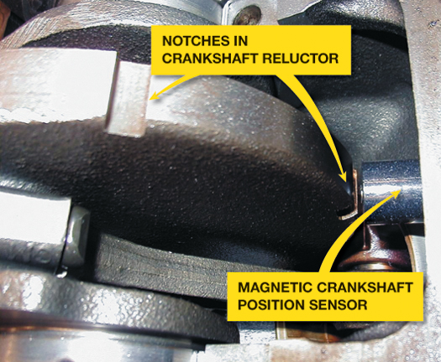
FIGURE 18–6 A typical magnetic crankshaft position sensor.

Slide 10
DISTRIBUTOR IGNITION (DI) (1 OF 2)
The purpose of a distributor is to distribute the high-voltage spark from the output terminal of the ignition coil to the spark plugs for each cylinder.
A gear or shaft drives the distributor that is connected to the camshaft and is driven at camshaft speed.

Slide 11
DISTRIBUTOR IGNITION (DI) (2 OF 2)
Most distributor ignition systems also use a sensor to trigger the ignition control module.
Magnetic pulse alternators, also called pickup coils
Hall-effect sensors located in the distributor
Optical sensors located in the distributor
Operation of Distributor Ignition
Firing Order

Slide 12
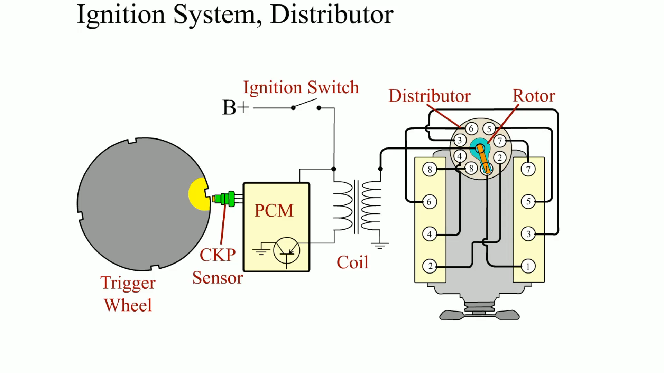
Animation: Ignition System, Distributor (The animation will automatically start in a few seconds)

Slide 13
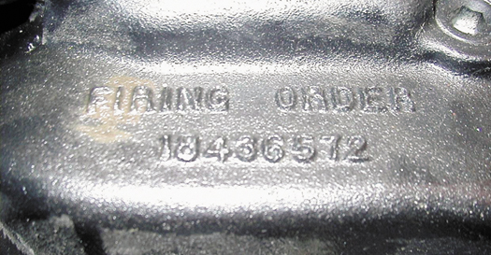
FIGURE 18–12 The firing order is cast or stamped on the intake manifold on most engines that have a distributor ignition.

Slide 14
WASTE-SPARK IGNITION SYSTEMS
Parts Involved
Waste-spark System Operation
Compression-sensing Waste-spark Ignition

Slide 15
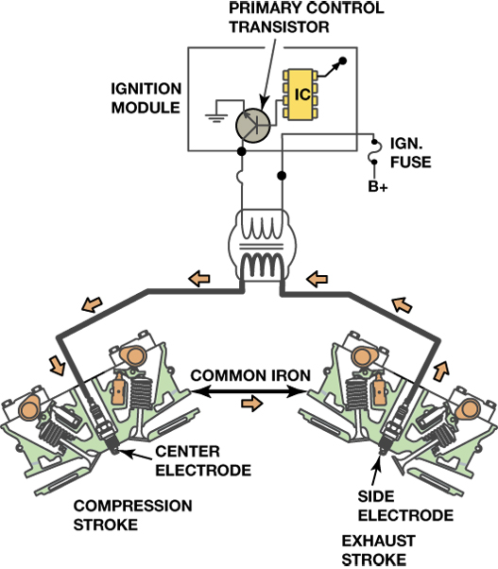
FIGURE 18–13 A waste-spark system fires one cylinder while its piston is on the compression stroke and into paired or companion cylinders while it is on the exhaust stroke. In a typical engine, it requires only about 2 to 3 kV to fire the cylinder on the exhaust stroke. The remaining coil energy is available to fire the spark plug under compression (typically about 8 to 12 kV).

Slide 16
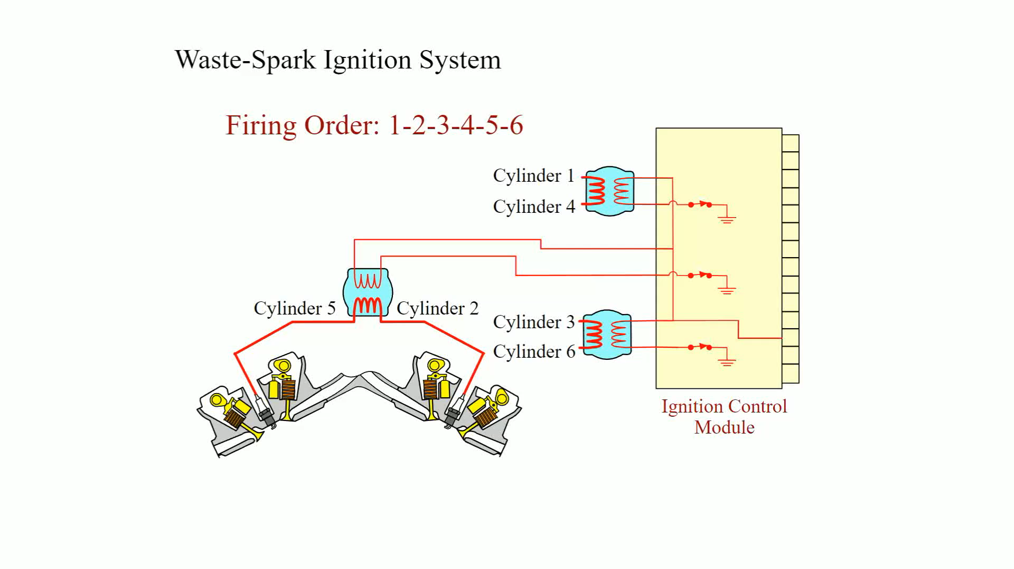
Animation: Waste-Spark Ignition System (The animation will automatically start in a few seconds)

Slide 17
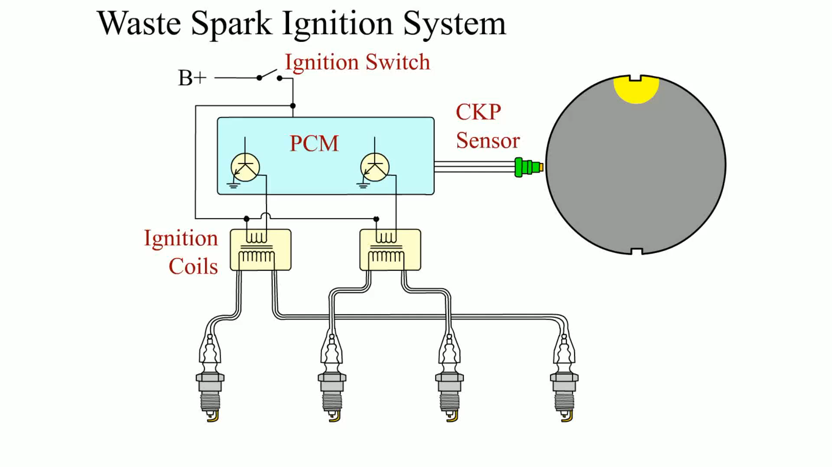
Animation: Waste Spark Ignition System (The animation will automatically start in a few seconds)

Slide 18
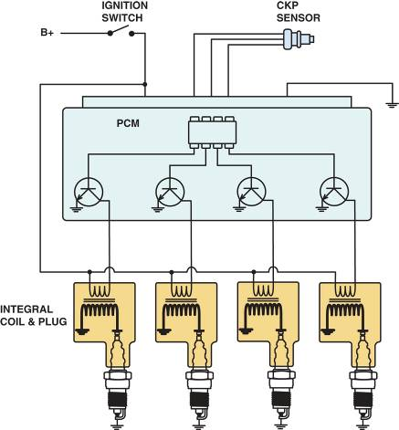
COIL-ON-PLUG IGNITION (1 OF 2)
Coil-on-plug (COP) ignition uses one ignition coil for each spark plug.
This system is also called coil-by-plug, coil-near-plug, or coil-over-plug ignition.
FIGURE 18–16 A typical coil-on-plug ignition system showing the triggering and the switching being performed by the PCM from input from the crankshaft position sensor.

Slide 19
COIL-ON-PLUG IGNITION (2 OF 2)
Advantages
Types of Cop Systems
Two primary wires
Three primary wires
Ion-sensing Ignition

Slide 20
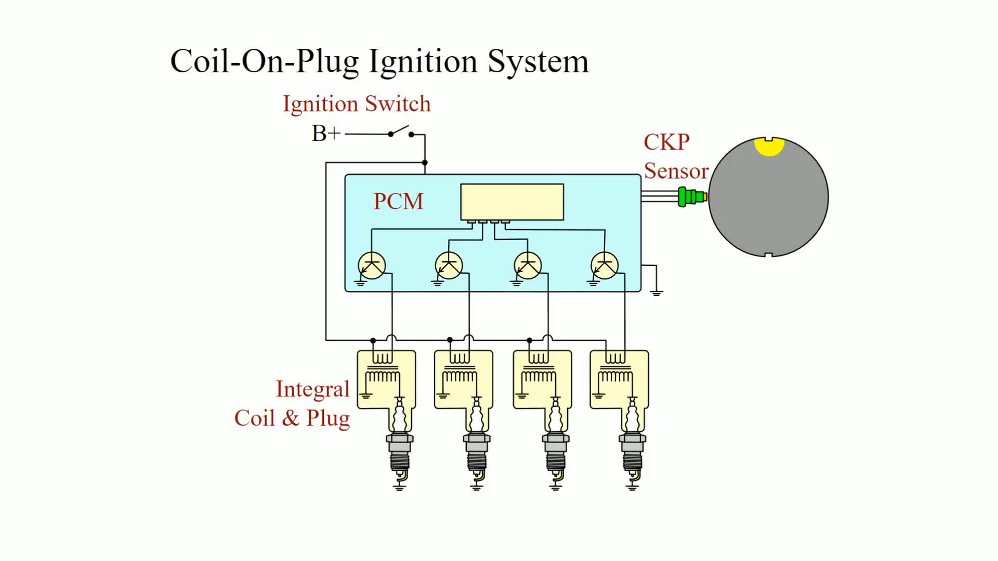
Animation: Coil-On-Plug Ignition System (The animation will automatically start in a few seconds)

Slide 21
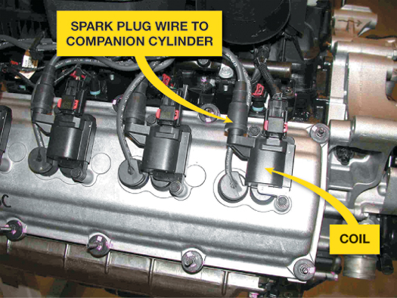
FIGURE 18–18 A Chrysler Hemi V-8 that has two spark plugs per cylinder. The coil on top of one spark fires that plug plus, through a spark plug wire, fires a plug in the companion cylinder.

Slide 22
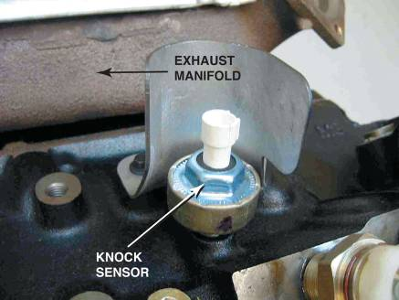
KNOCK SENSORS
Knock sensors are used to detect abnormal combustion, often called ping, spark knock, or detonation.
Diagnosing the Knock Sensor
Replacing a Knock Sensor
FIGURE 18–20 A typical knock sensor on the side of the block. Some are located in the "V" of a V-type engine and are not noticeable until the intake manifold has been removed.

Slide 23
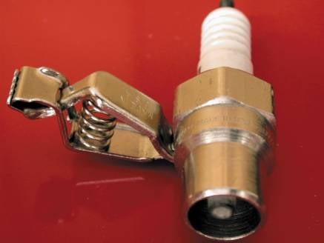
IGNITION SYSTEM DIAGNOSIS
Checking For Spark
Ignition Coil Testing Using An Ohmmeter
Magnetic Sensor Testing
Testing Hall-effect Sensors
Testing Optical Sensors
FIGURE 18–22 A spark tester looks like a regular spark plug with an alligator clip attached to the shell. This tester has a specified gap that requires at least 25,000 volts (25 kV) to fire.

Slide 24
SPARK PLUG WIRE INSPECTION (1 OF 2)
Spark plug wires should be visually inspected for cuts or defective insulation.
Faulty spark plug wire insulation can cause hard starting or no starting in rainy or damp weather conditions.

Slide 25
SPARK PLUG WIRE INSPECTION (2 OF 2)
When removing a spark plug wire, be sure to rotate the boot of the wire at the plug before pulling it off the spark plug.
This will help prevent damaging the wire as many wires are stuck to the spark plug and are often difficult to remove.

Slide 26
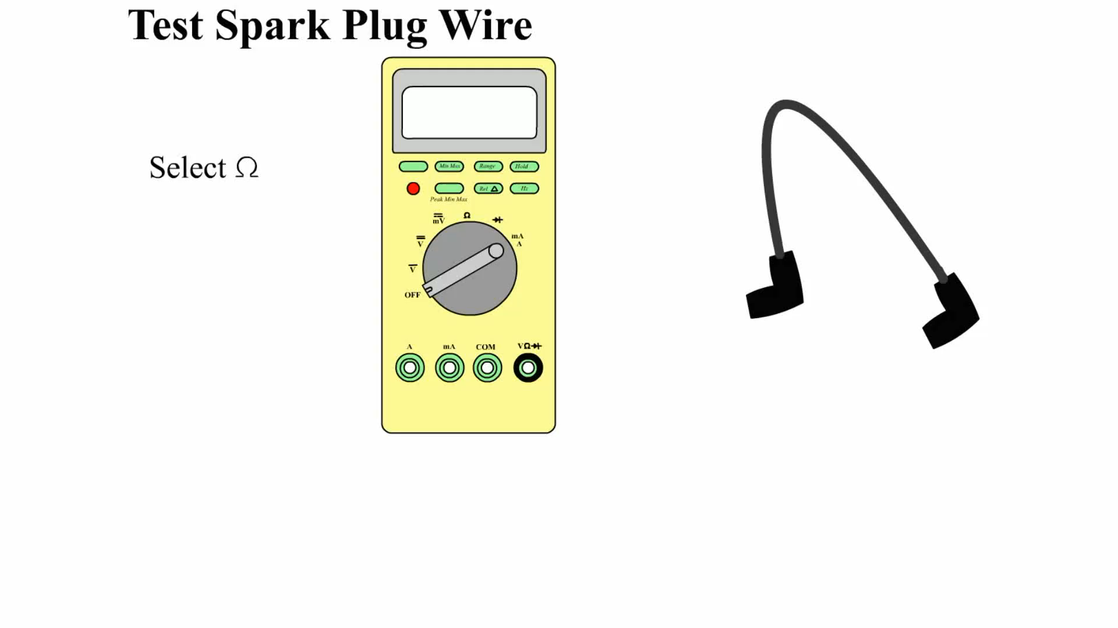
Animation: Test Spark Plug Wire (The animation will automatically start in a few seconds)

Slide 27
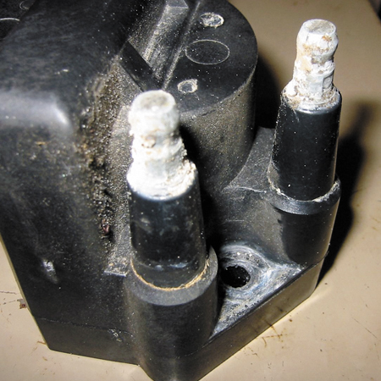
FIGURE 18–29 Corroded terminals on a waste-spark coil can cause misfire diagnostic trouble codes to be set.

Slide 28
SPARK PLUGS (1 OF 2)
Spark plugs are manufactured from ceramic insulators inside a steel shell.
The threads of the shell are rolled and a seat is formed to create a gas-tight seal with the cylinder head.
Resistor Spark Plugs
Platinum Spark Plugs

Slide 29
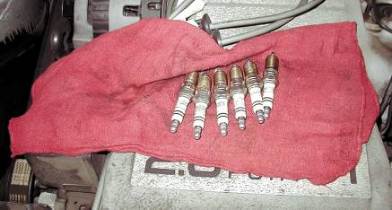
SPARK PLUGS (2 OF 2)
Iridium Spark Plugs
Spark Plug Service
The physical differences in spark plugs include:
Reach.
Heat range.
Type of seat.
FIGURE 18–36 When removing spark plugs, it is wise to arrange them so that they can be compared and any problem can be identified with a particular cylinder.

Slide 30
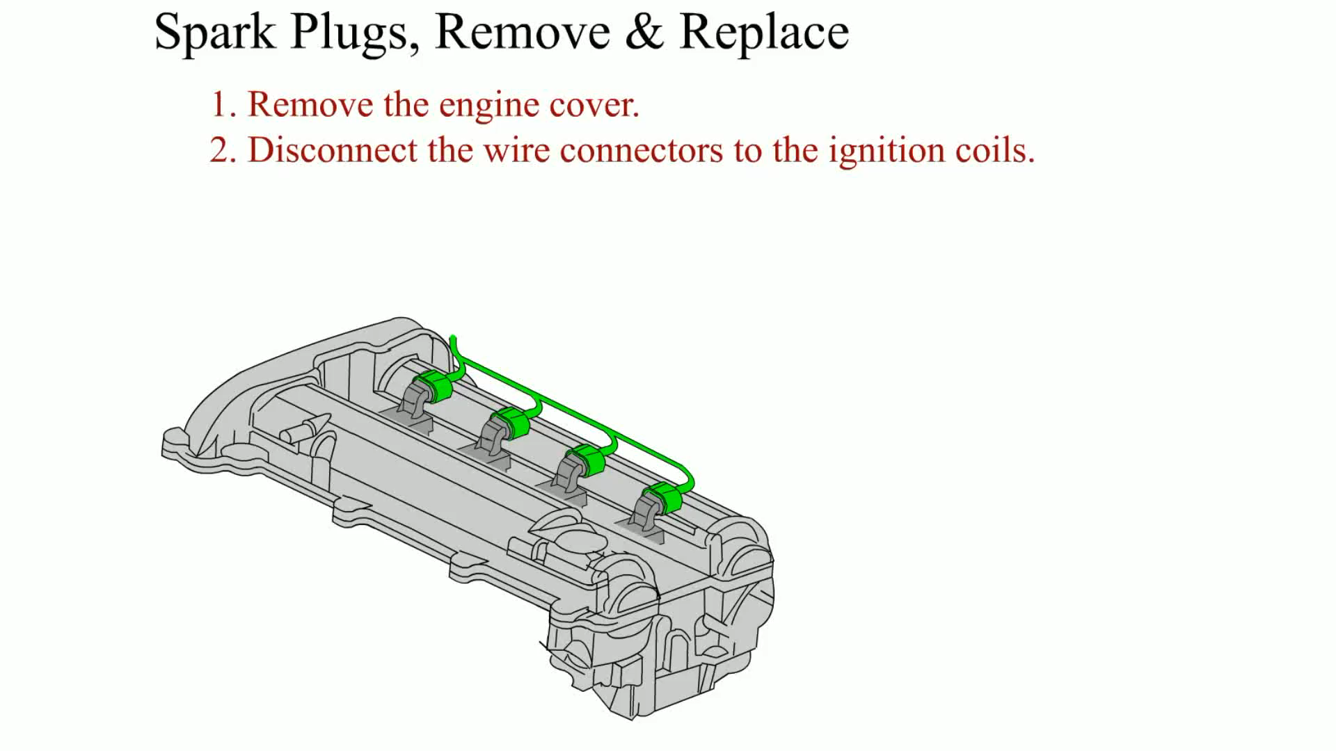
Animation: Spark Plugs, Remove & Replace (The animation will automatically start in a few seconds)

Slide 31
IGNITION TIMING
Ignition timing is when the spark plug fires in relation to piston position.
The time when the spark occurs depends on engine speed and, therefore, must be advanced as the engine rotates faster.
Follow exactly the timing procedure indicated on the underhood vehicle emission control information (VECI) decal.

Slide 32
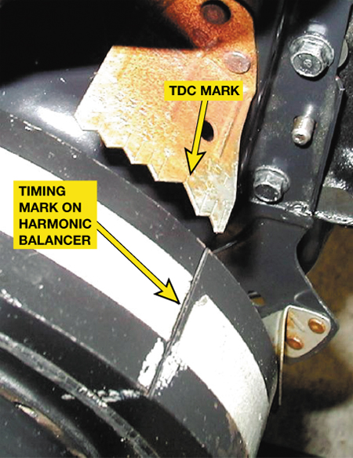
FIGURE 18–42 Ignition timing marks are found on the harmonic balancers on engines equipped with distributors that can be adjusted for timing.

Slide 33
SUMMARY (1 OF 3)
All inductive ignition systems supply battery voltage to the positive side of the ignition coil and pulse the negative side of the coil on and off to ground to create a high-voltage spark.
If an ignition system uses a distributor, it is a distributor ignition (DI) system.
If an ignition system does not use a distributor, it is an electronic ignition (EI) system.

Slide 34
SUMMARY (2 OF 3)
A waste-spark ignition system fires two spark plugs at the same time.
A coil-on-plug ignition system uses an ignition coil for each spark plug.
A thorough visual inspection should be performed on all ignition components when diagnosing an engine performance problem.

Slide 35
SUMMARY (3 OF 3)
Platinum spark plugs should not be regapped after use in an engine.

Slide 36
Video Links (Internet Access Required)
Distributor installation (time 2:34)
Cylinder deactivation (time 2:35)
Ignition system (time 5:26)
Distributor cap and rotor (time 2:57)
Spark plugs (time 3:25)
Ignition fault codes (time 10:00)
Check for spark (time 1:58)
Ignition coil (time 3:40)
Setting ignition timing (time 1:44)
Spark plug tube repair (time 7:08)

Slide 37
Video Links (Internet Access Required)
Spark plug thread repair (time 6:55)
Finding an ignition voltage leak (time 6:28)
Misfire diagnosis (time 8:12)
Subaru no spark (time 13:25)
Basic ignition (time 1:07:57)
COP misfire diagnosis (time 11:01)
COP ignition system (time 3:00)
Ignition system primary testing (time 5:04)
Electronic ignition distributor (time 2:21)
Scanning to detect misfires (time 5:03)

Slide 38
Video Links (Internet Access Required)
Ignition coil signal circuit (time 2:38)
Spark plugs (time 6:56)
Spark plug replacement (time 3:11)
Spark plug wires (time 1:20)
Ignition coil (time 0:53)
Coil testing (time 14:39)

