Slide 1

Automotive Engines Theory and Servicing
Ninth Edition
Chapter 17
Engine Starting and Charging Systems

Slide 2
OBJECTIVES
17.1 Explain the purpose and function of a battery, and discuss battery ratings.
17.2 Discuss battery service and battery service safety considerations.
17.3 Discuss battery voltage test, battery load testing, and conductance testing.
17.4 Explain how to safely jump start a battery, and discuss battery charging and charging circuit.

Slide 3
OBJECTIVES
17.5 Explain the battery electrical drain test.
17.6 Describe the cranking circuit, and discuss how to diagnose starter problems using visual inspection.
17.7 Explain starter testing on a vehicle and how to test a starter using a scan tool.
17.8 Discuss voltage drop testing and how to check charging system voltage.

Slide 4
OBJECTIVES
17.9 Discuss the need for proper starter drive-to-flywheel clearance.
17.10 Discuss how to test an alternator using a scan tool and using a scope.
17.11 Discuss AC ripple voltage check and AC current check.
17.12 Explain charging system voltage drop testing and alternator output test.

Slide 5
PURPOSE AND FUNCTION OF A BATTERY
An automotive battery provides a source of electrical power for starting and for electrical demands that exceed alternator output.
  The battery also acts as a voltage stabilizer for the entire electrical system.

Slide 6
BATTERY RATINGS
Batteries are rated according to the amount of current they can produce under specific conditions.
  Cold-cranking Amperes
  Cranking Amperes
  Marine Cranking Amperes
  Ampere-hour Rating
  Reserve Capacity

Slide 7
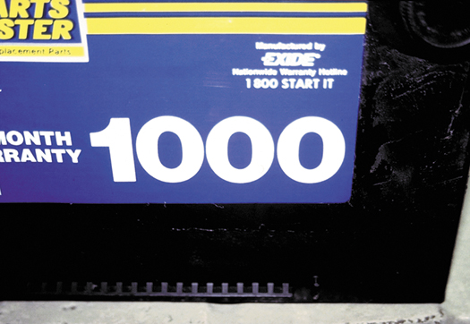
Figure 17–1 This battery shows a large “1000” on the front panel but this is the CA rating and not the more important CCA rating. Always compare batteries with the same rating.

Slide 8
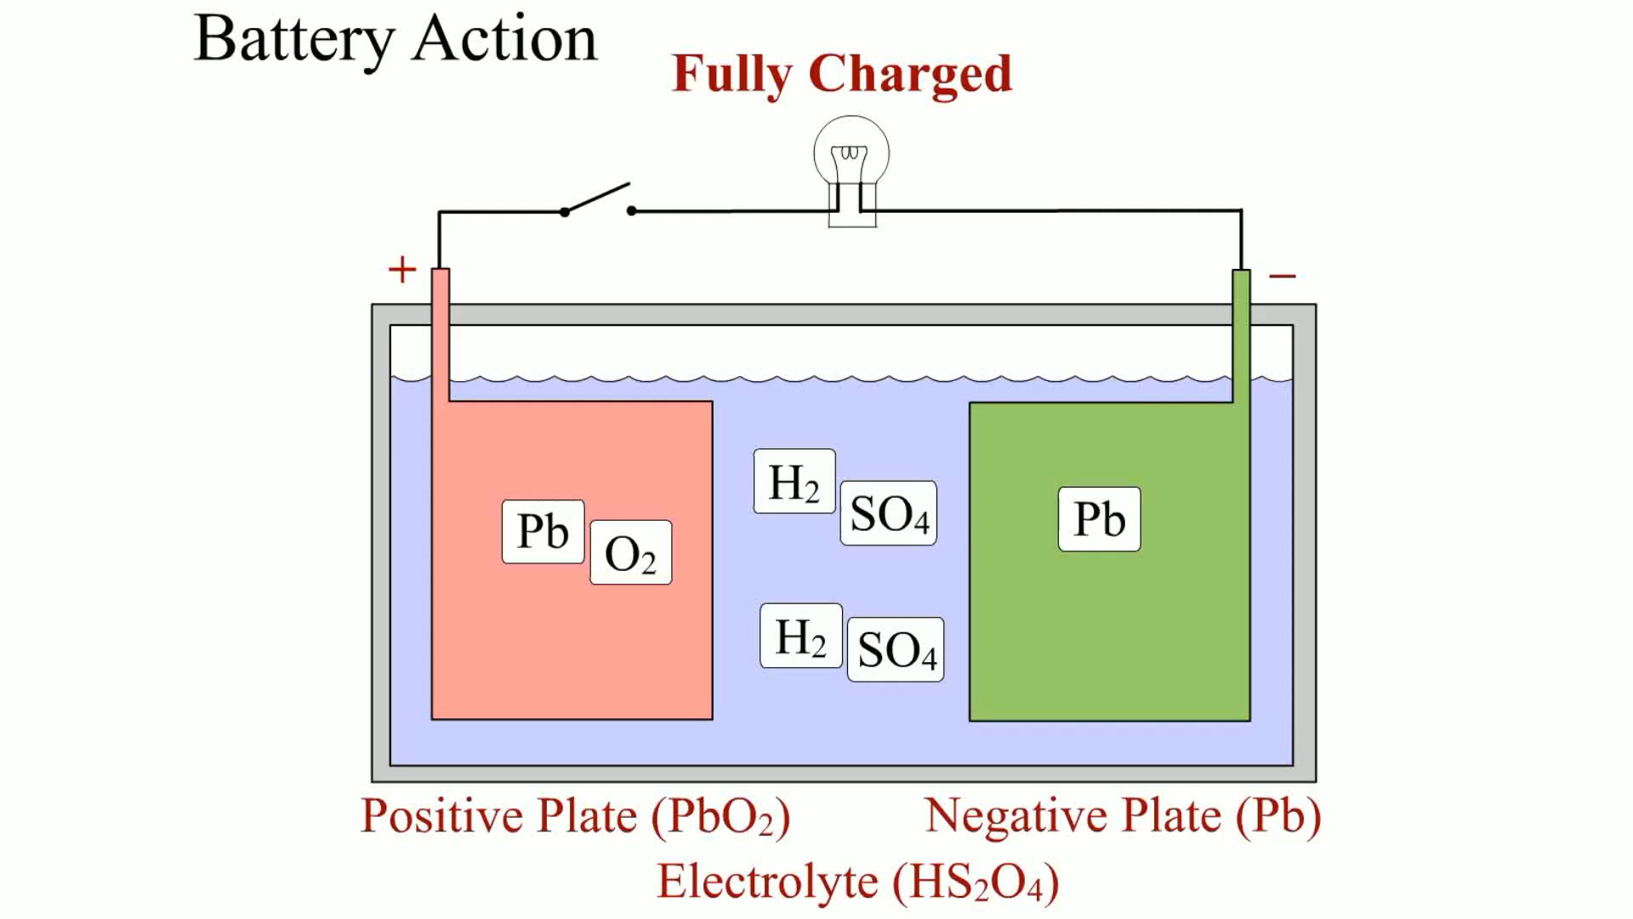
Animation: Battery Action (Lead Acid)
(The animation will automatically start in a few seconds)

Slide 9
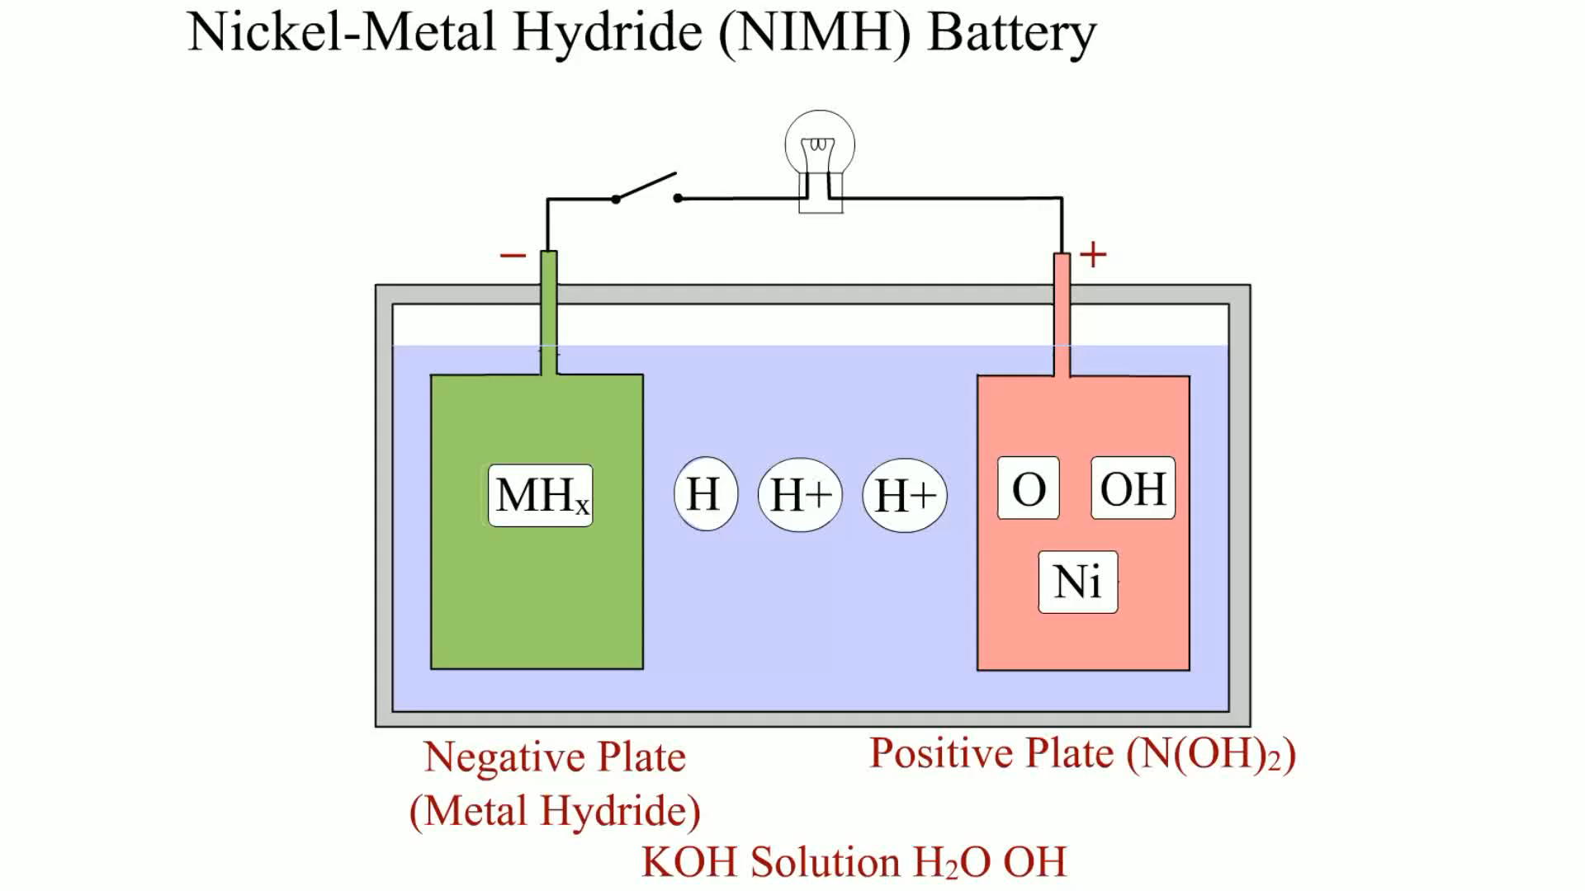
Animation: Nickel-Metal Hydride (NIMH) Battery
(The animation will automatically start in a few seconds)

Slide 10
BATTERY SERVICE SAFETY CONSIDERATIONS (1 OF 2)
Batteries contain acid and release explosive gases (hydrogen and oxygen) during normal charging and discharging cycles.
To help prevent physical injury or damage to the vehicle, always adhere to the following safety procedures.
  Disconnect the negative battery cable from the battery.

Slide 11
BATTERY SERVICE SAFETY CONSIDERATIONS (2 OF 2)
  Wear eye protection whenever working around any battery.
  Wear protective clothing to avoid skin contact with battery acid.
  Always adhere to all safety precautions as stated in the service procedures for the equipment used for battery service and testing.
  Never smoke or use an open flame around any battery.

Slide 12
BATTERY VISUAL INSPECTION AND VOLTAGE TEST
The battery and battery cables should be included in the list of items checked during a thorough visual inspection.
Check the battery cables for corrosion and tightness
Testing the battery voltage with a voltmeter is a simple method for determining the state of charge of any battery.

Slide 13
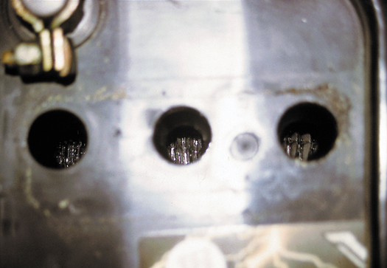
Figure 17–3 A visual inspection on this battery showed that the electrolyte level was below the plates in all cells.

Slide 14
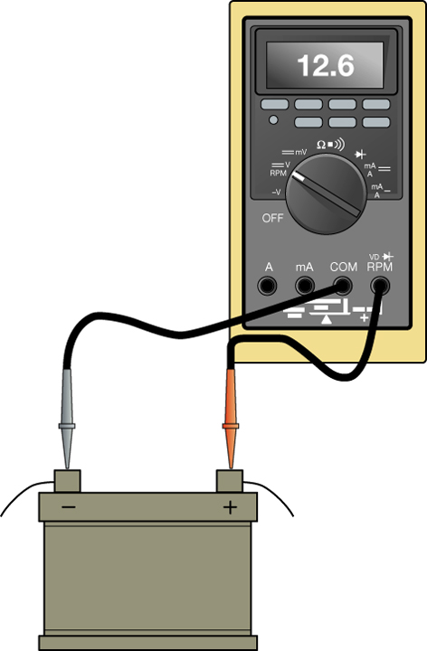
Figure 17–4 Using a DMM to measure the open-circuit voltage of a battery.

Slide 15
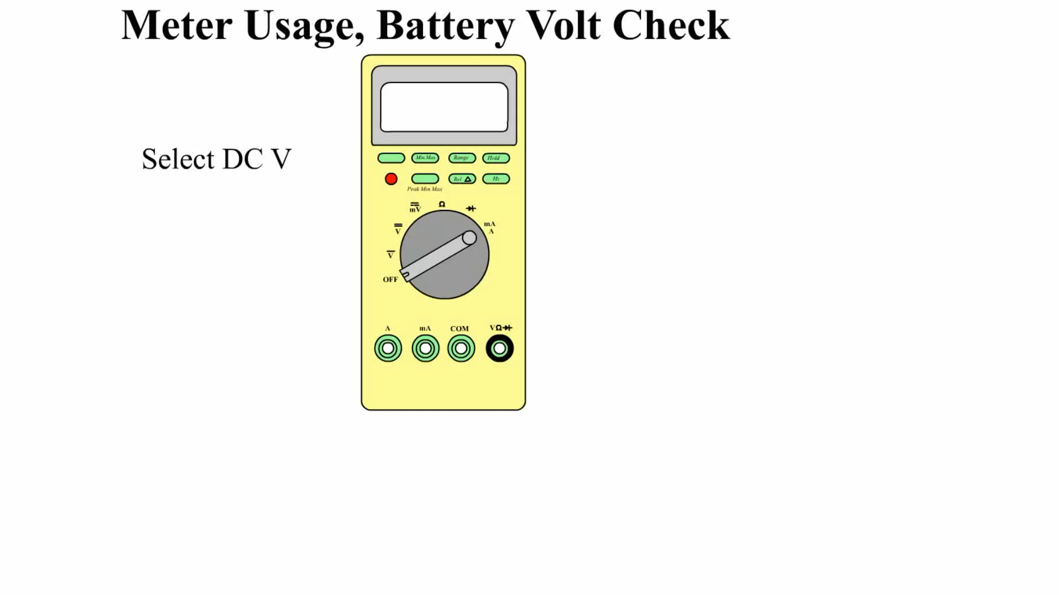
Animation: Meter Usage, Battery Volt Check
(The animation will automatically start in a few seconds)

Slide 16
BATTERY LOAD TESTING
What is a battery load test?
If the battery fails the load test, recharge the battery and retest.
If the battery fails the load test again, replace the battery.

Slide 17
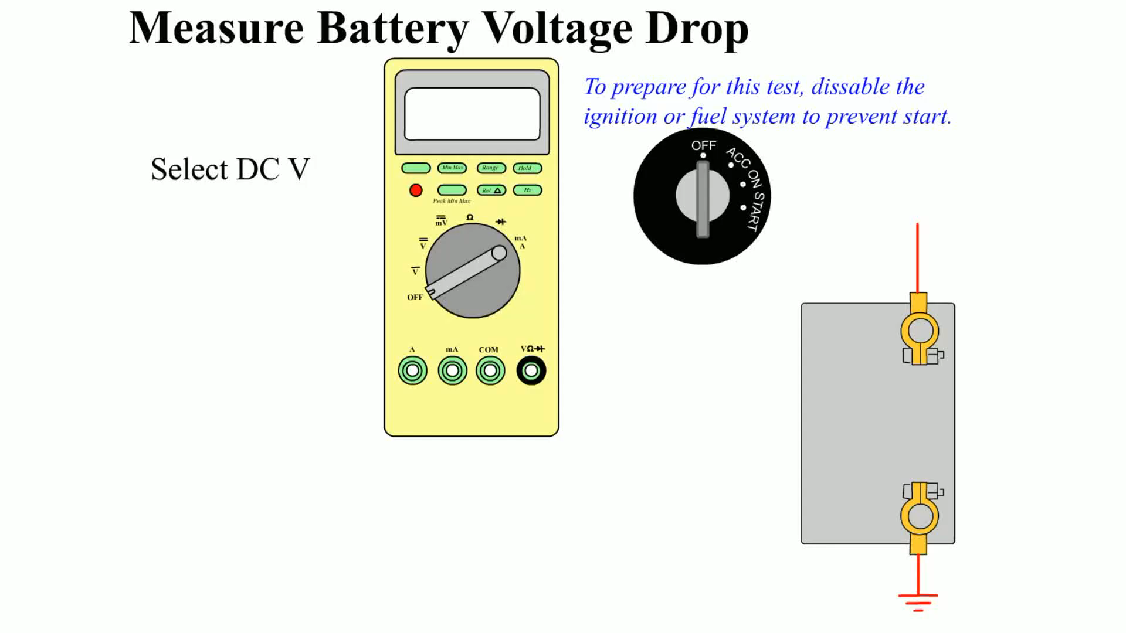
Animation: Measure Battery Voltage Drop
(The animation will automatically start in a few seconds)

Slide 18
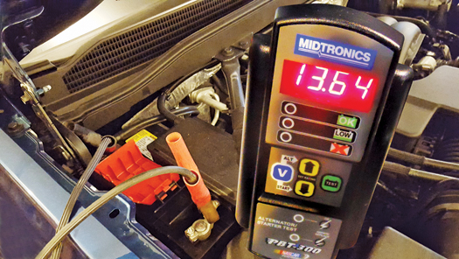
Figure 17–7 A Midtronics tester that can not only test the battery but can also detect faults with the starter and alternator.

Slide 19
CONDUCTANCE TESTING
General Motors Corporation, Chrysler Corporation, Ford, and other vehicle manufacturers specify that a conductance tester be used to test batteries in vehicles still under factory warranty.
  It uses its internal electronic circuitry to determine the state of charge and capacity of the battery by measuring the voltage and conductance of the plates.

Slide 20
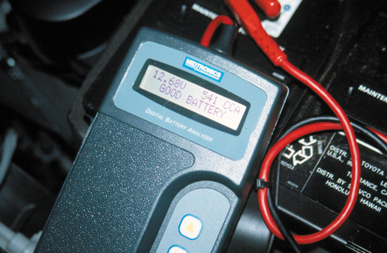
Figure 17–9 An electronic battery tester.

Slide 21
JUMP STARTING (1 OF 2)
To safely jump start a vehicle without doing any harm, use the following procedure.
  Be certain the ignition switch is off on both vehicles.
  Connect good-quality copper jumper cables.

Slide 22
JUMP STARTING (2 OF 2)
  Start the vehicle with the good battery and allow it to run for 5 to 10 minutes. This allows the alternator of the good vehicle to charge the battery on the disabled vehicle.
  Start the disabled vehicle and, after the engine is operating smoothly, disconnect the jumper cables in the reverse order of step 2.

Slide 23
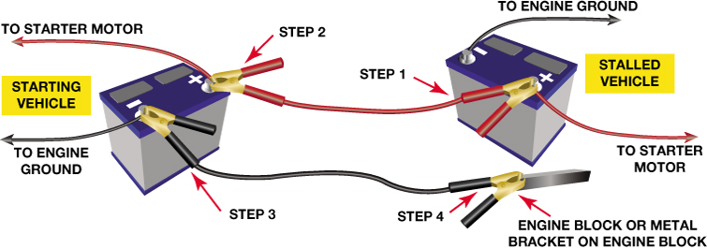
Figure 17–10 Jumper cable usage guide. Follow the same connections if using a portable jump box.

Slide 24
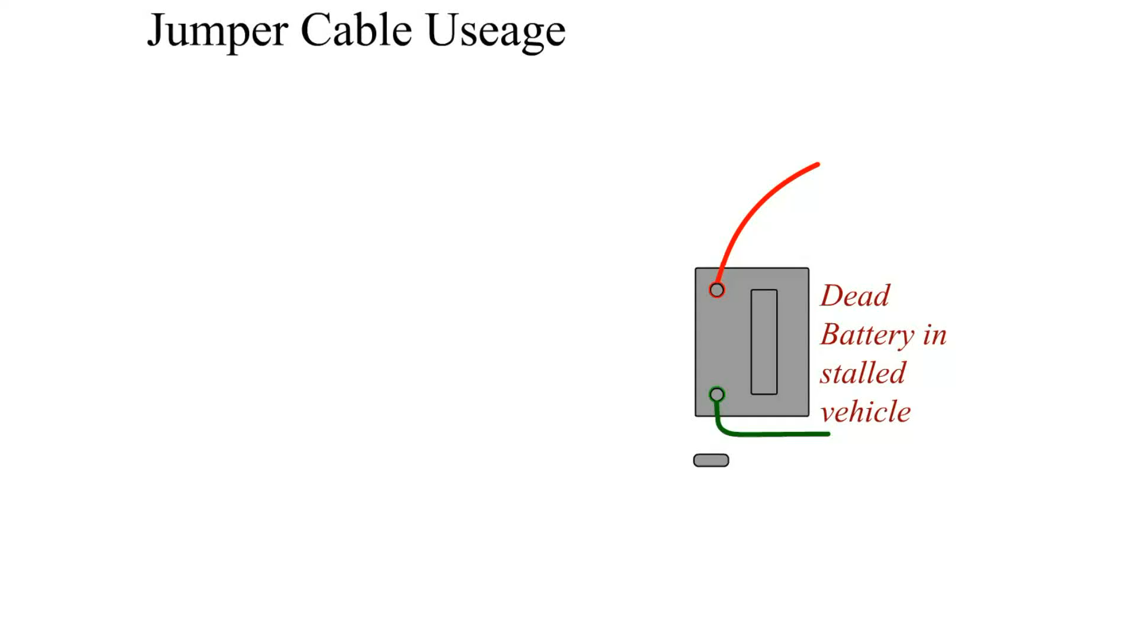
Animation: Jumper Cable Usage
(The animation will automatically start in a few seconds)

Slide 25

Animation: Jumper Box Usage
(The animation will automatically start in a few seconds)
Jumper Box Usage

Slide 26
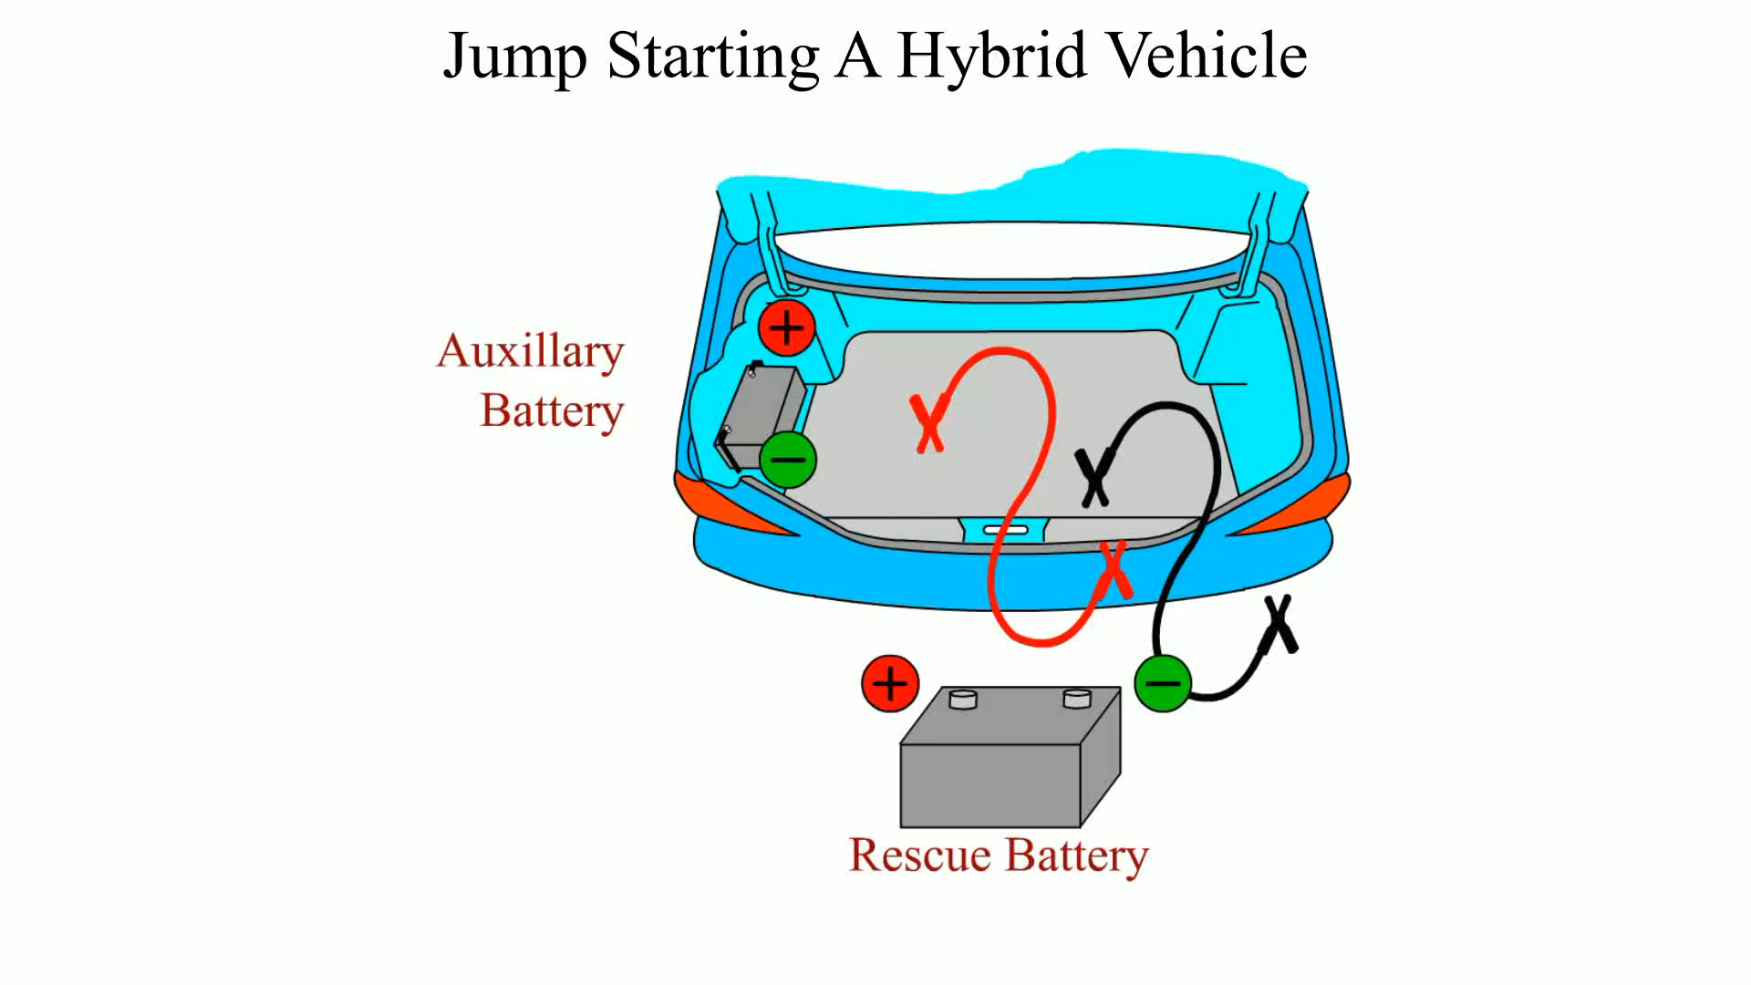
Animation: Jump Starting a Hybrid Vehicle
(The animation will automatically start in a few seconds)

Slide 27
BATTERY CHARGING AND SERVICE (1 OF 2)
It is best to slow-charge any battery to prevent possible overheating damage to the battery.
Remember, it may take eight hours or more to charge a fully discharged battery.

Slide 28
BATTERY CHARGING AND SERVICE (2 OF 2)
Check and service the following items if needed.
  Neutralize and clean any corrosion from the battery terminals with a solution of baking soda and water.
  Carefully inspect the battery cables by visual inspection.
  Check the tightness and cleanliness of all ground connections.

Slide 29
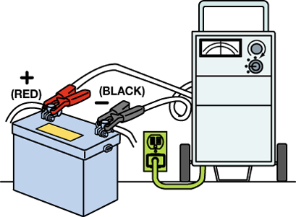
Figure 17–11 To use a battery charger, make sure the charger is connected to the battery before plugging in the charger.

Slide 30
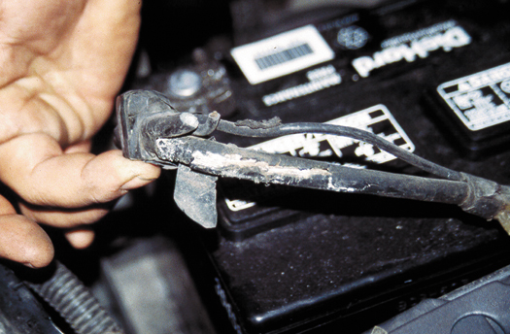
Figure 17–12 This battery cable was found corroded underneath. The corrosion had eaten through the insulation yet was not noticeable without careful inspection. This cable should be replaced.

Slide 31
BATTERY ELECTRICAL DRAIN TEST (1 OF 2)
The battery electrical drain test determines if some component or circuit in a vehicle or truck is causing a drain on the battery when everything is off.
  This test is also called the ignition off-draw (IOD) or parasitic load test.

Slide 32
BATTERY ELECTRICAL DRAIN TEST (2 OF 2)
This test should be performed whenever one of the following conditions exists.
  Whenever a battery is being charged or replaced
  Whenever the battery is suspected of being drained

Slide 33
BATTERY ELECTRICAL DRAIN TESTING USING AN AMMETER (1 OF 2)
The ammeter method is the most accurate way to test for a possible battery drain.
Connect an ammeter in series between the battery terminal (post) and the disconnected cable.
  Normal battery drain is 0.020 to 0.030 A and any drain greater than 0.050 A should be found and corrected.

Slide 34
BATTERY ELECTRICAL DRAIN TESTING USING AN AMMETER (2 OF 2)
Many digital multimeters have an ammeter scale that can be used to safely and accurately test for an abnormal parasitic drain.

Slide 35
PROCEDURE FOR BATTERY ELECTRICAL DRAIN TEST
What conditions should exist in order to perform this test?
Normal battery drain on a vehicle equipped with electronic radio, climate control, computerized fuel injection, and so forth,

Slide 36
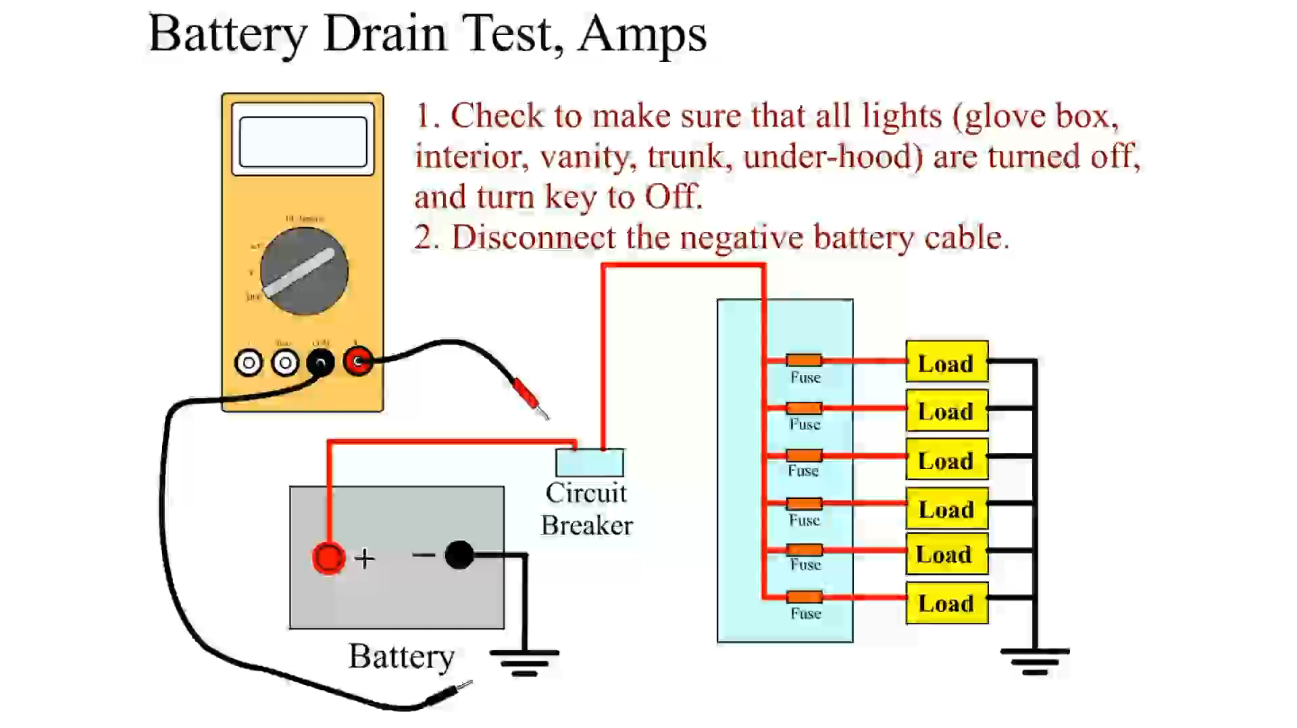
Animation: Battery Drain Test, Amps
(The animation will automatically start in a few seconds)

Slide 37
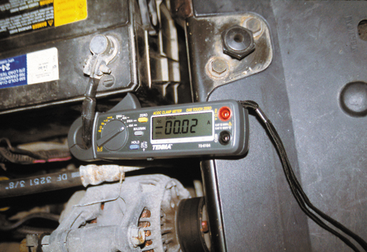
Figure 17–14 This mini clamp-on DMM is being used to measure the amount of battery electrical drain that is present. In this case, a reading of 20 mA (displayed on the meter as 00.02 A) is within the normal range of 20 to 30 mA. Be sure to clamp around all of the positive battery cables or all of the negative battery cables, whichever is easiest to clamp.

Slide 38
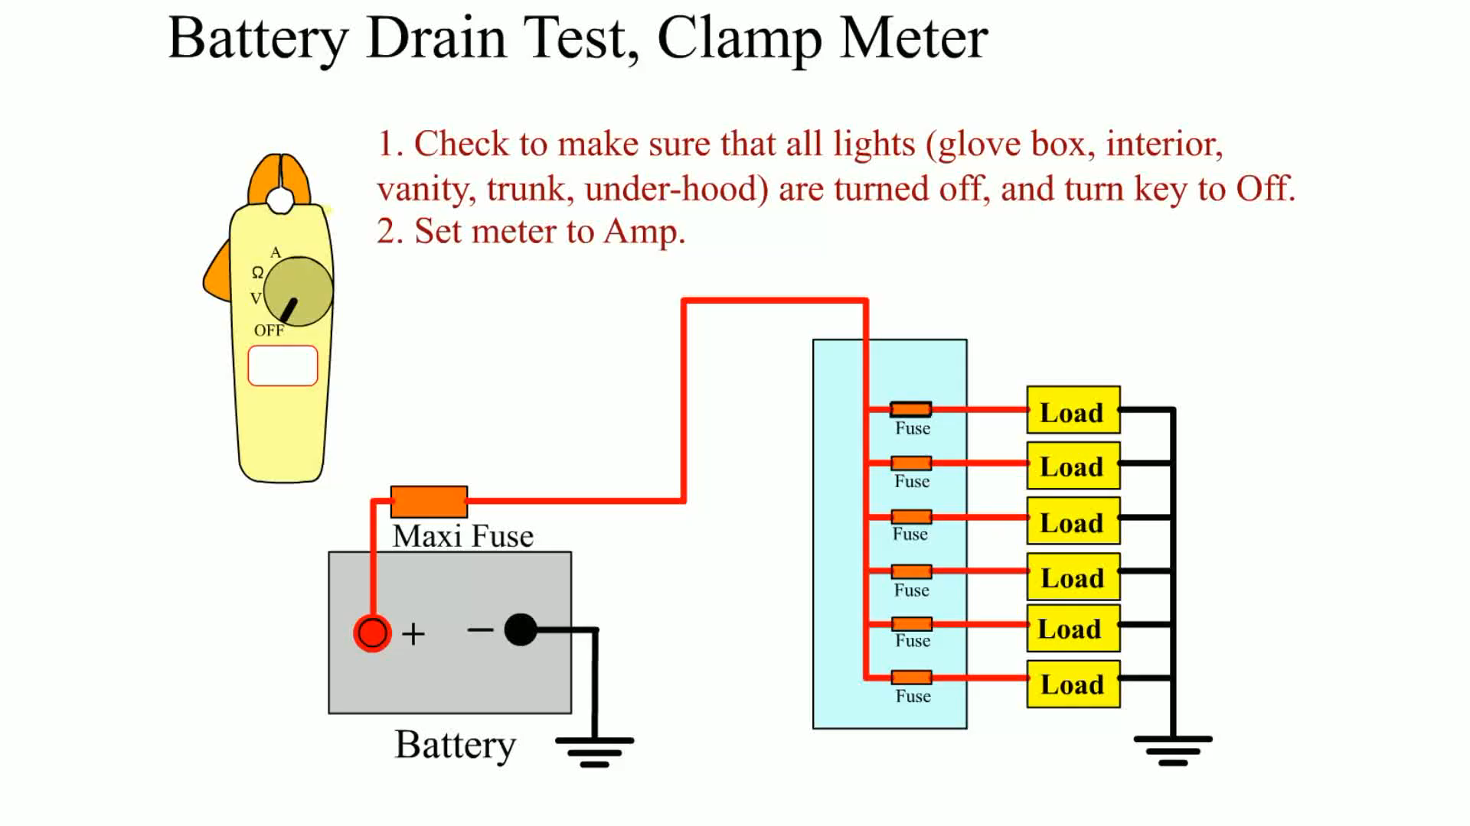
Animation: Battery Drain Test, Clamp Meter
(The animation will automatically start in a few seconds)

Slide 39
FINDING THE SOURCE OF THE DRAIN
If there is a drain, check and temporarily disconnect the following components.
  1. Cell phone or MP3 player still connected to the vehicle
  2. Glove compartment light
  3. Trunk light

Slide 40
WHEN A BATTERY DRAIN EXISTS AFTER FUSES ARE DISCONNECTED
What are the most common sources of drain under the hood?

Slide 41
CRANKING CIRCUIT (1 OF 2)
The cranking circuit includes those mechanical and electrical components required to crank the engine for starting.
The cranking force in the early 1900s was the driver's arm.

Slide 42
CRANKING CIRCUIT (2 OF 2)
Modern cranking circuits include the following:
  Starter motor
  Battery
  Starter solenoid or relay
  Starter drive
  Ignition switch

Slide 43
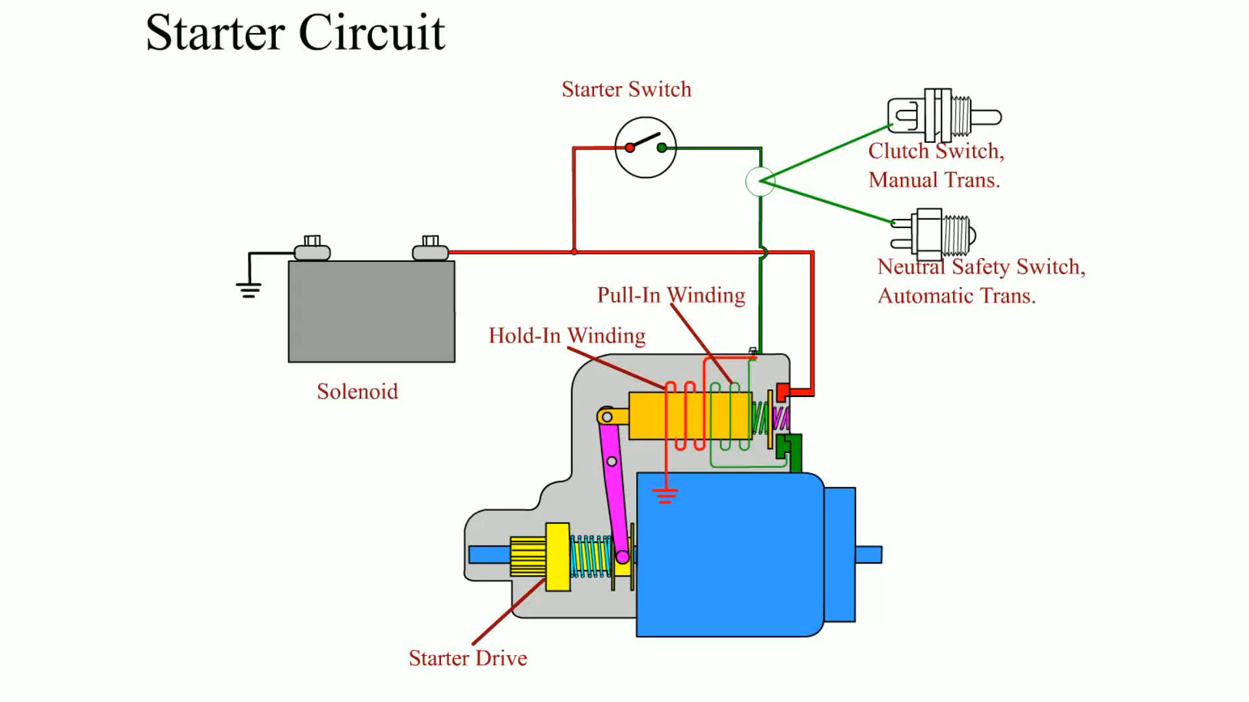
Animation: Starter Circuit
(The animation will automatically start in a few seconds)

Slide 44
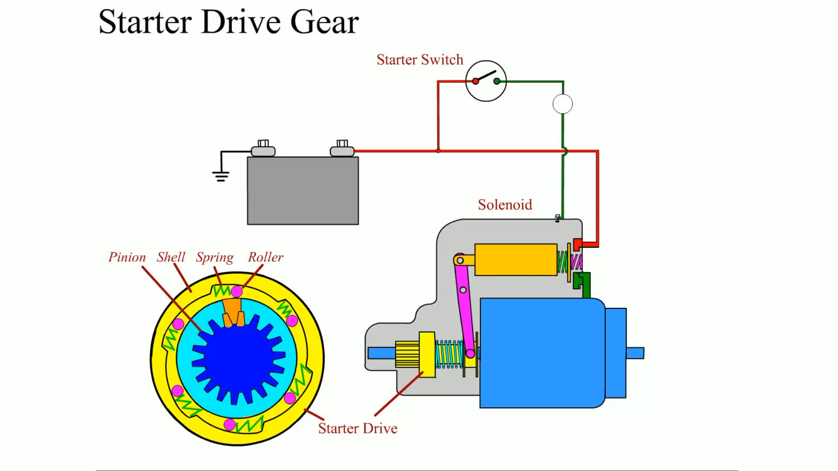
Animation: Starter Drive Gear
(The animation will automatically start in a few seconds)

Slide 45
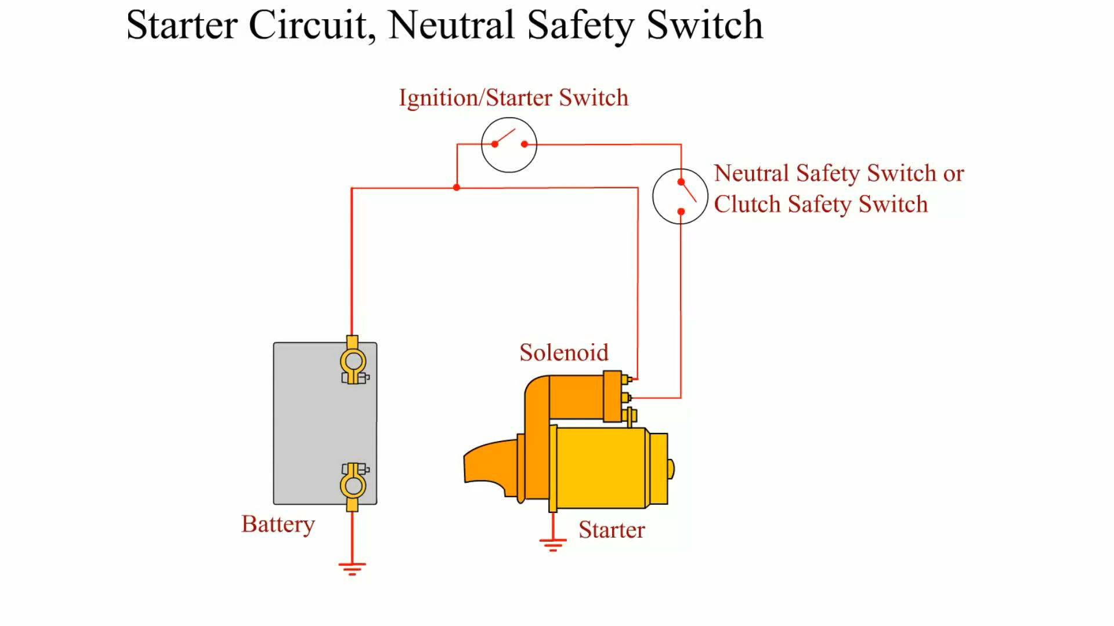
Animation: Starter Circuit, Neutral Safety Switch
(The animation will automatically start in a few seconds)

Slide 46
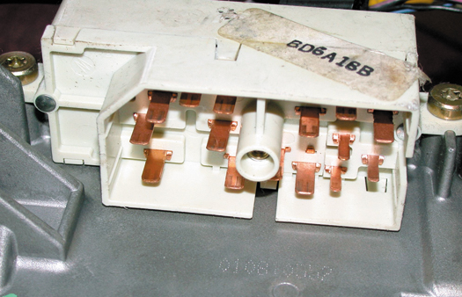
Figure 17–17 A typical ignition switch showing all of the electrical terminals after the connector has been removed.

Slide 47
DIAGNOSING STARTER PROBLEMS USING VISUAL INSPECTION (1 OF 2)
Carefully check the battery cables for tightness both at the battery and at the starter, and block connections.
Check to see if the heat shield (if equipped) is in place.

Slide 48
DIAGNOSING STARTER PROBLEMS USING VISUAL INSPECTION (2 OF 2)
Check for any nonstock add-on accessories or equipment that may drain the battery such as a sound system or extra lighting.
Crank the engine.

Slide 49
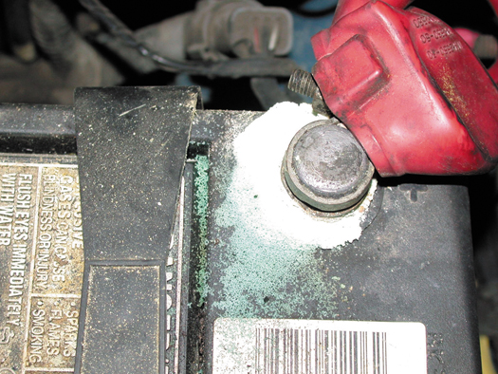
Figure 17–20 Carefully inspect all battery terminals for corrosion.

Slide 50
STARTER TESTING ON THE VEHICLE (1 OF 2)
Check Battery
Starter Amperage Test
  Excessive current draw may indicate one or more of the following:
    Low battery voltage (discharged or defective battery)
    Binding of starter armature as a result of worn bushings

Slide 51
STARTER TESTING ON THE VEHICLE (2 OF 2)
    Oil too thick (viscosity too high) for weather conditions
    Shorted or grounded starter windings or cables
    Tight or seized engine

Slide 52
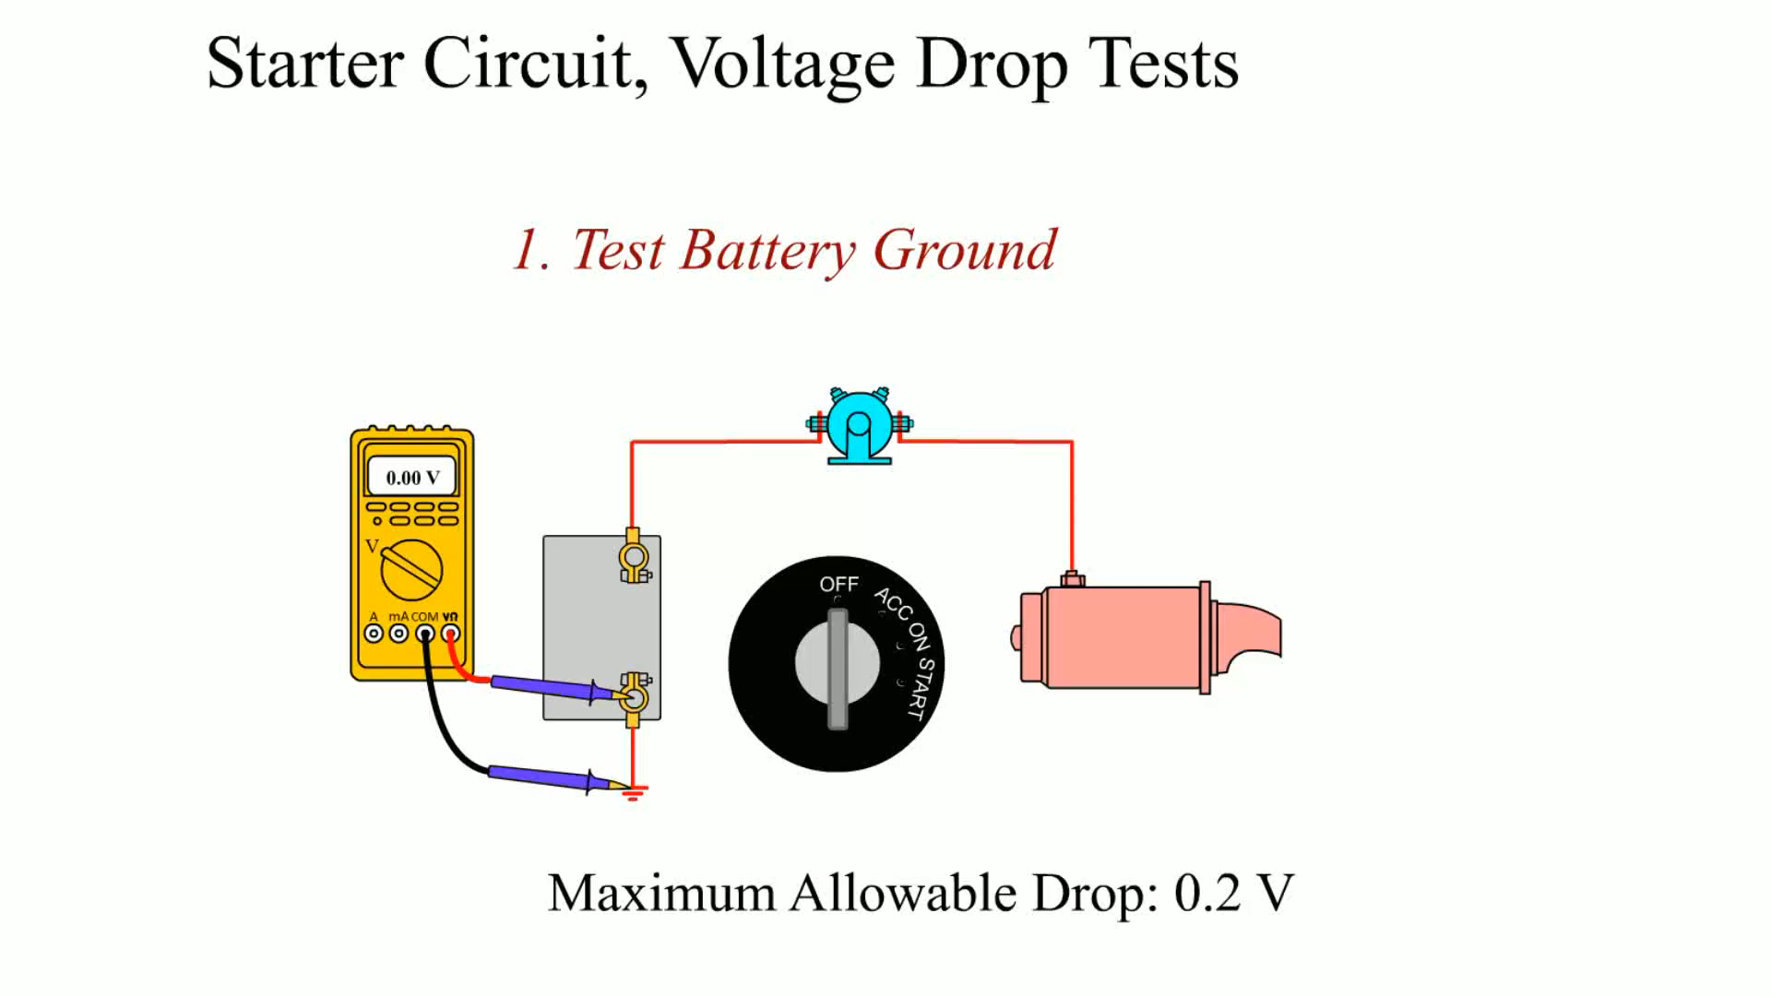
Animation: Starter Circuit, Voltage Drop Test
(The animation will automatically start in a few seconds)
Starter Circuit, Voltage Drop Test

Slide 53
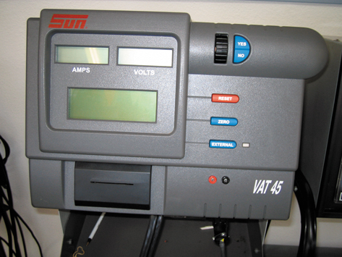
Figure 17–21 When connecting a starter tester such as a Sun VAT 45 to the vehicle, make certain that the inductive probe is placed over all of the cables or wires from the battery.

Slide 54
TESTING A STARTER USING A SCAN TOOL (1 OF 2)
Connect the scan tool according to the manufacturer's instructions.
Select battery voltage and engine RPM on the scan tool.
Select "snapshot" and start recording or graphing if the scan tool is capable.

Slide 55
TESTING A STARTER USING A SCAN TOOL (2 OF 2)
Crank the engine. Stop the scan tool recording.
Retrieve the scan data and record cranking RPM and battery voltage during cranking.

Slide 56
VOLTAGE DROP TESTING AND DRIVE-TO-FLYWHEEL CLEARANCE
Purpose of Voltage Drop Testing
Results of Excessive Voltage Drop
Performing A Voltage Drop Test
Need For Proper Clearance
  There must be a slight clearance between the starter pinion and the engine flywheel ring gear.
Checking For Proper Clearance

Slide 57
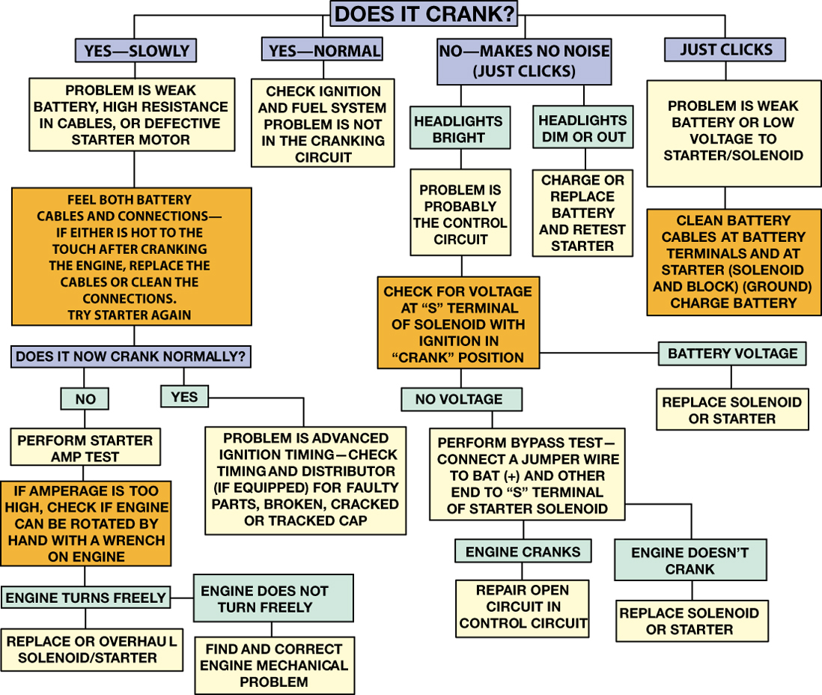
Figure 17–26 Starter diagnosis chart.

Slide 58
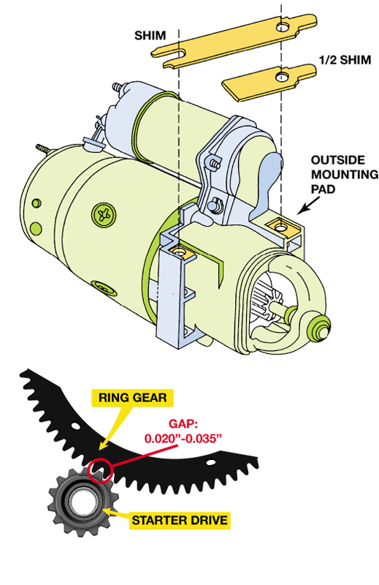
Figure 17–27 A shim (or half shim) may be needed to provide the proper clearance between the flywheel teeth of the engine and the pinion teeth of the starter.

Slide 59
CHARGING CIRCUIT (1 OF 2)
An alternator is constructed of a two-piece cast-aluminum housing.
  Aluminum is used because of its lightweight, nonmagnetic properties and heat transfer properties

Slide 60
CHARGING CIRCUIT (2 OF 2)
  A front ball bearing is pressed into the front housing to provide the support and friction reduction necessary for the belt-driven rotor assembly.
  The rear housing usually contains a roller-bearing support for the rotor and mounting for the brushes, diodes, and internal voltage regulator

Slide 61
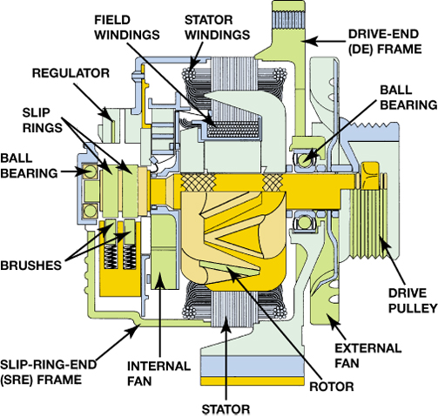
Figure 17–28 Cutaway view of a typical AC alternator.

Slide 62
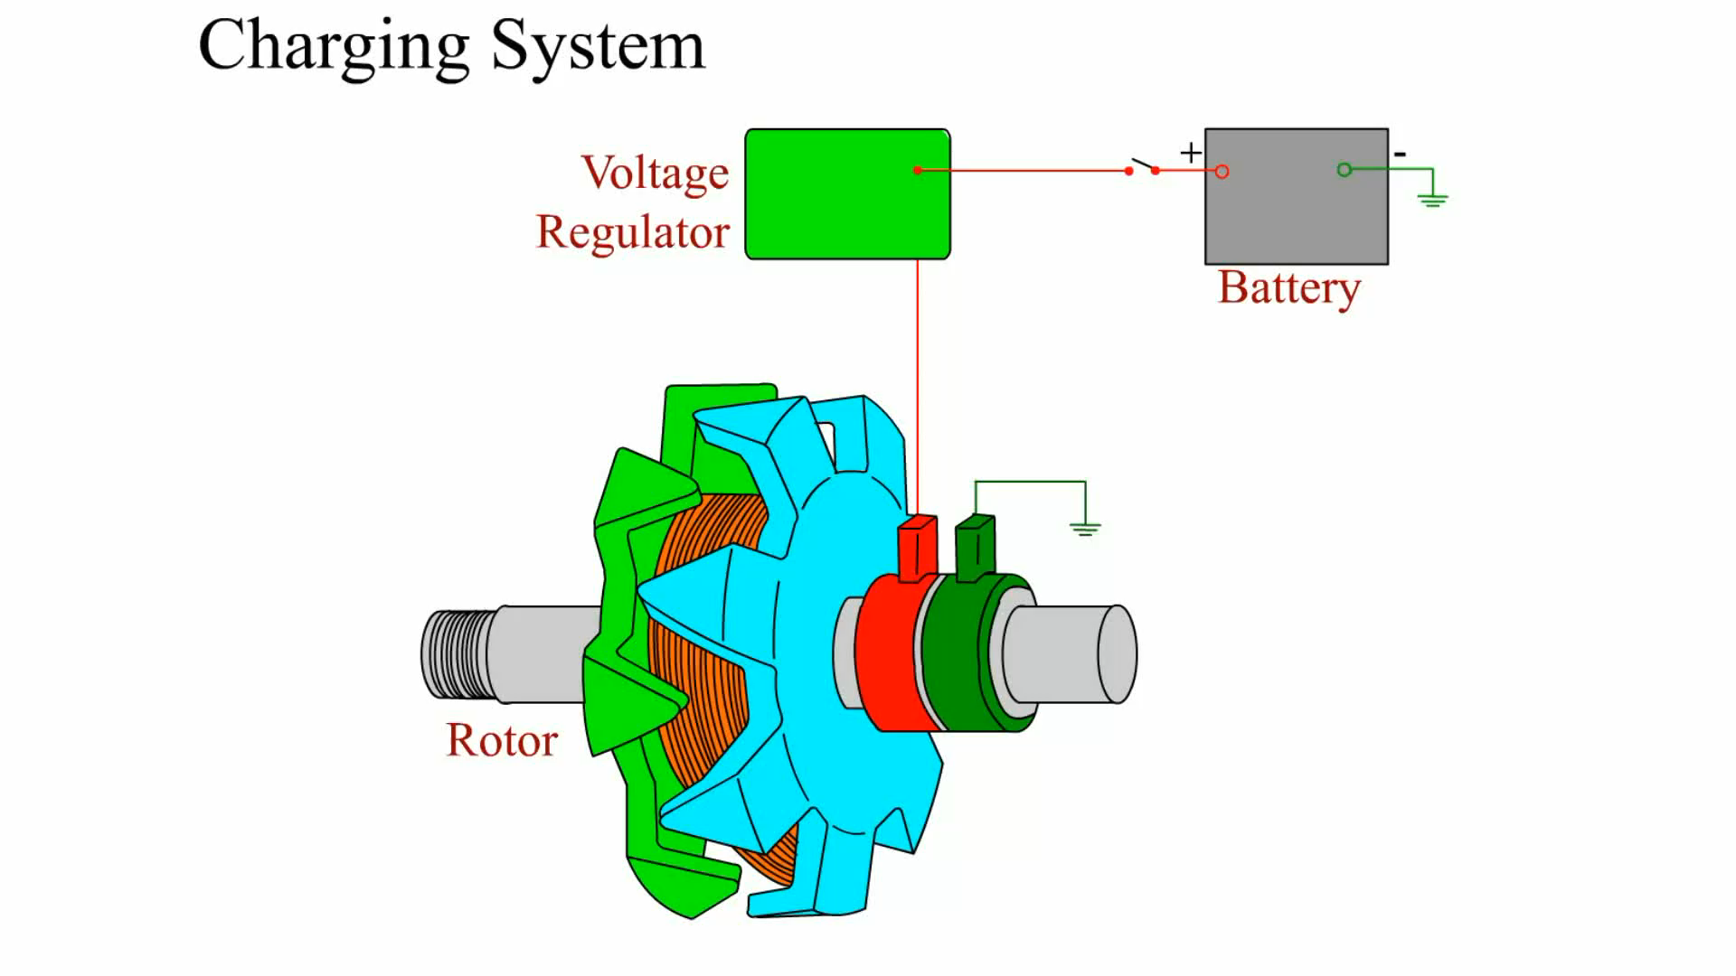
Animation: Charging System
(The animation will automatically start in a few seconds)

Slide 63
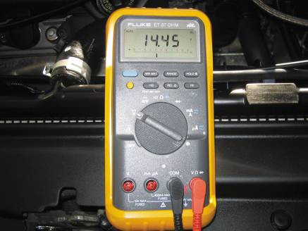
CHECKING CHARGING SYSTEM VOLTAGE
Digital Multimeter Connections
Charging System Voltage Specifications
Charging System Voltage Test Procedure
FIGURE 17–29 The digital multimeter should be set to read DC volts and the red lead connected to the battery positive (+) terminal and the black meter lead connected to the negative (-) battery terminal.

Slide 64
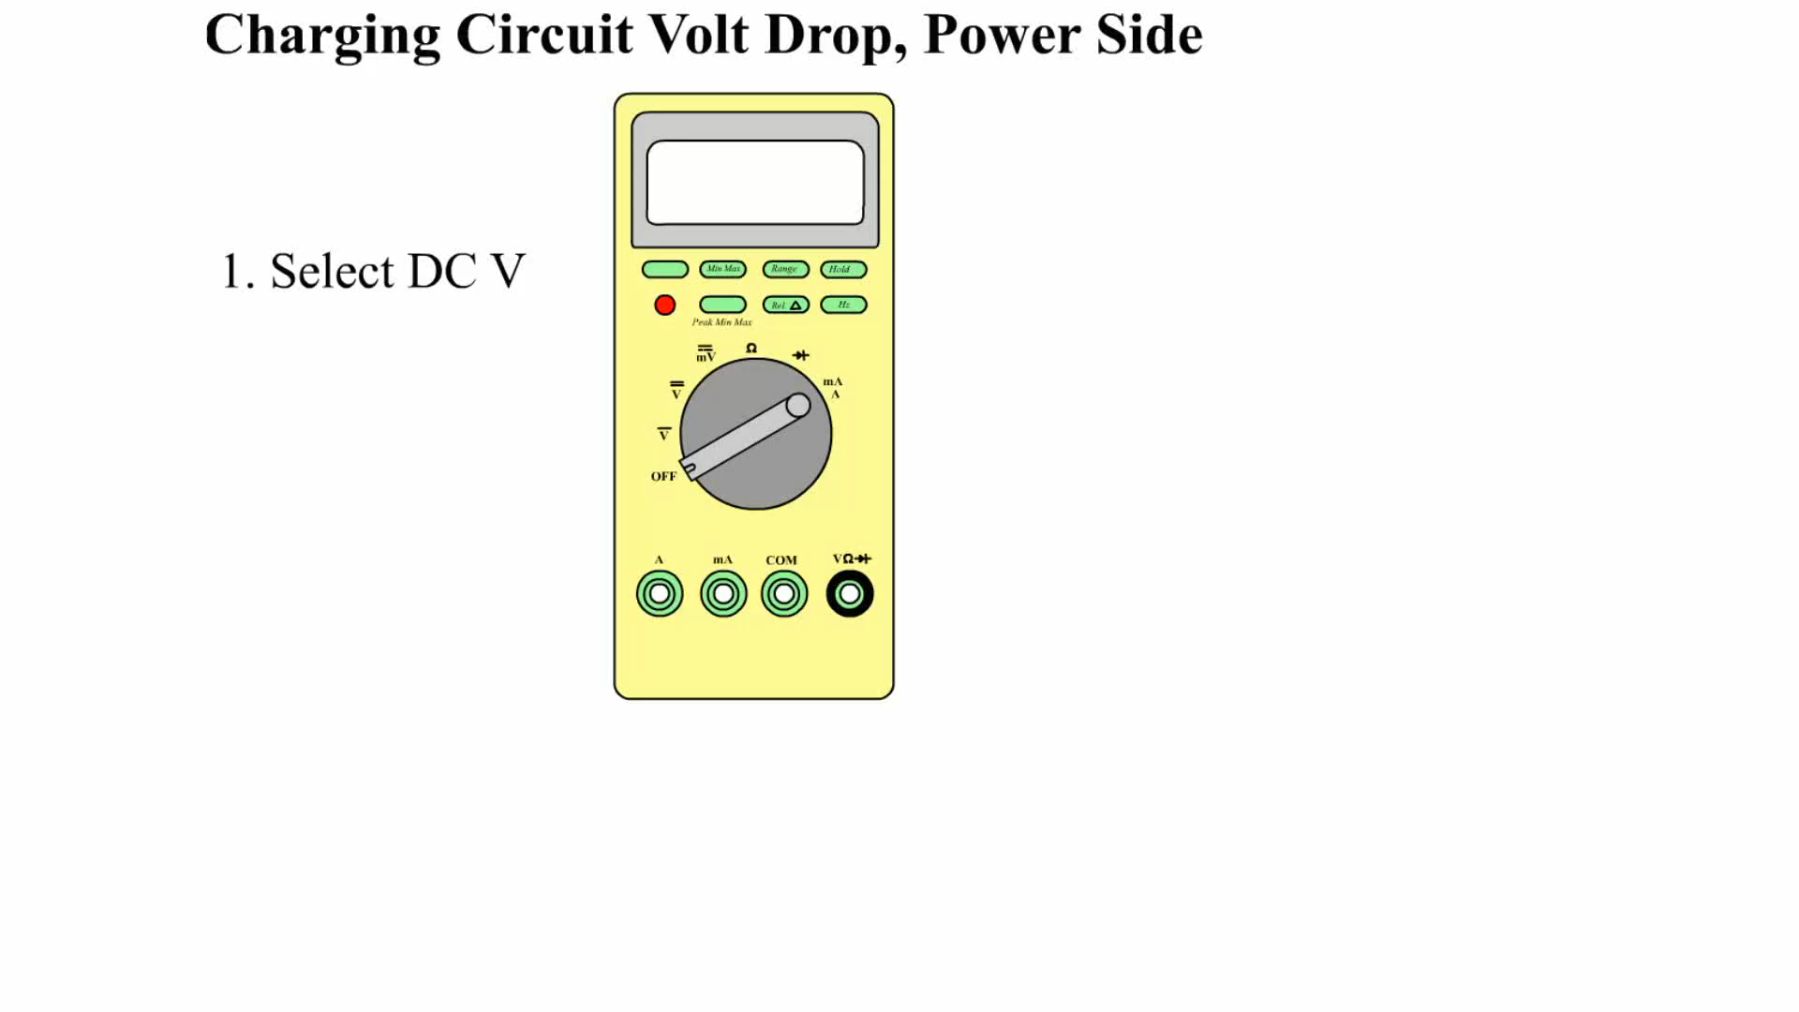
Animation: Charging Circuit Volt Drop, Power Side
(The animation will automatically start in a few seconds)

Slide 65

Animation: Charging Circuit Volt Drop, Ground Side
(The animation will automatically start in a few seconds)

Slide 66
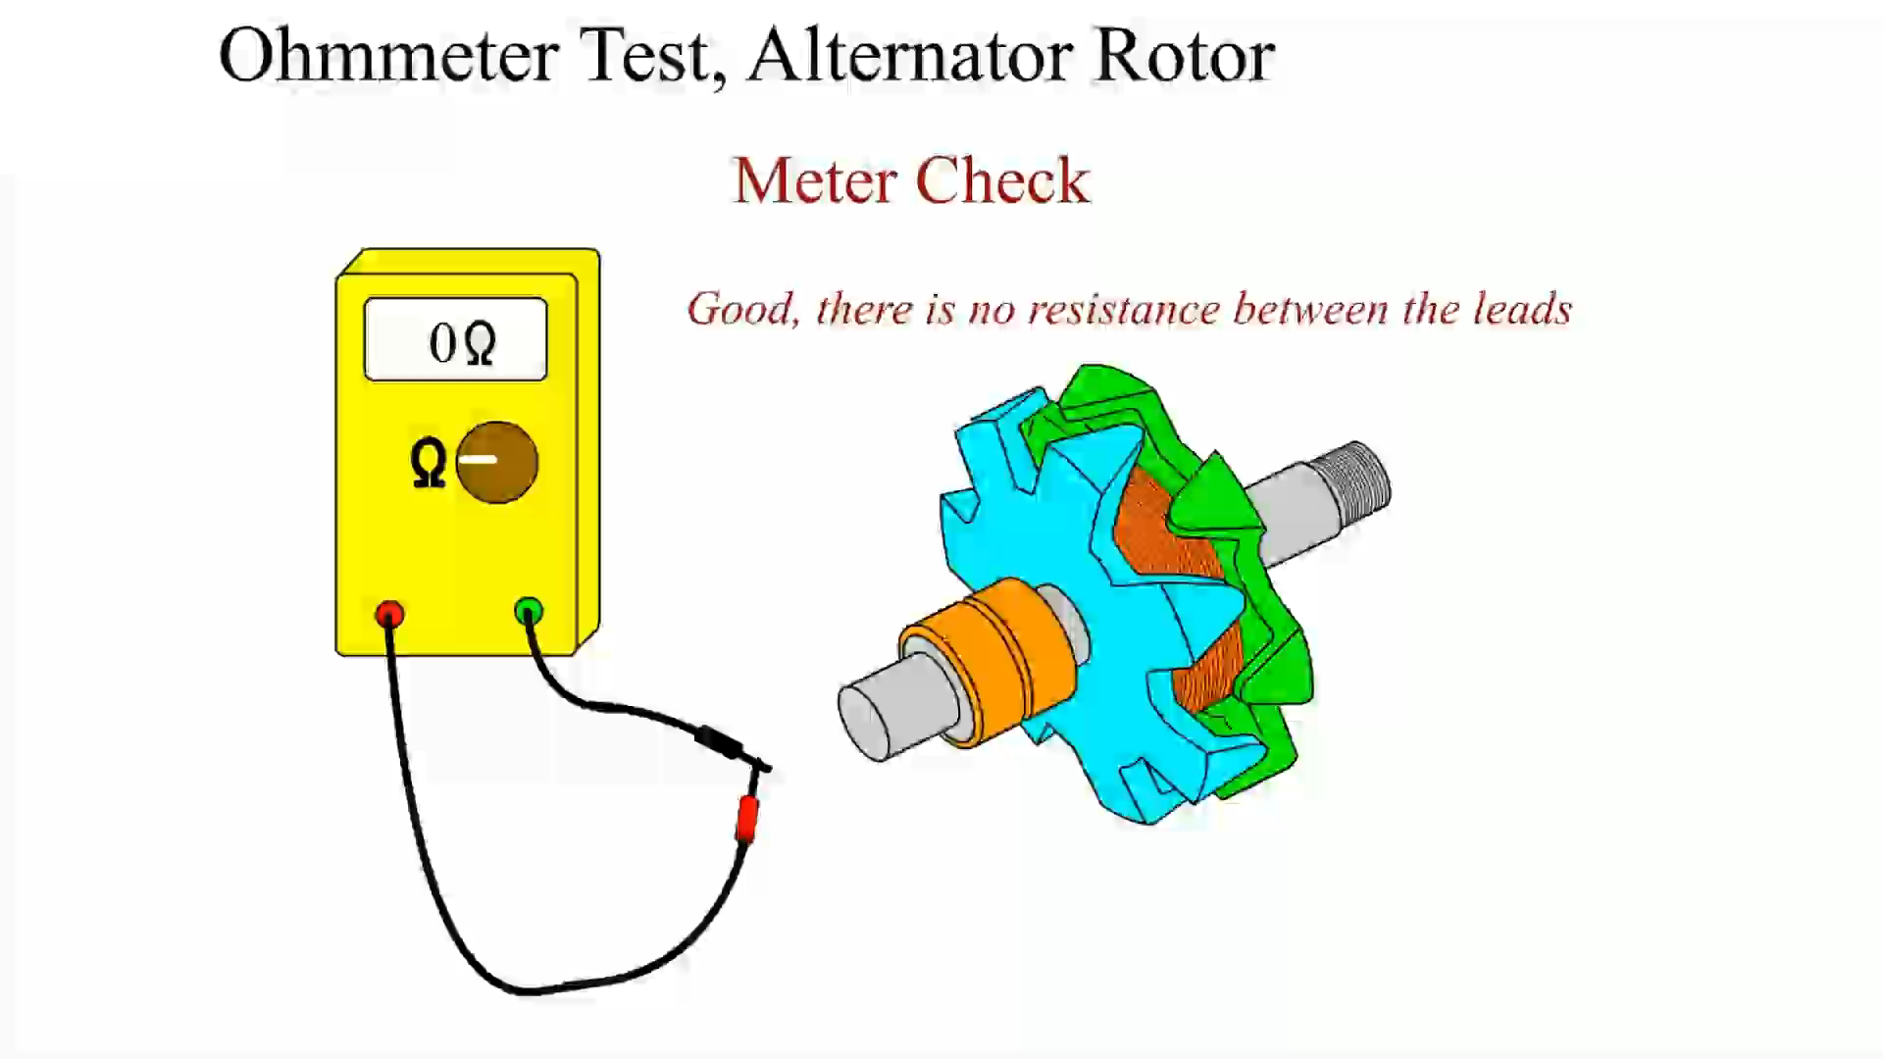
Animation: Ohmmeter Test, Alternator Rotor
(The animation will automatically start in a few seconds)

Slide 67
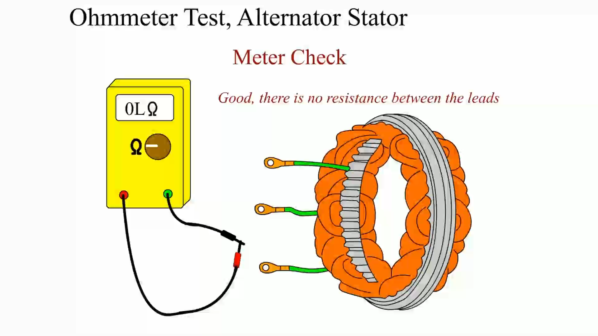
Animation: Ohmmeter Test, Alternator Stator
(The animation will automatically start in a few seconds)

Slide 68
TESTING AN ALTERNATOR USING A SCAN TOOL (1 OF 2)
A scan tool can be used on most General Motors and Chrysler Corporation vehicles and others that have datastream information.
Follow these steps:
  Connect the scan tool according to the manufacturer's instructions.

Slide 69
TESTING AN ALTERNATOR USING A SCAN TOOL (2 OF 2)
  Select battery voltage and engine RPM on the scan tool.
  Start the engine and operate at 2,000 RPM.
  Observe the battery voltage. This voltage should be between 13.5 and 15 volts (or within the manufacturer's specifications).

Slide 70
AC RIPPLE VOLTAGE CHECK AND VOLTAGE DROP TESTING (1 OF 2)
Set the digital meter to read AC volts.
Start the engine and operate it at 2,000 RPM (fast idle).
Connect the voltmeter leads to the positive and negative battery terminals.

Slide 71
AC RIPPLE VOLTAGE CHECK AND VOLTAGE DROP TESTING (2 OF 2)
Turn on the headlights to provide an electrical load on the alternator.
Purpose of Charging System Voltage Drop Testing
Charging System Voltage Drop Testing Procedure

Slide 72
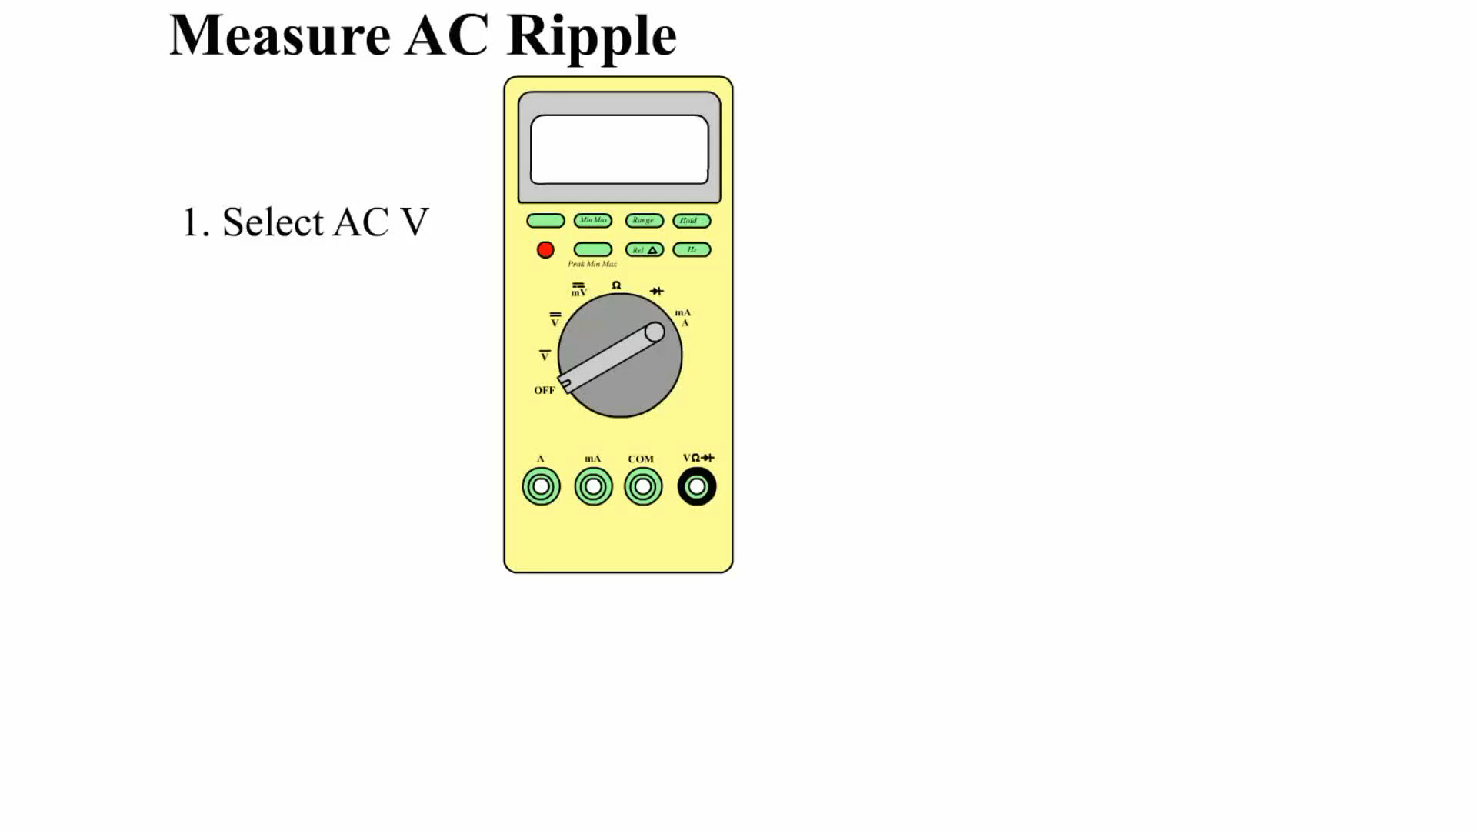
Animation: Measure AC Ripple
(The animation will automatically start in a few seconds)

Slide 73
AC CURRENT CHECK
The amount of AC current (also called ripple current) in amperes flowing from the alternator to the battery can be measured using a clamp-on digital multimeter set to read AC amperes.

Slide 74
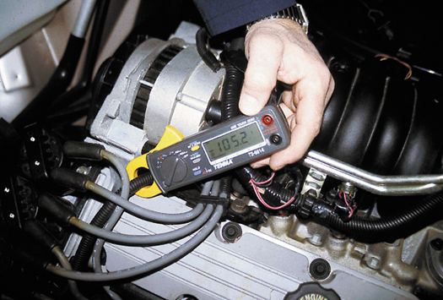
Figure 17–32 A mini clamp-on digital multimeter can be used to measure alternator output and unwanted AC current by switching the meter to read DC amperes.

Slide 75
ALTERNATOR OUTPUT TEST (1 OF 2)
Connect the starting and charging test leads according to the manufacturer's instructions.
Turn the ignition on and observe the ammeter. It should be about 2 to 8 amperes.

Slide 76
ALTERNATOR OUTPUT TEST (2 OF 2)
Start the engine and operate it at 2,000. Turn the load increase control slowly to obtain the highest reading on the ammeter scale while maintaining a battery voltage of at least 13 volts
Total the amperes from steps 2 and 3. Results should be within 10% (or 15 amperes) of the rated output.

Slide 77
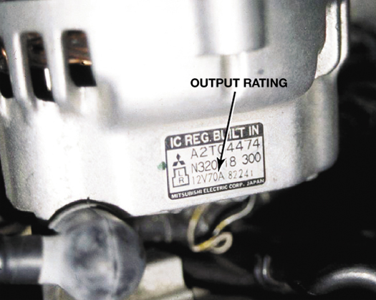
Figure 17–35 The output on this alternator is printed on a label.

Slide 78
SUMMARY (1 OF 3)
Batteries can be tested with a voltmeter to determine the state of charge.
A battery drain test should be performed if the battery runs down.
Proper operation of the starter motor depends on the battery being at least 75% charged and the battery cables being of the correct size (gauge) and having no more than a 0.2 volt drop.

Slide 79
SUMMARY (2 OF 3)
Charging system testing requires that the battery be at least 75% charged to be assured of accurate test results.
Cranking system voltage drop testing includes cranking the engine, measuring the drop in voltage from the battery to the starter, and measuring the drop in voltage from the negative terminal of the battery to the engine block.

Slide 80
SUMMARY (3 OF 3)
The cranking circuit should be tested for proper amperage draw.
An open in the control circuit can prevent starter motor operation.
To check for excessive resistance in the wiring between the alternator and the battery, perform a voltage drop test.

Slide 81
Video Links (Internet Access Required)
Starting system (time 1:05)
Starting system and wiring diagram (time 3:43)
Ignition key transponders (time 3:19)
Starter (time 5:32)
Charging system test (time 4:49)
No crank/ no start diagnostics (time 6:20)
Remote starter switch (time 3:58)
Solenoid testing (time 2:59)
Starter diagnosis (time 14:59)
Starter system voltage drop (time 1:55)

Slide 82
Video Links (Internet Access Required)
No start no crank testing (time 4:28)
Starter diagnosis (time 14:58)
Starter replacement (time 3:09)
Clutch switch (time 2:40)
Car no start (time 4:20)
Ignition switch replacement (time 4:26)
Starter test (time 8:59)
Ignition lock cylinder (time 2:29)
Starter (time 9:47)
Wiring diagram for an alternator (time 4:03)

Slide 83
Video Links (Internet Access Required)
Alternator voltage drop (time 7:48)
Alternator (time 13:52)
Alternator replacement (time 3:20)
How to test a voltage regulator (time 2:19)
Alternator replacement (time 9:40)
Alternator replacement (time 7:37)
Battery and alternator testing (time 21:08)
Electronic load detector (time 3:21)

