Slide 1
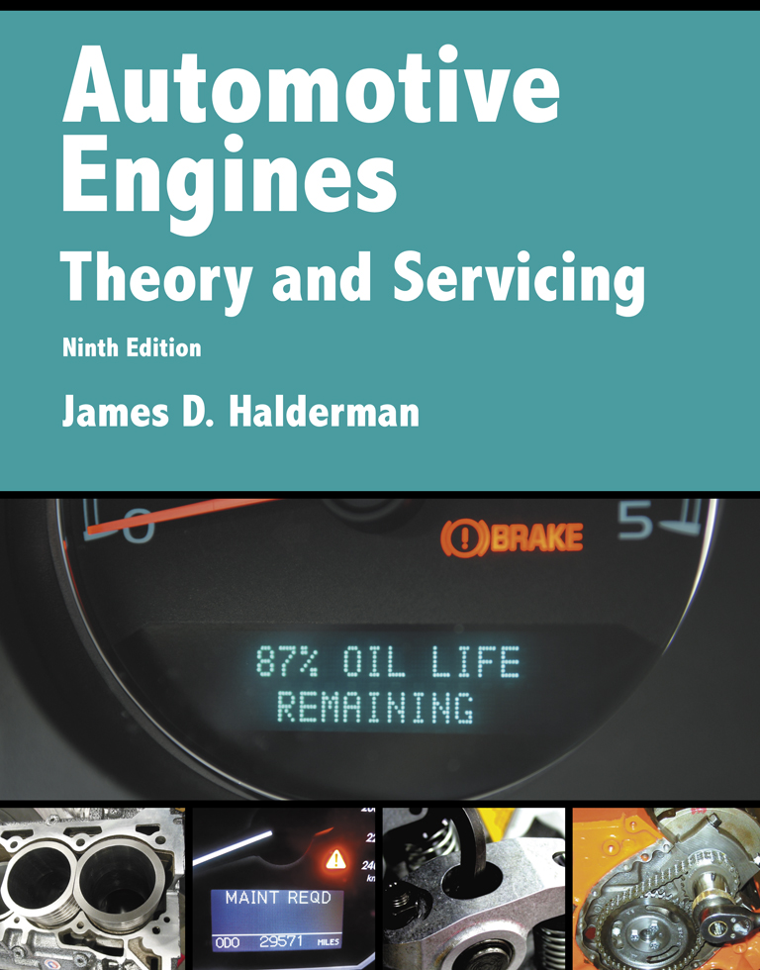
Automotive Engines Theory and Servicing
Ninth Edition
Chapter 16
Lubrication System Operation and Diagnosis

Slide 2
OBJECTIVES (1 OF 2)
16.1 Explain the purpose of the lubrication system, and state the lubrication principles.
16.2 Discuss engine lubrication systems.
16.3 Describe the purpose and function of oil pumps.

Slide 3
OBJECTIVES (2 OF 2)
16.4 Discuss the purpose and function of oil passages.
16.5 Discuss oil pans, oil coolers, and the dry sump system.

Slide 4
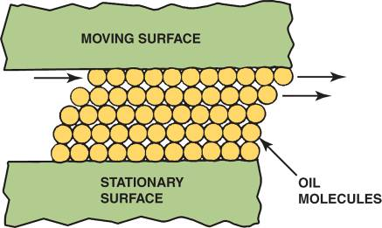
LUBRICATION PRINCIPLES (1 OF 2)
Lubrication between two moving surfaces results from an oil film that separates the surfaces and supports the load.
FIGURE 16–1 Oil molecules cling to metal surfaces but easily slide against each other.

Slide 5
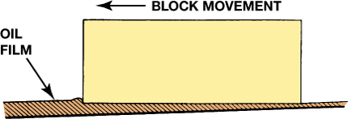
FIGURE 16–2 Wedge-shaped oil film developed below a moving block.

Slide 6
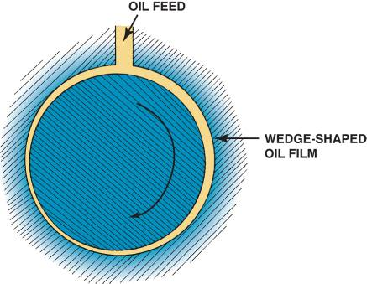
LUBRICATION PRINCIPLES (1 OF 2)
This wedging action is called hydrodynamic lubrication, and depends on the force applied to the rate of speed between the objects and the thickness of the oil.
FIGURE 16–3 Wedge-shaped oil film curved around a bearing journal.

Slide 7
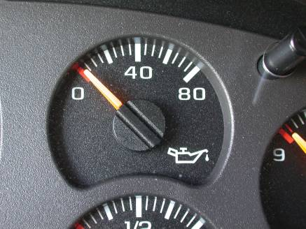
ENGINE LUBRICATION SYSTEMS
Purpose and Function
Normal Oil Pressure
Oil Temperature
FIGURE 16–4 The dash oil pressure gauge may be a good indicator of engine oil pressure. If there is any concern about the oil pressure, always use a mechanical gauge to be sure.

Slide 8
OIL PUMPS (1 OF 2)
Purpose and Function
Parts and Operation
Types of Oil Pumps
  External gear type
  Internal/external gear type
  Rotor type
  Gerotor type

Slide 9
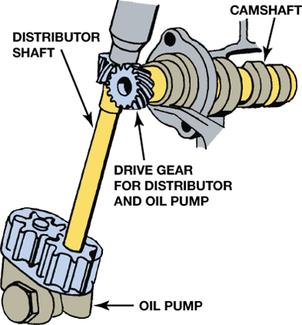
FIGURE 16–5 An oil pump driven by the camshaft.

Slide 10
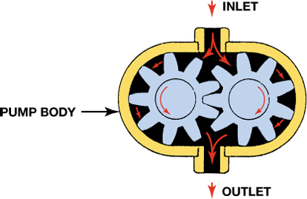
FIGURE 16–6 In an external gear-type oil pump, the oil flows through the pump around the outside of each gear. This is an example of a positive displacement pump, wherein everything entering the pump must leave the pump.

Slide 11
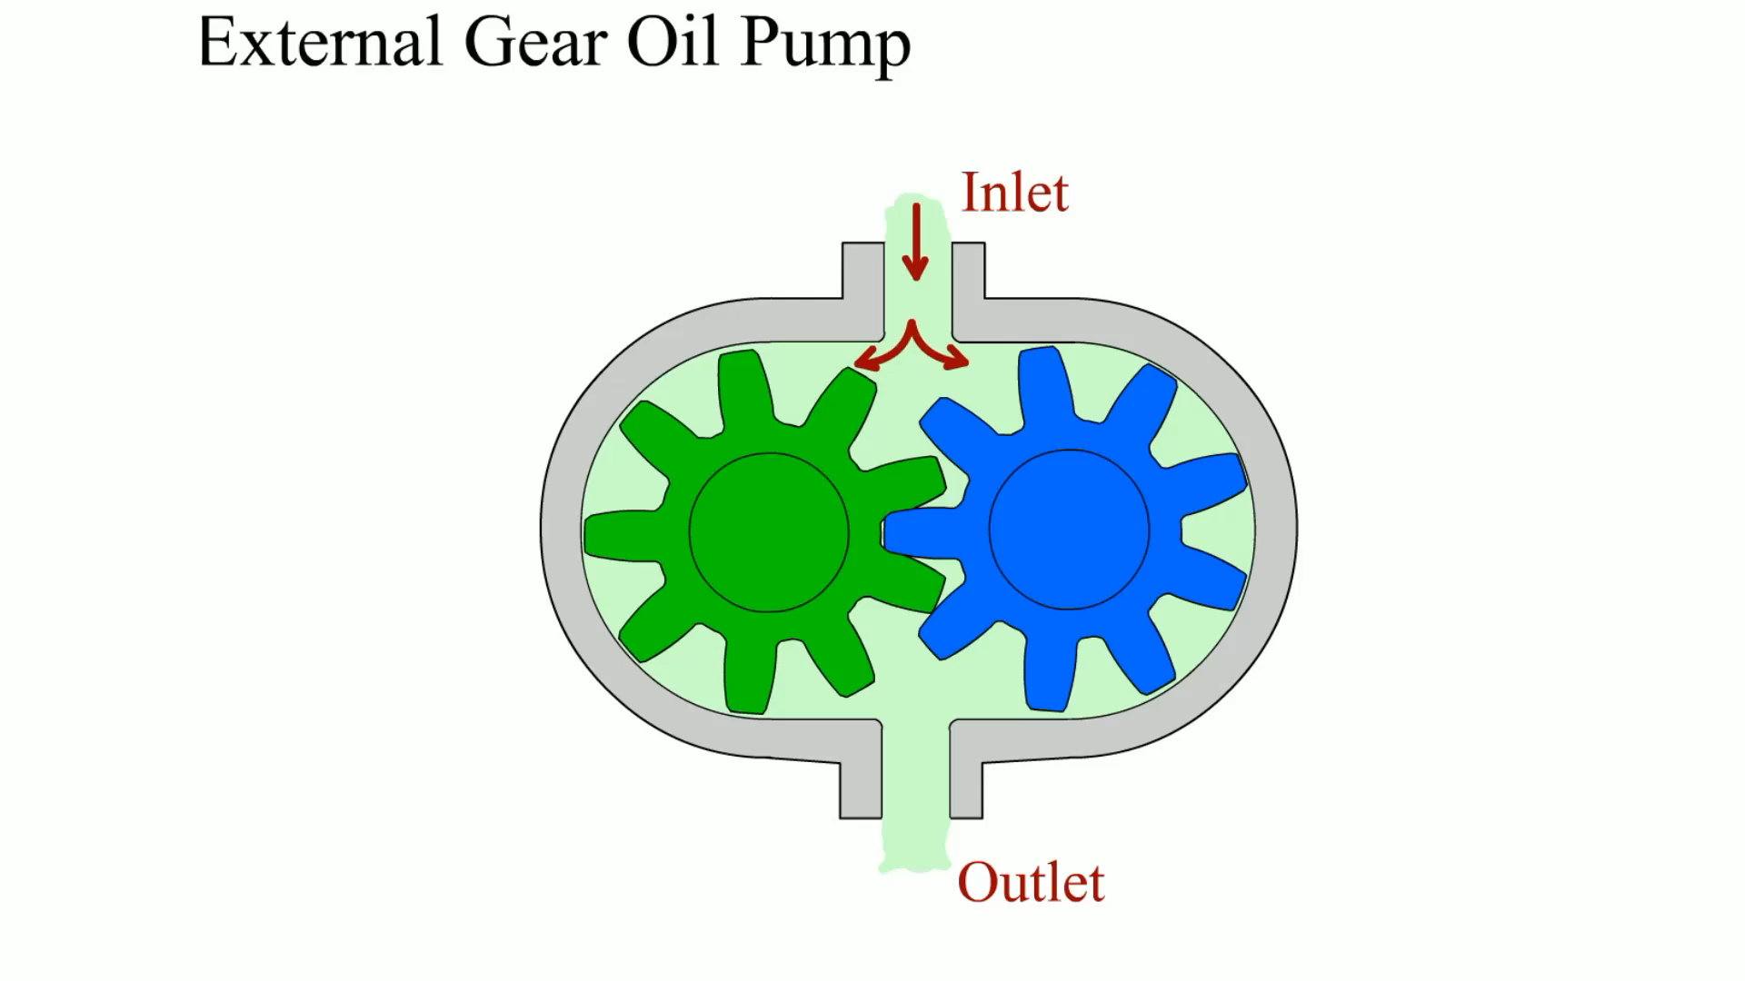
Animation: External Gear Oil Pump
(The animation will automatically start in a few seconds)

Slide 12
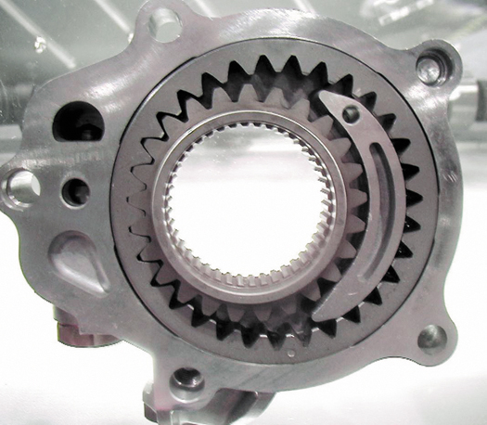
FIGURE 16–7 A typical internal/external oil pump mounted in the front cover of the engine that is driven by the crankshaft.

Slide 13
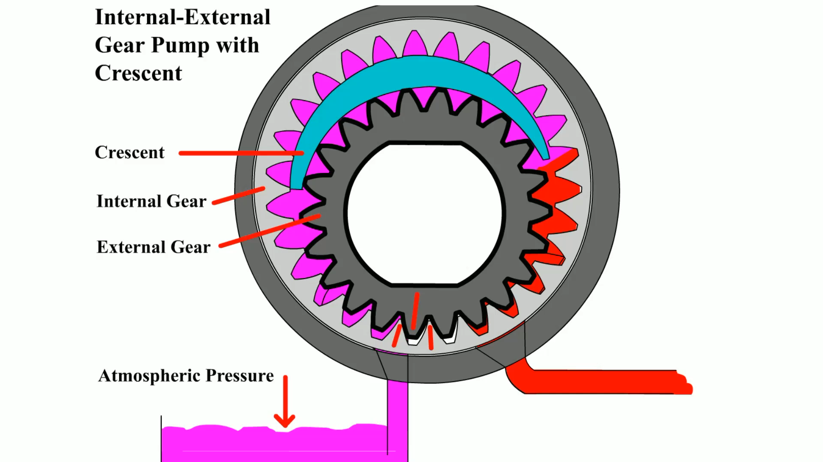
Animation: Internal-External Gear Pump with Crescent
(The animation will automatically start in a few seconds)

Slide 14
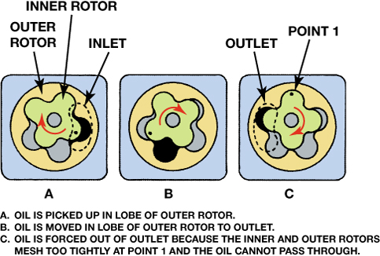
FIGURE 16–8 The operation of a rotor-type oil pump.

Slide 15
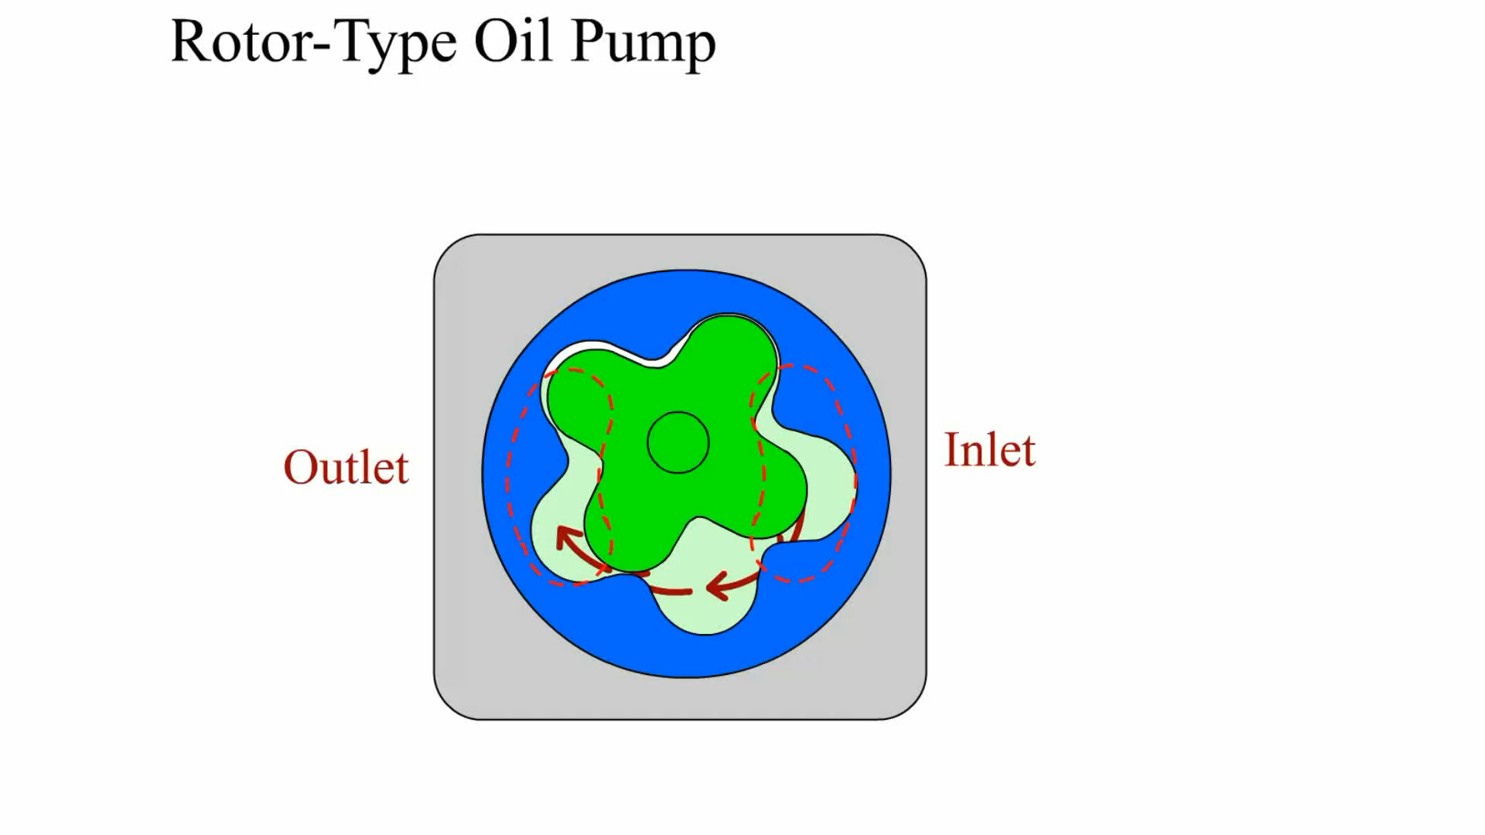
Animation: Rotor-Type Oil Pump
(The animation will automatically start in a few seconds)

Slide 16
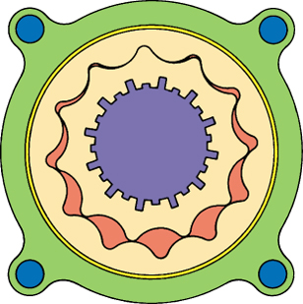
FIGURE 16–9 Gerotor-type oil pump driven by the crankshaft.

Slide 17
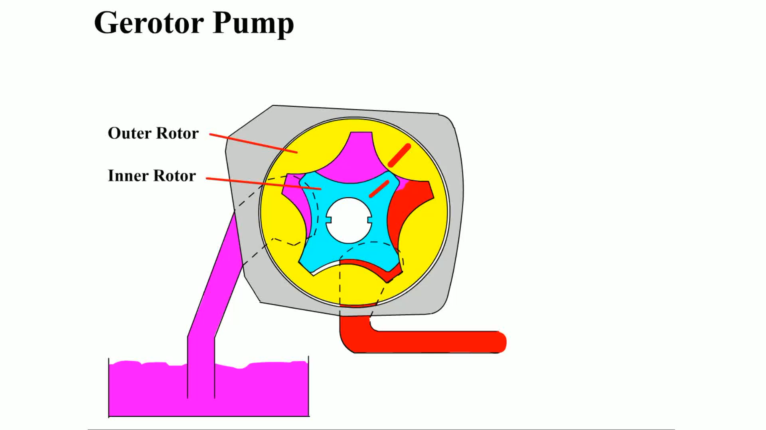
Animation: Gerotor Pump
(The animation will automatically start in a few seconds)

Slide 18
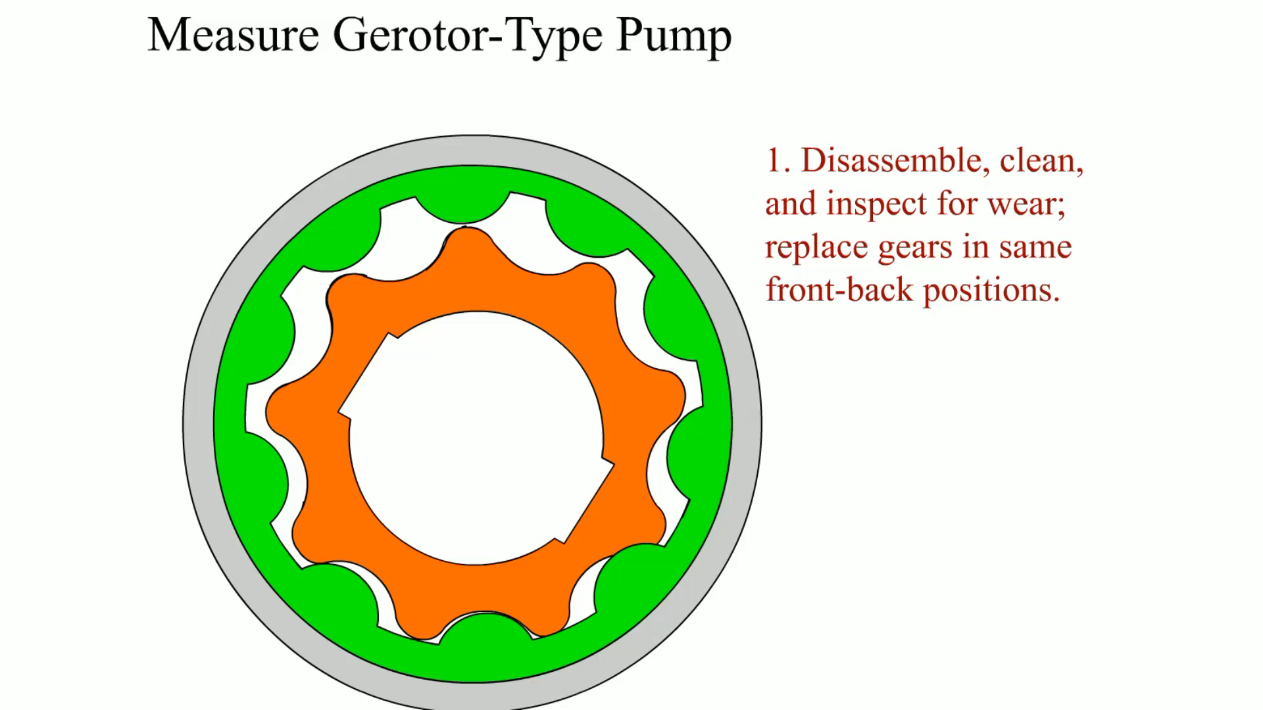
Animation: Measure Gerotor-Type Pump
(The animation will automatically start in a few seconds)

Slide 19
OIL PUMPS (2 OF 2)
Oil Pressure Regulation
Factors Affecting Oil Pressure
  Leaks
  Oil pump capacity
  Viscosity of the engine oil
Oil Pump Checks
  Visual inspection
  Measurements

Slide 20
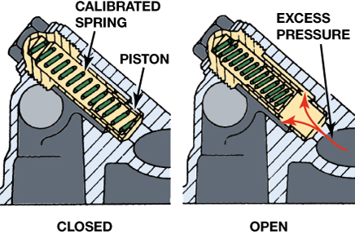
FIGURE 16–10 Oil pressure relief valves are spring loaded. The stronger the spring tension, the higher the oil pressure.

Slide 21
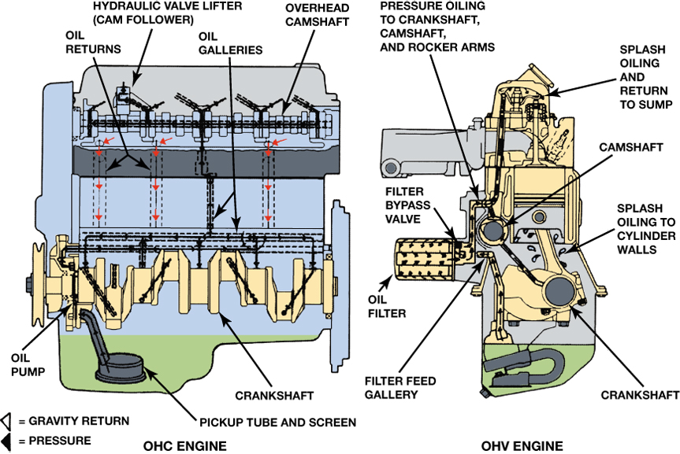
FIGURE 16–11 A typical engine design that uses both pressure and splash lubrication. Oil travels under pressure through the galleries (passages) to reach the top of the engine. Other parts are lubricated as the oil flows back down into the oil pan or is splashed onto parts.

Slide 22
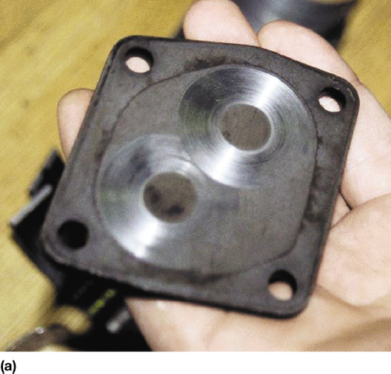
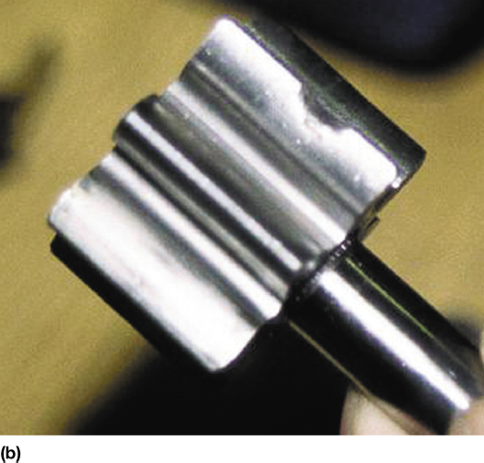
FIGURE 16–12 (a) A visual inspection indicated that this pump cover was worn. (b) An embedded particle of something was found on one of the gears, making this pump worthless except for scrap metal.

Slide 23
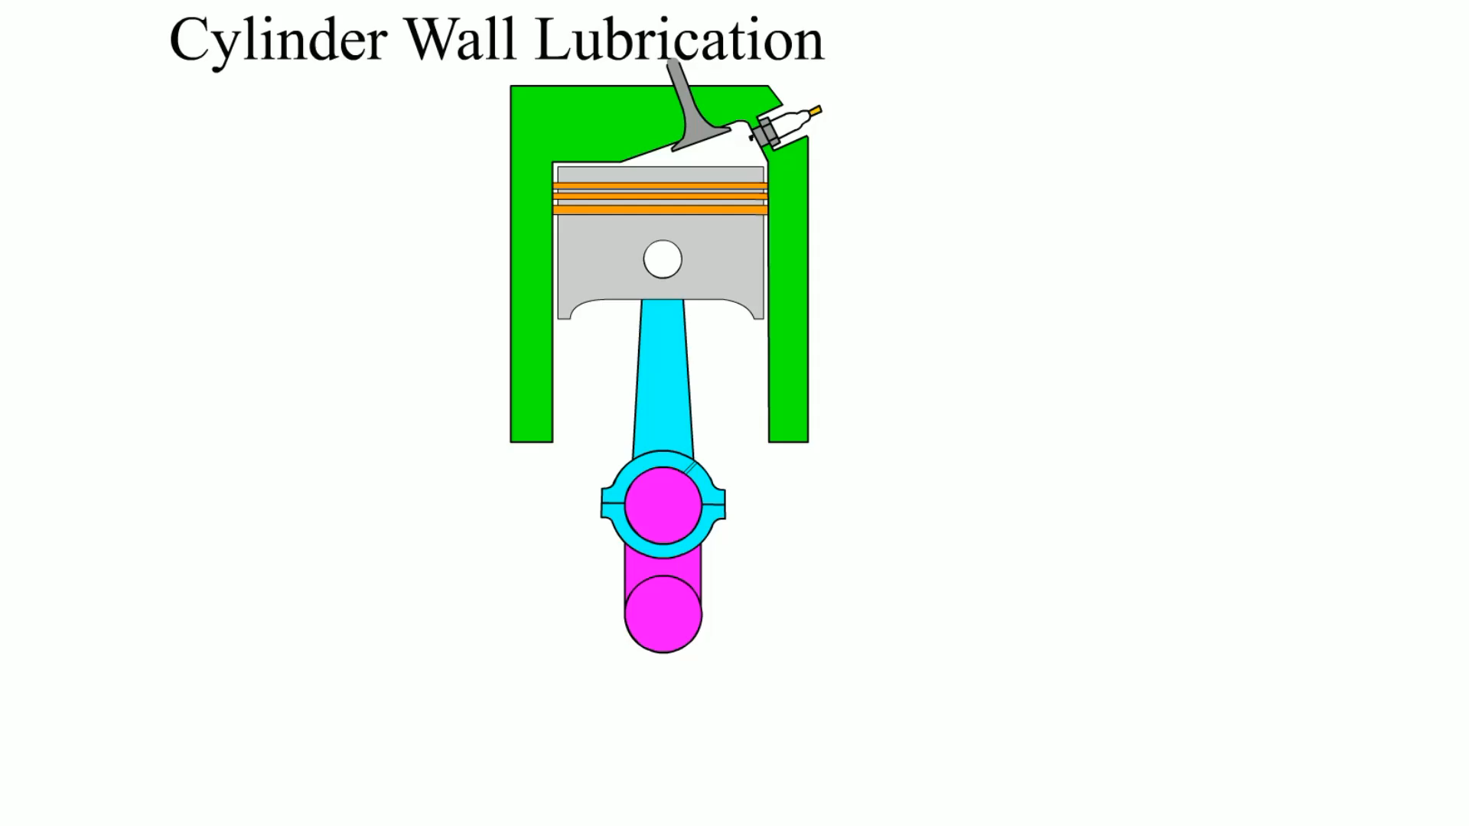
Animation: Cylinder Wall Lubrication
(The animation will automatically start in a few seconds)

Slide 24
OIL PASSAGES
Oil from the oil pump first flows through the oil filter then goes through a drilled hole that intersects with a drilled main oil gallery, or longitudinal header.
  This is a long hole drilled from the front of the block to the back.
    Inline engines use one oil gallery.
    V-type engines may use two or three galleries.

Slide 25
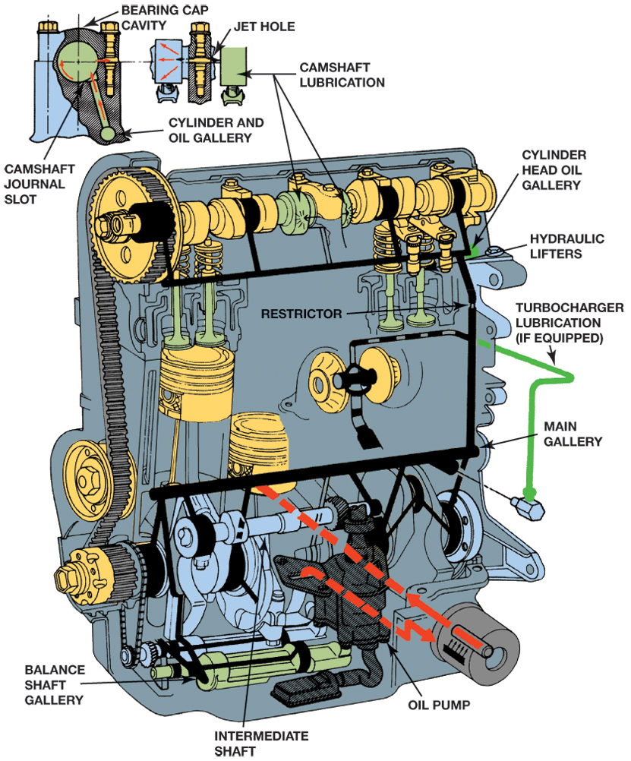
FIGURE 16–14 An intermediate shaft drives the oil pump on this overhead camshaft engine. Note the main gallery and other drilled passages in the block and cylinder head.

Slide 26
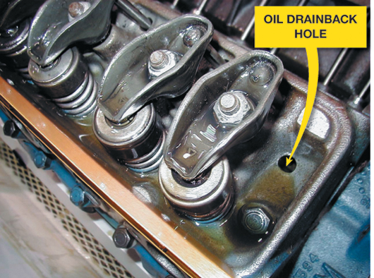
FIGURE 16–15 Oil is sent to the rocker arms on this Chevrolet V-8 engine through the hollow pushrods. The oil returns to the oil pan through the oil drainback holes in the cylinder head.

Slide 27
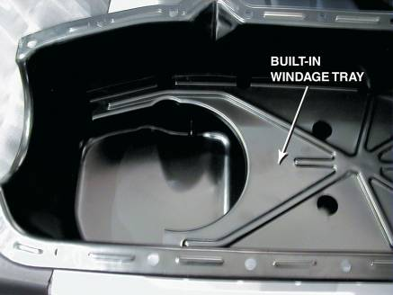
OIL PANS
The oil pan is where engine oil is used for lubricating the engine.
  Another name for the oil pan is a sump.
FIGURE 16–16 A typical oil pan with a built-in windage tray used to keep oil from being churned up by the rotating crankshaft.

Slide 28
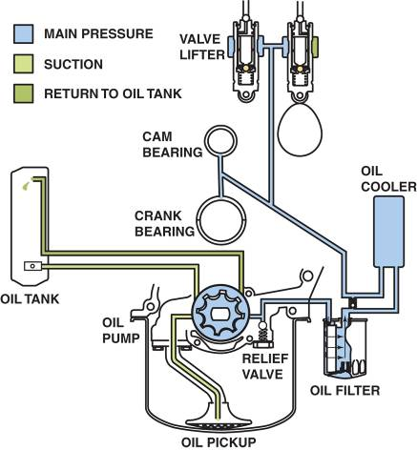
DRY SUMP SYSTEM
Construction and Operation
Advantages
Disadvantages
FIGURE 16–17 A dry sump system as used in a Chevrolet Corvette.

Slide 29
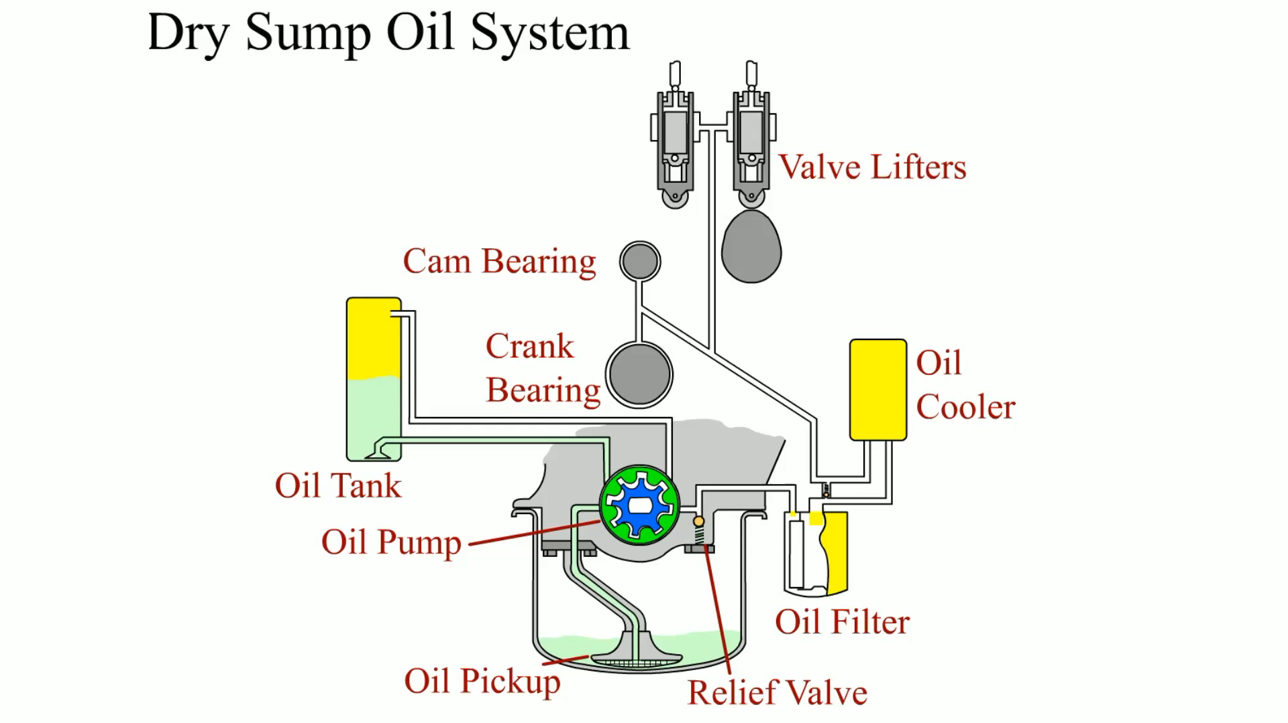
Animation: Dry Sump Oil System
(The animation will automatically start in a few seconds)

Slide 30
OIL COOLERS
Coolant flows through the oil cooler to help warm the oil when the engine is cold and cool the oil when the engine is hot.
Oil temperature should be:
  Above 212°F (100°C) to boil off any accumulated moisture
  Below 280°F to 300°F (138°C to 148°C)

Slide 31
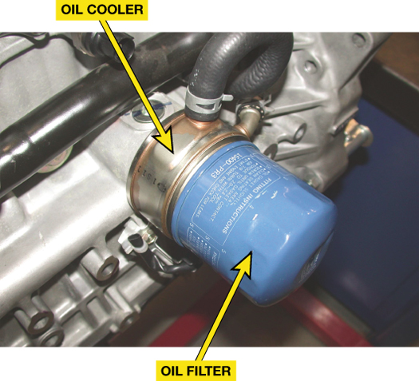
FIGURE 16–18 Oil is cooled by the flow of coolant through the oil filter adaptor.

Slide 32
SUMMARY
Viscosity is the oil's thickness or resistance to flow.
Normal engine oil pump pressure ranges from 10 to 60 PSI (200 to 400 kPa) or 10 PSI for every 1000 engine RPM.
Hydrodynamic oil pressure around engine bearings is usually over 1,000 PSI (6,900 kPa).
The oil pump is driven directly by the crankshaft or by a gear or shaft from the camshaft.

Slide 33
Video Links (Internet Access Required)
Low oil pressure (time 3:26)
Oil pressure (time 9:00)
OIL SYSTEM (time 0:54)
Priming an oil pump (time 4:39)
Oil cooler inspection (time 2:54)
Oil pump inspection (time 1:49)

