Slide 1

Automotive Engines Theory and Servicing
Ninth Edition
Chapter 15
Engine Oil

Slide 2
OBJECTIVES (1 OF 2)
15.1 Explain the purpose of engine oil and engine oil additives.
15.2 Discuss the properties of engine oil.
15.3 Discuss SAE rating, API rating, ILSAC oil rating, European oil rating system, and Japanese oil rating.

Slide 3
OBJECTIVES (2 OF 2)
15.4 Discuss synthetic oil and high mileage oils.
15.5 Discuss vehicle-specific specifications of oil.
15.6 Discuss the purpose and function of oil filters.
15.7 Describe the oil change procedure.

Slide 4
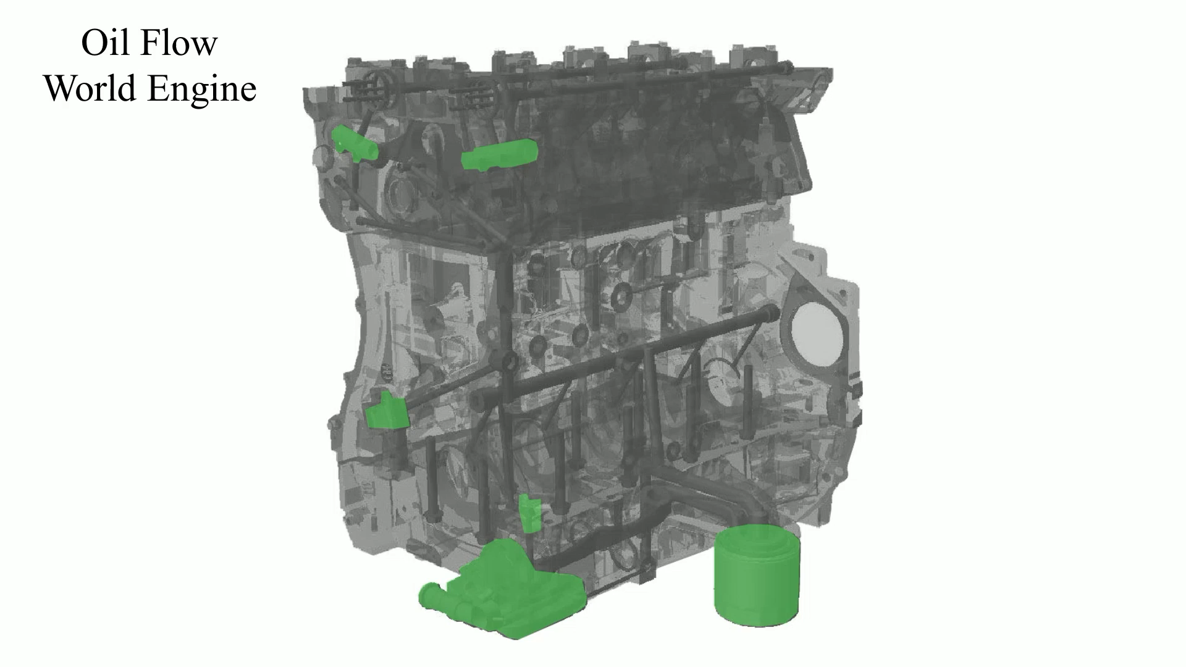
Animation: Oil Flow World Engine
(The animation will automatically start in a few seconds)

Slide 5
PROPERTIES OF ENGINE OIL (1 OF 2)
Engine oil provides the following functions in every engine.
  Lubricates moving parts; helps cool engine parts; helps seal piston rings; helps to neutralize acids created by the by-products of combustion; reduces friction in the engine; helps to prevent rust and corrosion

Slide 6
PROPERTIES OF ENGINE OIL (2 OF 2)
The most important engine oil property is its thickness or viscosity.
  As oil is cooled, it gets thicker.
  As oil is heated, it gets thinner.

Slide 7
SAE RATING (1 OF 2)
Engine oils are sold with a Society of Automotive Engineers (SAE) grade number, which indicates the viscosity range into which the oil fits.
Oils tested at 212°F (100°C) have a number with no letter following.

Slide 8
SAE RATING (2 OF 2)
An SAE 5W-30 multigrade oil meets the SAE 5W viscosity specification when cooled to 0°F (-18°C),
  And meets the SAE 30 viscosity specification when tested at 212°F (100°C).
Most vehicle manufacturers recommend the following multiviscosity engine oils.
  SAE 5W-30
  SAE 10W-30

Slide 9
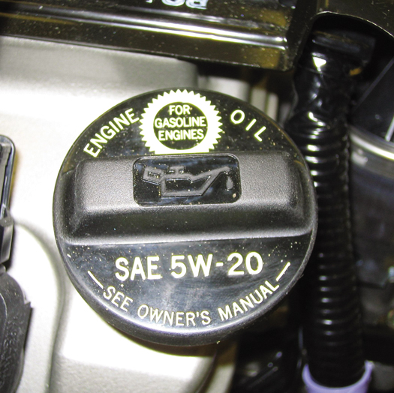
Figure 15–1 The SAE viscosity rating required is often printed on the engine oil filler cap. Most hybrid electric vehicles specify either SAE 0W-20 or SAE 5W-20 engine oil.

Slide 10
API RATING (1 OF 4)
The American Petroleum Institute (API) has established an engine oil performance classification.
  The only information available to help determine which oil is satisfactory for use in an engine.
Gasoline Engine Ratings
  SA - Straight mineral oil (no additives), not suitable for use in any engine

Slide 11

Figure 15–2 API doughnut for a SAE 5W-30, SM engine oil. When compared to a reference oil, the “energy conserving” designation indicates a 1.1% better fuel economy for SAE 10W-30 oils and 0.5% better fuel economy for SAE 5W-30 oils.

Slide 12
API RATING (2 OF 4)
Diesel Engine Ratings
  CA Obsolete
  CB Obsolete
  CC Obsolete
  CD Minimum rating for use in a diesel engine service
  CE Designed for certain turbocharged or supercharged heavy-duty diesel engine service

Slide 13
API RATING (3 OF 4)
Diesel Engine Ratings
  CF For off-road indirect injected diesel engine service
  CF-2 Two-stroke diesel engine service
  CF-4 High-speed four-stroke cycle diesel engine service
  CG-4 Severe-duty high-speed four-stroke diesel engine service

Slide 14
API RATING (4 OF 4)
  CI-4 Severe-duty high-speed four-stroke diesel engine service
  CJ-4 Required for use in all 2007 and newer diesels using ultra-low-sulfur diesel (ULSD) fuel

Slide 15
ILSAC OIL RATING (1 OF 2)
The International Lubricant Standardization and Approval Committee (ILSAC) developed an oil rating that consolidates the SAE viscosity rating and the API quality rating.
If an engine oil meets the standards, a "starburst" symbol is displayed on the front of the oil container.

Slide 16
ILSAC OIL RATING (2 OF 2)
The original GF-1 (gasoline fueled) rating in 1993
Updated to GF-2 in 1997
Updated to GF-3 in 2000
Updated to GF-4 in 2004
Updated to GF-5 in 2010

Slide 17
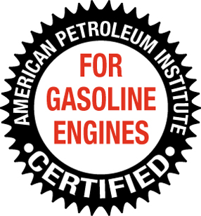
Figure 15–3 The International Lubricant Standardization and Approval Committee (ILSAC) starburst symbol. If this symbol is on the front of the container of oil, then it is acceptable for use in almost any gasoline engine.

Slide 18
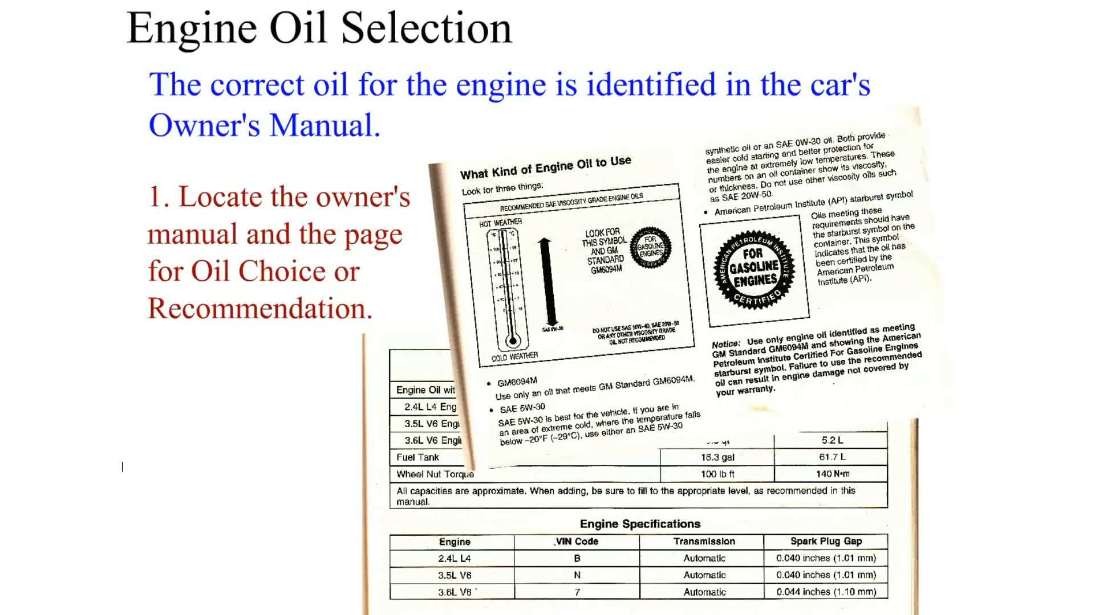
Animation: Engine Oil Selection
(The animation will automatically start in a few seconds)

Slide 19
EUROPEAN OIL RATING SYSTEM
How are gasoline engine oils and diesel engine oils rated?
Starting in 2004, the ACEA began using combined ratings such as A1/B1, A3/B3, A3/B4, and A5/B5.

Slide 20
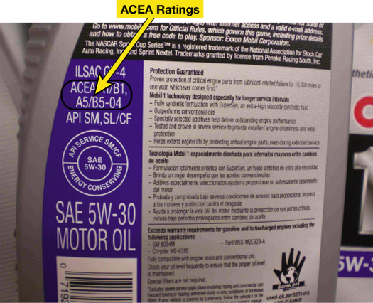
Figure 15–4 ACEA ratings are included on the back of the oil container if it meets any of the standards. ACEA ratings apply to European vehicles only such as BMW, Mercedes, Audi, and VW.

Slide 21
ENGINE OIL ADDITIVES (1 OF 2)
Oil producers are careful to check the compatibility of the oil additives they use.
  A number of chemicals that will help each other can be used for each of the additive requirements.

Slide 22
ENGINE OIL ADDITIVES (2 OF 2)
The balanced additives are called an additive package.
  Additives to Improve the Base Oil
  Additives to Protect the Base Oil
  Additives to Protect the Engine

Slide 23
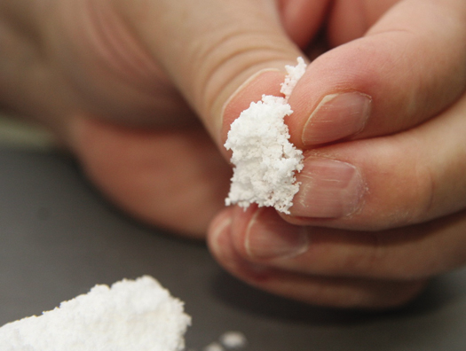
Figure 15–5 Viscosity index (VI) improver is a polymer and feels like finely ground foam rubber. When dissolved in the oil, it expands when hot to keep the oil from thinning.

Slide 24
OIL BRAND COMPATIBILITY
Many technicians and vehicle owners have their favorite brand of engine oil.
The choice is often made as a result of marketing and advertising, as well as comments from friends, relatives, and technicians.

Slide 25
SYNTHETIC OIL (1 OF 3)
Synthetic engine oils have been available for years for military, commercial, and general public use.
  Synthetic means that it is a manufactured product and not refined from a naturally occurring substance, as engine oil (petroleum base) is refined from crude oil.
  Synthetic oil is processed from several different base stocks using several different methods.

Slide 26
SYNTHETIC OIL (2 OF 3)
According to the American Petroleum Institute, engine oil is classified into the following groups.
  Group I
  Group II
  Group III
  Group IV
  Group V

Slide 27
SYNTHETIC OIL (3 OF 3)
Advantages of Synthetics
Disadvantages of Synthetics
Synthetic Blends
FIGURE 15–8 Both oils have been cooled to -20°F (-29°C). Notice that the synthetic oil on the left flows more freely than the mineral oil on the right even though both are SAE 5W-30.

Slide 28
VEHICLE-SPECIFIC SPECIFICATIONS
Some oils can meet industry specifications, such as SAE, API, and/or ILSAC ratings, but not pass the tests specified by the vehicle manufacturer.

Slide 29
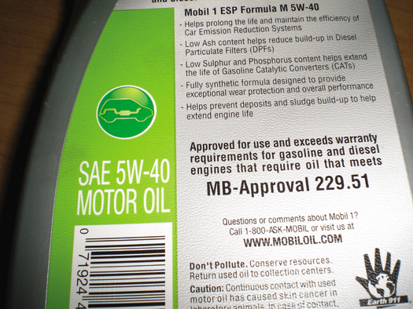
Figure 15–9 European vehicle manufacturers usually specify engine oil with a broad viscosity range, such as SAE 5W-40, and their own unique standards, such as the Mercedes specification 229.51. Always use the oil specified by the vehicle manufacturer.

Slide 30
HIGH MILEAGE OILS
What is high mileage oil?
What makes it different?

Slide 31
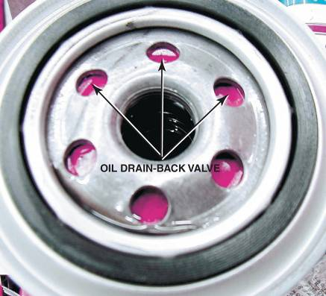
OIL FILTERS
Construction
Oil Filter Valves
Oil Filter Disposal
FIGURE 15–10 A rubber diaphragm acts as an antidrainback valve to keep the oil in the filter when the engine is stopped and the oil pressure drops to zero.

Slide 32
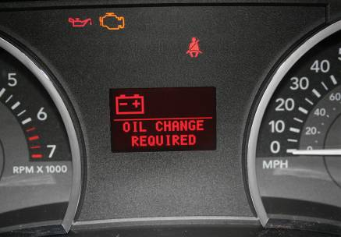
OIL CHANGE
Intervals
Oil Life Monitors
Oil Change Procedure
FIGURE 15–13 Many vehicle manufacturers can display the percentage of oil life remaining, whereas others simply turn on a warning lamp when it has been determined that an oil change is required.

Slide 33
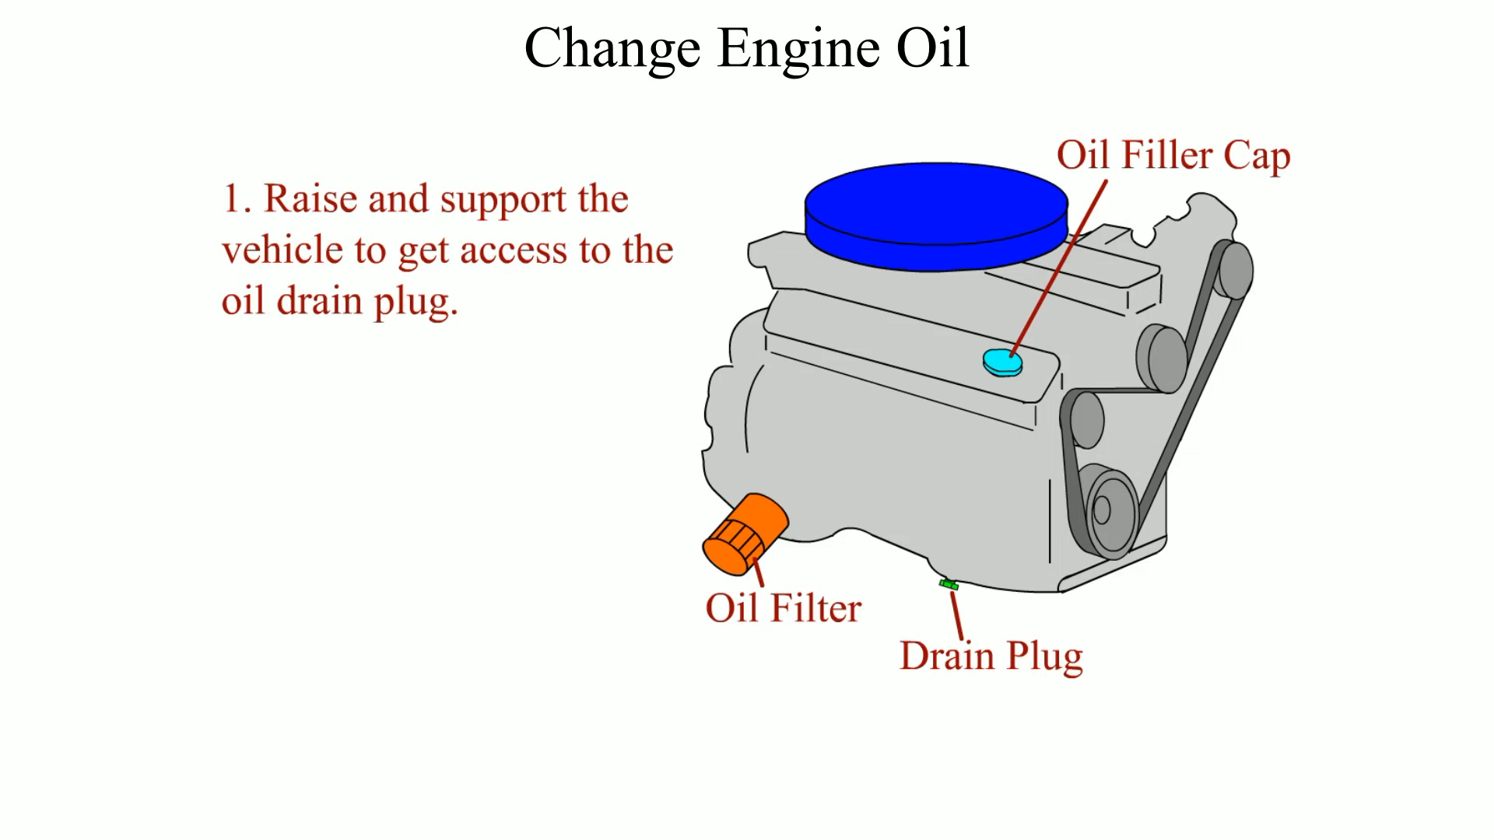
Animation: Change Engine Oil
(The animation will automatically start in a few seconds)

Slide 34

1 Before entering the customer’s car for the first time, be sure to install a seat cover as well as a steering wheel cover to protect the vehicle’s interior.

Slide 35
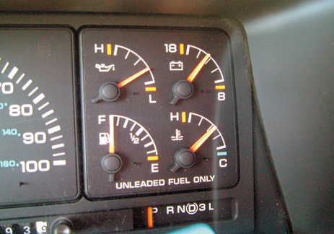
2 Run the engine until it is close to operating temperature. This will help the used oil drain more quickly and thoroughly.

Slide 36
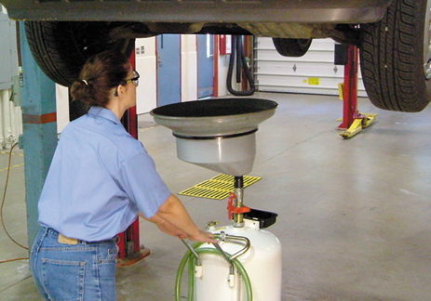
3 Raise the vehicle on a hoist, and place the oil drain container in position under the oil drain plug. Be sure to wear protective gloves.

Slide 37
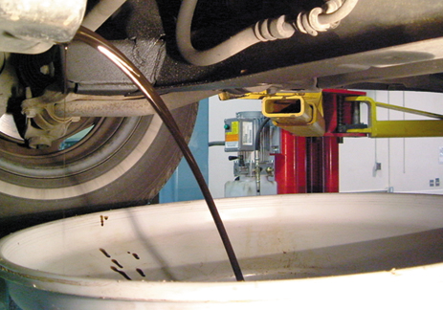
4 Remove the plug and allow the hot oil to drain from the engine. Use caution during this step as hot oil can cause painful burns!

Slide 38
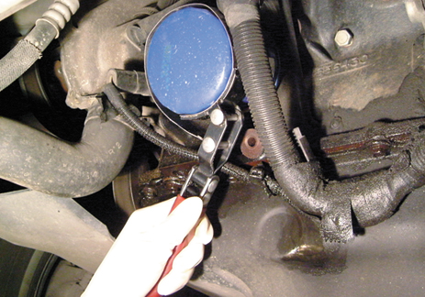
5 While the engine oil continues to drain, remove the engine oil filter using a filter wrench. Some oil will drain from the filter, so be sure to have the oil drain container underneath when removing it.

Slide 39
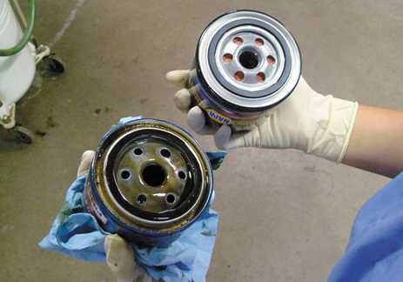
6 Compare the new oil filter with the old one to be sure that it is the correct replacement.

Slide 40
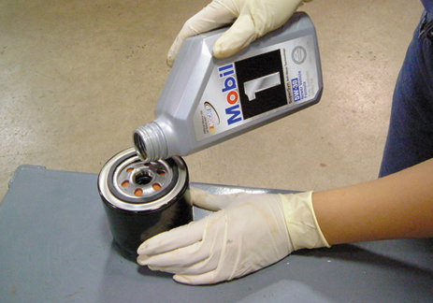
7 The wise service technician adds oil to the oil filter whenever possible. This provides faster filling of the filter during start-up and a reduced amount of time that the engine does not have oil pressure.

Slide 41
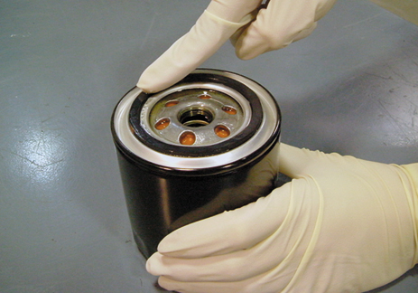
8 Apply a thin layer of clean engine oil to the gasket of the new filter. This oil film will allow the rubber gasket to slide and compress as the oil filter is being tightened.

Slide 42
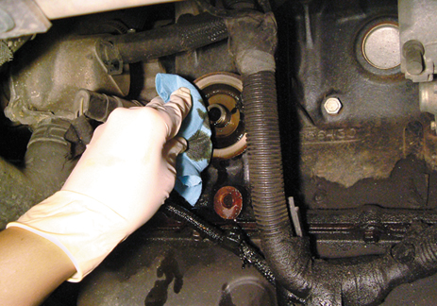
9 Clean the area where the oil filter gasket seats to be sure that no part of the gasket remains that could cause an oil leak if not fully removed.

Slide 43
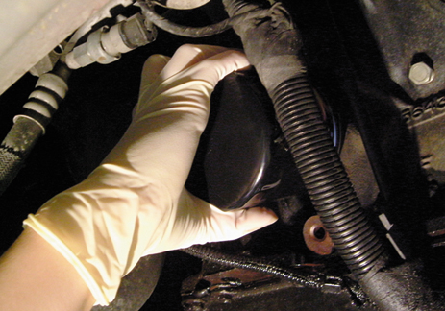
10 Install the new oil filter and tighten it by hand. Do not use an oil filter wrench to tighten the filter! Most filters should be tightened 3/4 of a turn after the gasket contacts the engine.

Slide 44
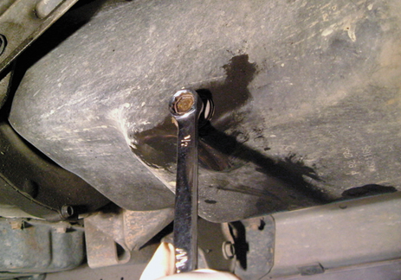
11 Carefully inspect the oil drain plug and gasket. Replace the gasket as needed. Install the drain plug and tighten firmly but do not overtighten!

Slide 45
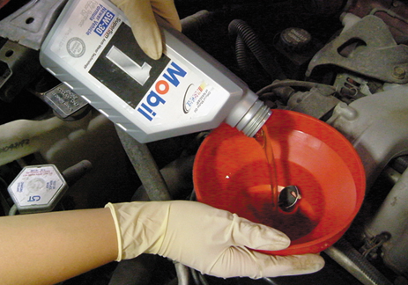
12 Use a funnel to add the specified amount of oil to the engine at the oil fill opening. When finished, replace the oil fill cap.

Slide 46
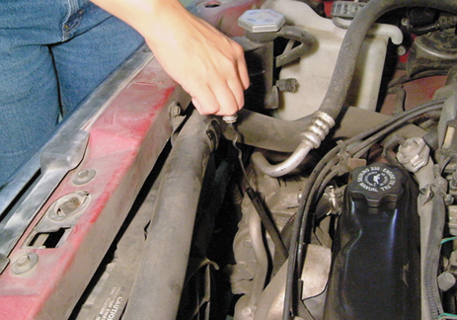
13 Remove the oil-level dipstick and wipe it clean with a shop cloth. Reinstall the oil-level dipstick. Remove the dipstick a second time and read the oil level.

Slide 47
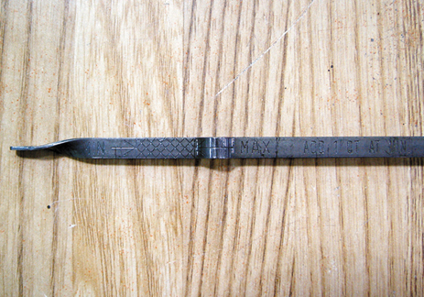
14 The oil level should be between the MIN and the MAX lines. In this case, the oil level should be somewhere in the cross-hatched area of the dipstick.

Slide 48
SUMMARY (1 OF 2)
Viscosity is the oil's thickness or resistance to flow.
SAE rating measures the viscosity of the oil.
API ratings reflect the quality of the oil.
The ILSAC rating symbol on the front of the container helps consumers find oil suitable for use in most gasoline engines.
Most vehicle manufacturers recommend use of SAE 5W-30 or SAE 10W-30 engine oil.

Slide 49
SUMMARY (2 OF 2)
Many vehicle manufacturers provide specific oil standards for their vehicles.
Most vehicle manufacturers recommend changing the engine oil every six months or every 7,500 miles (12,000 km), whichever comes first.
  Most experts recommend changing the engine oil every 3,000 miles (5,000 km), or every three months, to help ensure long engine life.

Slide 50
Video Links (Internet Access Required)
How Engine Lubrication System Works (time 3:26)
What Is an Indication of Bad Engine Oil? (time 2:14)

