Slide 1
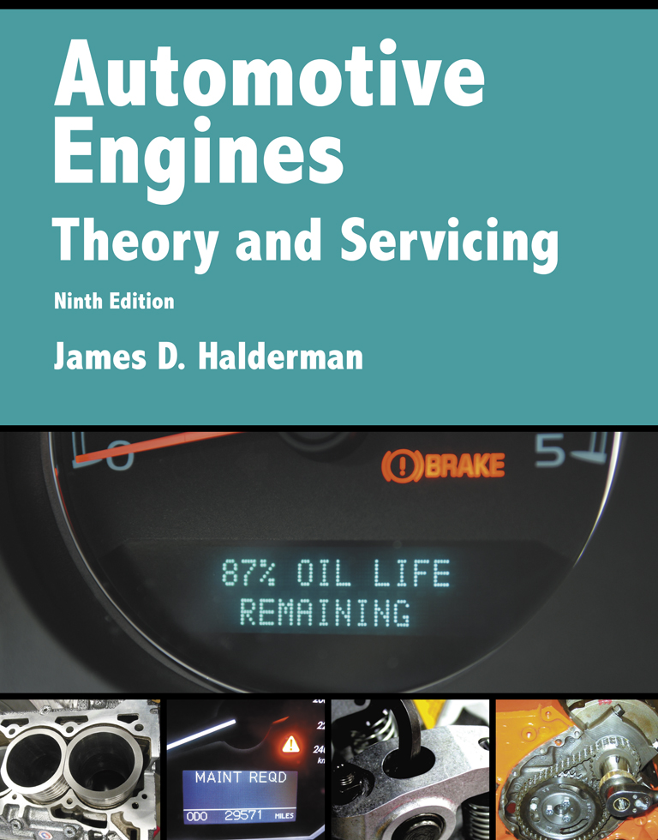
Automotive Engines Theory and Servicing
Ninth Edition
Chapter 14
Cooling System Operation and Diagnosis

Slide 2
OBJECTIVES
14.1 Explain the purpose and function of the cooling system, and cooling system operation.
14.2 Explain the purpose of thermostats, radiators, pressure caps, and water pumps.
14.3 Explain coolant flow in the engine and coolant recovery systems.
14.4 Explain the purpose of cooling fans and heater cores.

Slide 3
OBJECTIVES
14.5 Describe cooling system testing and explain the purpose of coolant temperature warning light.
14.6 Explain cooling system inspection and cooling system service.

Slide 4
COOLING SYSTEM (1 OF 2)
Satisfactory cooling system operation depends on the design and operating conditions of the system.
The design is based on heat output of the engine, radiator size, type of coolant, size of water pump, type of fan, thermostat, and system pressure.
The cooling system must allow the engine to warm up to the required operating temperature as rapidly as possible and then maintain that temperature.

Slide 5
COOLING SYSTEM (2 OF 2)
Low-temperature Engine Problems
High-temperature Engine Problems

Slide 6
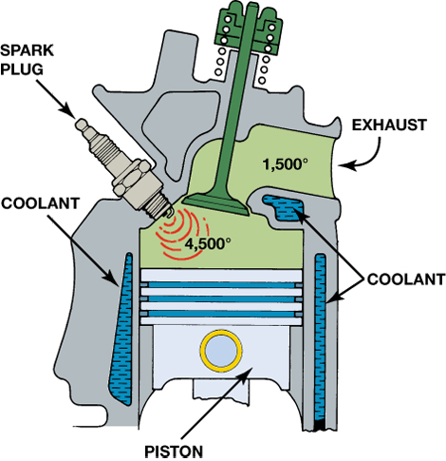
Figure 14–1 Typical combustion and exhaust temperatures.

Slide 7
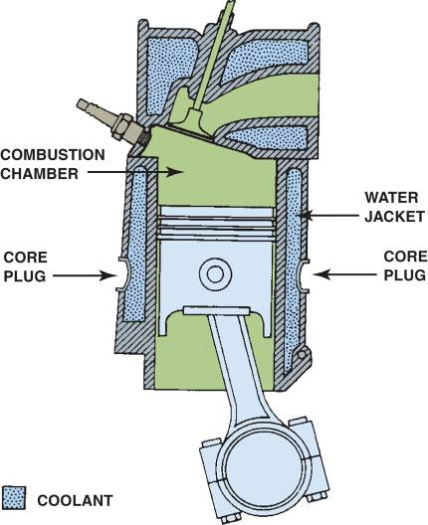
COOLING SYSTEM OPERATION
Coolant flows through the engine, where it picks up heat.
It then flows to the radiator, where the heat is given up to the outside air.
The coolant continually recirculates through the cooling system.
FIGURE 14–2 Coolant circulates through the water jackets in the engine block and cylinder head.

Slide 8
THERMOSTATS (1 OF 2)
Purpose and Function
There is a normal operating temperature range between low-temperature and high-temperature.
The thermostat controls the minimum normal temperature.
The thermostat is a temperature-controlled valve placed at the engine coolant outlet on most engines.

Slide 9
THERMOSTATS (2 OF 2)
Thermostat Operation
Thermostat Testing
Thermostat Replacement

Slide 10
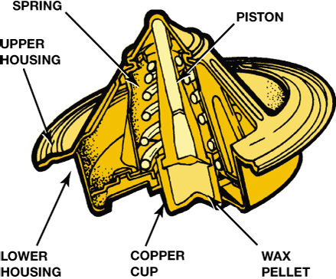
Figure 14–4 A cross section of a typical wax-actuated thermostat showing the position of the wax pellet and spring.

Slide 11
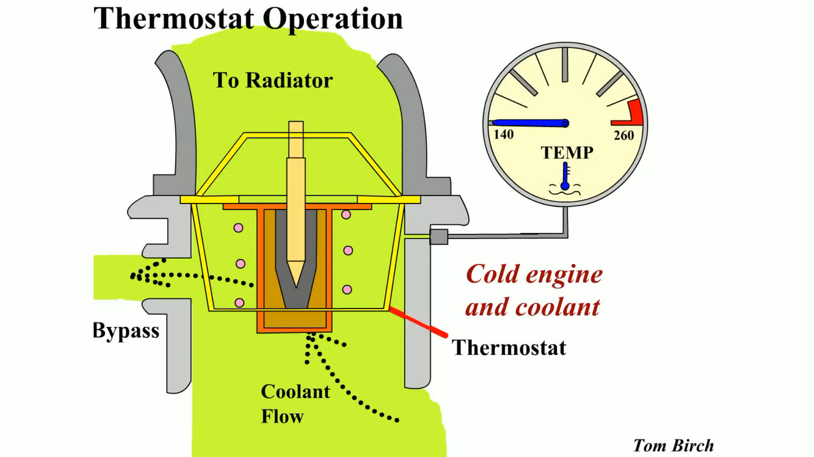
Animation: Thermostat Operation (The animation will automatically start in a few seconds)

Slide 12
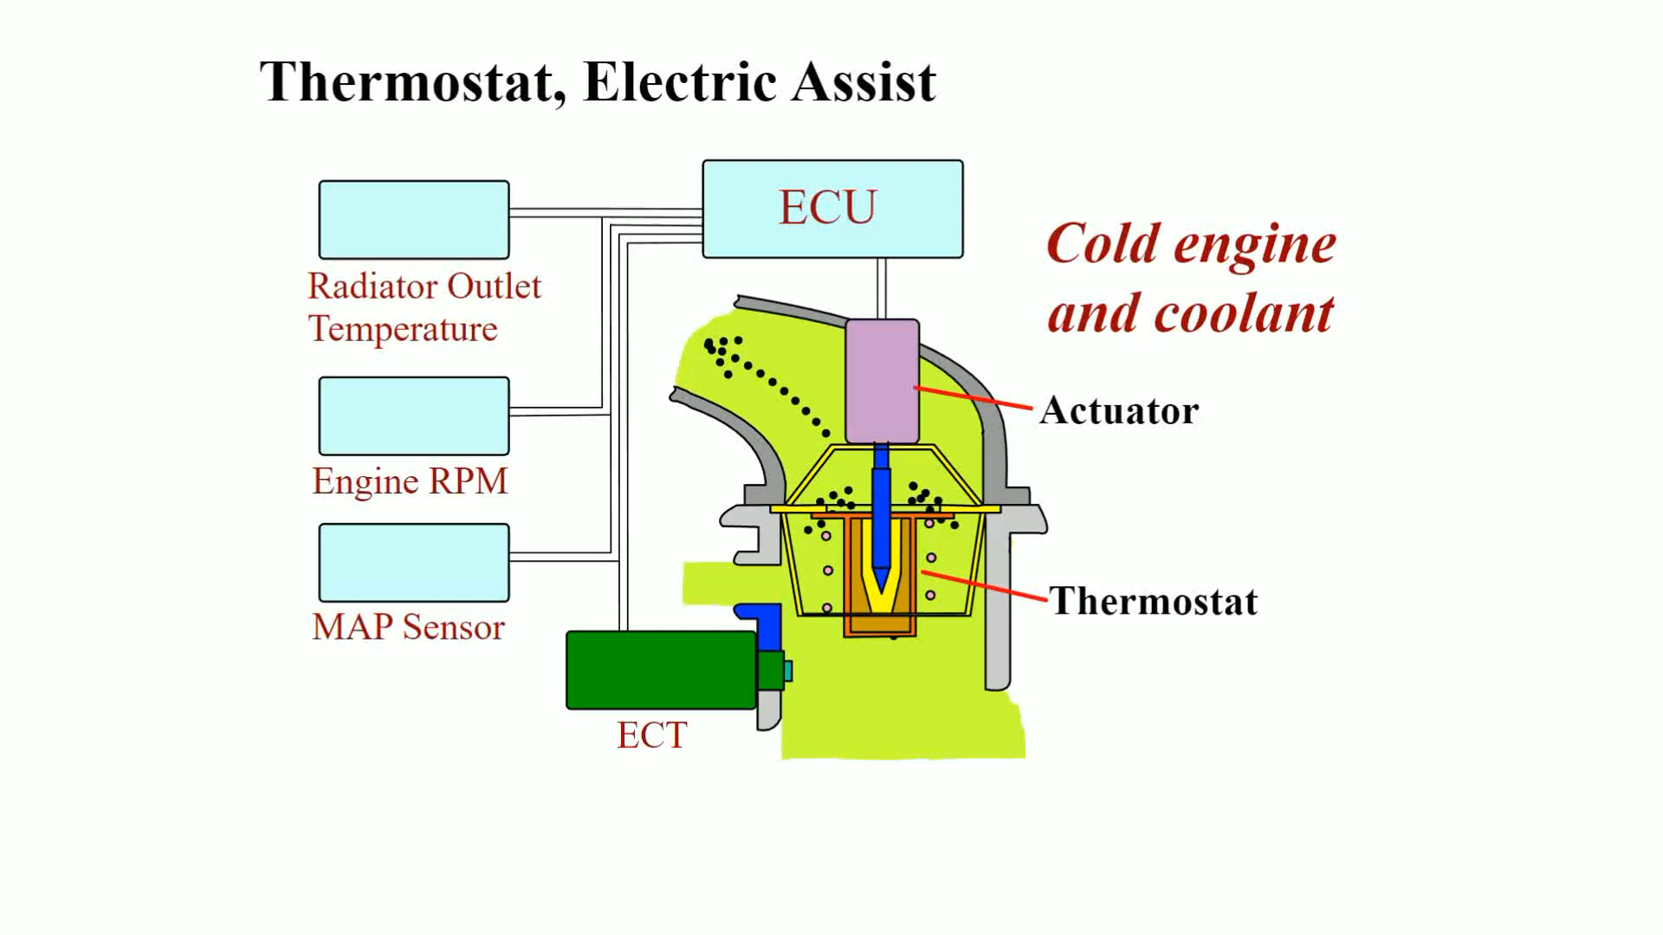
Animation: Thermostat, Electric Assist (The animation will automatically start in a few seconds)

Slide 13
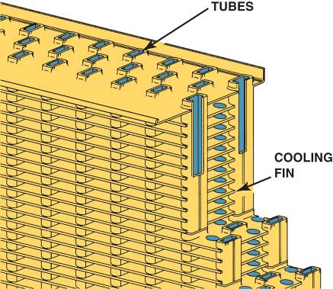
RADIATORS
Types
The two types of radiator cores in common use in most vehicles are:
Serpentine fin core
Plate fin core
FIGURE 14–11 The tubes and fins of the radiator core.

Slide 14
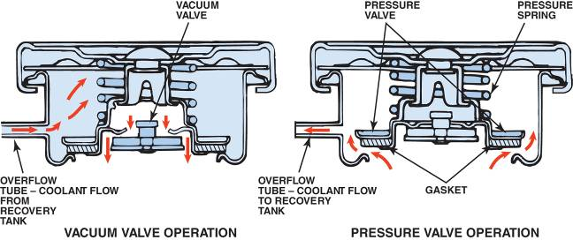
PRESSURE CAPS
Operation
Functions
Metric Radiator Caps
FIGURE 14–14 The pressure valve maintains the system pressure and allows excess pressure to vent. The vacuum valve allows coolant to return to the system from the recovery tank.

Slide 15
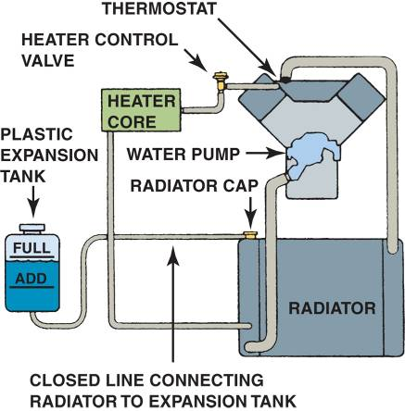
COOLANT RECOVERY SYSTEMS
Purpose and Function
Excess pressure usually forces some coolant from the system through an overflow.
Most cooling systems connect the overflow to a plastic reservoir to hold excess coolant while the system is hot.
Surge Tank
FIGURE 14–15 The level in the coolant recovery system raises and lowers with engine temperature.

Slide 16
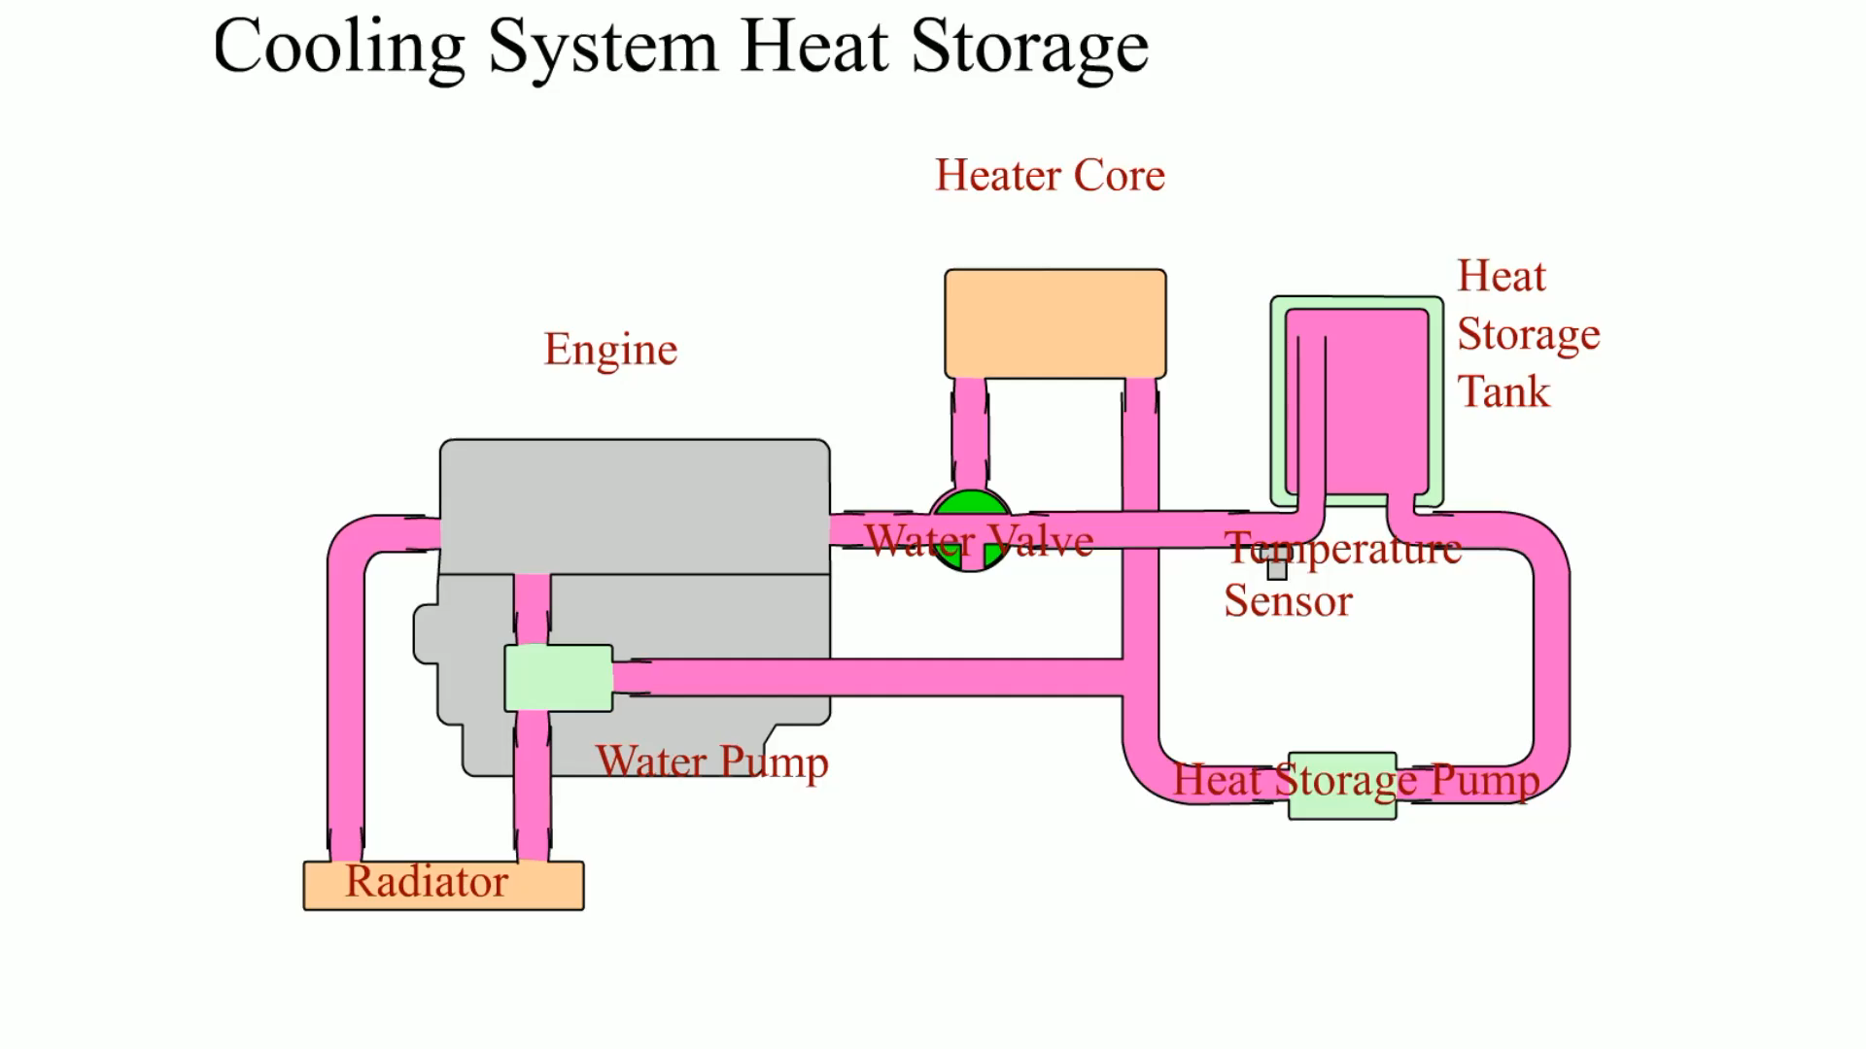
Animation: Cooling System Heat Storage (The animation will automatically start in a few seconds)
Cooling System Heat Storage

Slide 17
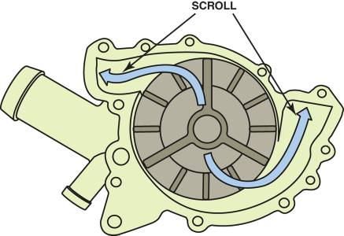
WATER PUMPS
The water pump (also called a coolant pump) is driven by one of two methods.
Crankshaft belt
Camshaft
Water Pump Service
FIGURE 14–17 Coolant flow through the impeller and scroll of a coolant pump for a V-type engine.

Slide 18
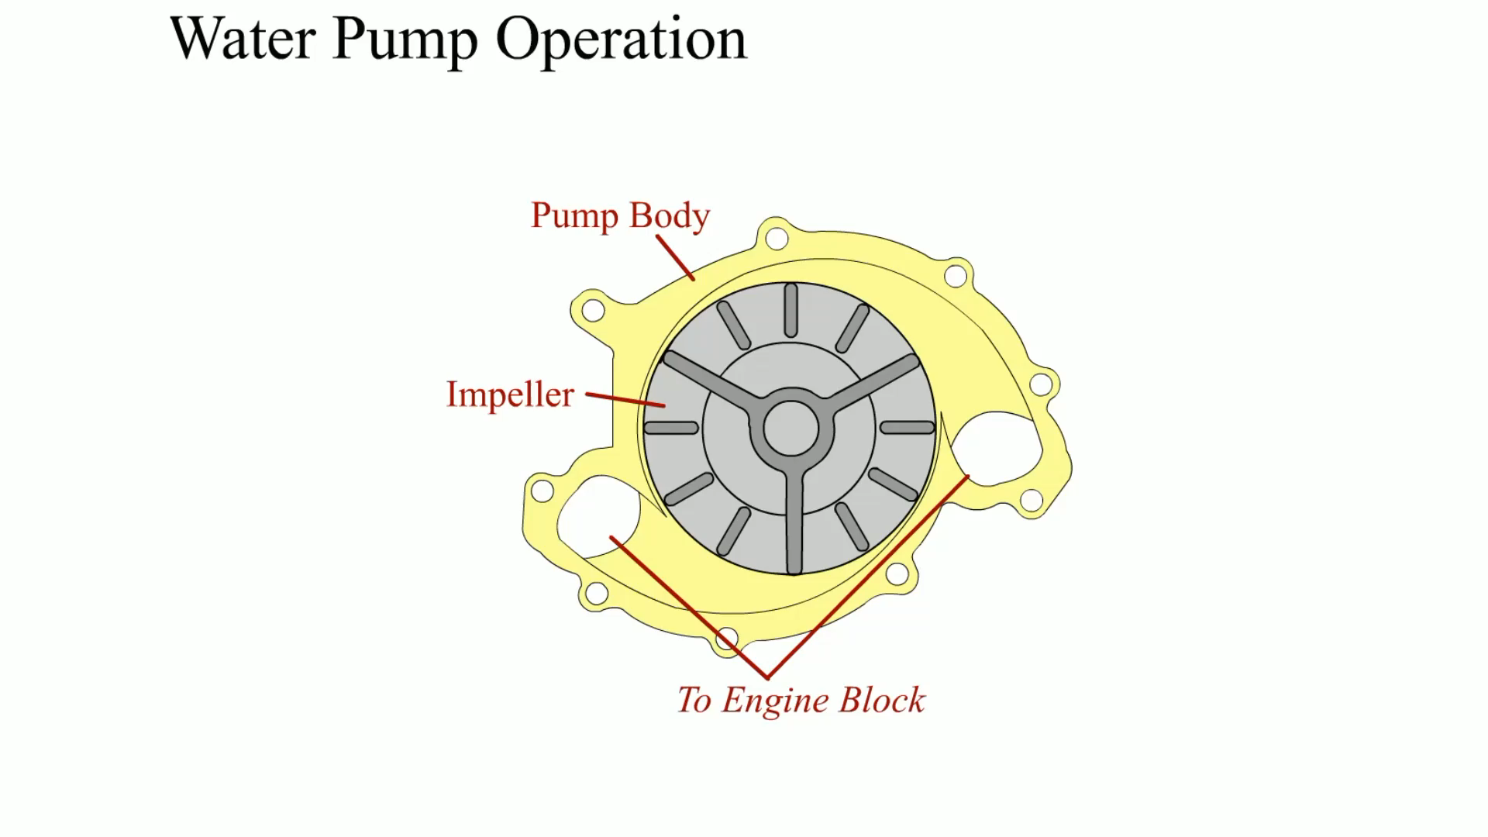
Animation: Water Pump Operation (The animation will automatically start in a few seconds)

Slide 19
COOLANT FLOW IN THE ENGINE
What are the two ways coolant flows through the engine?
Coolant flow and head gasket design

Slide 20
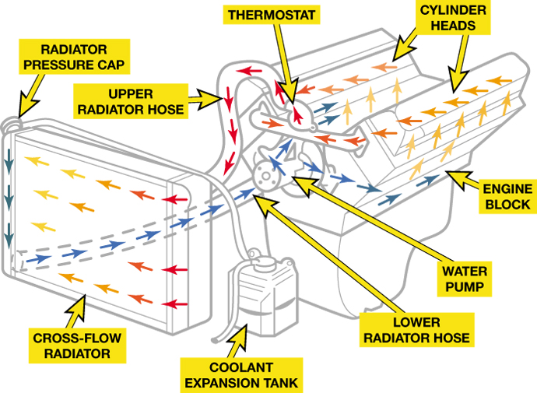
Figure 14–22 A series-type cooling system where the coolant first flows through the engine block then to the heads before returning to the radiator after passing through the thermostat.

Slide 21
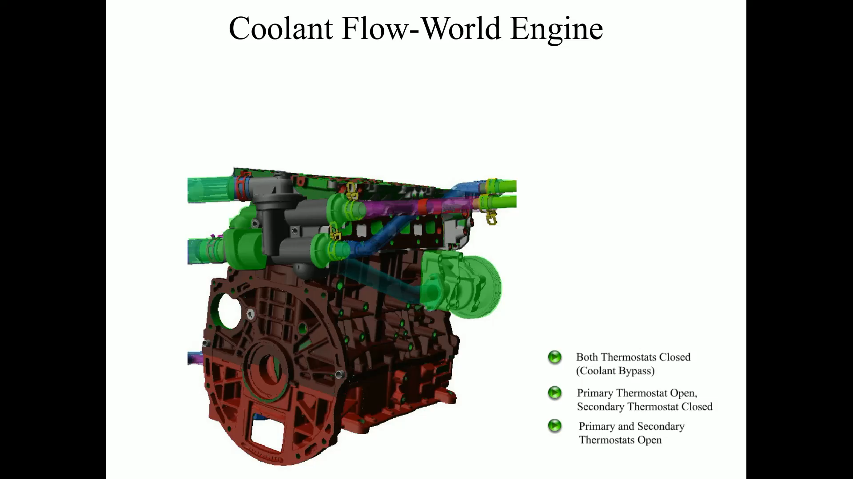
Animation: Coolant Flow-World Engine (The animation will automatically start in a few seconds)

Slide 22
COOLING FANS
Electronically Controlled Cooling Fan
Thermostatic Fans
Silicone coupling
Thermostatic spring

Slide 23
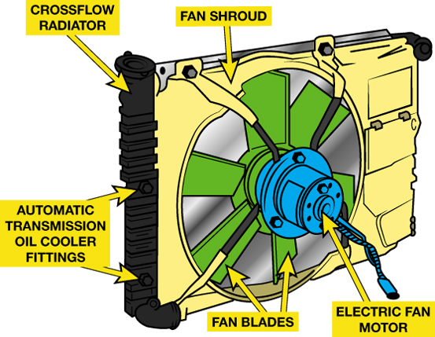
Figure 14–24 A typical electric cooling fan assembly showing the radiator and related components.

Slide 24
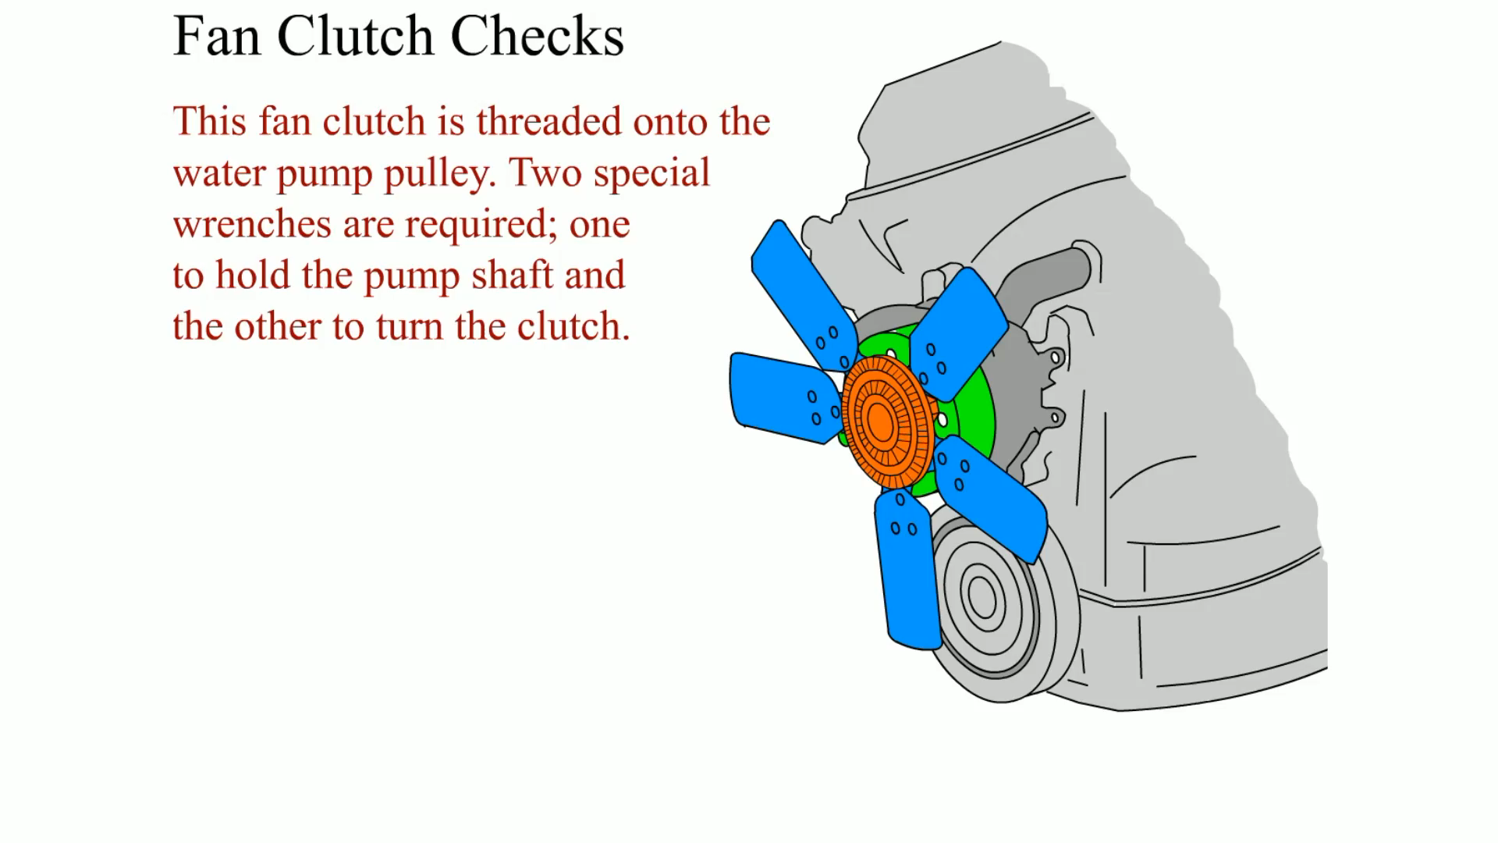
Animation: Fan Clutch Checks (The animation will automatically start in a few seconds)

Slide 25
HEATER CORES (1 OF 2)
Most of the heat absorbed from the engine by the cooling system is wasted.
Some of this heat, however, is recovered by the vehicle heater.
Heated coolant is passed through tubes in the small core of the heater.

Slide 26
HEATER CORES (2 OF 2)
Air is passed across the heater fins and is then sent to the passenger compartment.
In some vehicles, the heater and air conditioning work in series to maintain vehicle compartment temperature.

Slide 27
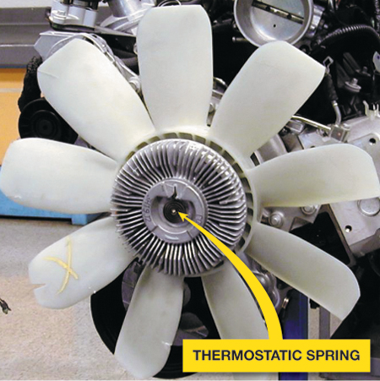
Figure 14–25 A typical engine-driven thermostatic spring cooling fan.

Slide 28
COOLING SYSTEM TESTING (1 OF 5)
Many cooling system faults can be found by performing a thorough visual inspection. Items that can be inspected visually include:
Water pump drive belt for tension or faults
Cooling fan for faults

Slide 29
COOLING SYSTEM TESTING (2 OF 5)
Heater and radiator hoses for condition and leaks
Coolant overflow or surge tank coolant level
Evidence of coolant loss
Radiator condition

Slide 30
COOLING SYSTEM TESTING (3 OF 5)
Pressure testing using a hand-operated pressure tester is a quick and easy cooling system test.
The radiator cap is removed (engine cold!) and the tester is attached in the place of the radiator cap.
By operating the plunger on the pump, the entire cooling system is pressurized.

Slide 31
COOLING SYSTEM TESTING (4 OF 5)
One of the best methods to check for a coolant leak is to use a fluorescent dye in the coolant, one that is specifically designed for coolant.
Operate the vehicle with the dye in the coolant until the engine reaches normal operating temperature.

Slide 32
COOLING SYSTEM TESTING (5 OF 5)
Use a black light to inspect all areas of the cooling system.
When there is a leak, it will be easy to spot because the dye in the coolant will be seen as bright green.

Slide 33
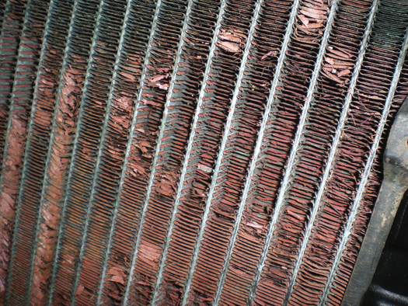
Figure 14–27 A heavily corroded radiator from a vehicle that was overheating. A visual inspection discovered that the corrosion had eaten away many of the cooling fins, yet did not leak. This radiator was replaced and it solved the overheating problem.

Slide 34
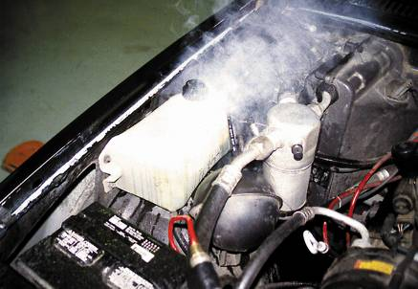
COOLANT TEMPERATURE WARNING LIGHT
Purpose and Function
Precautions
Common Causes of Overheating
FIGURE 14–31 When an engine overheats, often the coolant overflow container boils.

Slide 35
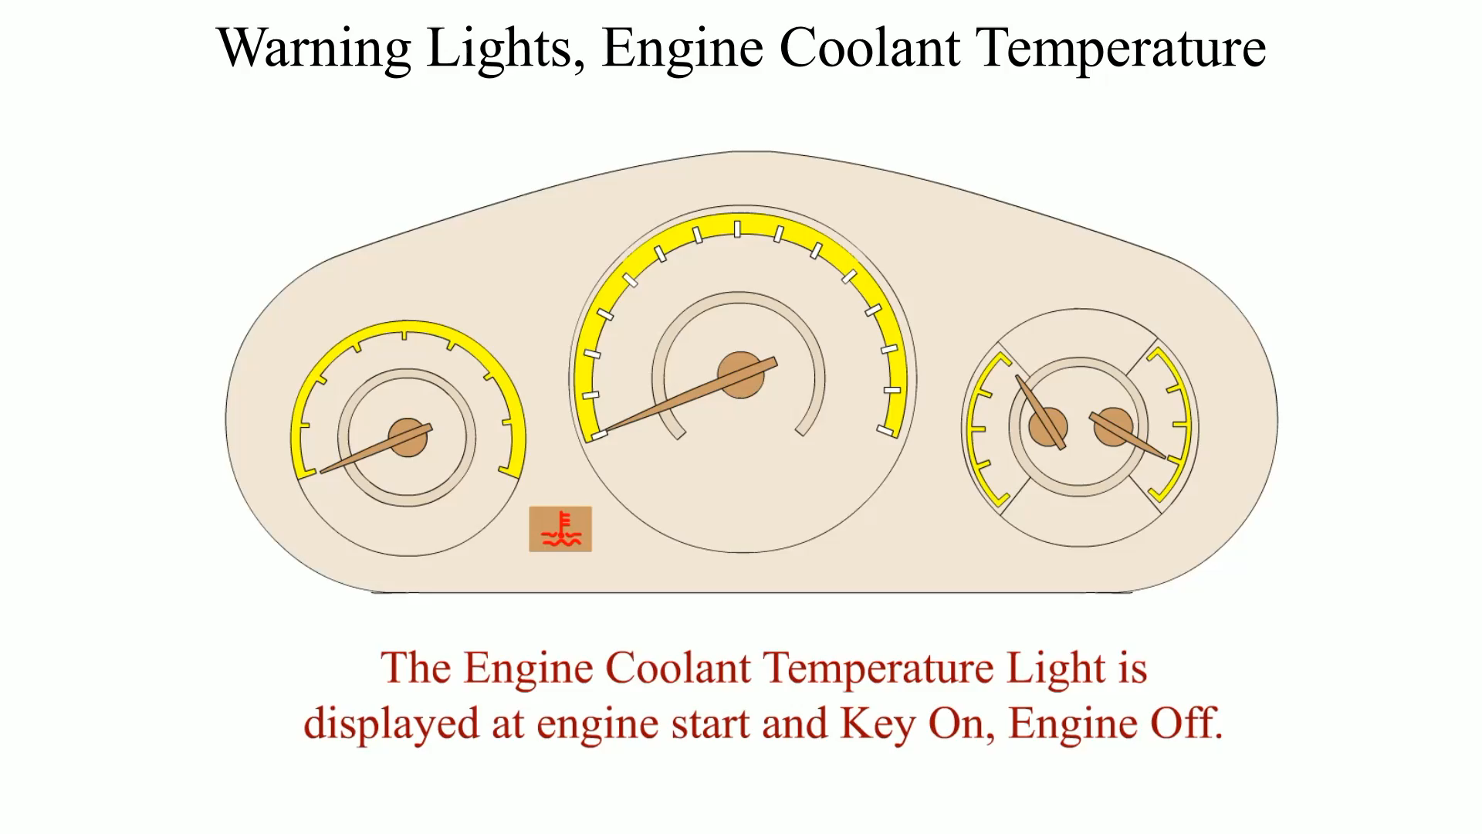
Animation: Warning Lights, Engine Coolant Temperature (The animation will automatically start in a few seconds)

Slide 36
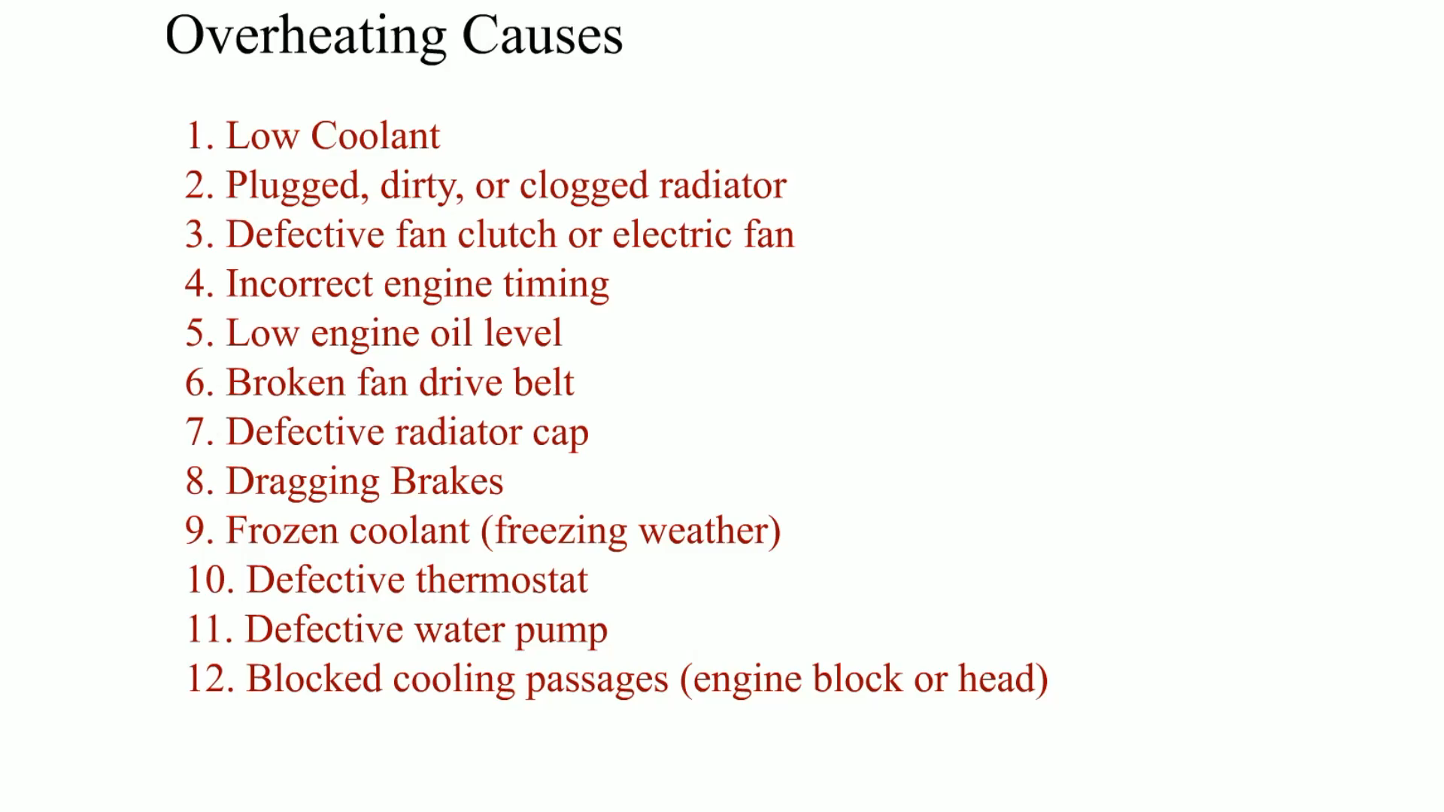
Animation: Overheating Causes (The animation will automatically start in a few seconds)

Slide 37
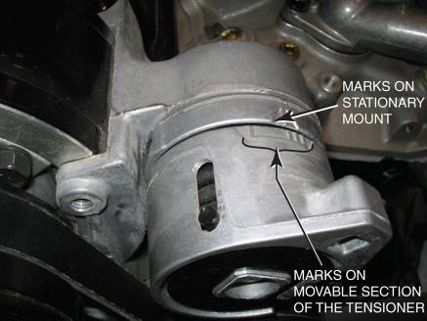
COOLING SYSTEM INSPECTION
Coolant Level
Accessory Drive Belt Tension
Belt tension gauge
Marks on the tensioner
Torque wrench reading
Deflection
FIGURE 14–32 Typical marks on an accessory drive belt tensioner.

Slide 38
COOLING SYSTEM SERVICE
Flushing Coolant
Coolant Exchange Machine
Hose Inspection
Disposing of Used Coolant
Cleaning the Radiator Exterior

Slide 39
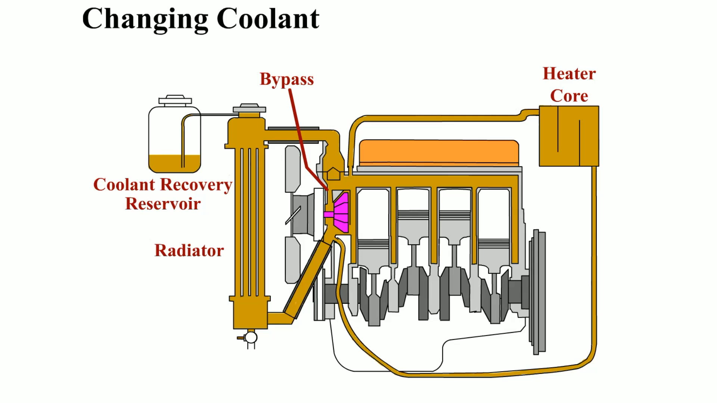
Animation: Changing Coolant (The animation will automatically start in a few seconds)

Slide 40
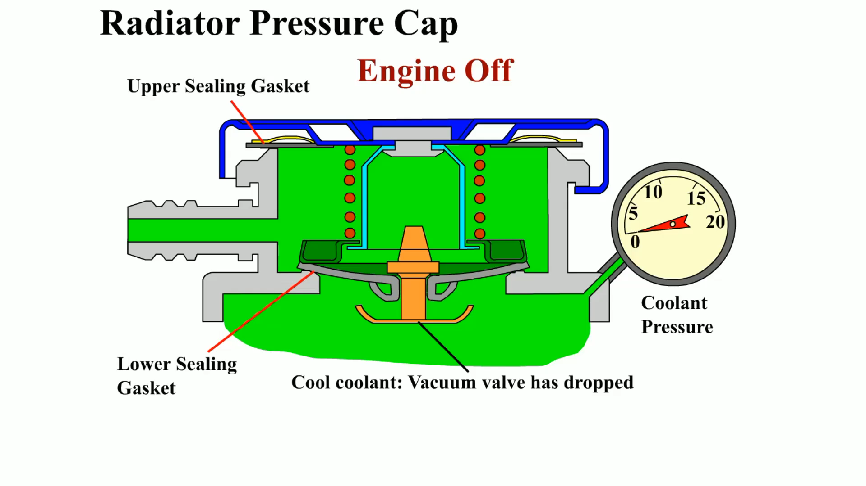
Animation: Radiator Pressure Cap (The animation will automatically start in a few seconds)

Slide 41
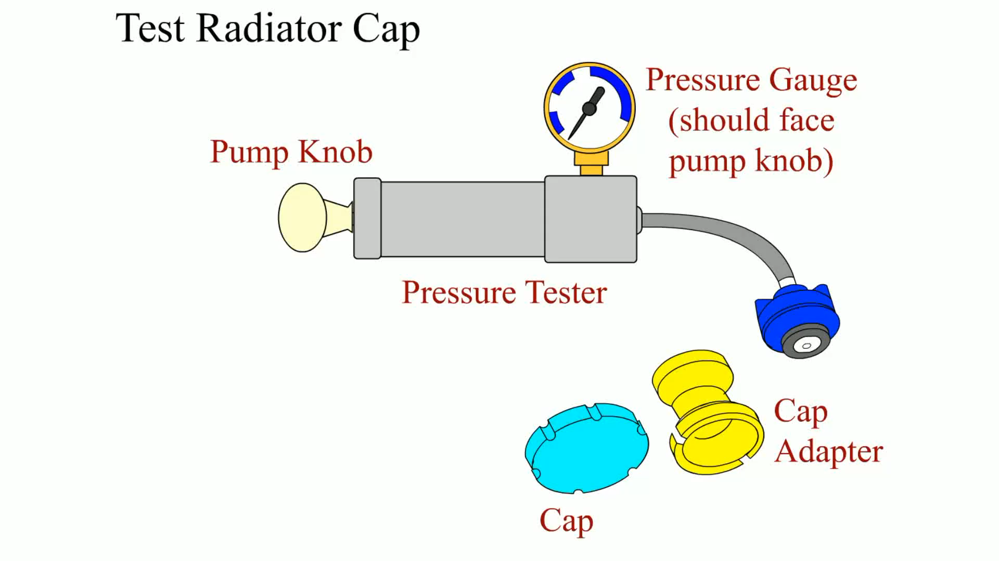
Animation: Test Radiator Cap (The animation will automatically start in a few seconds)

Slide 42
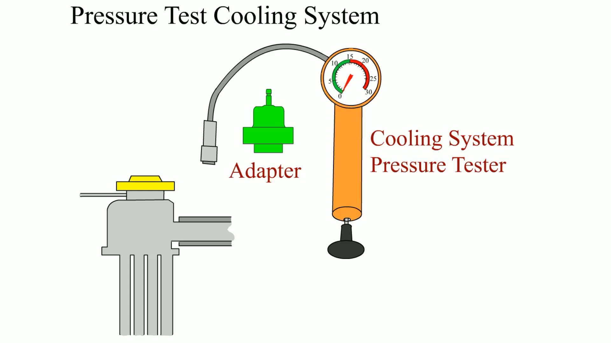
Animation: Pressure Test Cooling System (The animation will automatically start in a few seconds)

Slide 43
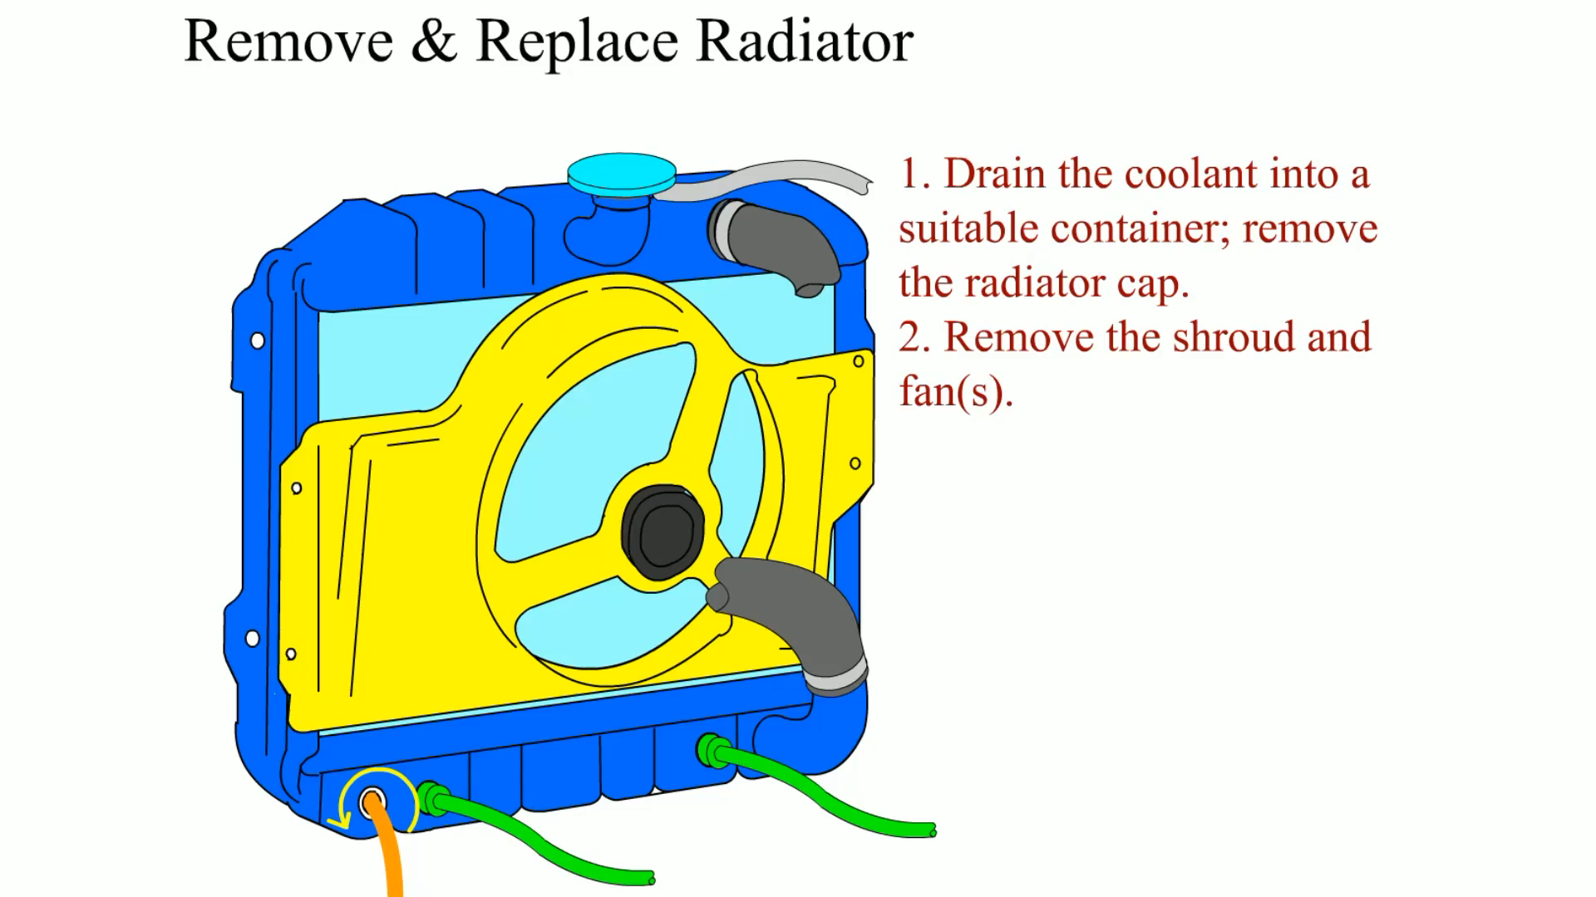
Animation: Remove & Replace Radiator (The animation will automatically start in a few seconds)

Slide 44
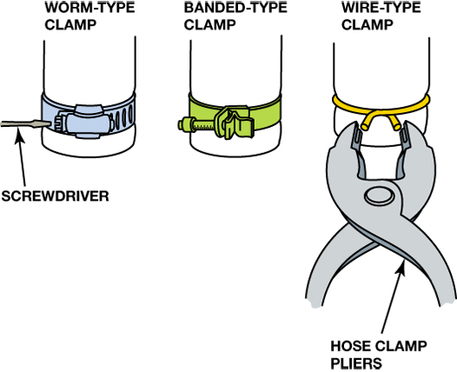
Figure 14–35 Hose clamps come in a variety of shapes and designs.

Slide 45
SUMMARY (1 OF 3)
The purpose and function of the cooling system is to maintain proper engine operating temperature.
The thermostat controls engine coolant temperature by opening at its rated opening temperature to allow coolant to flow through the radiator.

Slide 46
SUMMARY (2 OF 3)
Coolant fans are designed to draw air through the radiator to aid in the heat transfer process, drawing the heat from the coolant and transferring it to the outside air through the radiator.
The cooling system should be tested for leaks using a hand-operated pressure pump.

Slide 47
SUMMARY (3 OF 3)
Water pumps are usually engine driven and circulate coolant through the engine and the radiator when the thermostat opens.
Coolant flows through the radiator hoses to and from the engine and through heater hoses to send heated coolant to the heater core in the passenger compartment.

Slide 48
Video Links (Internet Access Required)
Heater box removal (time 6:44)
Flushing a heater core (time 9:49)
Plugged heater core (time 9:33)
F 150 heater core part 1 (time 7:15)
F 150 heater core part 2 (time 15:28)
Heater core removal (time 9:16)
Dodge heater core (time 6:41)
Audi heater core (time 6:09)
S 10 heater core (time 3:52)
Thunderbird heater core (time 5:35)

Slide 49
Video Links (Internet Access Required)
Chevy 1500 heater core (time 11:59)
Lincoln heater core (time 21:46)
Kia Sportage heater core (time 7:14)
Cooling system pressure test (time 9:02)
Cooling system animation (time 0:22)
Thermostat (time 0:05)
Water pump replacement (time 8:36)
Coolant by pass pipe (time 9:14)
Thermostat (time 6:20)
Thermostat (time 8:27)

Slide 50
Video Links (Internet Access Required)
Radiator replacement (time 11:32)
Water pump and timing belt (time 12:22)
Coolant testing (time 2:11)
Coolant temp sensor (time 5:18)
Draining the radiator (time 2:33)
Cooling system (time 4:02)
Replace freeze plugs (time 3:43)
Engine overheat (time 26:09)
Water pump failure (time 6:00)
Does stop leak work (time 8:29)

Slide 51
Video Links (Internet Access Required)
Cooling system check (time 4:12)
Cooling fan (time 5:15)
Water pump (time 2:31)
Thermostat (time 1:07)
Thermostat (time 1:40)
Radiator (time 3:52)
Coolant tube (time 14:54)
Radiator (time 4:05)
Water pump replacement (time 2:19)
Radiator replacement (time 3:02)

Slide 52
Video Links (Internet Access Required)
Belt tensioner (time 3:59)
Belt and pulley basics (time 10:58)
Idler pulley (time 2:50)
Cooling fan (time 2:10)
Pressure Testing Cooling Systems (time 11:06)
How To Replace A Radiator In Your Car (time 3:01)
How To Replace A Thermostat In Your Car (time 6:57)
How To Replace A Water Pump And Timing Belt Yourself (time 3:58)
How to Replace the Upper Radiator Hose (time 1:52)
Heater Hose Replacement (time 9:47)

Slide 53
Video Links (Internet Access Required)
Belt replacement (time 2:23)

