Slide 1
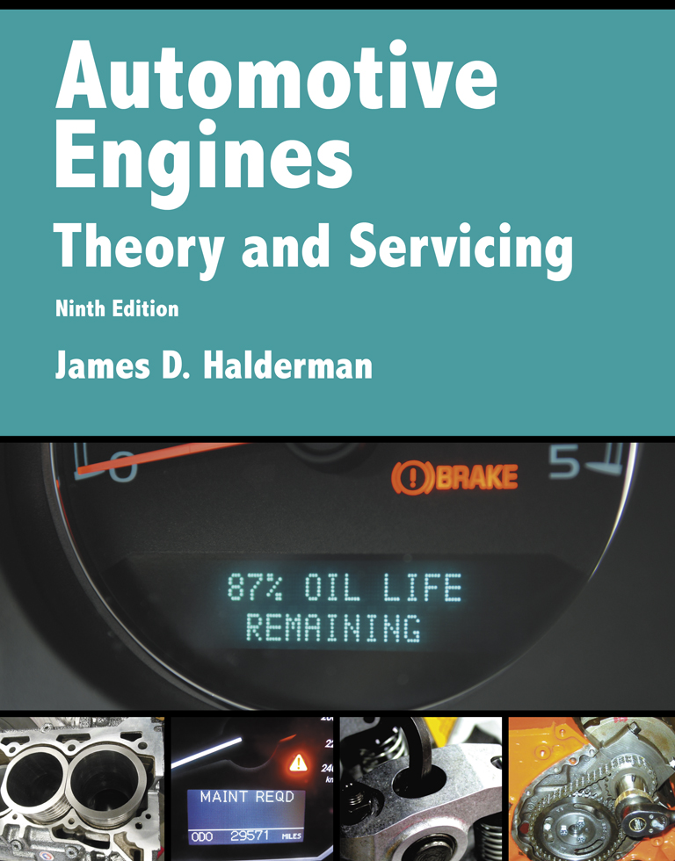
Automotive Engines Theory and Servicing
Ninth Edition
Chapter 13
Coolant

Slide 2
OBJECTIVES
13.1 Discuss coolant fundamentals.
13.2 Compare the different types of coolant.
13.3 Discuss coolant freezing/boiling temperatures and water as coolant.
13.4 Discuss coolant testing and coolant replacement issues.

Slide 3
COOLANT FUNDAMENTALS (1 OF 4)
Coolant is used in the cooling system because it:
  Transfers heat from the engine to the radiator
  Protects the engine and the cooling system from rust and corrosion
  Prevents freezing in cold climates

Slide 4
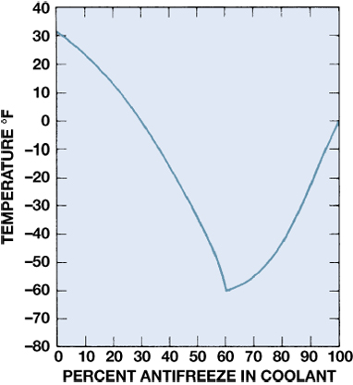
Figure 13–1 Graph showing the relationship of the freezing point of the coolant to the percentage of antifreeze used in the coolant.

Slide 5
COOLANT FUNDAMENTALS (2 OF 4)
It should be noted that the freezing point increases as the antifreeze concentration is increased above 60%.
  The normal mixture is 50% antifreeze and 50% water.

Slide 6
COOLANT FUNDAMENTALS (3 OF 4)
Ethylene glycol antifreeze contains:
  Anticorrosion additives
  Rust inhibitors
  Water pump lubricants

Slide 7
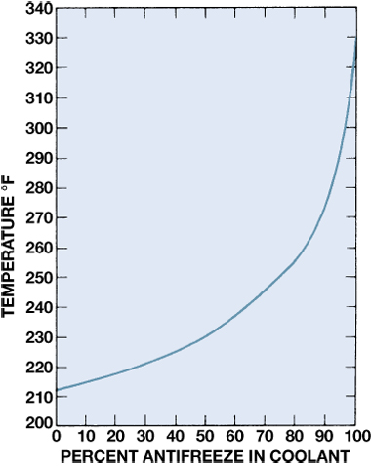
Figure 13–2 Graph showing how the boiling point of the coolant increases as the percentage of antifreeze in the coolant increases.

Slide 8
COOLANT FUNDAMENTALS (4 OF 4)
All manufacturers recommend the use of ethylene glycol based coolant, which contains:
  Ethylene glycol (EG): 47%
  Water: 50%
  Additives: 3%

Slide 9
TYPES OF COOLANT
Inorganic Acid Technology
Organic Acid Technology
Hybrid Organic Acid Technology
Phosphate Hybrid Organic Acid Technology
Universal Coolant

Slide 10
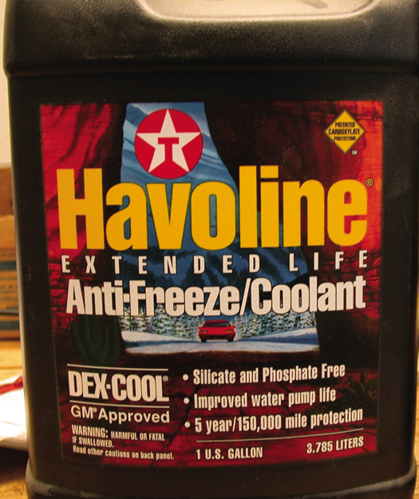
Figure 13–3 Havoline was the first company to make and market OAT coolant. General Motors uses the term DEX-COOL.

Slide 11
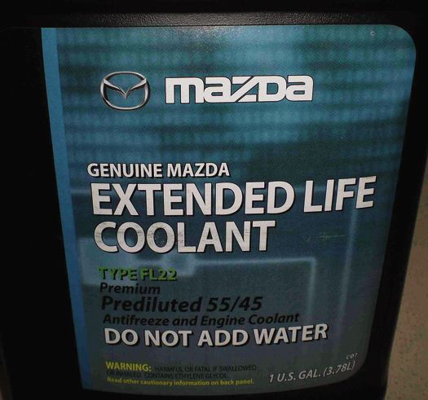
Figure 13–4 Coolant used in Fords that use Mazda engines and in Mazda vehicles. It requires the use of a PHOAT coolant which is dark green.

Slide 12
WATER (1 OF 2)
Water is about half of the coolant and is used because of the following qualities.
  It is inexpensive.
  It is an efficient heat exchange fluid because of its excellent thermal conductivity.

Slide 13
WATER (2 OF 2)
  It has good specific heat capacity, meaning it takes more heat energy to increase the temperature, versus one with low specific heat capacity.
  The boiling point is 212°F (100°C) (at sea level).
  The freezing point is 32°F (0°C).

Slide 14
COOLANT FREEZING/BOILING TEMPERATURES (1 OF 4)
Freezing Point
  Pure water
    32°F (0°C)
  Pure antifreeze*
    0°F (-18°C)
  50/50 mixture
    - 34°F (-37°C)

Slide 15
COOLANT FREEZING/BOILING TEMPERATURES (2 OF 4)
  70% antifreeze/30% water
    - 84°F (-64°C)
Boiling Point at Sea Level
  Pure water
    212°F (100°C)
  50/50 mixture
    218°F (103°C)

Slide 16
COOLANT FREEZING/BOILING TEMPERATURES (3 OF 4)
  70/30 mixture
    225°F (107°C)
Boiling Point with 15 PSI Pressure Cap
  Pure water
    257°F (125°C)
  50/50 mixture
    265°F (130°C)

Slide 17
COOLANT FREEZING/BOILING TEMPERATURES (4 OF 4)
  70/30 mixture
    276°F (136°C)

Slide 18
COOLANT TESTING (1 OF 3)
Normal coolant tests include:
  Visual inspection.
    Coolant should be clean and bright.
  Freeze/boiling point.
    A high freezing point or low boiling point indicates dilution (too much water).

Slide 19
COOLANT TESTING (2 OF 3)
  pH.
    The wrong pH indicates buffer loss, which is used to help maintain the pH level.
  Coolant voltage.
    A high voltage indicates the wrong pH or a stray current flow.
Hydrometer Testing
Refractometer

Slide 20
COOLANT TESTING (3 OF 3)
Ph
Galvanic Activity
Electrolysis
Testing For Galvanic Activity And Electrolysis
Test Strip Testing

Slide 21
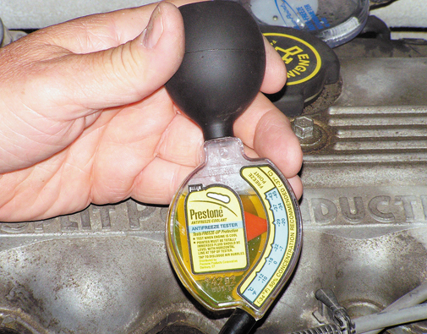
Figure 13–6 Checking the freezing temperature of the coolant using a hydrometer.

Slide 22
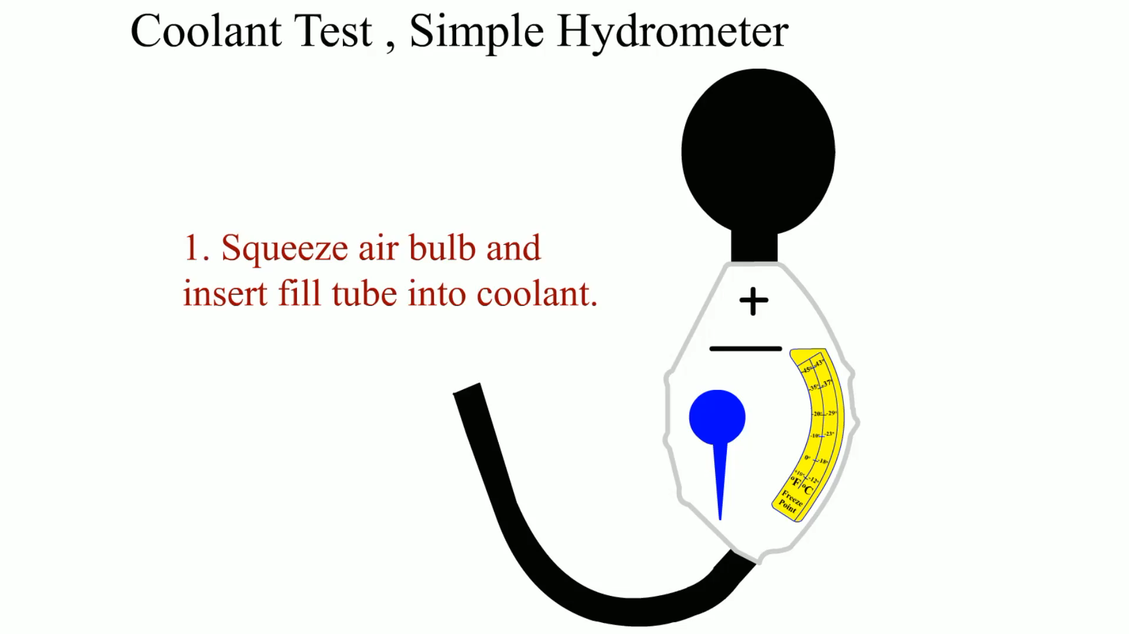
Animation: Coolant Test, Simple Hydrometer
(The animation will automatically start in a few seconds)

Slide 23
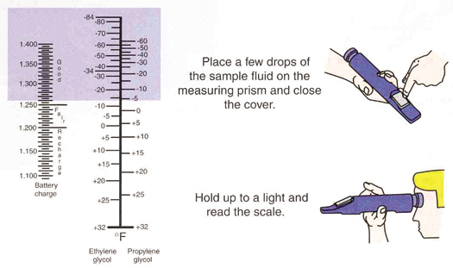
Figure 13–7 Using a refractometer is an accurate method to check the freezing point of coolant.

Slide 24
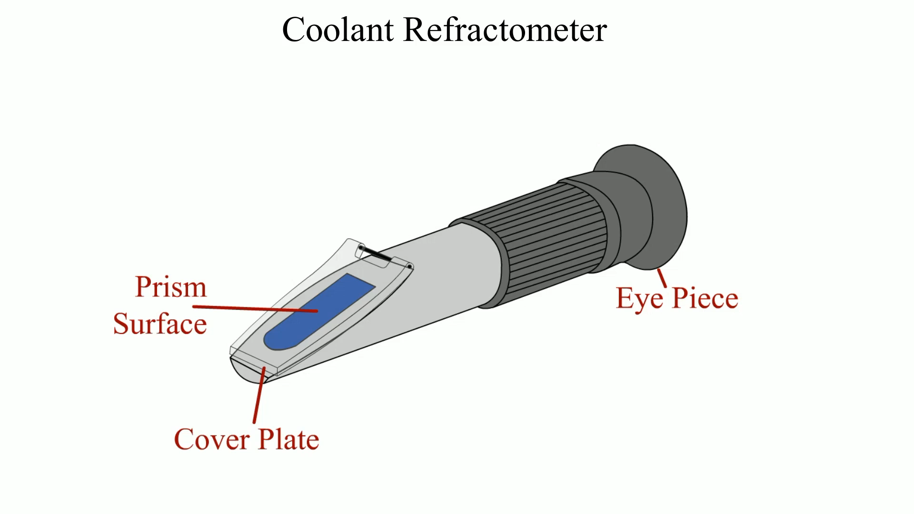
Animation: Coolant Refractometer
(The animation will automatically start in a few seconds)

Slide 25
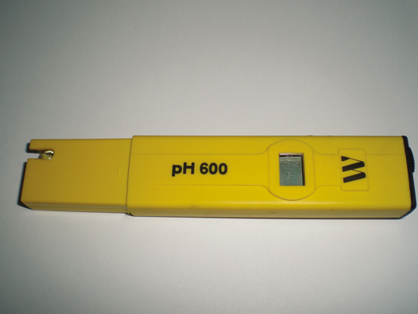
Figure 13–8 A meter that measures the actual pH of the coolant can be used for all coolants, unlike many test strips that cannot be used to test the pH of red or orange coolants.

Slide 26
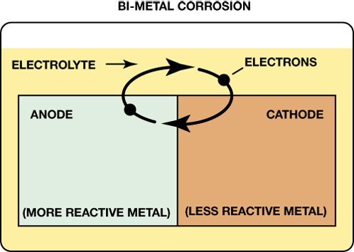
Figure 13–9 Galvanic activity is created by two dissimilar metals in contact with a liquid, in this case coolant.

Slide 27
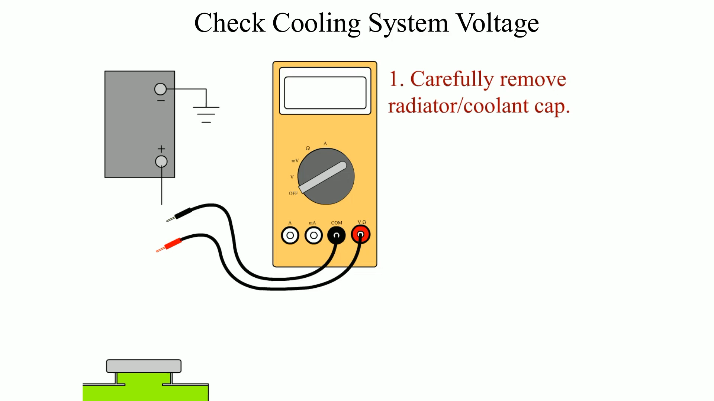
Animation: Check Cooling System Voltage
(The animation will automatically start in a few seconds)

Slide 28
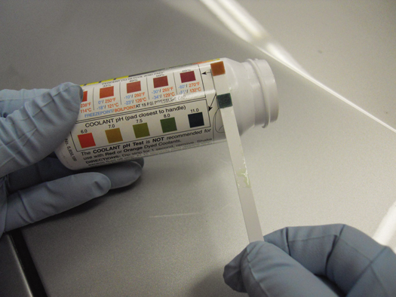
FIGURE 13–10 A test strip can be used to determine the pH and percentage of glycol of the coolant. The percentage of glycol determines the freezing and boiling temperatures, as shown on the bottle that contains the test strips.

Slide 29
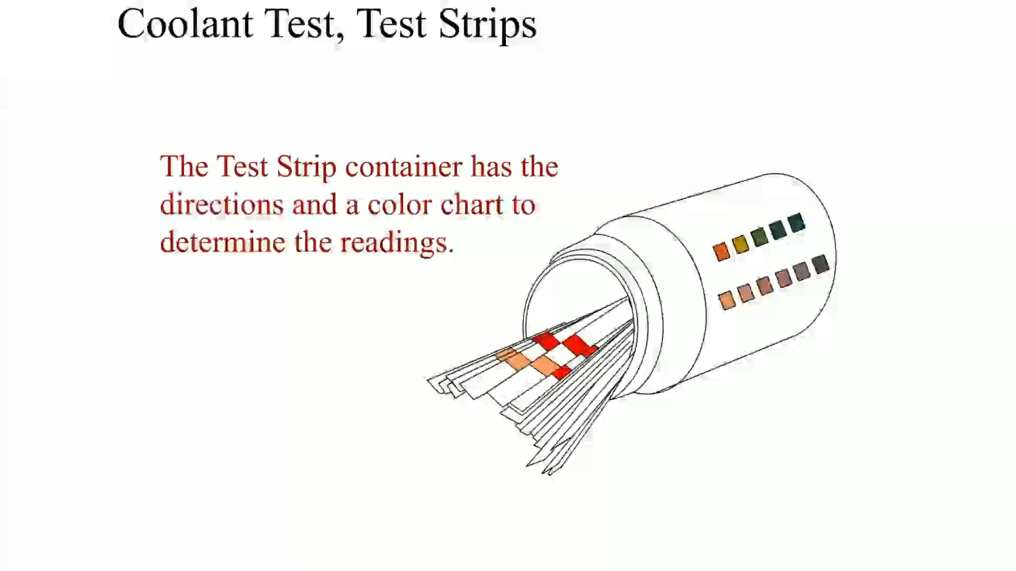
Animation: Coolant Test, Test Strips
(The animation will automatically start in a few seconds)

Slide 30
COOLANT REPLACEMENT ISSUES
Intervals
Passivation
Recycling Coolant

Slide 31
SUMMARY (1 OF 2)
All coolant is ethylene glycol based. Some aftermarket coolants use propylene glycol.
Used coolant should be recycled whenever possible.
The freezing temperature of the coolant can be tested using a hydrometer or refractometer.

Slide 32
SUMMARY (2 OF 2)
Proper cooling system maintenance usually calls for replacing the coolant every two years or every 24,000 miles (36,000 km) for IAT coolant.
  Longer for OAT, HOAT, and PHOAT coolants.

Slide 33
Video Links (Internet Access Required)
When will your coolant freeze? (time 5:00)
Coolant testing (time 2:11)

