Slide 1
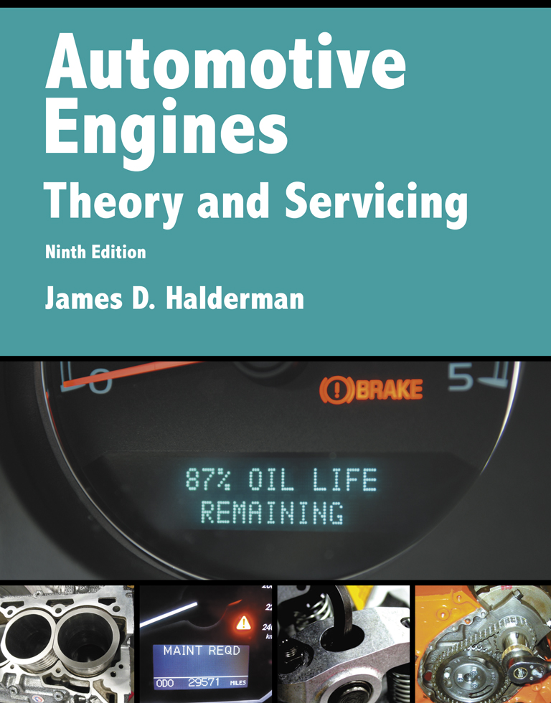
Automotive Engines Theory and Servicing
Ninth Edition
Chapter 12
Gasoline, Alternative Fuels, and Diesel Fuels

Slide 2
OBJECTIVES (1 OF 3)
12.1 Discuss the characteristics of gasoline, refining of gasoline, and volatility of gasoline.
12.2 Explain air-fuel ratios, normal and abnormal combustion, and octane rating.
12.3 Discuss gasoline additives, gasoline blending, and testing gasoline for alcohol content.
12.4 Discuss general gasoline recommendations.

Slide 3
OBJECTIVES (2 OF 3)
12.5 Explain alternative fuel vehicles, and discuss the safety procedures when working with alternative fuels.
12.6 Discuss E85, methanol, and propane fuel.
12.7 Discuss compressed natural gas, liquefied natural gas, and P-series fuels.

Slide 4
OBJECTIVES (3 OF 3)
12.8 Discuss synthetic fuels.
12.9 Compare diesel fuel, biodiesel, and E-diesel fuel.

Slide 5
GASOLINE (1 OF 2)
Gasoline is a complex mixture of various hydrocarbons refined from crude petroleum oil for use as a fuel in engines.
  Gasoline and air burns in the cylinder of the engine and produces heat and pressure
    Which is transferred to rotary motion inside the engine and eventually powers the drive wheels of a vehicle.

Slide 6
GASOLINE (2 OF 2)
  When the combustion process in the engine is perfect, all of the fuel and air are consumed and only carbon dioxide and water are produced.

Slide 7
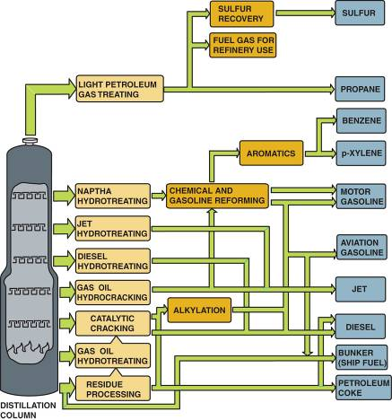
REFINING
Distillation
Cracking
Shipping
FIGURE 12–1 The crude oil refining process showing most of the major steps and processes.

Slide 8
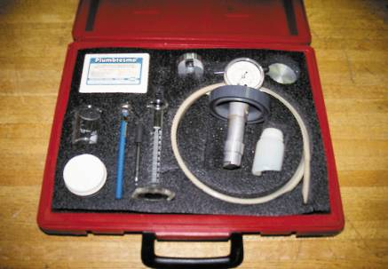
VOLATILITY
Definition
Reid Vapor Pressure
Seasonal Blending
  Winter Blend
  Summer Blend
Volatility-related Problems
FIGURE 12–3 A gasoline testing kit, including an insulated container where water at 100°F is used to heat a container holding a small sample of gasoline. The reading on the pressure gauge is the Reid vapor pressure (RVP).

Slide 9
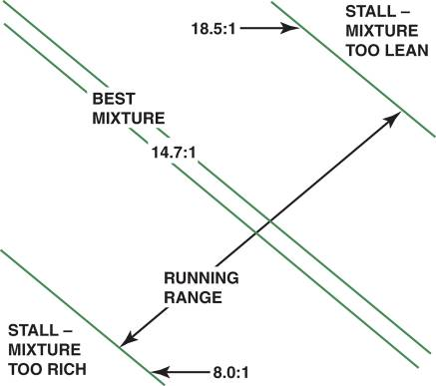
AIR-FUEL RATIOS
The air-fuel ratio is the proportion by weight of air and gasoline that the injection system mixes as needed for engine combustion.
Air-fuel ratios in which a gasoline engine can operate without stalling range from 8:1 to 18.5:1.
FIGURE 12–4 An engine will not run if the air-fuel mixture is either too rich or too lean.

Slide 10
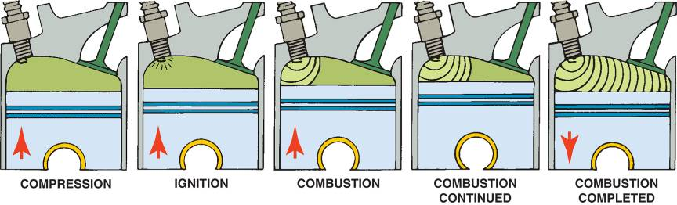
NORMAL AND ABNORMAL COMBUSTION
Terminology
Abnormal Combustion
Controlling Spark Knock
FIGURE 12–6 Normal combustion is a smooth, controlled burning of the air-fuel mixture.

Slide 11
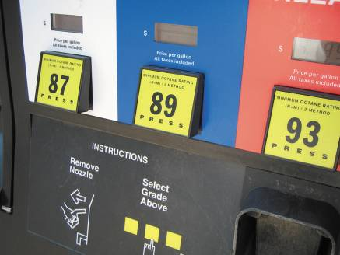
OCTANE RATING
Rating Methods
Gasoline Grades
Octane Effects of Altitude
Volatility Effects of Altitude
FIGURE 12–8 A pump showing regular with a pump octane of 87, plus rated at 89, and premium rated at 93. These ratings can vary with brand as well as in different parts of the country.

Slide 12
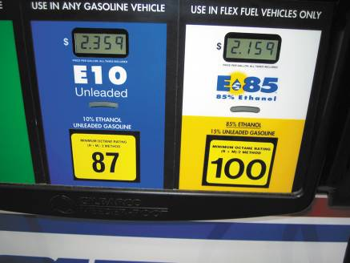
GASOLINE ADDITIVES
Dye
Oxygenated Fuel Additives
  Methyl tertiary butyl ether (MTBE)
  Tertiary-amyl methyl ether (TAME)
  Ethyl tertiary butyl ether (ETBE)
  Ethanol
FIGURE 12–10 This fuel tank indicates that the gasoline is blended with 10% ethanol (ethyl alcohol) and can be used in any gasoline vehicle. E85 contains 85% ethanol and can only be used in vehicles specifically designed to use it.

Slide 13
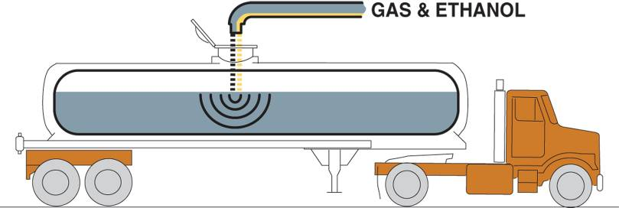
GASOLINE BLENDING
There are three basic methods used to blend ethanol with gasoline to create E10 (10% ethanol, 90% gasoline).
  In-line blending
  Sequential blending
  Splash blending
FIGURE 12–12 In-line blending is the most accurate method for blending ethanol with gasoline because computers are used to calculate the correct ratio.

Slide 14
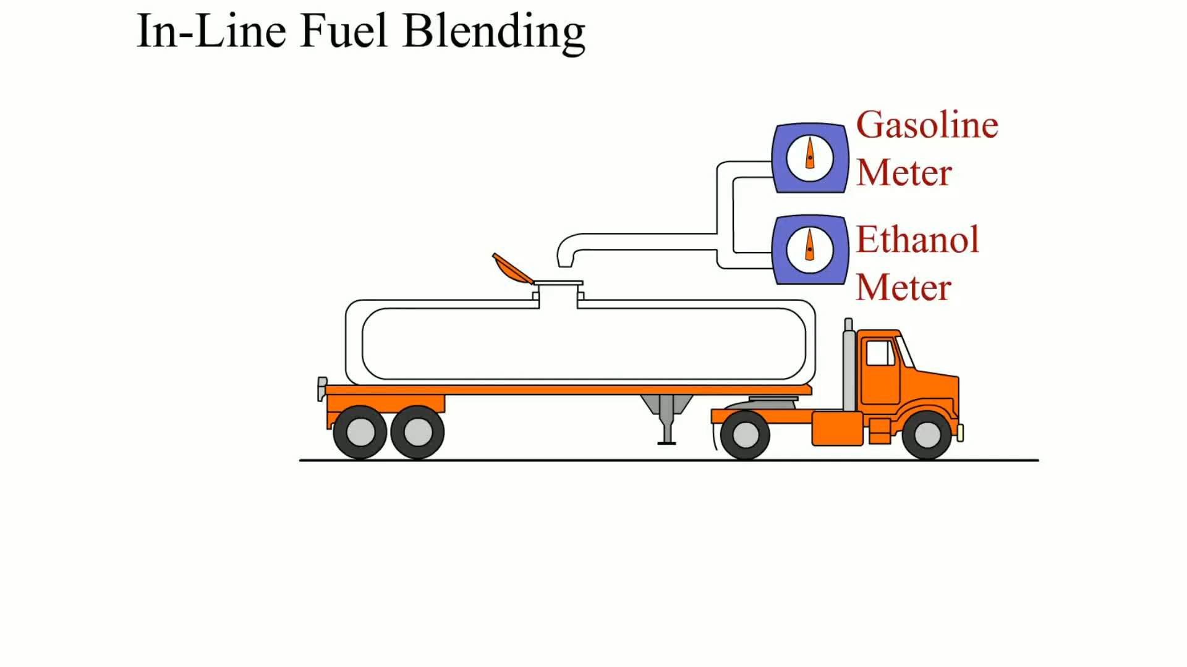
Animation: In-Line Fuel Blending
(The animation will automatically start in a few seconds)

Slide 15
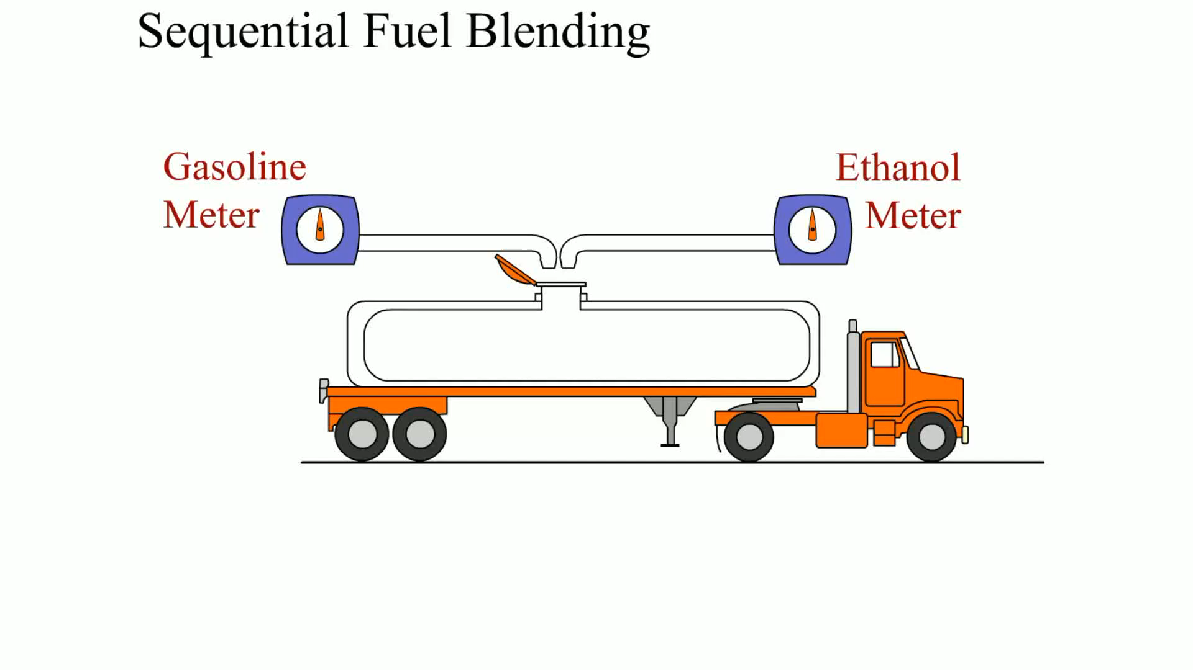
Animation: Sequential Fuel Blending
(The animation will automatically start in a few seconds)

Slide 16
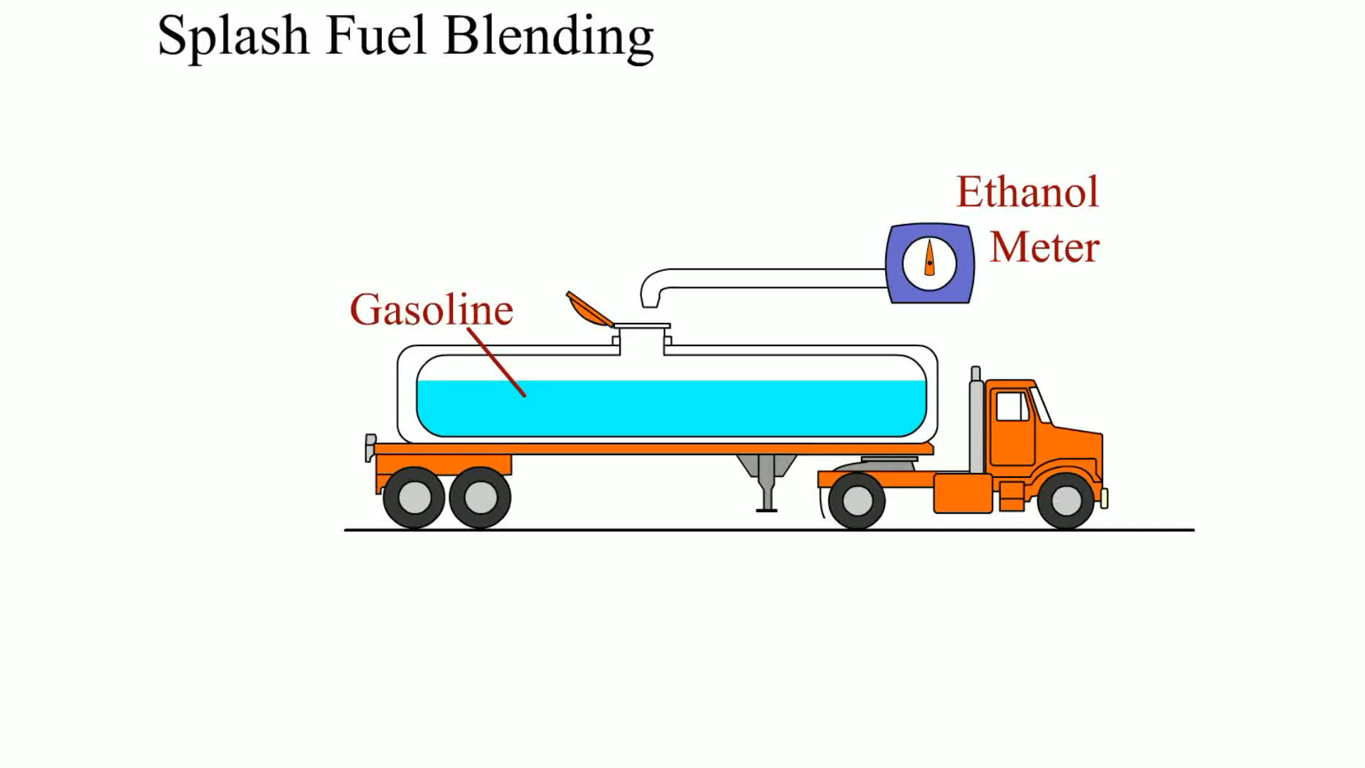
Animation: Splash Fuel Blending
(The animation will automatically start in a few seconds)

Slide 17
TESTING GASOLINE FOR ALCOHOL CONTENT (1 OF 2)
Take the following steps when testing gasoline for alcohol content.
  Pour suspect gasoline into a graduated cylinder.
  Fill the graduated cylinder to the 90 mL mark.
  Add 10 mL of water to the graduated cylinder.
  Put the stopper in the cylinder and shake vigorously for one minute.

Slide 18
TESTING GASOLINE FOR ALCOHOL CONTENT (2 OF 2)
  Place the cylinder on a flat surface for two minutes.
  Take a reading near the bottom of the cylinder at the boundary between the two liquids.
  For percent of alcohol in gasoline, subtract 10 to get the percentage.

Slide 19
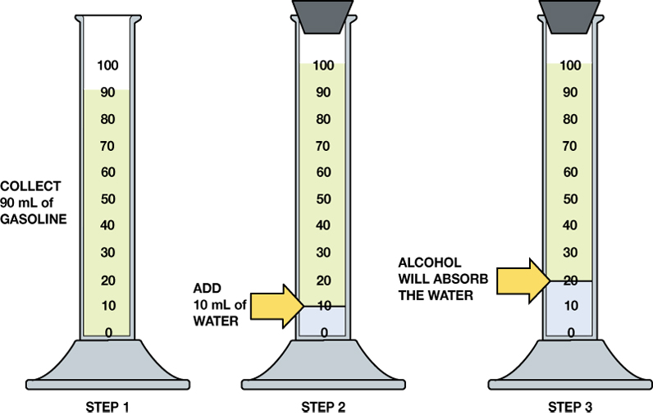
FIGURE 12–15 Checking gasoline for alcohol involves using a graduated cylinder and adding water to check if the alcohol absorbs the water.

Slide 20
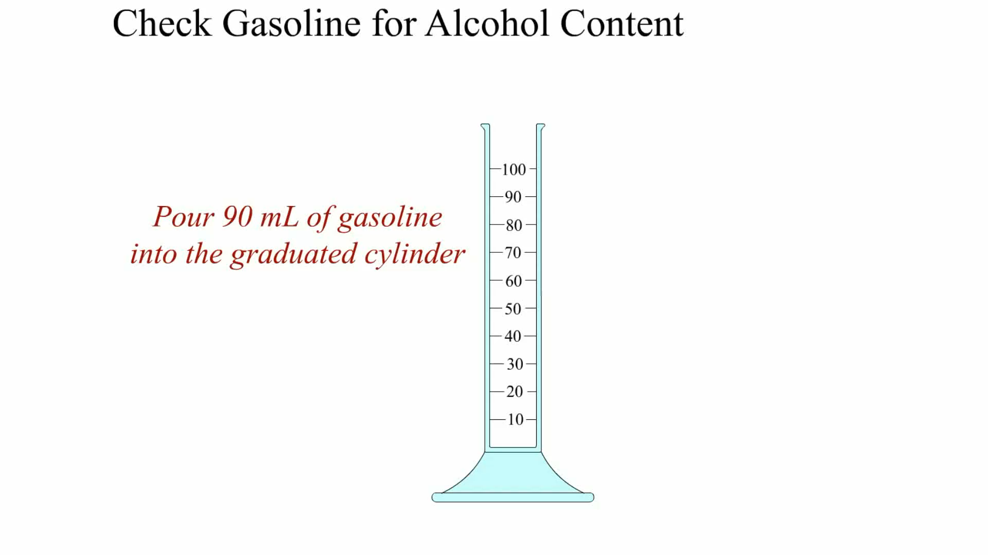
Animation: Check Gasoline for Alcohol Content
(The animation will automatically start in a few seconds)

Slide 21
GENERAL GASOLINE RECOMMENDATIONS (1 OF 2)
To help ensure proper engine operation and keep fuel costs to a minimum, follow these guidelines.
  Purchase fuel from a busy station
  Keep the fuel tank above one-quarter full
  Do not purchase fuel with a higher octane rating than is necessary.

Slide 22
GENERAL GASOLINE RECOMMENDATIONS (2 OF 2)
  Try to avoid using gasoline with alcohol in warm weather
  Do not purchase fuel from a retail outlet when a tanker truck is filling the underground tanks.
  Do not overfill the gas tank.
  Be careful when filling gasoline containers.

Slide 23
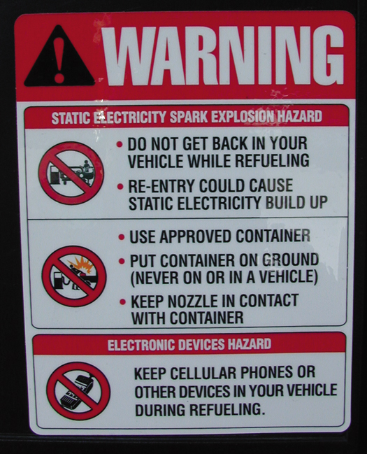
FIGURE 12–17 Many service stations have signs posted warning customers to place plastic fuel containers on the ground while filling. If placed in a trunk or pickup truck bed equipped with a plastic liner, static electricity could build up during fueling and discharge from the container to the metal nozzle, creating a spark and possible explosion. Some service stations have warning signs not to use cell phones while fueling to help avoid the possibility of an accidental spark creating a fire hazard.

Slide 24
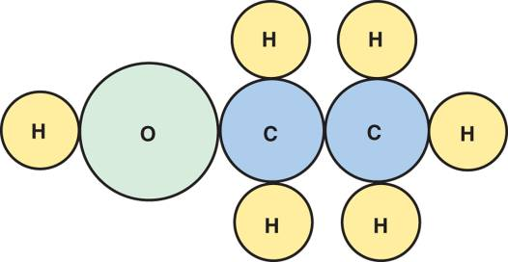
E85
Vehicle manufacturers have available vehicles that are capable of operating on gasoline plus ethanol
  Or a combination of gasoline and ethanol called E85, composed of 85% ethanol and 15% gasoline.
FIGURE 12–18 The ethanol molecule showing two carbon atoms, six hydrogen atoms, and one oxygen atom.

Slide 25
ALTERNATIVE FUEL VEHICLES
The 15% gasoline in the E85 blend helps the engine start, especially in cold weather.
Vehicles equipped with this capability are commonly referred to as:
  Alternative fuel vehicles (AFVs)
  Flex fuels
  Flexible fuel vehicles (FFVs)

Slide 26
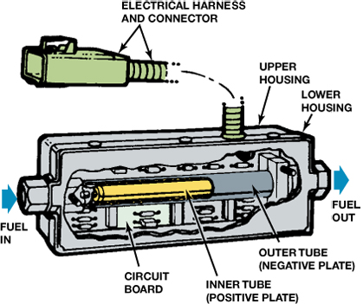
FIGURE 12–21 A cutaway view of a typical variable fuel sensor.

Slide 27
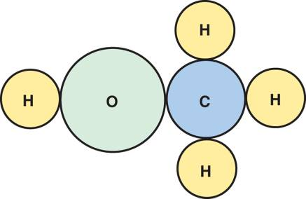
METHANOL
Methanol, also known as methyl alcohol, wood alcohol, or methyl hydrate is a chemical compound formula that includes one carbon atom, four hydrogen atoms, and one oxygen atom.
FIGURE 12–24 The molecular structure of methanol showing the one carbon atom, four hydrogen atoms, and one oxygen atom.

Slide 28
PROPANE AND COMPRESSED NATURAL GAS (1 OF 2)
Propane is the most widely used of all the alternative fuels mainly because of its use in fleets, which utilize a central refueling station.
Propane is normally a gas but is easily compressed into a liquid and stored in inexpensive containers.

Slide 29
PROPANE AND COMPRESSED NATURAL GAS (2 OF 2)
CNG vehicle design
CNG composition
CNG fuel systems

Slide 30
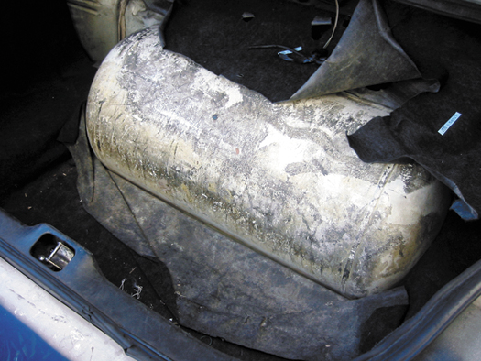
FIGURE 12–26 Propane fuel storage tank in the trunk of a Ford taxi.

Slide 31
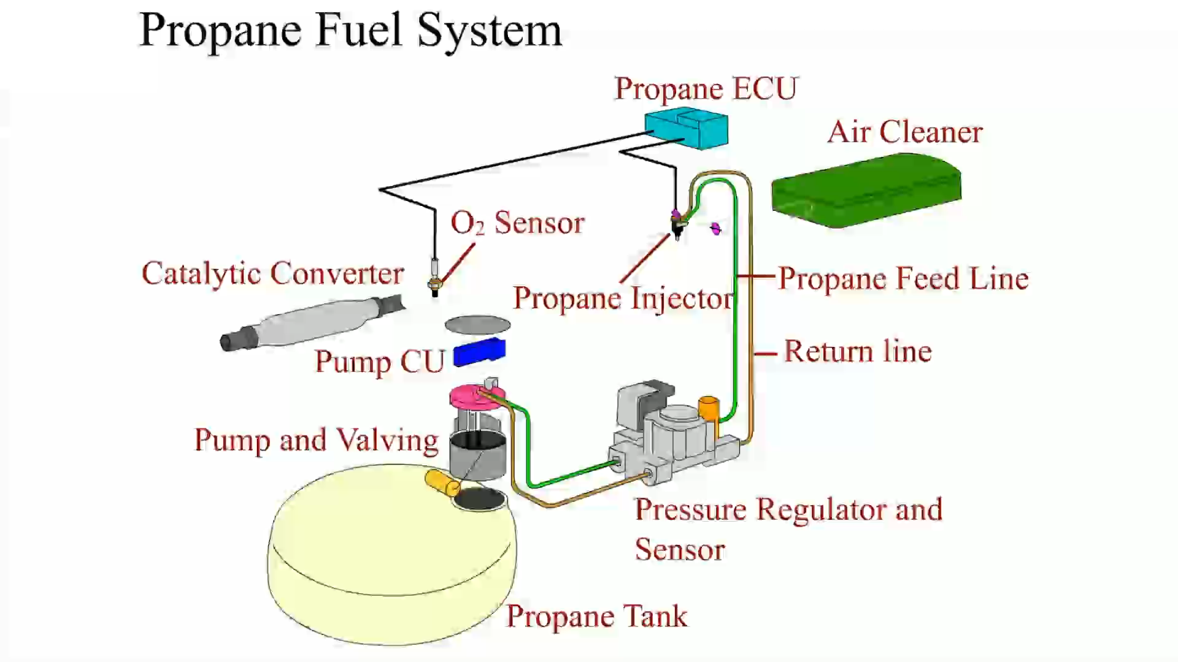
Animation: Propane Fuel System
(The animation will automatically start in a few seconds)

Slide 32
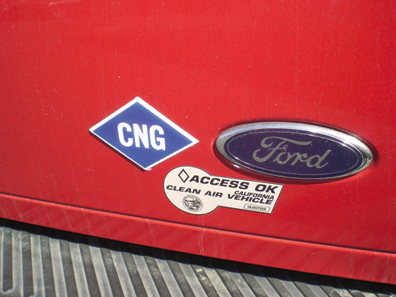
FIGURE 12–27 The blue sticker on the rear of this vehicle indicates that it is designed to use compressed natural gas. This Ford truck also has a sticker that allows it to be driven in the high occupancy vehicle (HOV) lane, even if there is just the driver, because it is a CNG vehicle.

Slide 33
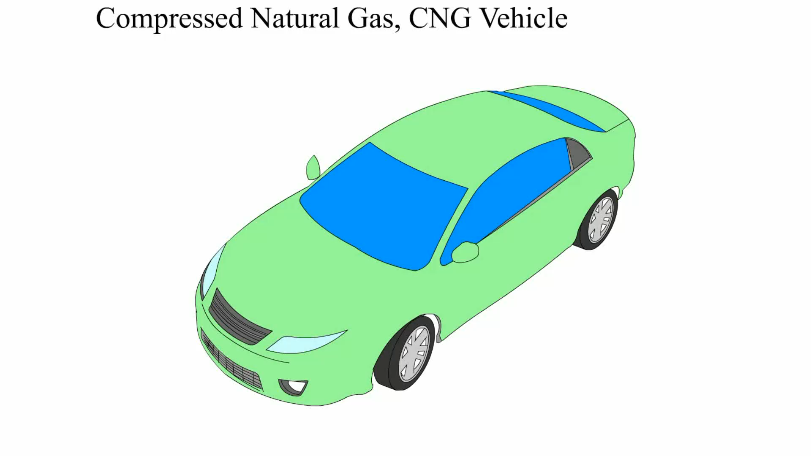
Animation: Compressed Natural Gas, CNG Vehicle
(The animation will automatically start in a few seconds)

Slide 34
LIQUIFIED NATURAL GAS (1 OF 2)
Natural gas can be turned into a liquid if cooled to below −260°F (−127°C).
  The natural gas condenses into a liquid at normal atmospheric pressure and the volume is reduced by about 600 times.

Slide 35
LIQUIFIED NATURAL GAS (2 OF 2)
Because the temperature of liquefied natural gas (LNG) must be kept low, it is best used for fleets where a central LPG station can be used to refuel the vehicles.

Slide 36
P-SERIES FUELS (1 OF 2)
A nonpetroleum or natural gas based fuel suitable for use in flexible fuel vehicles or any vehicle designed to operate on E85
Recognized by the U.S. Department of Energy as being an alternative fuel, but is not yet available to the public.

Slide 37
P-SERIES FUELS (2 OF 2)
Blends of the following:
  Ethanol (ethyl alcohol)
  Methyltetrahydrofuron (MTHF)
  Natural gas liquids, such as pentanes
  Butane

Slide 38
SYNTHETIC FUELS
Introduction
Fischer-Tropsch
Coal To Liquid
  Direct method
  Indirect method
Methanol to Gasoline
Future of Synthetic Fuels

Slide 39
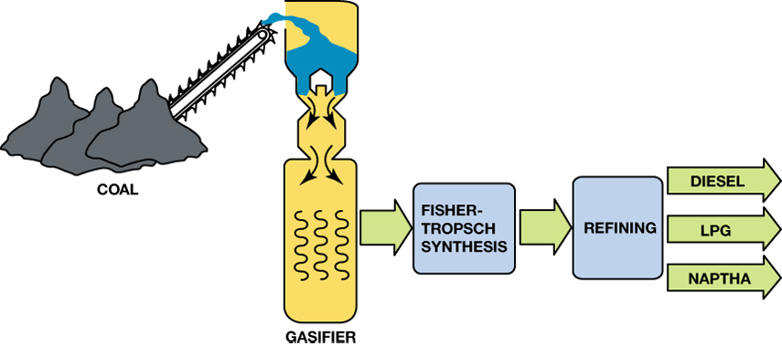
FIGURE 12–31 A Fischer-Tropsch processing plant is able to produce a variety of fuels from coal.

Slide 40
SAFETY PROCEDURES WHEN WORKING WITH ALTERNATIVE FUELS
All fuels are flammable and many are explosive under certain conditions.
Whenever working around compressed gases of any kind (CNG, LNG, propane, or LPG), always wear personal protective equipment (PPE)
Dealing with spills

Slide 41
DIESEL FUEL (1 OF 2)
Features of Diesel Fuel
Diesel Fuel Requirements
Cetane Number
Sulfur Content
Diesel Fuel Color

Slide 42
DIESEL FUEL (2 OF 2)
Grades of Diesel Fuel
Diesel Fuel Specific Gravity Testing
Ultra-low-sulfur Diesel Fuel

Slide 43
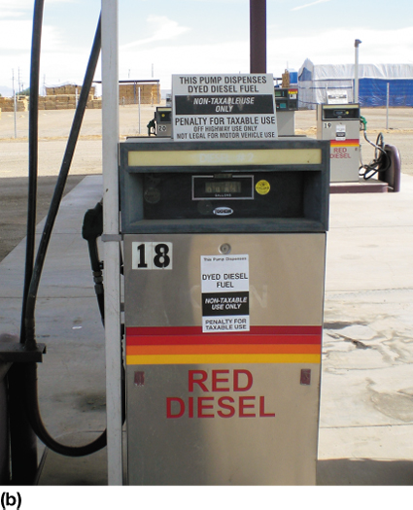
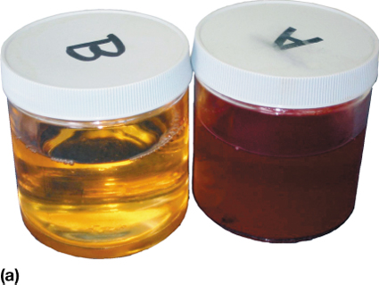
FIGURE 12–32 (a) Regular diesel fuel on the left has a clear or greenish tint, whereas fuel for off-road use is tinted red for identification. (b) This fuel pump in a farming area clearly states the red diesel fuel is for off-road use only.

Slide 44
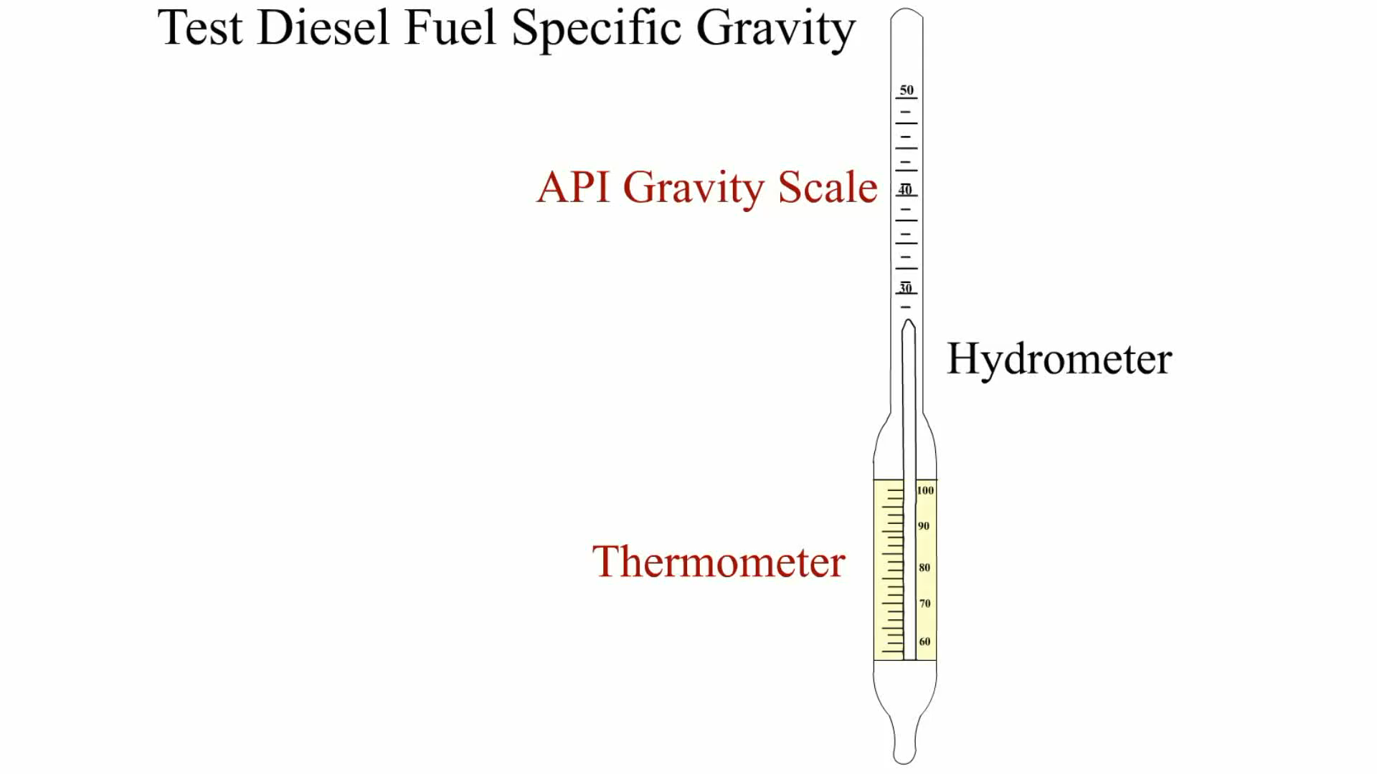
Animation: Test Diesel Fuel Specific Gravity
(The animation will automatically start in a few seconds)

Slide 45
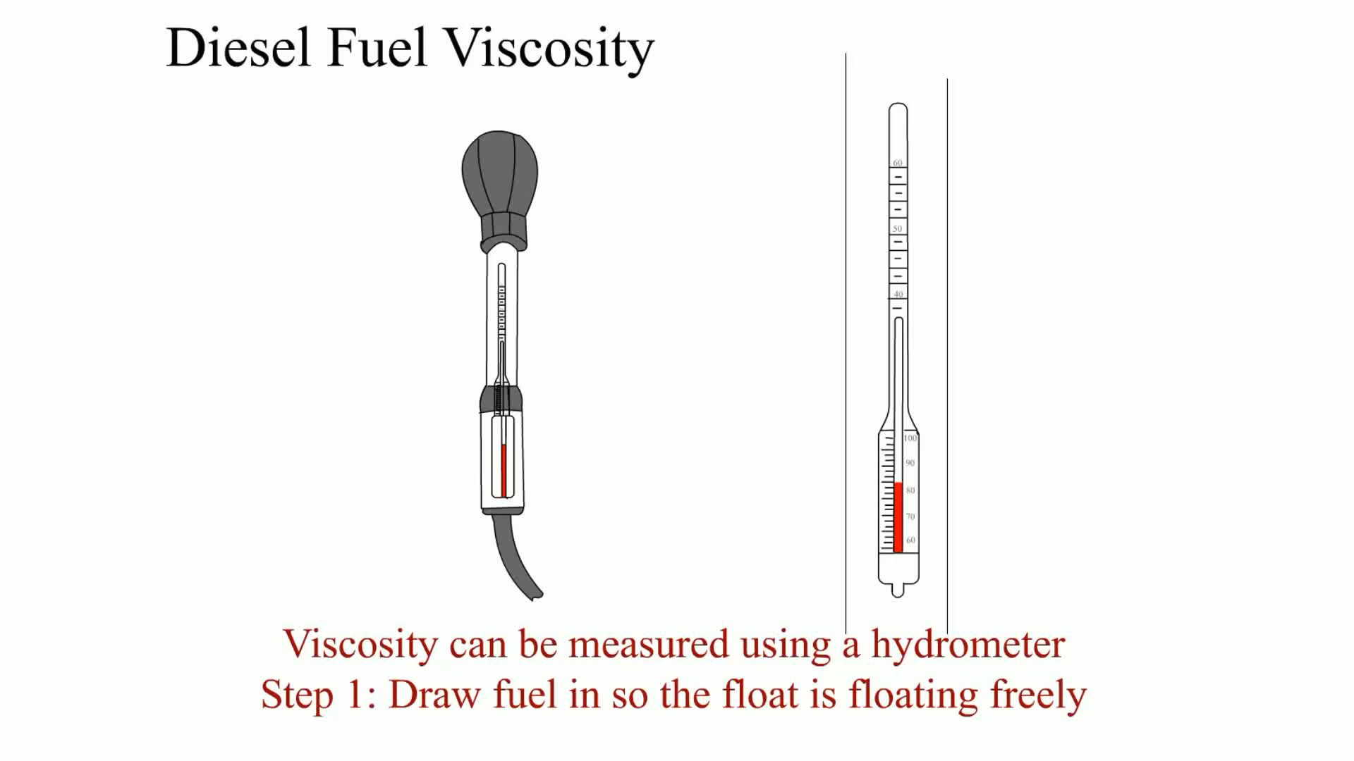
Animation: Diesel Fuel Viscosity
(The animation will automatically start in a few seconds)

Slide 46
BIODIESEL AND E-DIESEL
Biodiesel is a domestically produced, renewable fuel that can be manufactured from vegetable oils, animal fats, or recycled restaurant greases.
E-diesel, also called diesohol outside of the United States, is standard No. 2 diesel fuel that contains up to 15% ethanol.
Cetane Rating of E-diesel

Slide 47
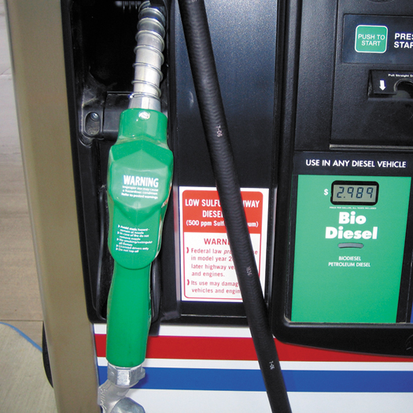
FIGURE 12–34 A biodiesel pump decal indicating that the diesel fuel is ultra-low-sulfur diesel (ULSD) and must be used in 2007 and newer diesel vehicles.

Slide 48
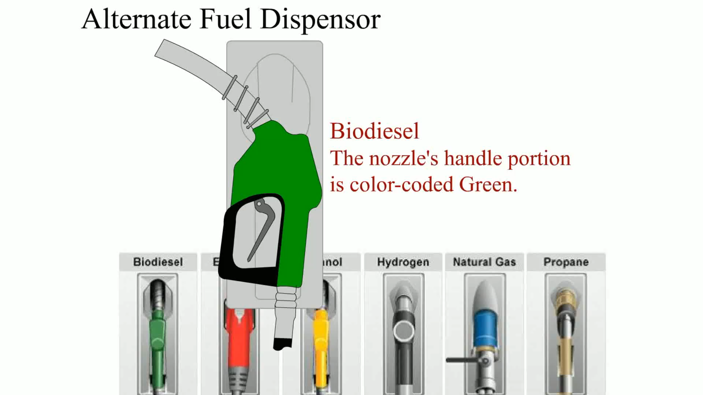
Animation: Alternative Fuel Dispenser
(The animation will automatically start in a few seconds)

Slide 49
SUMMARY (1 OF 3)
Gasoline is a complex blend of hydrocarbons.
Abnormal combustion increases the temperature and the pressure inside the combustion chamber.
E85 has fewer BTUs of energy per gallon compared with gasoline and will therefore provide lower fuel economy.

Slide 50
SUMMARY (2 OF 3)
Methanol can be made from wood, it is mostly made from natural gas.
Compressed natural gas (CNG) is available for refilling in several pressures
Propane is the most widely used alternative fuel.
Wear necessary personal protective equipment when working around alternative fuel

Slide 51
SUMMARY (3 OF 3)
Diesel fuel requirements include cleanliness, low-temperature fluidity, and proper cetane rating.
Emission control require the use of ultra-low-sulfur diesel (ULSD) that has less than 15 parts per million (ppm) of sulfur.
Biodiesel is the blend of vegetable-based liquid with regular diesel fuel.

Slide 52
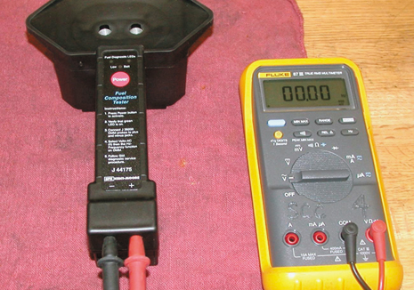
1 A fuel composition tester (SPX Kent-Moore J-44175) is the recommended tool to use to test the alcohol content of gasoline.

Slide 53
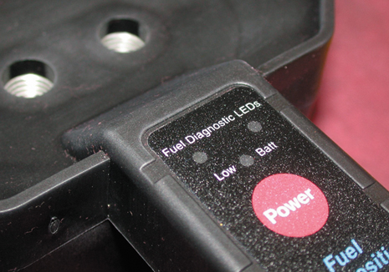
2 This battery-powered tester uses light-emitting diodes (LEDs), meter lead terminals, and two small openings for the fuel sample.

Slide 54
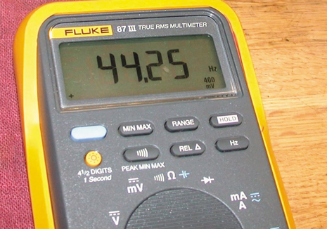
3 The first step is to verify the proper operation of the tester by measuring the air frequency by selecting AC hertz on the meter. The air frequency should be between 35 Hz and 48 Hz.

Slide 55
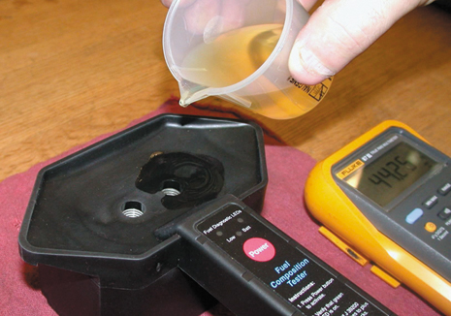
4 After verifying that the tester is capable of correctly reading the air frequency, gasoline is poured into the testing cell of the tool.

Slide 56
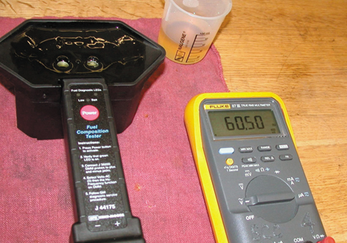
5 Record the AC frequency as shown on the meter and subtract 50 from the reading (e.g., 60.50 − 50.00 = 10.5). This number (10.5) is the percentage of alcohol in the gasoline sample.

Slide 57
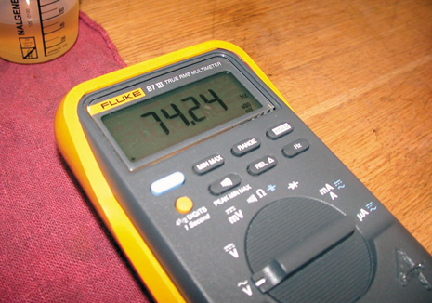
6 Adding additional amounts of ethyl alcohol (ethanol) increases the frequency reading.

Slide 58
Video Links (Internet Access Required)
Alternative Fuel: Water Powered Cars Part 1 (time 10:25)
Alternative Fuel: Water Powered Cars Part 2 (time 3:42)
Alternative Fuel Vehicles (time 2:55)
Octane rating and 4 stroke engine (time 7:52)

