Slide 1

Automotive Engines Theory and Servicing
Ninth Edition
Chapter 11
Diesel Engine Operation and Diagnosis

Slide 2
OBJECTIVES (1 OF 3)
11.1 State the characteristics of diesel engines.
11.2 Describe the fuel tank and lift pump, injection pump, and engine-driven vacuum pump.
11.3 Explain the HEUI system.
11.4 Discuss the purpose of glow plugs, diesel fuel heaters, diesel injector nozzles, and accelerator pedal position sensors.

Slide 3
OBJECTIVES (2 OF 3)
11.5 Explain the purpose of diesel engine turbochargers.
11.6 Discuss the purpose of the exhaust gas recirculation system, selective catalytic reduction, and diesel oxidation catalysts.
11.7 Explain diesel particulate matter, and discuss the function of diesel exhaust particulate filters.

Slide 4
OBJECTIVES (3 OF 3)
11.8 Discuss diesel exhaust smoke diagnosis.
11.9 Discuss compression testing, glow plug resistance balance test, injector pop testing, and diesel emission testing.

Slide 5
DIESEL ENGINES (1 OF 3)
The diesel engine uses heat created by compression to ignite the fuel, so it requires no spark ignition system.
  The diesel engine requires compression ratios of 16:1 and higher.
  Incoming air is compressed until its temperature reaches about 1,000°F (540°C).
  This is called heat of compression.

Slide 6
DIESEL ENGINES (2 OF 3)
As the piston reaches the top of its compression stroke, fuel is injected into the cylinder, where it is ignited by the hot air.
As the fuel burns, it expands and produces power.
  It is made heavier and stronger than the same size gasoline-powered engine.

Slide 7
DIESEL ENGINES (3 OF 3)
A diesel engine uses a fuel system with a precision injection pump and individual fuel injectors.
  The pump delivers fuel to the injectors at a high pressure and at timed intervals.
  Each injector sprays fuel into the combustion chamber at the precise moment required for efficient combustion.

Slide 8
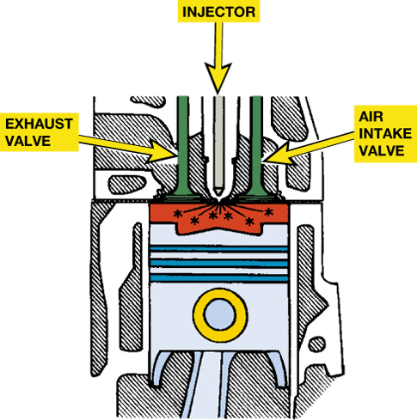
FIGURE 11–1 Diesel combustion occurs when fuel is injected into the hot, highly compressed air in the cylinder.

Slide 9
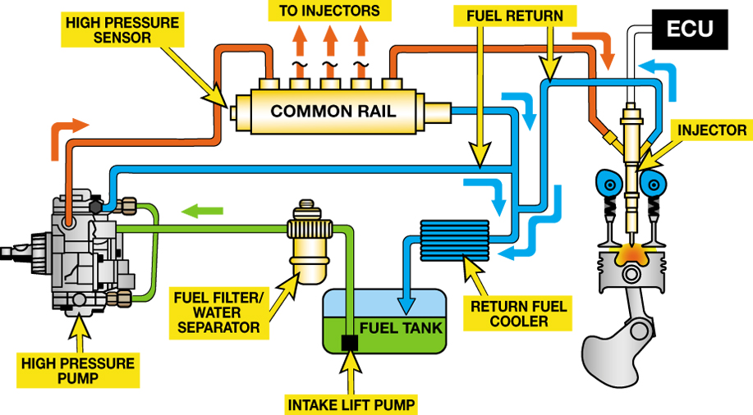
FIGURE 11–2 A Typical high-pressure common rail (HPCR) type diesel fuel system.

Slide 10
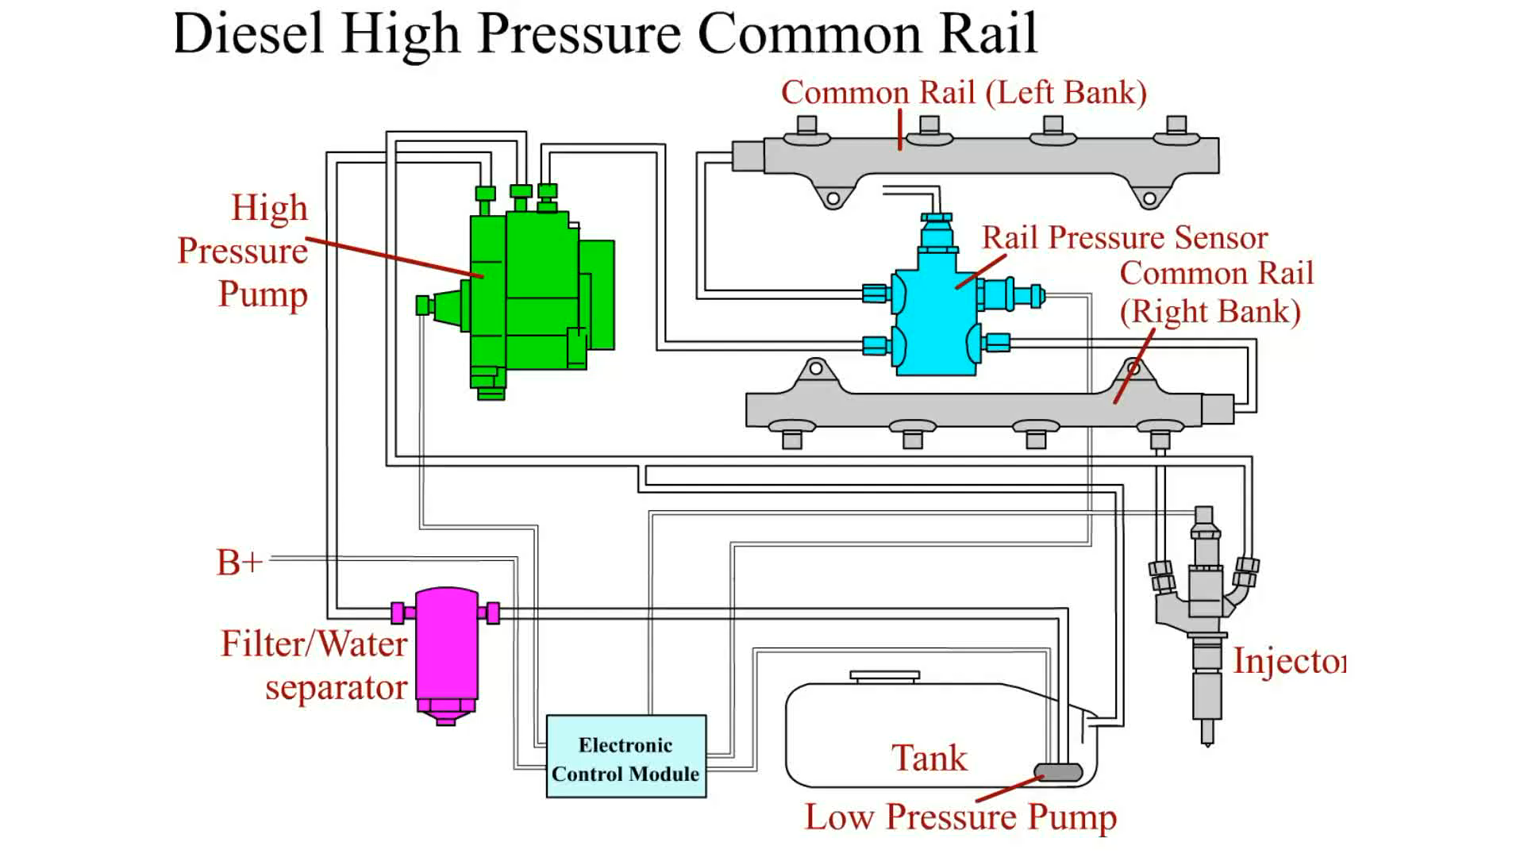
Animation: Diesel High Pressure Common Rail
(The animation will automatically start in a few seconds)

Slide 11
THREE PHASES OF COMBUSTION
What are the three phases to the combustion in a diesel engine?

Slide 12
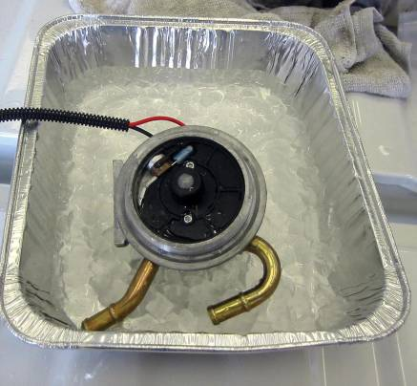
FUEL TANK AND LIFT PUMP
PARTS INVOLVED
A fuel tank used on a vehicle equipped with a diesel engine differs from the one used with a gasoline engine.
  The filler neck is larger for diesel fuel.
  There are no evaporative emission control devices or a charcoal (carbon) canister.
FIGURE 11–7 A fuel temperature sensor is being tested using an ice bath.

Slide 13
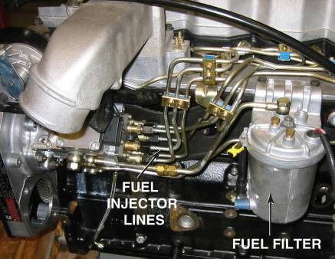
INJECTION PUMP
Need For High-pressure Fuel Pump
Distributor Injection Pump
High-pressure Common Rail
FIGURE 11–8 A typical distributor-type diesel injection pump showing the pump, lines, and fuel filter.

Slide 14
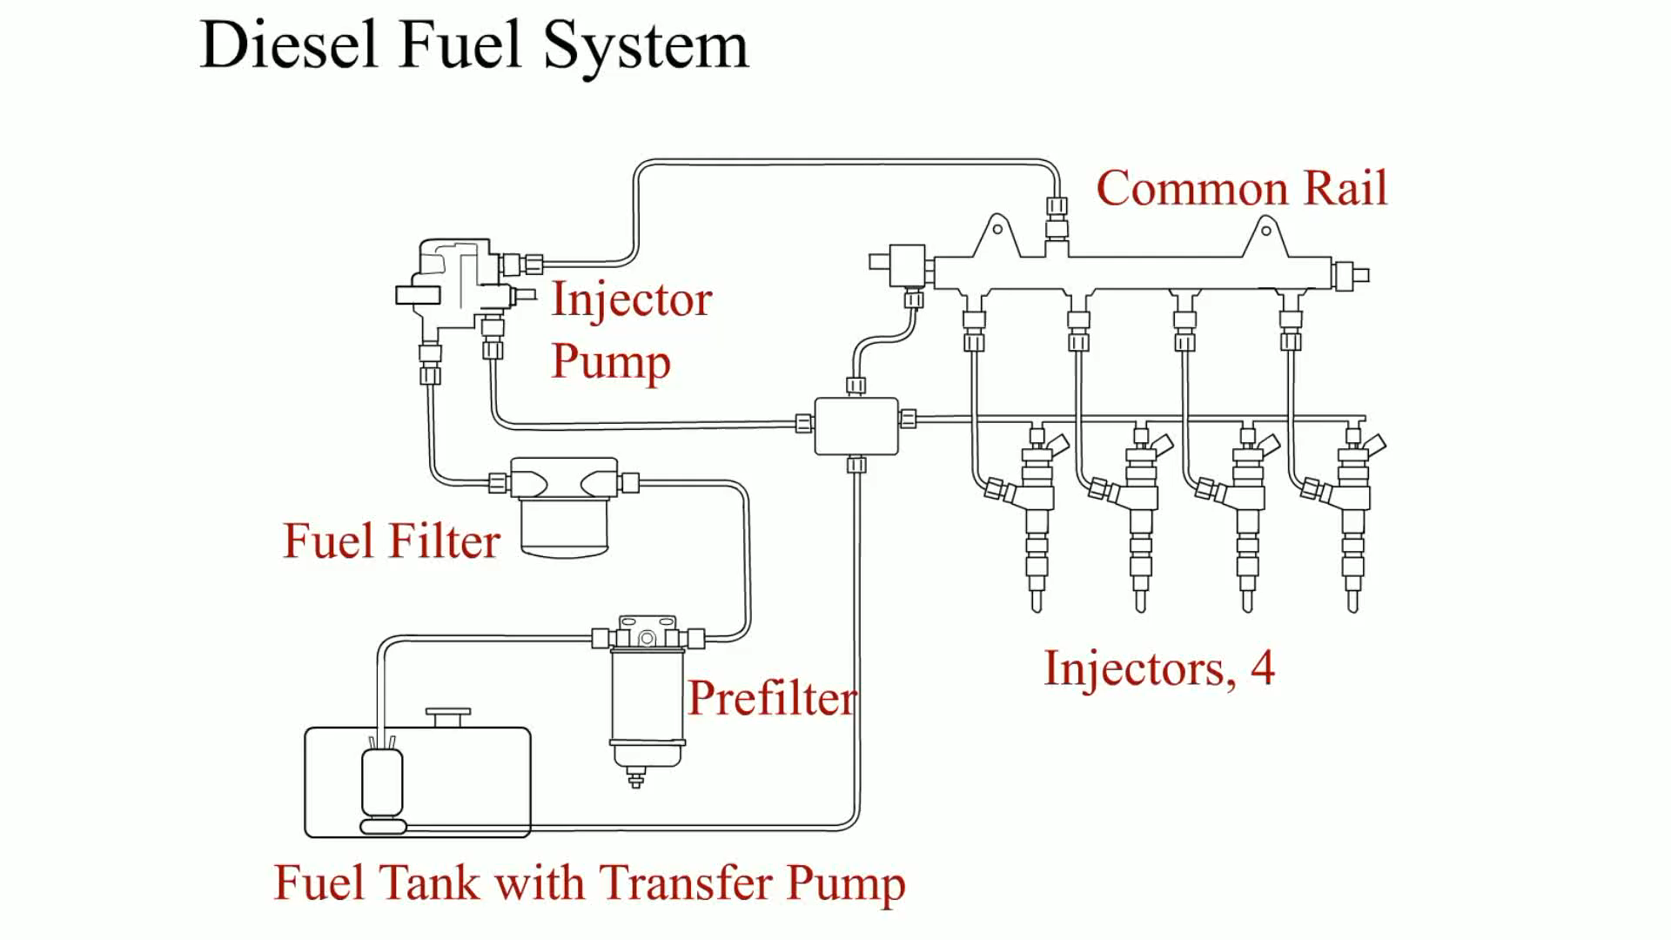
Animation: Diesel Fuel System
(The animation will automatically start in a few seconds)

Slide 15
HEUI SYSTEM (1 OF 2)
The components used include:
  High-pressure engine oil pump and reservoir
  Pressure regulator for the engine oil
  Passages in the cylinder head for flow of fuel to the injectors

Slide 16
HEUI SYSTEM (2 OF 2)
The engine oil is pressurized to provide an opening pressure strong enough to overcome the fuel pressure when the solenoid is commanded to open by the PCM.

Slide 17
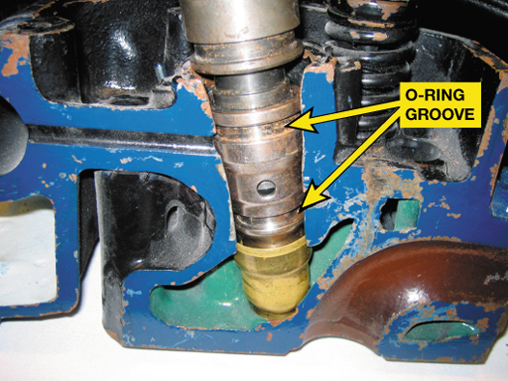
FIGURE 11–11 A HEUI injector from a Ford PowerStroke diesel engine. The O-ring grooves indicate the location of the O-rings that seal the fuel section of the injector from coolant and from the engine oil.

Slide 18
DIESEL INJECTOR NOZZLES (1 OF 2)
The tip of the injector nozzle has many holes to deliver an atomized spray of diesel fuel into the cylinder.
The electric solenoid attached to the injector nozzle is computer controlled and opens to allow fuel to flow into the injector pressure chamber.

Slide 19
DIESEL INJECTOR NOZZLES (2 OF 2)
Parts of a diesel injector nozzle include:
  Heat shield
  Injector body
  Diesel injector needle valve
  Injector pressure chamber

Slide 20
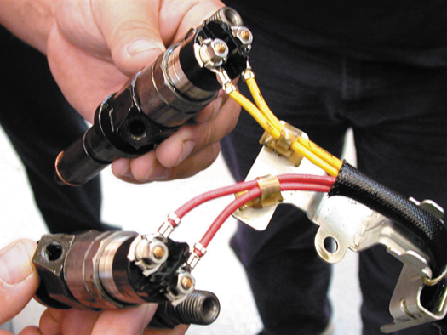
FIGURE 11–12 Typical computer-controlled diesel engine fuel injectors.

Slide 21
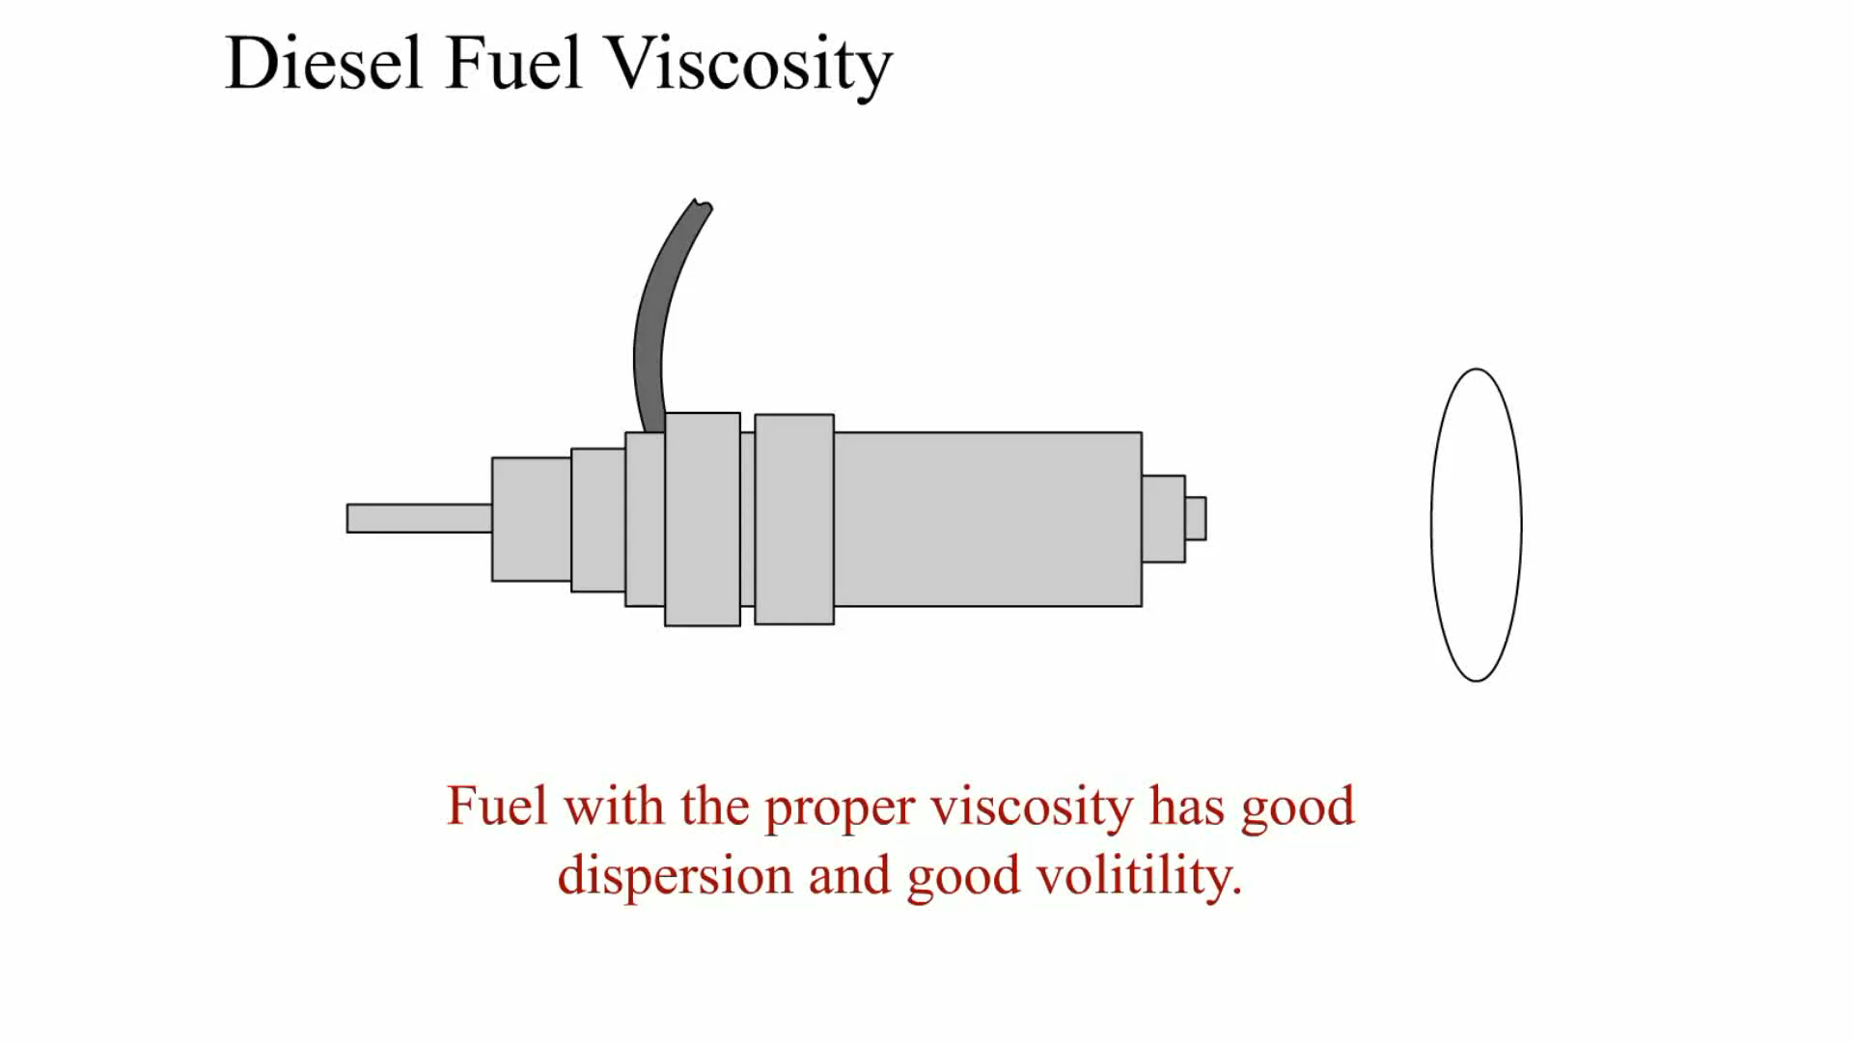
Animation: Diesel Fuel Viscosity
(The animation will automatically start in a few seconds)

Slide 22
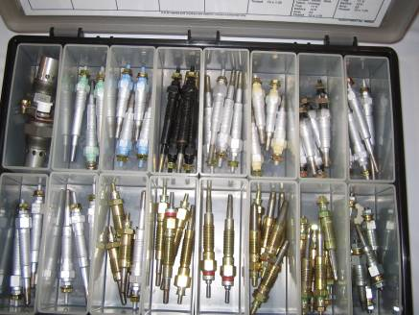
GLOW PLUGS
Purpose and Function
Operation
Heated Inlet Air
FIGURE 11–14 A glow plug assortment showing the various types and sizes of glow plugs used. Always use the specified glow plugs.

Slide 23
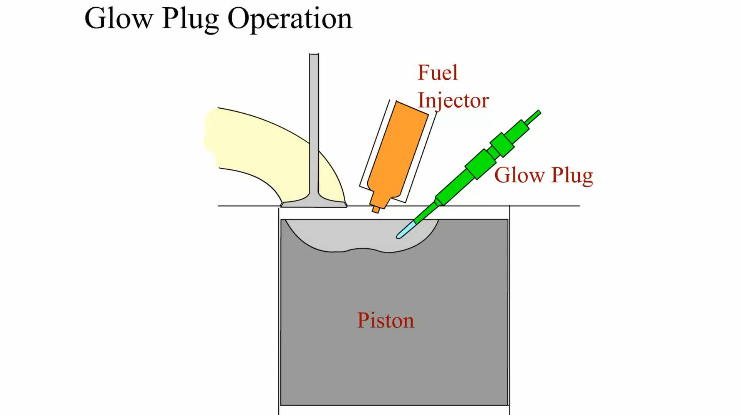
Animation: Glow Plug Operation
(The animation will automatically start in a few seconds)

Slide 24
ENGINE-DRIVEN VACUUM PUMP (1 OF 2)
Because a diesel engine is unthrottled, it creates very little vacuum in the intake manifold.
  Several engine and vehicle components operate using vacuum, such as the exhaust gas recirculation (EGR) valve and the heating and ventilation blend and air doors.

Slide 25
ENGINE-DRIVEN VACUUM PUMP (2 OF 2)
  Most diesels used in cars and light trucks are equipped with an engine-driven vacuum pump to supply the vacuum for these components.

Slide 26
DIESEL FUEL HEATERS
Diesel fuel heaters help prevent power loss and stalling in cold weather.
  The heater is placed in the fuel line between the tank and the primary filter.
  Some coolant heaters are thermostatically controlled, which allows fuel to bypass the heater once it has reached operating temperature.

Slide 27
ACCELERATOR PEDAL POSITION SENSOR
Some light-truck diesel engines are equipped with an electronic throttle to control the amount of fuel injected into the engine.
A throttle-by-wire system uses an accelerator pedal position (APP) sensor.

Slide 28
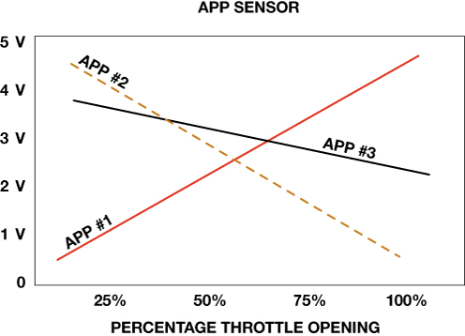
FIGURE 11–17 A typical accelerator pedal position (APP) sensor uses three different sensors in one package with each creating a different voltage as the accelerator is moved.

Slide 29
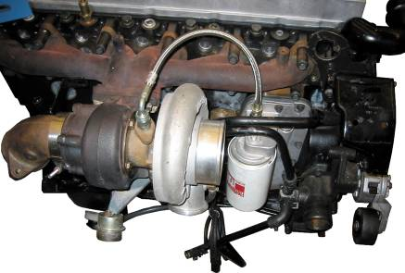
DIESEL ENGINE TURBOCHARGERS
Turbocharged Diesels
Air Charge Cooler
Variable Turbocharger
FIGURE 11–18 A Cummins diesel turbocharger is used to increase the power and torque of the engine.

Slide 30
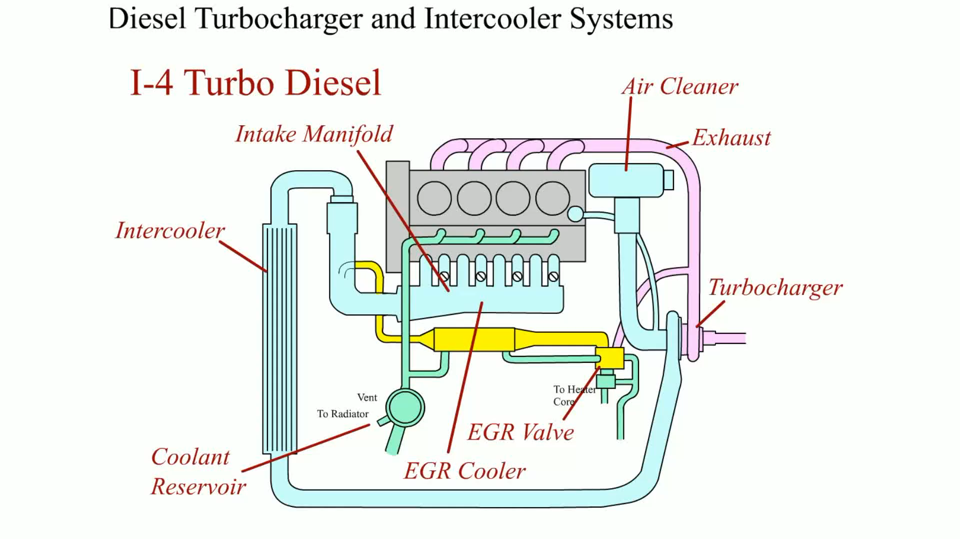
Animation: Diesel Turbocharger and Intercooler Systems
(The animation will automatically start in a few seconds)

Slide 31
EXHAUST GAS RECIRCULATION (1 OF 2)
The EGR system recycles some exhaust gas back into the intake stream to cool combustion, which reduces oxides of nitrogen (NOx) emissions.
The EGR system includes:
  Plumbing that carries some exhaust gas from the turbocharger exhaust inlet to the intake ports

Slide 32
EXHAUST GAS RECIRCULATION (2 OF 2)
  EGR control valve
  Stainless steel cooling element used to cool the exhaust gases

Slide 33
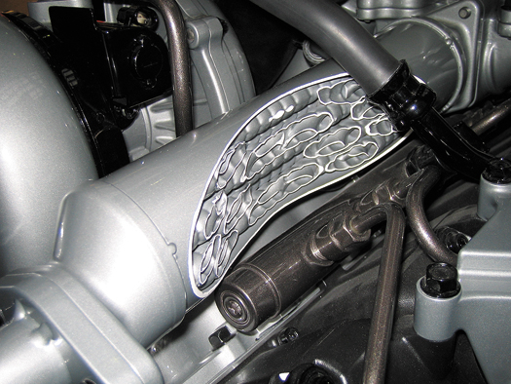
FIGURE 11–21 A cutaway showing the exhaust cooler. The cooler the exhaust is, the more effective it is in controlling NOx emissions.

Slide 34
DIESEL PARTICULATE MATTER
Particulate Matter Standards
  Total suspended particulate (TSP)
  PM10
  PM2.5
Soot Categories
  Fine
  Ultrafine

Slide 35
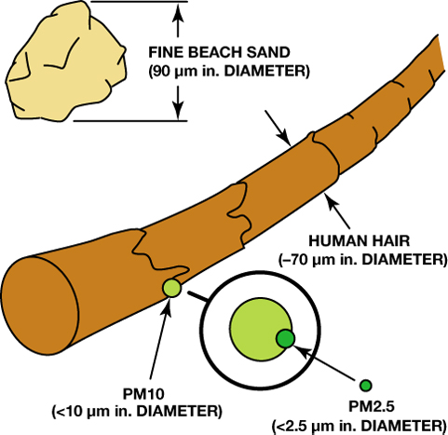
FIGURE 11–22 Relative size of particulate matter to a human hair.

Slide 36
DIESEL OXIDATION CATALYST (1 OF 2)
Catalysts chemically react with exhaust gas to convert harmful nitrogen oxide into nitrogen dioxide, and to oxidize absorbed hydrocarbons.
The chemical reaction acts as a combustor for the unburned fuel that is characteristic of diesel compression ignition.

Slide 37
DIESEL OXIDATION CATALYST (2 OF 2)
The DOC reduces: Carbon monoxide (CO), Hydrocarbons (HC), Odor-causing compounds such as aldehydes and sulfur.

Slide 38
DIESEL EXHAUST PARTICULATE FILTER (1 OF 2)
Purpose and Function
Operation
Exhaust Gas Temperature Sensors
DPF Differential Pressure Sensor
Diesel Particulate Filter Regeneration

Slide 39
DIESEL EXHAUST PARTICULATE FILTER (2 OF 2)
DPF Regeneration Process
Types of DPF Regeneration
Ash Loading

Slide 40
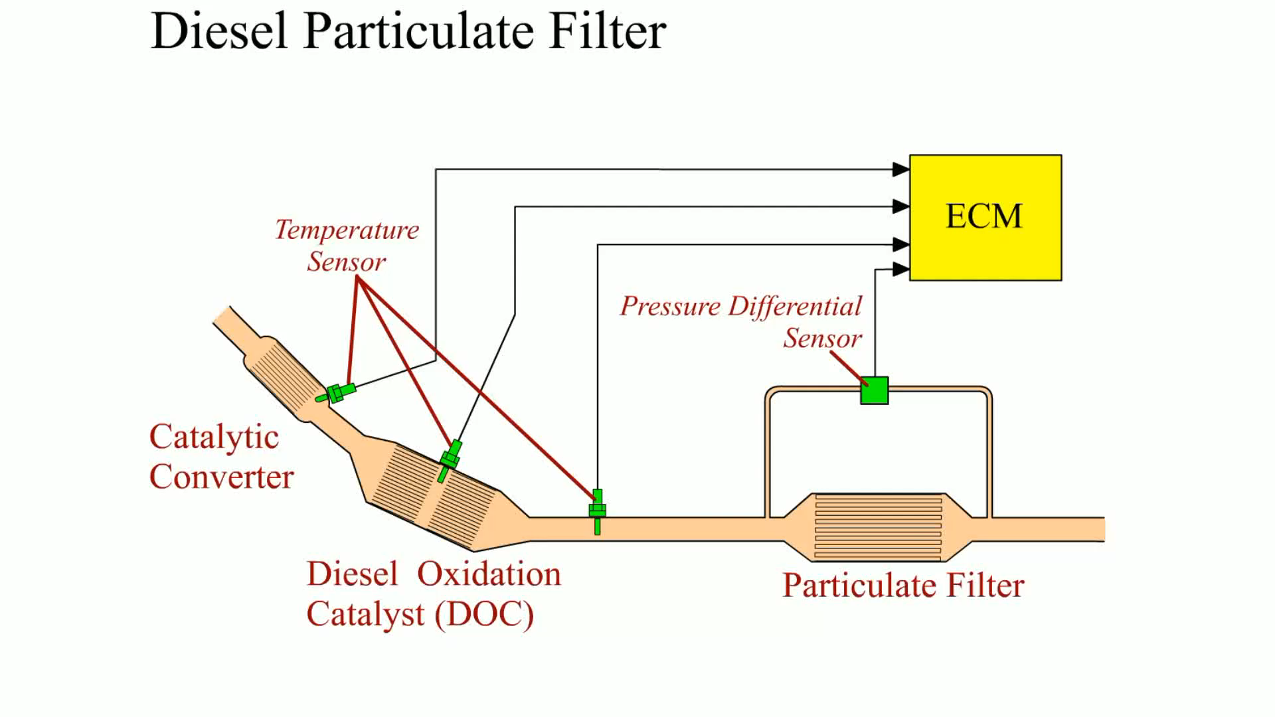
Animation: Diesel Particulate Filter
(The animation will automatically start in a few seconds)

Slide 41
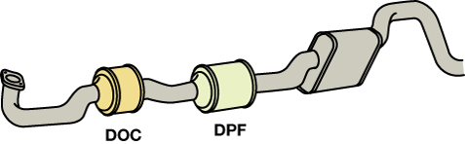
FIGURE 11–24 Aftertreatment of diesel exhaust is handled by the DOC and DPF.

Slide 42
SELECTIVE CATALYTIC REDUCTION
Purpose and Function
  Selective catalytic reduction (SCR) is a method used to reduce NOx emissions by injecting urea into the exhaust stream.
  Instead of using large amounts of exhaust gas recirculation (EGR), the SCR system uses a urea.
Advantages of SCR
Disadvantages of SCR

Slide 43
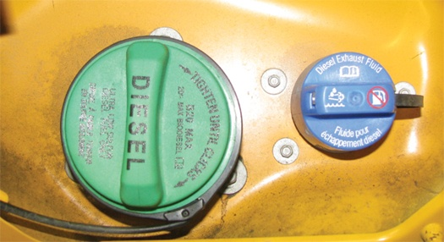
FIGURE 11–30 Diesel exhaust fluid is housed in a separate container that holds from 5 to 10 gallons, or enough to last until the next scheduled oil change in most diesel vehicles that use SCR.

Slide 44
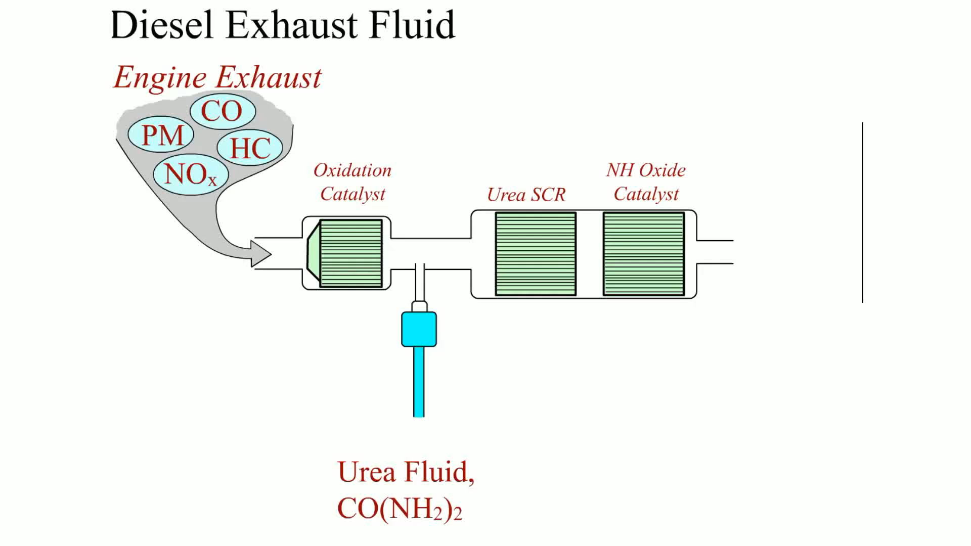
Animation: Diesel Exhaust Fluid
(The animation will automatically start in a few seconds)

Slide 45
DIESEL EXHAUST SMOKE DIAGNOSIS (1 OF 2)
Some exhaust smoke is considered normal operation for many diesel engines, especially older units.

Slide 46
DIESEL EXHAUST SMOKE DIAGNOSIS (2 OF 2)
The cause of excessive exhaust smoke should be diagnosed and repaired.
  Black Smoke
  White Smoke
  Gray or Blue Smoke

Slide 47
DISEL PERFORMANCE DIAGNOSIS
Common faults include:
  Hard starting
  No start
  Extended cranking before starting
  Low power

Slide 48
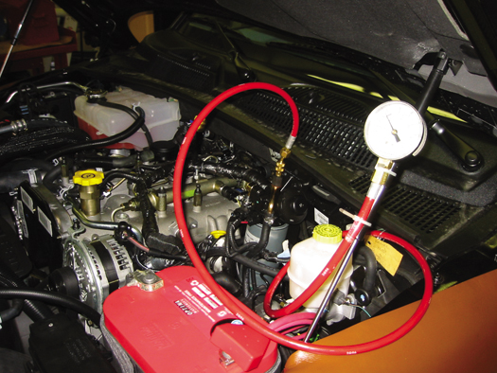
FIGURE 11–32 A pressure gauge checking the fuel pressure from the lift pump on a Cummins 6.7 liter diesel.

Slide 49
COMPRESSION TESTING (1 OF 2)
A compression test is fundamental for determining the mechanical condition of a diesel engine.
Worn piston rings can cause low power and excessive exhaust smoke.

Slide 50
COMPRESSION TESTING (2 OF 2)
To test the compression on a diesel engine, the following will have to be done.
  Remove the glow plug (if equipped) or the injector.
  Use a diesel compression gauge, as the compression is too high to use a gasoline engine compression gauge.

Slide 51
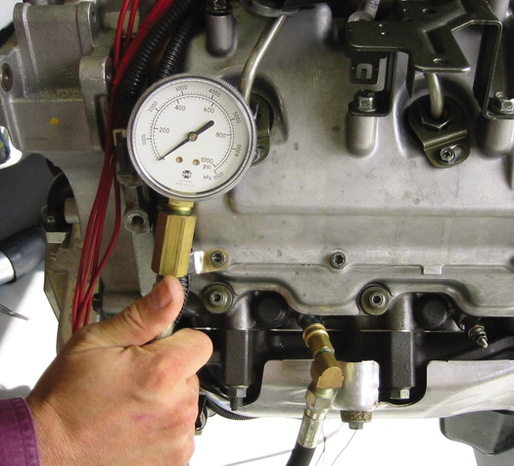
FIGURE 11–33 A compression gauge that is designed for the higher compression ratio of a diesel engine should be used when checking the compression.

Slide 52
GLOW PLUG RESISTANCE BALANCE TEST
Glow plugs increase in resistance as their temperature increases.
All glow plugs should have about the same resistance when checked with an ohmmeter.
A similar test of the resistance of the glow plugs can be used to detect a weak cylinder.
This test is particularly helpful on a diesel engine that is not computer controlled.

Slide 53
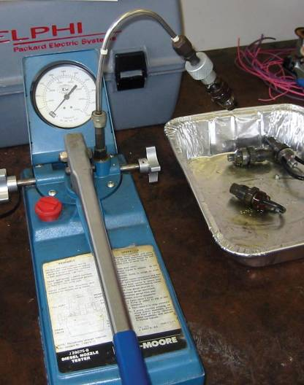
INJECTOR POP TESTING
A pop tester is a device used for checking a diesel injector nozzle for proper spray pattern.
The handle is depressed and popoff pressure is displayed on the gauge.
FIGURE 11–34 A typical pop tester used to check the spray pattern of a diesel engine injector.

Slide 54
DIESEL EMISSION TESTING
Opacity Test
Snap Acceleration Test
Rolling Acceleration Test
Stall Acceleration Test

Slide 55
SUMMARY (1 OF 3)
A diesel engine uses heat of compression to ignite the diesel fuel when it is injected into the compressed air in the combustion chamber.
The typical diesel engine fuel system consists of the fuel tank, lift pump, water-fuel separator, and fuel filter.

Slide 56
SUMMARY (2 OF 3)
The engine-driven injection pump supplies high-pressure diesel fuel to the injectors.
Injector nozzles are either opened by the high-pressure pulse from the distributor pump or electrically by the computer on a common rail design.

Slide 57
SUMMARY (3 OF 3)
Glow plugs are used to help start a cold diesel engine and help prevent excessive white smoke during warm-up.
Emissions are controlled on newer diesel engines
Diesel engine testing

Slide 58
Video Links (Internet Access Required)
How Diesel Engines Work Part 1 (time 4:13)
How Diesel Engines Work Part 2 (time 2:02)
How Diesel Engines Work Part 3 (time 2:32)
How Diesel Engines Work! (time 2:23)

