Slide 1
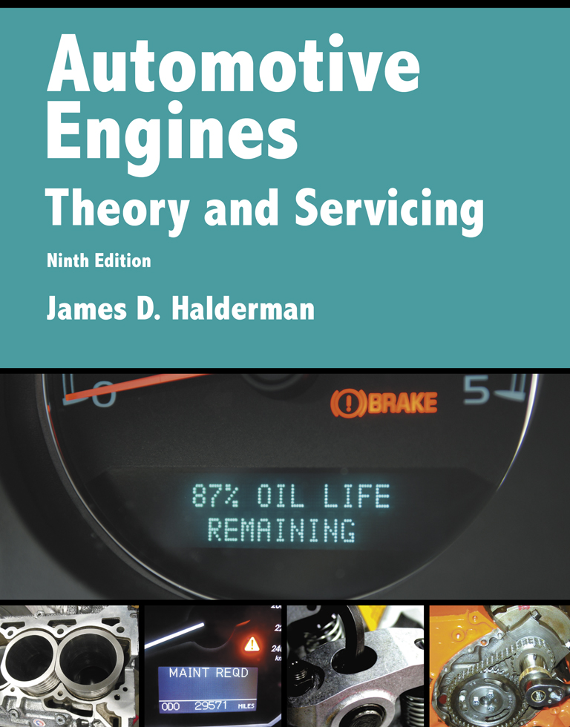
Automotive Engines Theory and Servicing
Ninth Edition
Chapter 10
Gasoline Engine Operation, Parts, and Specifications

Slide 2
OBJECTIVES (1 OF 2)
10.1 Discuss engine construction, purpose and function of an engine, and energy and power of an engine.
10.2 Explain engine parts and systems.
10.3 Explain four-stroke cycle operation.

Slide 3
OBJECTIVES (2 OF 2)
10.4 Discuss engine classification and construction.
10.5 Explain engine measurement.
10.6 Discuss compression ratio, torque, and horsepower.

Slide 4
PURPOSE AND FUNCTION
The purpose and function of an engine is to convert the heat energy of burning fuel into mechanical energy.
In a typical vehicle, mechanical energy is then used to perform the following:
Propel the vehicle
Power the air-conditioning system and power steering
Produce electrical power for use throughout the vehicle

Slide 5
ENERGY AND POWER (1 OF 2)
Engines use energy to produce power.
The chemical energy in fuel is converted to heat energy by the burning of the fuel at a controlled rate.
This process is called combustion.
If engine combustion occurs within the power chamber, the engine is called an internal combustion engine.

Slide 6
ENERGY AND POWER (2 OF 2)
The pressure developed within the combustion chamber is applied to the head of a piston to produce a usable mechanical force, which is then converted into useful mechanical power.

Slide 7
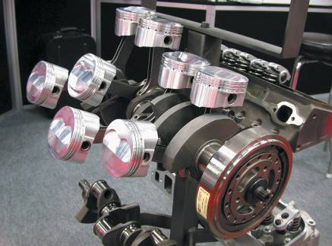
ENGINE CONSTRUCTION OVERVIEW
Block
Rotating Assembly
Cylinder Heads
FIGURE 10–1 The rotating assembly for a V-8 engine that has eight pistons and connecting rods and one crankshaft.

Slide 8
ENGINE PARTS AND SYSTEMS (1 OF 2)
Intake and Exhaust Manifolds
Cooling System
Lubrication System

Slide 9
ENGINE PARTS AND SYSTEMS (2 OF 2)
Fuel System and Ignition System
Spark plugs
Sensor(s)
Ignition coils
Ignition control module (ICM)
Associated wiring

Slide 10
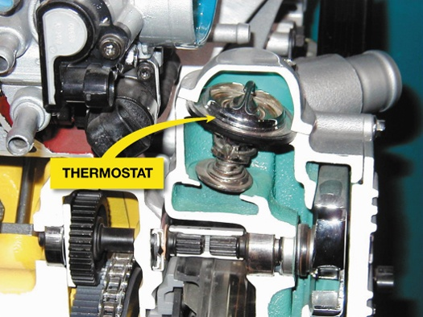
FIGURE 10–3 The coolant temperature is controlled by the thermostat, which opens and allows coolant to flow to the radiator when the temperature reaches the rating temperature of the thermostat.

Slide 11
FOUR-STROKE CYCLE OPERATION
Principles
Operation
Intake stroke
Compression stroke
Power stroke
Exhaust stroke
The 720-degree Cycle

Slide 12
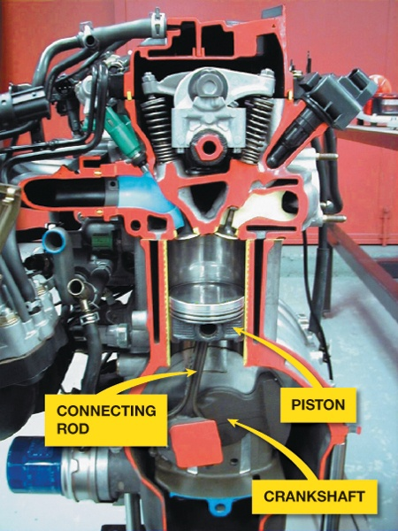
FIGURE 10–6 Cutaway of an engine showing the cylinder, piston, connecting rod, and crankshaft.

Slide 13
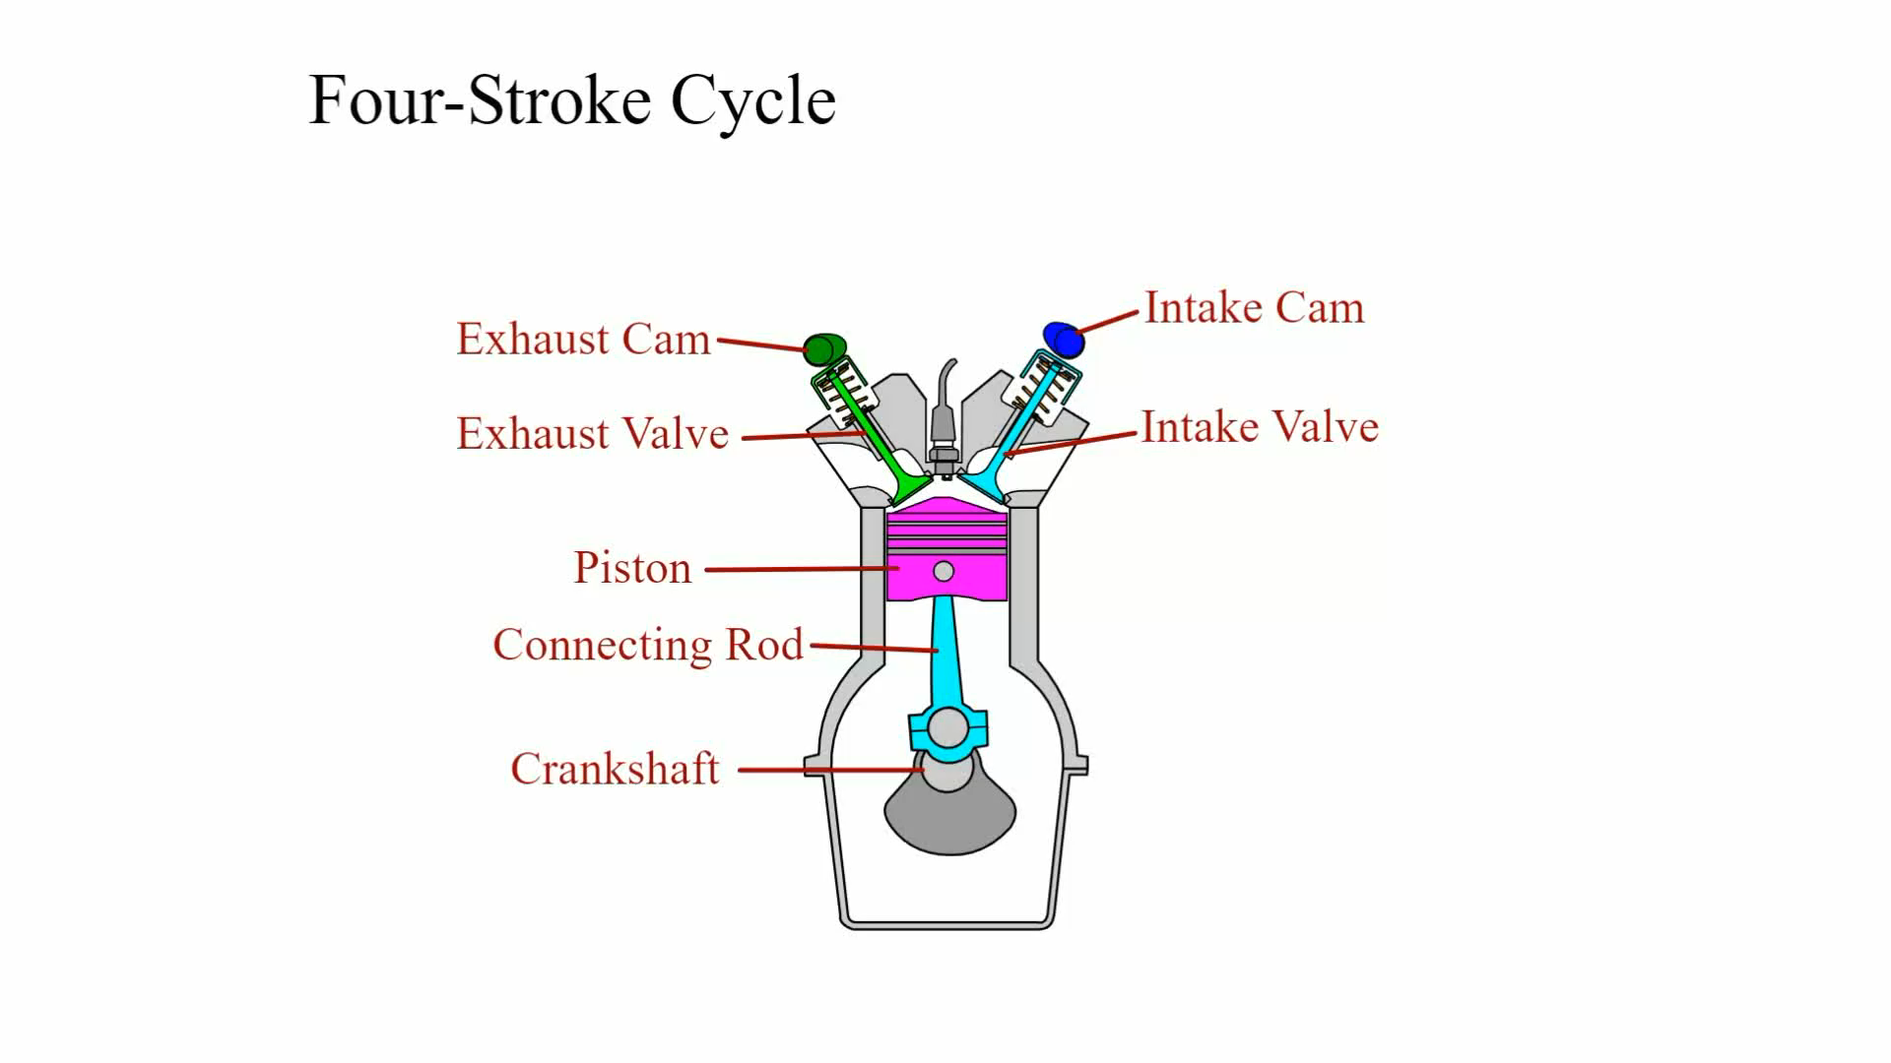
Animation: Four-Stroke Cycle (The animation will automatically start in a few seconds)

Slide 14
ENGINE CLASSIFICATION AND CONSTRUCTION (1 OF 3)
Engines are classified by several characteristics, including:
Number of strokes
Cylinder arrangement
Longitudinal and transverse mounting
Valve and camshaft number and location

Slide 15
ENGINE CLASSIFICATION AND CONSTRUCTION (2 OF 3)
Type of fuel
Cooling method
Type of induction pressure

Slide 16
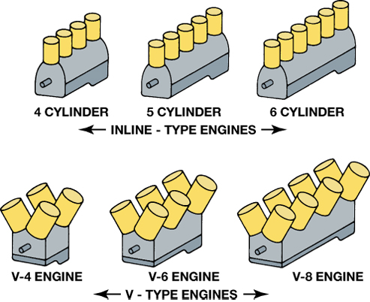
FIGURE 10–7 Automotive engine cylinder arrangements.

Slide 17
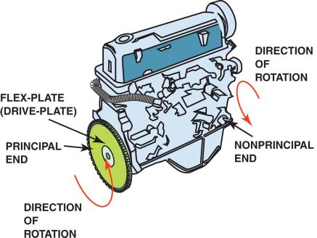
ENGINE CLASSIFICATION AND CONSTRUCTION (3 OF 3)
Engine Rotation Direction
FIGURE 10–15 Inline 4-cylinder engine showing principal and nonprincipal ends. Normal direction of rotation is clockwise (CW) as viewed from the front or accessory belt (nonprincipal) end.

Slide 18
ENGINE MEASUREMENT
Bore
Stroke
Displacement
Conversion
Calculating Cubic Inch Displacement
Engine Size Conversion

Slide 19
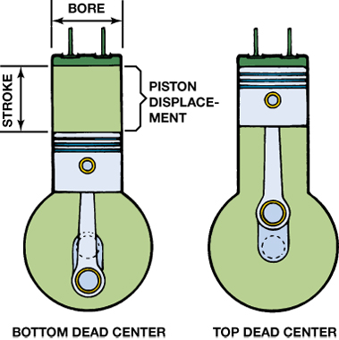
FIGURE 10–16 The bore and stroke of pistons are used to calculate an engine’s displacement.

Slide 20
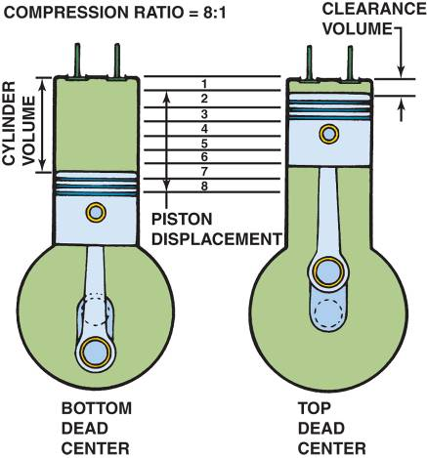
COMPRESSION RATIO (1 OF 2)
Compression ratio (CR) is the ratio of the difference in the cylinder volume when the piston is at the bottom of the stroke to the volume in the cylinder above the piston when the piston is at the top of the stroke.
FIGURE 10–18 Compression ratio is the ratio of the total cylinder volume (when the piston is at the bottom of its stroke) to the clearance volume (when the piston is at the top of its stroke).

Slide 21
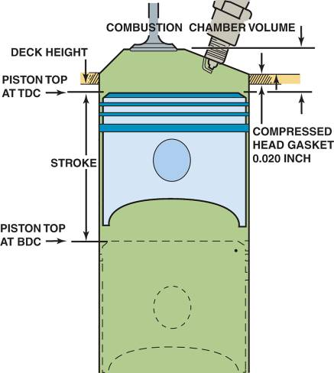
COMPRESSION RATIO (2 OF 2)
Calculating Compression Ratio
Changing Compression Ratio
Head gasket thickness
Increasing the cylinder size
FIGURE 10–19 Combustion chamber volume is the volume above the piston with the piston is at top dead center.

Slide 22
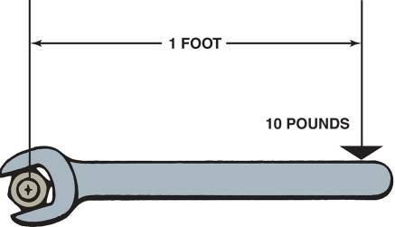
TORQUE AND HORSEPOWER
Definition of Torque
Definition of Power
Horsepower and Altitude
FIGURE 10–20 Torque is a twisting force equal to the distance from the pivot point times the force applied expressed in units called pound-feet (lb-ft) or newton-meters (N-m).

Slide 23
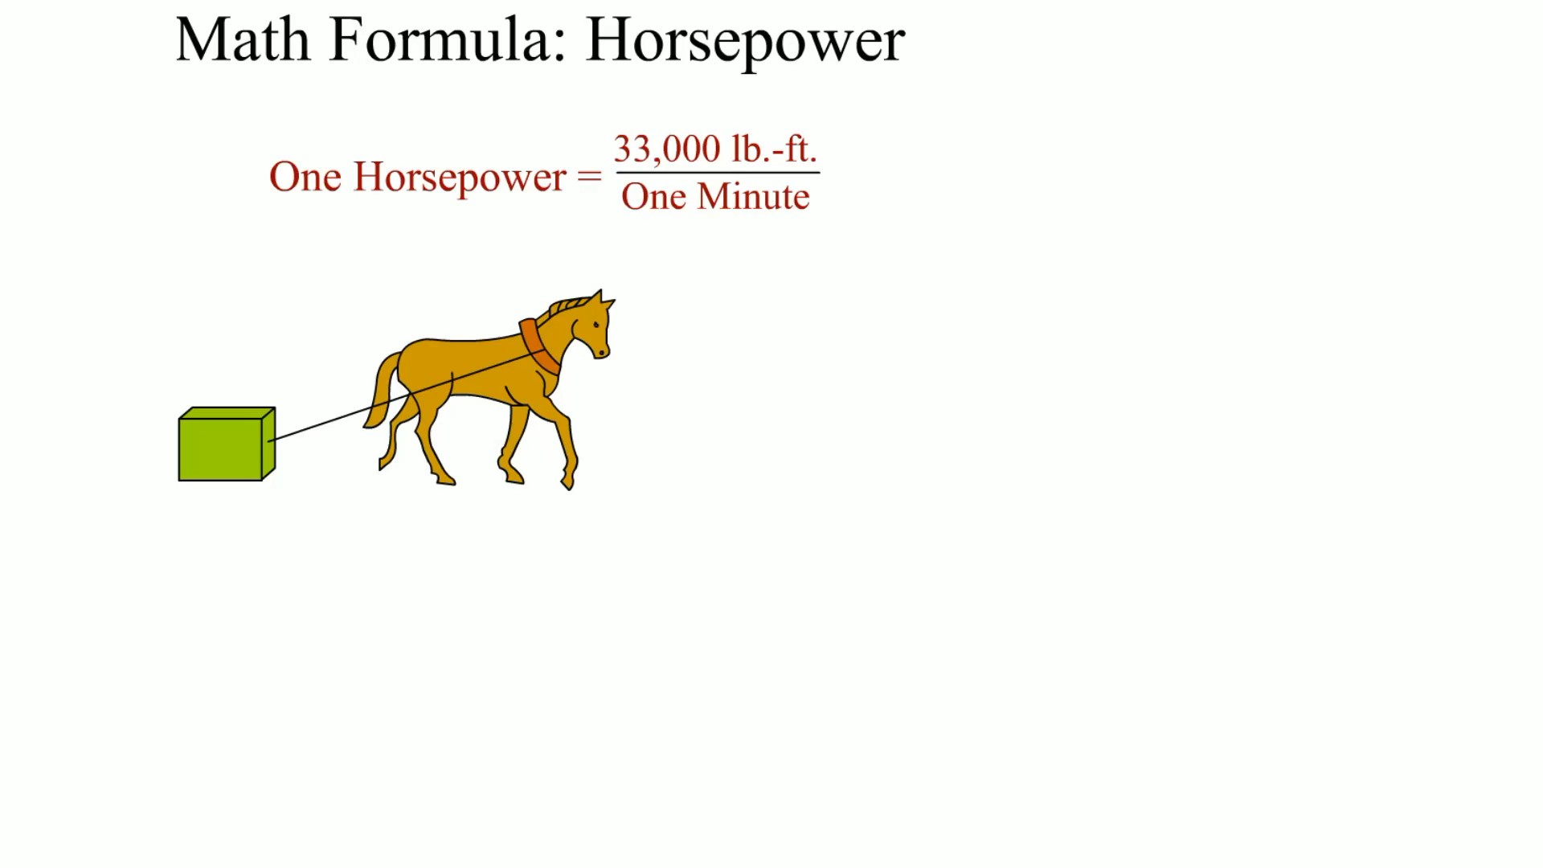
Animation: Math Formula: Horsepower (The animation will automatically start in a few seconds)

Slide 24
SUMMARY (1 OF 2)
The four strokes of the four-stroke cycle are intake, compression, power, and exhaust.
Engines are classified by number and arrangement of cylinders and by number and location of valves and camshafts.

Slide 25
SUMMARY (2 OF 2)
Most engines rotate clockwise as viewed from the front (accessory) end of the engine.
Engine size is called displacement and represents the volume displaced by all of the pistons.

Slide 26
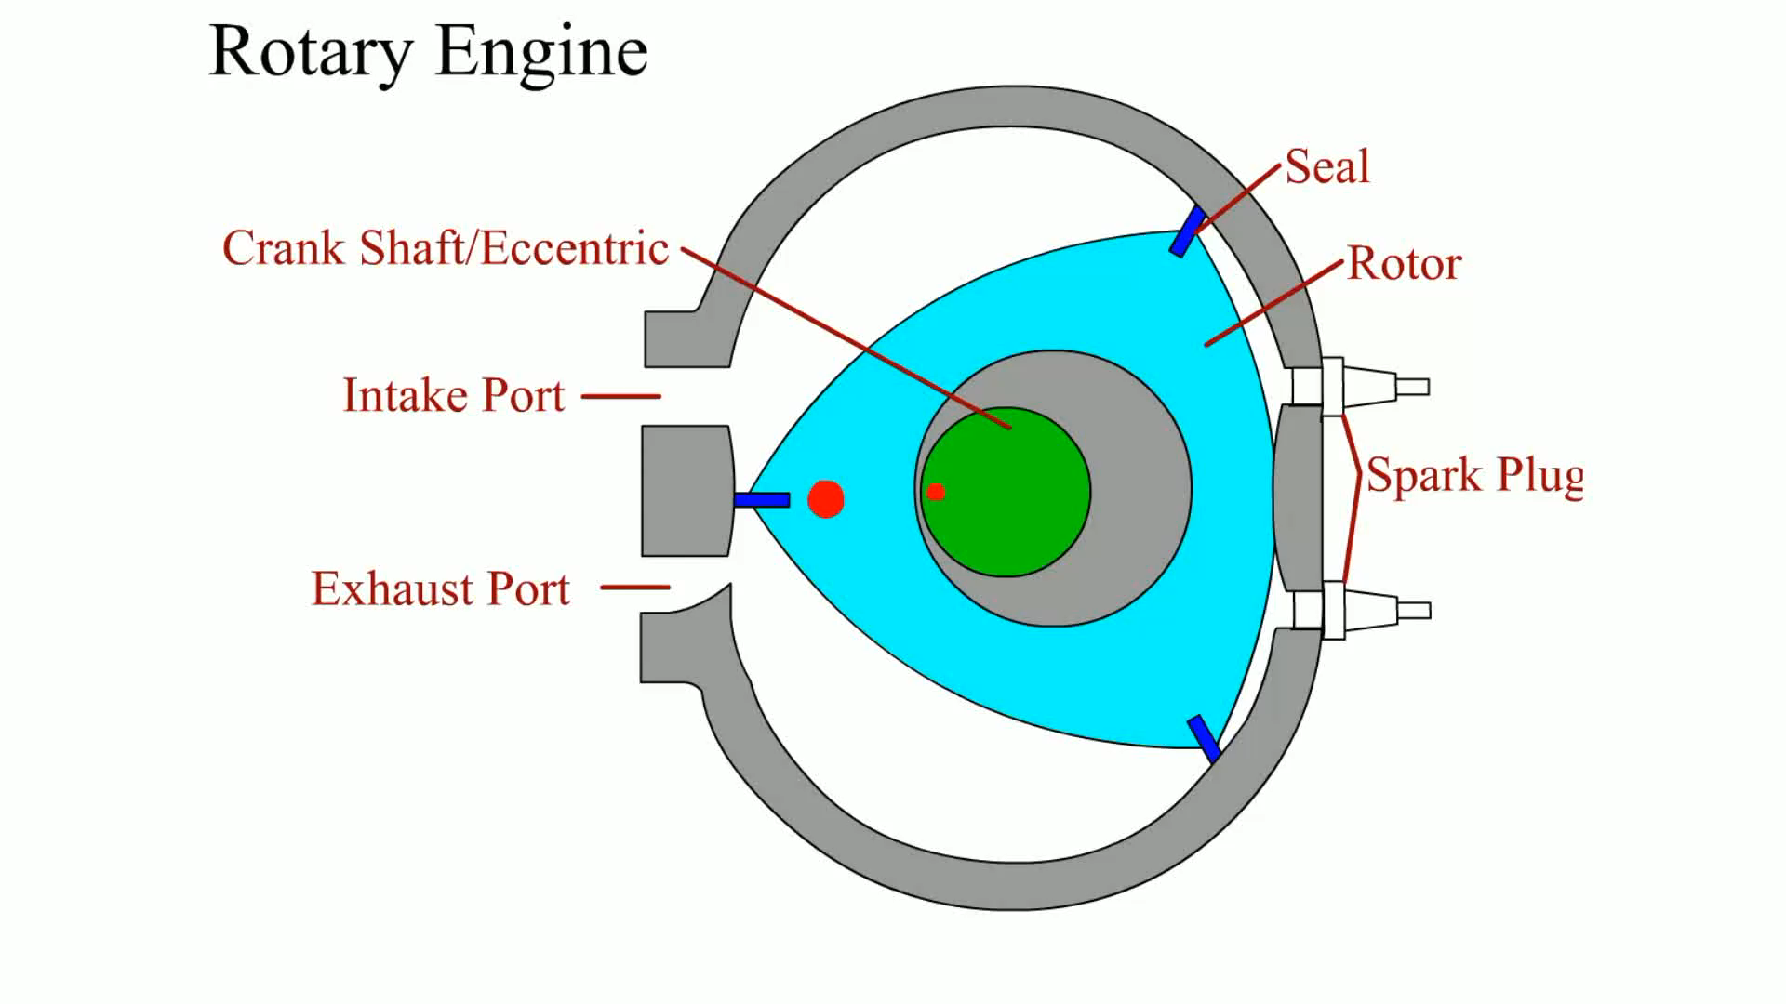
Animation: Rotary Engine (The animation will automatically start in a few seconds)

Slide 27
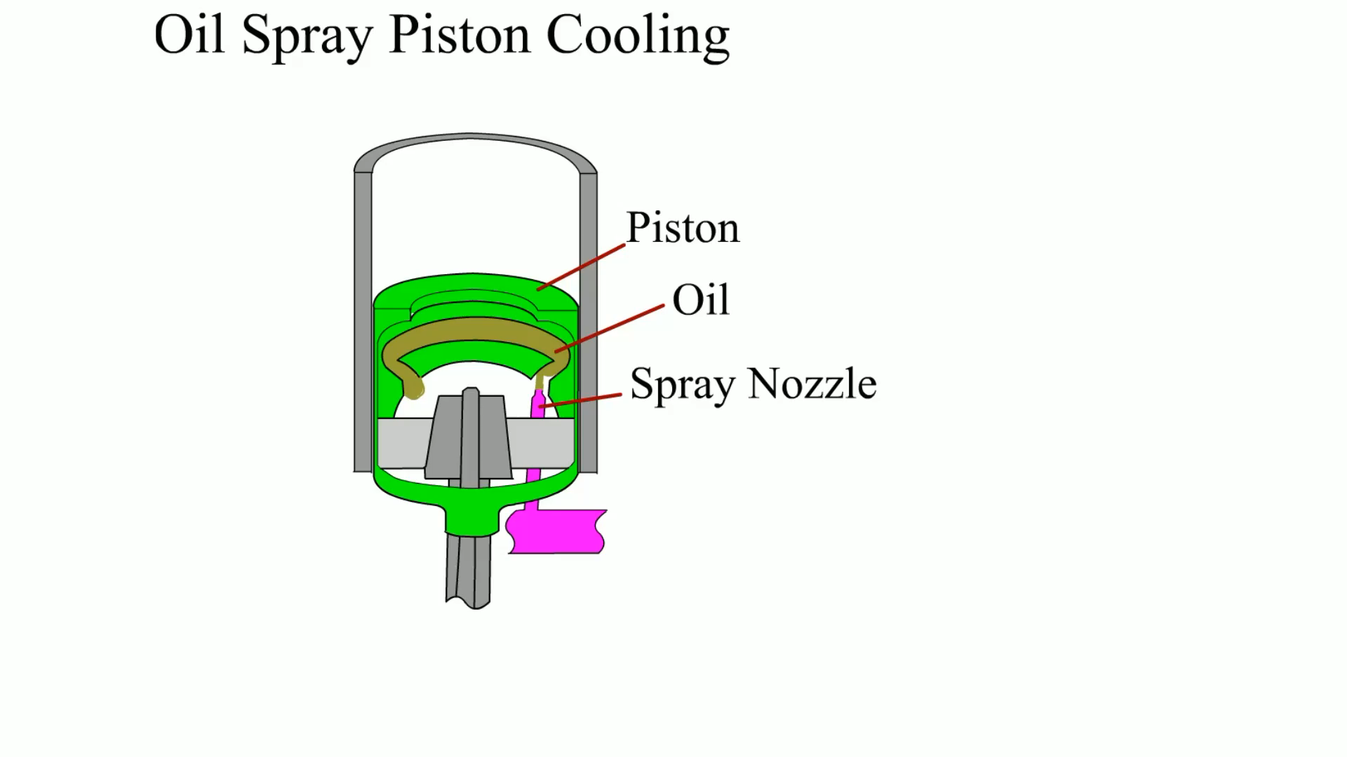
Animation: Oil Spray Piston Cooling (The animation will automatically start in a few seconds)

Slide 28
Video Links (Internet Access Required)
Timing belt (time 5:00)
Octane rating and 4 stroke engine (time 7:52)
How to find TDC (time 1:14)
Engine (time 5:02)
Basic engine parts (time 32:26)
Piston animation (time 0:56)
V-8 animation (time 1:21)
Rotary engine animation (time 3:25)
Engine assembly animation (time 3:12)
Engine assembly (time 1:51)

Slide 29
Video Links (Internet Access Required)
Ford Ecoboost Animation (time 2:41)
Ford Ecoboost Animation (time 1:32)
16 cylinder engine (time 0:44)
Rotary engine failures (time 2:42)
Rotary engine (time 5:17)
Rotary engine construction (time 4:17)
Rotary engine basics (time 3:07)
Transparent engine (time 2:21)

