Slide 1
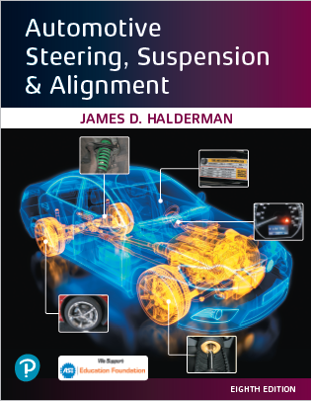
Automotive Steering, Suspension and Alignment Systems
Eighth Edition
Chapter 15
Electric Power Steering Systems
Copyright © 2021 Pearson Education, Inc. All Rights Reserved
Notes:
If this PowerPoint presentation contains mathematical equations, you may need to check that your computer has the following installed:
1) Math Type Plugin
2) Math Player (free versions available)
3) NVDA Reader (free versions available)

Slide 2
Figure 32.1 A rack-mounted electric power steering gear on a Lexus RX 400 h taken from underneath the vehicle

Slide 3
Figure 32.2 A belt-driven electric power steering system used on many Ford vehicles
Notes:
Long Description:
The system contains a control unit on the left. A motor is connected to the right of the control unit. A belt drive reducer is connected to the right of the motor. A ball screw is displayed at the bottom of the belt drive reducer. On the right side of the system, a steering angle sensor is displayed. The steering angle sensor is connected at the bottom to a steering torque sensor. The steering torque sensor is further connected to a rack and pinion gear at the bottom.

Slide 4
Figure 32.3 A typical column-mounted electric power steering (EPS) system showing the location of the major components involved including the dash warning light symbol
Notes:
Long Description:
The illustration also displays an instrument cluster. The E P S system contains a column. The major parts of the column are as follows. A steering wheel is located at the top of the column. A steering column and shaft is displayed below the steering wheel. Below the steering column and shaft, an E P S C M, E P S motor is located. The E P S C M, E P S motor is connected to a torque sensor, reduction gear. Below the torque sensor, reduction gear, an intermediate shaft is displayed. A steering gear and linkage is displayed to the right of the column of the E P S system.
The instrument cluster contains a speedometer including a power steering malfunction indicator light on the left of the speedometer.

Slide 5
Figure 32.4 Honda electric power steering unit cutaway, which is an example of pinion-mounted electric power steering system

Slide 6
Figure 32.5 A Ford electric power steering rack-mounted motor tat drives the rack through a toothed belt. This assembly is located on the passenger side of the vehicle opposite to where the steering column shaft is attached to the rack
Notes:
Long Description:
The motor contains a position feedback connector. The position feedback connector is connected to a motor and belt-drive housing at the bottom. On the right of the position feedback connector, a power connector is displayed. A steering rack is displayed at the bottom of the motor.

Slide 7
Figure 32.6 The torque sensor converts the torque the driver is applying to the steering wheel into a voltage signal
Notes:
Long Description:
The figure shows the whole input shaft as a torsion bar with a set of detection rings on the shaft. There are three detection rings on the shaft surrounded by a detection coil and a correction coil.

Slide 8
Figure 32.7 A cutaway view showing the operation of the torque sensor used in electric power steering systems
Notes:
Long Description:
The figure shows a torsion bar rotating in clockwise direction. The torsion bar has a magnetic rotor connected to it and a magnetic resistor sensing element in front of it.

Slide 9
Figure 32.8 The power steering control module (PSCM) is attached to the motor of the electric power steering assembly

Slide 10
Figure 32.9 Schematic showing the electric power steering and the torque/position sensor
Notes:
Long Description:
The diagram shows a motor connected to a DPDT switches in the PSCM. A 5-volt regulator connected to B plus terminal gives power to the voltage sensing circuit and also provides 5-V reference voltage to the position and torque sensors. The SPS has its sensors connected between a 5-volt reference and sensor low. The sensor low is connected to the ground. Two combined position sensors and two individual torque sensors are connected to the voltage sensing circuit in the PSCM.

Slide 11
Figure 32.10 The blown fuse is the yellow 60 ampere fuse next to the terminal at the top

Slide 12
Figure 32.11 An electrohydraulic power steering assembly on a Chevrolet hybrid pickup truck

Slide 13
Copyright

