Slide 1
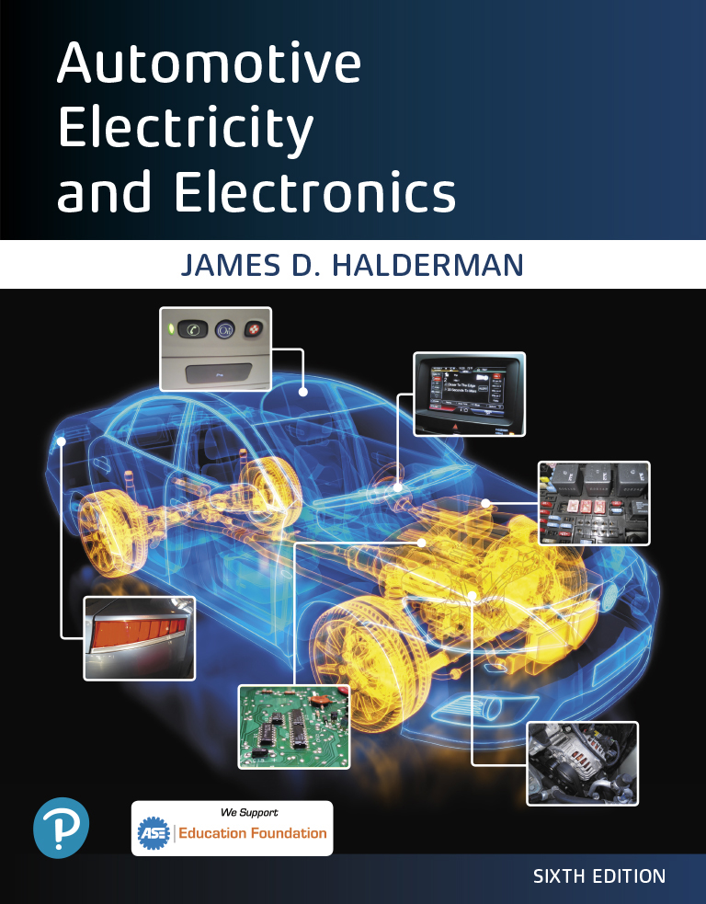
Automotive Electricity and Electronics
Sixth Edition
Chapter 7
Parallel Circuits
Copyright © 2021 Pearson Education, Inc. All Rights Reserved
Notes:
If this PowerPoint presentation contains mathematical equations, you may need to check that your computer has the following installed:
1) Math Type Plugin
2) Math Player (free versions available)
3) NVDA Reader (free versions available)

Slide 2
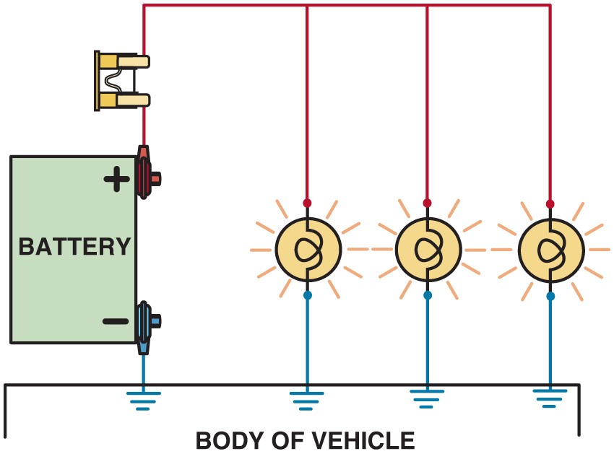
Figure 7.1 A typical parallel circuit used in vehicles includes many of the interior and exterior lights

Slide 3
Animation: Parallel Circuit (The animation will automatically start in a few seconds)

Slide 4
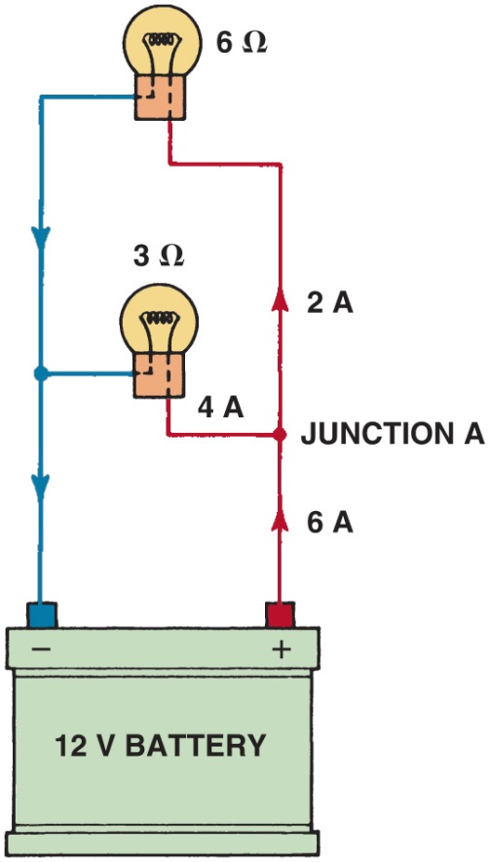
Figure 7.2 The amount of current flowing into junction A equals the total amount of current flowing out of the junction

Slide 5
Animation: Parallel Circuit, Volts (The animation will automatically start in a few seconds)

Slide 6
Animation: Parallel Circuit, Open (The animation will automatically start in a few seconds)

Slide 7
Animation: Parallel Circuit Power Side Switching (The animation will automatically start in a few seconds)

Slide 8
Animation: Parallel Circuit Ground Side Switching (The animation will automatically start in a few seconds)

Slide 9
Animation: Parallel Circuit Law 1 (The animation will automatically start in a few seconds)

Slide 10
Animation: Parallel Circuit Law 2 (The animation will automatically start in a few seconds)

Slide 11
Animation: Parallel Circuit Law 3 (The animation will automatically start in a few seconds)

Slide 12
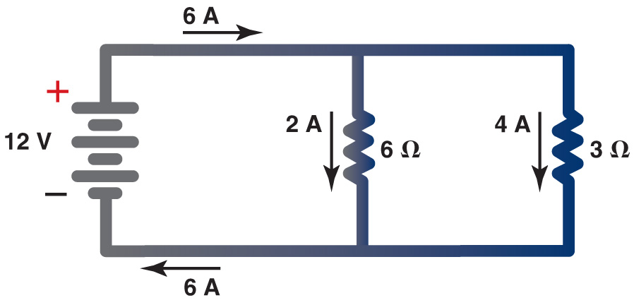
Figure 7.3 The current in a parallel circuit splits (divides) according to the resistance in each branch. Each branch has 12 volts applied to the resistors

Slide 13
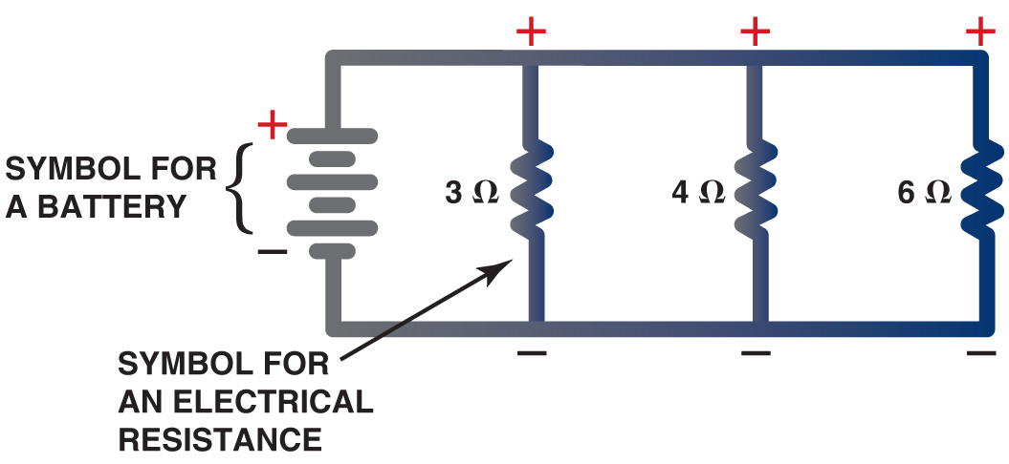
Figure 7.4 In a typical parallel circuit, each resistance has power and ground and each leg operates independently of the other legs of the circuit

Slide 14
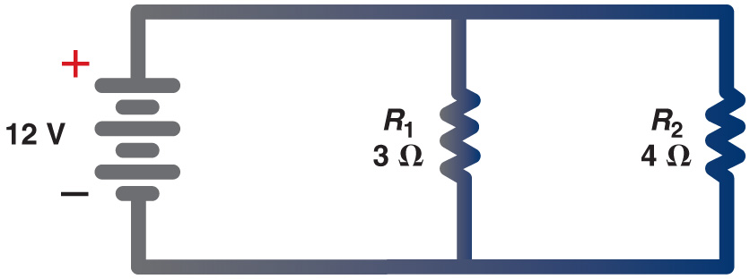
Figure 7.5 A schematic showing two resistors in parallel connected to a 12 volt battery

Slide 15
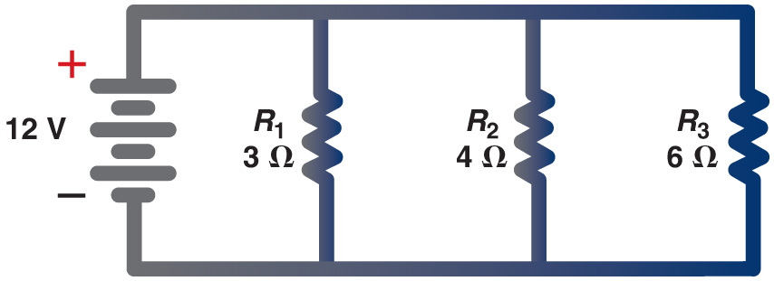
Figure 7.6 A parallel circuit with three resistors connected to a 12 volt battery

Slide 16
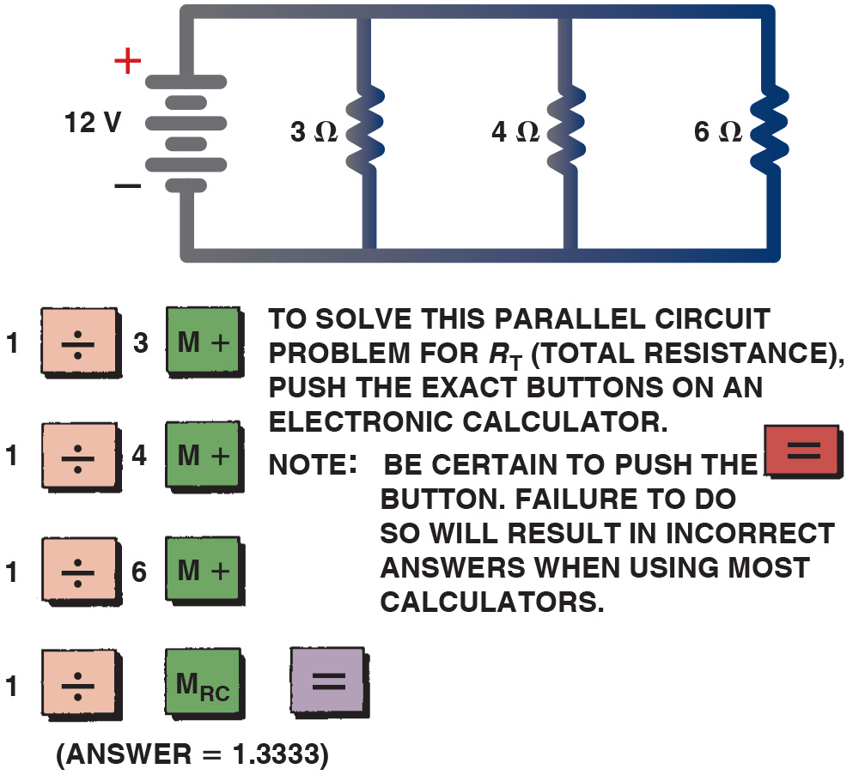
Figure 7.7 Using an electronic calculator to determine the total resistance of a parallel circuit

Slide 17
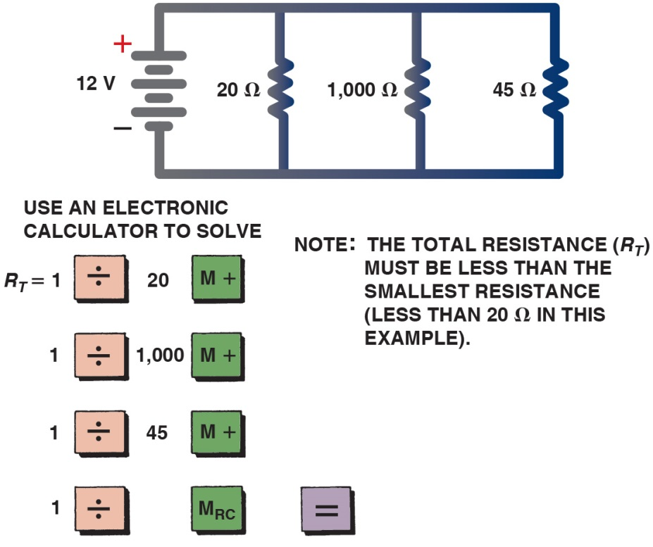
Figure 7.8 Another example of how to use an electronic calculator to determine the total resistance of a parallel circuit. The answer is 13.45 ohms. Notice that the effective resistance of this circuit is less than the resistance of the lowest branch (20 ohms)

Slide 18
Figure 7.9 A parallel circuit containing four 12 ohm resistors. When a circuit has more than one resistor of equal value, the total resistance can be determined by simply dividing the value of the resistance (12 ohms in this example) by the number of equal-value resistors (4 in this example) to get 3 ohms

Slide 19
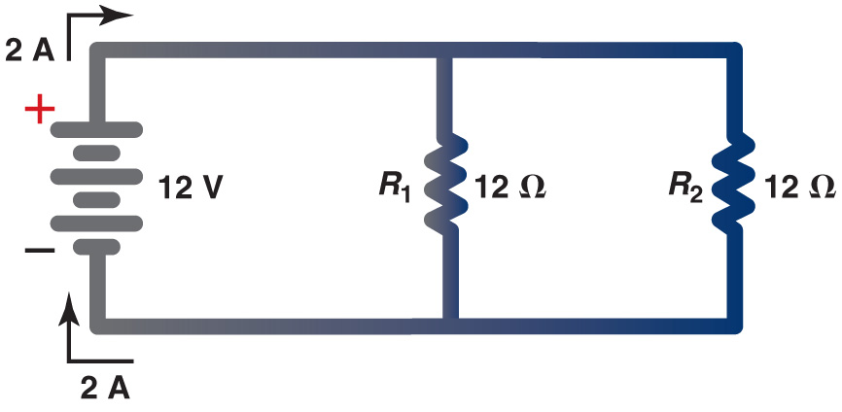
Figure 7.10 Example 1

Slide 20
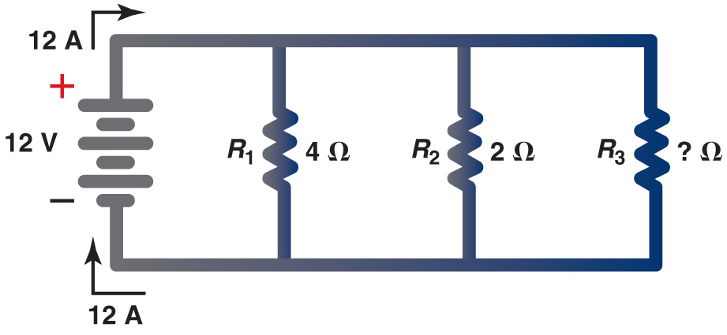
Figure 7.11 Example 2

Slide 21
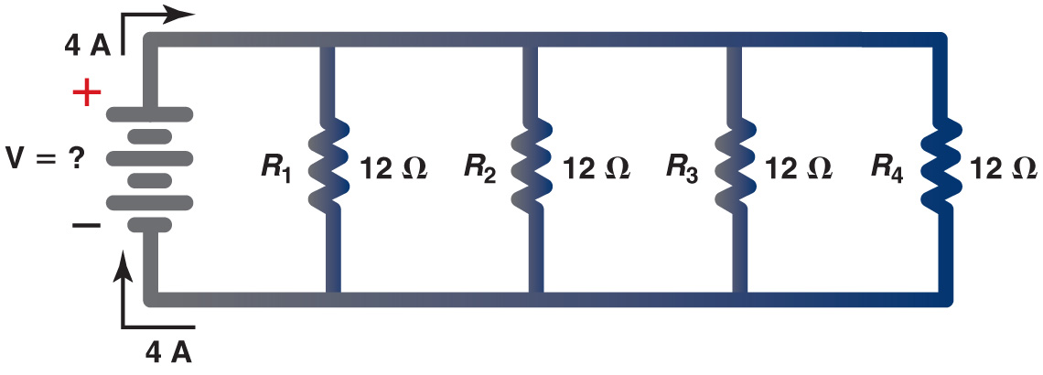
Figure 7.12 Example 3

Slide 22
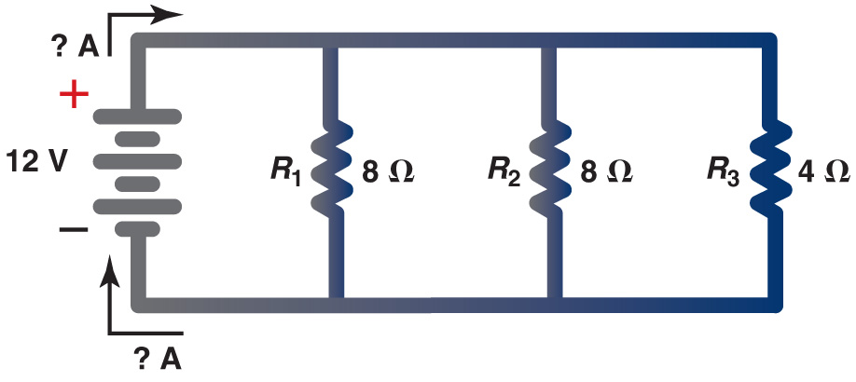
Figure 7.13 Example 4

Slide 23
Video Links (Internet Access Required)
Intro to Parallel Circuits (time 5:43)
Calculating Current in a Parallel Circuit (time 11:00)

Slide 24
Copyright

