Slide 1
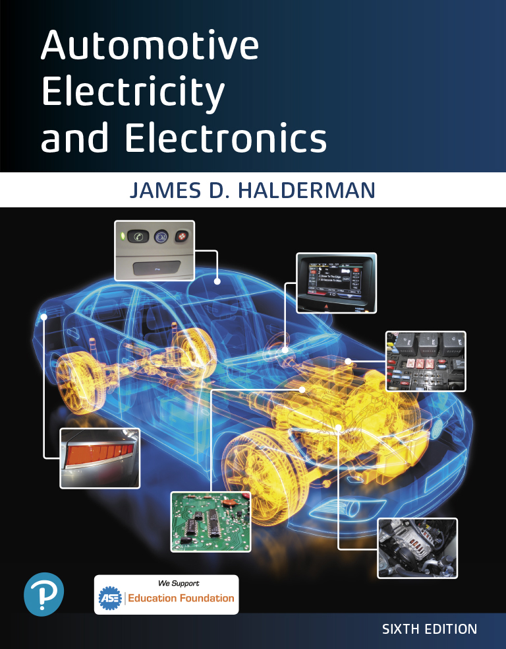
Automotive Electricity and Electronics
Sixth Edition
Chapter 5
Electrical Circuits and Ohm’s Law
Copyright © 2021 Pearson Education, Inc. All Rights Reserved
Notes:
If this PowerPoint presentation contains mathematical equations, you may need to check that your computer has the following installed:
1) Math Type Plugin
2) Math Player (free versions available)
3) NVDA Reader (free versions available)

Slide 2
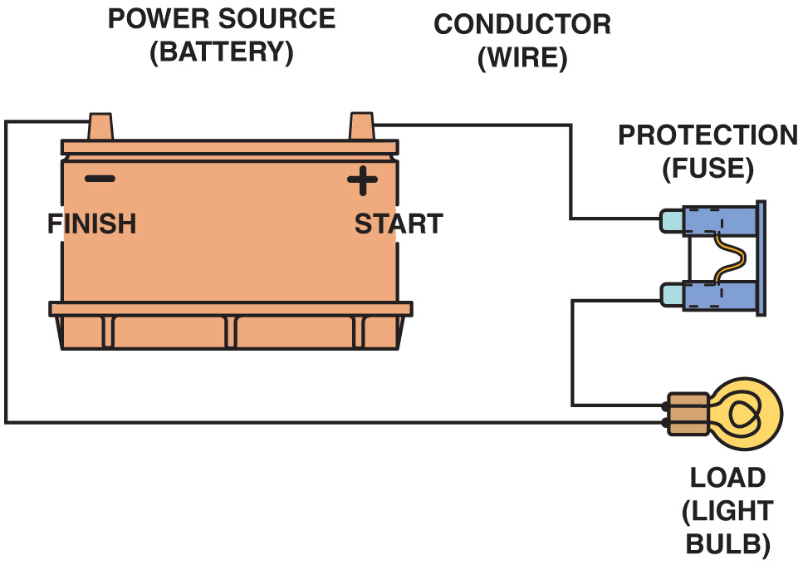
Figure 5.1 All complete circuits must have a power source, a power path, protection (fuse), an electrical load (lightbulb in this case), and a return path back to the power source

Slide 3
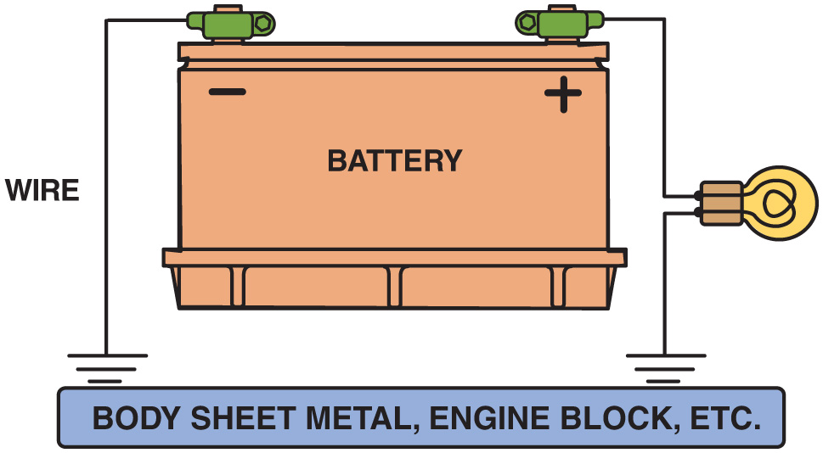
Figure 5.2 The return path back to the battery can be any electrical conductor, such as a copper wire or the metal frame or body of the vehicle

Slide 4
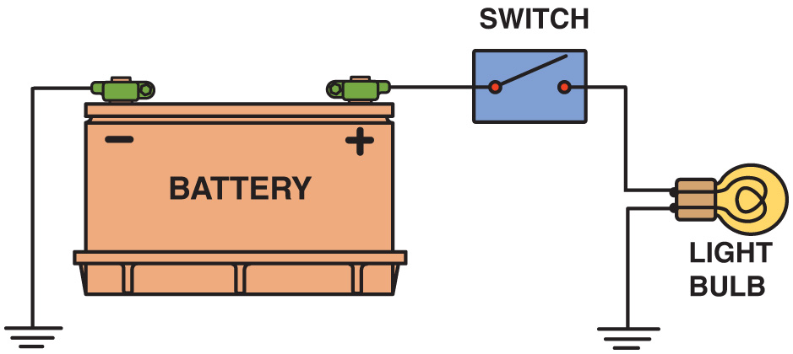
Figure 5.3 An electrical switch opens the circuit and no current flows. The switch could also be on the return (ground) path wire

Slide 5
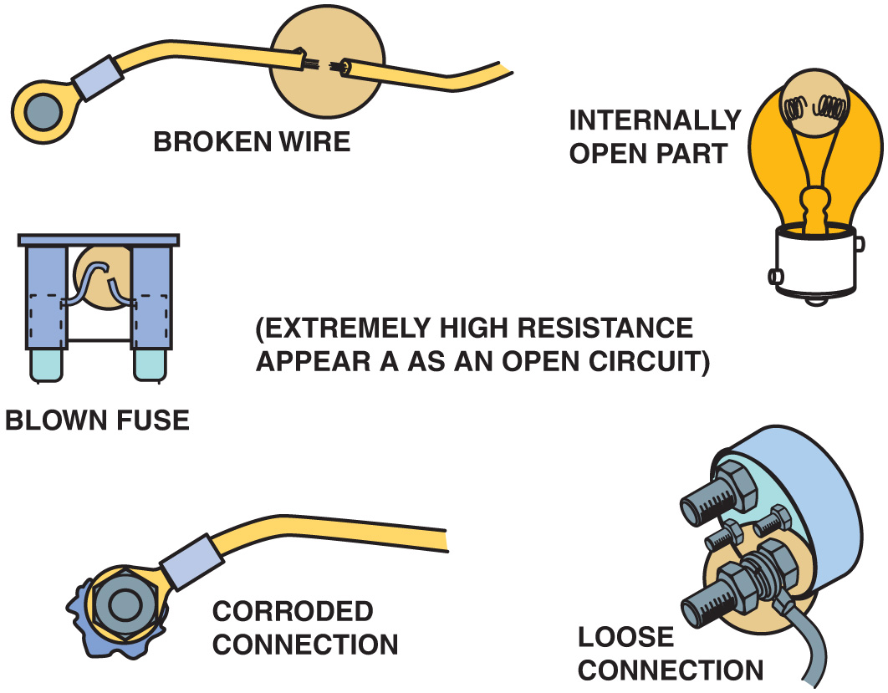
Figure 5.4 Examples of common causes of open circuits. Some of these causes are often difficult to find

Slide 6
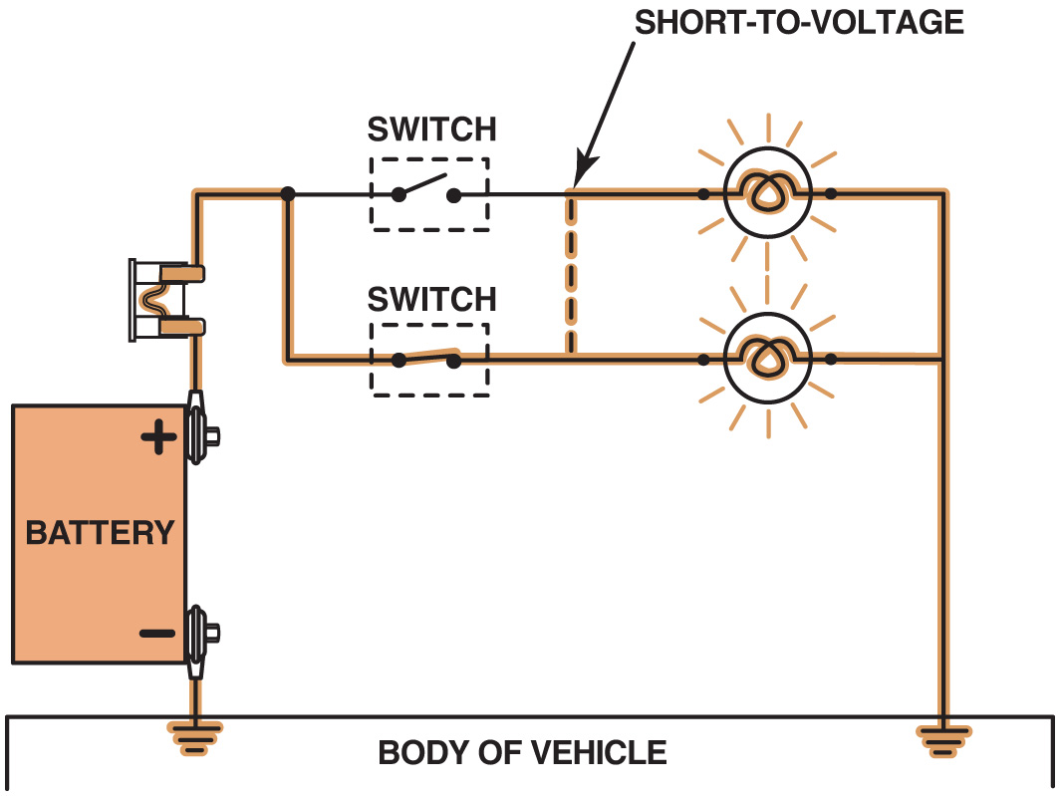
Figure 5.5 A short circuit permits electrical current to bypass some or all of the resistance in the circuit

Slide 7
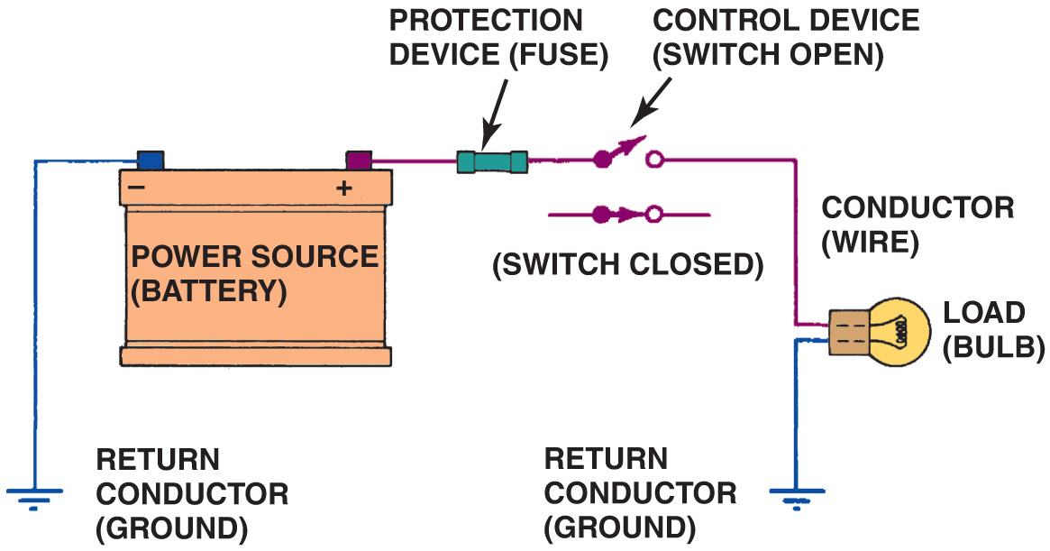
Figure 5.6 A fuse or circuit breaker opens the circuit to prevent possible overheating damage in the event of a short circuit

Slide 8
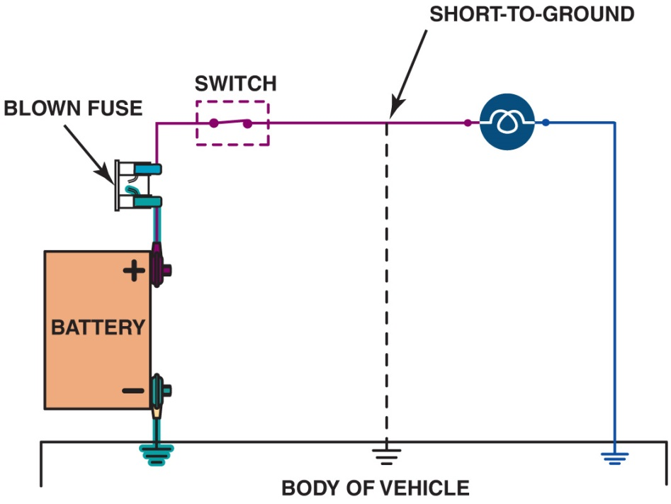
Figure 5.7 A short-to-ground affects the power side of the circuit. Current flows directly to the ground return, bypassing some or all of the electrical loads in the circuit. There is no current in the circuit past the short. A short-to-ground will also causes the fuse to blow

Slide 9
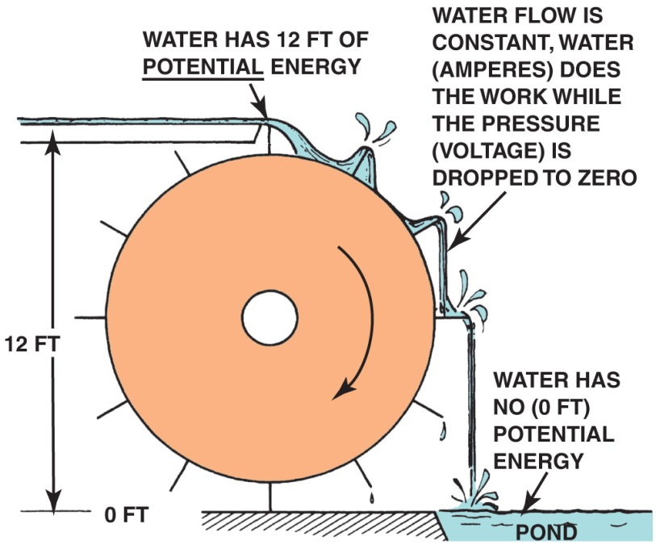
Figure 5.8 Electrical flow through a circuit is similar to water flowing over a waterwheel. The more water (amperes in electricity), the greater the amount of work (waterwheel). The amount of water remains constant, yet the pressure (voltage in electricity) drops as the current flows through the circuit

Slide 10
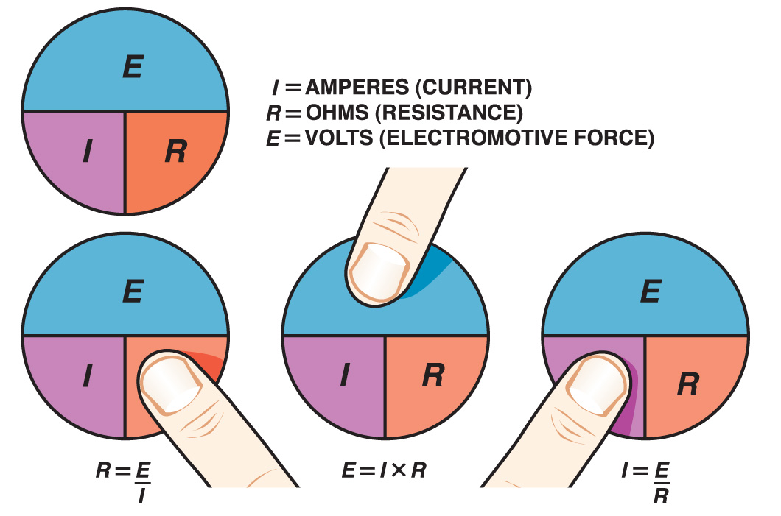
Figure 5.9 To calculate one unit of electricity when the other two are known, simply use your finger and cover the unit you do not know. For example, if both voltage (E) and resistance (R) are known, cover the letter I (amperes). Notice that the letter E is above the letter R, so divide the resistor’s value into the voltage to determine the current in the circuit

Slide 11
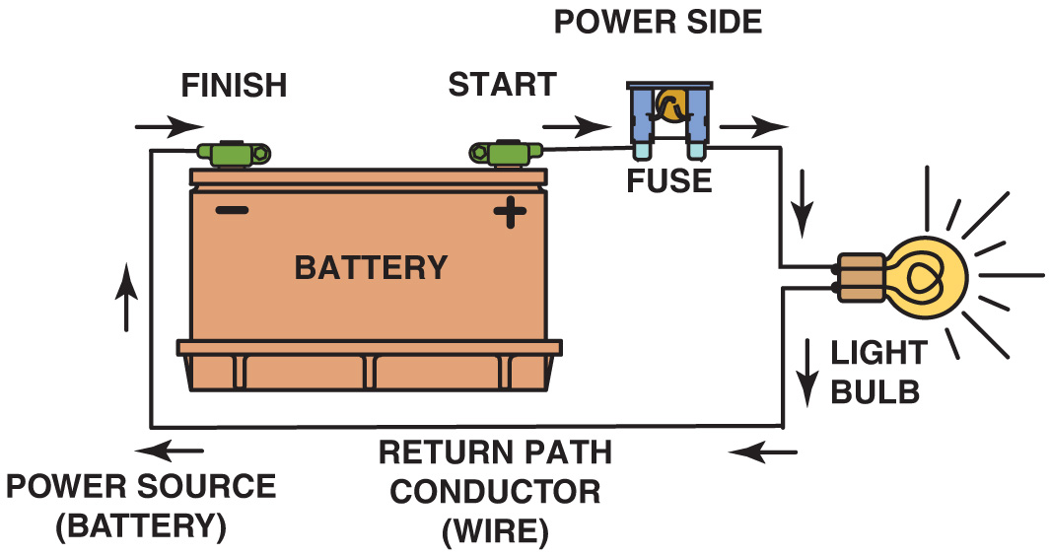
Figure 5.10 This closed circuit includes a power source, power-side wire, circuit protection (fuse), resistance (bulb), and return path wire. In this circuit, if the battery has 12 volts and the electrical load has 4 ohms, then the current through the circuit is 3 amperes

Slide 12
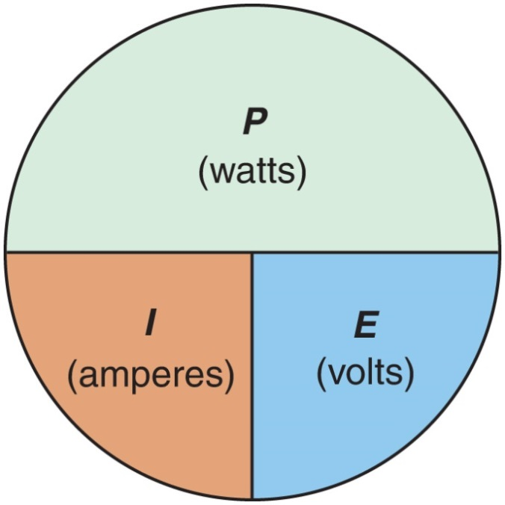
Figure 5.11 To calculate one unit when the other two are known, simply cover the unknown unit to see what unit needs to be divided or multiplied to arrive at the solution. The power of electric motors such as starter motors and propulsion (traction) motors used in electric and hybrid electric vehicles are rated in watts

Slide 13
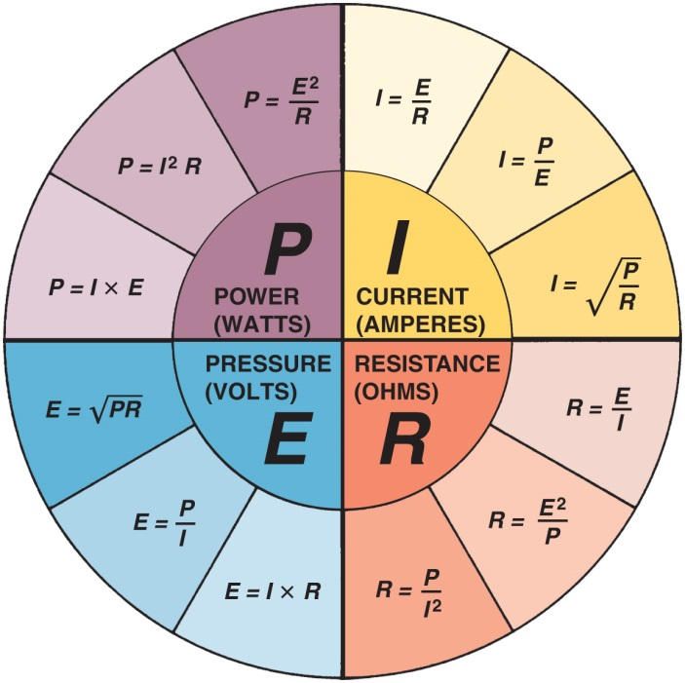
Figure 5.12 “Magic circle” of most formulas for problems involving Ohm’s law. Each quarter of the “pie” has formulas used to solve for a particular unknown value: current (amperes), in the upper right segment; resistance (ohms), in the lower right; voltage (E), in the lower left; and power (watts), in the upper left

Slide 14
Animation: Ohm’s Law, Current (The animation will automatically start in a few seconds)

Slide 15
Animation: Ohm’s Law, Volt (The animation will automatically start in a few seconds)

Slide 16
Animation: Ohm’s Law, Resistance (The animation will automatically start in a few seconds)

Slide 17
Video Links (Internet Access Required)
Ohm’s Law (time 7:09)
Voltage Drop Part 1 (time 2:01)
Voltage Drop Part 2 (time 2:25)
Voltage Drop Part 3 (time 3:16)
Voltage Drop Part 4 (time 2:23)
Ampere Draw (time 1:42)
Automotive Electrical Basics (time 10:14)
Ohm’s Law Series and Parallel (time 24:04)
Ohm’s Law Explained (time 11:47)

Slide 18
Copyright

