Slide 1
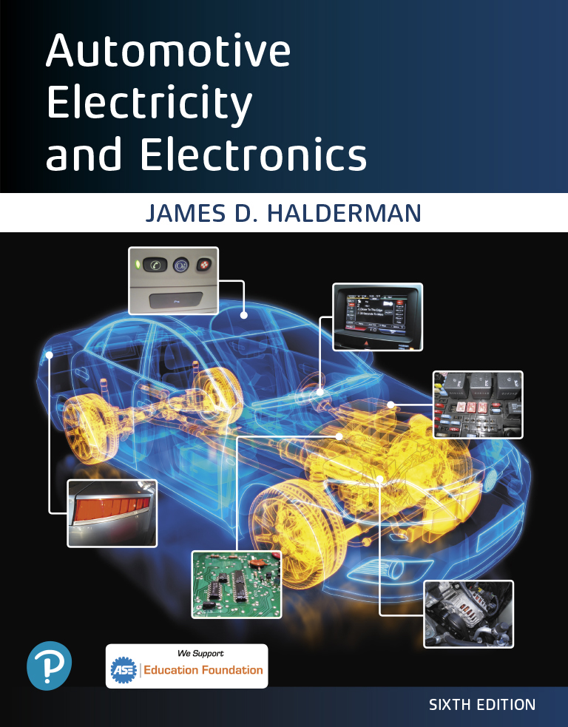
Automotive Electricity and Electronics
Sixth Edition
Chapter 4
Electrical Fundamentals
Copyright © 2021 Pearson Education, Inc. All Rights Reserved
Notes:
If this PowerPoint presentation contains mathematical equations, you may need to check that your computer has the following installed:
1) Math Type Plugin
2) Math Player (free versions available)
3) NVDA Reader (free versions available)

Slide 2
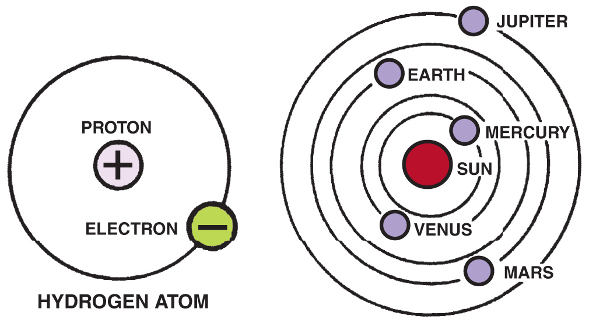
Figure 4.1 In an atom (left), electrons orbit protons in the nucleus just as planets orbit the sun in our solar system (right)

Slide 3
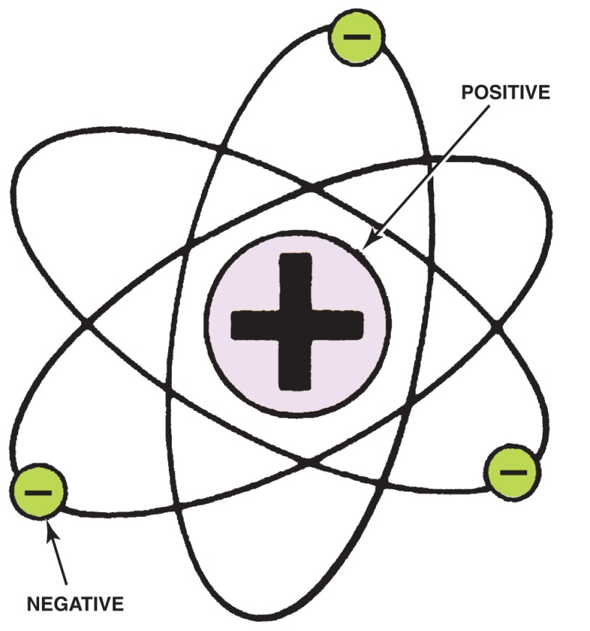
Figure 4.2 The nucleus of an atom has a positive (+) charge and the surrounding electrons have a negative (−) charge

Slide 4
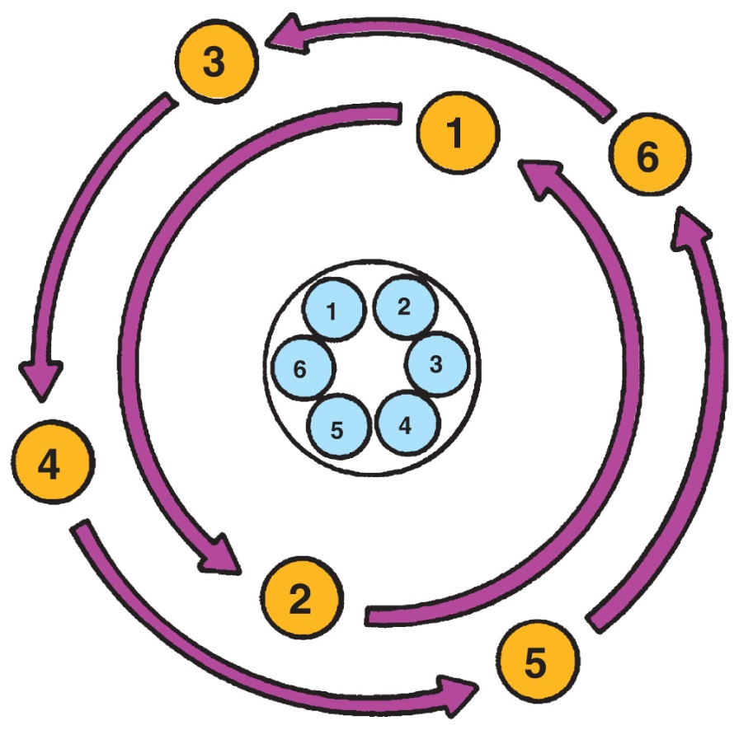
Figure 4.3 This figure shows a balanced atom. The number of electrons is the same as the number of protons in the nucleus

Slide 5
Figure 4.4 Unlike charges attract and like charges repel

Slide 6
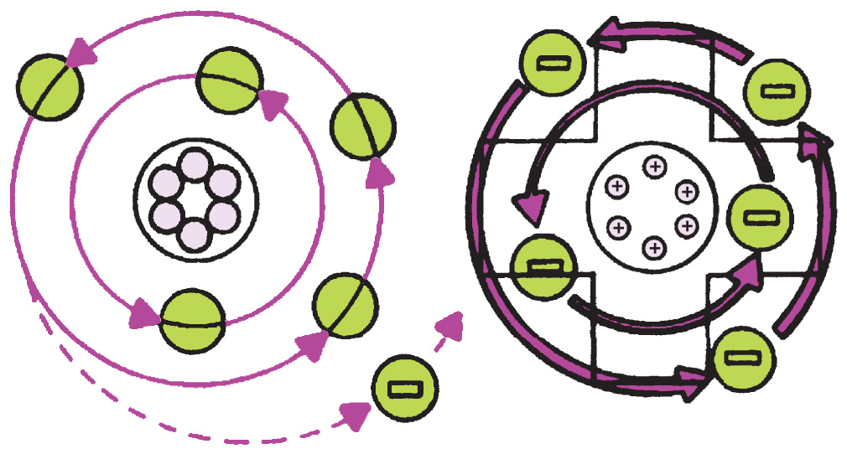
Figure 4.5 An unbalanced, positively charged atom (ion) attracts electrons from neighboring atoms

Slide 7
Animation: Electron Travel, Magnet (The animation will automatically start in a few seconds)

Slide 8
Animation: Generating AC, Alternating Current (The animation will automatically start in a few seconds)

Slide 9
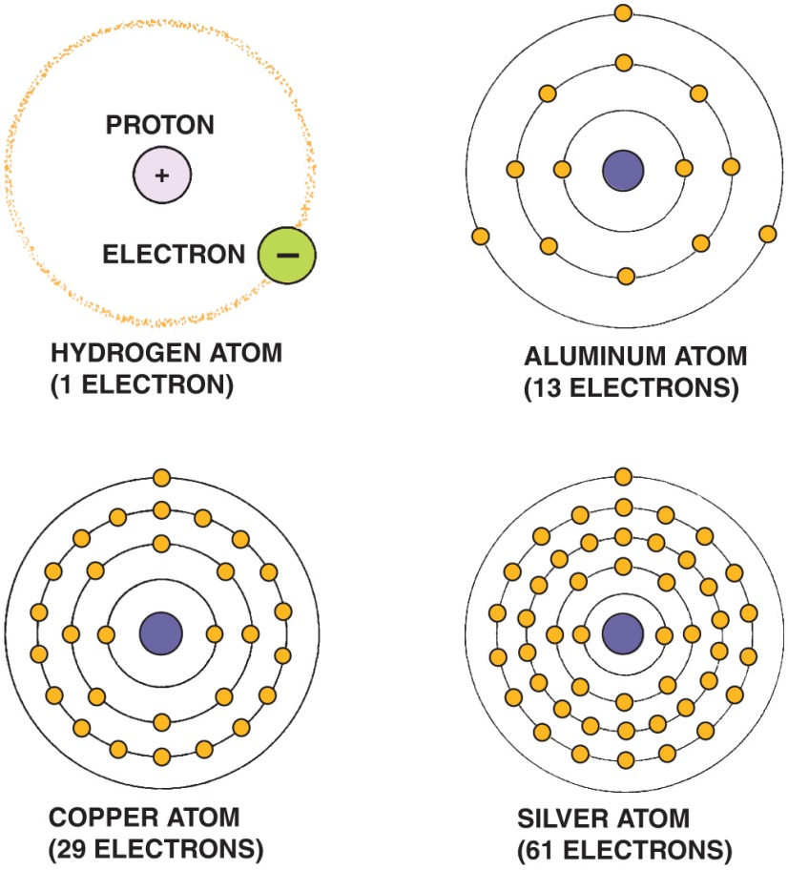
Figure 4.6 The hydrogen atom is the simplest atom, with only one proton, one neutron, and one electron. More complex elements contain higher numbers of protons, neutrons, and electrons

Slide 10
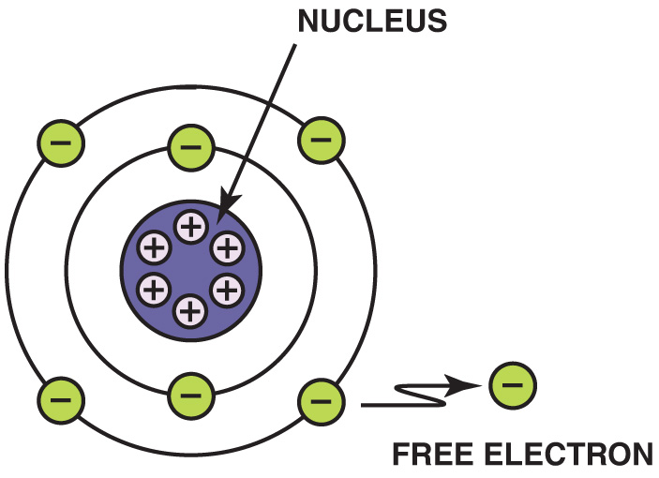
Figure 4.7 Electrons in the outer orbit, or shell, can often be drawn away from the atom and become free electrons

Slide 11
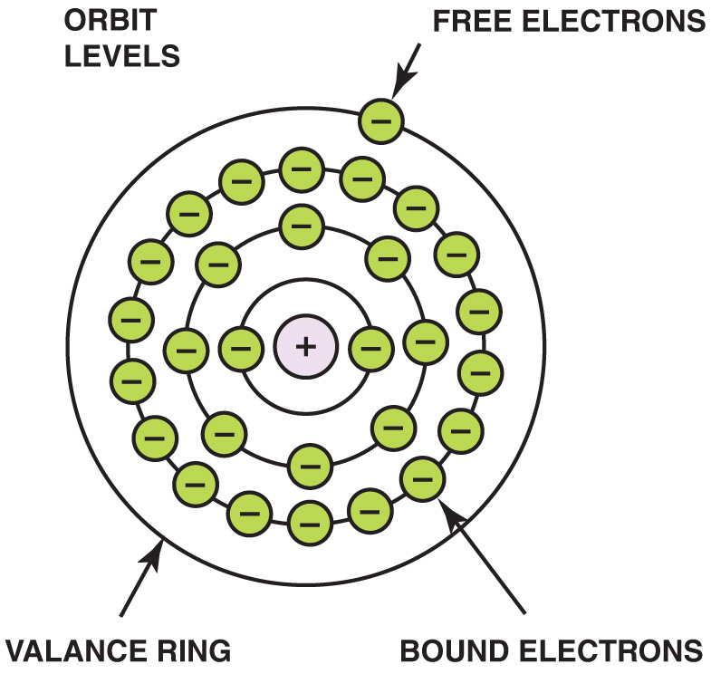
Figure 4.8 As the number of electrons increases, they occupy increasing energy levels that are farther from the center of the atom

Slide 12
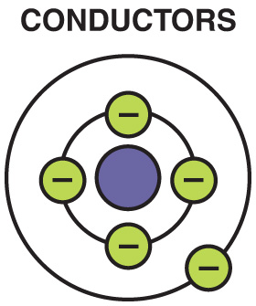
Figure 4.9 A conductor is any element that has one to three electrons in its outer orbit

Slide 13
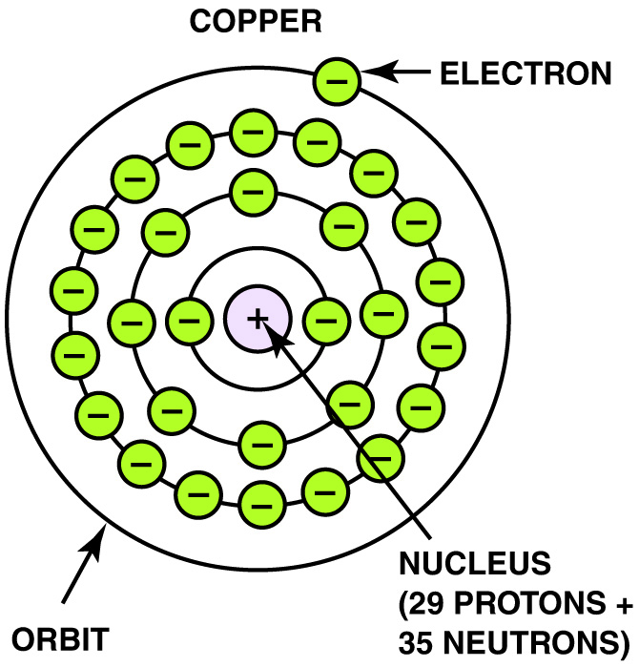
Figure 4.10 Copper is an excellent conductor of electricity because it has just one electron in its outer orbit, making it easy to be knocked out of its orbit and flow to other nearby atoms. This causes electron flow, which is the definition of electricity

Slide 14
Animation: Copper Atom (The animation will automatically start in a few seconds)

Slide 15
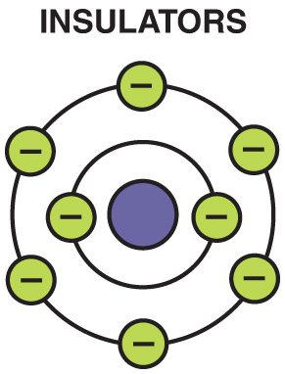
Figure 4.11 Insulators are elements with five to eight electrons in the outer orbit

Slide 16
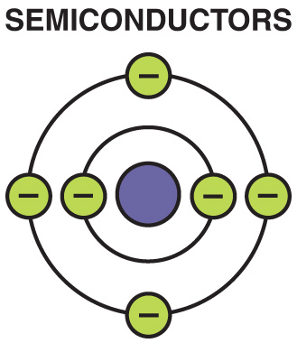
Figure 4.12 Semiconductor elements contain exactly four electrons in the outer orbit

Slide 17
Figure 4.13 Current electricity is the movement of electrons through a conductor

Slide 18
Animation: Electron Flow (The animation will automatically start in a few seconds)

Slide 19
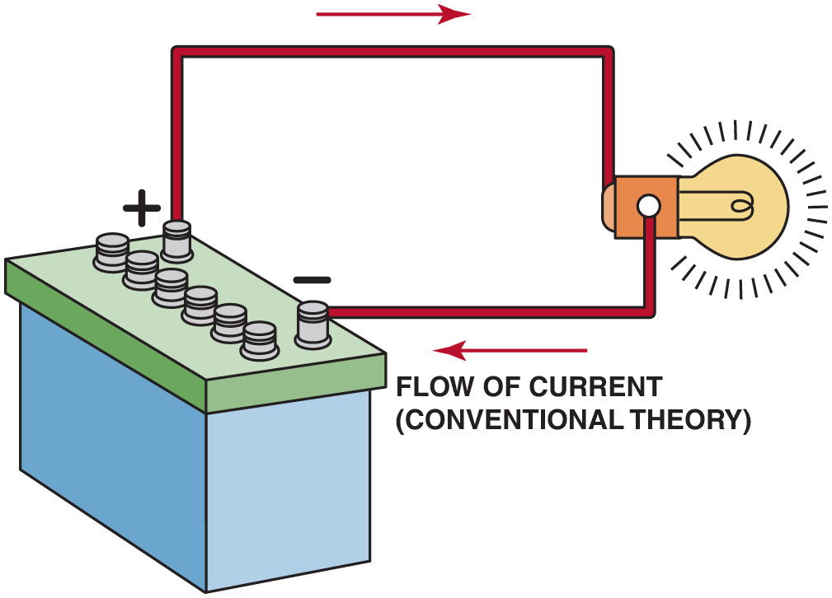
Figure 4.14 Conventional theory states that current flows through a circuit from positive (+) to negative (−). Automotive electricity uses the conventional theory in all electrical diagrams and schematics

Slide 20
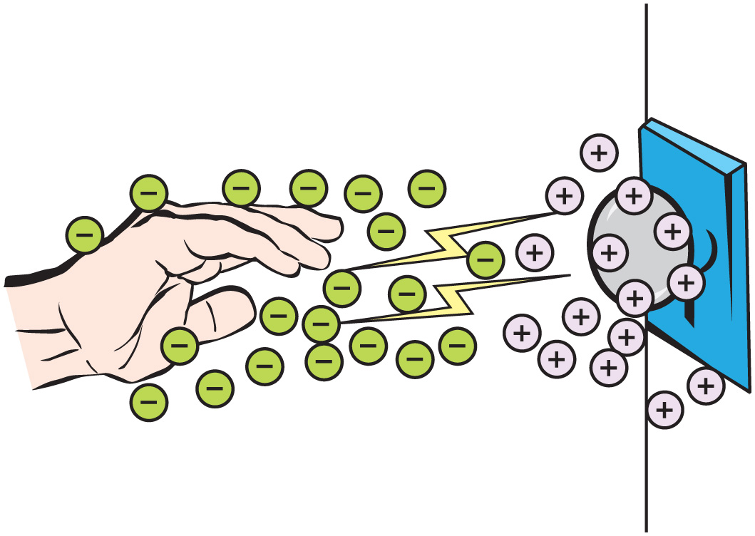
Figure 4.15 A static electrical charge can build up in the body if walking on an insulated floor such as on carpet. Then the static charge can discharge to a conductor such as a door knob resulting in a mild shock and often heard as a snapping sound too

Slide 21
Animation: Static Electricity (The animation will automatically start in a few seconds)

Slide 22
Figure 4.16 One ampere is the movement of 1 coulomb (6.28 billion billion electrons) past a point in 1 second

Slide 23
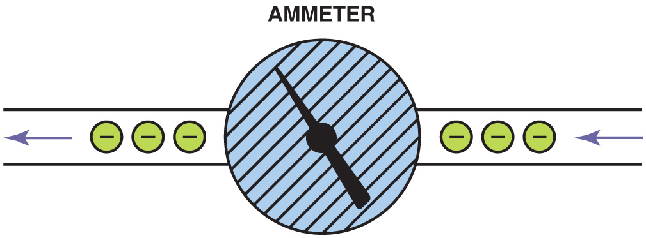
Figure 4.17 An ammeter is installed in the path of the electrons similar to a water meter used to measure the flow of water in gallons per minute. The ammeter displays current flow in amperes

Slide 24
Figure 4.18 Voltage is the electrical pressure that causes the electrons to flow through a conductor

Slide 25
Figure 4.19 This digital multimeter set to read D C volts is being used to test the voltage of a vehicle battery. Most multimeters can also measure resistance (ohms) and current flow (amperes)

Slide 26
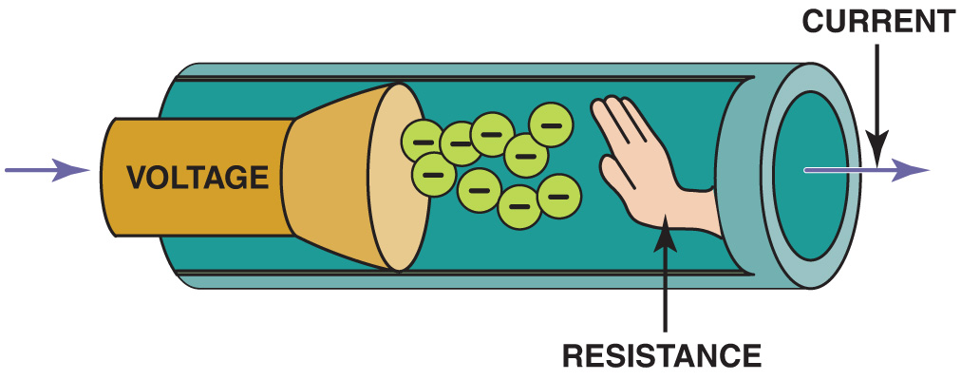
Figure 4.20 Resistance to the flow of electrons through a conductor is measured in ohms

Slide 27
Animation: Voltage & Resistance (The animation will automatically start in a few seconds)

Slide 28
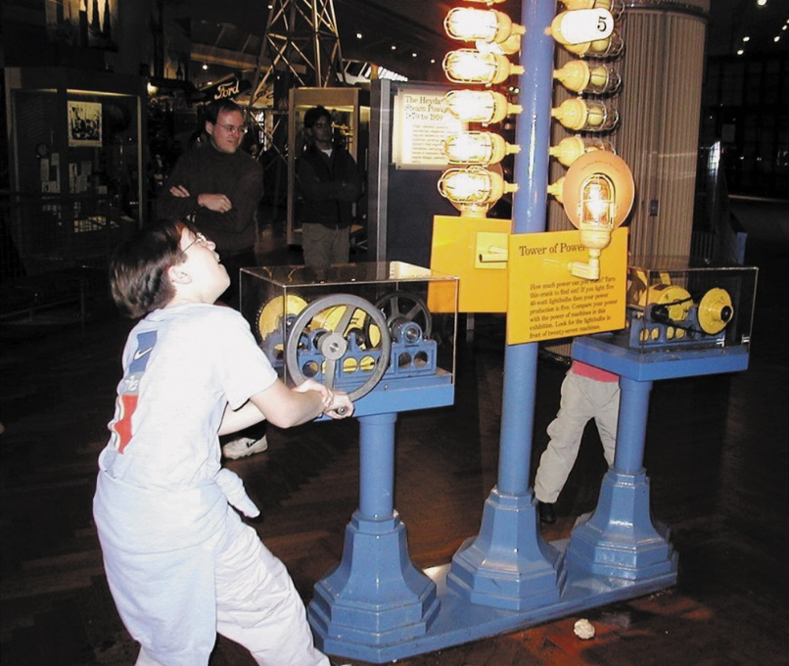
Figure 4.21 A display at the Henry Ford Museum in Dearborn, Michigan, which includes a hand-cranked generator and a series of lightbulbs. This figure shows a young man attempting to light as many bulbs as possible. The crank gets harder to turn as more bulbs light because it requires more power to produce the necessary watts of electricity

Slide 29
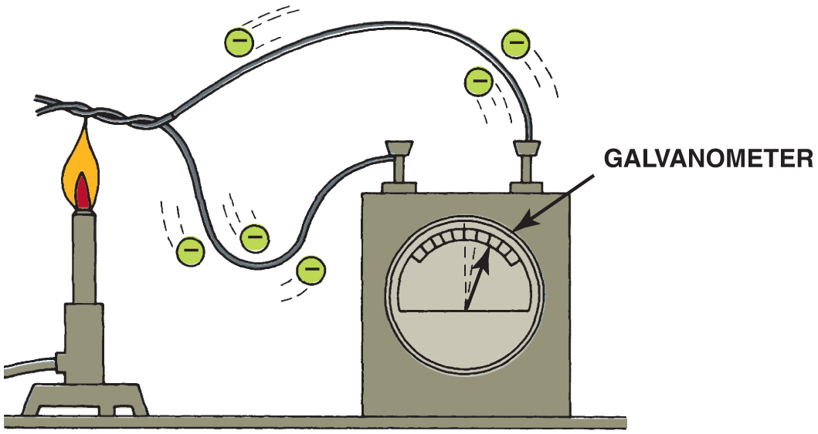
Figure 4.22 Electron flow is produced by heating the connection of two different metals. A galvanometer is an analog (needle-type) meter designed to detect weak voltage signals

Slide 30
Animation: Electron Travel, Heat (The animation will automatically start in a few seconds)

Slide 31
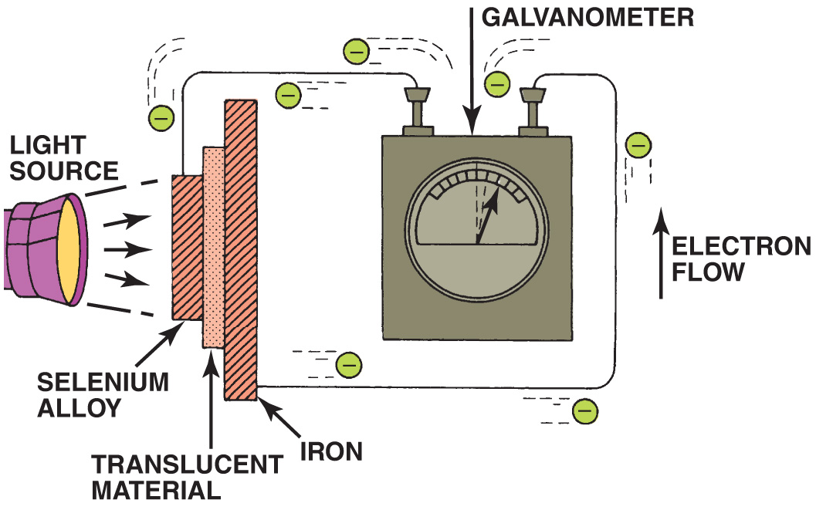
Figure 4.23 Electron flow is produced by light striking a light-sensitive material

Slide 32
Animation: Electron Travel, Light (The animation will automatically start in a few seconds)

Slide 33
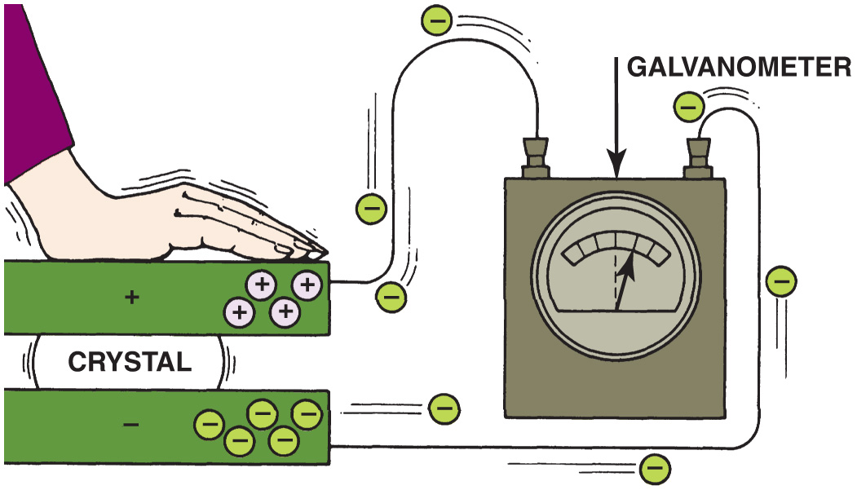
Figure 4.24 Electron flow is produced by pressure on certain crystals

Slide 34
Animation: Electron Travel, Pressure (The animation will automatically start in a few seconds)

Slide 35
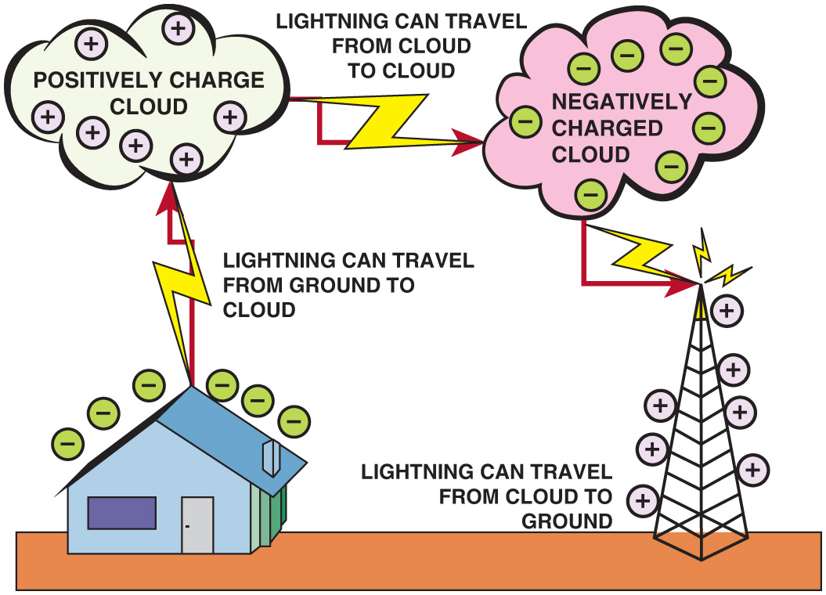
Figure 4.25 Lightning is created by the static charges that build up in clouds and can discharge to another cloud or to the earth

Slide 36
Animation: Lightning (The animation will automatically start in a few seconds)

Slide 37
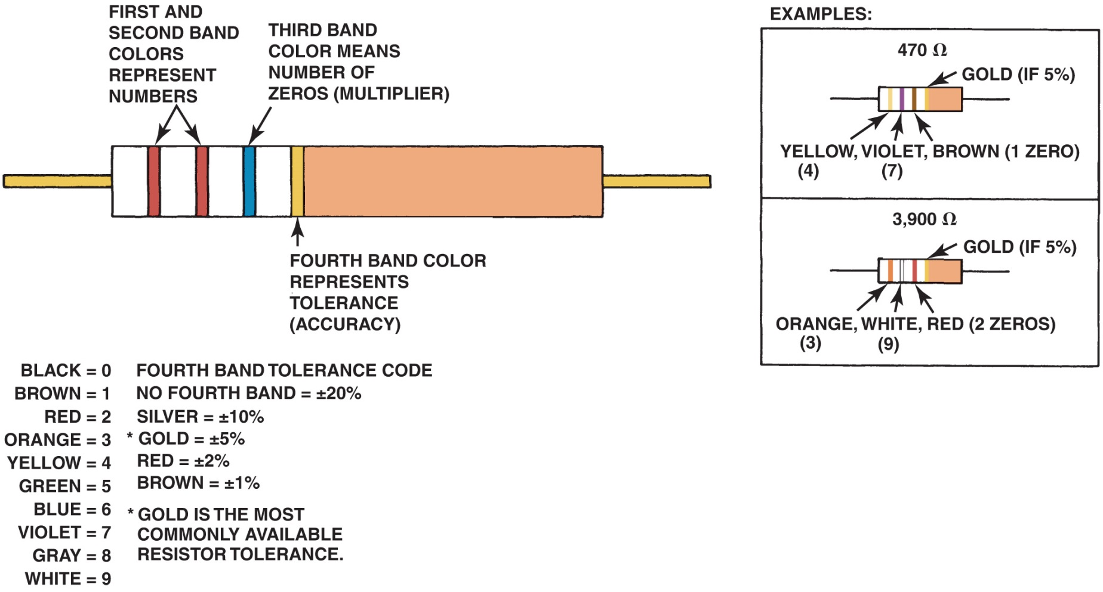
Figure 4.26 This figure shows a resistor color-code interpretation

Slide 38
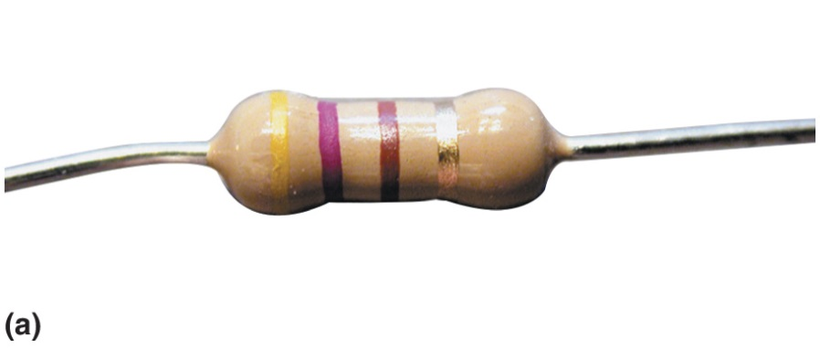
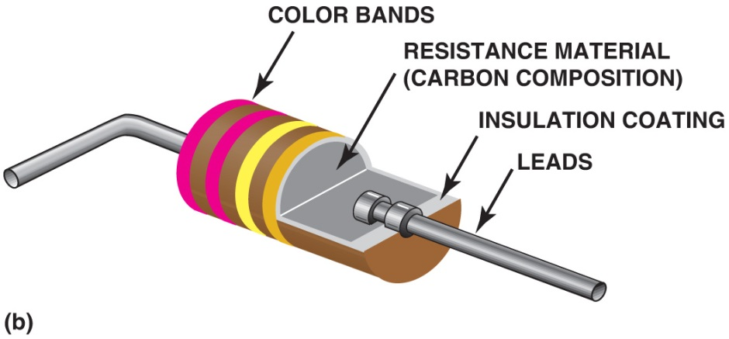
Figure 4.27 (a) A typical carbon resistor. (b) A cutaway view of a typical carbon resistor showing what is inside

Slide 39
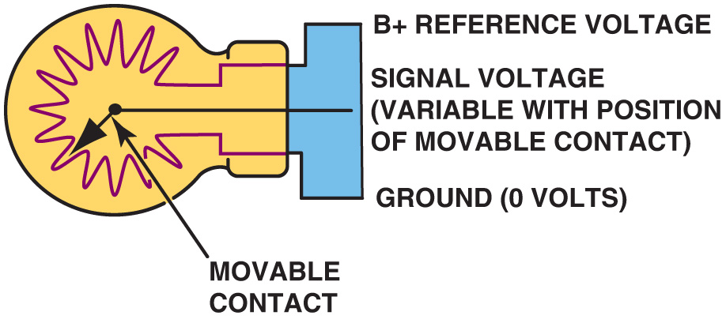
Figure 4.28 A three-wire variable resistor is called a potentiometer

Slide 40
Animation: Potentiometer (The animation will automatically start in a few seconds)

Slide 41
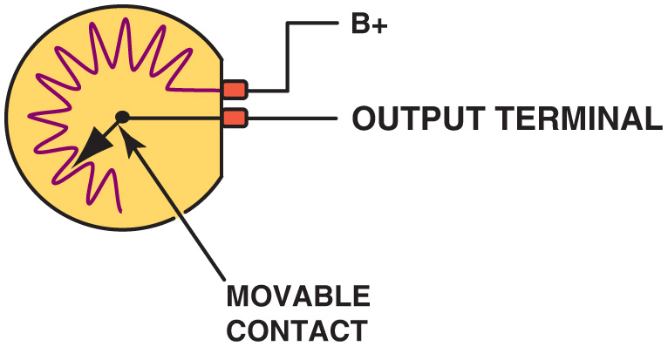
Figure 4.29 A two-wire variable resistor is called a rheostat

Slide 42
Video Links (Internet Access Required)
Voltage Testing Fundamentals (time 39:42)

Slide 43
Copyright

