Slide 1
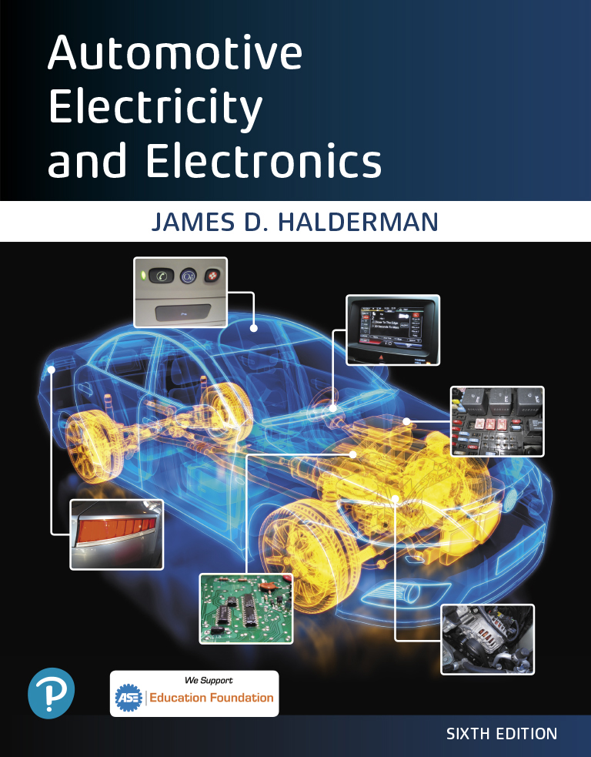
Automotive Electricity and Electronics
Sixth Edition
Chapter 24
Lighting and Signaling Circuits
Copyright © 2021 Pearson Education, Inc. All Rights Reserved
Notes:
If this PowerPoint presentation contains mathematical equations, you may need to check that your computer has the following installed:
1) Math Type Plugin
2) Math Player (free versions available)
3) NVDA Reader (free versions available)

Slide 2
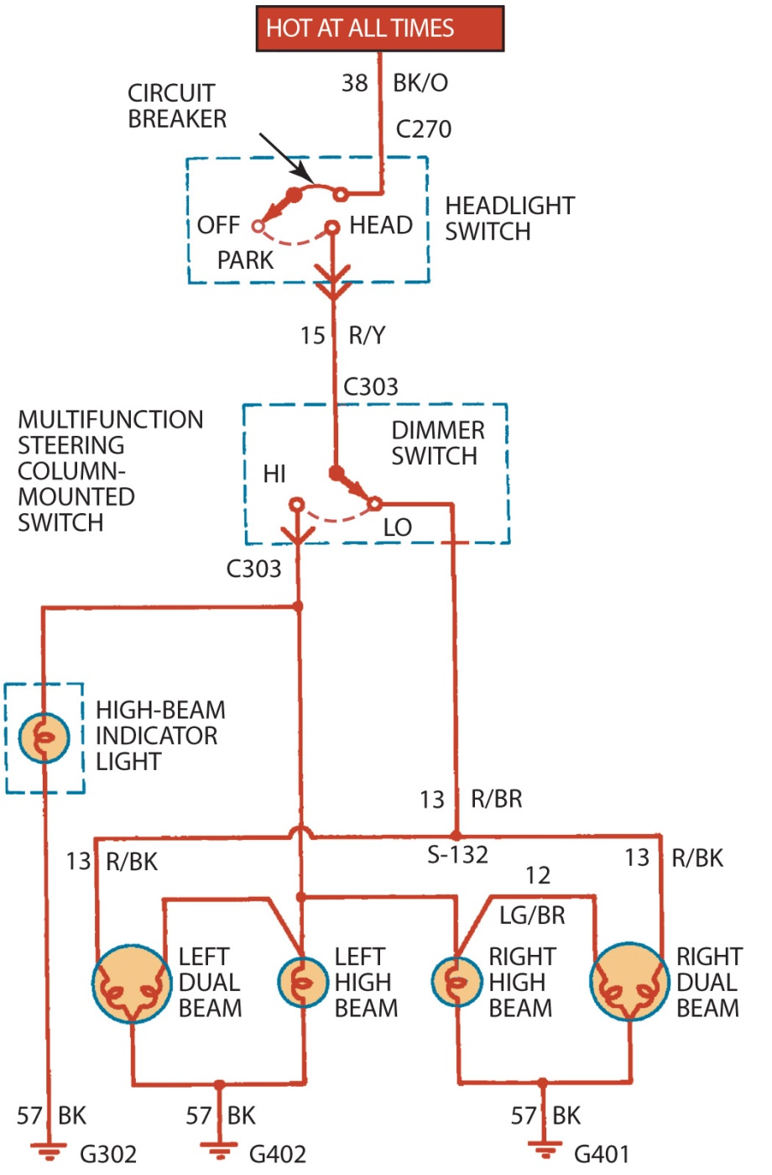
Figure 24.1 A typical headlight circuit diagram on an older vehicle that does not use a controller, such as the body control module (B C M) to control the operation of the lights. Note that the headlight switch is represented by a dotted outline indicating that other circuits (such as dash lights) also operate from the switch

Slide 3
Animation: Headlight Circuit, Low Beam (The animation will automatically start in a few seconds)

Slide 4
Animation: Headlight Circuit, High Beam (The animation will automatically start in a few seconds)

Slide 5
Animation: Headlight Circuit, Parking Lights (The animation will automatically start in a few seconds)

Slide 6
Animation: Rear Lights (The animation will automatically start in a few seconds)

Slide 7
Animation: Courtesy Lights (The animation will automatically start in a few seconds)

Slide 8
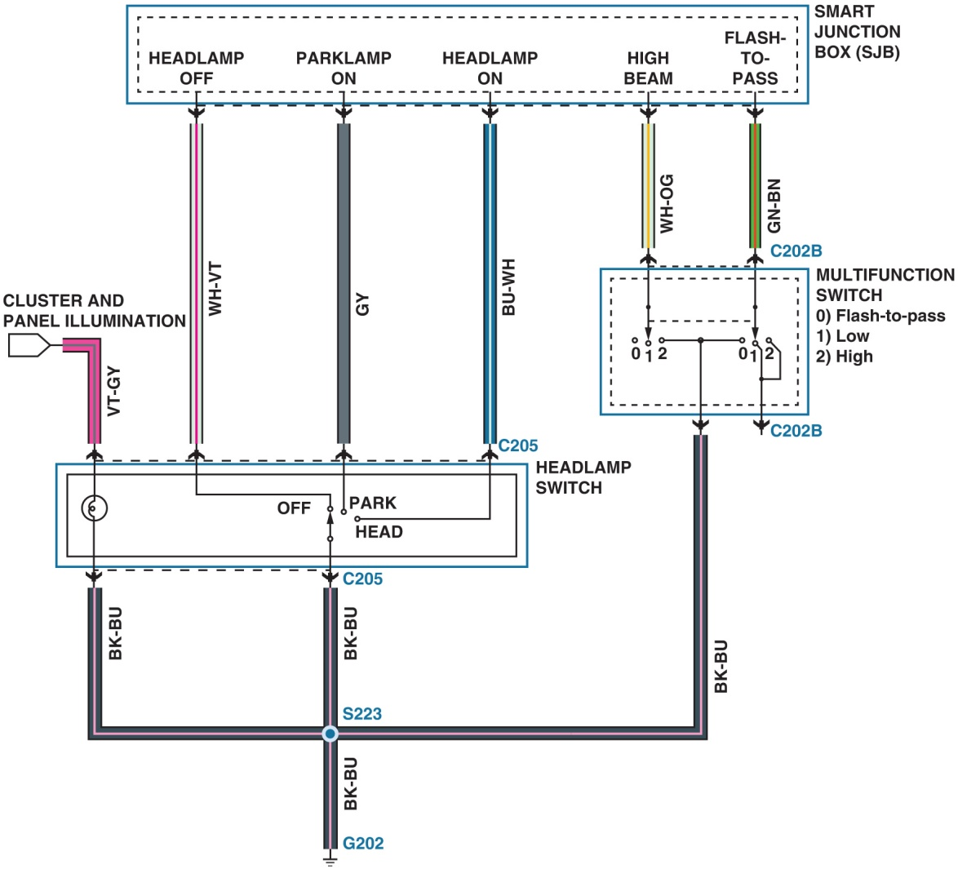
Figure 24.2 A schematic showing the inputs from the multi-function switch and the headlight switch to the smart junction box (S J B). The S J B then uses the body control module (B C M) to operate the lights

Slide 9
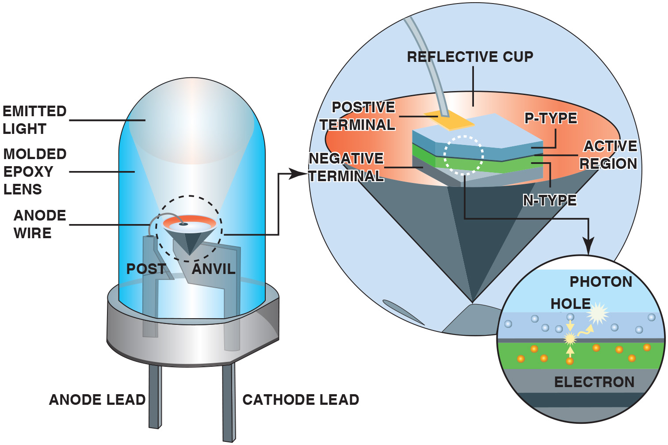
Figure 24.3 An L E D emits light when a photon is released at the P–N junction

Slide 10
Figure 24.4 A replacement L E D taillight bulb is constructed of many small, individual light-emitting diodes

Slide 11
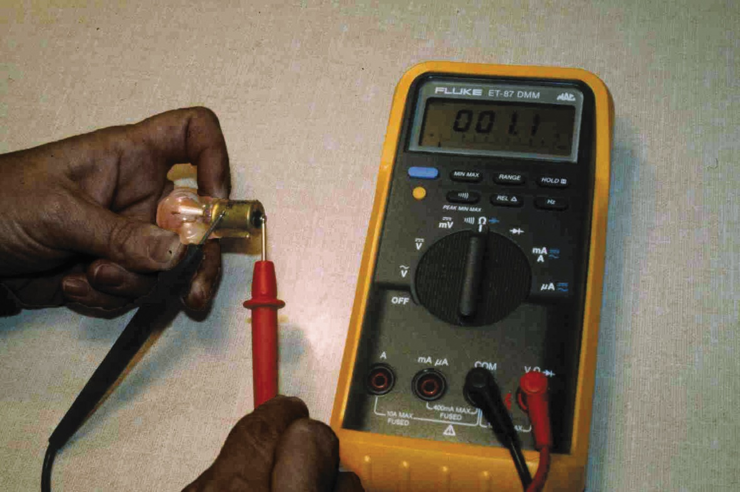
Figure 24.5 This single-filament bulb is being tested with a digital multimeter set to read resistance in ohms. The reading of 1.1 ohms is the resistance of the bulb when cold. As soon as current flows through the filament, the resistance increases about 10 times. It is the initial surge of current flowing through the filament, when the bulb is cool, that causes many bulbs to fail in cold weather as a result of the reduced resistance. As the temperature increases, the resistance increases

Slide 12
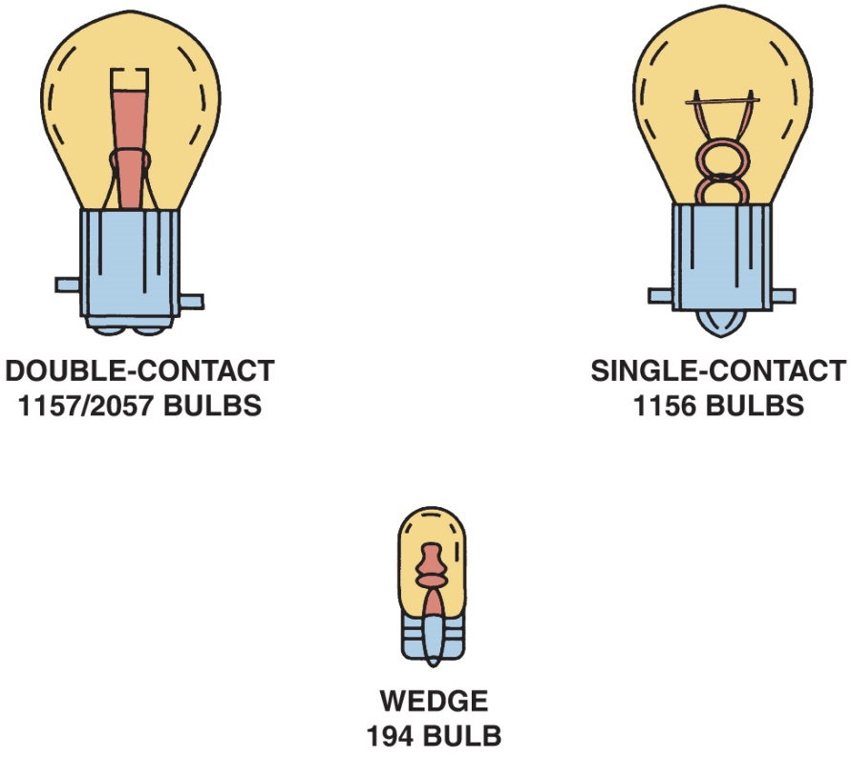
Figure 24.6 Dual-filament (double-contact) bulbs contain both a low-intensity filament for taillights or parking lights, and a high intensity filament for brake lights and turn signals. Bulbs come in a variety of shapes and sizes. The numbers shown are the trade numbers

Slide 13
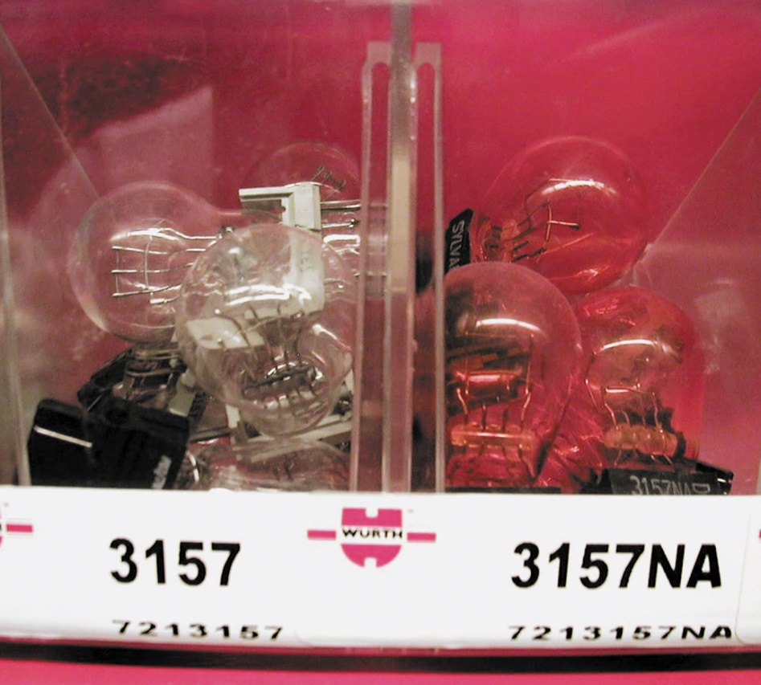
Figure 24.7 Bulbs that have the same trade number have the same operating voltage and wattage. N A means that the bulb uses a natural amber glass ampoule with clear turn-signal lenses

Slide 14
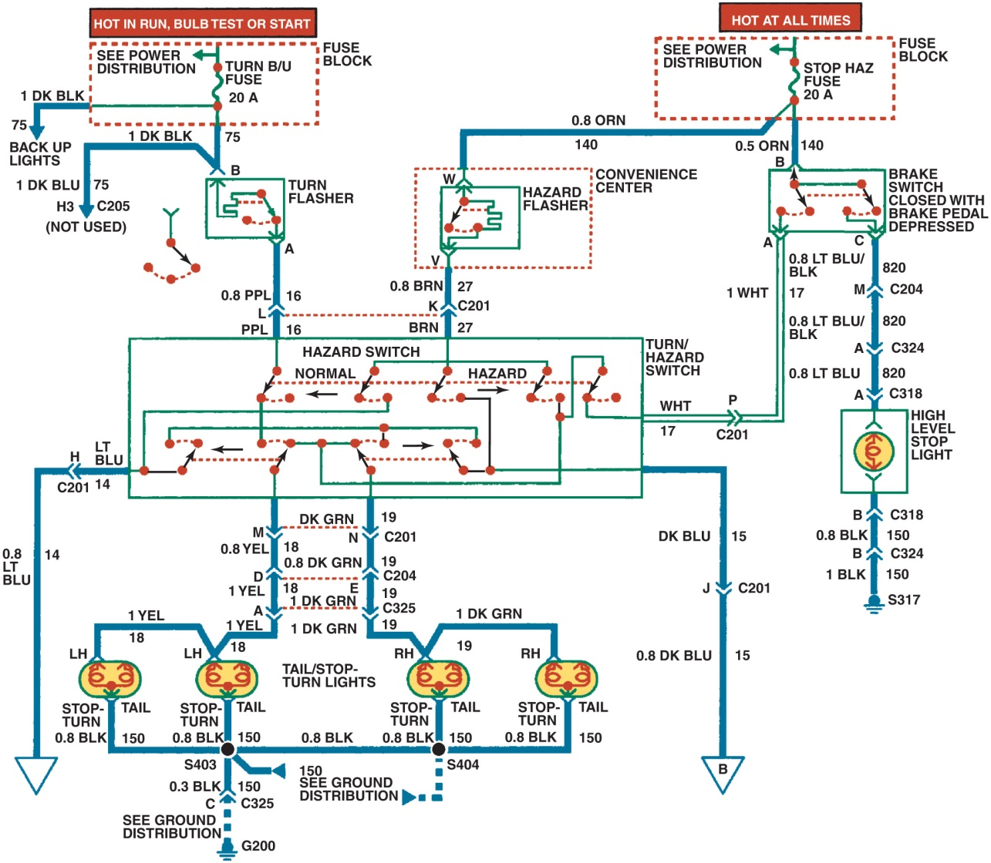
Figure 24.8 A typical older-type brake light circuit showing the brake switch and all of the related circuit components

Slide 15
Animation: Stop Lights (The animation will automatically start in a few seconds)

Slide 16
Animation: Turn Indicators (The animation will automatically start in a few seconds)

Slide 17
Animation: Lights, Turn and Stop (The animation will automatically start in a few seconds)

Slide 18
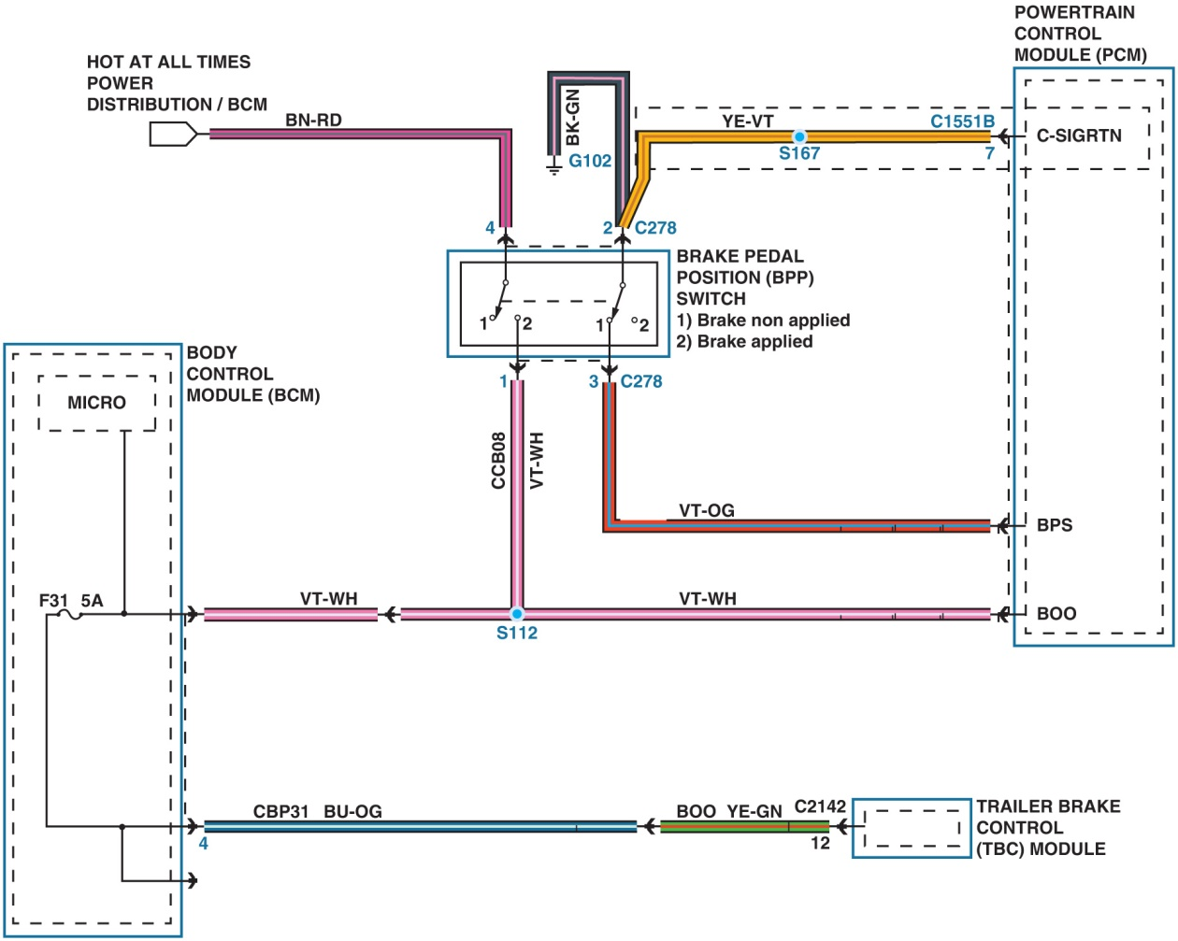
Figure 24.9 A schematic of the B C M-controlled brake light circuit that includes the brake pedal position (B P P) switch, which creates signals to the powertrain control module (P C M) with inputs labeled B P S (brake pedal position) and B O O (brake on-off)

Slide 19
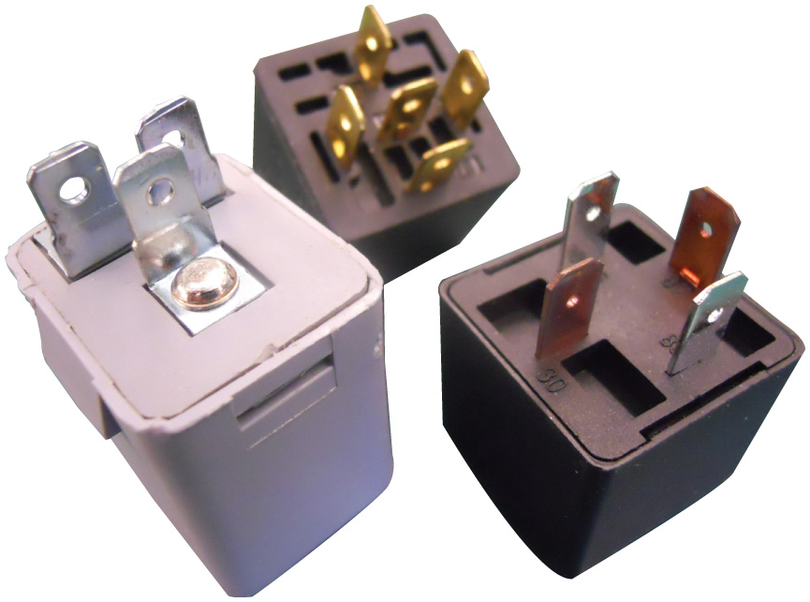
Figure 24.10 Three styles of flasher units

Slide 20
Animation: Hazard Lights (The animation will automatically start in a few seconds)

Slide 21
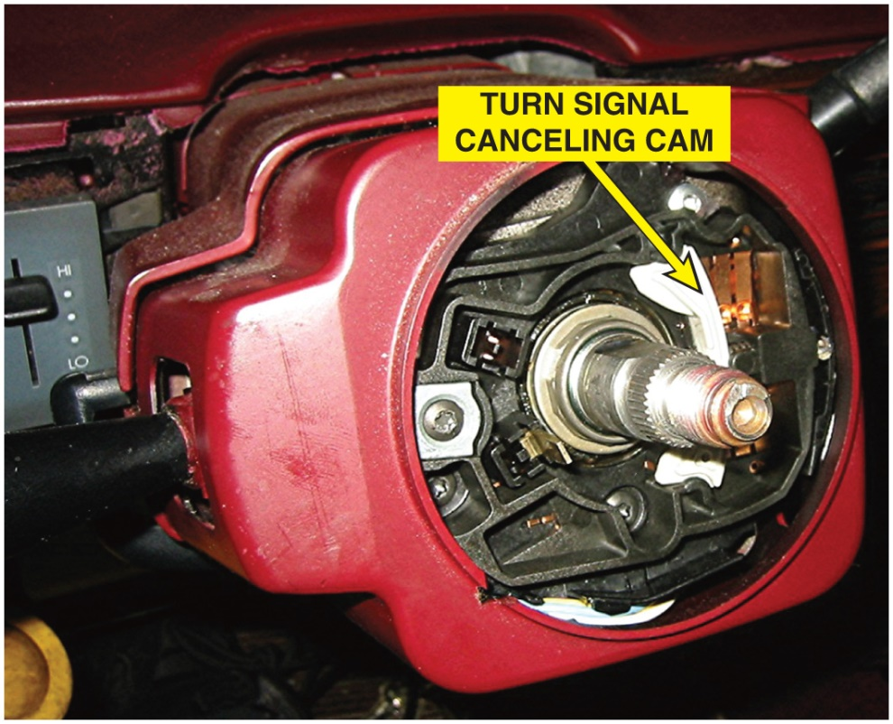
Figure 24.11 A steering column with the steering wheel removed, showing the turn signal canceling cam used to return the lever to the neutral position after a turn. The switches are an input to the body control module for left and right turn-signal operation

Slide 22
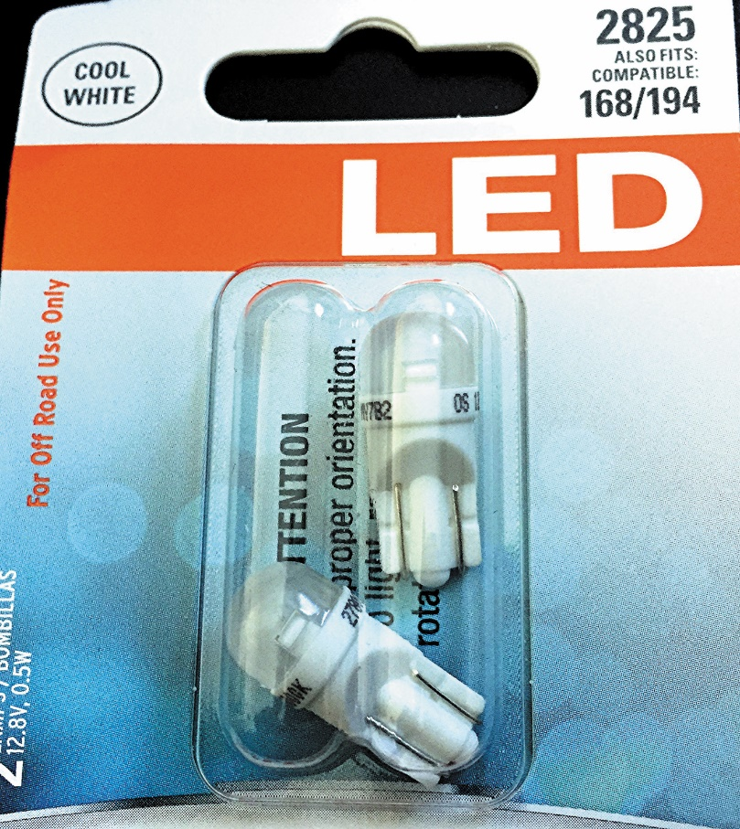
Figure 24.12 Replacement side marker L E D lamps that could be used to replace standard bulbs. However, the current draw is lower and using these bulbs could cause the lamp outage warning lamp to be turned on

Slide 23
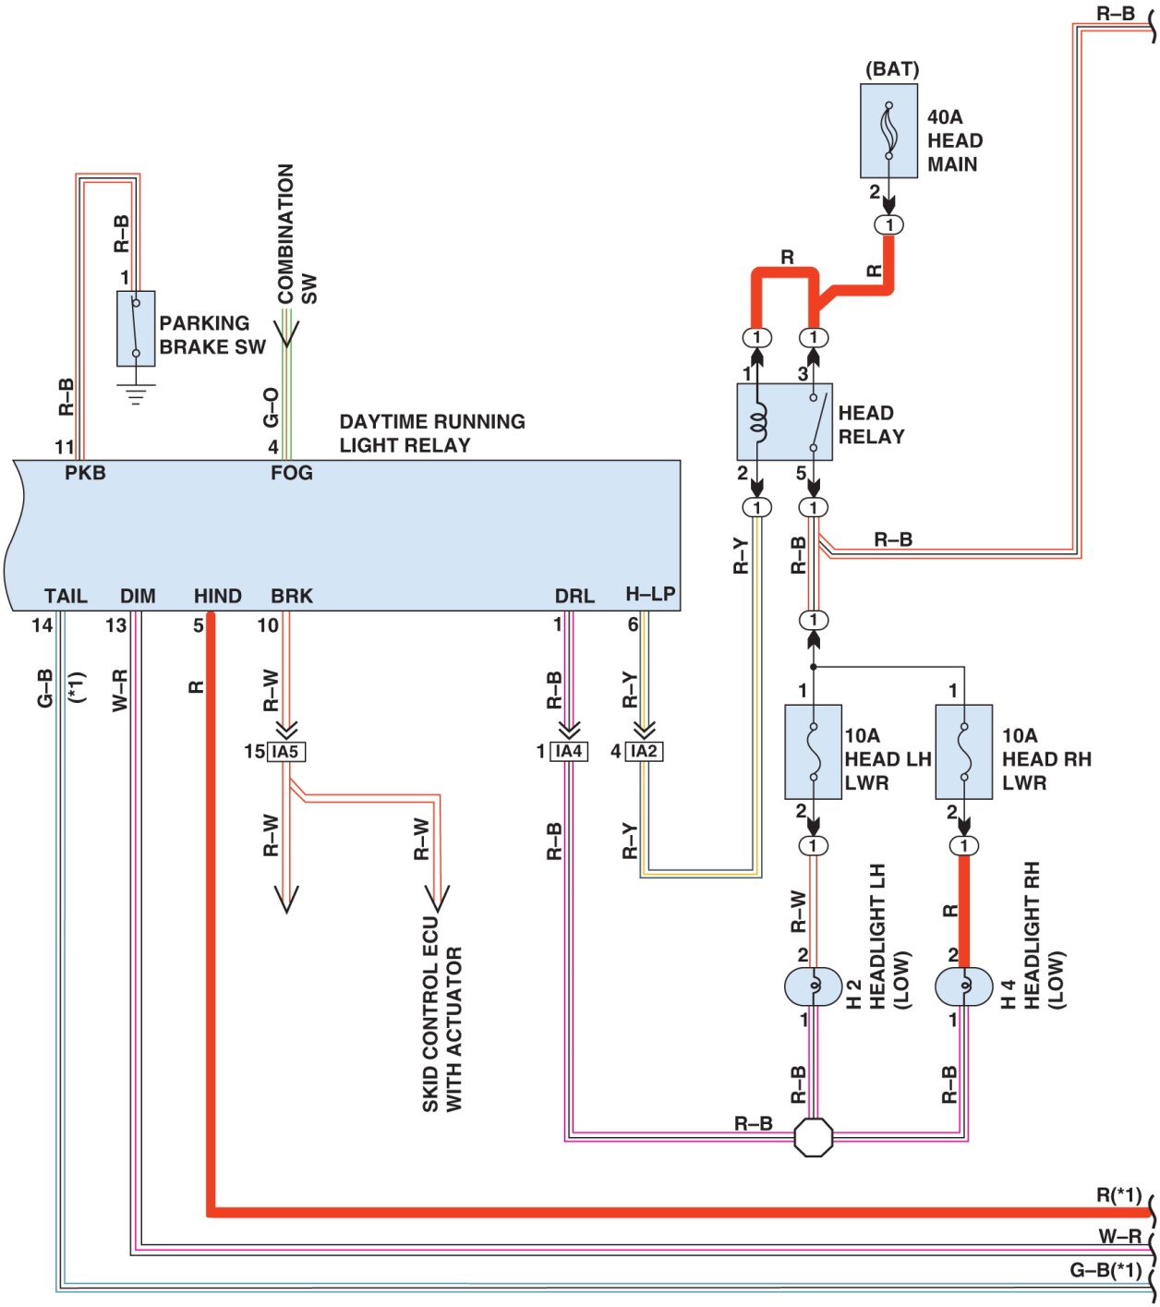
Figure 24.13 A schematic showing a D R L circuit that uses the headlights. Also notice that each headlight has its own fuse to protect the circuit. Check service information for how the D R L s operate on the vehicle being serviced

Slide 24
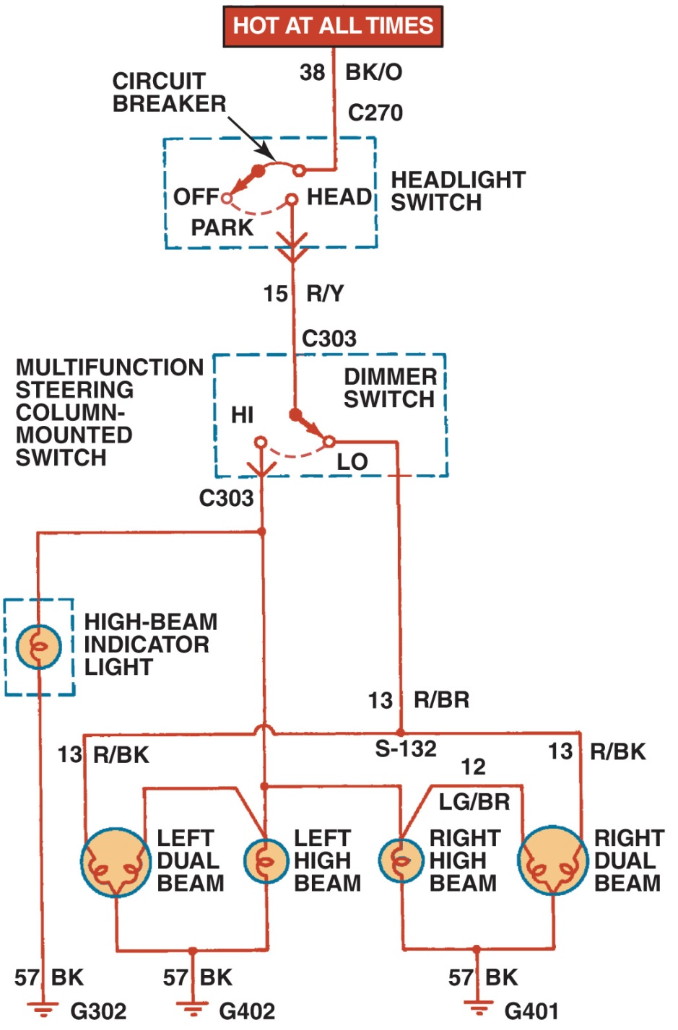
Figure 24.14 A Typical headlight circuit diagram on an older vehicle that does not use a controller, such as the B C M, to control the operation of the lights. Note that the headlight switch is represented by a dotted outline, indicating that other circuits (such as dash lights) also operate from the switch

Slide 25
Figure 24.15 A typical composite headlamp assembly. The lens, housing, and bulb sockets are usually included as a complete assembly

Slide 26
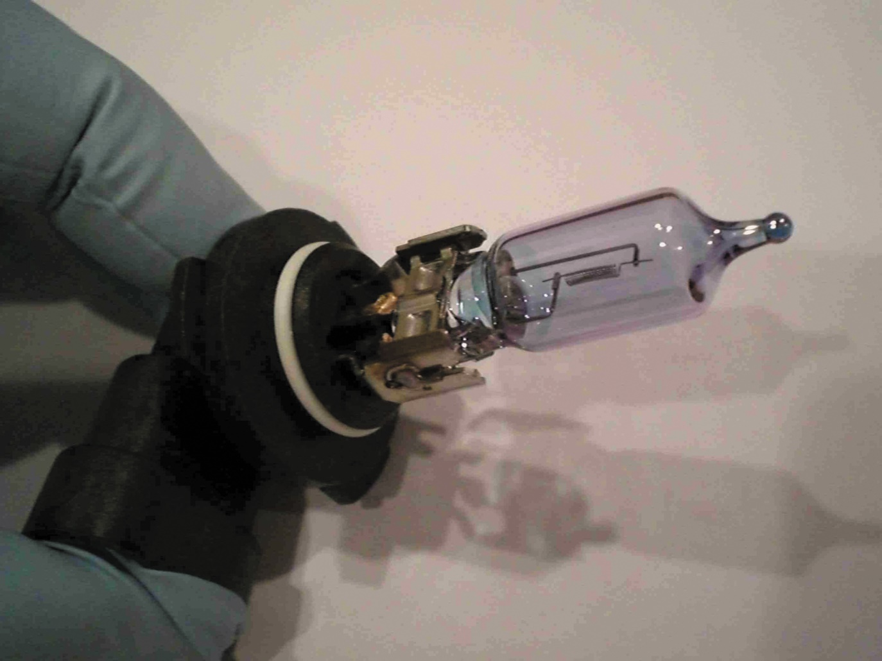
Figure 24.16 Handle a halogen bulb by the base to prevent the skin’s oil from getting on the glass

Slide 27
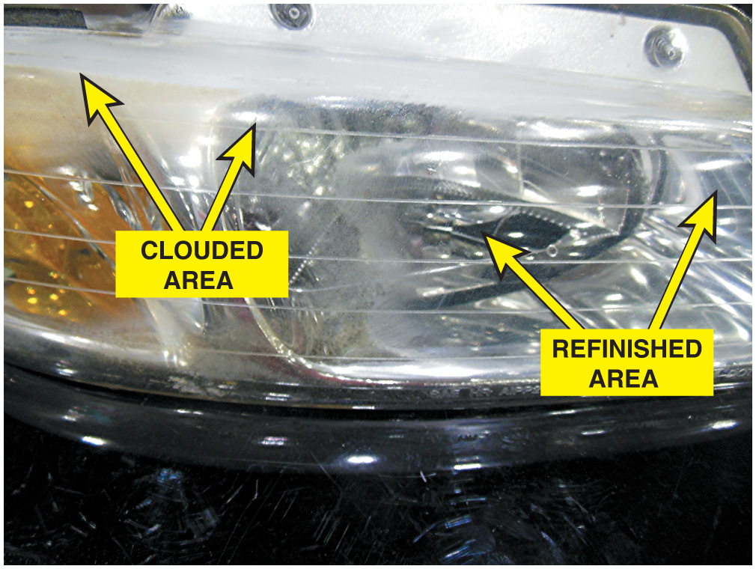
Figure 24.17 The right side of this headlight assembly has been restored, but still needs to be polished. The left side is cloudy and not yet restored

Slide 28
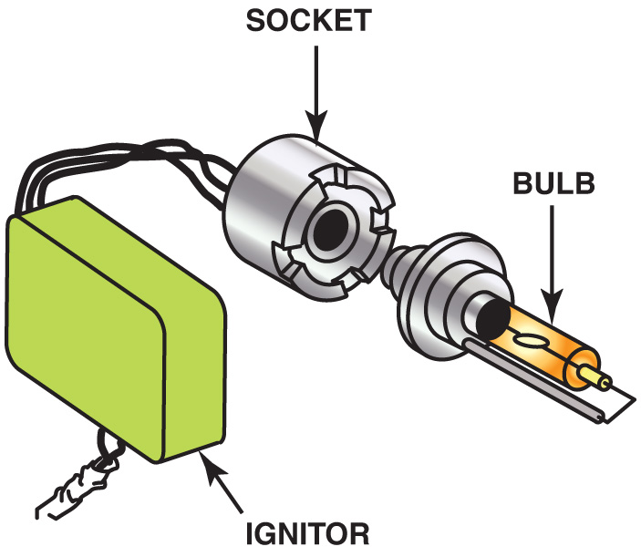
Figure 24.18 The igniter contains the ballast and transformer needed to provide high-voltage pulses to the arctube bulb

Slide 29
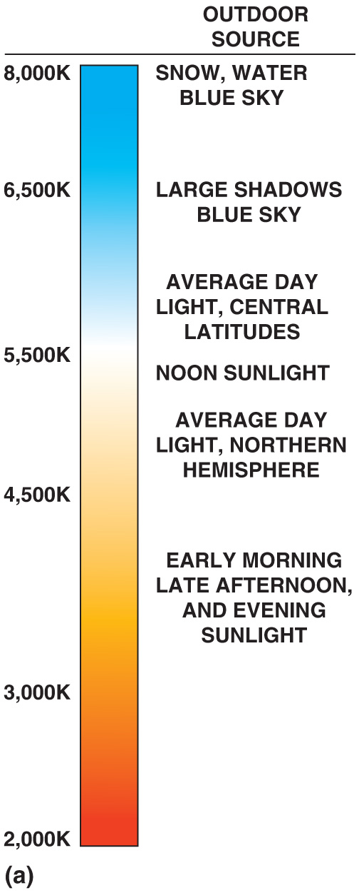
Figure 24.19 (a) The color of light is measured in degrees Kevin (K). The higher the temperature of the light, the bluer the appearance. (Line drawing to be drafted.)

Slide 30
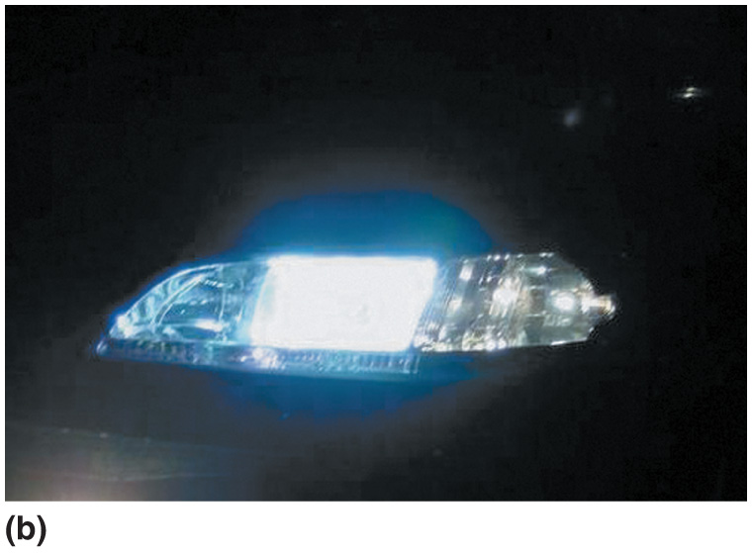
Figure 24.19 (b) H I D (xenon) headlights emit a whiter light than halogen headlights and usually look blue compared to halogen bulbs

Slide 31
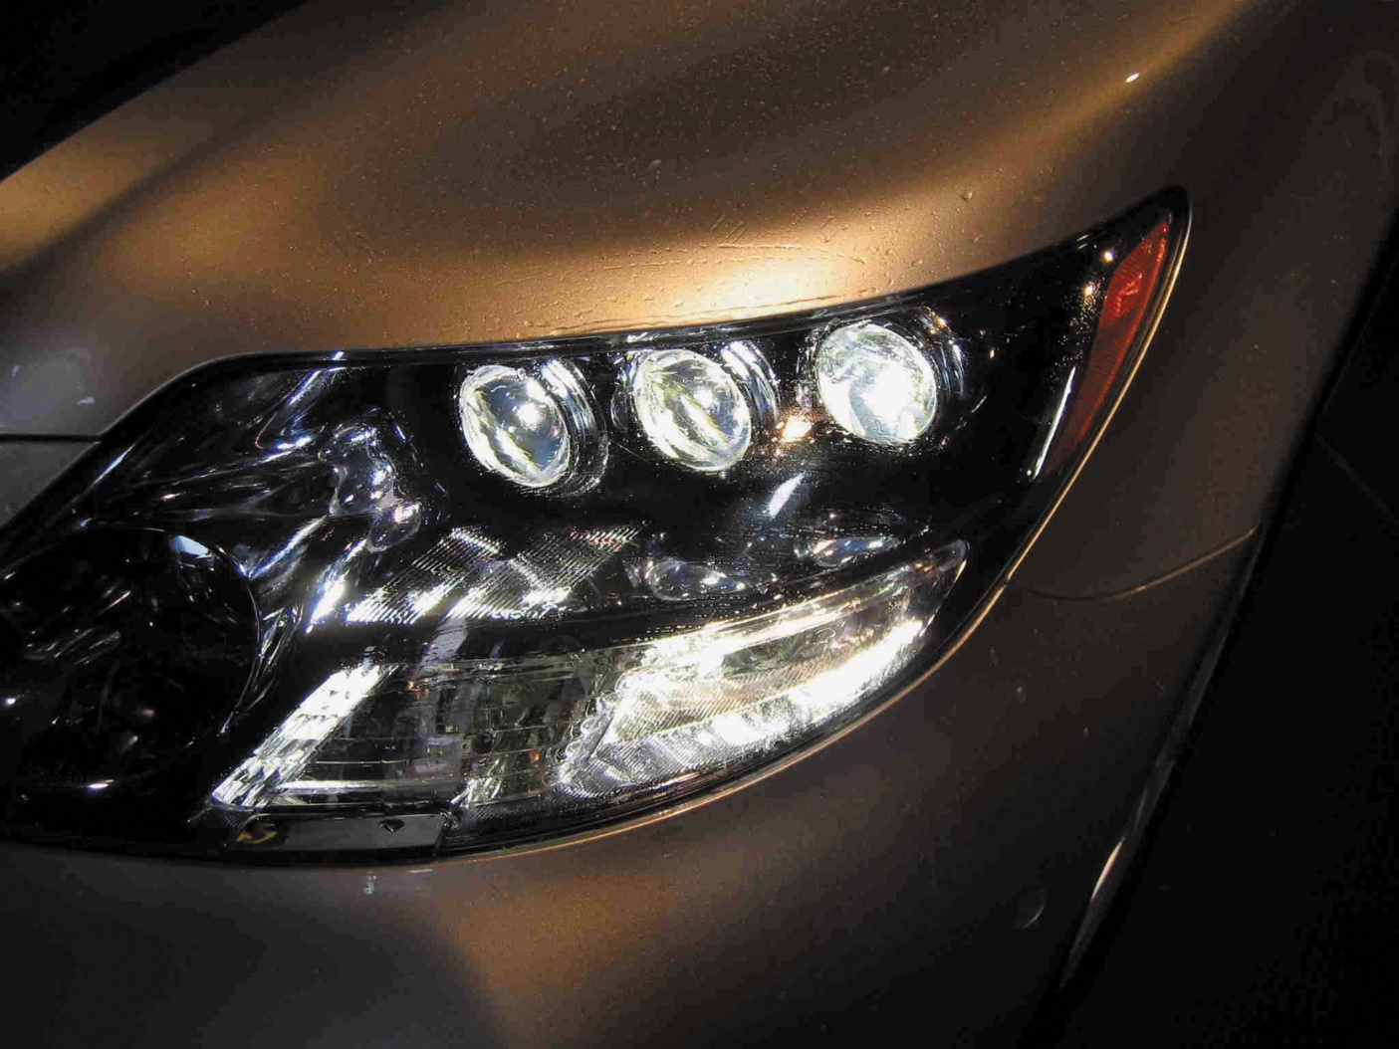
Figure 24.20 L E D headlights usually require multiple units to provide the needed light, as seen on this Lexus L S600h

Slide 32
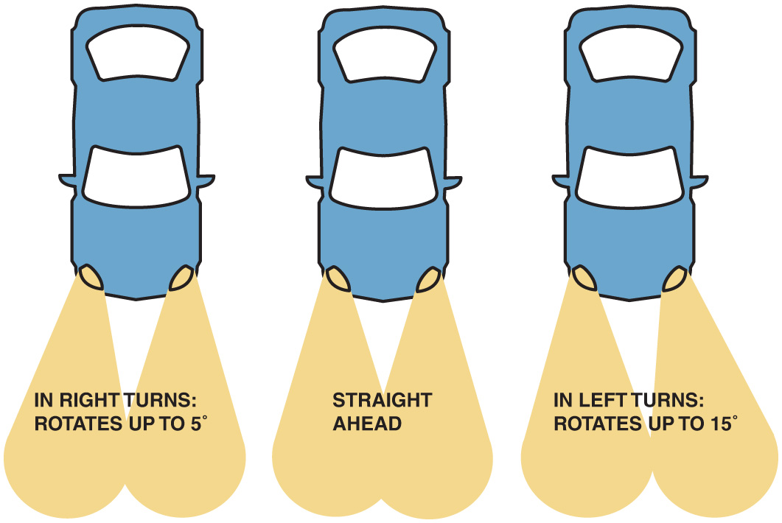
Figure 24.21 Adaptive front lighting systems rotate the low-beam headlight in the direction of travel

Slide 33
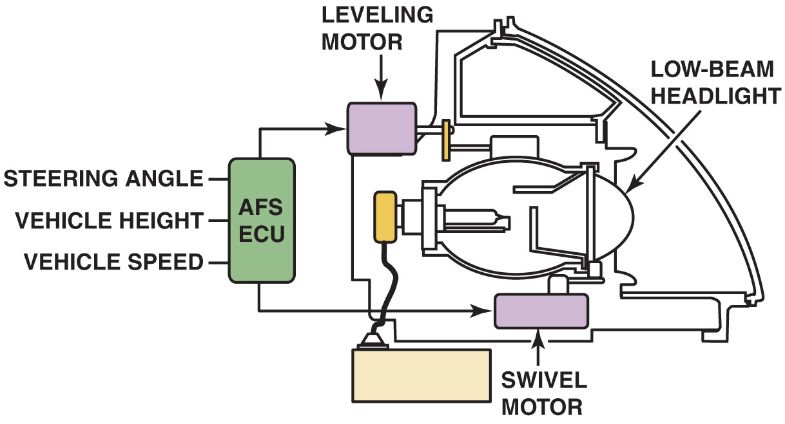
Figure 24.22 A typical adaptive front lighting system uses two motors: one for the up-and-down movement and the other for rotating the low-beam headlight to the left and right

Slide 34
Figure 24.23 Typical dash-mounted switch that allows the driver to turn off the front lighting system

Slide 35
Figure 24.24 A dash symbol used to inform the driver that the automatic headlights are on

Slide 36
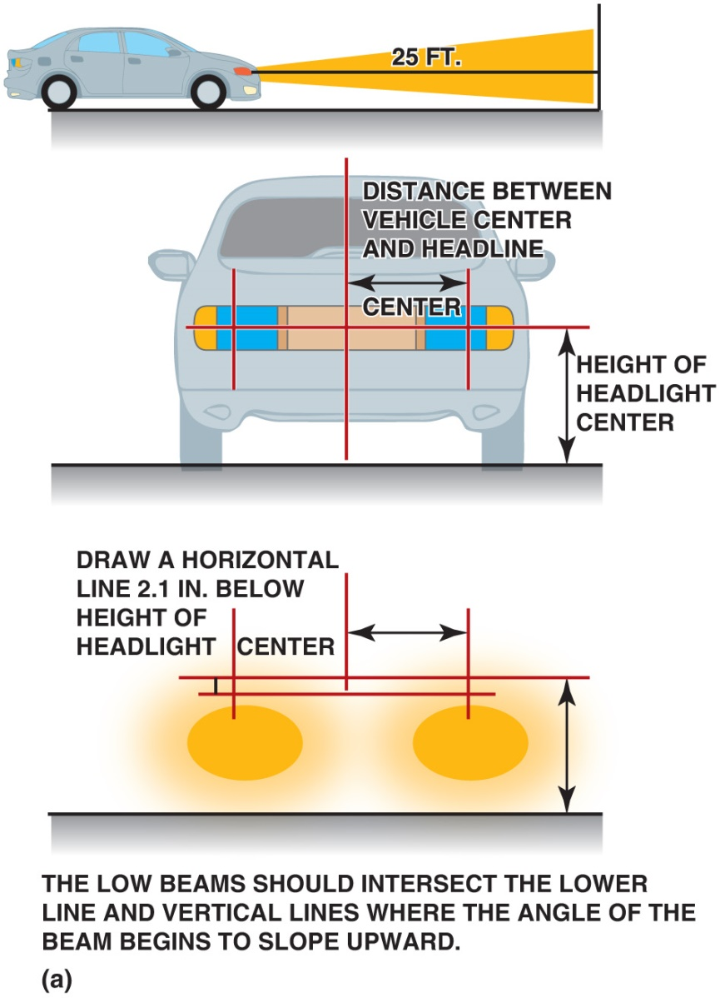
Figure 24.25 (a) A typical headlight-aiming diagram as found in service information

Slide 37
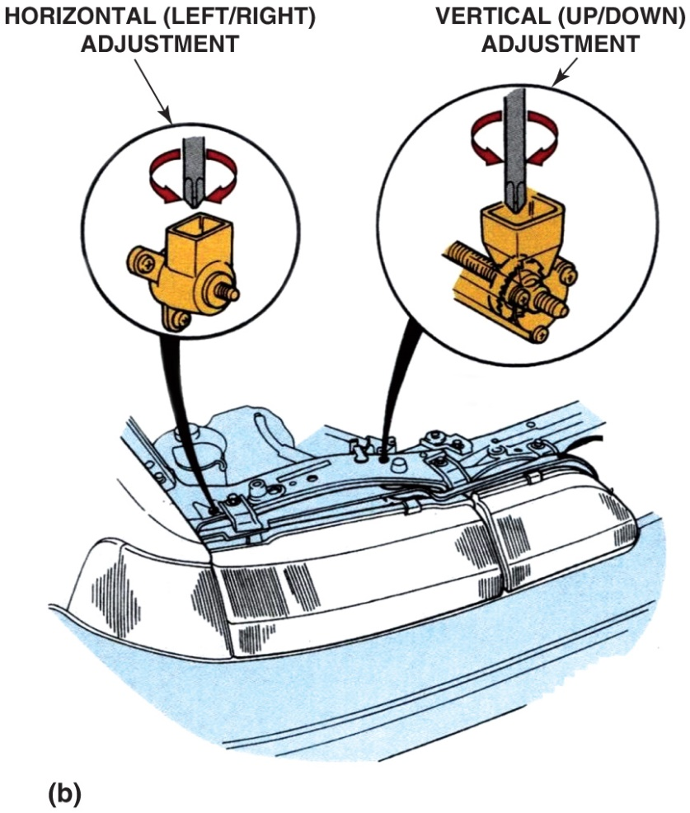
Figure 24.25 (b) Adjustments to move the head light aiming point left or right or up and down are usually made using a screwdriver to move the headlight housing

Slide 38
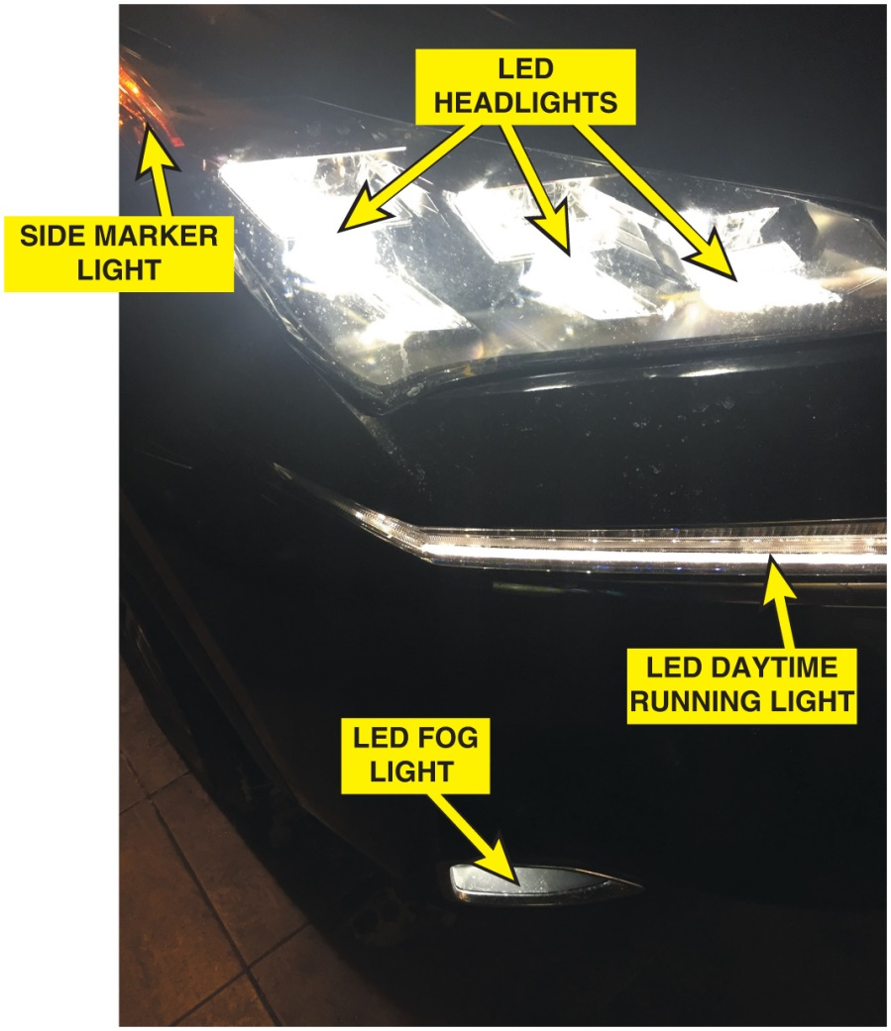
Figure 24.26 Fog lights are often included on many vehicles, such as these on a Lexus S U V

Slide 39
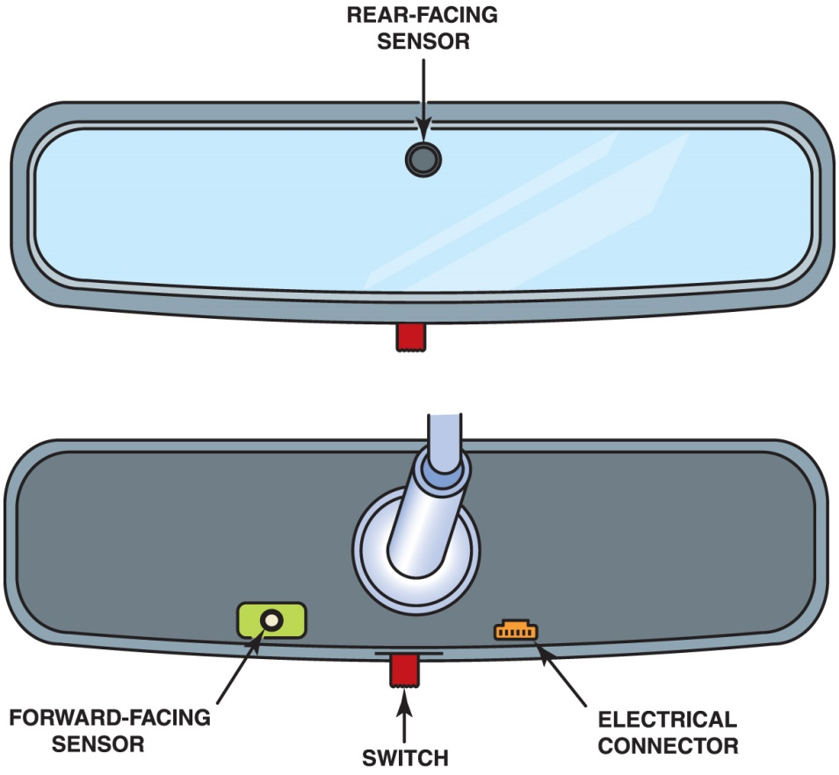
Figure 24.27 An automatic dimming mirror compares the amount of light toward the front of the vehicle to the rear of the vehicle and allows a voltage to cause the gel to darken the mirror

Slide 40
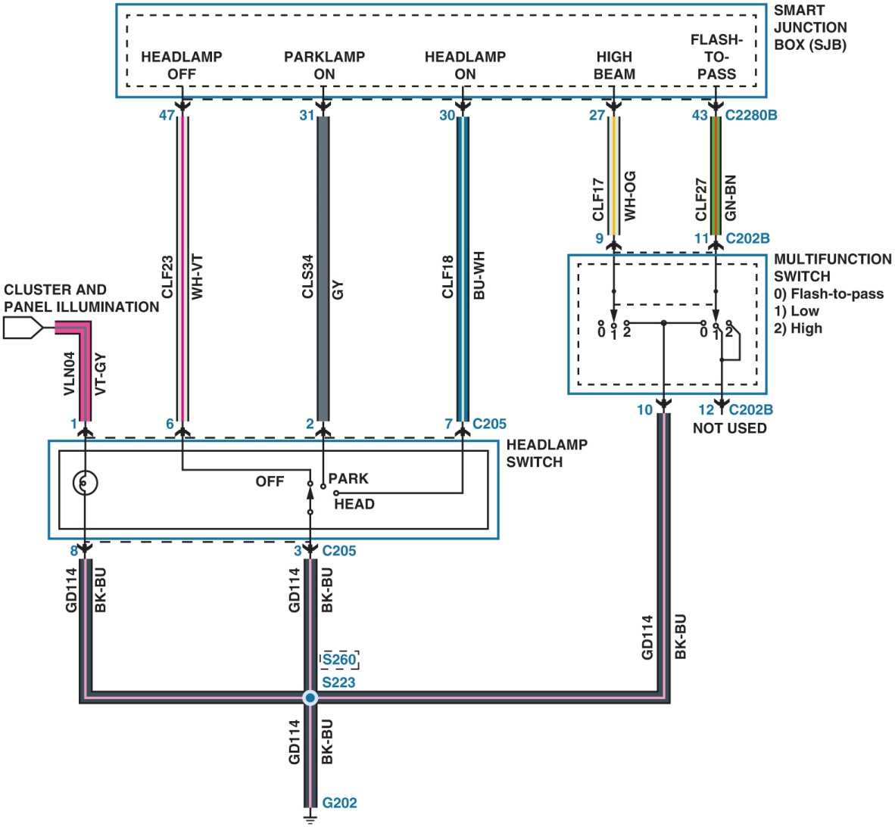
Figure 24.28 A Ford headlight circuit showing the control of the power side of the circuit comes from the smart junction box (S J B)

Slide 41
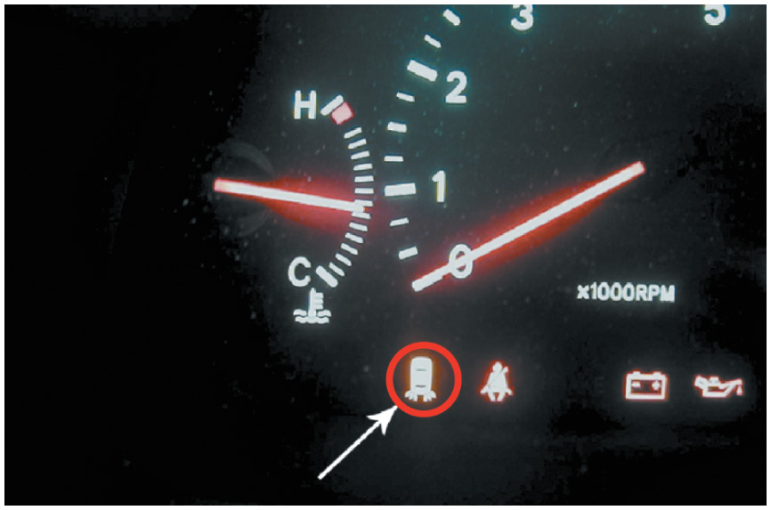
TAILLIGHT BULB REPLACEMENT 1

Slide 42
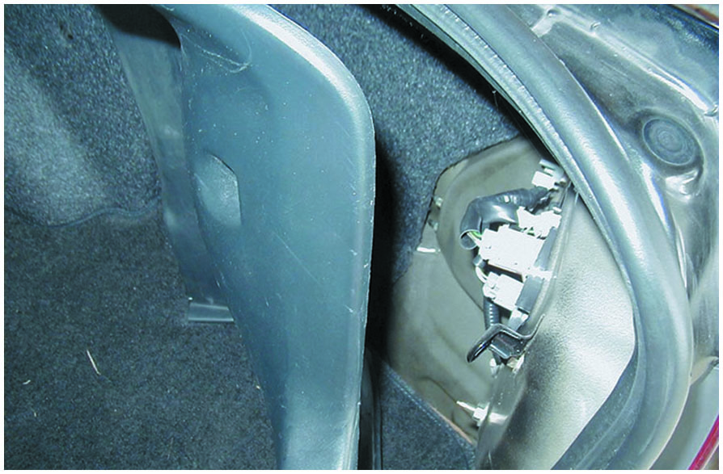
TAILLIGHT BULB REPLACEMENT 2

Slide 43
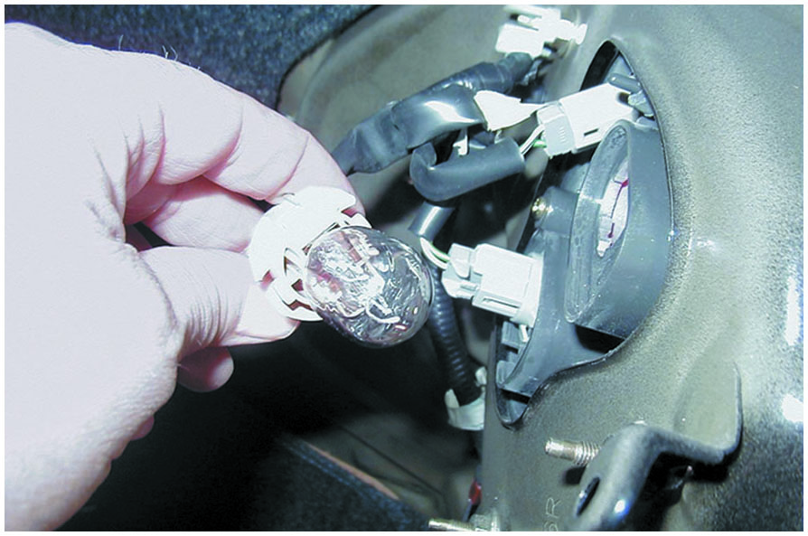
TAILLIGHT BULB REPLACEMENT 3

Slide 44
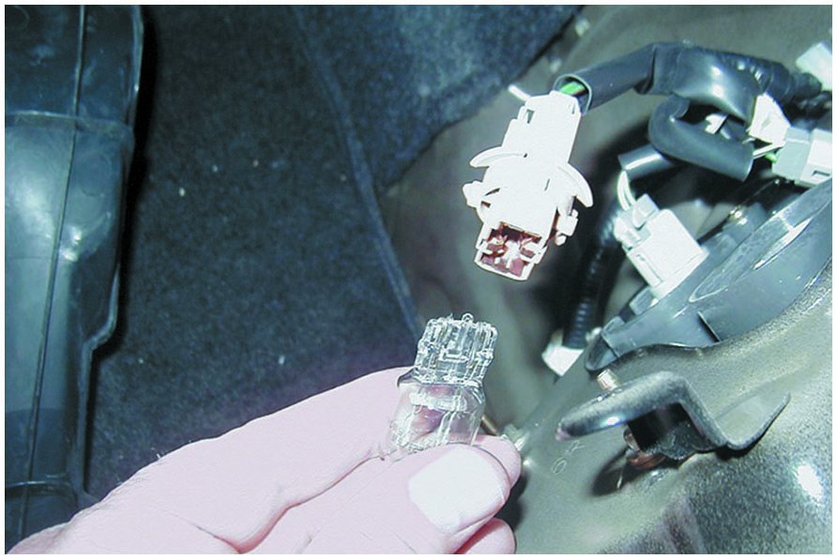
TAILLIGHT BULB REPLACEMENT 4

Slide 45
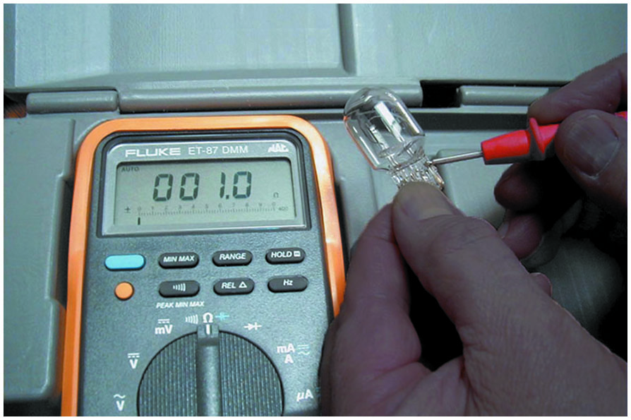
TAILLIGHT BULB REPLACEMENT 5

Slide 46
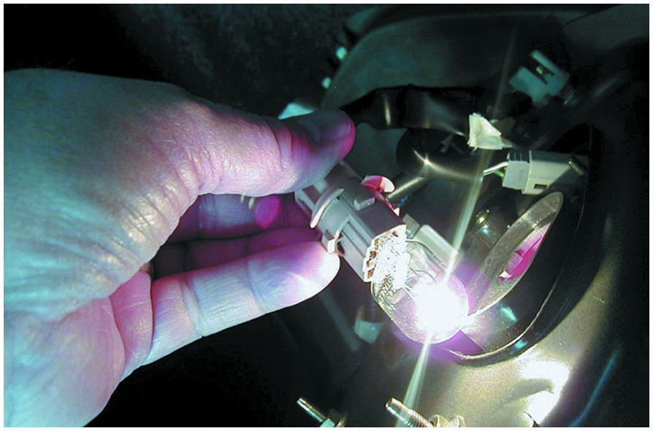
TAILLIGHT BULB REPLACEMENT 6

Slide 47
Video Links (Internet Access Required)
Dome light (time 2:37)
Brake lights (time 3:11)
Door ajar light (time 7:13)
Turn signal switch (time 2:25)
Clean an electrical socket (time 1:27)
Multifunction switch (time 8:50)
Brake lights repair (time 2:27)
Radio bulb replacement (time 9:21)
Dash bulb replacement (time 5:40)
Corvette lights (time 7:35)

Slide 48
Video Links (Internet Access Required)
Turn signal repair (time 6:01)
Interior lights repair (time 1:18)
Headlight switch (time 4:28)
Brake light repair (time 3:47)
Turn signal socket (time 1:52)
Dash lights (time 8:07)
Tail lights (time 2:09)
Head light switch (time 1:30)
Head light bulb (time 1:34)
Brake light switch (time 7:07)

Slide 49
Video Links (Internet Access Required)
Head light bulb (time 7:17)
Head light switch (time 7:45)
Multi function switch (time 12:55)
Multi function switch (time 8:18)
Dome light switch (time 2:50)
Multi function switch (time 8:55)
Turn signal switch (time 1:24)
Dim headlight diagnosis (time 6:54)
Headlight Aiming (time 8:41)
HID headlight diagnosis (time 7:56)

Slide 50
Video Links (Internet Access Required)
Dim Headlight Diagnosis (time 6:54)
Headlight Aiming (time 8:41)
HID Headlight Diagnosis (time 7:56)
How to Replace a Brake Pedal Switch (time 1:30)

Slide 51
Copyright

