Slide 1
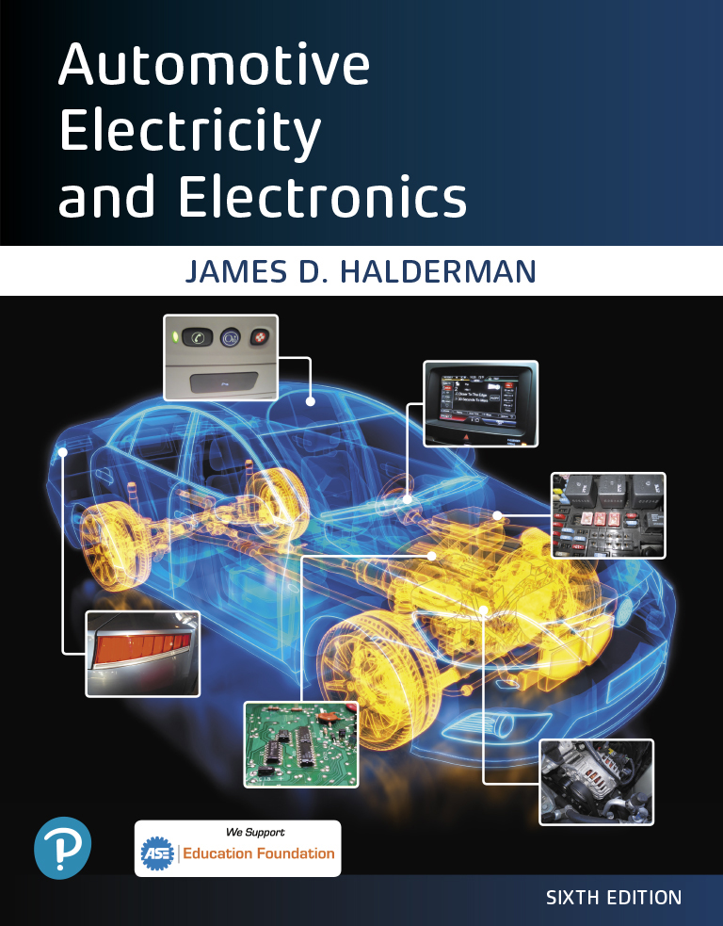
Automotive Electricity and Electronics
Sixth Edition
Chapter 22
Charging System
Copyright © 2021 Pearson Education, Inc. All Rights Reserved
Notes:
If this PowerPoint presentation contains mathematical equations, you may need to check that your computer has the following installed:
1) Math Type Plugin
2) Math Player (free versions available)
3) NVDA Reader (free versions available)

Slide 2
Figure 22.1 A typical alternator on a Chevrolet V-8 engine that is driven by the accessory drive belt at the front of the engine

Slide 3
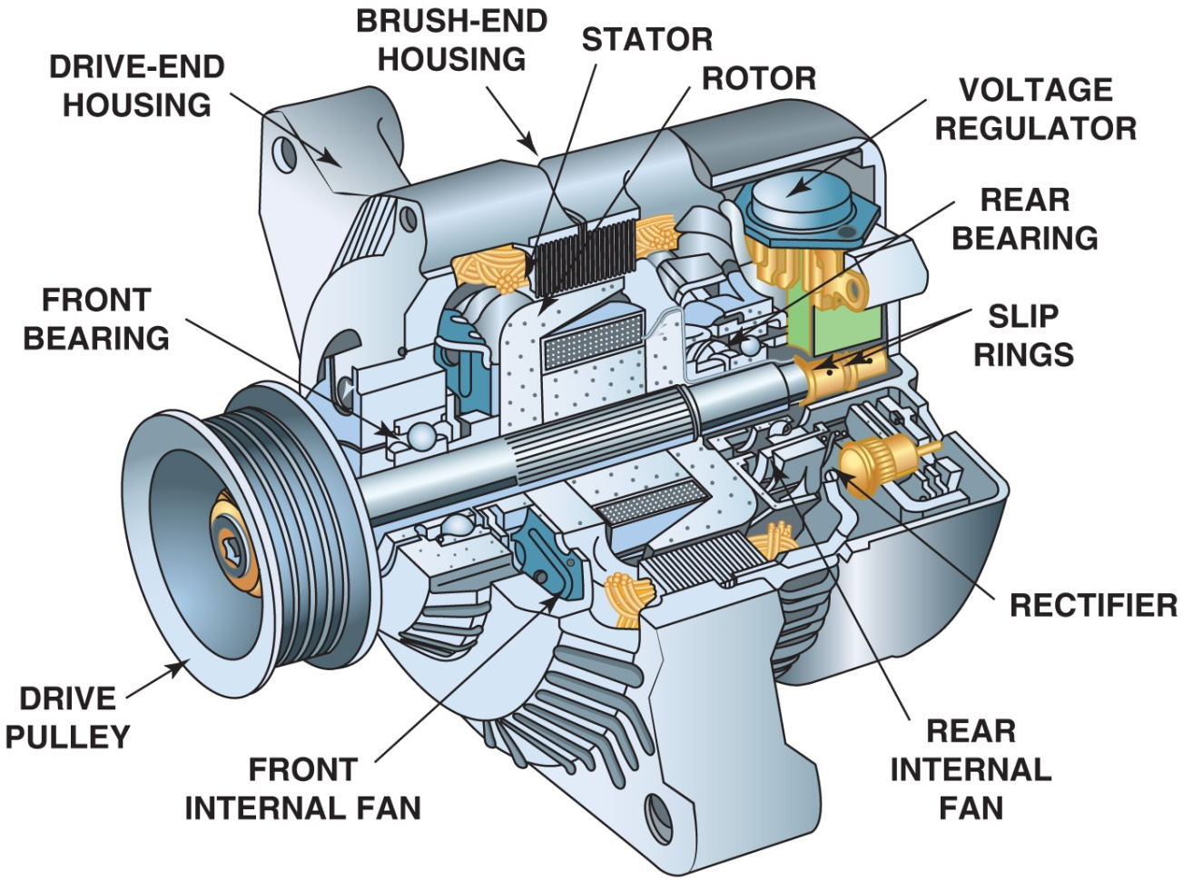
Figure 22.2 The end frame toward the drive belt is called the drive-end housing and the rear section is called the slip-ring-end housing

Slide 4
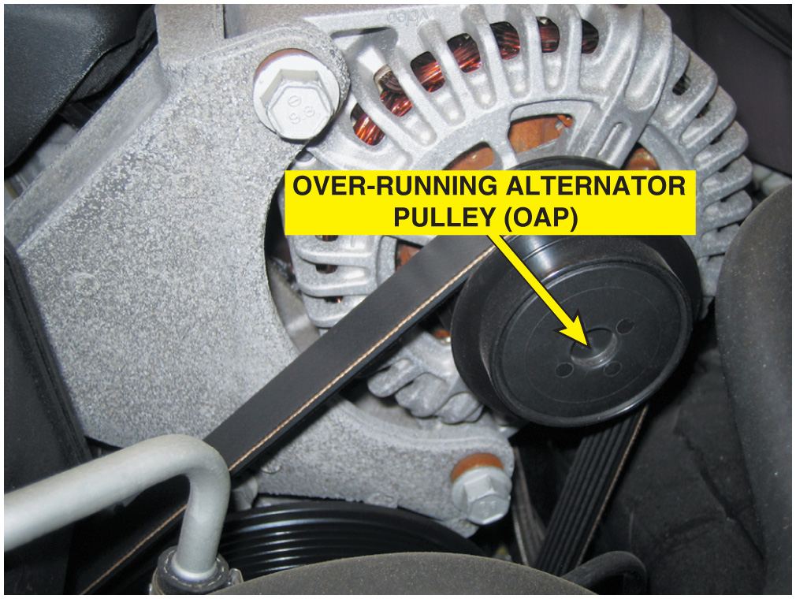
Figure 22.3 An O A P on a Chevrolet Corvette alternator

Slide 5
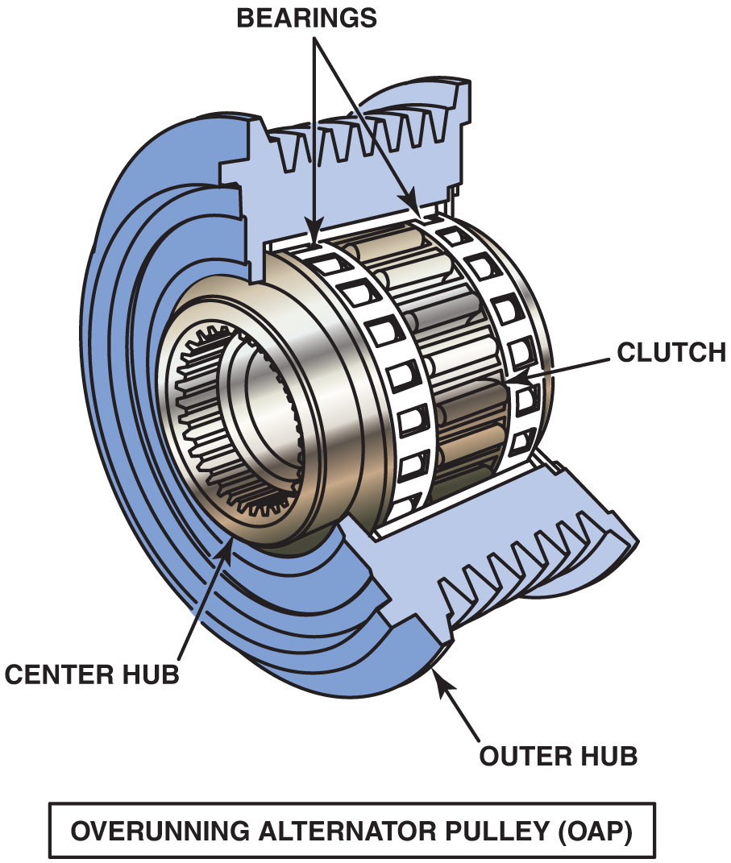
Figure 22.4 An exploded view of an overrunning alternator pulley showing all of the internal parts

Slide 6
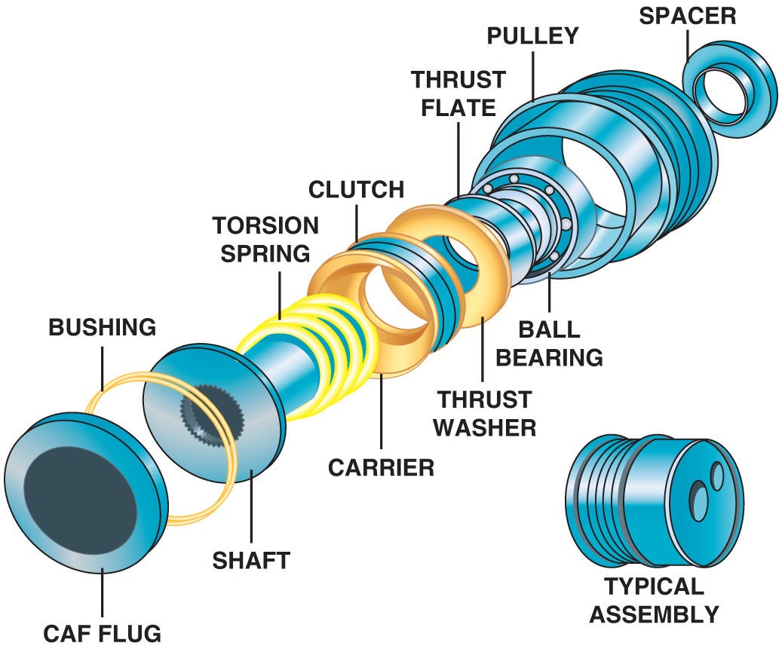
Figure 22.5 An overrunning alternator damper (O A D) is not a simple one-way clutch or a solid pulley, but instead is engineered to dampen noises and vibrations in the front accessory drive belt system

Slide 7
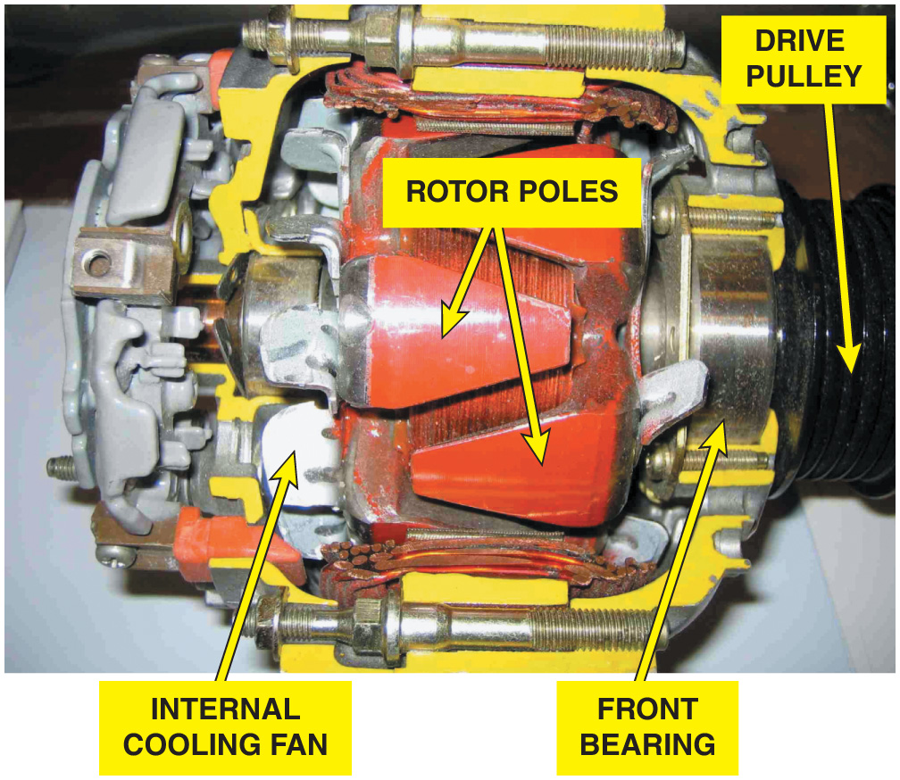
Figure 22.6 A cutaway of an alternator, showing the rotor and cooling fan that is used to force air through the unit to remove the heat created when it is charging the battery and supplying electrical power for the vehicle

Slide 8
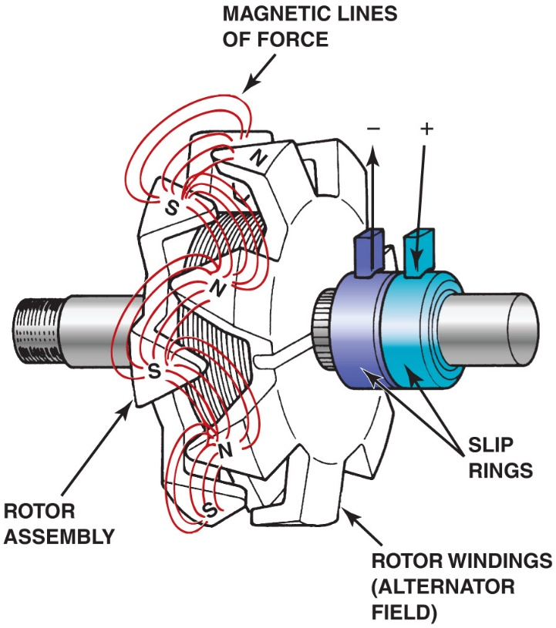
Figure 22.7 Rotor assembly of a typical alternator. Current through the slip rings causes the “fingers” of the rotor to become alternating north and south magnetic poles. As the rotor revolves, these magnetic lines of force induce a current in the stator windings

Slide 9
Animation: Charging System (The animation will automatically start in a few seconds)

Slide 10
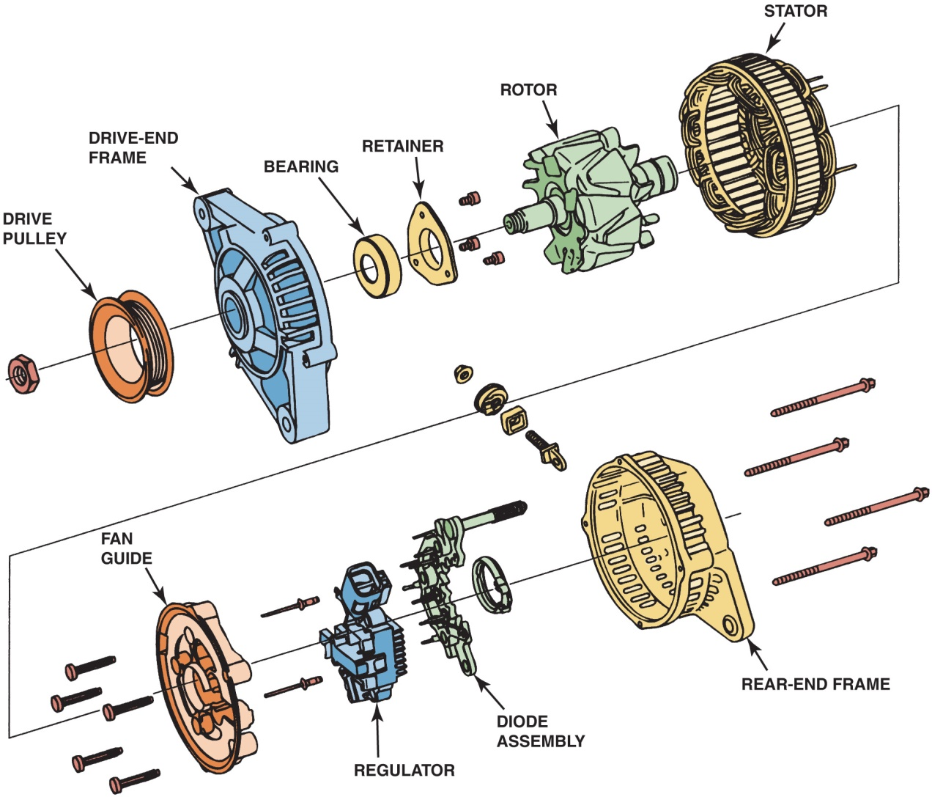
Figure 22.8 An exploded view of a typical alternator showing all of its internal parts including the stator windings

Slide 11
Figure 22.9 A rectifier usually includes six diodes in one assembly and is used to rectify A C voltage from the stator windings into D C voltage suitable for use by the battery and electrical devices in the vehicle

Slide 12
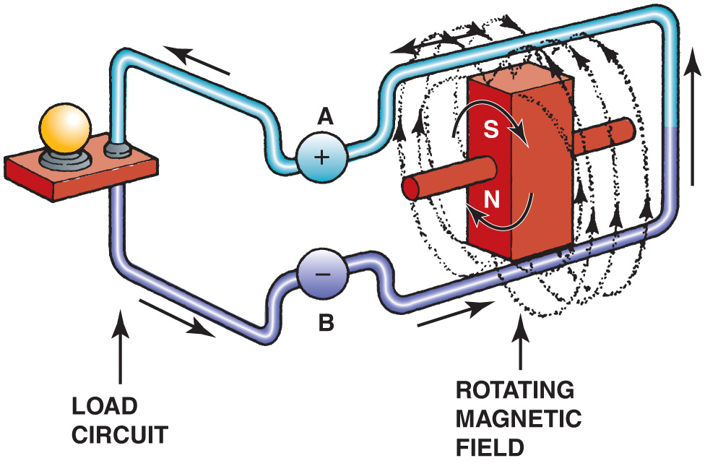
Figure 22.10 Magnetic lines of force cutting across a conductor induce a voltage and current in the conductor

Slide 13
Animation: DC Motor, Simple (The animation will automatically start in a few seconds)

Slide 14
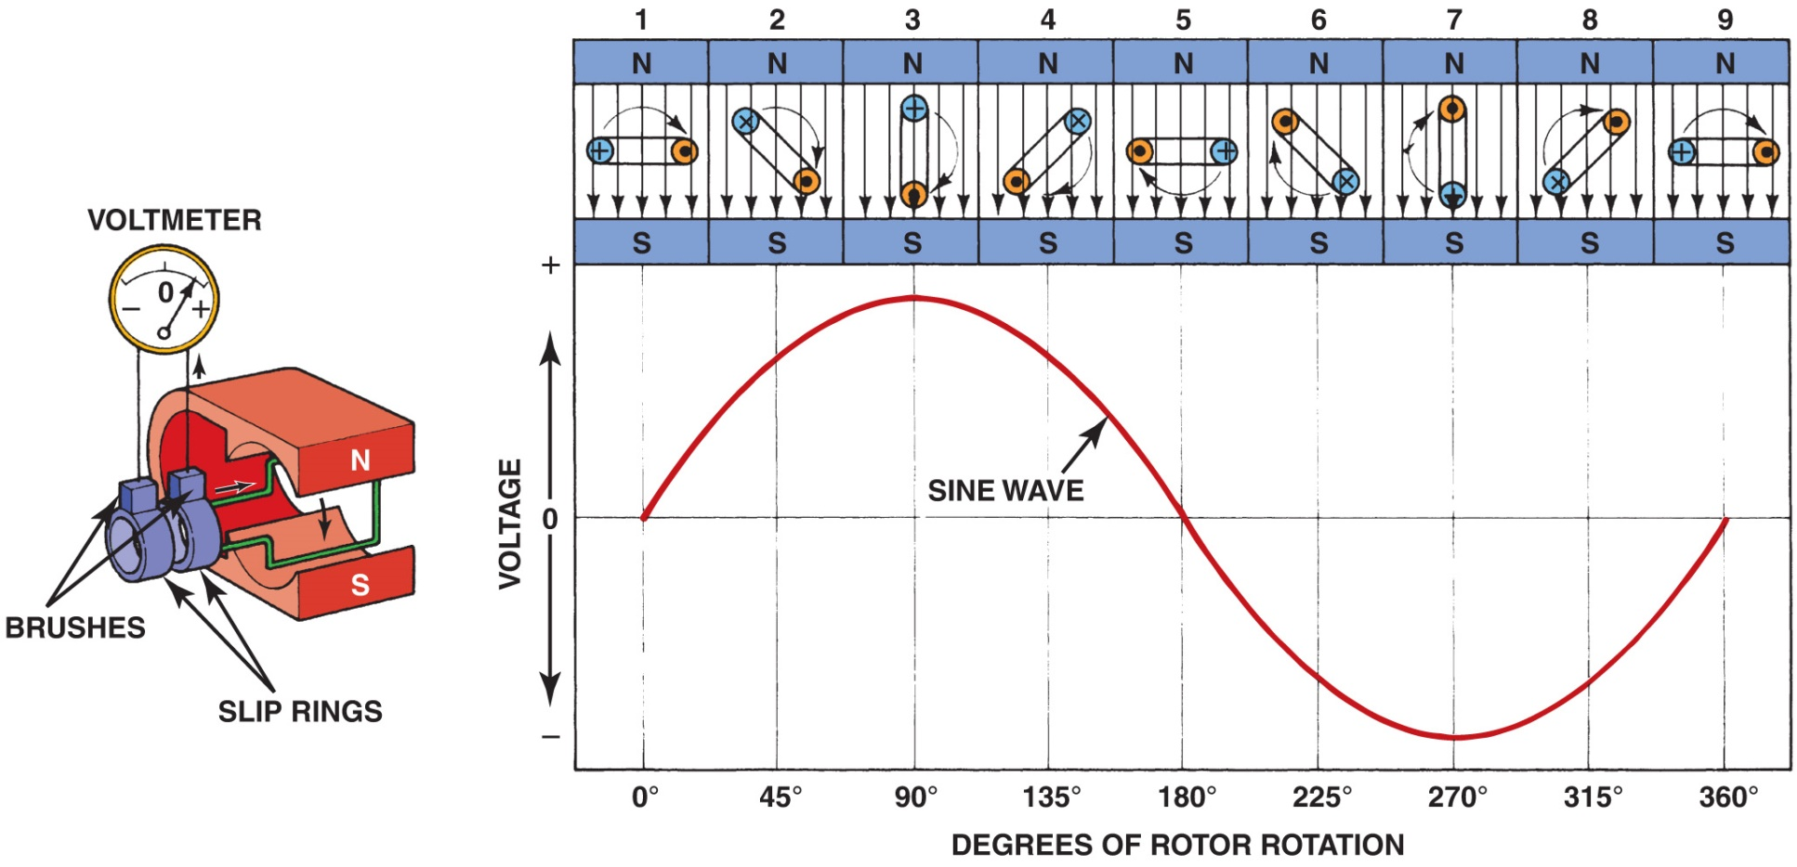
Figure 22.11 A sine wave (shaped like the letter S on its side) voltage curve is created by one revolution of a winding as it rotates in a magnetic field

Slide 15
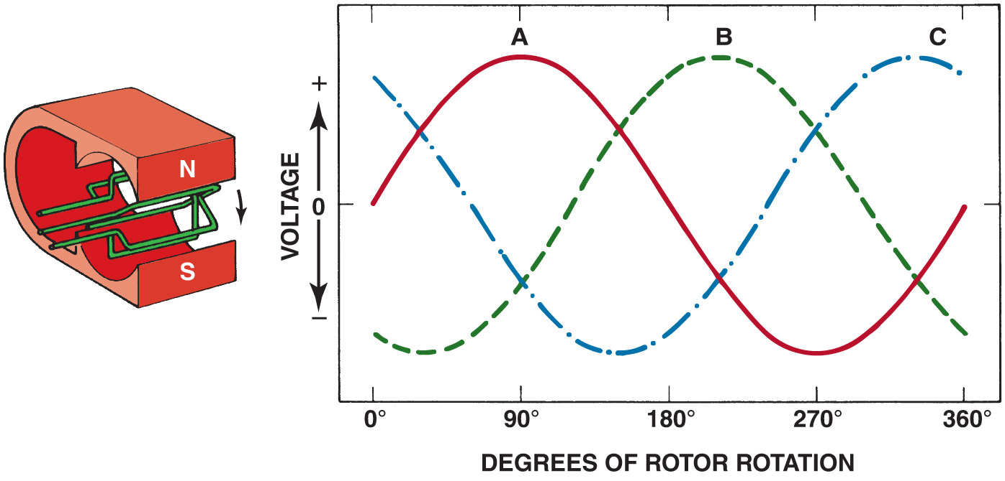
Figure 22.12 When three windings (A, B, and C) are present in a stator, the resulting current generation is represented by the three sine waves. The voltages are 120 degrees out of phase. The connection of the individual phases produces a three-phase alternating voltage

Slide 16
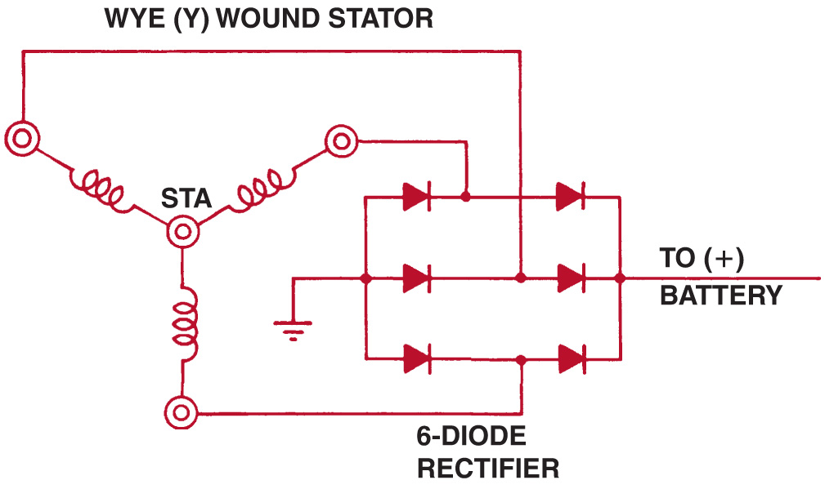
Figure 22.13 Wye-connected stator winding

Slide 17
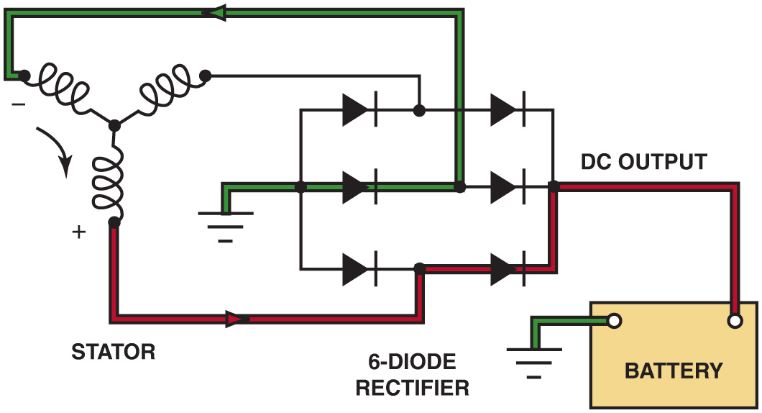
Figure 22.14 As the magnetic field, created in the rotor, cuts across the windings of the stator, a current is induced. Notice that the current path includes passing through one positive (+) diode on the way to the battery and one negative (−) diode as a complete circuit is completed through the rectifier and stator. It is the flow of current through the diodes that converts the A C voltage produced in the stator windings to D C voltage available at the output terminal of the alternator

Slide 18
Animation: WYE Stator Winding & Diode (The animation will automatically start in a few seconds)

Slide 19
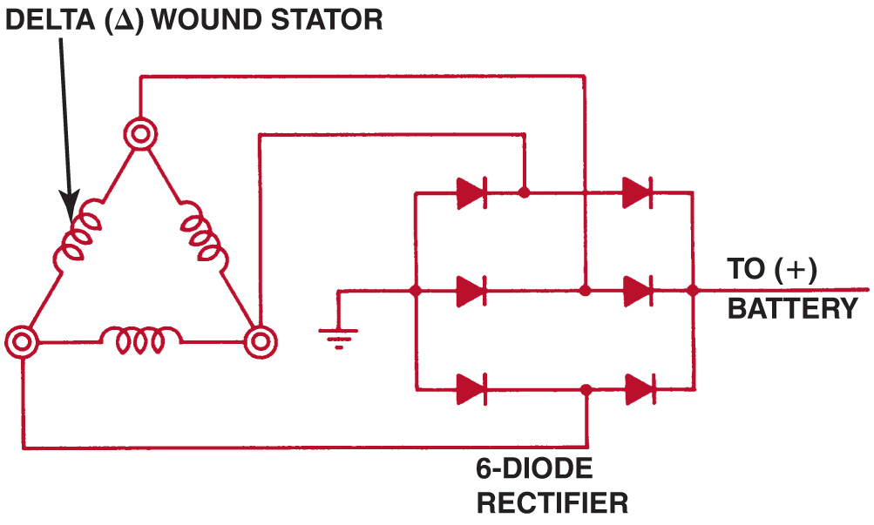
Figure 22.15 Delta-connected stator winding

Slide 20
Figure 22.16 A stator assembly with six, rather than the normal three, windings

Slide 21
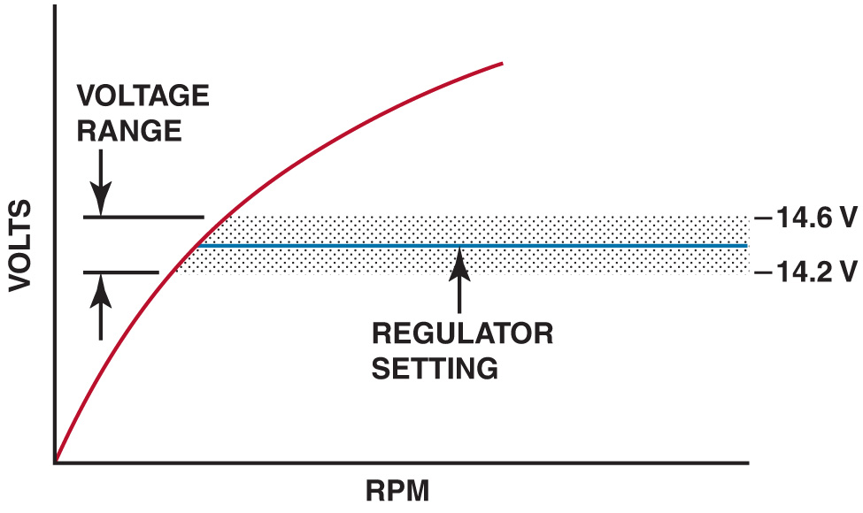
Figure 22.17 Typical voltage regulator range

Slide 22
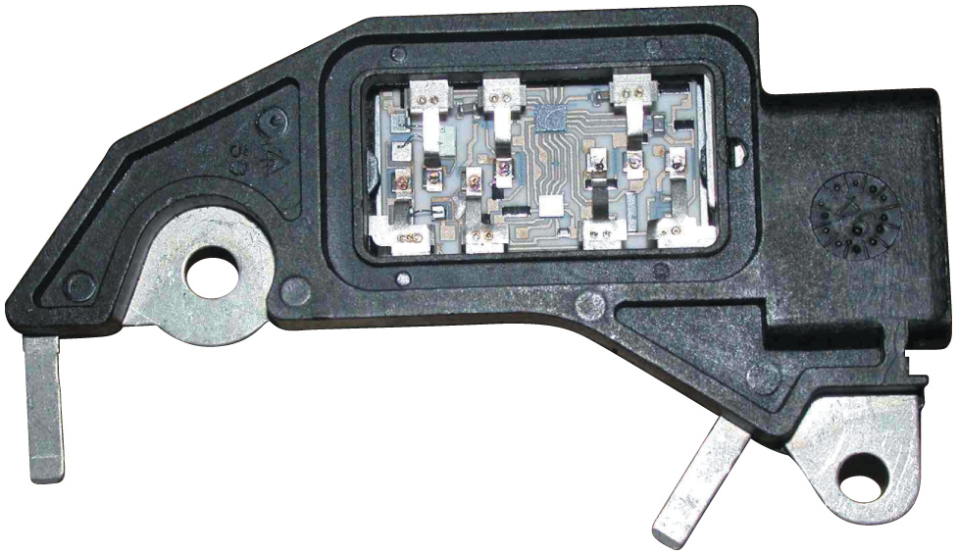
Figure 22.18 A typical electronic voltage regulator with the cover removed showing the circuits inside

Slide 23
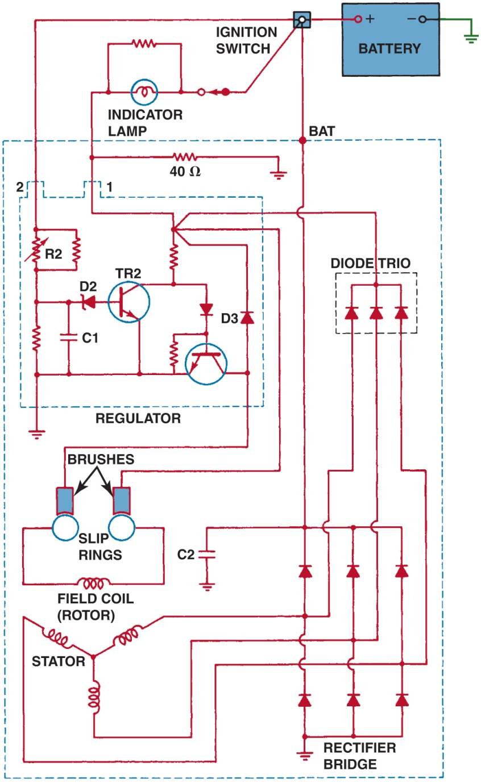
Figure 22.19 Typical General Motors S I-style alternator with an integral voltage regulator. Voltage present at terminal 2 is used to reverse bias the zener diode (D2) that controls T R2. The positive brush is fed by the ignition current (terminal 1) plus current from the diode trio

Slide 24
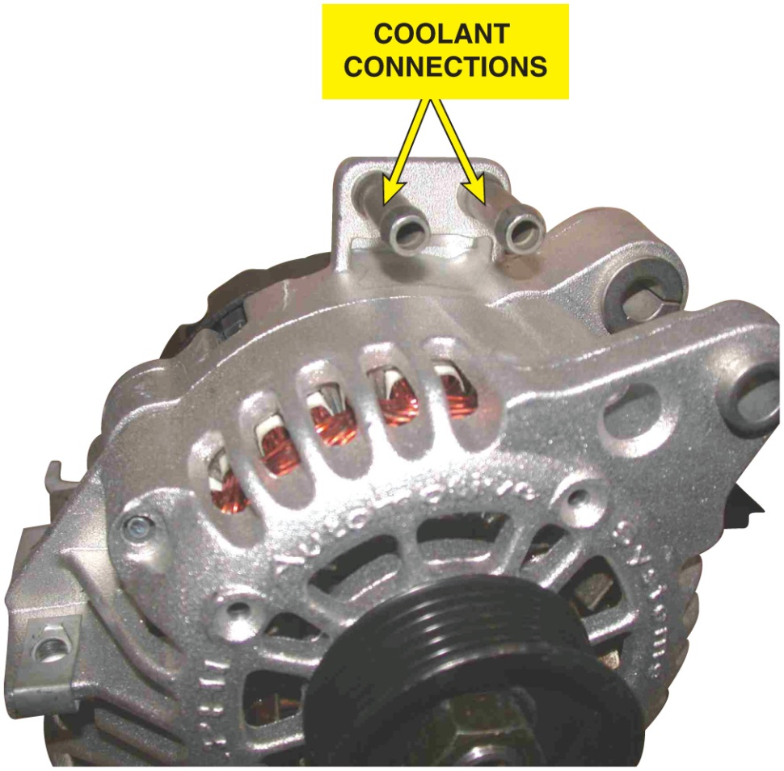
Figure 22.20 A coolant-cooled alternator showing the hose connections where coolant from the engine flows through the rear frame of the alternator

Slide 25
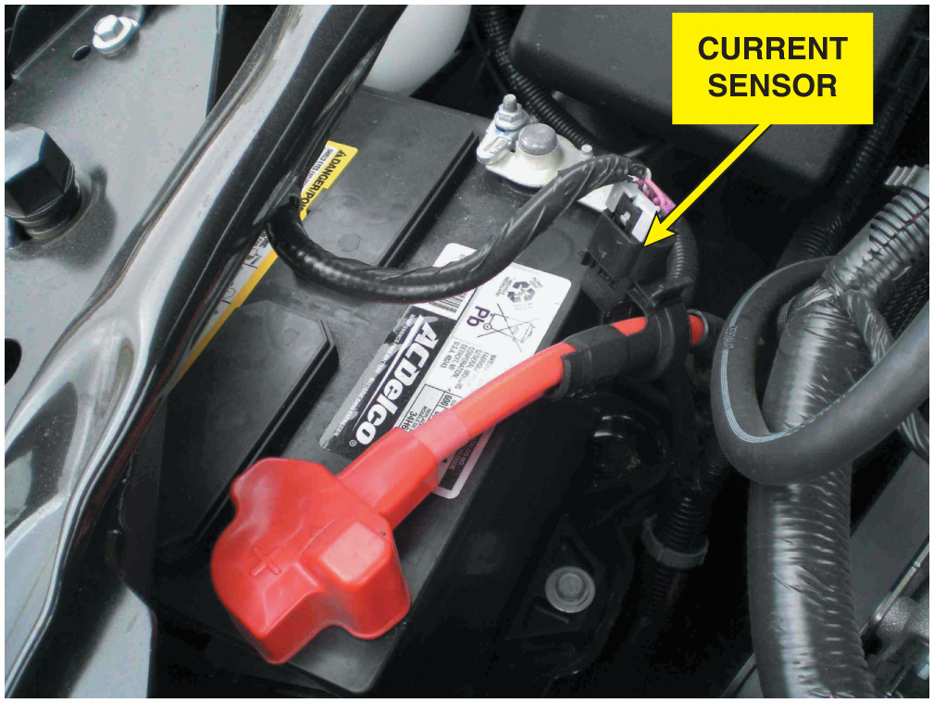
Figure 22.21 A Hall-effect current sensor attached to the positive battery cable is used as part of the E P M system

Slide 26
Animation: Hall-Effect Sensor (The animation will automatically start in a few seconds)

Slide 27
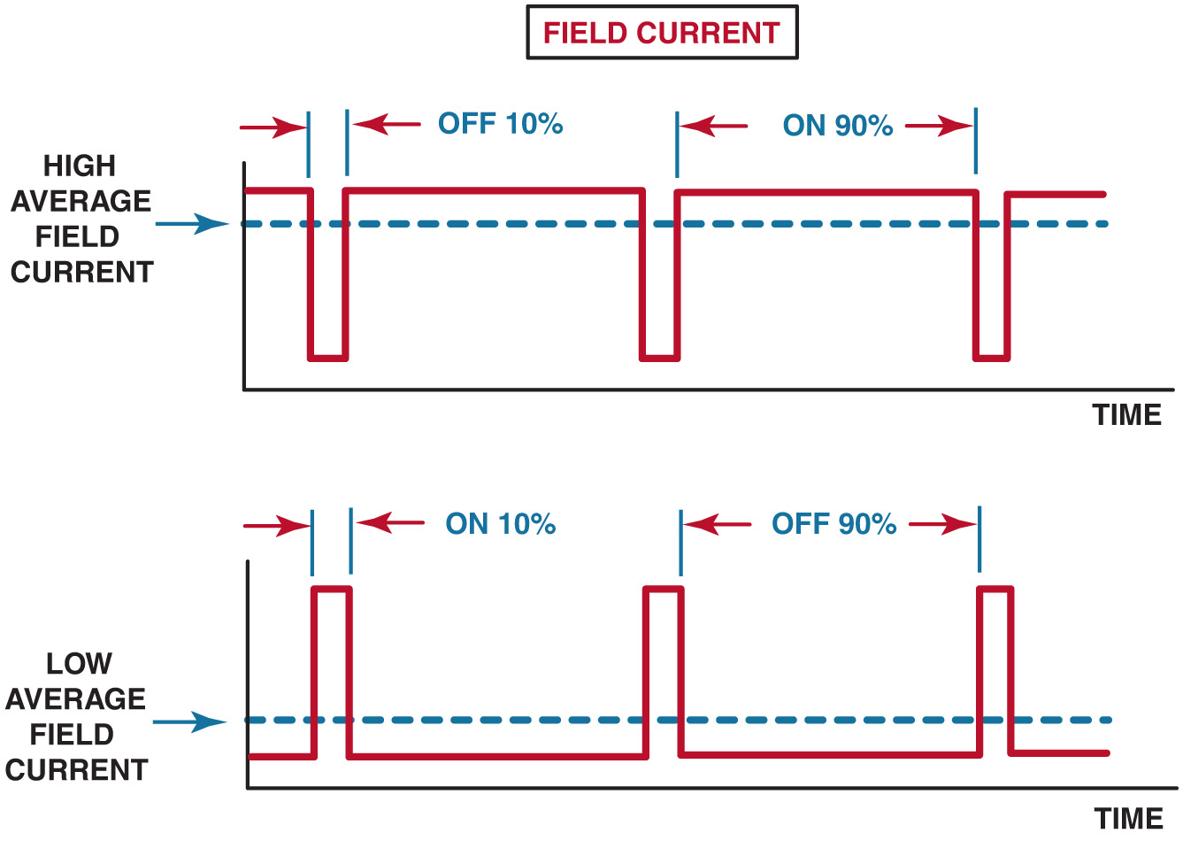
Figure 22.22 The amount of time current flowing through the field (rotor) determines the alternator output

Slide 28
Video Links (Internet Access Required)
Alternator replacement (time 3:20)
How to test a voltage regulator (time 2:19)
Alternator replacement (time 9:40)
Alternator replacement (time 7:37)
Battery and alternator testing (time 21:08)
Electronic load detector (time 3:21)
Serpentine belt replacement (time 8:05)
Charging system test (time 4:49)
Alternator (time 13:52)
How to test a voltage regulator (time 2:19)

Slide 29
Video Links (Internet Access Required)
Wiring diagram for an alternator (time 4:03)
Alternator Voltage Drop (time 7:48)
How to Replace an Alternator (time 11:52)

Slide 30
Copyright

