Slide 1
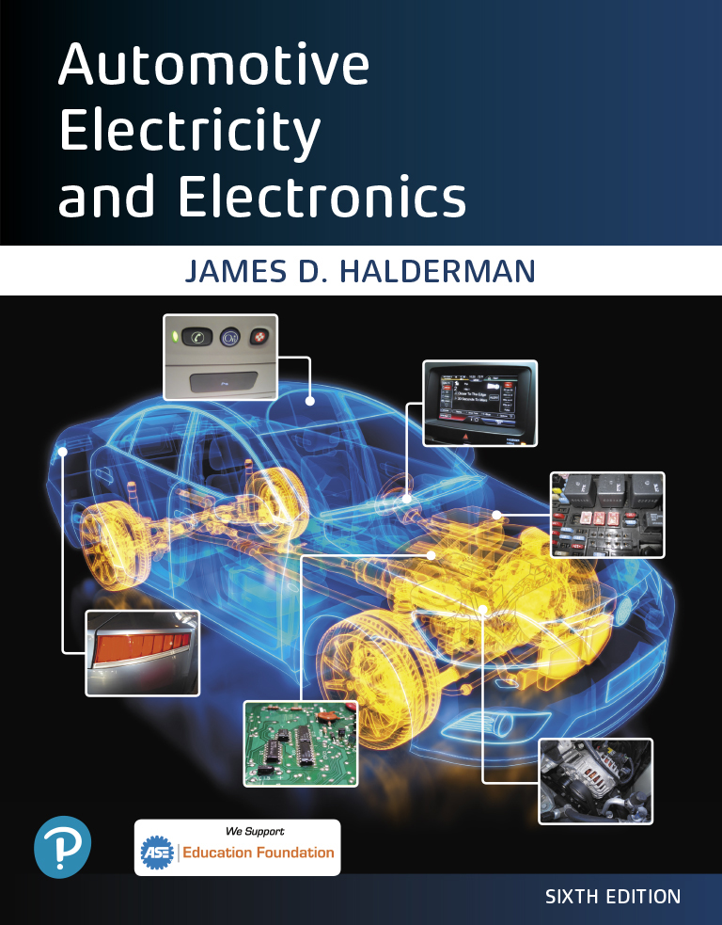
Automotive Electricity and Electronics
Sixth Edition
Chapter 20
Cranking System
Copyright © 2021 Pearson Education, Inc. All Rights Reserved
Notes:
If this PowerPoint presentation contains mathematical equations, you may need to check that your computer has the following installed:
1) Math Type Plugin
2) Math Player (free versions available)
3) NVDA Reader (free versions available)

Slide 2
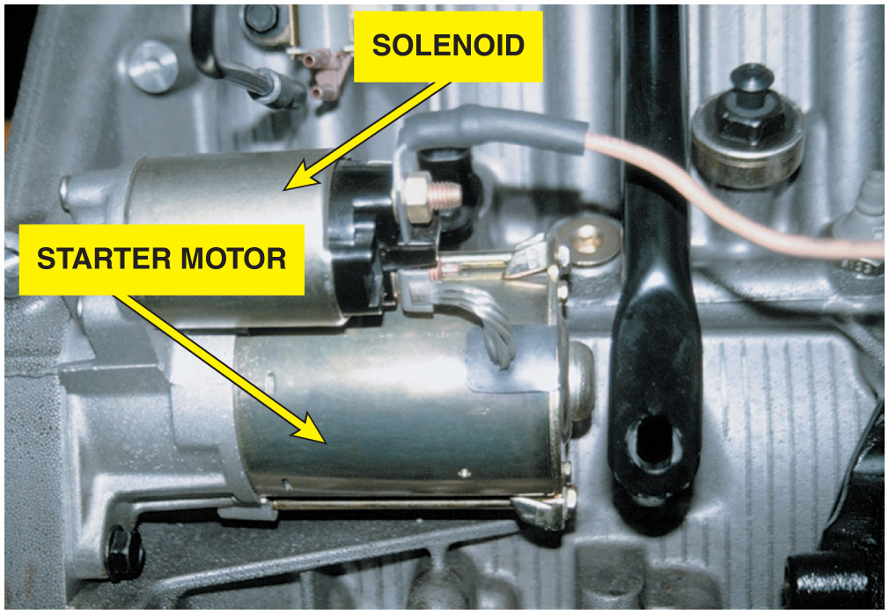
Figure 20.1 A typical solenoid-operated starter

Slide 3
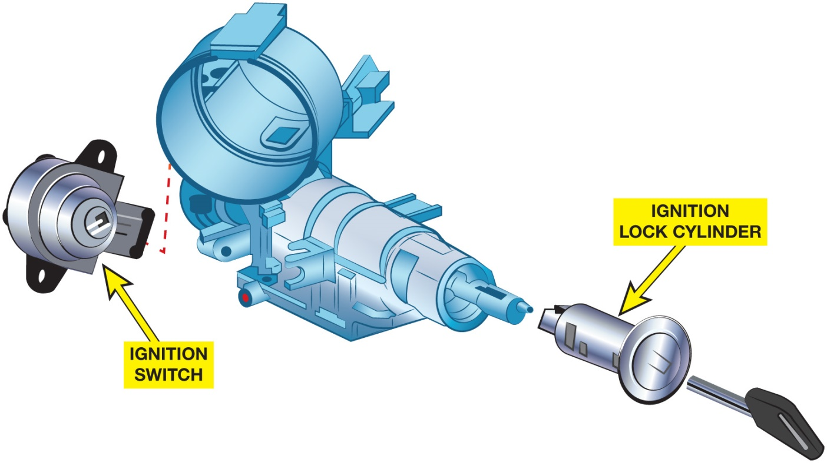
Figure 20.2 The lock cylinder is often a separate part from the electrical ignition switch and operates it directly or uses a link between two components

Slide 4
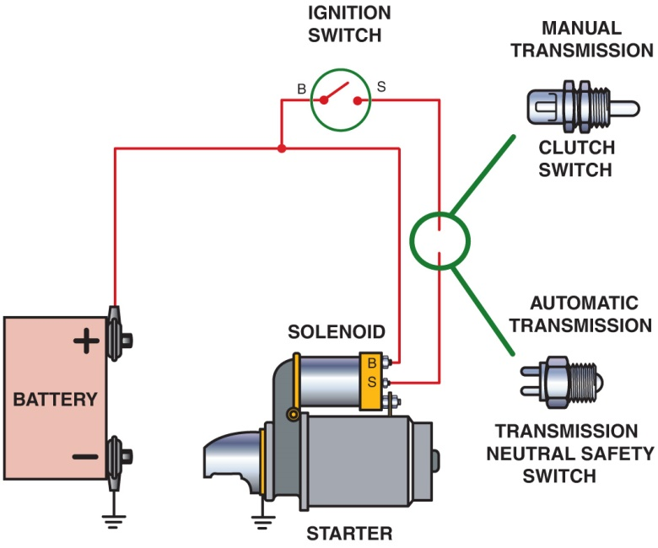
Figure 20.3 To prevent the engine from cranking, an electrical switch is usually installed to open the circuit between the ignition switch and the starter solenoid. The control circuit includes the small wiring and components needed to control the solenoid. The starter solenoid controls the electrical current flow through the large battery cables of the power circuit that operates the starter motor

Slide 5
Animation: Starter Circuit (The animation will automatically start in a few seconds)

Slide 6
Animation: Starter Circuit, Neutral Safety Switch (The animation will automatically start in a few seconds)

Slide 7
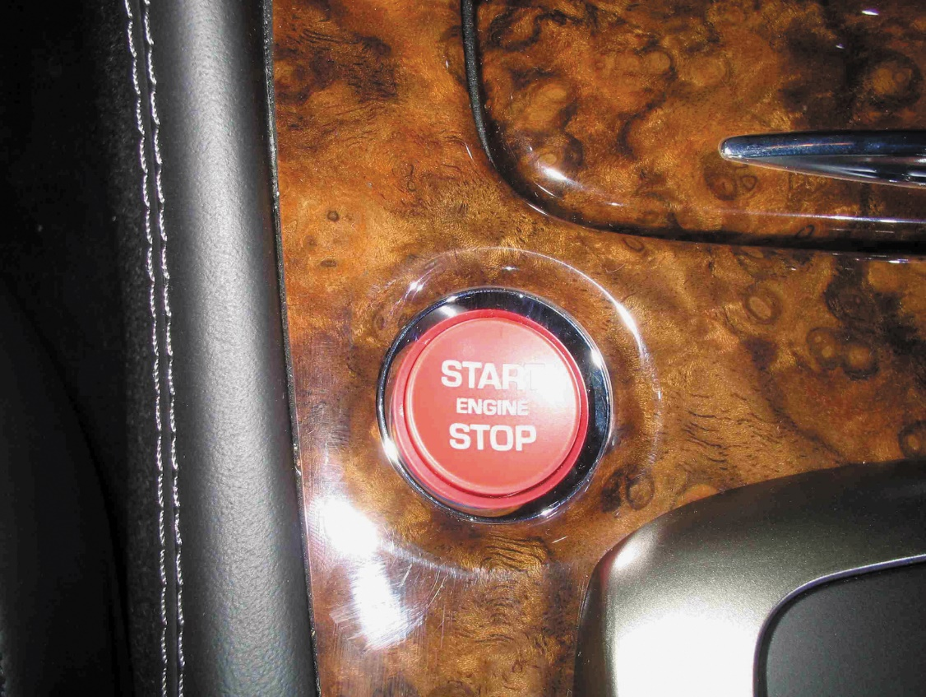
Figure 20.4 Instead of using an ignition key to start the engine, some vehicles are using a start button, which is also used to stop the engine, as shown on this Jaguar

Slide 8
Figure 20.5 The top button on this key fob is the remote start button

Slide 9
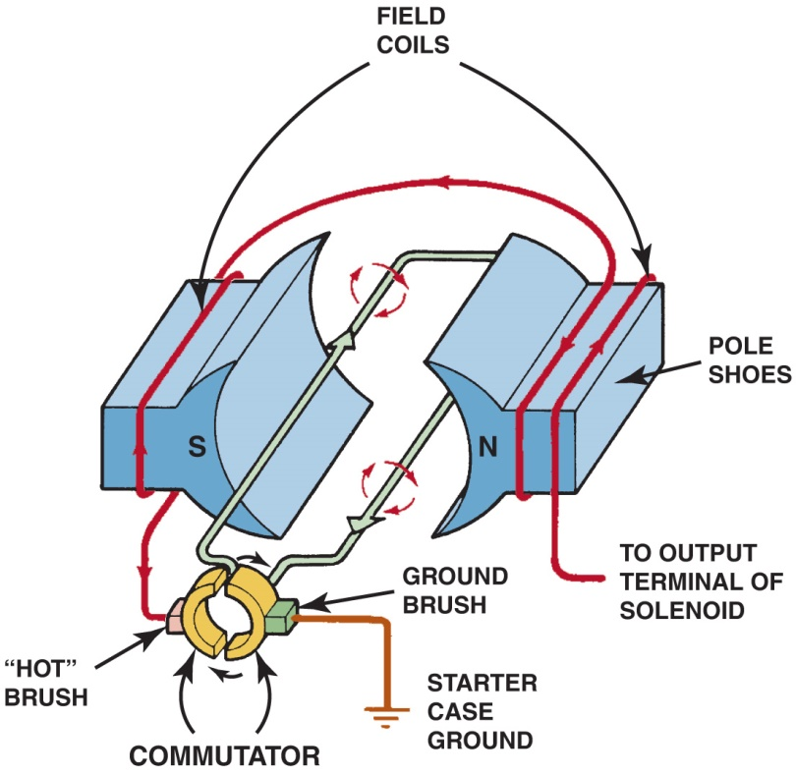
Figure 20.6 This series-wound electric motor shows the basic operation with only two brushes: one hot brush and one ground brush. The current flows through both field coils, then through the hot brush and the loop winding of the armature, before reaching ground through the ground brush

Slide 10
Animation: DC Motor, Simple (The animation will automatically start in a few seconds)

Slide 11
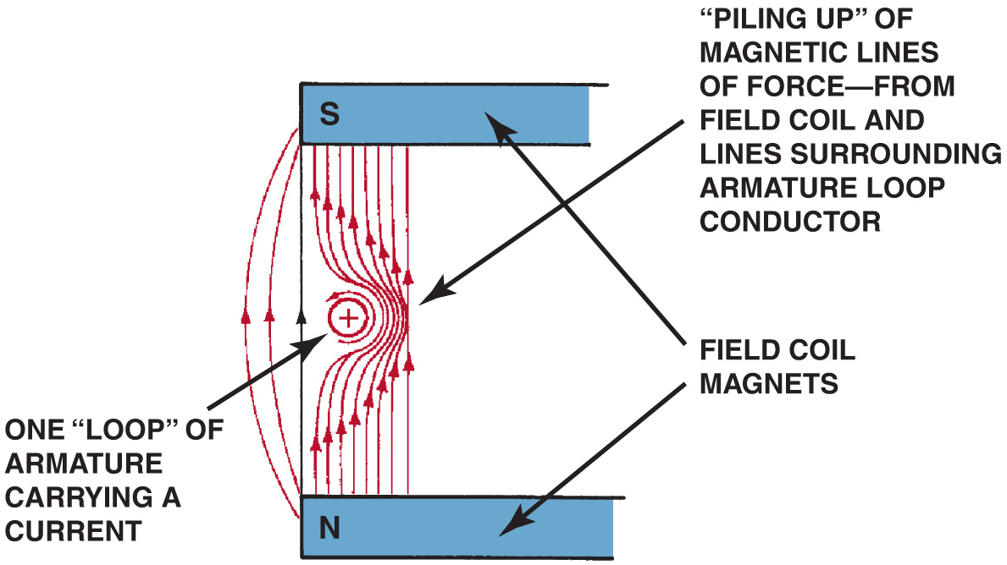
Figure 20.7 The interaction of the magnetic fields of the armature loops and field coils creates a stronger magnetic field on the right side of the conductor, causing the armature loop to move toward the left

Slide 12
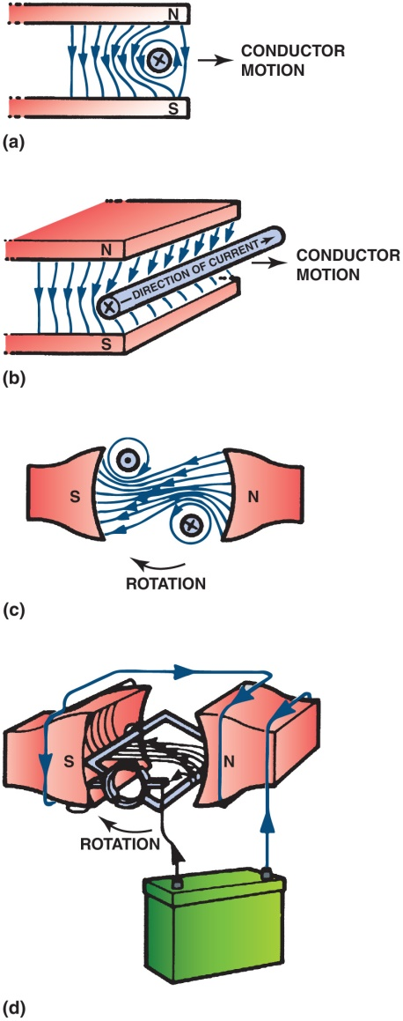
Figure 20.8 The armature loops rotate due to the difference in the strength of the magnetic field. The loops move from a strong magnetic field strength toward a weaker magnetic field strength

Slide 13
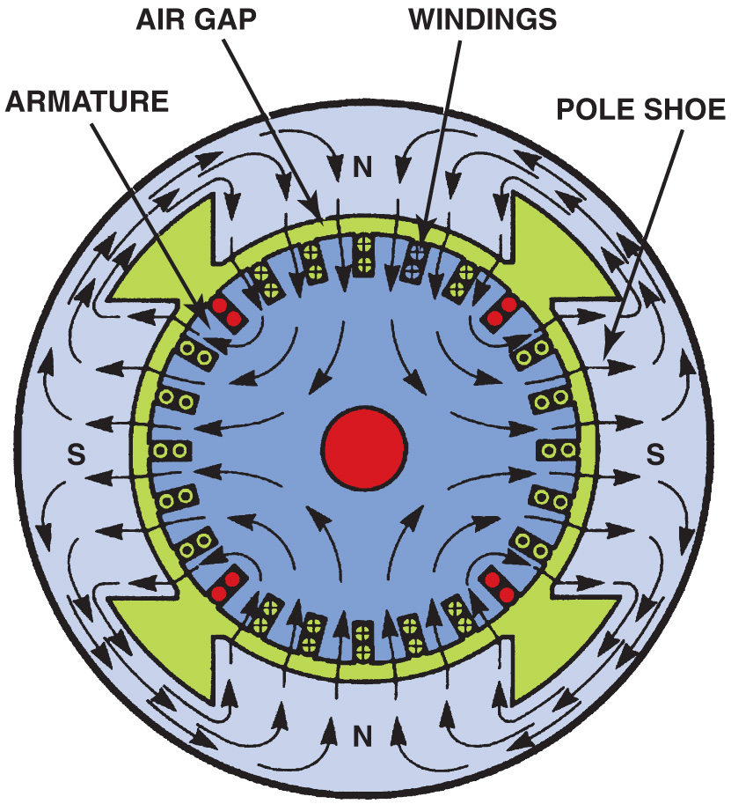
Figure 20.9 Magnetic lines of force in a four-pole motor

Slide 14
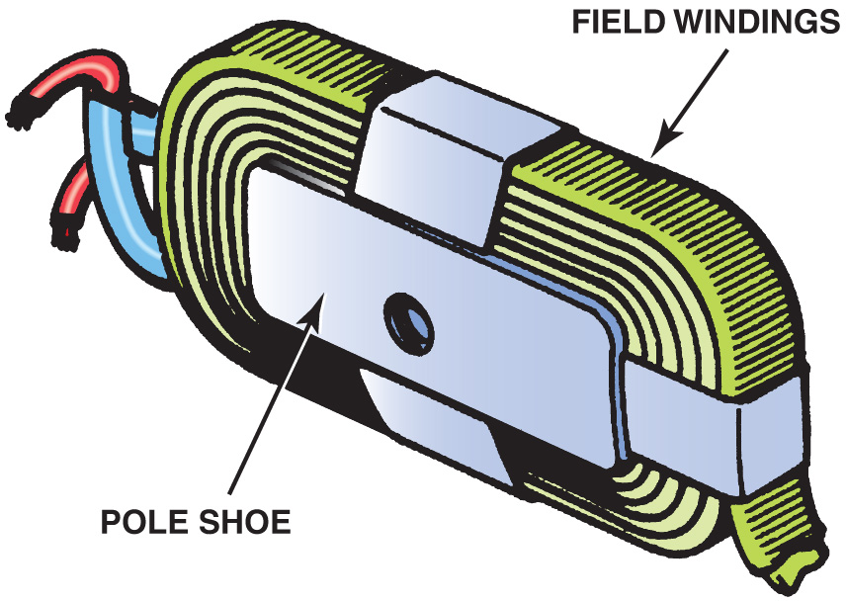
Figure 20.10 A pole shoe and field winding

Slide 15
Figure 20.11 This wiring diagram illustrates the construction of a series-wound electric motor. Notice that all current flows through the field coils, then through the armature (in series) before reaching ground

Slide 16
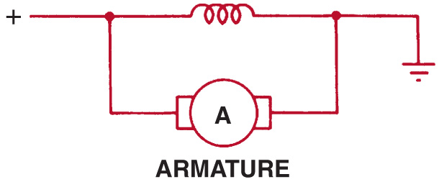
Figure 20.12 This wiring diagram illustrates the construction of a shunt-type electric motor and shows the field coils in parallel (or shunt) across the armature

Slide 17
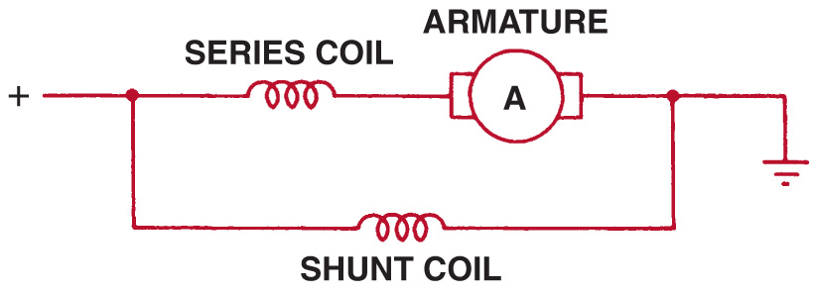
Figure 20.13 A compound motor is a combination of series and shunt types, using part of the field coils connected electrically in series with the armature and part in parallel (shunt)

Slide 18
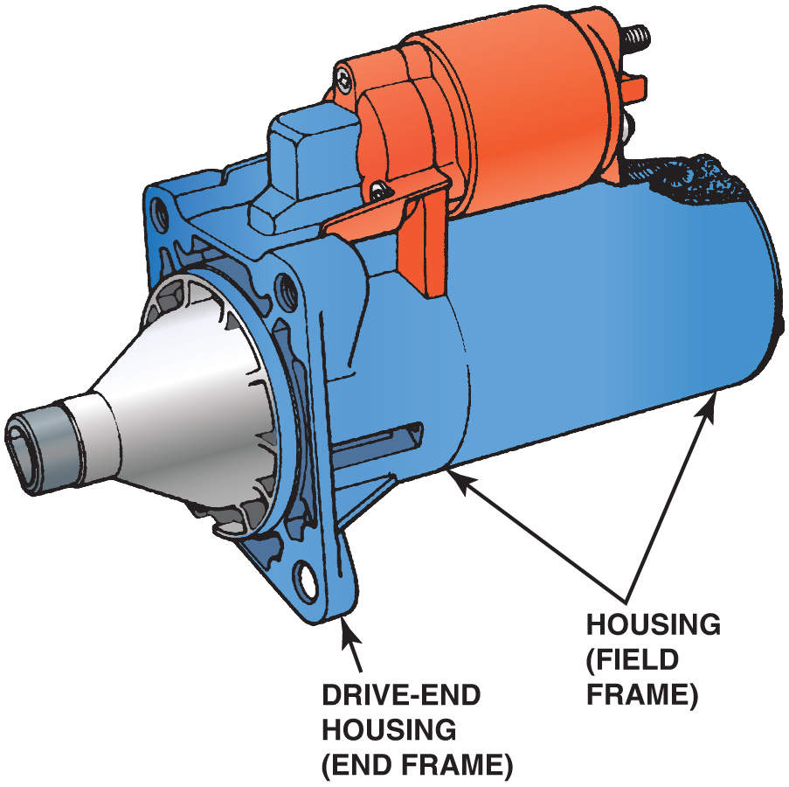
Figure 20.14 A typical starter motor showing the drive-end housing

Slide 19
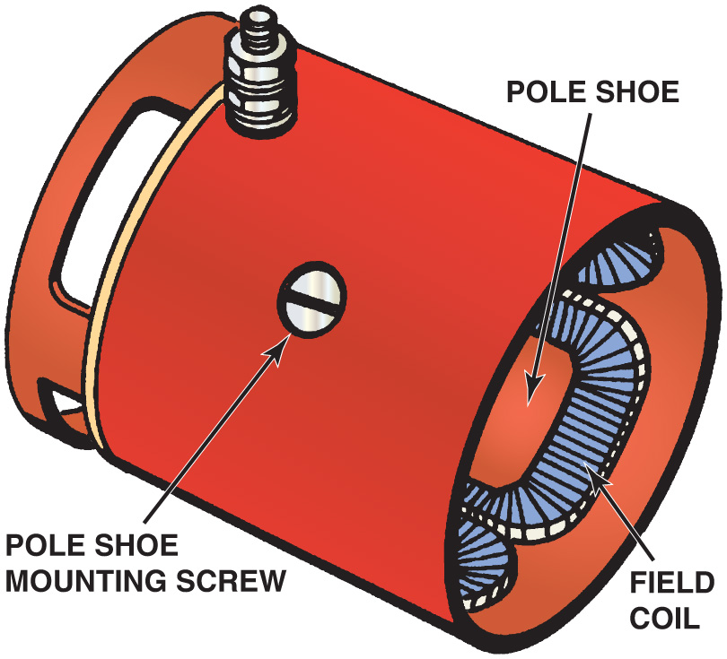
Figure 20.15 Pole shoes and field windings installed in the housing

Slide 20
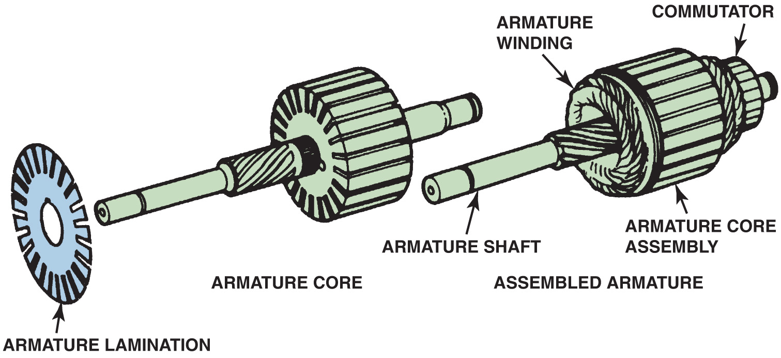
Figure 20.16 A typical starter motor armature. The armature core is made from thin sheet metal sections assembled on the armature shaft, which is used to increase the magnetic field strength

Slide 21
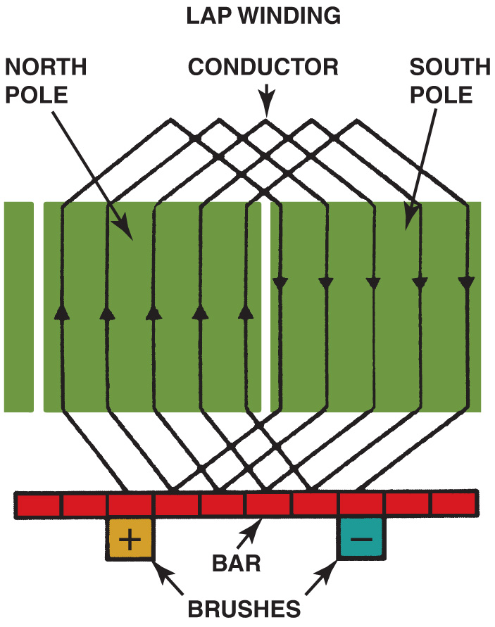
Figure 20.17 An armature showing how its copper wire loops are connected to the commutator

Slide 22
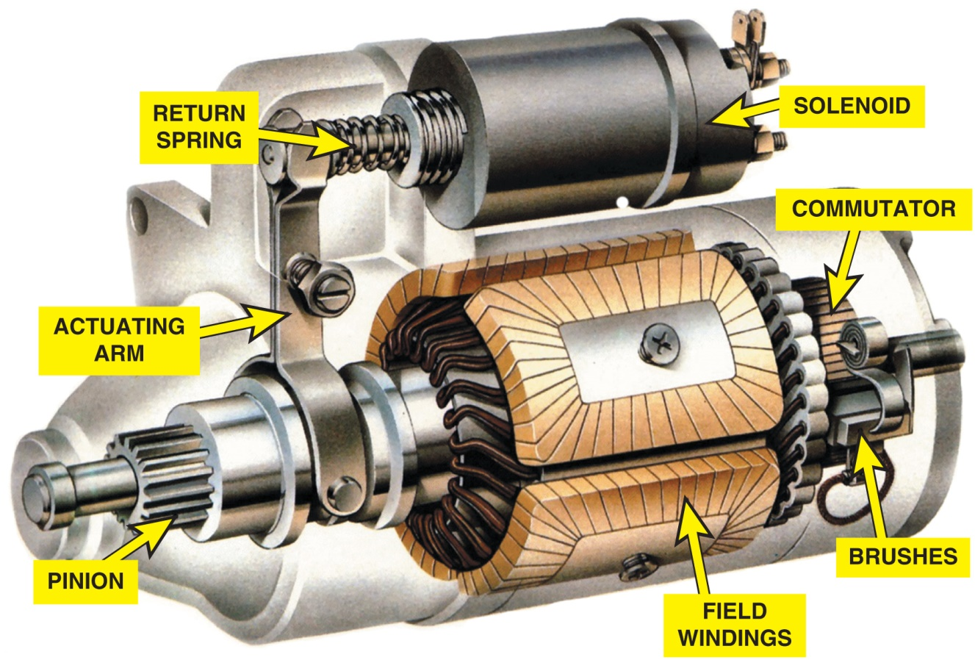
Figure 20.18 A cutaway of a typical starter motor showing the commutator, brushes, and brush spring

Slide 23
Figure 20.19 This starter permanent magnet field housing was ruined when someone used a hammer on the field housing in an attempt to “fix” a starter that did not work. A total replacement is the only solution in this case

Slide 24
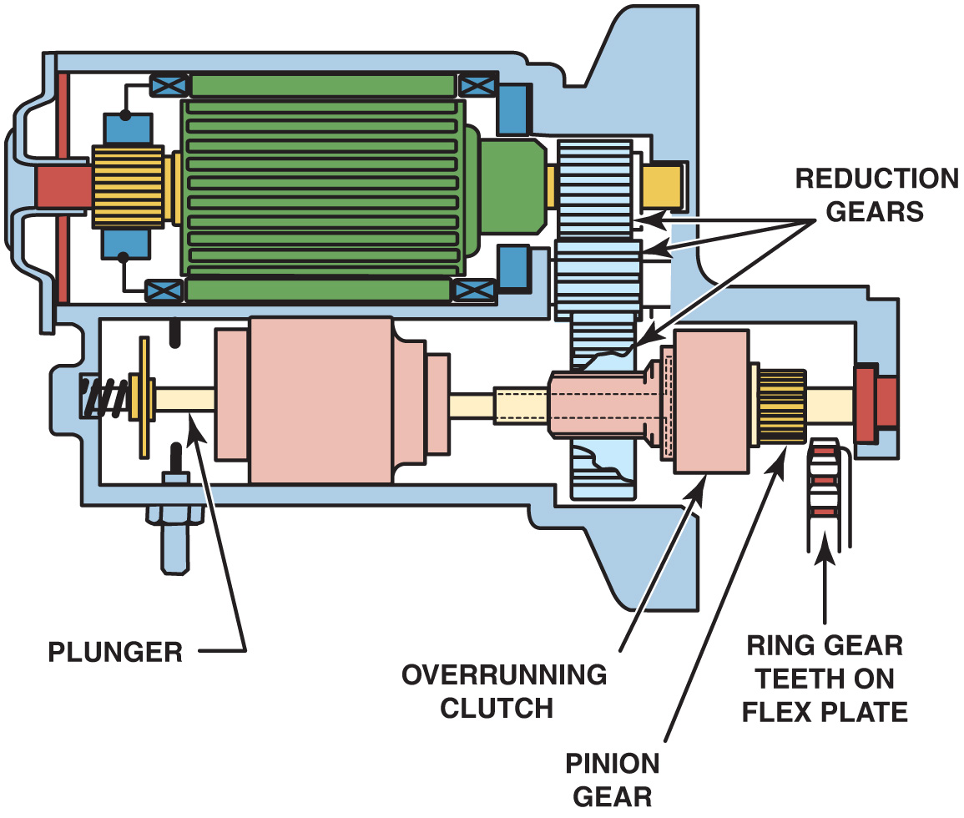
Figure 20.20 A typical gear-reduction starter

Slide 25
Animation: Starter Drive Gear (The animation will automatically start in a few seconds)

Slide 26
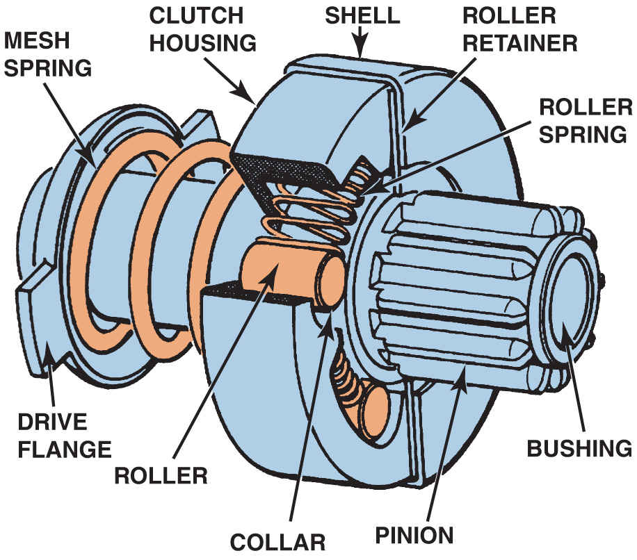
Figure 20.21 A cutaway of a typical starter drive showing all of the internal parts

Slide 27
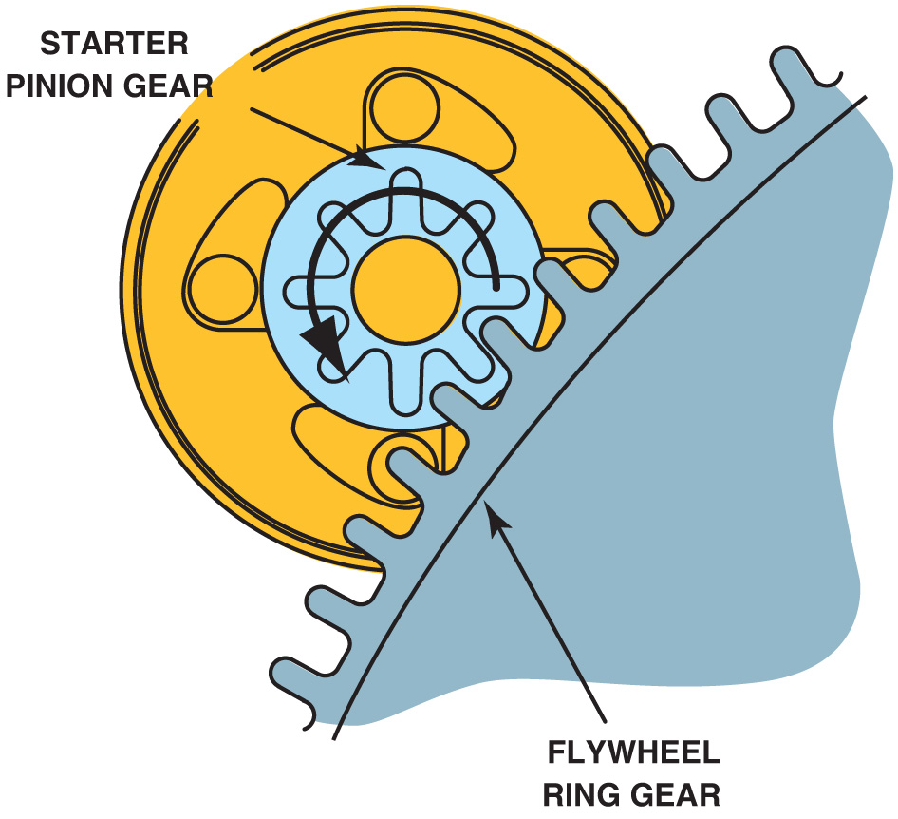
Figure 20.22 The ring gear to pinion gear ratio is usually 15:1 to 20:1

Slide 28
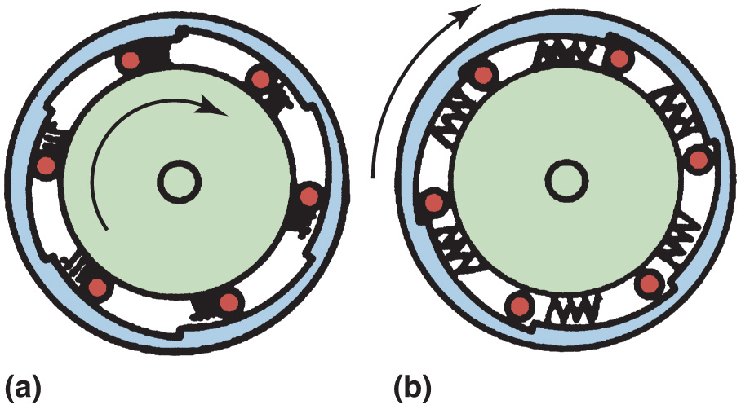
Figure 20.23 Operation of the overrunning clutch. (a) Starter motor is driving the starter pinion and cranking the engine. The rollers are wedged against spring force into their slots. (b) The engine has started and is rotating faster than the starter armature. Spring force pushes the rollers so they can rotate freely

Slide 29
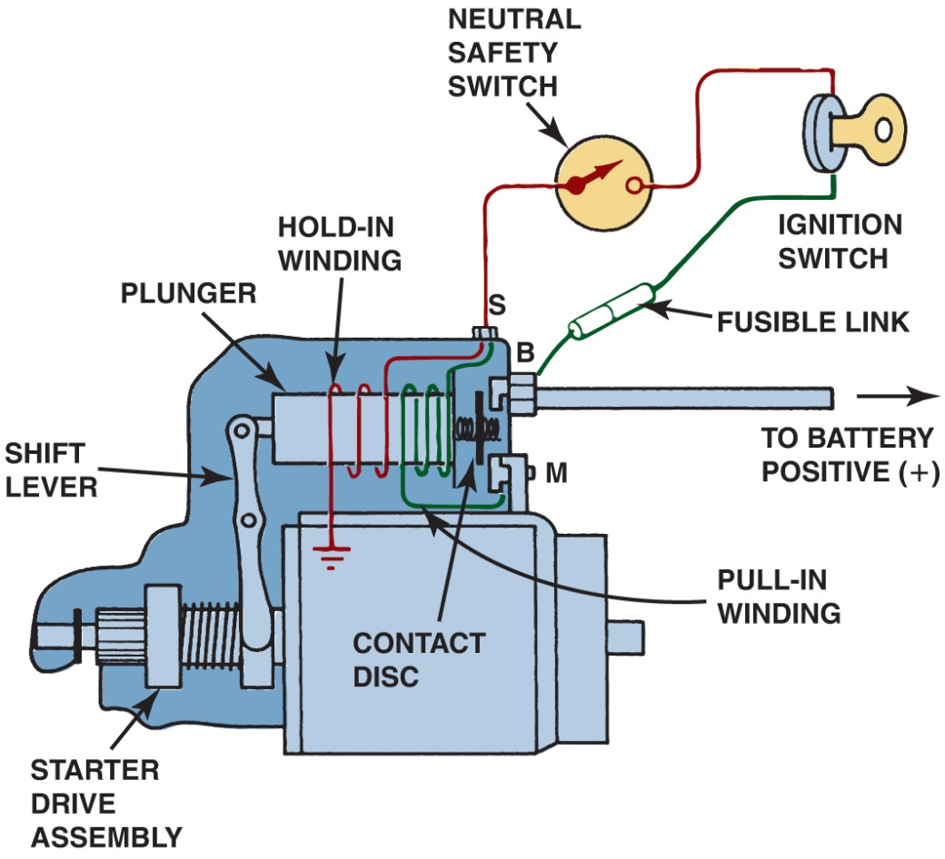
Figure 20.24 Wiring diagram of a typical starter solenoid. Notice that both the pull-in winding and the hold-in winding are energized when the ignition switch is first turned to the “start” position. As soon as the solenoid contact disc makes electrical contact with both the B and M terminals, the battery current is conducted to the starter motor and electrically neutralizes the pull-in winding

Slide 30
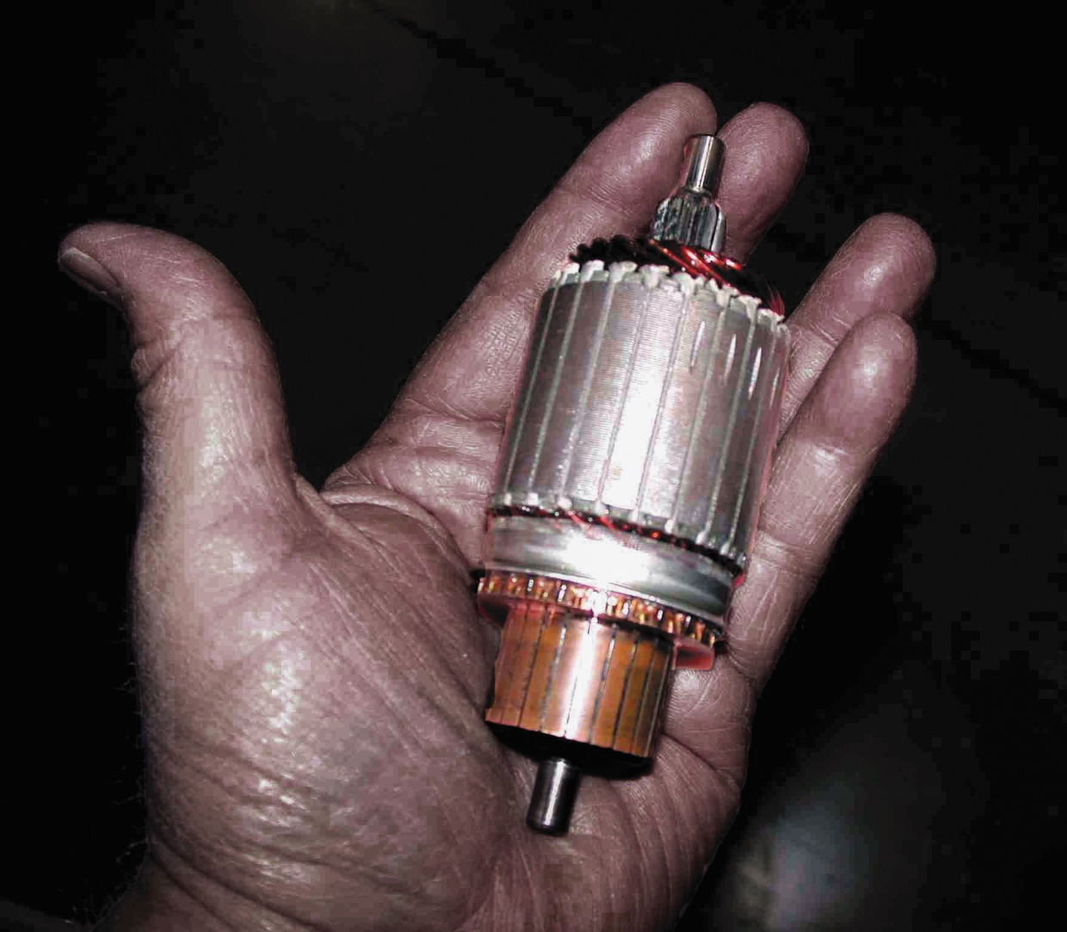
Figure 20.25 A palm-size starter armature

Slide 31
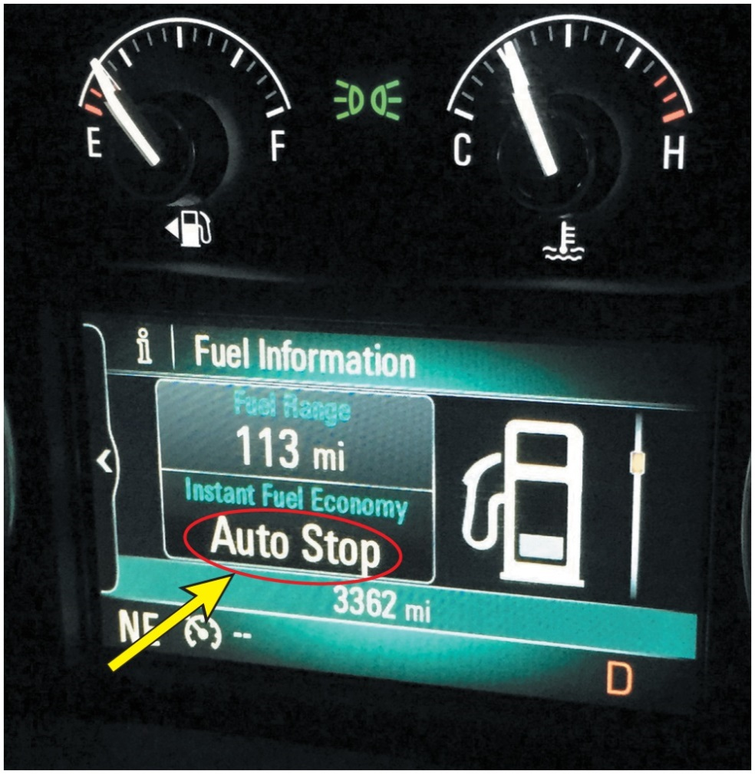
Figure 20.26 A Buick Auto Stop system lets the driver know when the engine is stopped

Slide 32
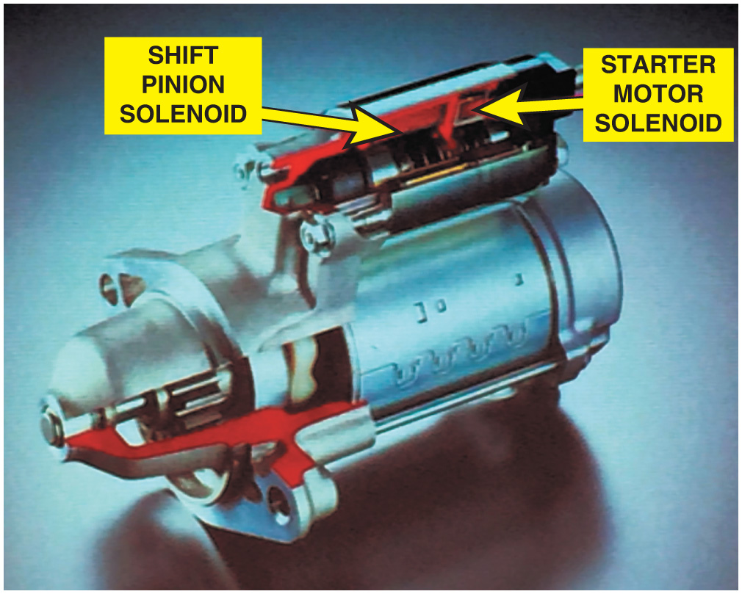
Figure 20.27 Using two solenoids allows independent control of the pinion gear and motor energization

Slide 33
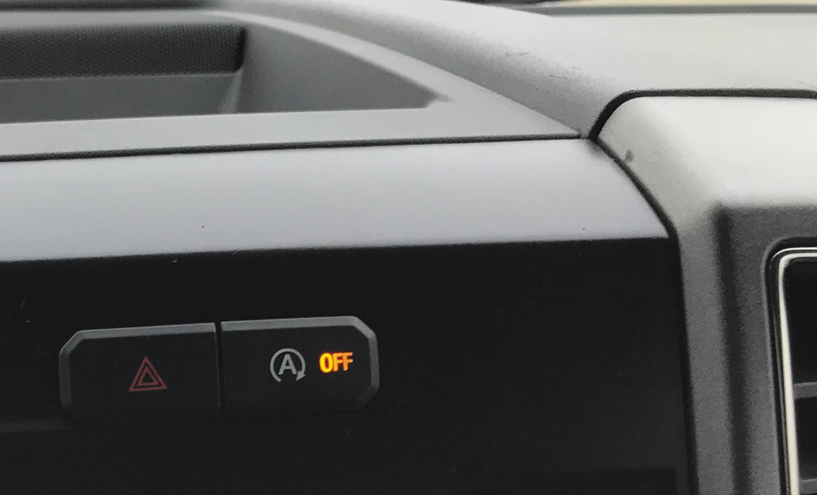
Figure 20.28 The stop-start system on this Ford F-150 pickup truck can be turned off using a switch on the dash

Slide 34
Video Links (Internet Access Required)
Starting system (time 1:05)
Starting system and wiring diagram (time 3:43)
Ignition key transponders (time 3:19)
Starter (time 5:32)
Solenoid wiring diagrams (time 3:06)

Slide 35
Copyright

