Slide 1
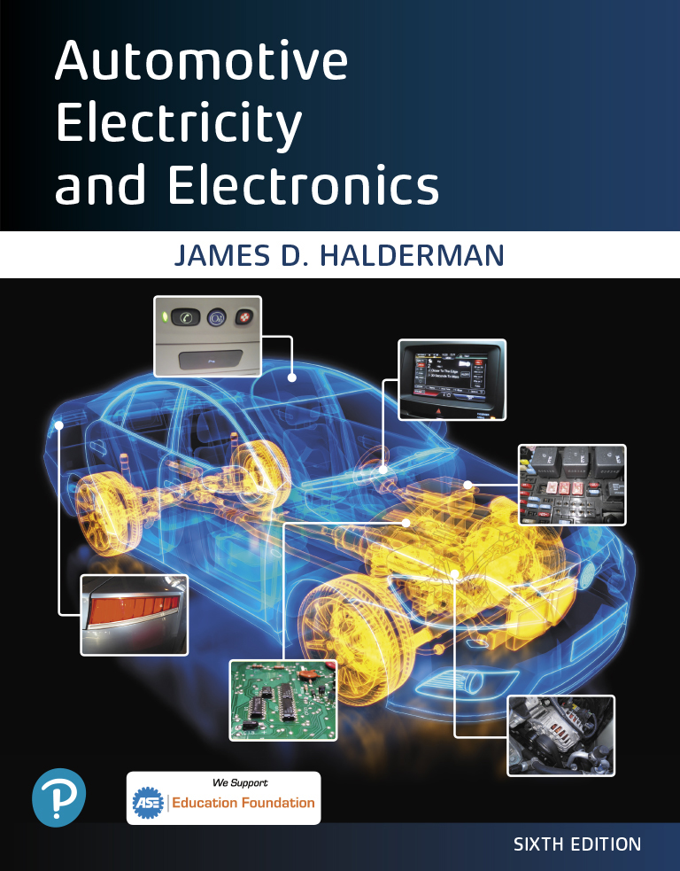
Automotive Electricity and Electronics
Sixth Edition
Chapter 13
Capacitance and Capacitors
Copyright © 2021 Pearson Education, Inc. All Rights Reserved
Notes:
If this PowerPoint presentation contains mathematical equations, you may need to check that your computer has the following installed:
1) Math Type Plugin
2) Math Player (free versions available)
3) NVDA Reader (free versions available)

Slide 2
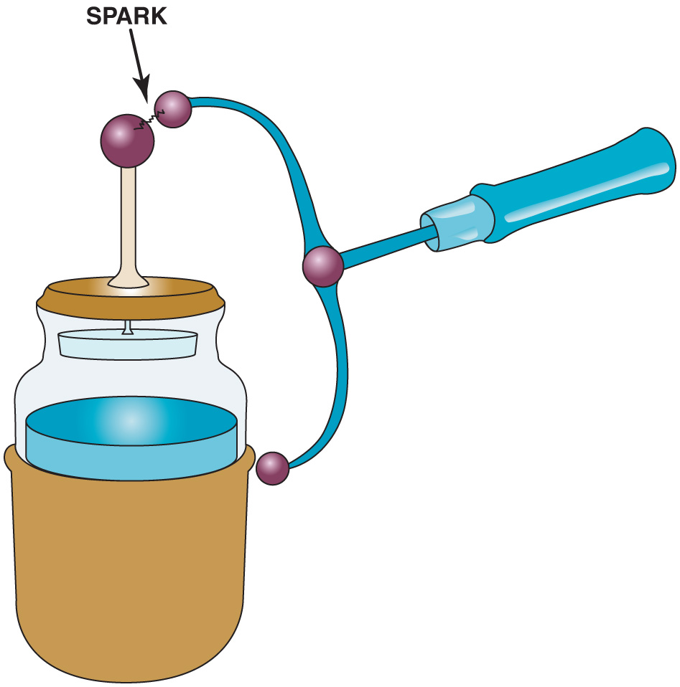
Figure 13.1 A Leyden jar can be used to store an electrical charge

Slide 3
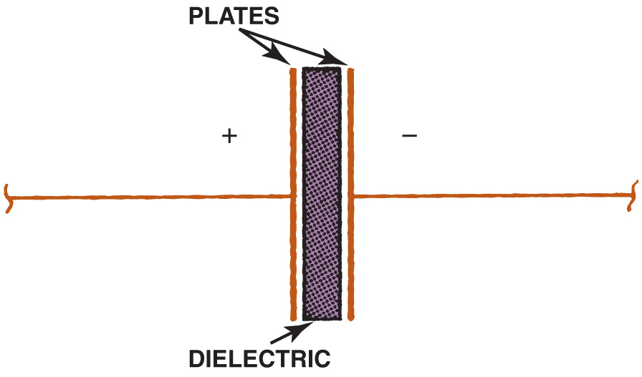
Figure 13.2 This simple capacitor is made of two plates separated by an insulating material, called a dielectric

Slide 4
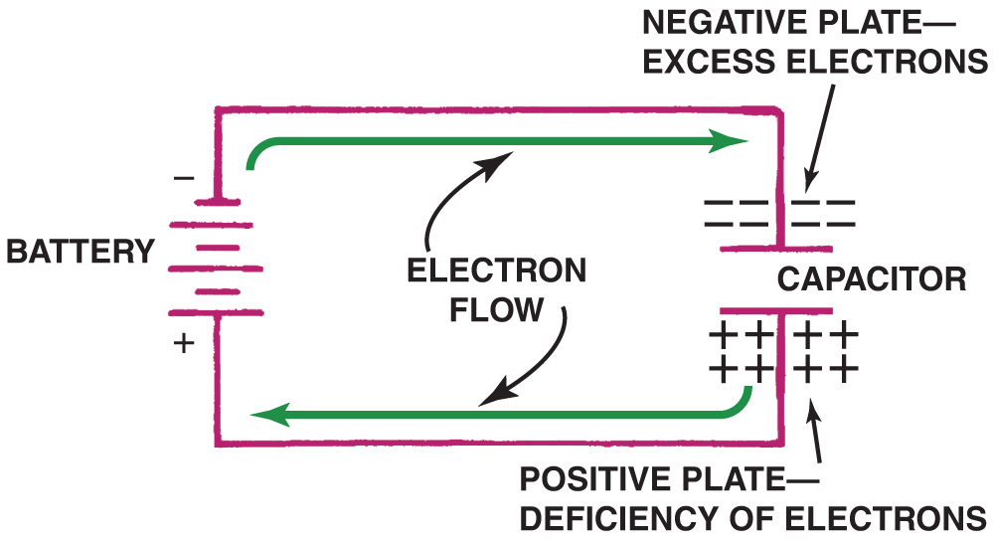
Figure 13.3 As the capacitor is charging, the battery forces electrons through the circuit

Slide 5
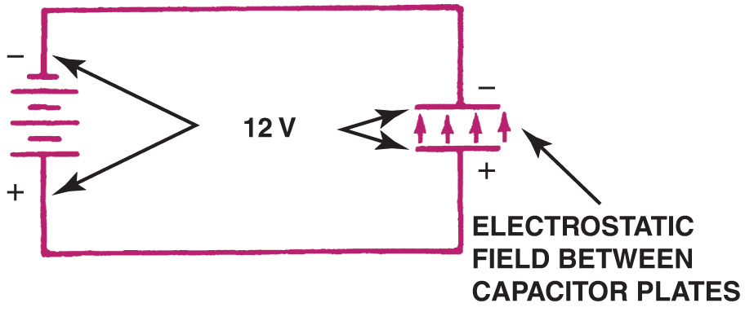
Figure 13.4 When the capacitor is charged, there is equal voltage across the capacitor and the battery. An electrostatic field exists between the capacitor plates. No current flows in the circuit

Slide 6
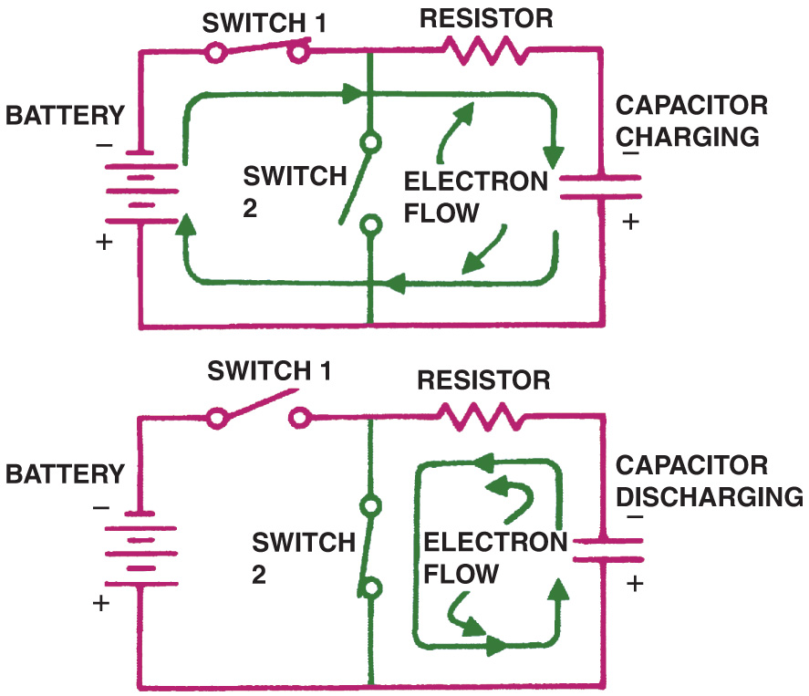
Figure 13.5 The capacitor is charged through one circuit (top) and discharged through another (bottom)

Slide 7
Animation: Capacitor (The animation will automatically start in a few seconds)

Slide 8
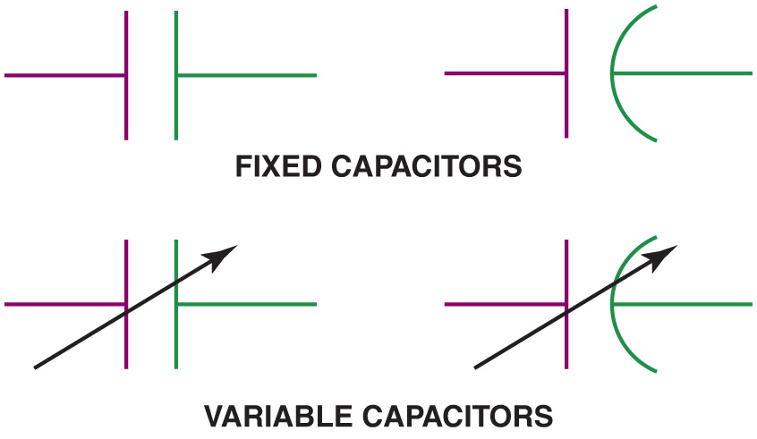
Figure 13.6 Capacitor symbols as shown in electrical diagrams. The negative plate is often shown curved

Slide 9
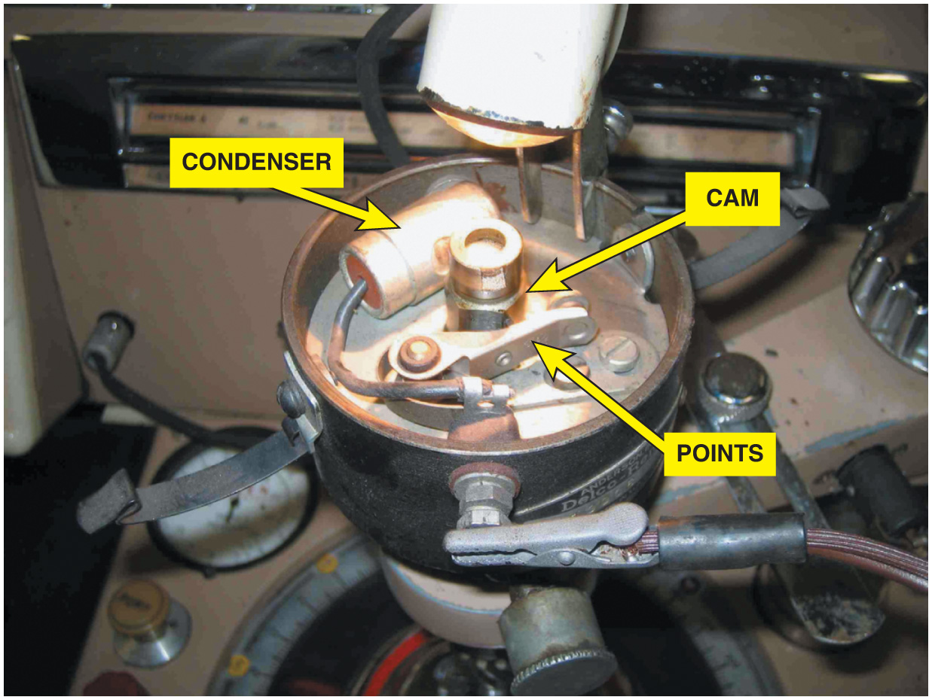
Figure 13.7 A point-type distributor shown with the condenser from an old vehicle being tested on a distributor machine

Slide 10
Animation: Ignition System Distributor (The animation will automatically start in a few seconds)

Slide 11
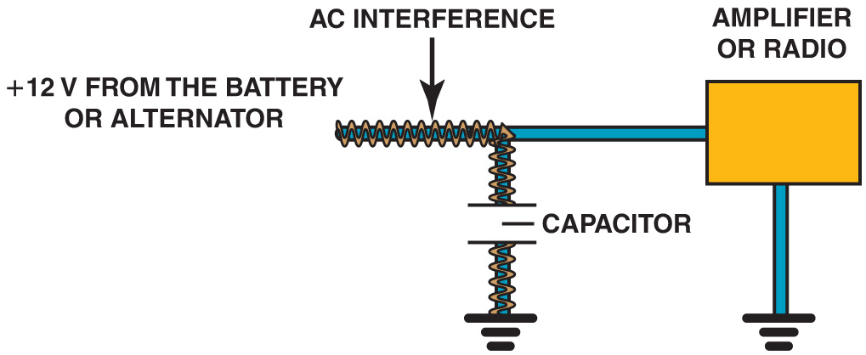
Figure 13.8 A capacitor blocks direct current (D C), but passes alternating current (A C). A capacitor makes a very good noise suppressor because most of the interference is A C, and the capacitor conducts this A C to ground before it can reach the radio or amplifier

Slide 12
Figure 13.9 A 1 farad capacitor used to boost the power to large speakers

Slide 13
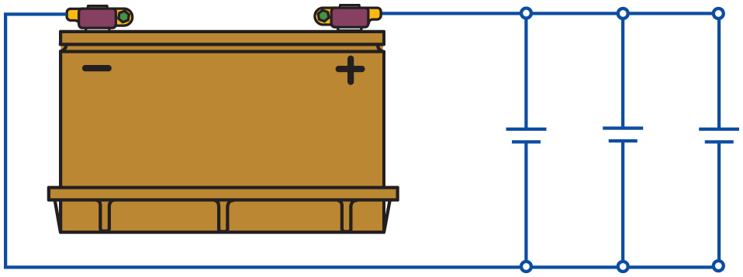
Figure 13.10 Capacitors in parallel effectively increase the capacitance

Slide 14
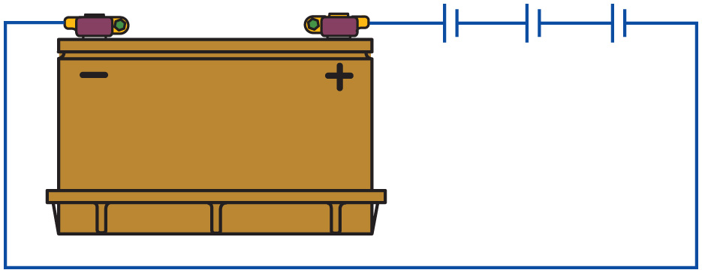
Figure 13.11 Capacitors in series decrease the capacitance

Slide 15
Video Links (Internet Access Required)
Basics of Capacitors (time 8:19)
The Capacitor (time 8:00)

Slide 16
Copyright

