Slide 1
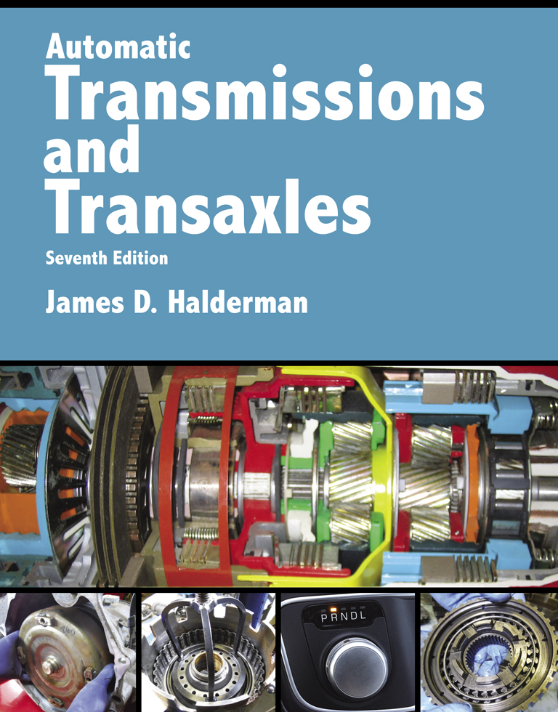
Automatic Transmissions and Transaxles
Seventh Edition
Chapter 2
Automatic Transmission Fluid, Filters and Coolers

Slide 2
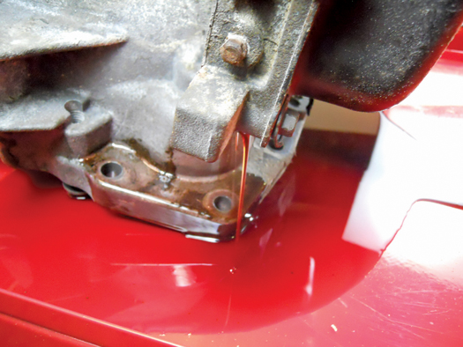
FIGURE 2–1 ATF being drained from a recycling center automatic transaxle still looks bright red in this unit being used for training.

Slide 3
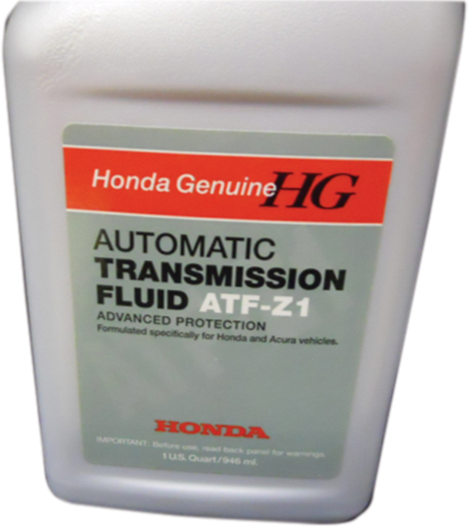
FIGURE 2–2 The use of the factory-specific fluid is the recommend fluid to insure the best possible shifting and transmission operation.

Slide 4
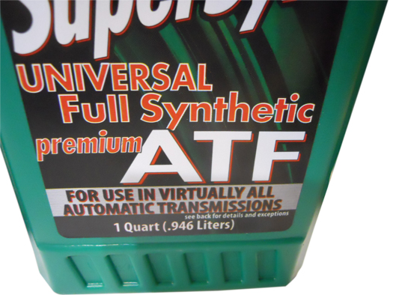
FIGURE 2–3 Multi-vehicle, or universal fluid, is designed to meet the specifications of many types of fluids, making it popular with independent shops that service many makes and models of vehicles.

Slide 5
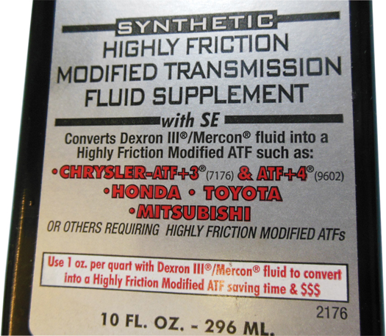
FIGURE 2–4 Aftermarket additives are available that can convert friction-modified ATF into highly friction-modified ATF.

Slide 6
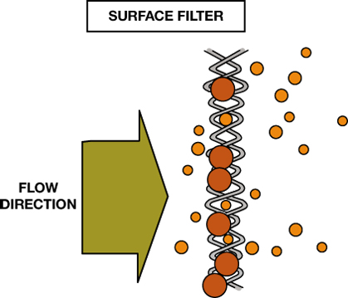
FIGURE 2–5 A surface filter traps particles that are too big to pass through the openings in the screen.

Slide 7
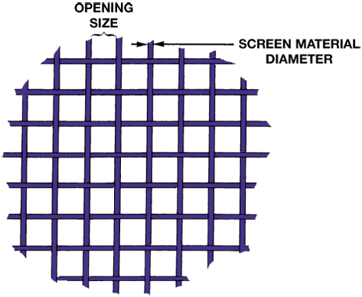
FIGURE 2–6 The surface area of a surface filter is reduced somewhat by the material that makes up the screen. The size of the screen openings determines how small of a particle can be filtered.

Slide 8
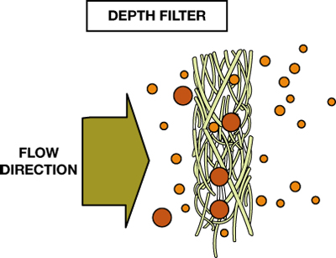
FIGURE 2–7 A depth filter is a group of woven fibers of a certain thickness. Foreign particles are trapped at different levels as they try to flow through.

Slide 9
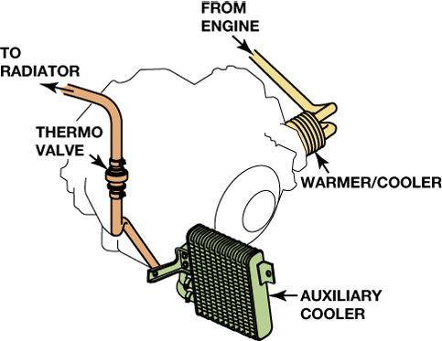
FIGURE 2–8 Engine coolant from the engine block flows through the passages in the warmer/cooler, and then out through the thermostatic valve to the upper radiator tank. The thermostatic valve uses a wax element–type valve to control the flow of engine coolant through the case-mounted cooler/warmer. The thermostatic valve improves the ATF warm-up times and maintains ATF temperature within the optimum operating range between 170°F and 180°F (77°C and 82°C).

Slide 10
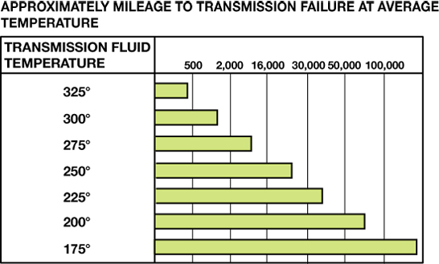
FIGURE 2–9 The life of automatic transmission fluid drops drastically when the temperature increases above normal.

Slide 11
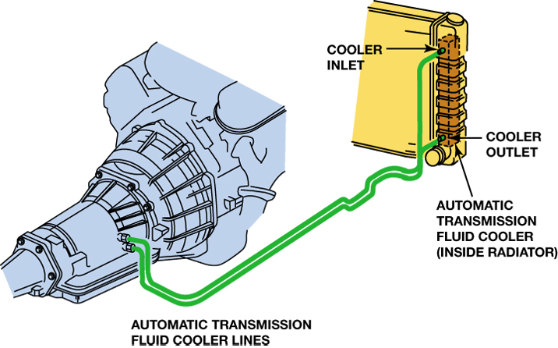
FIGURE 2–10 Automatic transmission fluid is routed from the torque converter, where most of the heat is generated, to the radiator where it is cooled. The fluid then returns to the transmission/transaxle to lubricate the bearings and bushings.

Slide 12
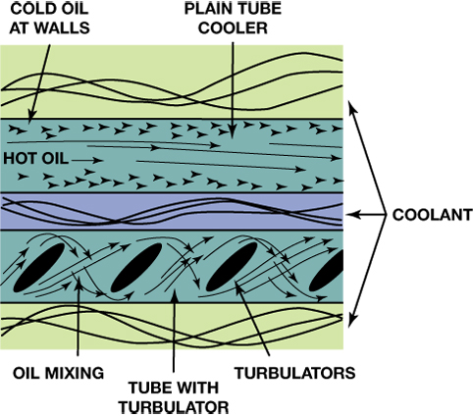
FIGURE 2–11 Cold fluid tends to stick to the walls of a plain tube cooler (top). The turbulator causes fluid turbulence to promote mixing so all of the fluid cools (bottom).

Slide 13
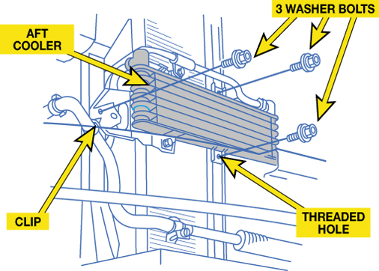
FIGURE 2–12 If the vehicle is being used for towing and it is not equipped with a supplemental cooler, an aftermarket cooler can be installed.

Slide 14
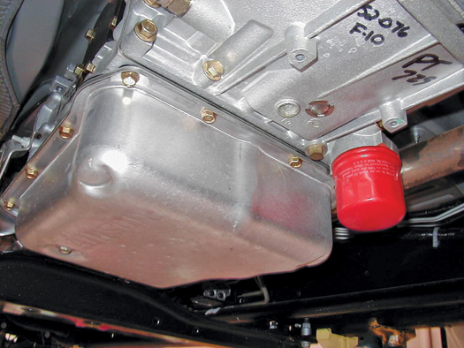
FIGURE 2–13 While most automatic transmissions use an internal filter only, this Allison transmission uses a spin-on-type filter that is designed to be replaced as part of routine service. There is another filter inside that is designed to be replaced only if the unit is overhauled or repaired.

Slide 15
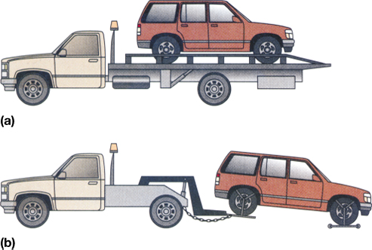
FIGURE 2–14 If an all-wheel-drive vehicle must be towed, it should be either on (a) a flatbed truck or (b) a dolly.

Slide 16
Animation: Traction Fluid (The animation will automatically start in a few seconds)

Slide 17
Video Links (Internet Access Required)
How to change automatic transmission fluid and filter (time 15:42)
How to check automatic transmission fluid (time 3:25)
Toyota transaxle fluid level check – No dipstick (time 34:42)
Can changing your transmission fluid cause damage? (time 10:57)

