Slide 1
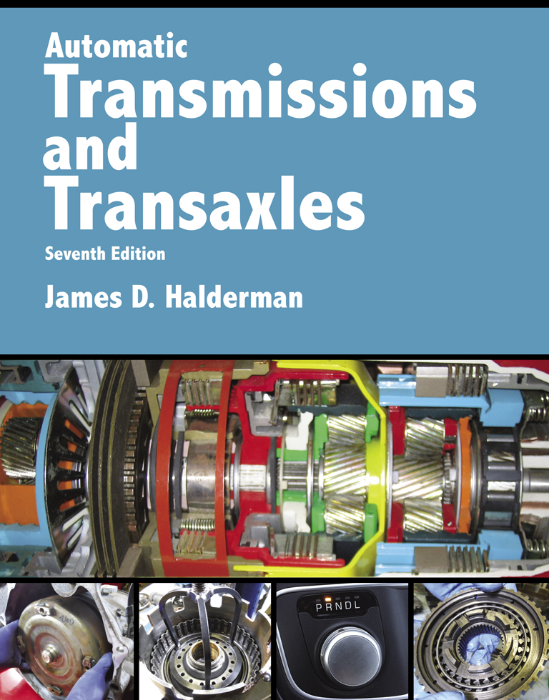
Automatic Transmissions and Transaxles
Seventh Edition
Chapter 12
Dual Clutch Automatic Transmissions/ Transaxles

Slide 2
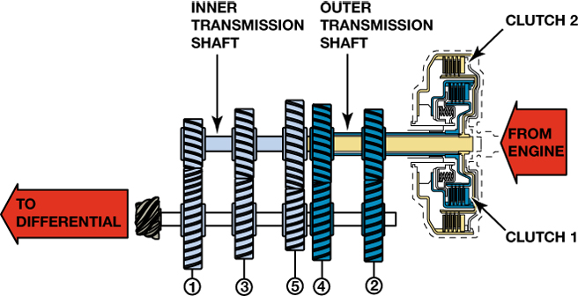
FIGURE 12–1 A dual clutch automatic uses the best features of an automatic transmission without the power loss of a torque converter.

Slide 3
Animation: 7-Speed Dual Clutch Transmission (The animation will automatically start in a few seconds)

Slide 4
Animation: Dual Clutch Transaxle (The animation will automatically start in a few seconds)

Slide 5
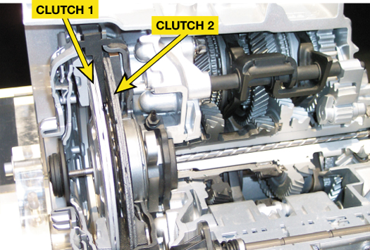
FIGURE 12–2 Dual clutch automatic transaxles that use two dry clutches. The larger clutch drives the odd number gear ratios (first, third, and fifth) and the smaller clutch drives the even numbered gear ratios (second, fourth, and sixth).

Slide 6
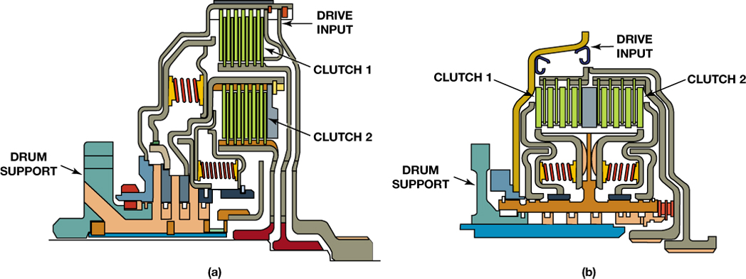
FIGURE 12–3 (a) A concentric (nested) clutch design, the assembly is shorter in length but taller in height. (b) A parallel clutch design is longer but has a smaller diameter drum assembly.

Slide 7
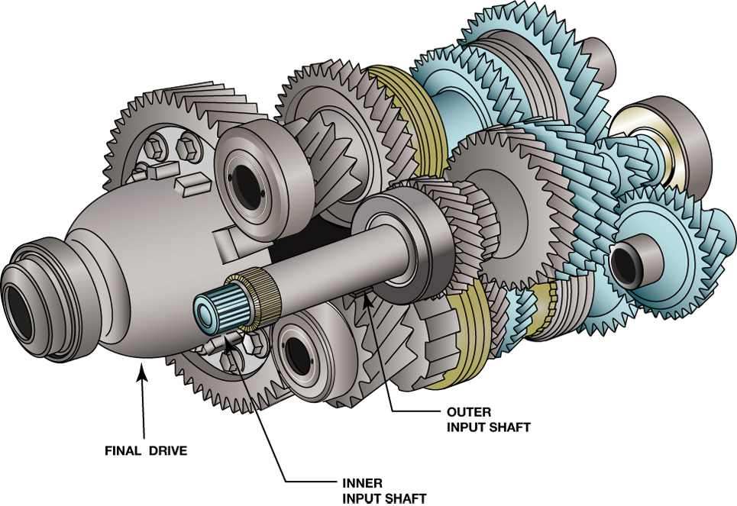
FIGURE 12–4 Notice the two concentric input shafts. Each shaft is splined to a clutch.

Slide 8
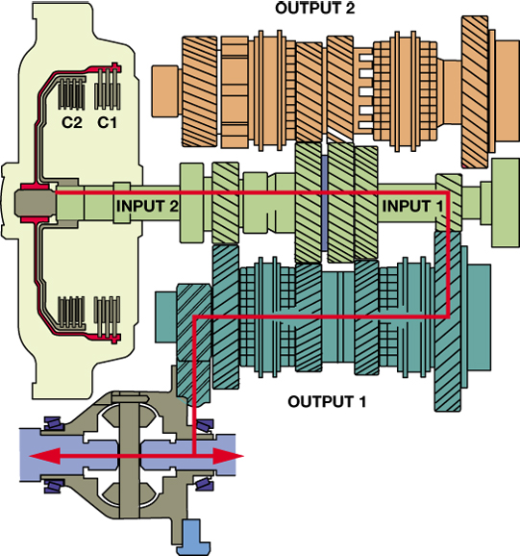
FIGURE 12–5 First gear engaged using clutch 1 (C1) to transmit engine torque.

Slide 9
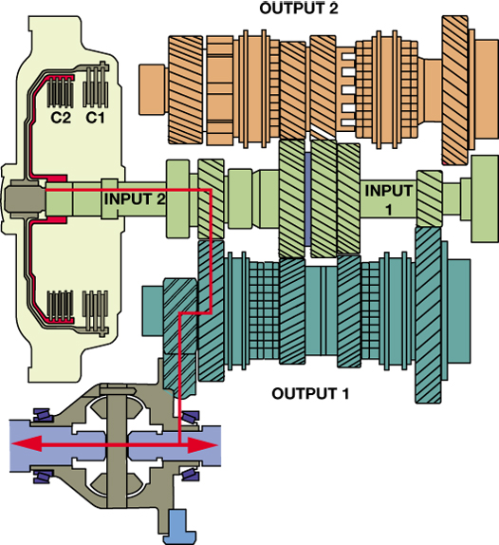
FIGURE 12–6 Second gear engaged using clutch 2 (C2) to transmit engine torque.

Slide 10
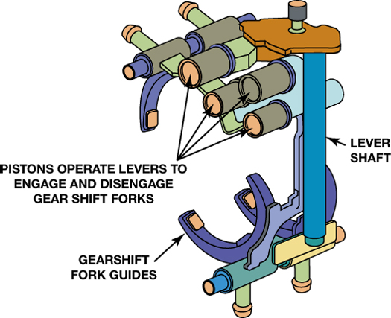
FIGURE 12–7 The shift forks are similar to those used in a manual transmission but are moved using hydraulic pistons.

Slide 11
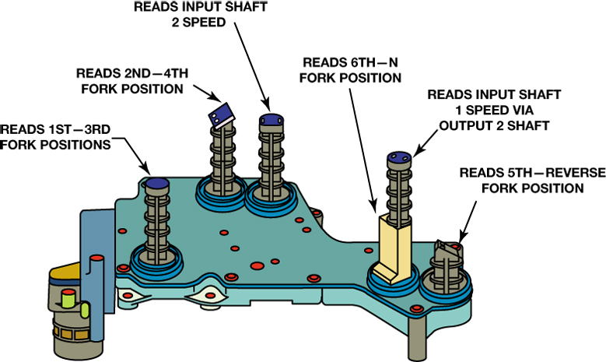
FIGURE 12–8 Fork position and shaft speed sensors are used as inputs to the TCM.

Slide 12
Animation: Dual Clutch Transmission Hydraulic & Electronic Control (The animation will automatically start in a few seconds)

Slide 13
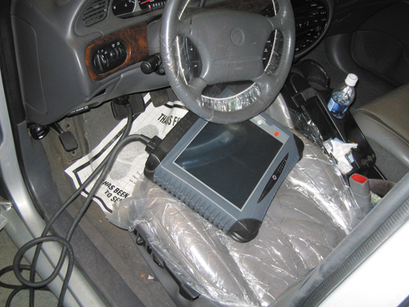
FIGURE 12–9 The use of a factory or a factory-level aftermarket scan tool is often needed to diagnose the dual clutch transmission system.

Slide 14
Video Links (Internet Access Required)
Dual clutch transmission (time 7:21)
ZF TTD transmission (time 3:11)

