Slide 1

Automotive Technology Principles, Diagnosis, and Service
Sixth Edition
Chapter 126
Clutches
Copyright © 2018, 2015, 2011 Pearson Education, Inc. All Rights Reserved

Slide 2
LEARNING OBJECTIVES
126.1 Explain the purpose, function, and operation of a clutch.
126.2 Describe diagnose clutch problems and how to replace a clutch.
126.3 Explain how to adjust the clutch pedal.
126.4 Explain how to bleed a hydraulic clutch system.

Slide 3
PURPOSE AND FUNCTION OF A CLUTCH
The purpose and function of a clutch include the following:
  To disconnect the engine from the transmission/transaxle to permit the engine to remain running when the vehicle is stopped.
  To connect and transmit engine torque to the transmission/transaxle.
  To dampen and absorb engine impulses and drive train vibration.
  To provide a smooth engagement and disengagement between the engine and the transmission/transaxle.

Slide 4
COMPONENT PARTS AND OPERATION OF A CLUTCH ASSEMBLY (1 OF 6)
Clutch Pedal Linkage
  There are three methods of transferring the force of the driver’s foot to the throwout (release) bearing, including:
  Levers and rods
  Cable operation
  Hydraulic
Clutch Disc
  Friction material that allows power transfer from the flywheel to the pressure plate.

Slide 5
COMPONENT PARTS AND OPERATION OF A CLUTCH ASSEMBLY (2 OF 6)
High-Performance Clutch Disc
  Friction material is a ceramic and metallic mixture that is long lasting but does not cushion the engagement.
Stock Clutch Disc
  Around the center hub of the clutch disc are torsional dampers that absorb the initial shock of engagement and help dampen engine-firing in pulses being transmitted into and through the transmission/transaxle.

Slide 6
COMPONENT PARTS AND OPERATION OF A CLUTCH ASSEMBLY (3 OF 6)
Pressure Plates
  The purpose of the pressure plate is to exert a force on the clutch disc so that engine torque can be transmitted from the engine to the transmission/transaxle.
  Several styles of pressure plates have been used, including:
  Coil Spring Style
  Diaphragm spring style

Slide 7
COMPONENT PARTS AND OPERATION OF A CLUTCH ASSEMBLY (4 OF 6)
Flywheels
  The engine flywheel serves four basic purposes:
    Smoothes out or dampens engine power pulses.
    Absorbs some of the heat created by clutch operation.
    Provides the connection point for the starter motor to crank the engine.
    Provides the application surface for the clutch friction disc.
Dual-Mass Flywheels
  The purpose of a dual-mass flywheel is to dampen engine vibrations and keep them from being transmitted to the passenger compartment.

Slide 8
COMPONENT PARTS AND OPERATION OF A CLUTCH ASSEMBLY (5 OF 6)
Pilot Bearing or Bushing
  Used to support the transmission input shaft on the engine end.
Release Bearings
  The release bearing presses against the diaphragm spring fingers or coil spring levers to disengage the friction disc.
Release Bearing Construction
  Most clutch release bearings are ball bearings.

Slide 9
COMPONENT PARTS AND OPERATION OF A CLUTCH ASSEMBLY (6 OF 6)
Release Bearing Installation
  A snap ring, spring clips, or lock pins secure the release bearing to the release fork.
  The release bearing sleeve slides on the outer surface of the front bearing retainer, which is commonly called the quill, quill shaft, or candlestick.
Release Bearing Lubrication
  The ball bearing portion of the release bearing is usually permanently lubricated and sealed during manufacture.

Slide 10
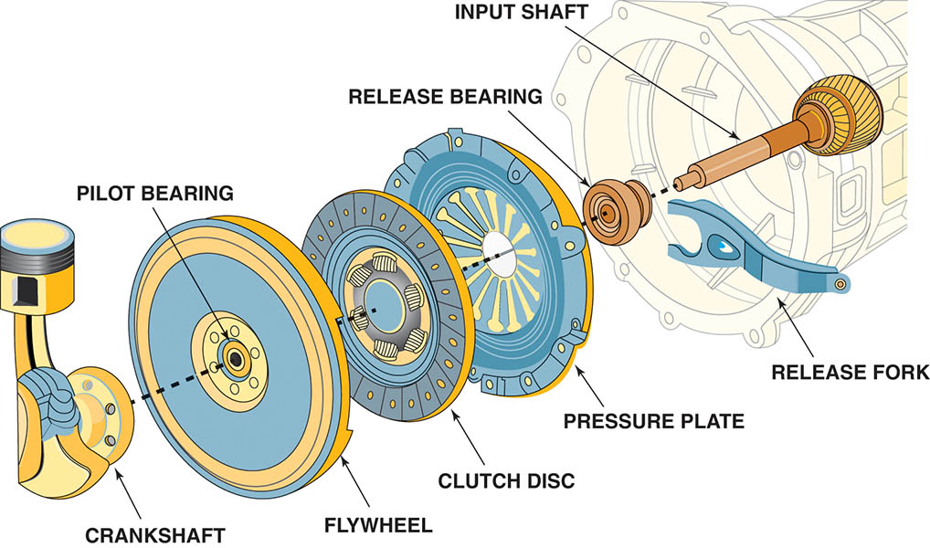
Figure 126.1 Typical automotive clutch assembly showing all related parts

Slide 11
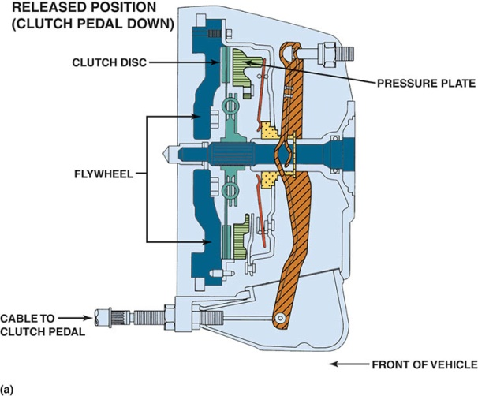
Figure 126.2 (a) When the clutch is in the released position (clutch pedal depressed), the clutch fork is applying a force to the throwout (release) bearing, which pushes on the diaphragm spring, releasing the pressure on the friction disc

Slide 12
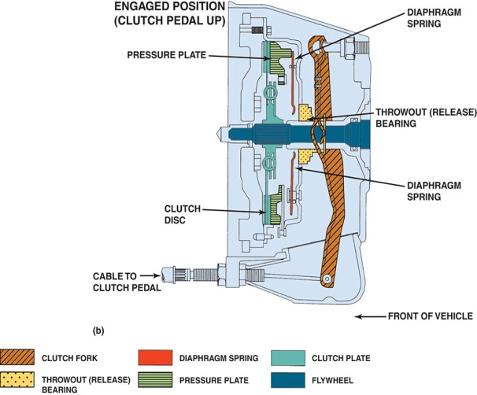
Figure 126.2 (b) When the clutch is in the engaged position (clutch pedal up), the diaphragm spring exerts force on the clutch disc, holding it between the flywheel and the pressure plate

Slide 13
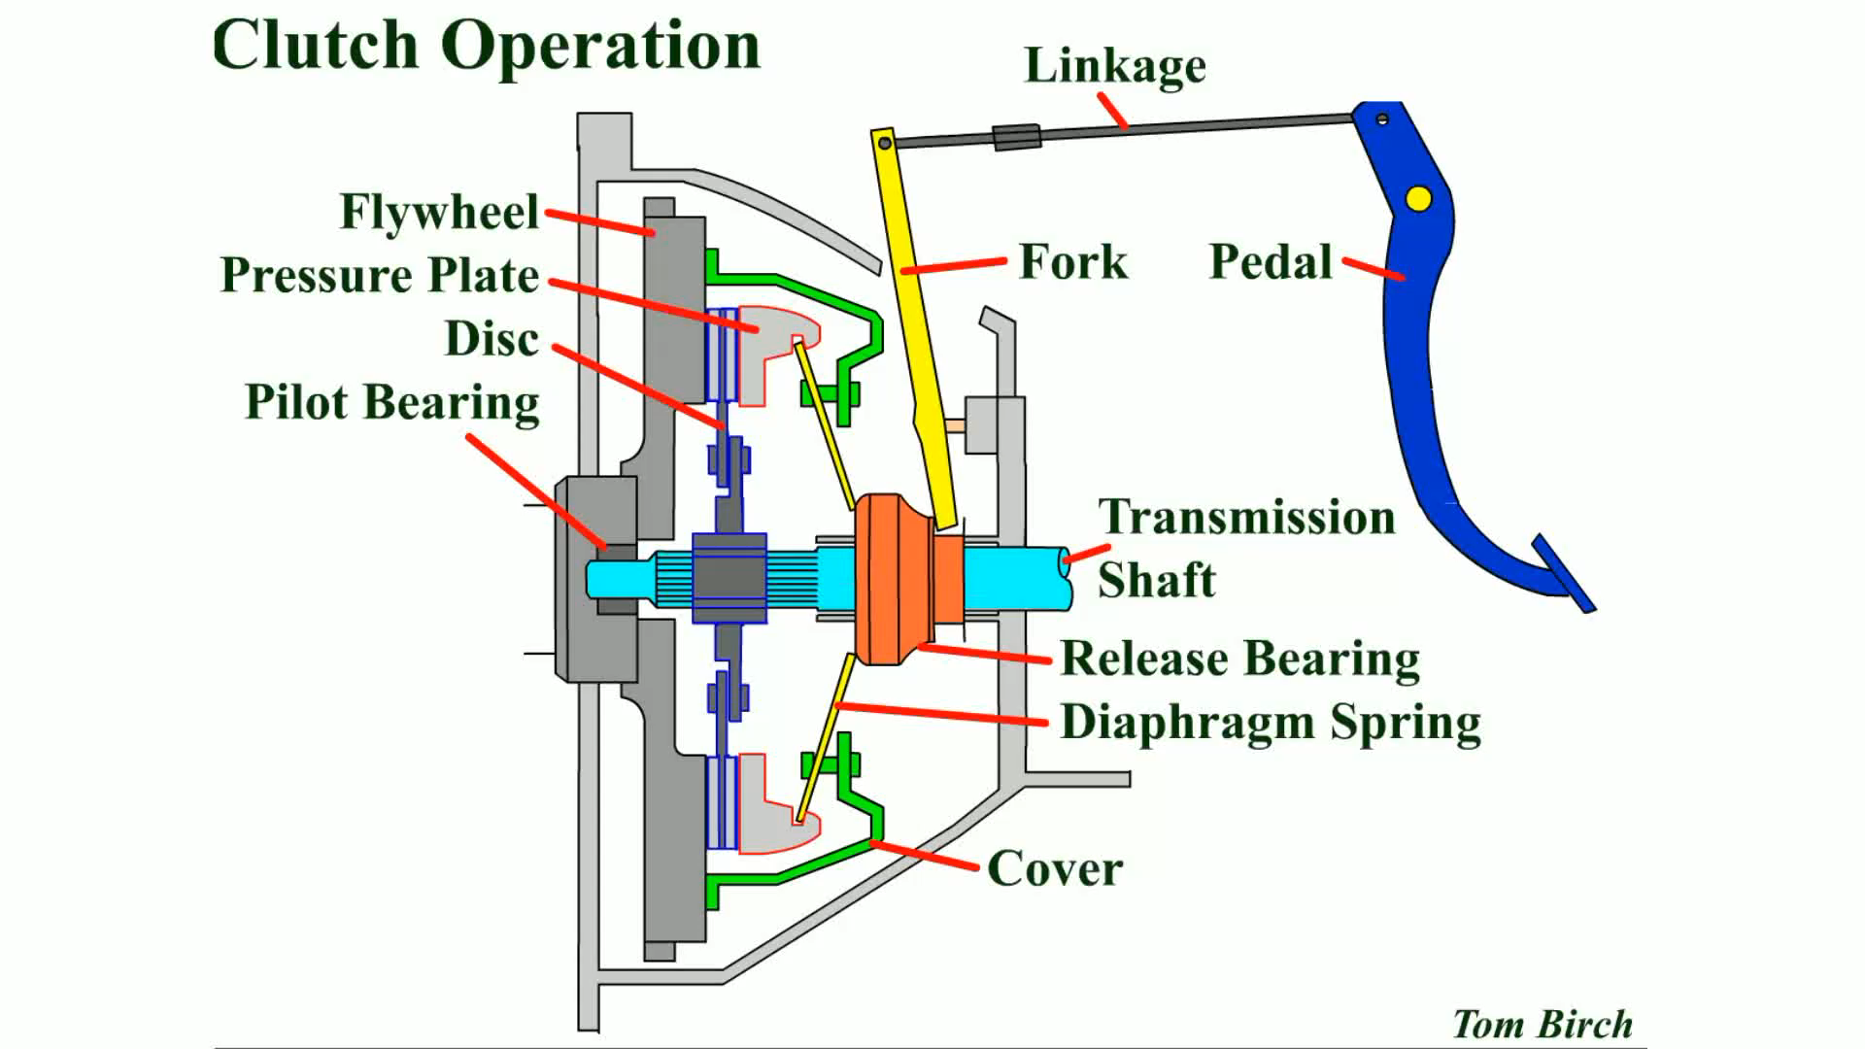
Animation: Clutch Operation
(The animation will automatically start in a few seconds)

Slide 14
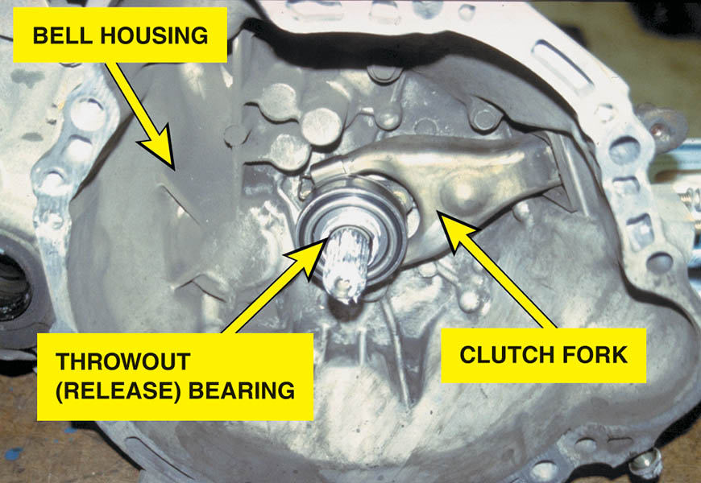
Figure 126.3 The transmission has just been removed. Note that this type of transmission incorporates the bell housing, which was therefore removed at the same time as the transmission. The clutch fork and throwout (release) bearing also came off together.

Slide 15
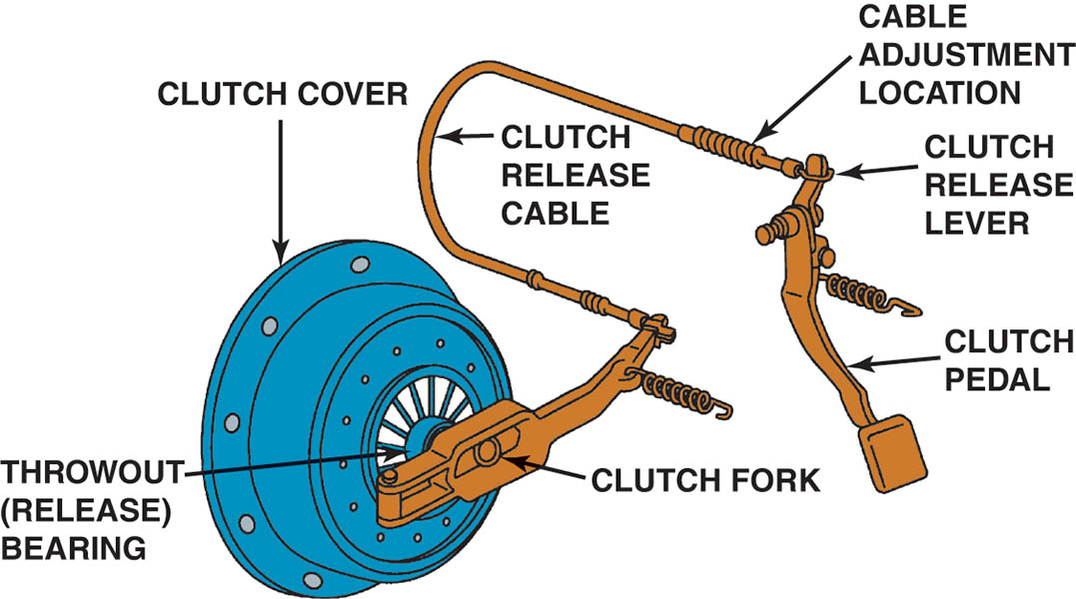
Figure 126.4 A typical cable-operated clutch

Slide 16
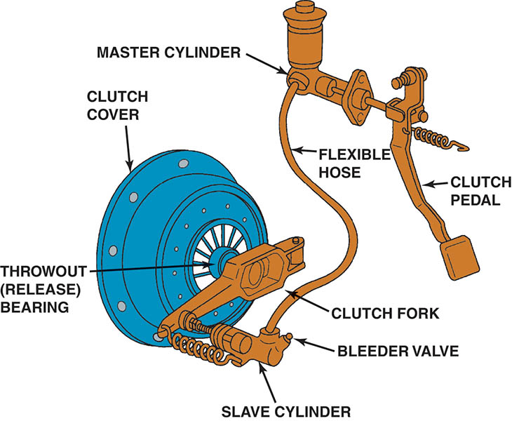
Figure 126.5 A hydraulic clutch linkage uses a master cylinder and a actuator cylinder
Actuator Cylinder

Slide 17
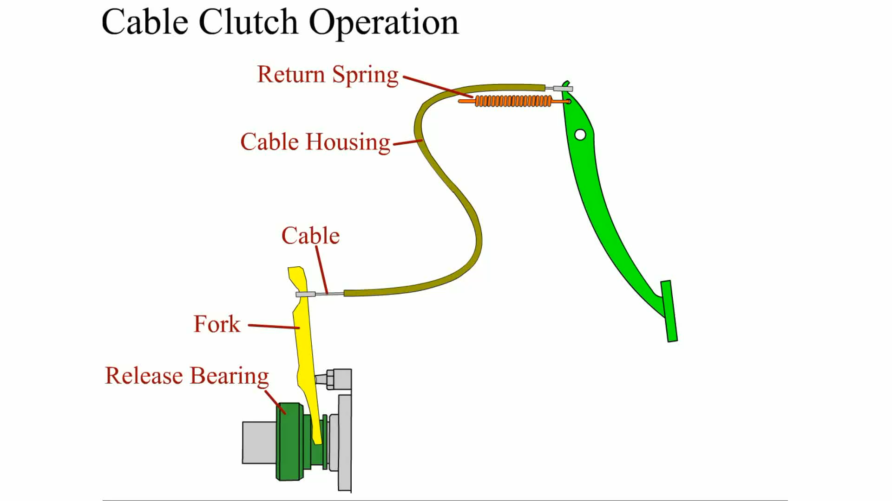
Animation: Cable Clutch Operation
(The animation will automatically start in a few seconds)

Slide 18
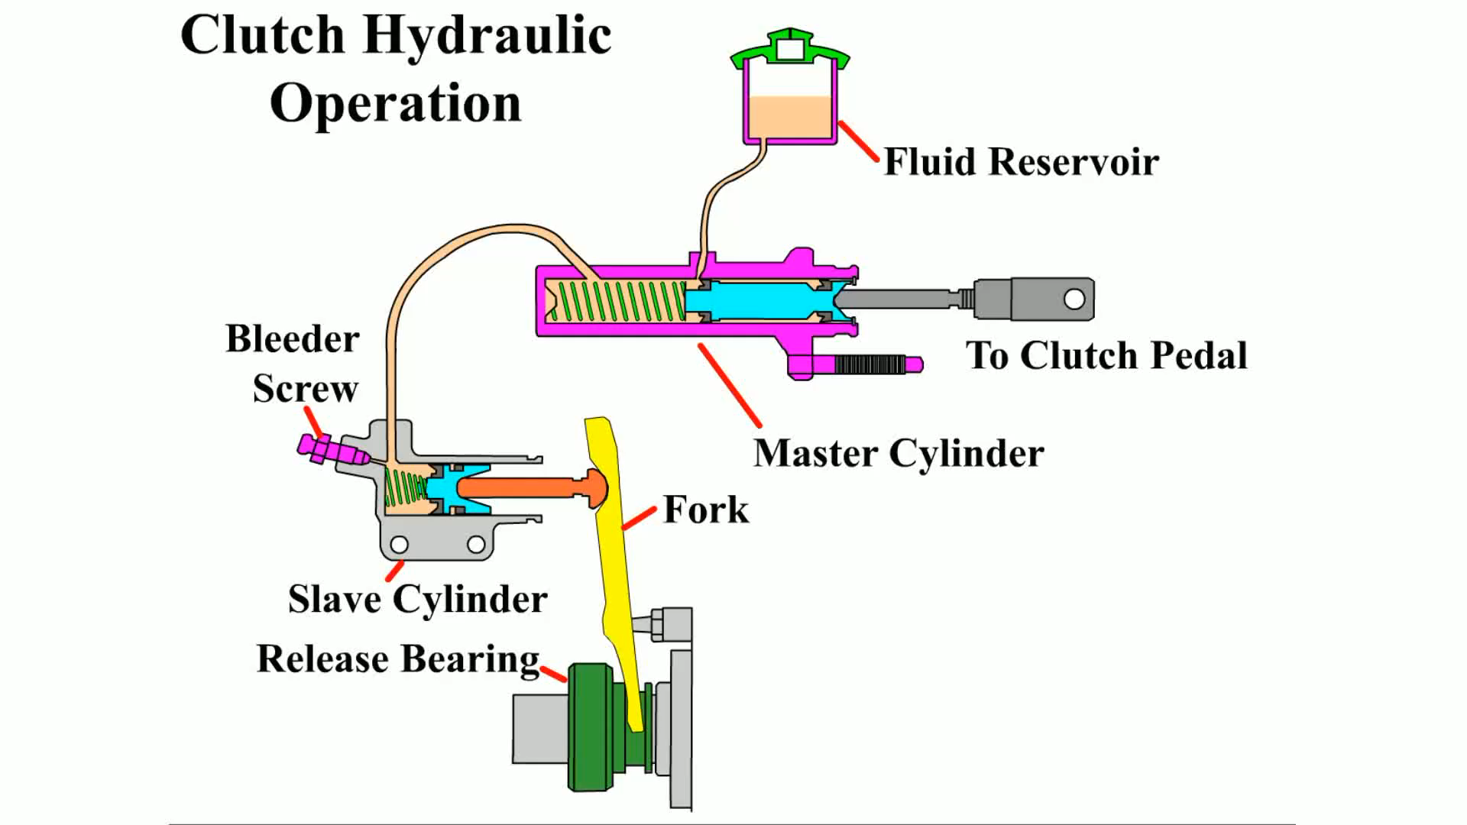
Animation: Clutch Hydraulic Operation
(The animation will automatically start in a few seconds)

Slide 19
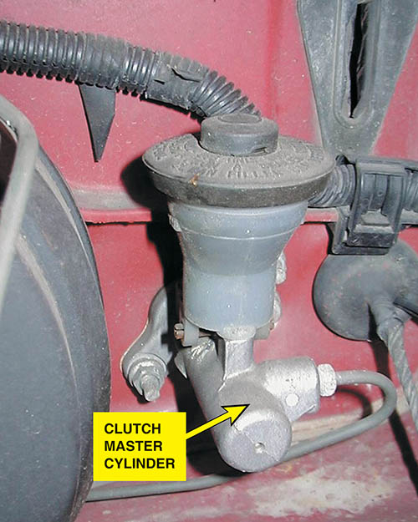
Figure 126.6 A typical clutch master cylinder and reservoir mounted on the bulkhead on the driver’s side of the vehicle. Brake fluid is used in the hydraulic system to operate the actuator cylinder located on the bell housing

Slide 20
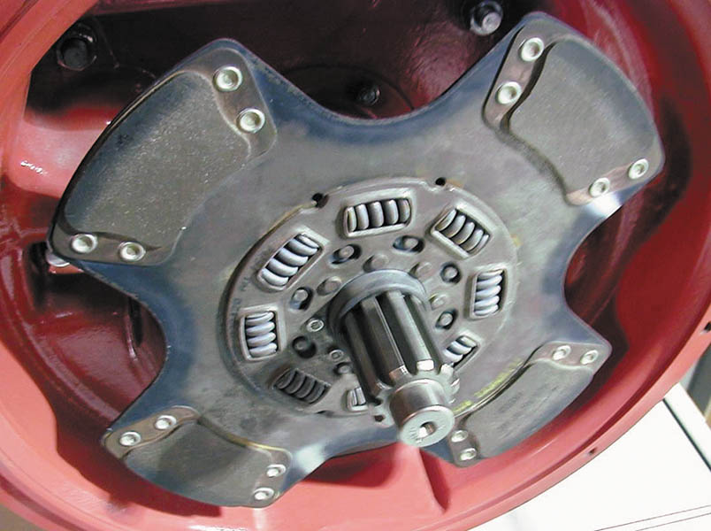
Figure 126.7 A racing or high-performance clutch disc lacks the features of a stock clutch disc that help provide smooth engagement

Slide 21
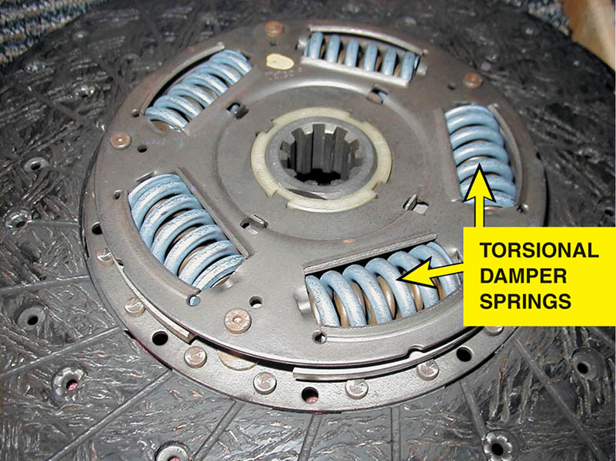
Figure 126.8 A typical stock clutch friction disc that uses coil spring torsional dampers

Slide 22
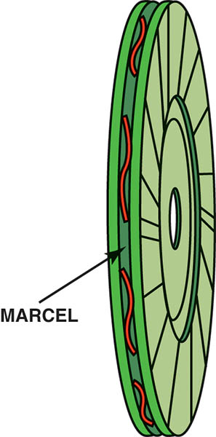
Figure 126.9 A marcel is a wavy spring that is placed between the two friction surfaces to cushion the clutch engagement

Slide 23
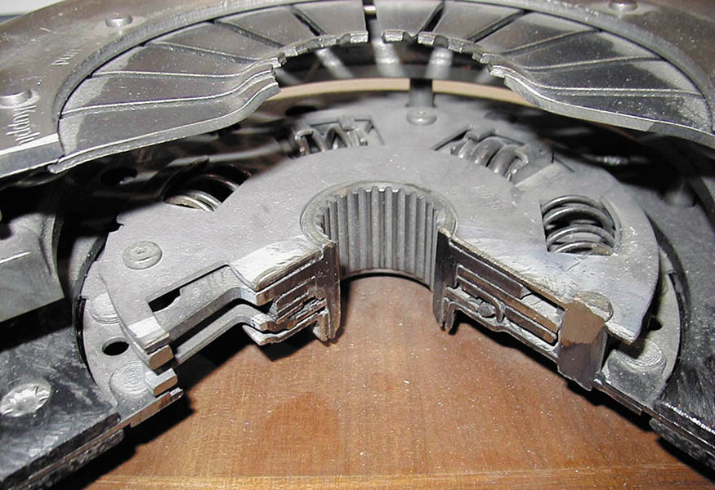
Figure 126.10 Cutaway of the center section of a clutch plate showing the various layers of steel plates used in the construction

Slide 24
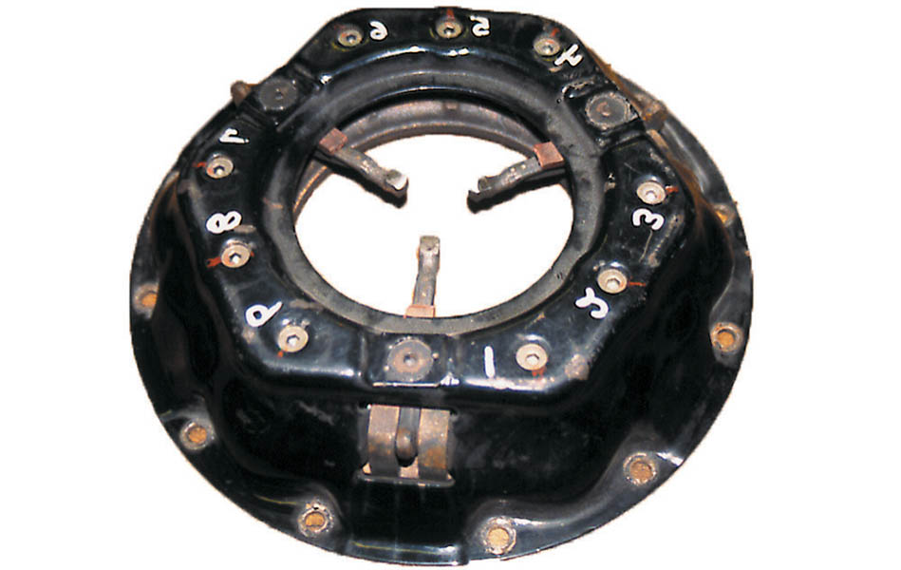
Figure 126.11 A coil spring (lever style) clutch pressure plate

Slide 25
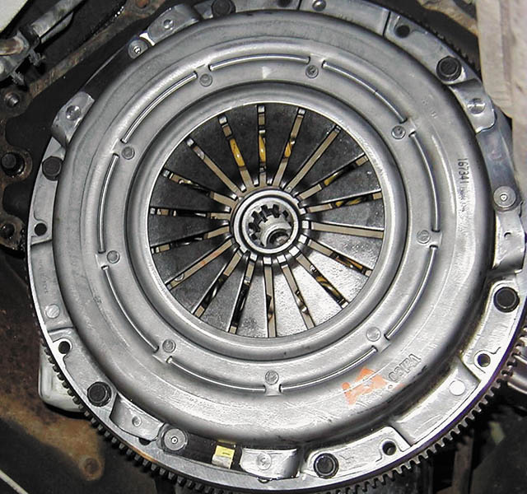
Figure 126.12 Typical diaphragm-style pressure plate that uses a Belleville spring

Slide 26
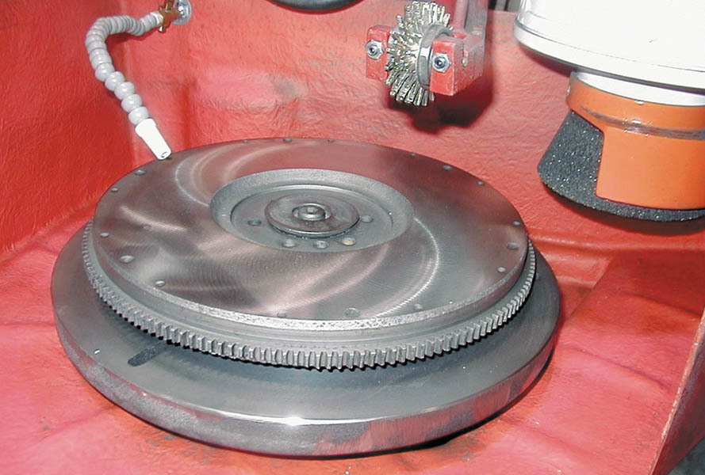
Figure 126.13 A flywheel after it has been machined (ground) to provide the correct surface finish for the replacement clutch disc

Slide 27
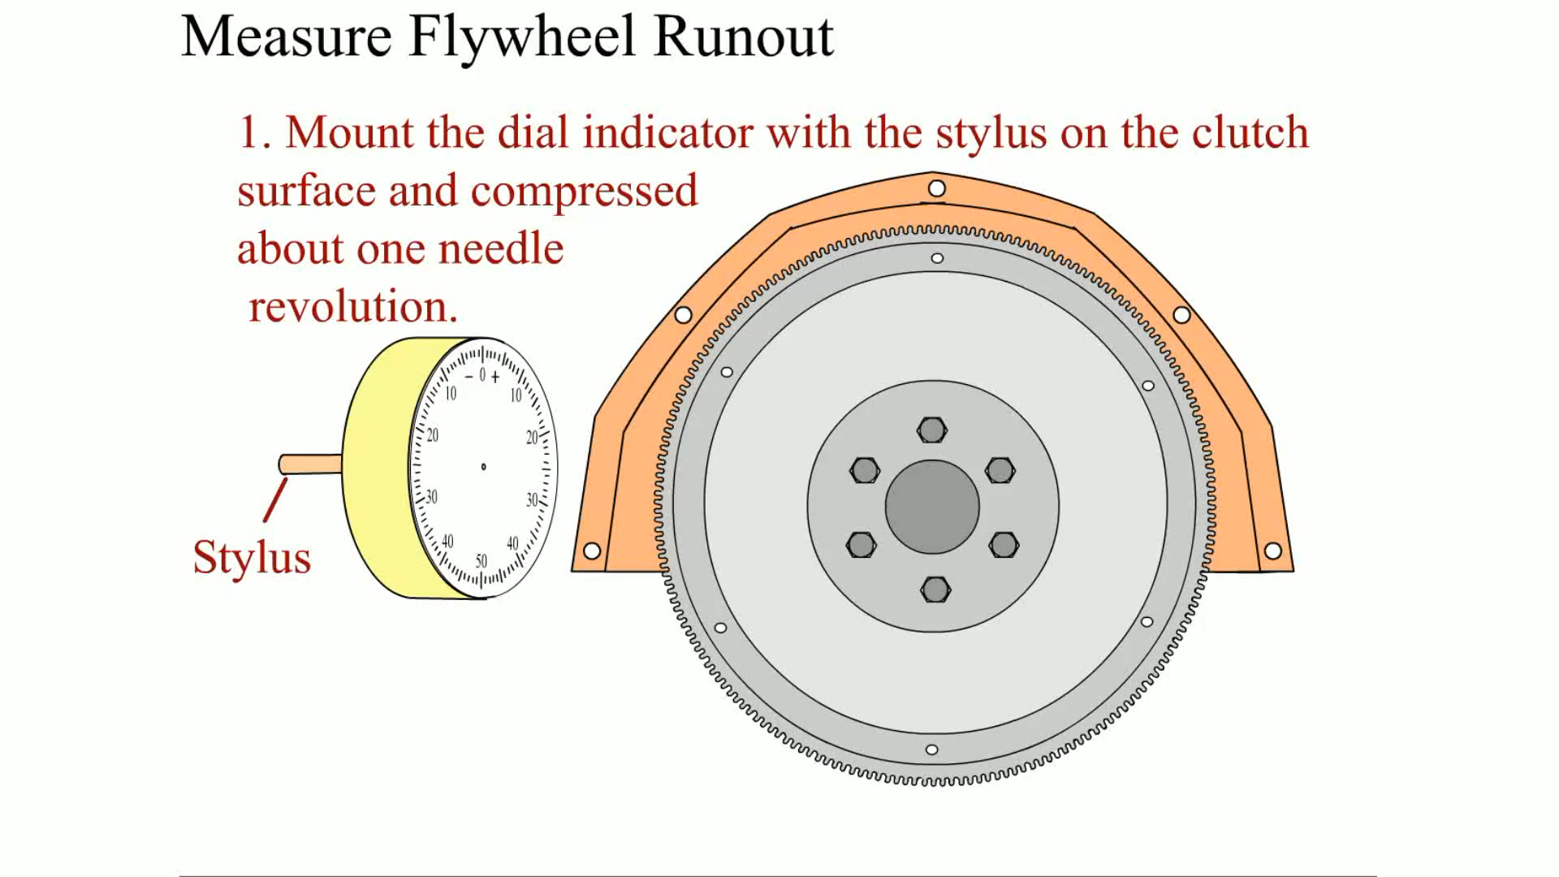
Animation: Measure Flywheel Runout
(The animation will automatically start in a few seconds)

Slide 28
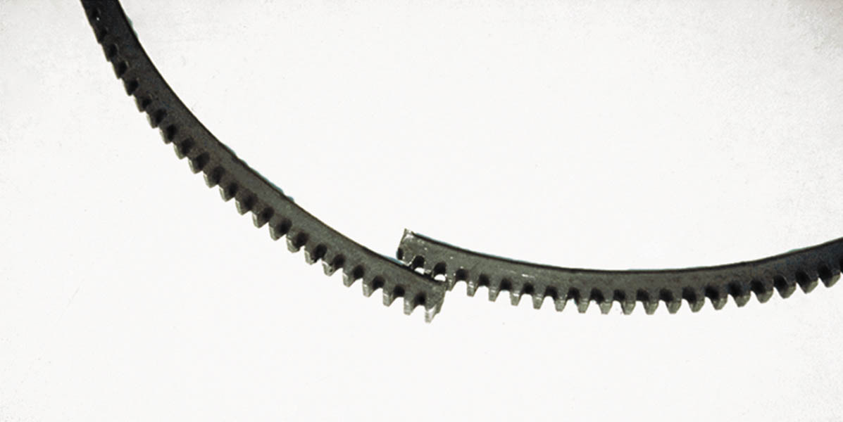
Figure 126.14 The starter motor will spin but the engine will not crank if the ring gear on the flywheel is broken

Slide 29
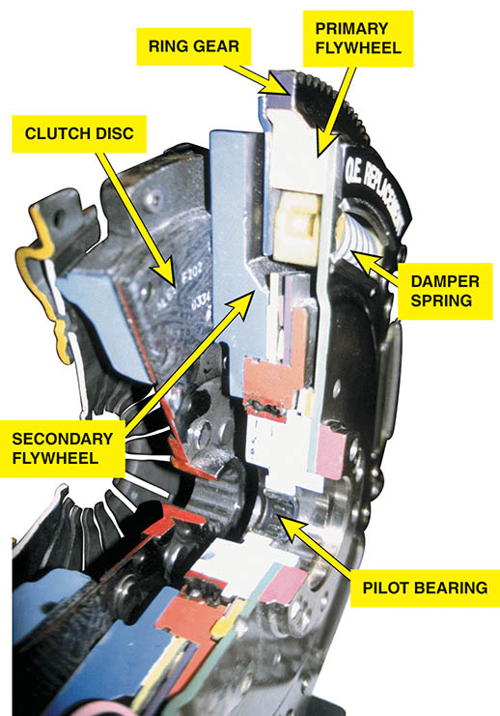
Figure 126.15 A cutaway of a dual-mass flywheel used on a Ford diesel pickup truck

Slide 30
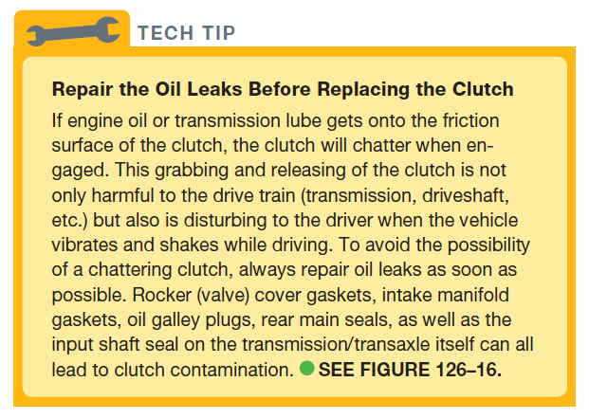
Tech Tip

Slide 31
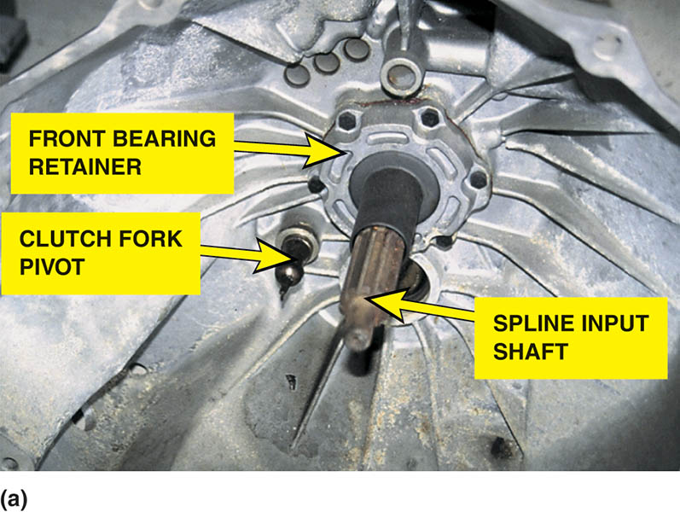
Figure 126.16 (a) Before replacing the clutch, the bell housing should be cleaned and the clutch fork pivot lightly lubricated

Slide 32
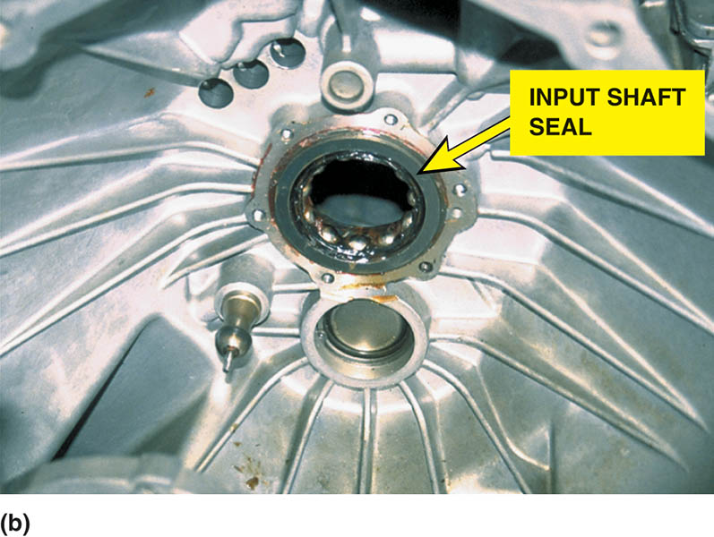
Figure 126.16 (b) The input shaft seal should also be replaced to prevent the possibility of getting transmission lubricant on the friction surfaces of the clutch

Slide 33
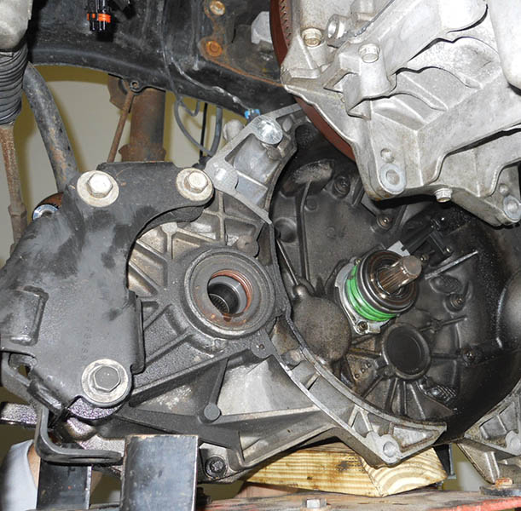
Figure 126.17 A transaxle assembly has been removed to replace the clutch. Note the short input shaft. This vehicle did not use a pilot bearing (bushing)

Slide 34
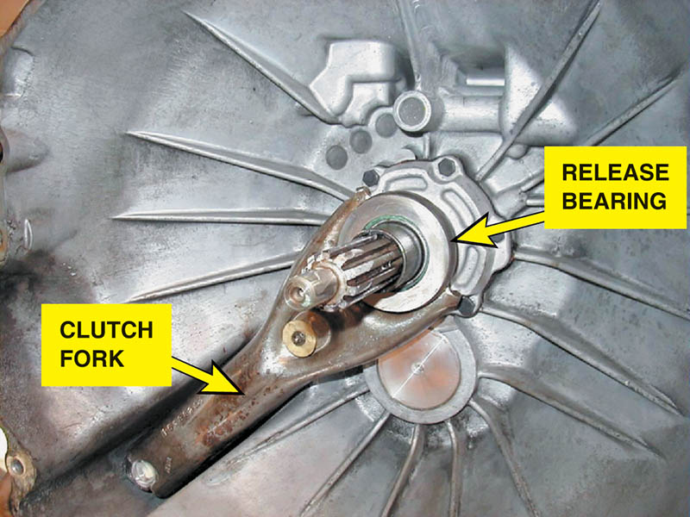
Figure 126.18 The clutch pedal linkage moves the clutch fork, which then applies a force against the release bearing, which then releases the clamping force the pressure plate is exerting on the clutch disc

Slide 35
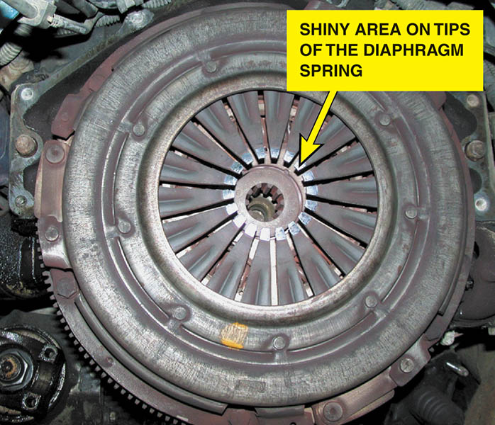
Figure 126.19 The release bearing rubs against the tips of the diaphragm spring

Slide 36
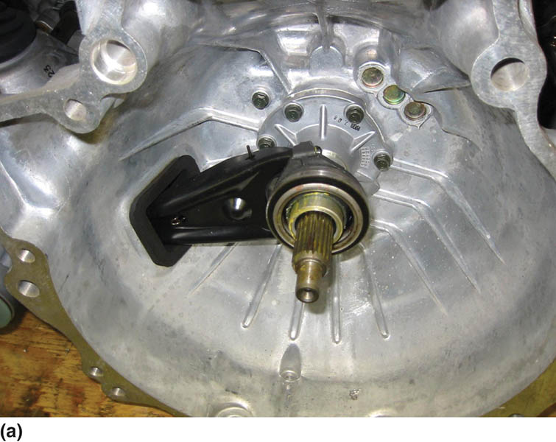
Figure 126.20 (a) A release (throwout) bearing on a transmission that uses a clutch fork and a mechanical or cable operated linkage

Slide 37
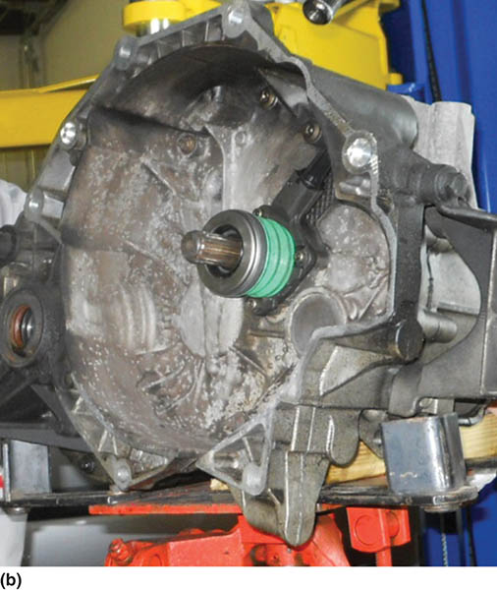
Figure 126.20 (b) A style of release bearing that includes the actuator cylinder, sometimes called a concentric actuator cylinder

Slide 38
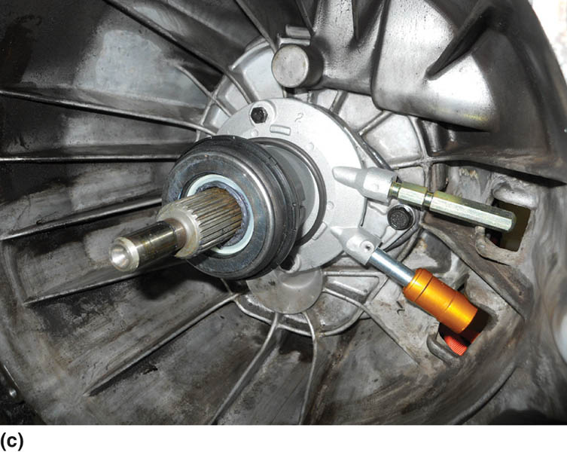
Figure 126.20 (c) A combination release bearing and actuator cylinder showing the two hydraulic lines. The lower line is from the master clutch cylinder and the upper line is used to bleed air from the hydraulic system

Slide 39
QUESTION 1: ?
What are the three methods of transferring the force of the driver’s foot to the release bearing?

Slide 40
ANSWER 1:
Levers and rods, cable operation, and hydraulic.

Slide 41
CLUTCH PROBLEM DIAGNOSIS (1 OF 2)
A common method used to check for a slipping clutch is the following:
  Drive the vehicle to a safe location where it can be accelerated safely.
  Rapidly accelerate the vehicle in first or second gear and rapidly shift the transmission into a higher gear.
The engine speed should drop as the clutch is released after selecting a higher gear. If the clutch is slipping, the engine speed will either rise or not drop after the clutch pedal is released (clutch is engaged).

Slide 42
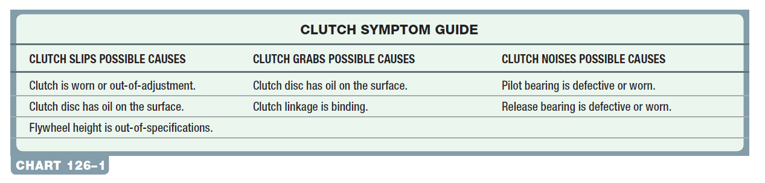
CLUTCH PROBLEM DIAGNOSIS (2 OF 2)

Slide 43
QUESTION 2: ?
What are the common causes of a slipping clutch?

Slide 44
ANSWER 2:
The disc is worn out, the disc is contaminated, or the flywheel height is out of specifications.

Slide 45
CLUTCH REPLACEMENT (1 OF 2)
The clutch replacement for a typical rear-wheel-drive vehicle includes the following steps.
  Hoist the vehicle safely and mark and remove the driveshaft.
  Disconnect the shift linkage, speedometer connections, and reverse light switch connection as well as the clutch linkage or cable or actuator cylinder.
  Support the transmission with a transmission jack and then remove the rear crossmember and bell housing bolts.
  Carefully remove the transmission.

Slide 46
CLUTCH REPLACEMENT (2 OF 2)
  Mark the pressure plate and flywheel if they are to be reused
  Remove the clutch pressure plate retaining bolts, and remove the clutch assembly including the release bearing, pressure plate, and clutch disc.
  Clean and inspect the flywheel.
  Inspect the new clutch to make sure that the parts match the original clutch.
  Replace or lightly lubricate the pilot bearing/bushing.
  Install the new clutch and related components.
  Reinstall the transmission and driveshaft.

Slide 47
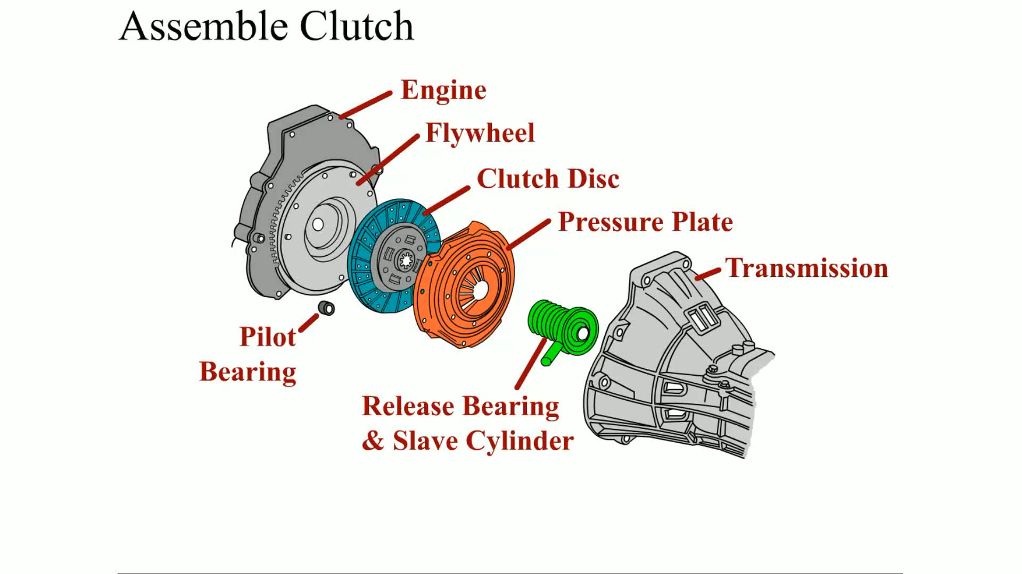
Animation: Assemble Clutch
(The animation will automatically start in a few seconds)

Slide 48
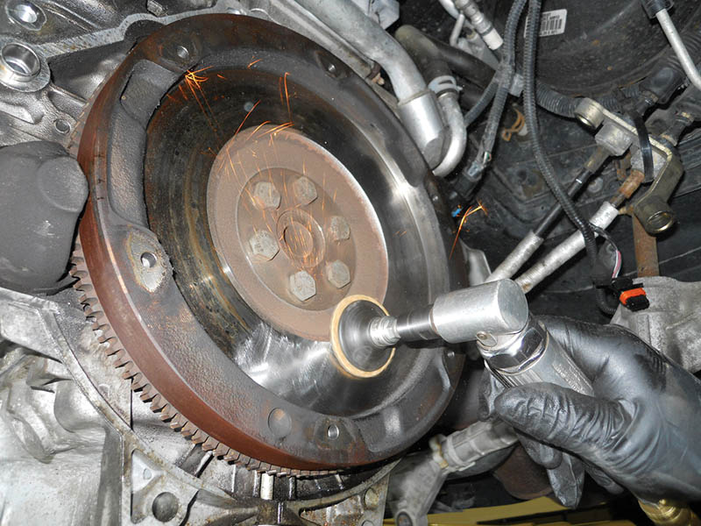
Figure 126.21 Using an abrasive disc to remove the glaze and to restore the proper surface finish to a flywheel

Slide 49
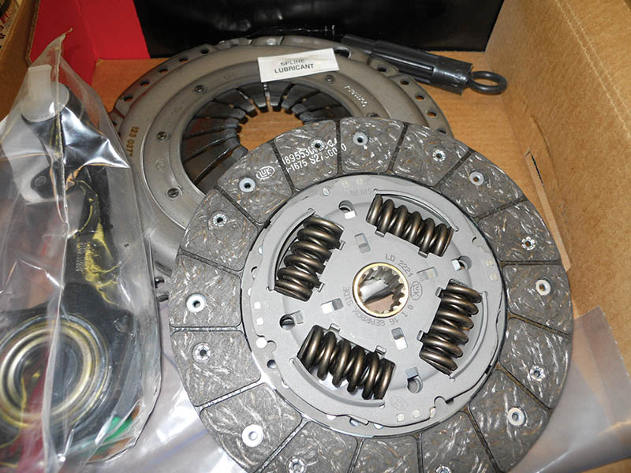
Figure 126.22 A typical clutch kit, which includes the clutch disc, pressure plate, and release (throwout) bearing as well as grease for the spline and a clutch disc alignment tool

Slide 50
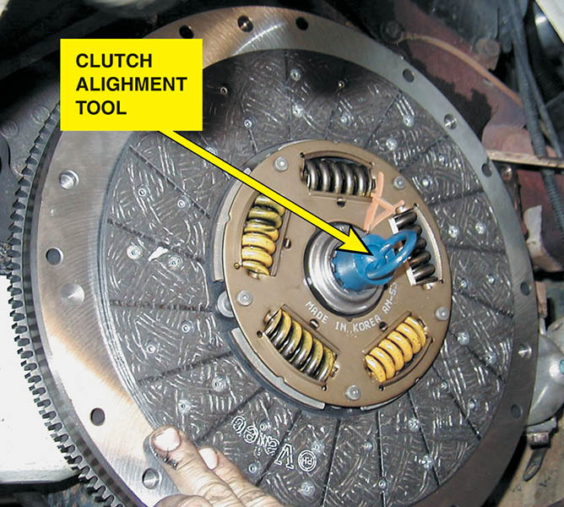
Figure 126.23 A clutch alignment tool is inserted into the pilot bearing and over the splines of the clutch disc to keep the disc properly centered before installing the pressure plate.

Slide 51
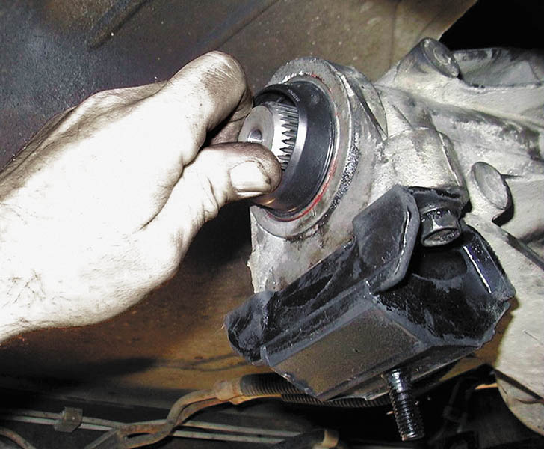
Figure 126.24 To check that the clutch is properly installed before replacing all of the components, try to turn the output shaft with the transmission in gear and the clutch pedal depressed by an assistant

Slide 52
CLUTCH PEDAL ADJUSTMENT
Most hydraulic clutch linkage is self-adjusting and does not require any adjustment in normal service.
Most lever type clutch linkage must be adjusted for proper clutch free pedal setting.
Some cable-operated clutches are either self-adjusting or are adjusted easily.

Slide 53
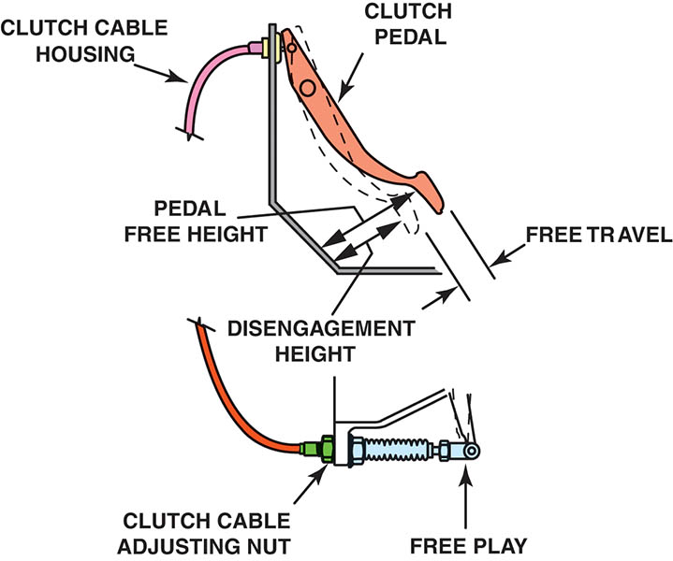
Figure 126.25 A typical cable-operated clutch adjustment location. The clutch can slip during acceleration if there is a lack of freeplay. The transmission may be difficult to shift into gear if there is too much freeplay

Slide 54
HYDRAULIC CLUTCH SERVICE
Precautions
  Fluid leaks or failure to release completely indicates the need for hydraulic system service.
Hydraulic Clutch Bleeding
  In many cases, a clutch hydraulic system can be bled by gravity bleeding while in others, a helper may be needed.

Slide 55
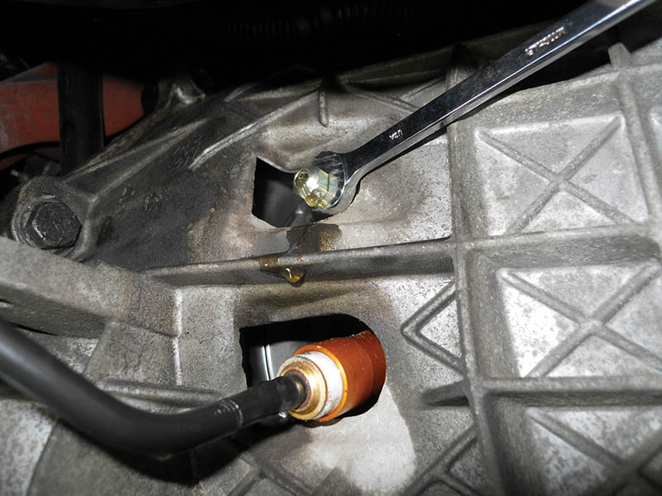
Figure 126.26 Gravity bleeding a hydraulic clutch. Opening the bleeder valve should allow air to escape and then fluid should flow

Slide 56
CLUTCH REPLACEMENT

Slide 57
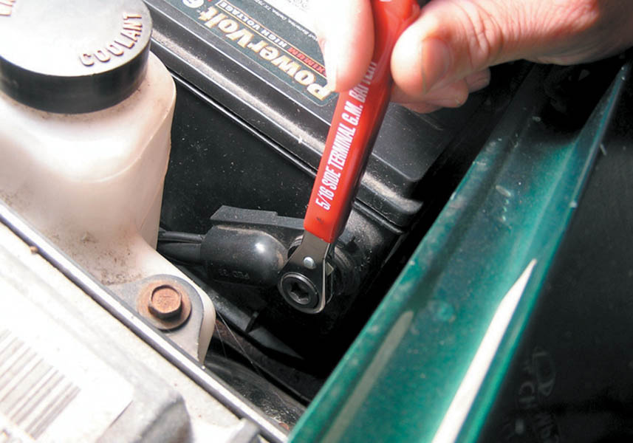
1 The first step in the process of replacing the clutch on this Chevrolet S-10 pickup truck is to remove the negative battery cable.

Slide 58
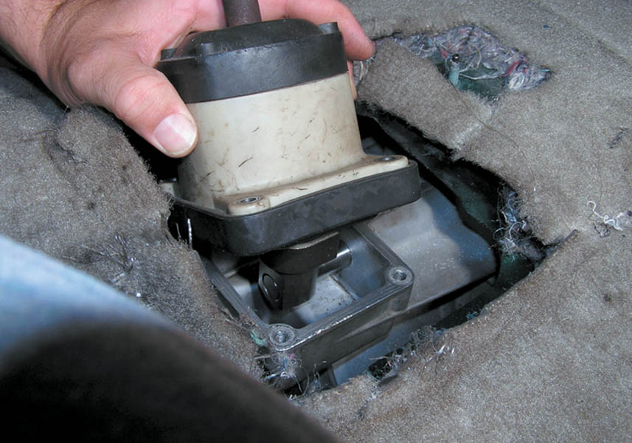
2 Remove the shifter mechanism inside the vehicle. This step may involve removing the center console and other components.

Slide 59
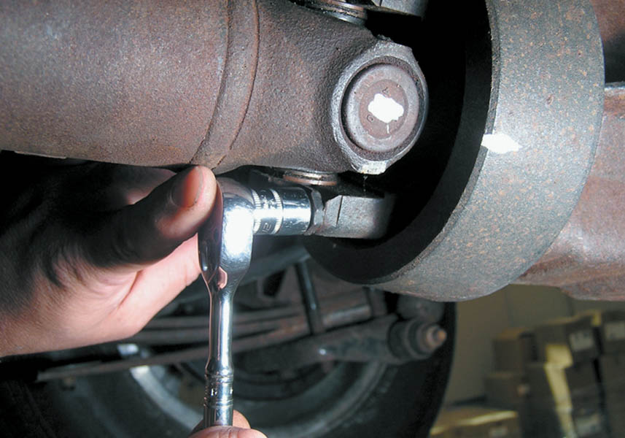
3 Mark and then remove the driveshaft.

Slide 60
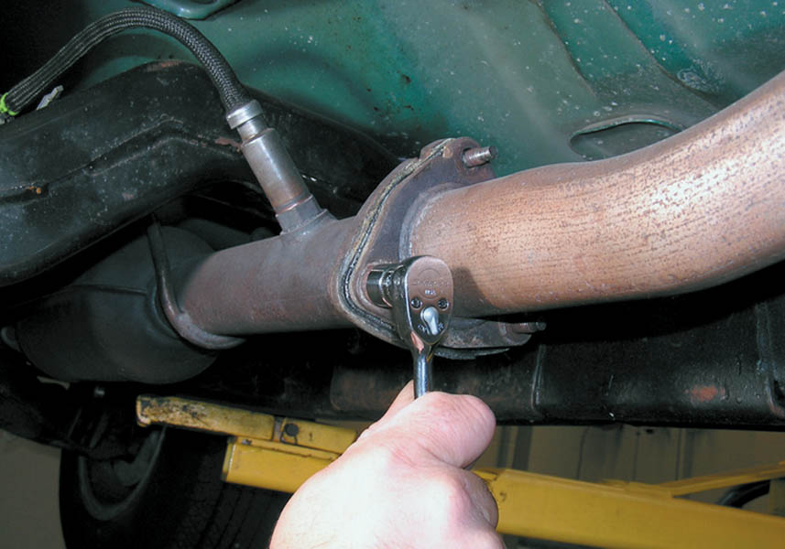
4 Remove the exhaust pipe if needed. It was needed in this case, according to service information.

Slide 61
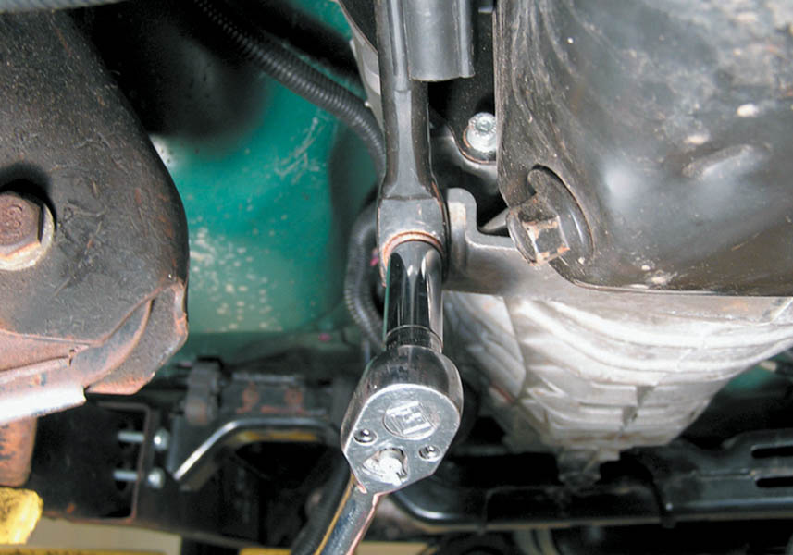
5 Remove the transmission mount fasteners.

Slide 62
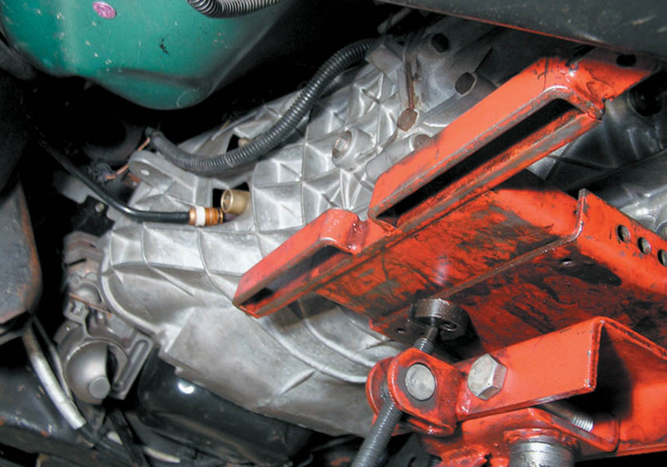
6 Using a transmission jack, support the transmission and remove the bell housing bolts.

Slide 63
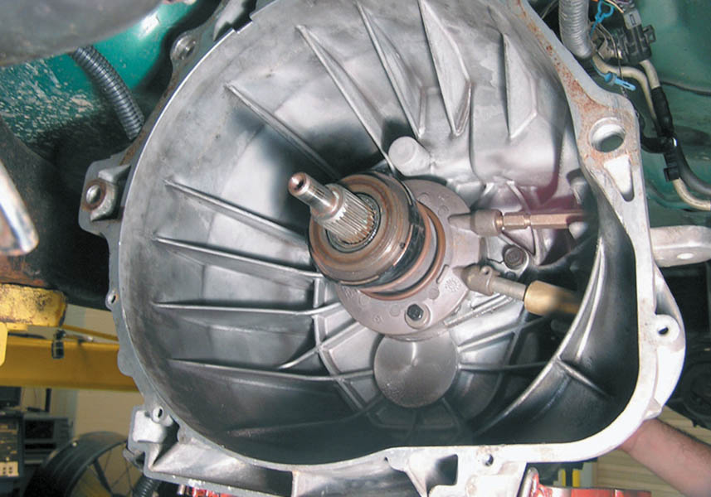
7 A view of the bell housing and throwout bearing as the transmission assembly is removed from the engine.

Slide 64
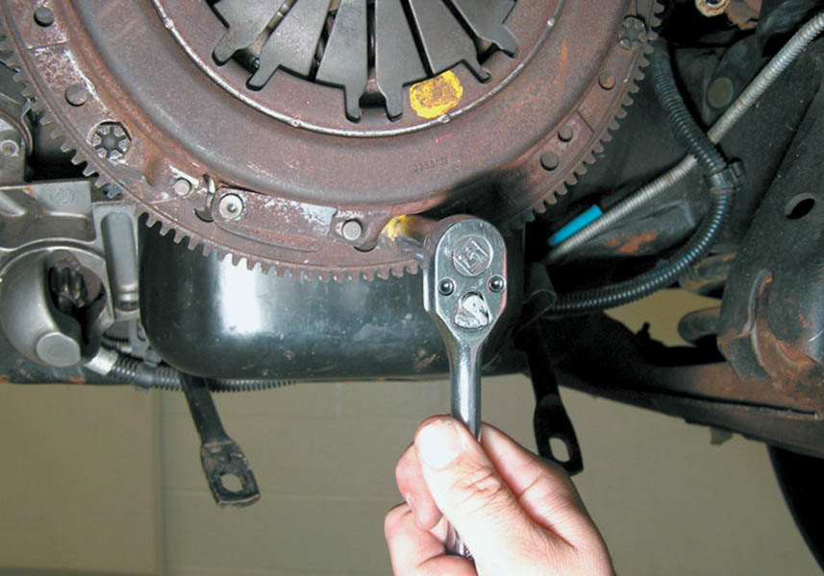
8 Removing the fasteners holding the pressure plate to the flywheel.

Slide 65
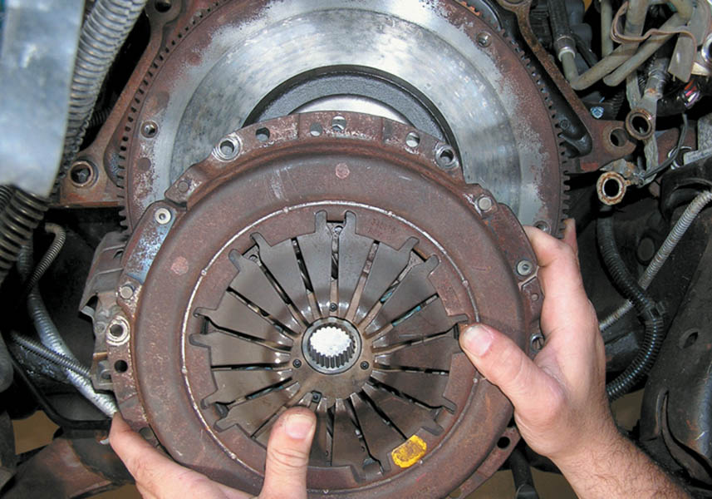
9 Removing the pressure plate and clutch disc.

Slide 66
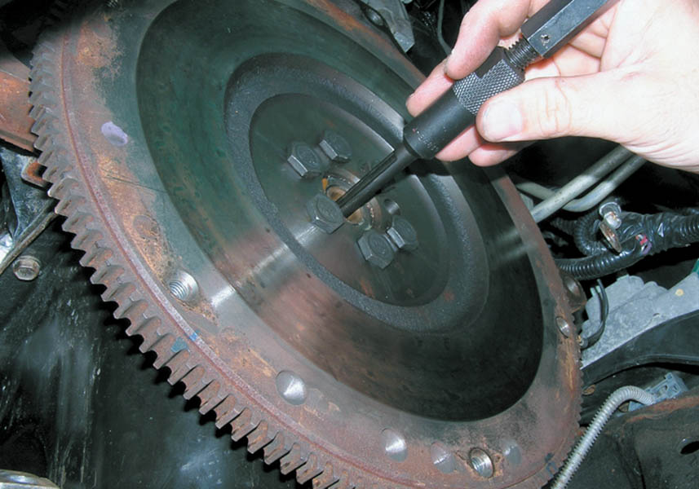
10 Using a special puller, remove the pilot bearing.

Slide 67
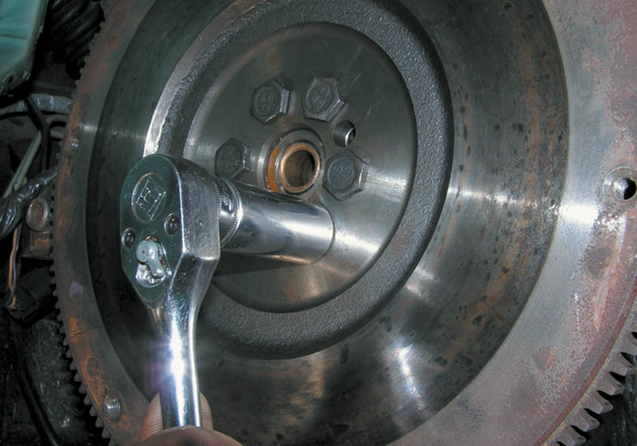
11 The flywheel is being removed to be refinished or replaced as needed.

Slide 68
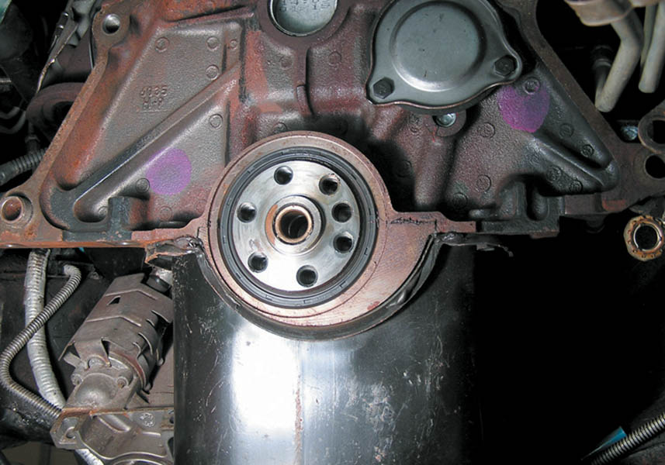
12 With the flywheel removed, check to see if the rear main seal is leaking and replace if needed.

Slide 69
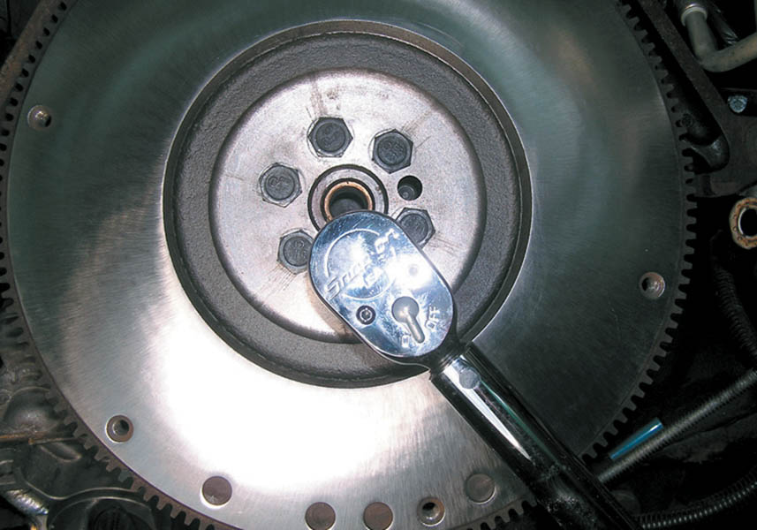
13 Installing a reconditioned flywheel and torqueing new bolts to factory specifications.

Slide 70

14 Installing a new pilot bearing and lubricate as per instructions in service information.

Slide 71

15 Using a pilot tool to align the clutch disc with the pilot bearing through the center opening of the pressure plate.

Slide 72

16 Installing the transmission assembly with a new throwout bearing.

Slide 73

17 Bleeding the air from the hydraulic clutch circuit.

Slide 74

16 Finish the clutch replacement by reinstalling all components removed and check for proper operation.

Slide 75
Video Links (Internet Access Required)
Clutch operation (time 0:28)
Clutch operation (time 4:33)
Clutch (time 1:09)
Clutch demo (time 0:24)
Hydraulic clutch demo (time 0:15)
Clutch operation (time 3:46)
Clutch (time 1:52)
Clutch and trans operation (time 3:30)
Clutch hydraulics (time 22:58)
Clutch diagnosis (time 8:53)

Slide 76
Video Links (Internet Access Required)
Actuator and master cylinder replace and bleed (time 9:50)
Clutch bleeding (time 13:38)
Bleed a clutch actuator cylinder (time 1:00)
Clutch cable adjustment (time 5:07)
Diagnose a bad clutch (time 5:41)
Clutch replacement Focus part 1 (time 32:41)
Clutch replacement Focus part 2 (time 33:52)
Clutch replacement Focus part 3 (time 27:27)
How to adjust a cable operated clutch (time 6:04)
Clutch fork travel (time 3:00)

Slide 77
Video Links (Internet Access Required)
Clutch replace part 1 (time 8:21)
Clutch replace part 2 (time 3:46)
Clutch (time 2:36)
Clutch (time 1:31)
Replace a ring gear (time 6:56)
Self adjust clutch (time 6:24)
Clutch diagnosis (time 1:35)
Slipping clutch (time 1:25)
Clutch replacement part 1 (time 3:19)
Clutch replacement part 2 (time 5:45)

Slide 78
Video Links (Internet Access Required)
Porsche Boxter trans and clutch (time 7:35)
Clutch master cylinder and actuator cylinder (time 8:23)
Clutch install (time 33:30)
2000 VW Beetle Clutch install (time 19:43)
Pull type clutch (time 14:13)
Bleed a clutch (time 8:31)
Bleed a clutch (time 9:38)
Flywheel hot spots (time 1:03)
Clutch fork and release bearing (time 7:19)
Clutch and cable install (time 14:58)

Slide 79
Video Links (Internet Access Required)
Honda clutch part 1 (time 1:28)
Honda clutch part 2 (time 1:41)
Clutch alignment (time 0:35)
Clutch slips (time 4:04)
Crankshaft endplay (time 0:05)
Clutch bleeding (time 1:00)

Slide 80

Copyright

