Slide 1
Advanced Engine Performance Diagnosis
Seventh Edition
Chapter 09
Can and Network Communications
Copyright © 2020 Pearson Education, Inc. All Rights Reserved

Slide 2
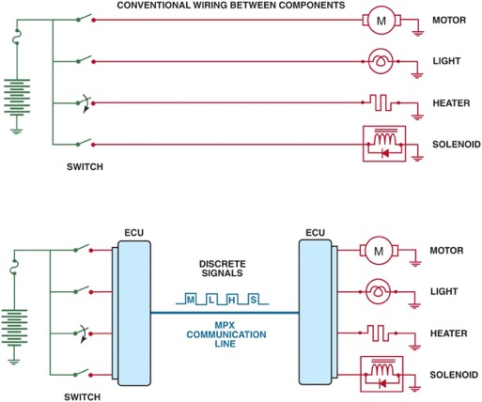
Figure 9.1 Module communications makes controlling multiple electrical devices and accessories easier by utilizing simple low-current switches to signal another module, which does the actual switching of the current to the device

Slide 3
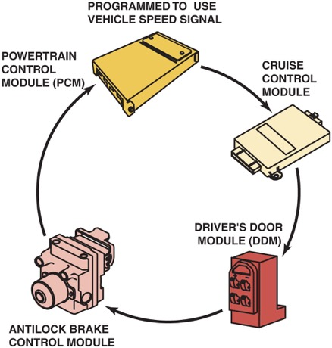
Figure 9.2 A network allows all modules to communicate with other modules

Slide 4
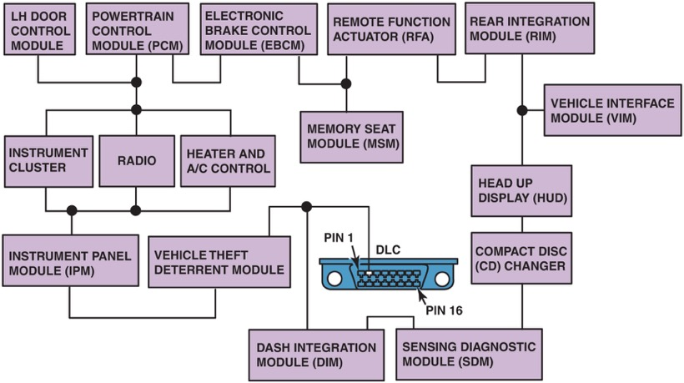
Figure 9.3 A ring link network reduces the number of wires it takes to interconnect all of the modules

Slide 5
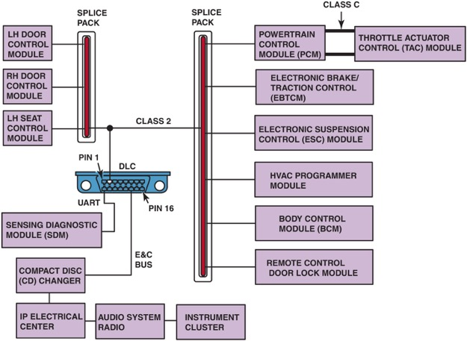
Figure 9.4 In a star link network, all of the modules are connected using splice packs

Slide 6
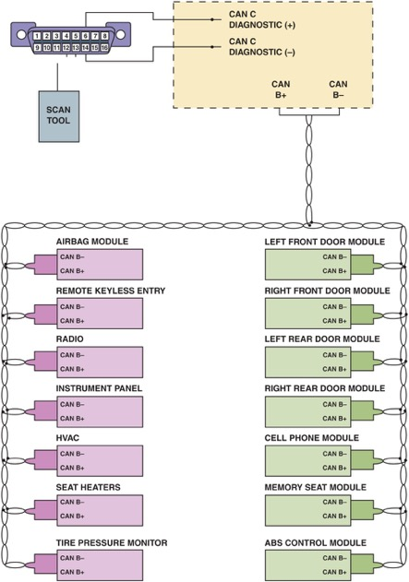
Figure 9.5 A typical B U S system showing module C A N communications and twisted pairs of wire

Slide 7
Animation: Controller Area Network, CAN ((Animation will automatically start in a few seconds)he animation will automatically start in a few seconds)

Slide 8
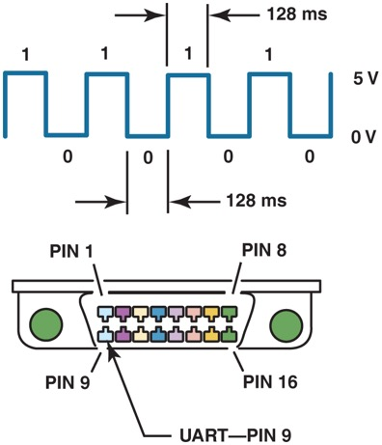
Figure 9.6 U A R T serial data master control module is connected to the data link connector (D L C) at pin 9

Slide 9
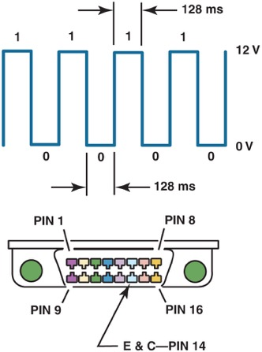
Figure 9.7 The E & C serial data is connected to the data link connector at pin 14

Slide 10
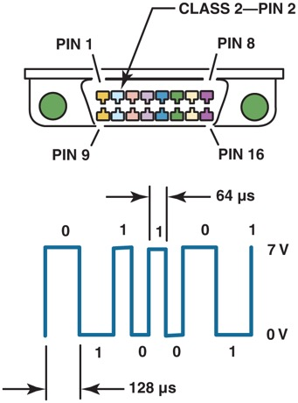
Figure 9.8 Class 2 serial data communication is accessible at the data link connector at pin 2

Slide 11
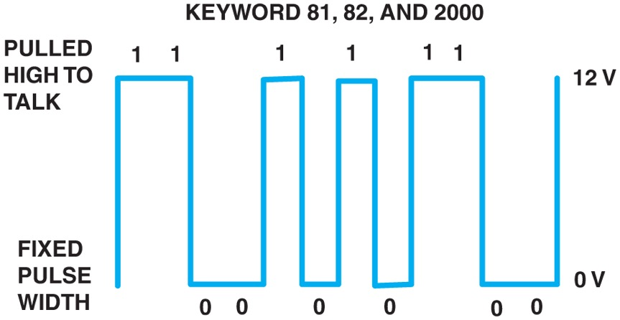
Figure 9.9 Keyword 82 operates at a rate of 8,192 bps, similar to U A R T, and keyword 2000 operates at a baud rate of 10,400 bps (the same as a Class 2 communicator)

Slide 12
Animation: CAN Signal ((Animation will automatically start in a few seconds)he animation will automatically start in a few seconds)

Slide 13
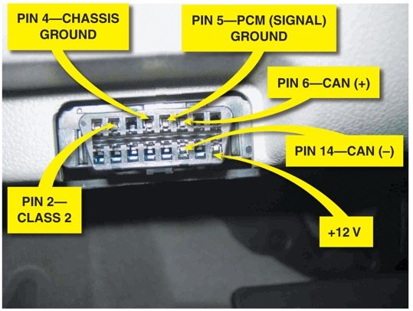
Figure 9.10 G M L A N uses pins at terminals 6 and 14. Pin 1 is used for low-speed G M L A N on 2006 and newer G M vehicles

Slide 14
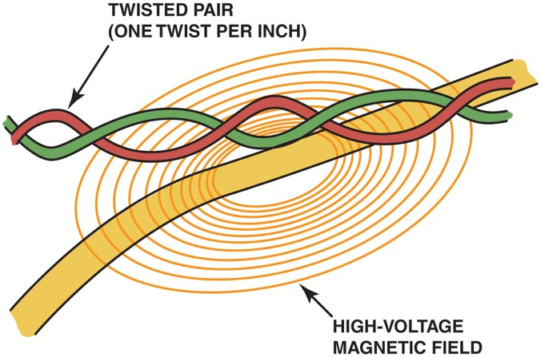
Figure 9.11 A twisted pair is used by several different network communications protocols to reduce interference that can be induced in the wiring from nearby electromagnetic sources

Slide 15
Animation: CAN Circuit Check ((Animation will automatically start in a few seconds)he animation will automatically start in a few seconds)

Slide 16
Animation: Meter Usage, Check CAN Circuit ((Animation will automatically start in a few seconds)he animation will automatically start in a few seconds)

Slide 17
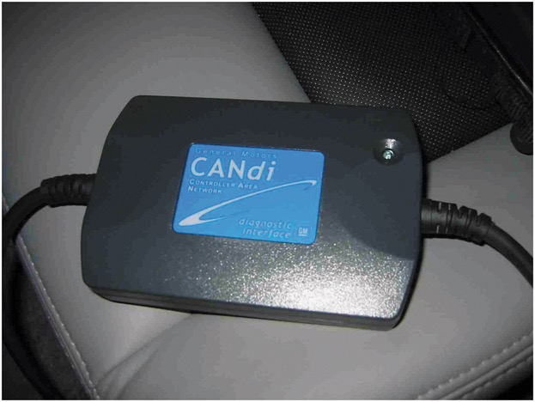
Figure 9.12 A CANDi module will flash the green L E D rapidly if communication is detected

Slide 18
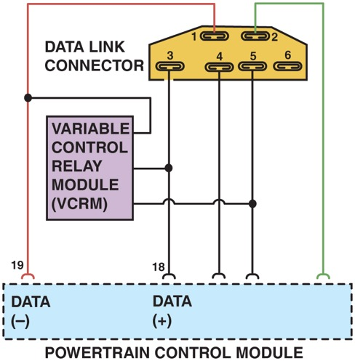
Figure 9.13 A Ford O B D-I diagnostic link connector showing that S C P communication uses terminals in cavities 1 (upper left) and 3 (lower left)

Slide 19
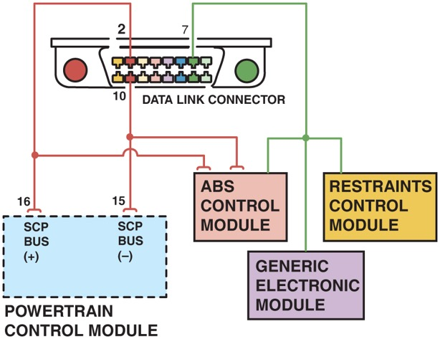
Figure 9.14 A scan tool can be used to check communications with the S C P B U S through terminals 2 and 10 and to the other modules connected to terminal 7 of the data link connector

Slide 20
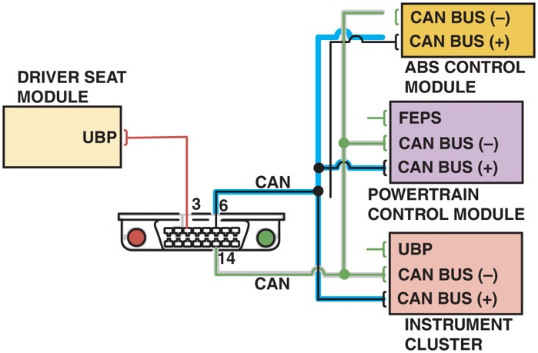
Figure 9.15 Many Fords use U B P module communications along with C A N

Slide 21
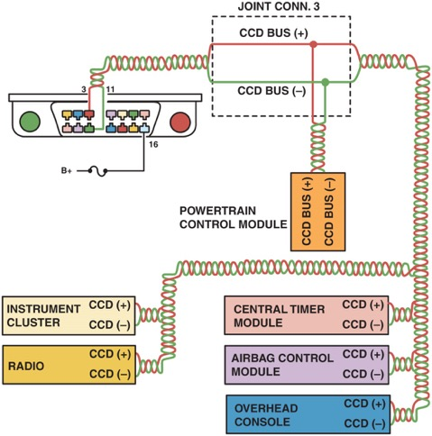
Figure 9.16 C C D signals are labeled plus (+) and minus (−) and use a twisted pair of wires. Notice that terminals 3 and 11 of the data link connector are used to access the C C D B U S from a scan tool. Pin 16 is used to supply 12 volts to the scan tool

Slide 22
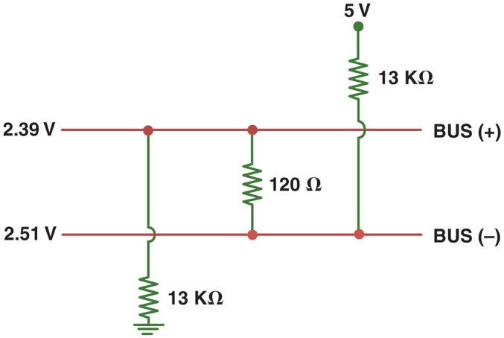
Figure 9.17 The differential voltage for the C C D B U S is created by using resistors in a module

Slide 23
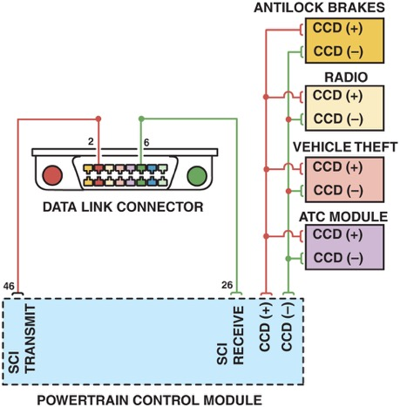
Figure 9.18 Many Chrysler vehicles use both S C I and C C D for module communication

Slide 24
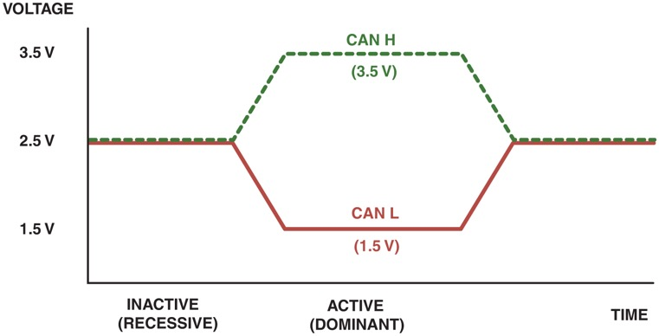
Figure 9.19 C A N uses a differential type of module communication where the voltage on one wire is the equal, but opposite voltage on the other wire. When no communication is occurring, both wires have 2.5 volts applied. When communication is occurring, C A N H goes up 1 to 3.5 volts and C A N L goes down 1 to 1.5 volts

Slide 25
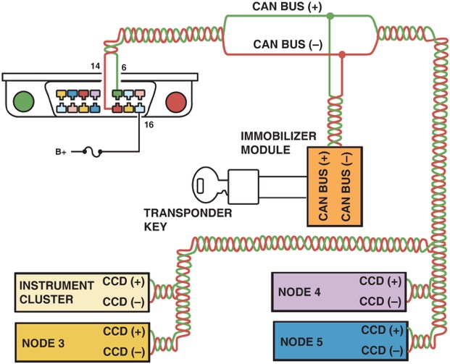
Figure 9.20 A typical (generic) system showing how the C A N B U S is connected to various electrical accessories and systems in the vehicle

Slide 26
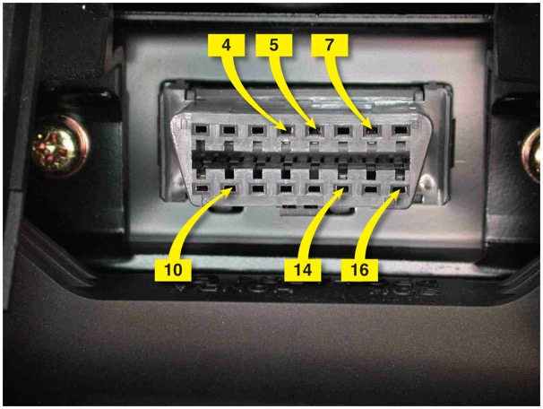
Figure 9.21 A D L C from a pre-C A N Acura. It shows terminals in cavities 4, 5 (grounds), 7, 10, 14, and 16 (B+)

Slide 27
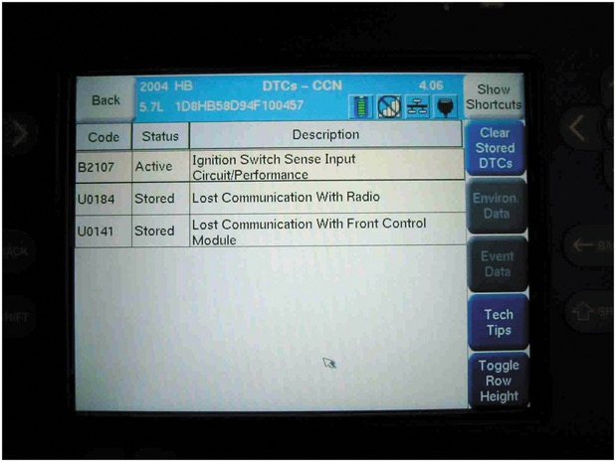
Figure 9.22 A Chrysler scan display showing a B and two U codes, all indicating a B U S-related problem(s)

Slide 28
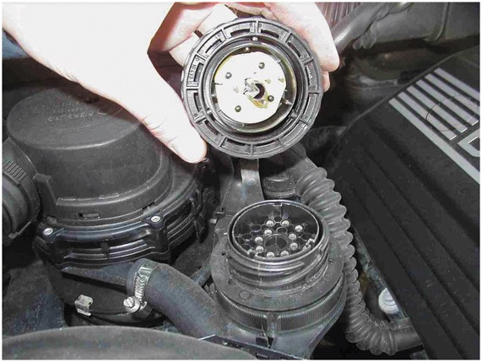
Figure 9.23 A typical 38-cavity diagnostic connector as found on many B M W and Mercedes vehicles under the hood. The use of a breakout box (B O B) connected to this connector can help gain access to module B U S information

Slide 29
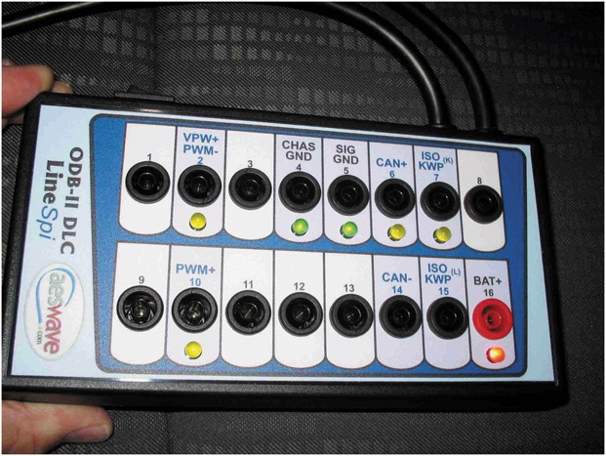
Figure 9.24 A breakout box (B O B) used to access the BUS terminals while using a scan tool to activate the modules. This breakout box is equipped with L E Ds that light when circuits are active

Slide 30
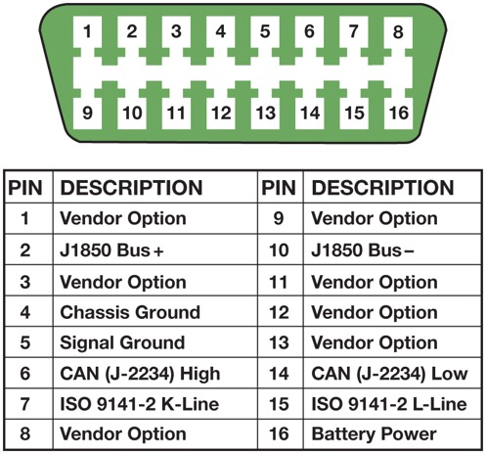
Figure 9.25 A 16 pin O B D-I I D L C with terminals identified. Scan tools use the power pin (16) and ground pin (4) for power so that a separate cigarette lighter plug is not necessary on O B D-I I vehicles

Slide 31
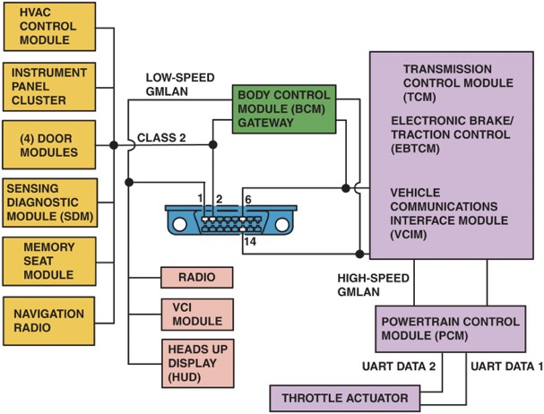
Figure 9.26 This schematic of a Chevrolet Equinox shows that the vehicle uses a G M L A N B U S (D L C pins 6 and 14), plus a Class 2 (pin 2) and U A R T. Pin 1 connects to the low-speed G M L A N network

Slide 32
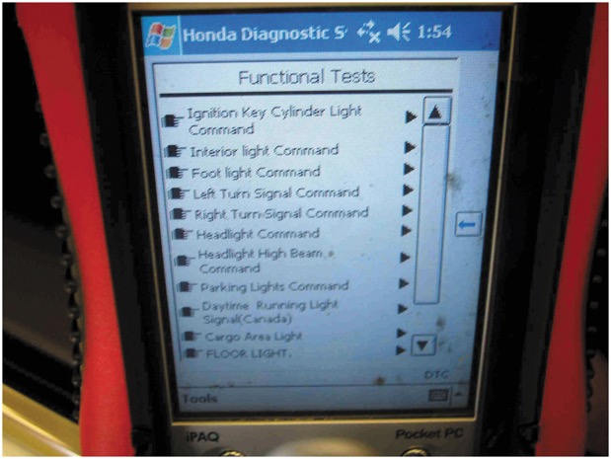
Figure 9.27 This Honda scan tool allows the technician to turn on individual lights and operate individual power windows and other accessories that are connected to the B U S system

Slide 33
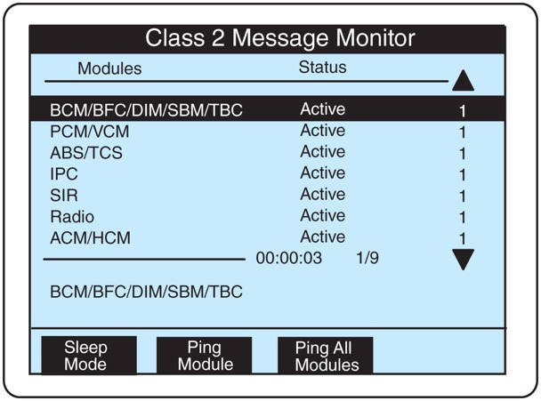
Figure 9.28 Modules used in a General Motors vehicle can be “pinged” using a Tech 2 scan tool

Slide 34
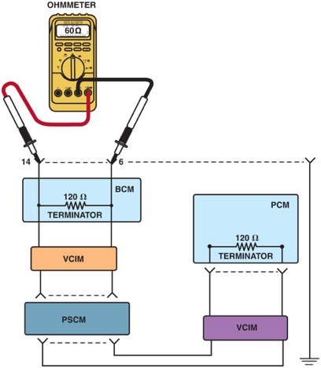
Figure 9.29 Checking the terminating resistors using an ohmmeter at the D L C

Slide 35
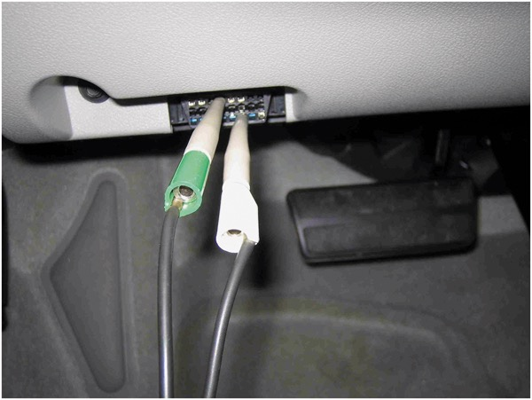
Figure 9.30 Use front-probe terminals to access the data link connector. Always follow the specified back-probe and front-probe procedures as found in service information

Slide 36
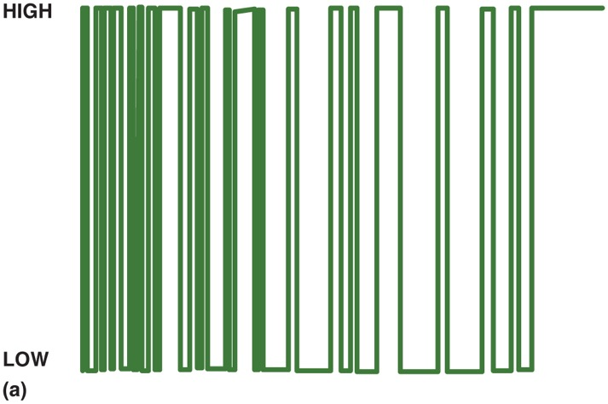
Figure 9.31 (a) Data is sent in packets, so it is normal to see activity and then a flat line between messages

Slide 37
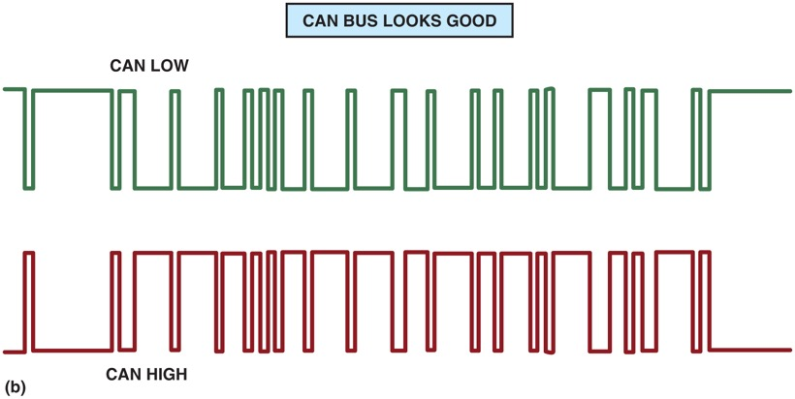
Figure 9.32 (b) A C A N B U S should show voltages that are opposite when there is normal communications. C A N H circuit should go from 2.5 volts at rest to 3.5 volts when active. The C A N L circuit goes from 2.5 volts at rest to 1.5 volts when active

Slide 38
Video Links (Internet Access Required)
CAN/BUS wire install (time 3:42)
Scanning CAN protocol (time 2:04)
How to use an OBD II scan tool (time 4:42)

Slide 39
Copyright

