Slide 1
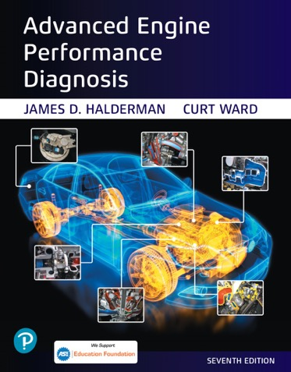
Advanced Engine Performance Diagnosis
Seventh Edition
Chapter 07
Valve Train and Variable Valve Timing Diagnosis
Copyright © 2020 Pearson Education, Inc. All Rights Reserved

Slide 2
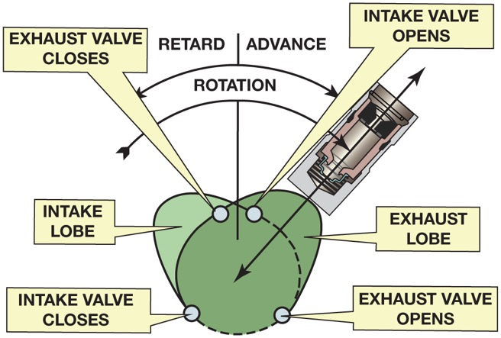
Figure 7.1 A camshaft uses lobes to open the valves and is timed to the crankshaft so that the opening and closing of the valves occur at the proper time

Slide 3
Animation: Camshaft and Roller Lifter ((Animation will automatically start in a few seconds)he animation will automatically start in a few seconds)

Slide 4
Animation: Camshaft and Flat Tappet ((Animation will automatically start in a few seconds)he animation will automatically start in a few seconds)

Slide 5
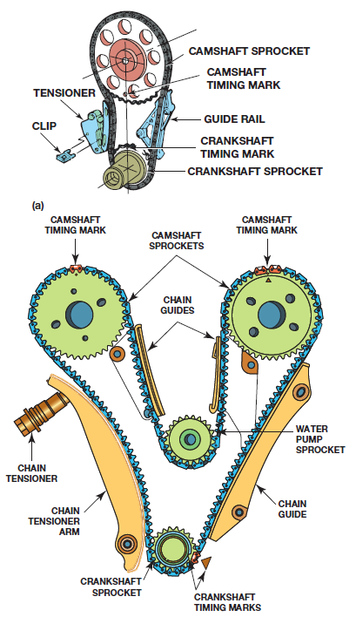
Figure 7.2 (a) A typical overhead valve (O H V) cam-in-block engine timing chain showing the timing marks. (b) An overhead camshaft (O H C) engine showing the water pump sprocket and hydraulic chain tensioners

Slide 6
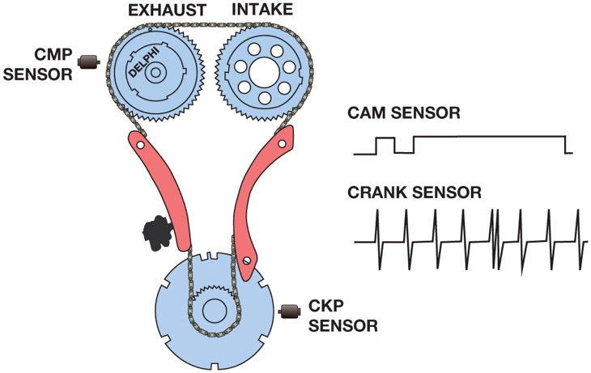
Figure 7.3 The crankshaft–camshaft relationship can be viewed using a scope connected to the crankshaft position (C K P), bottom trace, sensor and the camshaft (C M P) position sensor

Slide 7
Figure 7.4 Graphic representation of a typical camshaft showing the relationship between the intake and exhaust valves. The shaded area represents the overlap period of 100°

Slide 8
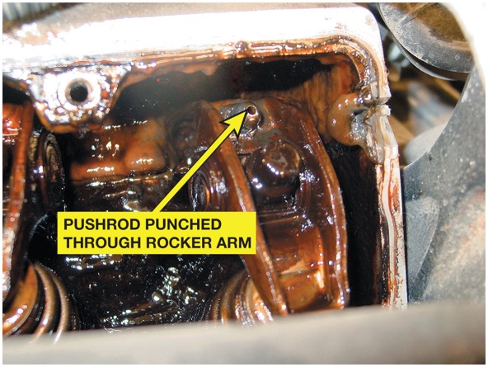
Figure 7.5 The cause of a misfire diagnostic trouble code was discovered to be a pushrod that had worn through the rocker arm on a General Motors 3.4 liter V-6 engine

Slide 9
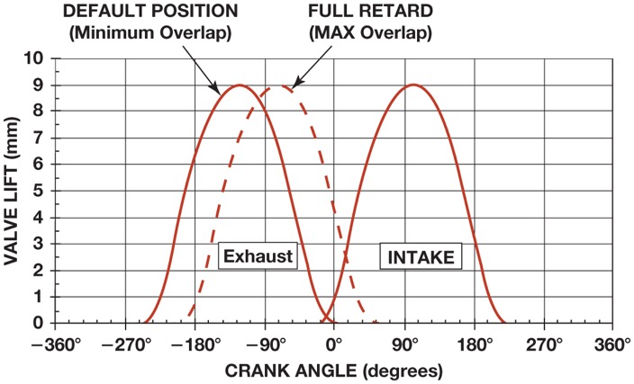
Figure 7.6 The exhaust only variable cam timing systems allow the overlap period where both valves are open to be changed. The at-rest position provides little valve overlap, whereas the maximum overlap allows for internal E G R needed to reduce N O _{x} exhaust emissions

Slide 10
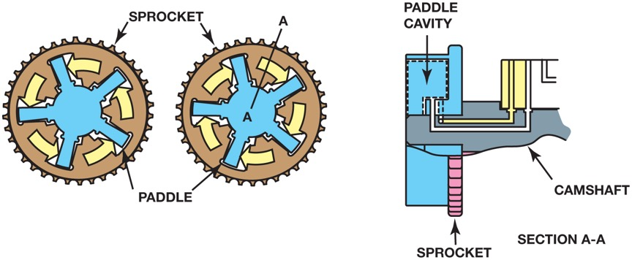
Figure 7.7 Camshaft rotation during advance and retard

Slide 11
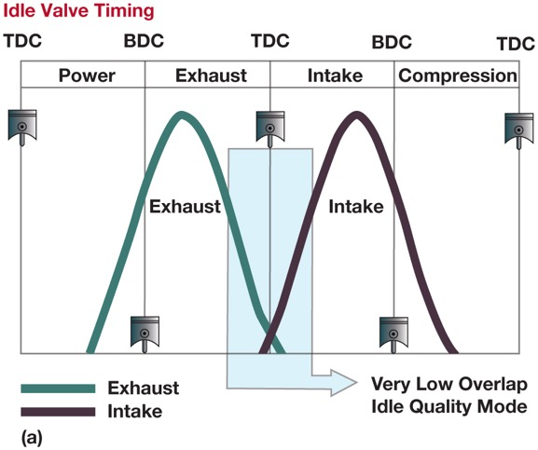
Figure 7.8 (a) At engine start, the camshaft timing has little valve overlap, which improves idle quality

Slide 12
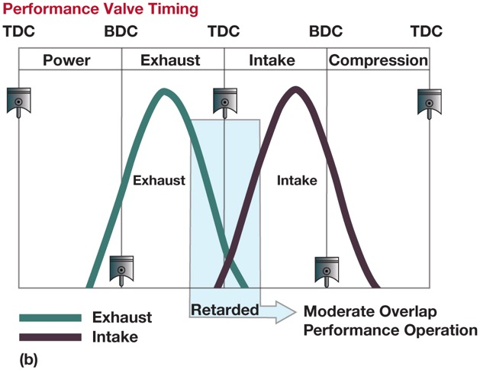
Figure 7.8 (b) During acceleration, the valve overlap is increased to improve engine performance

Slide 13
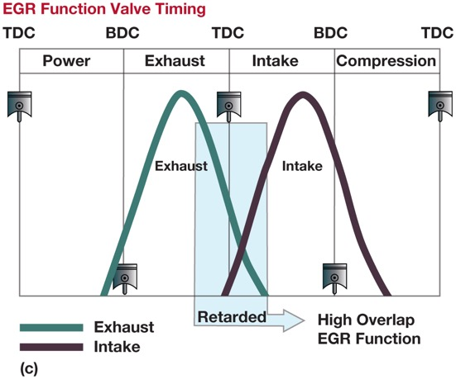
Figure 7.8 (c) To reduce N O x emissions, the valve timing is changed to trap some of the exhaust gases in the combustion chamber, thereby eliminating the needs for an E G R valve

Slide 14
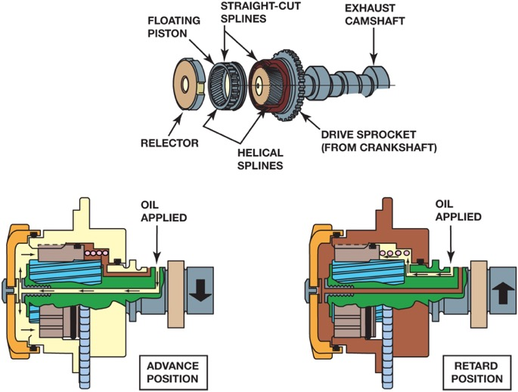
Figure 7.9 Spline cam phaser assembly

Slide 15
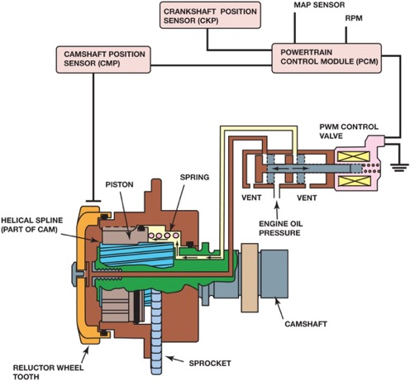
Figure 7.10 A spline phaser showing the control valve and how it works internally. Note that the P C M uses the engine speed (R P M), crankshaft position sensor (C K P) and the camshaft position sensor (C M P) to monitor and command the camshaft for maximum power and lowest possible exhaust emissions

Slide 16
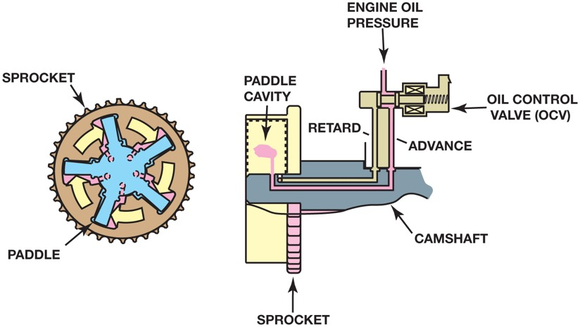
Figure 7.11 A vane phaser is used to move the camshaft using changes of oil pressure from the oil control valve

Slide 17
Animation: Vane Phaser ((Animation will automatically start in a few seconds)he animation will automatically start in a few seconds)

Slide 18
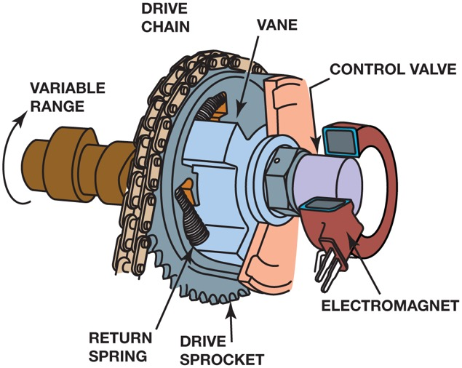
Figure 7.12 A magnetically controlled vane phaser

Slide 19
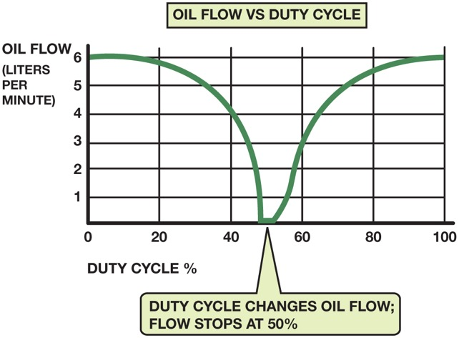
Figure 7.13 When the P C M commands 50% duty cycle, the oil flow through the phaser drops to zero

Slide 20
Figure 7.14 A camshaft position actuator used in a cam-in-block engine

Slide 21
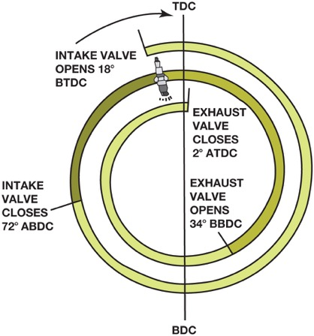
Figure 7.15 An Atkinson cycle engine valve timing diagram showing the intake valve remaining open well into the compression stroke. This delaying of the closing of the intake valve effectively reduces engine compression and displacement while keeping the expansion ratio high

Slide 22
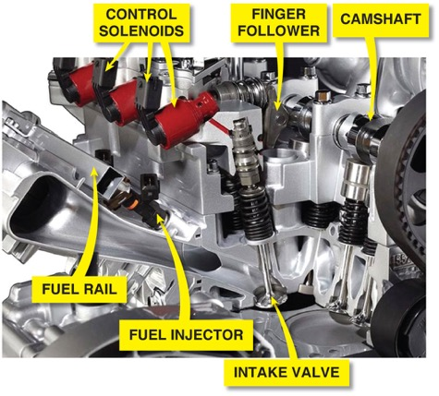
Figure 7.16 In a Multiair engine design, the exhaust valves are opened by the exhaust camshaft lobes. Intake valves are opened by the high-pressure engine oil, with the high pressure being produced by a lobe-actuated piston and controlled by P C M-controlled solenoids

Slide 23
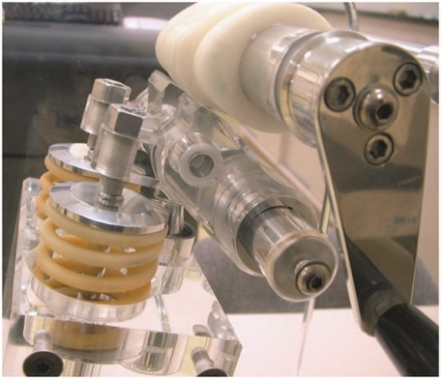
Figure 7.17 A plastic mock-up of a Honda VTEC system that uses two different camshaft profiles: one for low-speed engine operation and the other for high-speed operation

Slide 24
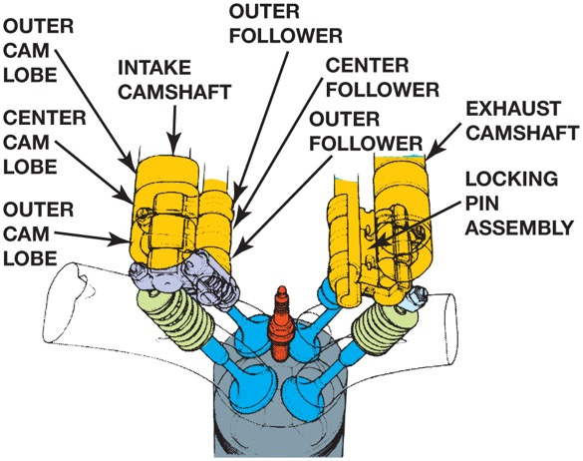
Figure 7.18 Engine oil pressure is used to switch cam lobes on a V T E C system

Slide 25
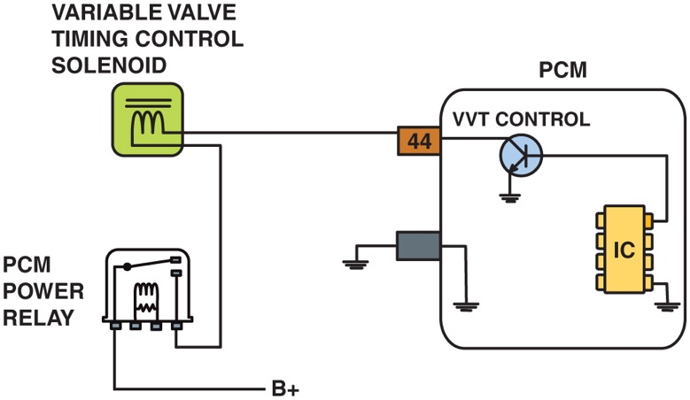
Figure 7.19 The schematic of a variable valve timing control circuit, showing that battery power (+), is being applied to the variable valve timing (VV T) solenoid and pulsed to ground by the P C M

Slide 26
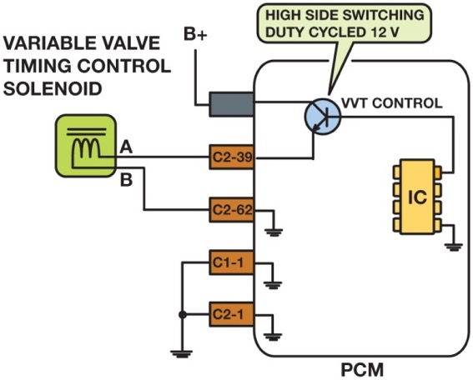
Figure 7.20 A variable valve timing solenoid being controlled by applying voltage from the P C M

Slide 27
Animation: VVT Operation ((Animation will automatically start in a few seconds)he animation will automatically start in a few seconds)

Slide 28
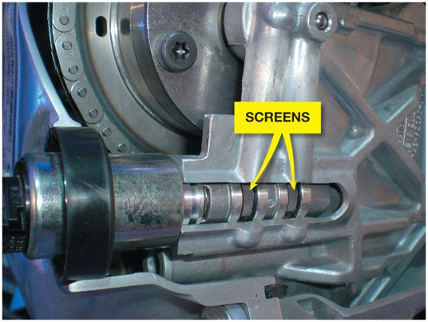
Figure 7.21 The screen(s) protects the solenoid valve from dirt and debris that can cause the valve to stick. This fault can set a P0017 diagnostic trouble code (crankshaft position– camshaft position correlation error)

Slide 29
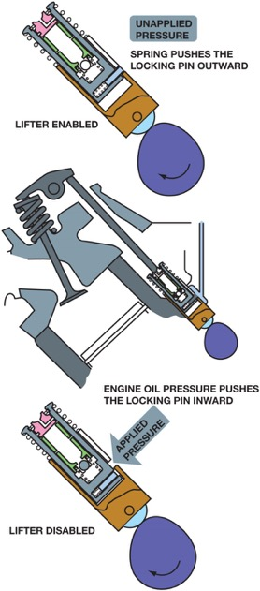
Figure 7.22 Oil pressure applied to the locking pin causes the inside of the lifter to freely move inside the outer shell of the lifter, thereby keeping the valve closed

Slide 30
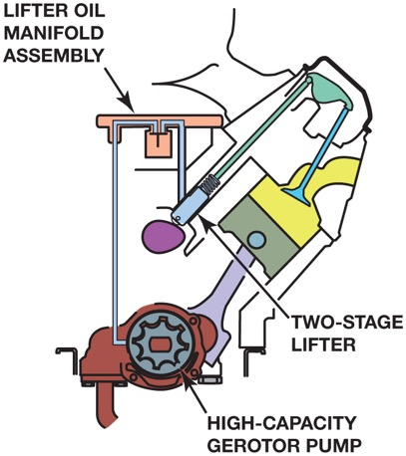
Figure 7.23 Active fuel management includes many different components and changes to the oiling system, which makes routine oil changes even more important on engines equipped with this system

Slide 31
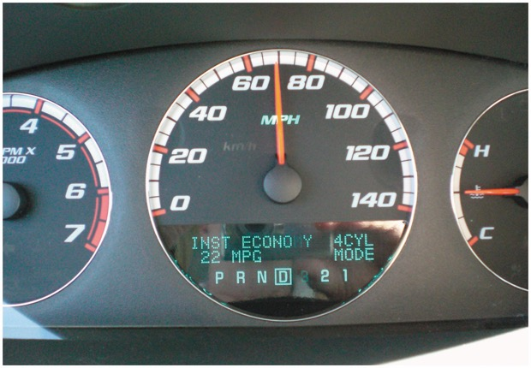
Figure 7.24 The driver information display on a Chevrolet Impala with a 5.3 liter V-8 equipped with active fuel management. The transition between four-cylinder mode and eight-cylinder mode is so smooth that most drivers are not aware that the switch is occurring

Slide 32
Video Links (Internet Access Required)
How to diagnose a burnt valve (time 4:29)
How to diagnose a bad engine lifer, Chevy Tahoe, pt 1 (time 2:03)
How to diagnose if you have valve float using HP Tuners 3.X scanner (time 6:36)
Cylinder head 105 – Valve job basics (time 14:56)
Diagnosing a bad cylinder head (time 3:01)
Variable Valve Timing Diagnostics (time 27:52)
Variable valve timing explained (time 3:52)
VVT Valve Diagnosis (time 0:56)
Variable valve timing oil control valve malfunction (time 7:25)
VW/Audi Variable Valve Timing Made Easy (time 9:16)

Slide 33
Copyright

