Slide 1
Advanced Engine Performance Diagnosis
Seventh Edition
Chapter 03
Circuit Testers and Digital Meters
Copyright © 2020 Pearson Education, Inc. All Rights Reserved

Slide 2
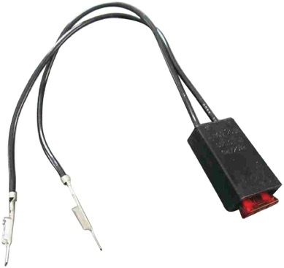
Figure 3.1 A technician-made fused jumper lead, which is equipped with a red 10 ampere fuse. This fused jumper wire uses terminals for testing circuits at a connector instead of alligator clips

Slide 3
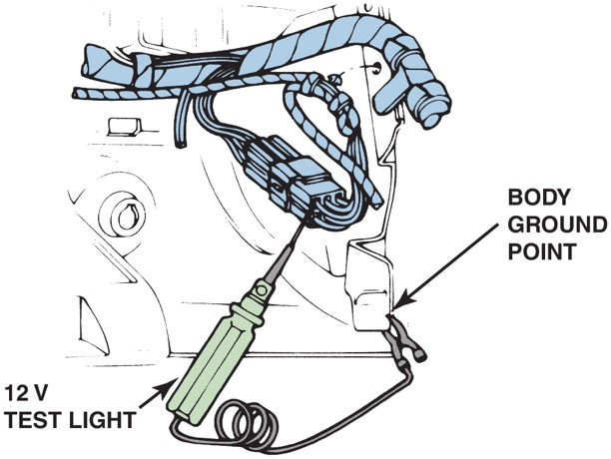
Figure 3.2 A 12 volt test light is attached to a good ground while probing for power

Slide 4
Animation: 8-Step Diagnostic Procedure ((Animation will automatically start in a few seconds)he animation will automatically start in a few seconds)

Slide 5
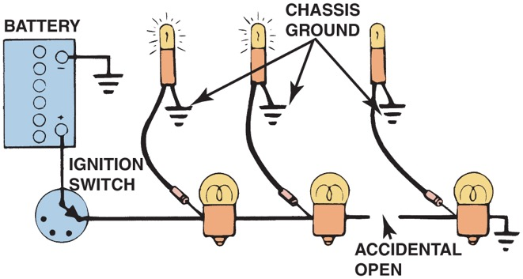
Figure 3.3 A test light can be used to locate an open in a circuit. Note that the test light is grounded at a different location than the circuit itself

Slide 6
Animation: Circuit Test, Test Light ((Animation will automatically start in a few seconds)he animation will automatically start in a few seconds)

Slide 7
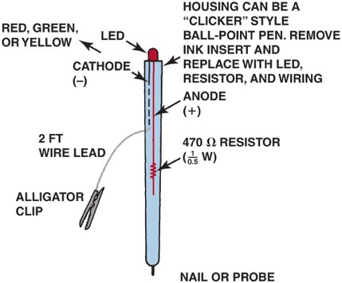
Figure 3.4 An L E D test light can be easily made using low cost components and an old ink pen. With the 470 ohm resistor in series with the L E D, this tester only draws 0.025 ampere (25 milliamperes) from the circuit being tested. This low current draw helps assure the technician that the circuit or component being tested will not be damaged by excessive current flow

Slide 8
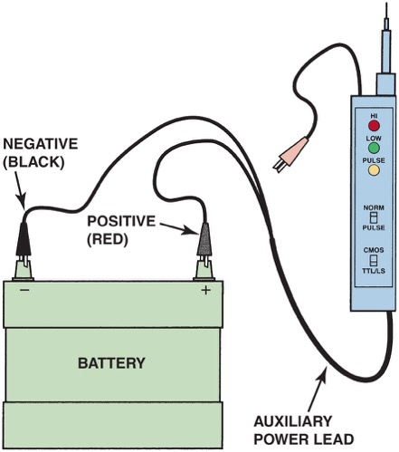
Figure 3.5 A logic probe connected to the vehicle battery. When the tip probe is connected to a circuit, it can check for power, ground, or a pulse

Slide 9
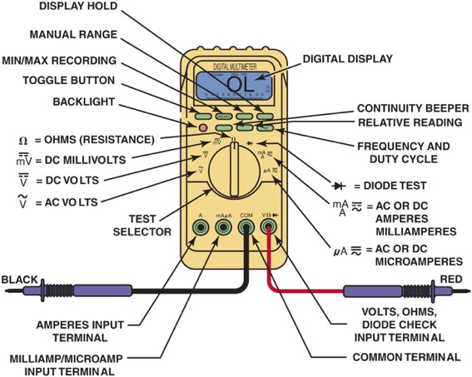
Figure 3.6 Typical digital multimeter. The black meter lead is always placed in the C O M terminal. The red meter test lead should be in the volt-ohm terminal except when measuring current in amperes

Slide 10
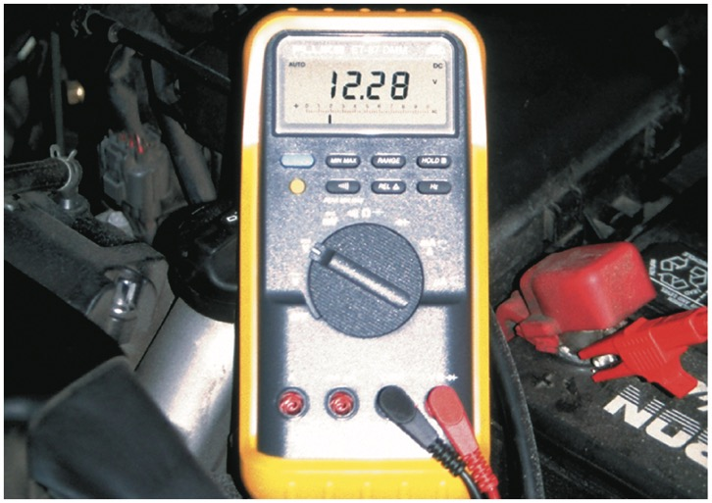
Figure 3.7 Typical digital multimeter (D M M) set to read D C volts

Slide 11
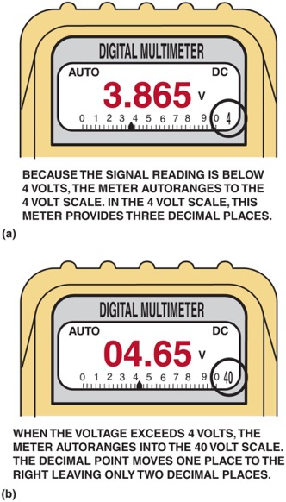
Figure 3.8 A typical autoranging digital multimeter automatically selects the proper scale to read the voltage being tested. The scale selected is usually displayed on the meter face. (a) Note that the display indicates “4,” meaning that this range can read up to 4 volts. (b) The range is now set to the 40 volt scale, meaning that the meter can read up to 40 volts on the scale. Any reading above this level will cause the meter to reset to a higher scale. If not set on autoranging, the meter display would indicate O L if a reading exceeds the limit of the scale selected

Slide 12
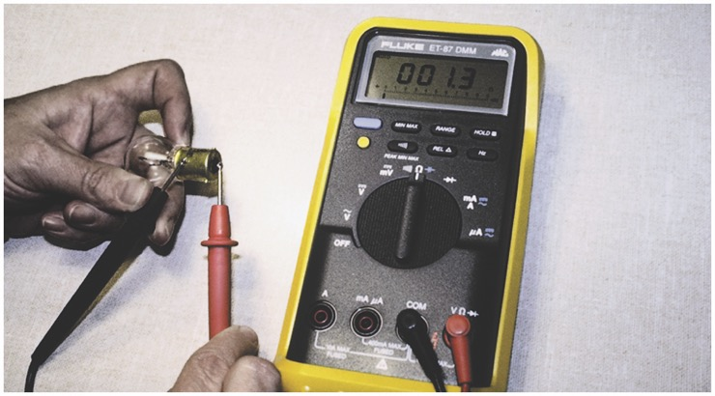
Figure 3.9 Using a digital multimeter set to read ohms Ω to test this lightbulb. The meter reads the resistance of the filament

Slide 13
Animation: Bulb Test, Meter (Animation will automatically start in a few seconds)he animation will automatically start in a few seconds)

Slide 14
Animation: Test Bulb ((Animation will automatically start in a few seconds)he animation will automatically start in a few seconds)

Slide 15
Animation: Meter Usage, Testing a Diode ((Animation will automatically start in a few seconds)he animation will automatically start in a few seconds)

Slide 16
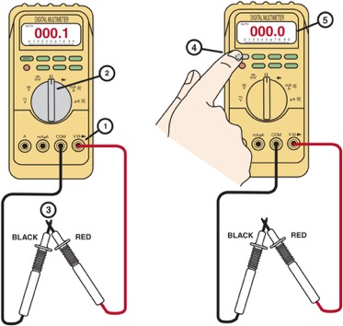
Figure 3.10 Many digital multimeters can have the display indicate zero to compensate for test lead resistance. (1) Connect leads in the Ω and C O M meter terminals. (2) Select the Ω scale. (3) Touch the two meter leads together. (4) Push the “zero” or “relative” button on the meter. (5) The meter display will now indicate zero ohms of resistance

Slide 17
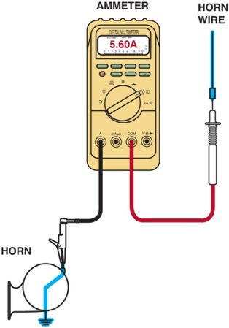
Figure 3.11 Measuring the current flow required by a horn requires that the ammeter be connected to the circuit in series and the horn button be depressed by an assistant

Slide 18
Animation: Meter Usage, Measure Amps ((Animation will automatically start in a few seconds)he animation will automatically start in a few seconds)

Slide 19
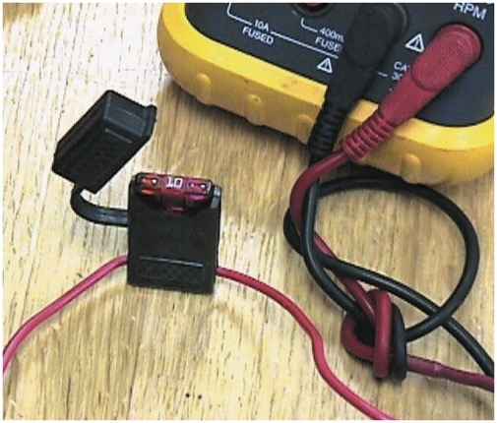
Figure 3.12 Note the blade-type fuse holder soldered in series with one of the meter leads. A 10 ampere fuse helps protect the internal meter fuse (if equipped) and the meter itself from damage that may result from excessive current flow if accidentally used incorrectly

Slide 20
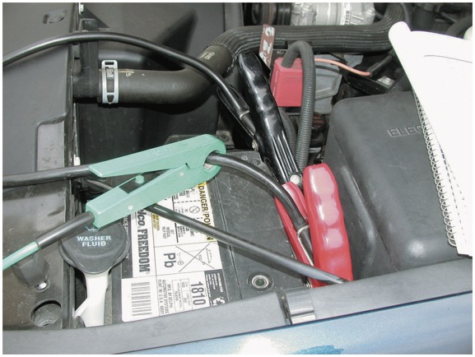
Figure 3.13 An inductive ammeter clamp is used with all starting and charging testers to measure the current flow through the battery cables

Slide 21
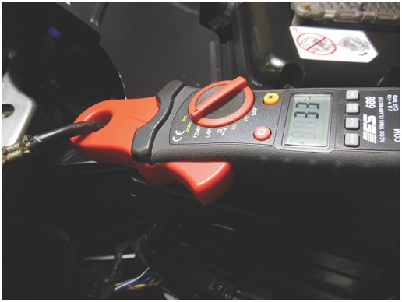
Figure 3.14 A typical mini clamp-on-type digital multimeter. This meter is capable of measuring alternating current (A C) and direct current (D C) without requiring that the circuit be disconnected to install the meter in series. The jaws are simply placed over the wire and current flow through the circuit is displayed

Slide 22
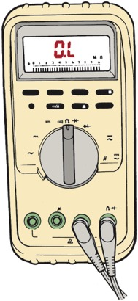
Figure 3.15 Typical digital multimeter showing O L (over limit) on the readout with the ohms (Ω) unit selected. This usually means that the unit being measured is open (infinite resistance) and has no continuity

Slide 23
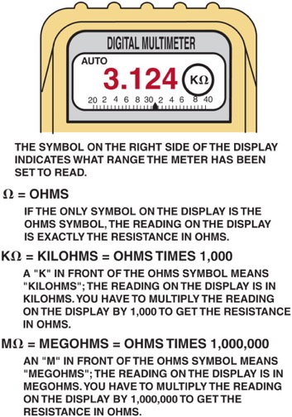
Figure 3.16 Always look at the meter display when a measurement is being made, especially if using an autoranging meter

Slide 24
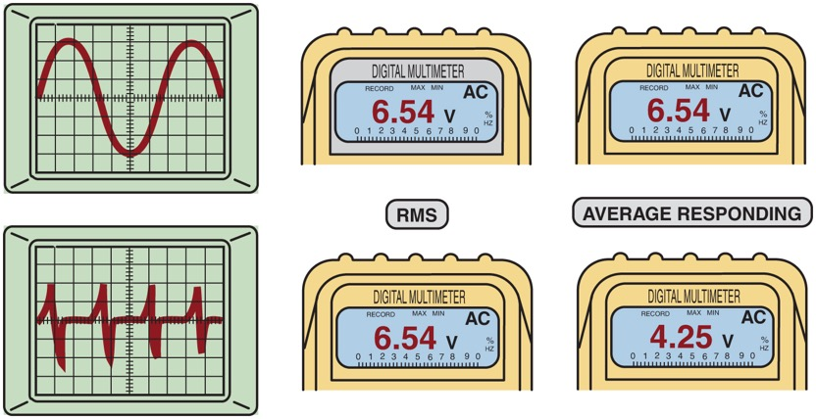
Figure 3.17 When reading A C voltage signals, a true R M S meter (such as a Fluke 87) provides a different reading than an average responding meter (such as a Fluke 88). The only place this difference is important is when a reading is to be compared with a specification

Slide 25
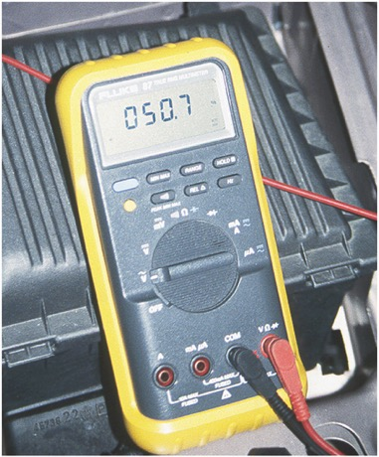
Figure 3.18 This meter display shows 050.7 A C volts. Notice that the zero beside the 5 indicates that the meter can read over 100 volts A C with a resolution of 0.1 volt

Slide 26
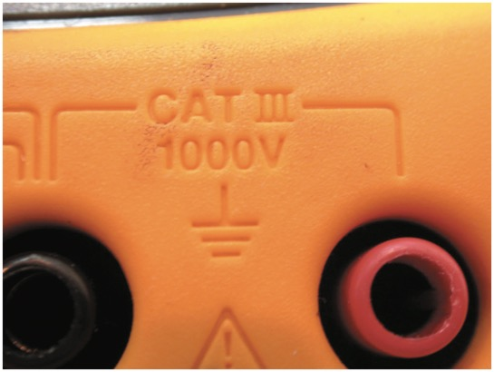
Figure 3.19 Be sure to use only a meter that is C A T III rated when taking electrical voltage measurements on a hybrid vehicle

Slide 27
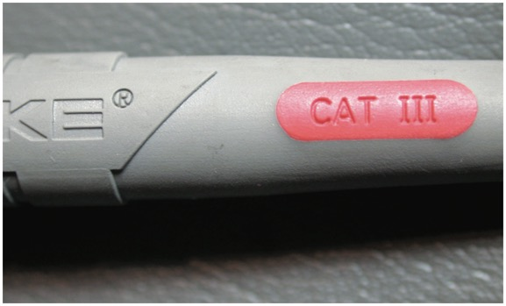
Figure 3.20 Always use meter leads that are C A T III rated on a meter that is also C A T III rated, to maintain the protection needed when working on hybrid vehicles

Slide 28
Animation: Meter Usage, Measure Frequency, Hz ((Animation will automatically start in a few seconds)he animation will automatically start in a few seconds)

Slide 29
Animation: Meter Usage, Measure Ohms ((Animation will automatically start in a few seconds)he animation will automatically start in a few seconds)

Slide 30
Animation: Circuit Test, Meter ((Animation will automatically start in a few seconds)he animation will automatically start in a few seconds)

Slide 31
Animation: Circuit Test Amps, Meter ((Animation will automatically start in a few seconds)he animation will automatically start in a few seconds)

Slide 32
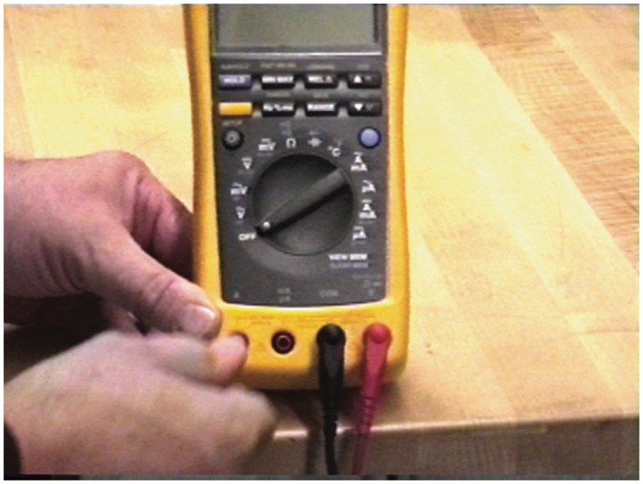
DIGITAL METER USAGE 1

Slide 33
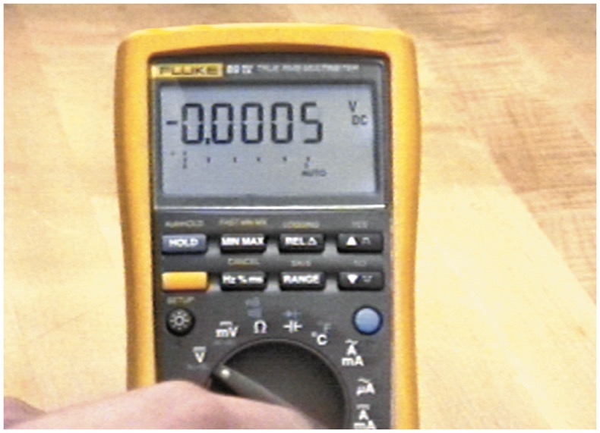
DIGITAL METER USAGE 2

Slide 34
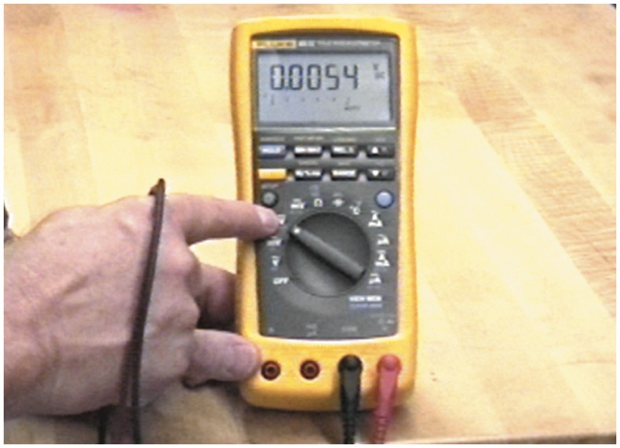
DIGITAL METER USAGE 3

Slide 35
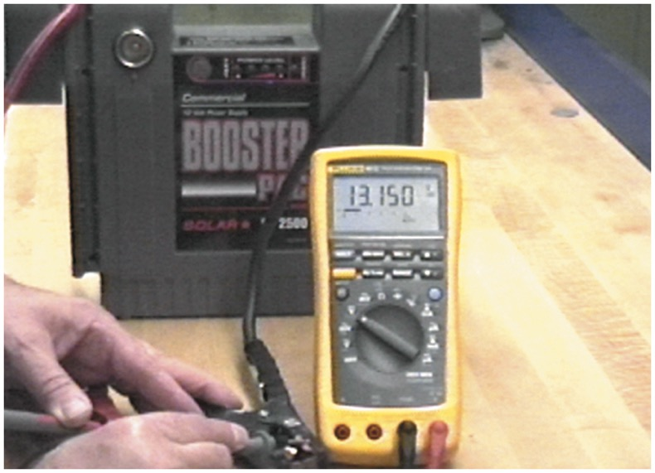
DIGITAL METER USAGE 4

Slide 36
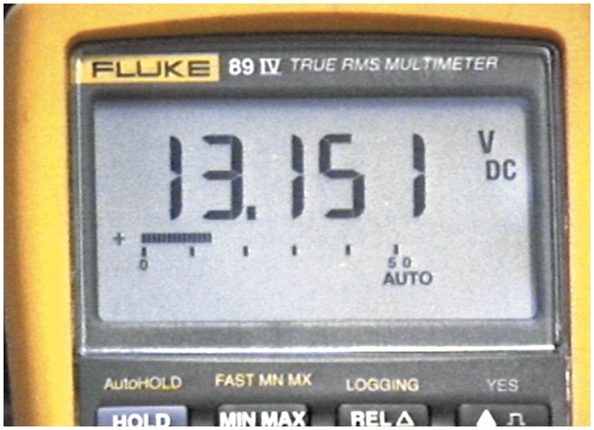
DIGITAL METER USAGE 5

Slide 37
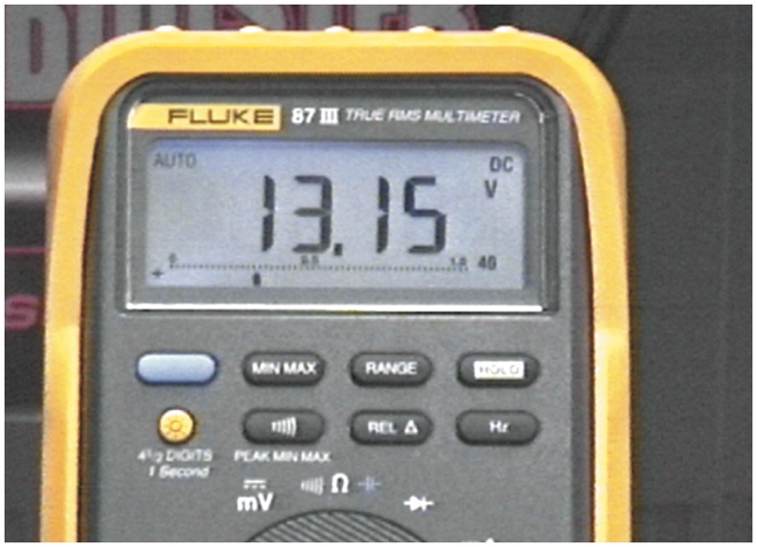
DIGITAL METER USAGE 6

Slide 38
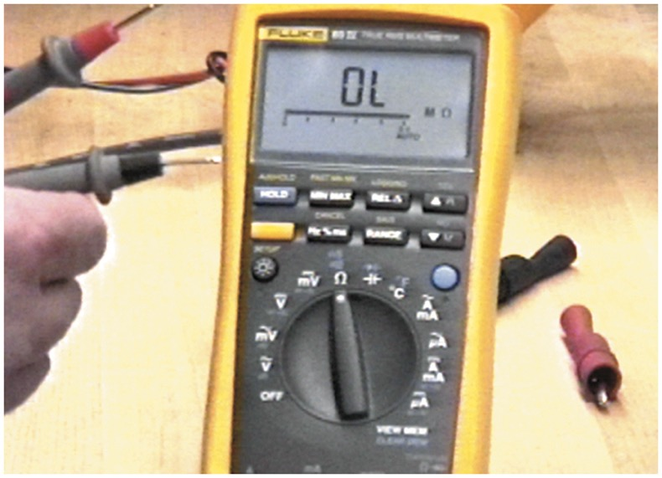
DIGITAL METER USAGE 7

Slide 39
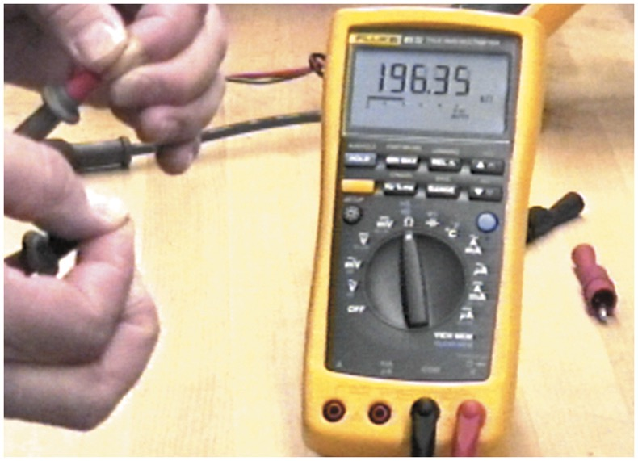
DIGITAL METER USAGE 8

Slide 40
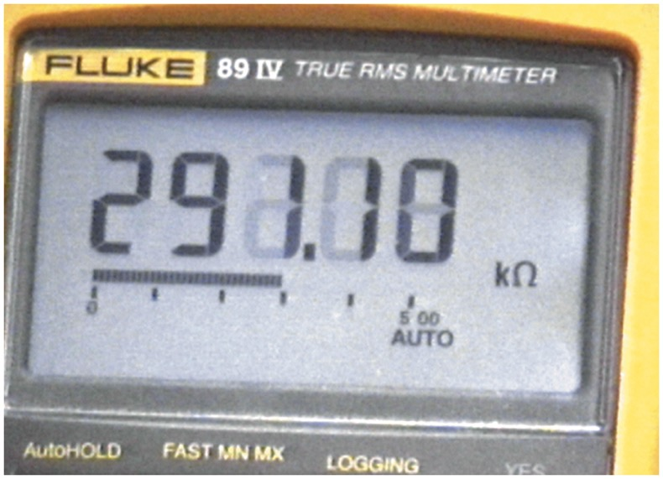
DIGITAL METER USAGE 9

Slide 41
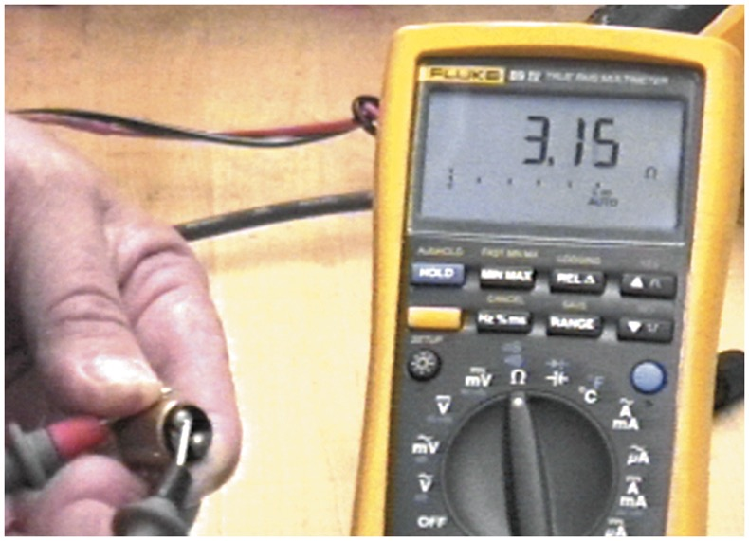
DIGITAL METER USAGE 10

Slide 42
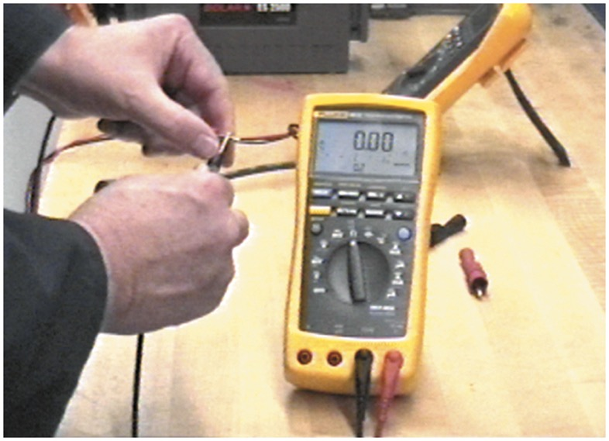
DIGITAL METER USAGE 11

Slide 43
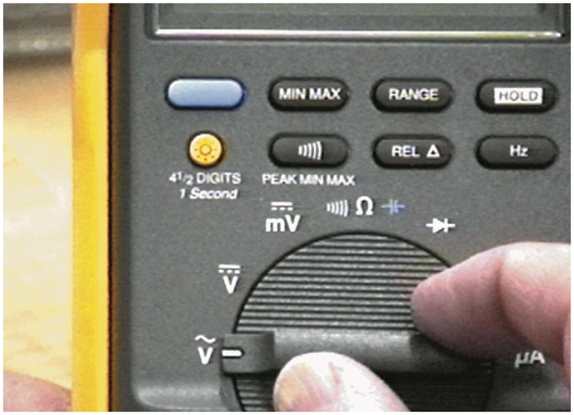
DIGITAL METER USAGE 12

Slide 44
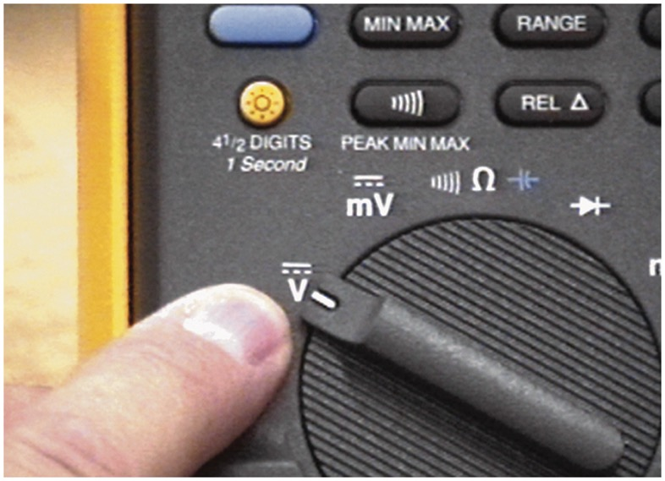
DIGITAL METER USAGE 13

Slide 45
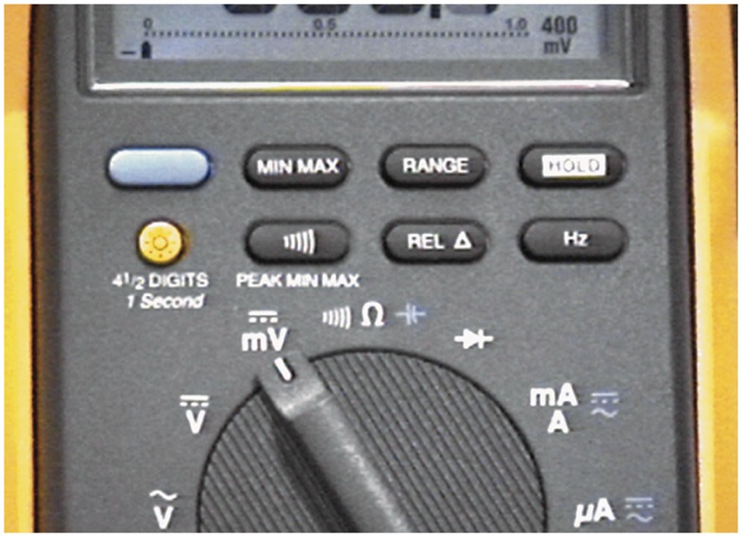
DIGITAL METER USAGE 14

Slide 46
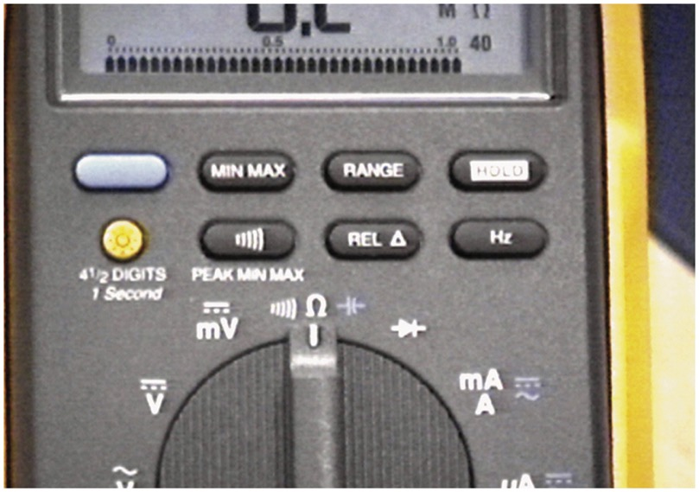
DIGITAL METER USAGE 15

Slide 47
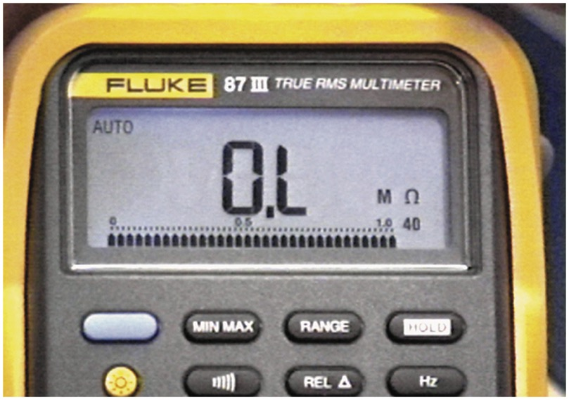
DIGITAL METER USAGE 16

Slide 48
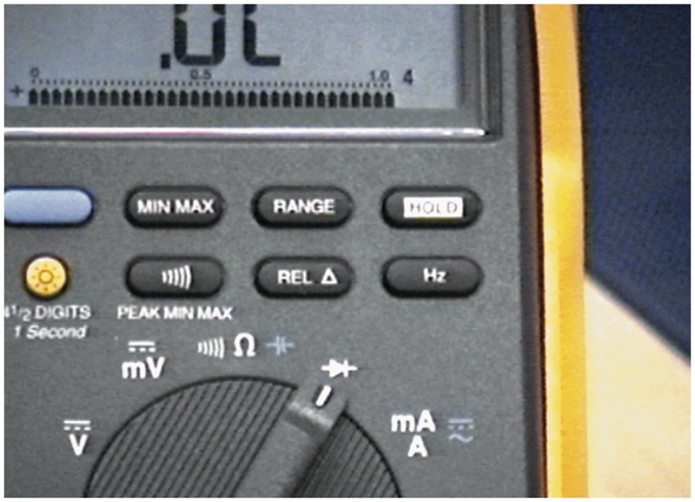
DIGITAL METER USAGE 17

Slide 49
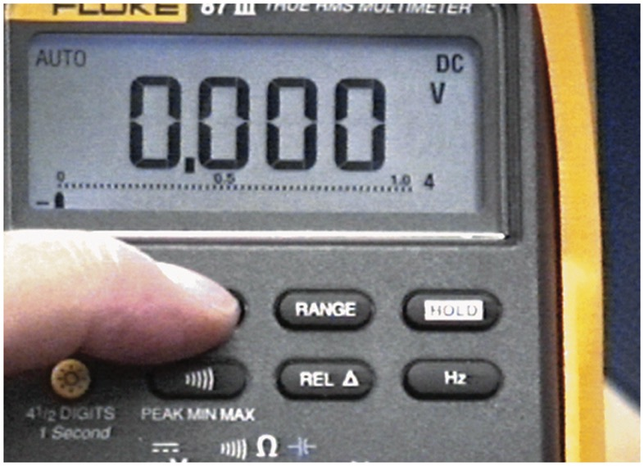
DIGITAL METER USAGE 18

Slide 50
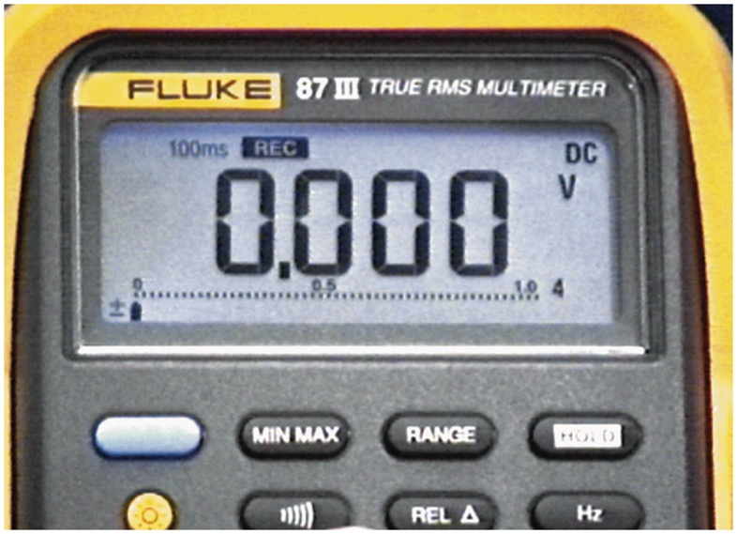
DIGITAL METER USAGE 19

Slide 51
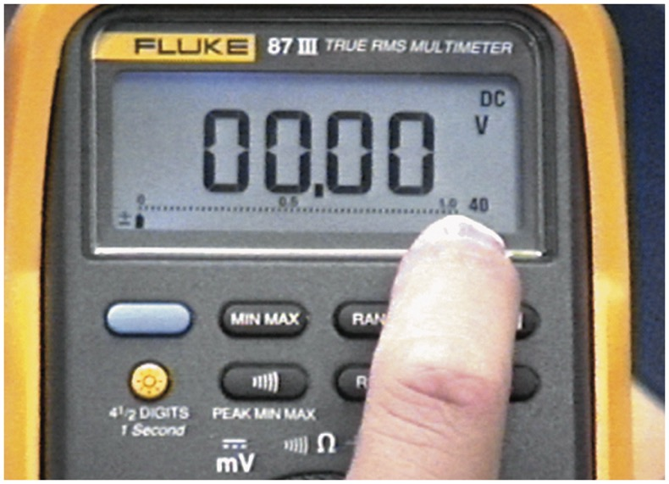
DIGITAL METER USAGE 20

Slide 52
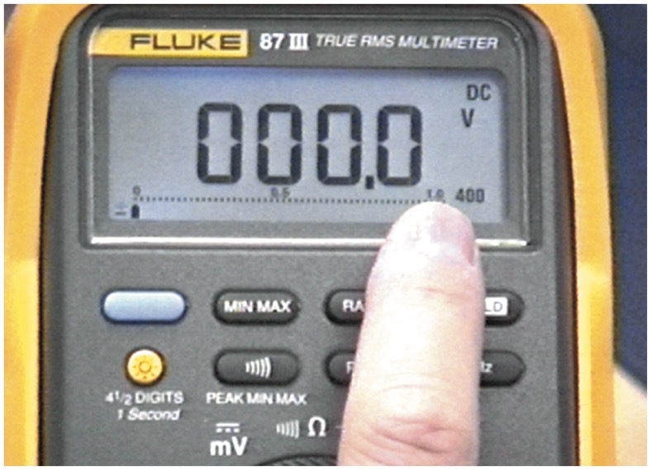
DIGITAL METER USAGE 21

Slide 53
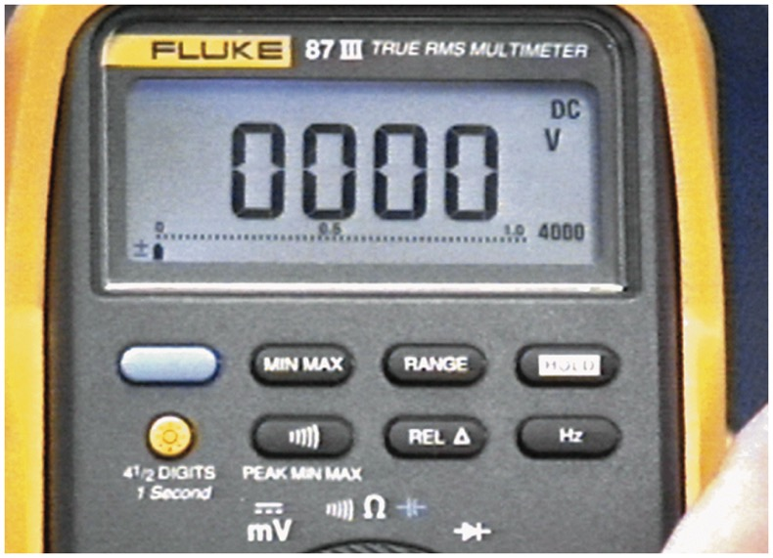
DIGITAL METER USAGE 22

Slide 54
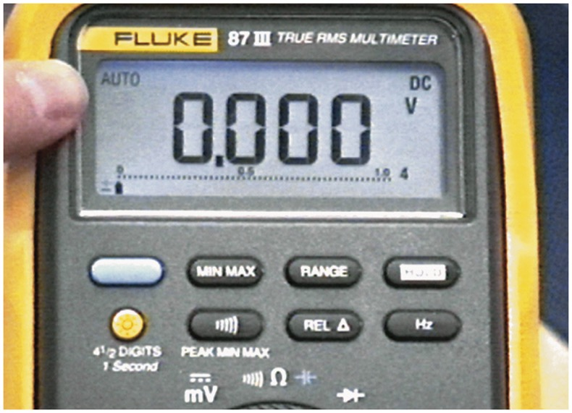
DIGITAL METER USAGE 23

Slide 55
Video Links (Internet Access Required)
Electrical shorts (time 2:44)
Electrical diagnosis (time 3:37)
How to use a DMM (time 9:27)
Fuse testing (time 3:01)
Resistance test with a DMM (time 6:26)
Fused jumper wire (time 16:21)
Inductive ammeter (time 1:30)

Slide 56
Copyright

