Slide 1
Advanced Engine Performance Diagnosis
Seventh Edition
Chapter 28
Module Reprogramming
Copyright © 2020 Pearson Education, Inc. All Rights Reserved

Slide 2
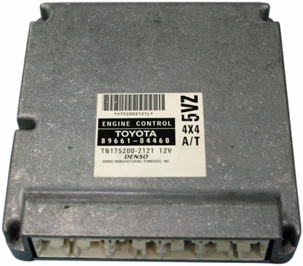
Figure 28.1 The Toyota engine control module pictured in the figure is an example of a module that must be replaced to update the programming memory

Slide 3
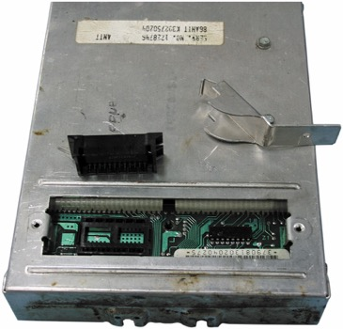
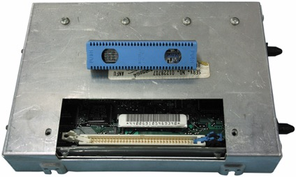
Figure 28.2A A N D B The two General Motors engine control modules above are examples of two styles of removable P R O Ms used to update programmable memory

Slide 4
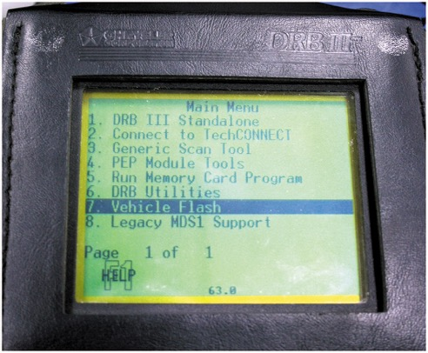
Figure 28.3 The manufacturer scan tool is being used to reprogram the engine control module via the data link connector

Slide 5
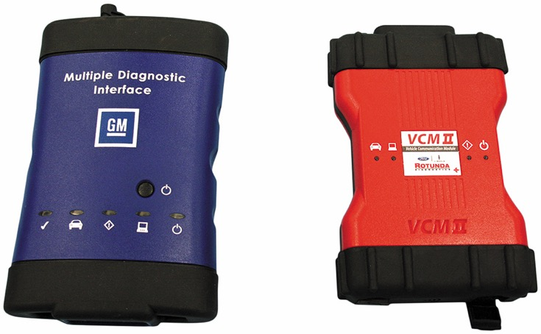
Figure 28.4 The G M M D I and Ford V C I are examples of manufacturer specific pass-through devices

Slide 6
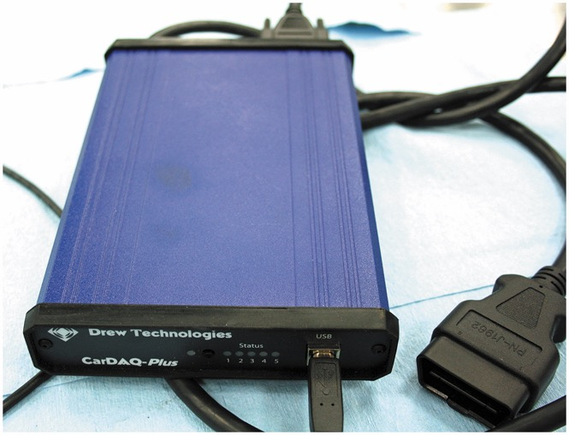
Figure 28.5 The CarDAQ Plus is a generic pass-through device

Slide 7
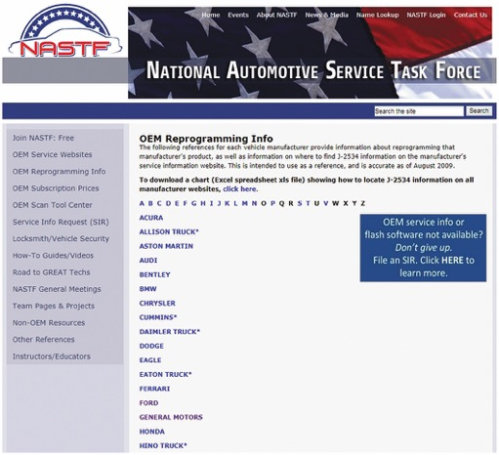
Figure 28.6 The screenshot of the N A S T F website provides an access point for the aftermarket automotive professional to obtain the needed reprogramming information

Slide 8
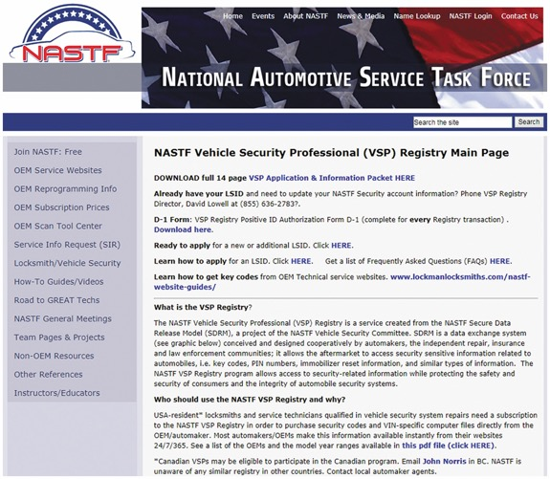
Figure 28.7 The screenshot from the N A S T F website provides the resources for the technician to apply for a locksmith I D

Slide 9
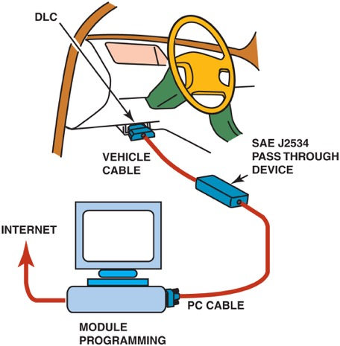
Figure 28.8 The J2534 device is being used to program the engine control module through the D L C

Slide 10
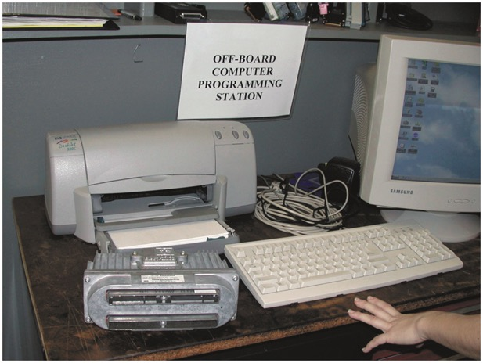
Figure 28.9 The engine control module is being programmed at an off-board location

Slide 11
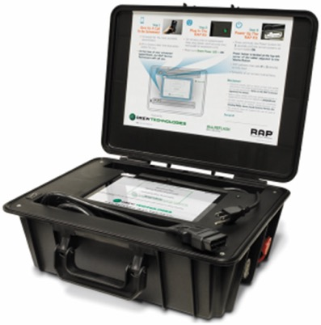
Figure 28.10 The Drew Technologies remote programming tool is an example of a tool that is connected to the vehicle and used remotely

Slide 12
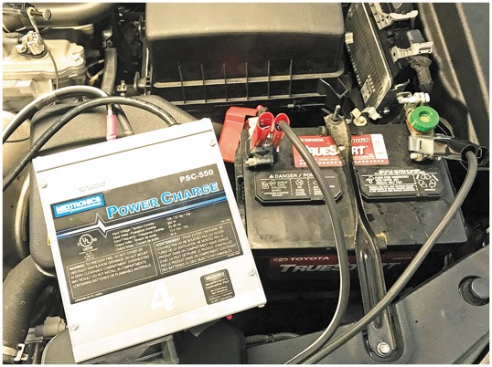
Figure 28.11 The Midtronics P S C -550 is an example of battery maintainer that meets the voltage and current requirements for reprogramming

Slide 13
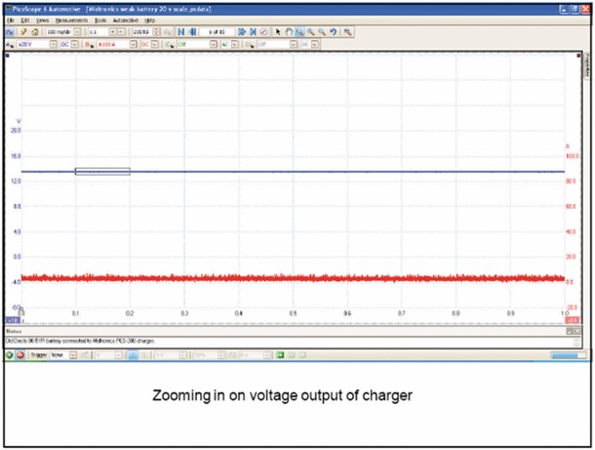
Figure 28.12 The scope patterns show stable voltage and current traces

Slide 14
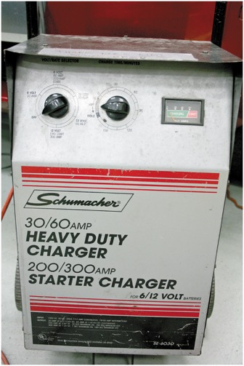
Figure 28.13 The Schumacher battery charger is an example of a device that does not meet the voltage and current requirements of a reprogramming event

Slide 15
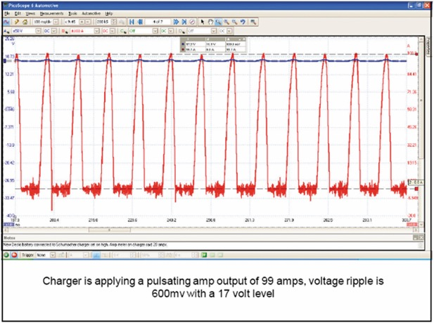
Figure 28.14 The scope trace shows unstable voltage and fluctuating current

Slide 16
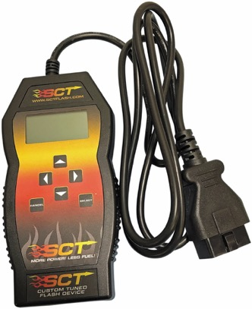
Figure 28.15 The S C T aftermarket tuner is an example of device that takes the vehicle out of compliance when reprogramming the module

Slide 17
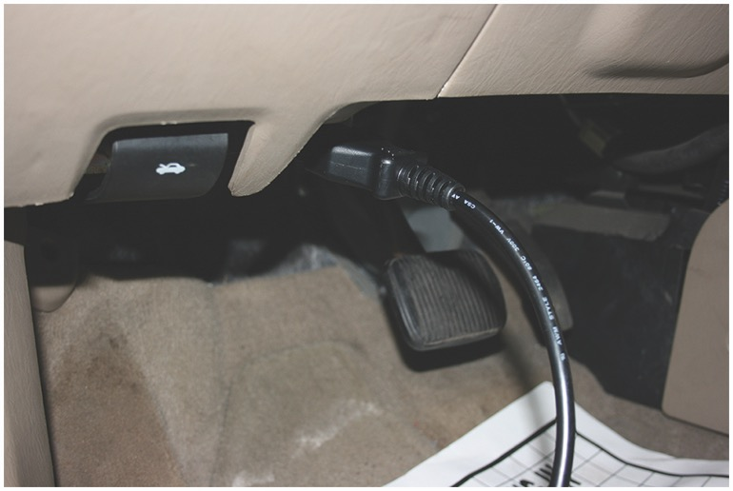
PHOTO SEQUENCE 28 - MODULE REPROGRAMMING 1

Slide 18
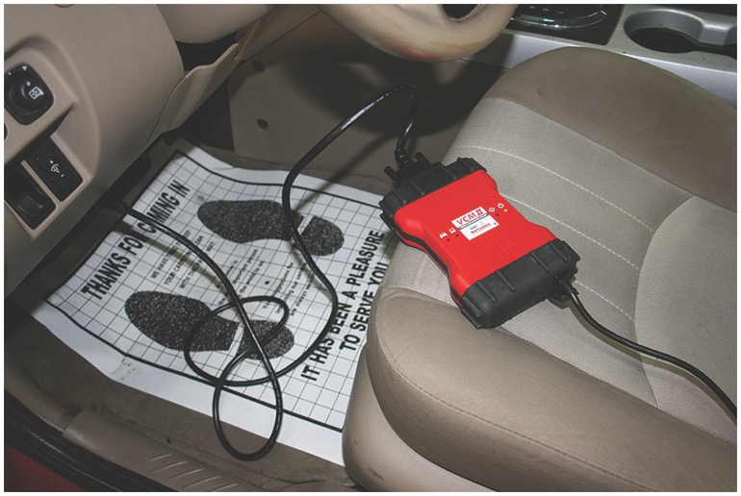
PHOTO SEQUENCE 28 – MODULE REPROGRAMMING 2

Slide 19
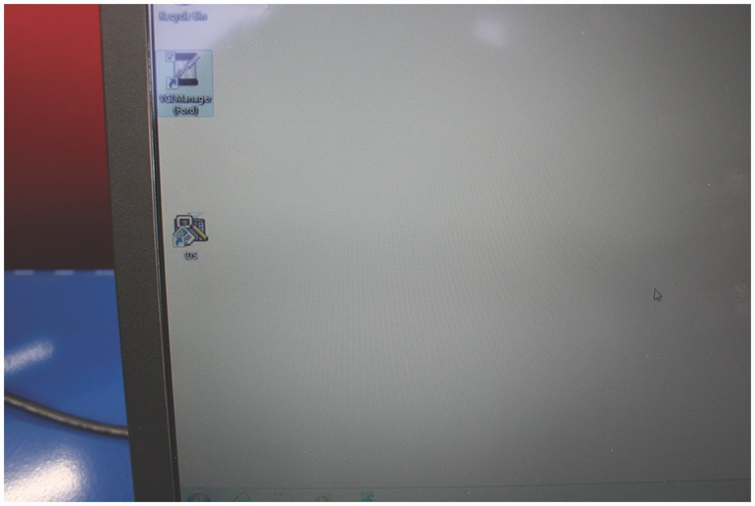
PHOTO SEQUENCE 28 – MODULE REPROGRAMMING 3

Slide 20
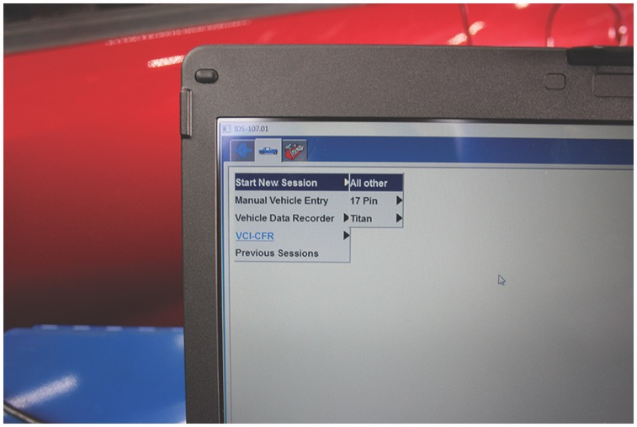
PHOTO SEQUENCE 28 – MODULE REPROGRAMMING 4

Slide 21
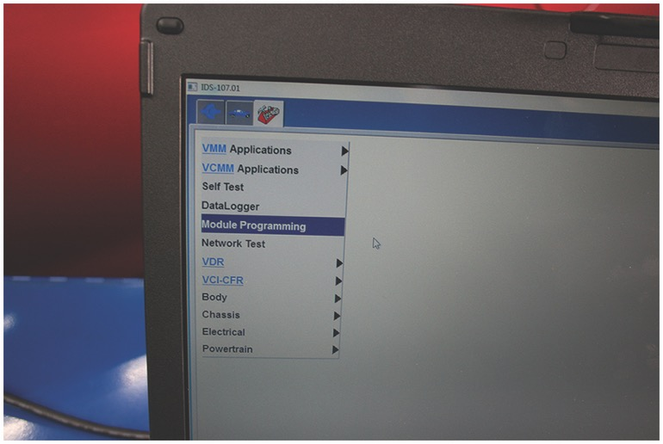
PHOTO SEQUENCE 28 – MODULE REPROGRAMMING 5

Slide 22
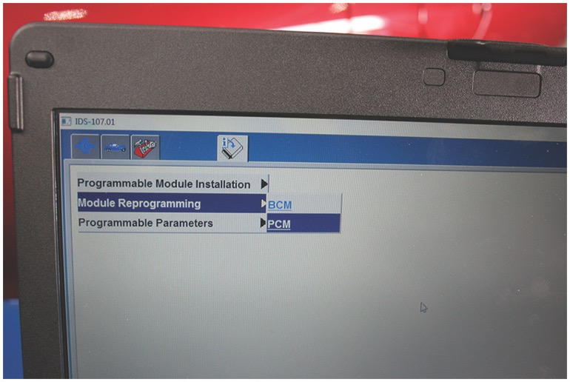
PHOTO SEQUENCE 28 – MODULE REPROGRAMMING 6

Slide 23
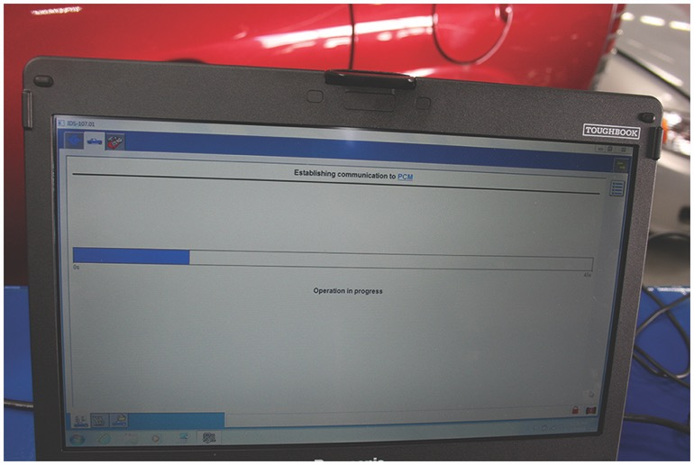
PHOTO SEQUENCE 28 – MODULE REPROGRAMMING 7

Slide 24
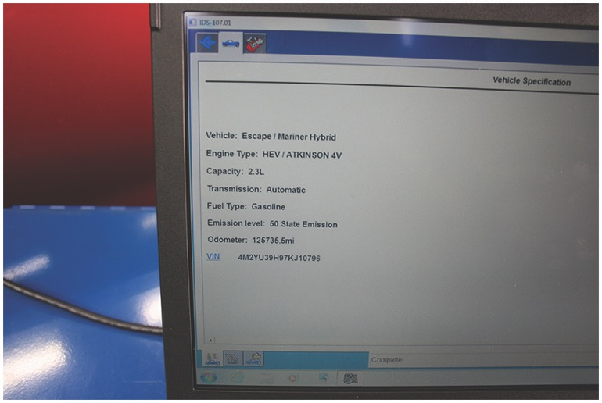
PHOTO SEQUENCE 28 – MODULE REPROGRAMMING 8

Slide 25
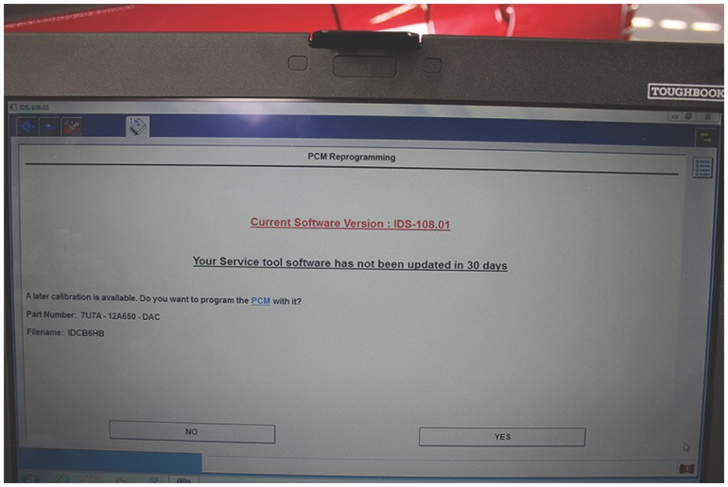
PHOTO SEQUENCE 28 – MODULE REPROGRAMMING 9

Slide 26
Video Links (Internet Access Required)
’09 Chevy Truck ECM Reprogram (time 7:38)
How to Reprogram a Ford PCM (time 5:37)
GM Service Repair Programming | AC DelcoTechConnect (time 5:11)
How to Program and Reprogram OBD 2 Modules (Example Code P0326 Knock Sensor) (time 5:50)
Ford Vehicles: ABS Module Programming Procedure (time 7:33)
What is POWERTRAIN CONTROL MODULE? What does POWERTRAIN CONTROL MODULE mean? (time 2:05)
ECM Reprogram (2004 VW Passat) (time 13:46)
Reprogram GM PCM using a Tech 2 scan tool (time 15:03)

Slide 27
Copyright

