Slide 1
Advanced Engine Performance Diagnosis
Seventh Edition
Chapter 27
Emission Control Devices Operation and Diagnosis
Copyright © 2020 Pearson Education, Inc. All Rights Reserved

Slide 2
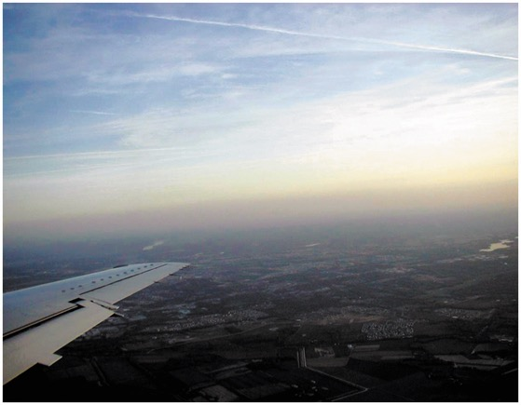
Figure 27.1 Notice the red-brown haze which is often over many major cities. This haze is the result of oxides or nitrogen in the atmosphere

Slide 3
Animation: Ozone Layer & CFCs ((Animation will automatically start in a few seconds)he animation will automatically start in a few seconds)

Slide 4
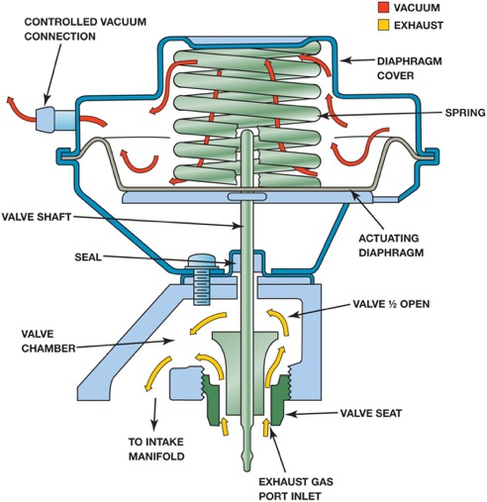
Figure 27.2 When the E G R valve opens, the exhaust gases flow through the valve and into passages in the intake manifold

Slide 5
Animation: Exhaust Gas Recirculation, EGR ((Animation will automatically start in a few seconds)he animation will automatically start in a few seconds)

Slide 6
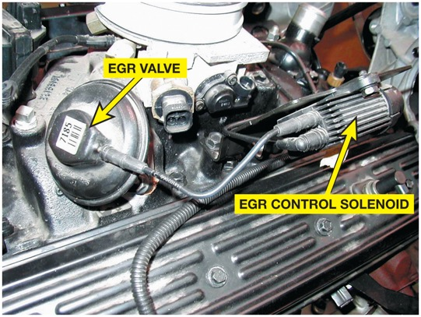
Figure 27.3 A vacuum-operated E G R valve. The vacuum to the E G R valve is computer controlled by the E G R valve control solenoid

Slide 7
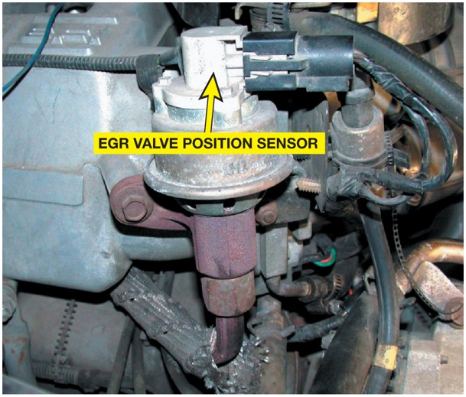
Figure 27.4 An E G R valve position sensor on top of an E G R valve

Slide 8
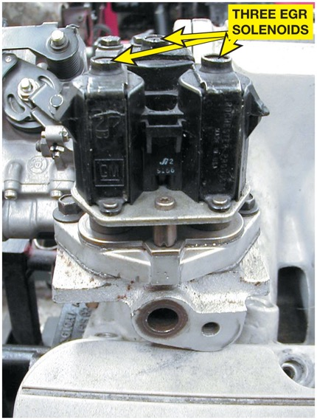
Figure 27.5 Digital E G R valve

Slide 9
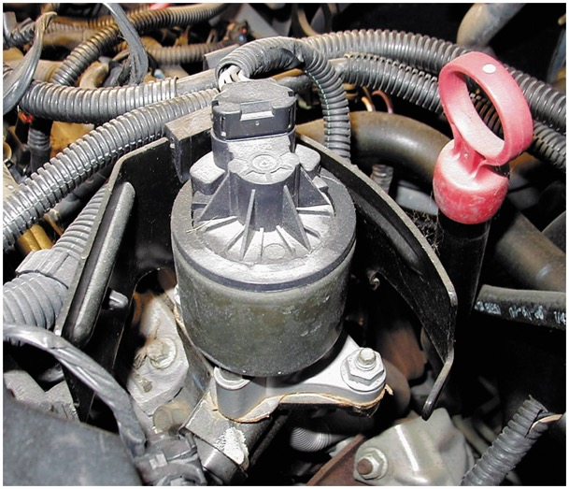
Figure 27.6 A General Motors linear E G R valve

Slide 10
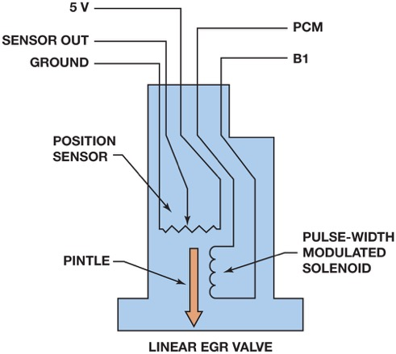
Figure 27.7 The E G R valve pintle is pulse-width modulated and a three-wire potentiometer provides pintle-position information back to the P C M

Slide 11
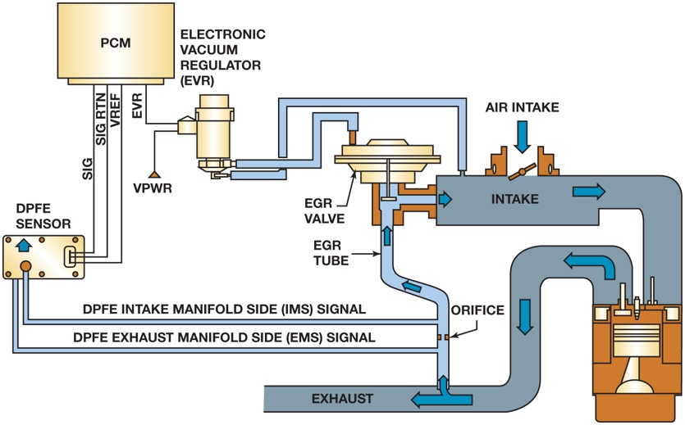
Figure 27.8 A D P F E sensor and related components

Slide 12
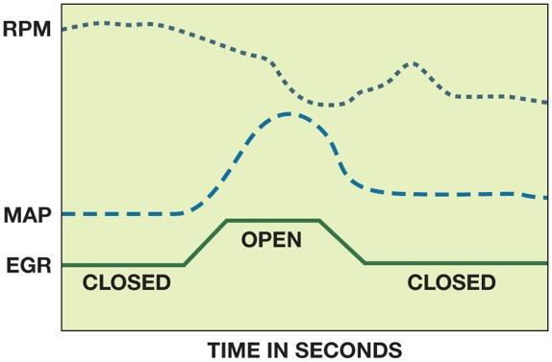
Figure 27.9 An O B D-I I active test. The P C M opens the E G R valve and then monitors the M A P sensor and/or engine speed (R P M) to verify that it meets acceptable values

Slide 13
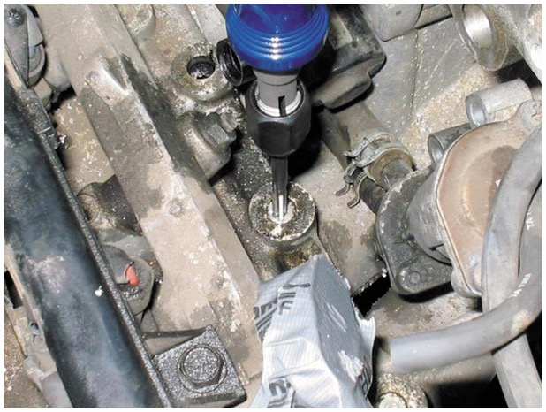
Figure 27.10 Removing the E G R passage plugs from the intake manifold on a Honda

Slide 14
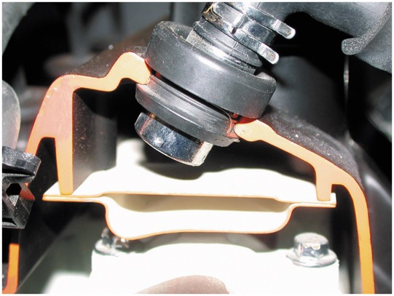
Figure 27.11 A P C V valve in a cutaway valve cover, showing the baffles that prevent liquid oil from being drawn into the intake manifold

Slide 15
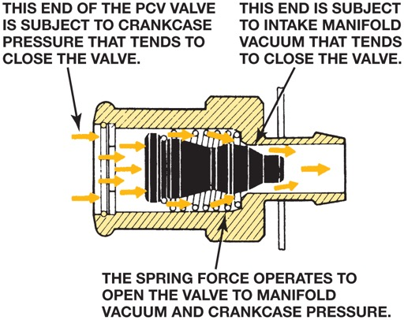
Figure 27.12 Spring force, crankcase pressure, and intake manifold vacuum work together to regulate the flow rate through the P C V valve

Slide 16
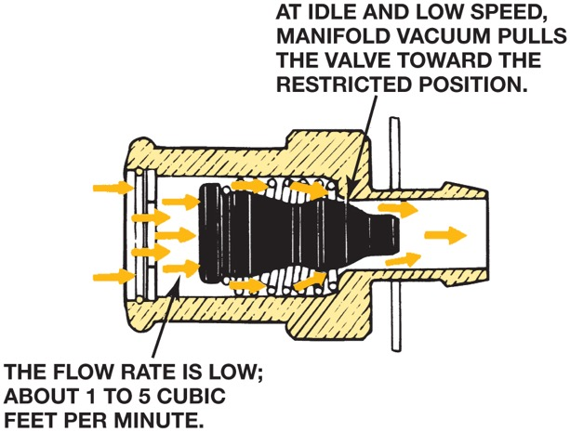
Figure 27.13 Air flows through the P C V valve during idle, cruising, and light-load conditions

Slide 17
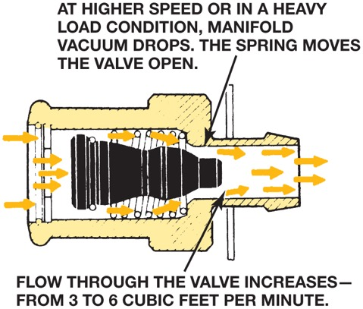
Figure 27.14 Air flows through the P C V valve during acceleration and when the engine is under a heavy load

Slide 18
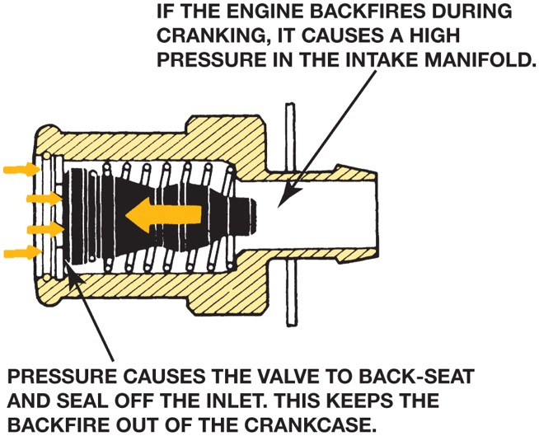
Figure 27.15 P C V valve operation in the event of a backfire

Slide 19
Animation: Positive Crankcase Ventilation (PCV) ((Animation will automatically start in a few seconds)he animation will automatically start in a few seconds)

Slide 20
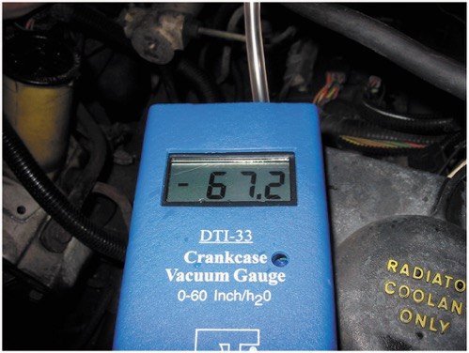
Figure 27.16 Using a gauge that measures vacuum in units of inches of water to test the vacuum at the dipstick tube, being sure that the P C V system is capable of drawing a vacuum on the crankcase. Note that 28 inches of water equals 1 P S I, or about 2 inches of mercury (inch Hg) of vacuum

Slide 21
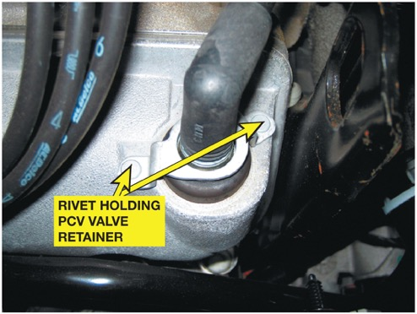
Figure 27.17 Most P C V valves used on newer vehicles are secured with fasteners, which makes it more difficult to disconnect, and therefore, less likely to increase emissions

Slide 22
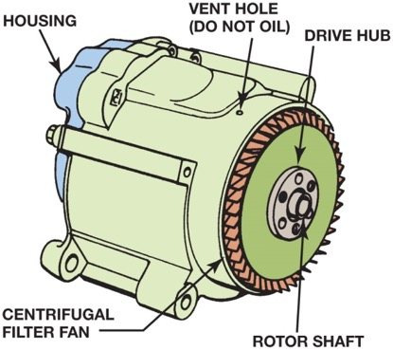
Figure 27.18 A typical belt-driven A I R pump. Air enters through the revolving fins behind the drive pulley. The fins act as an air filter because dirt is heavier than air, and therefore, the dirt is deflected off of the fins at the same time air is being drawn into the pump

Slide 23
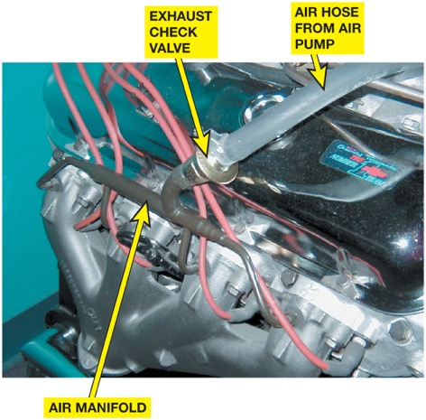
Figure 27.19 The external air manifold and exhaust check valve on a restored muscle car engine

Slide 24
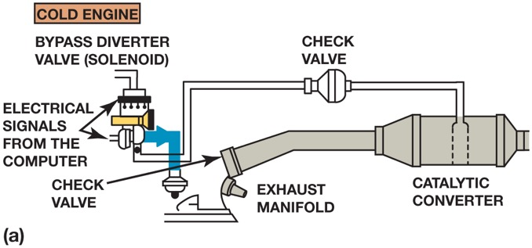
Figure 27.20 (a) When the engine is cold and before the oxygen sensor is hot enough to achieve closed loop, the airflow from the air pump is directed to the exhaust manifold(s) through the one-way check valves which keep the exhaust gases from entering the switching solenoids and the pump itself

Slide 25
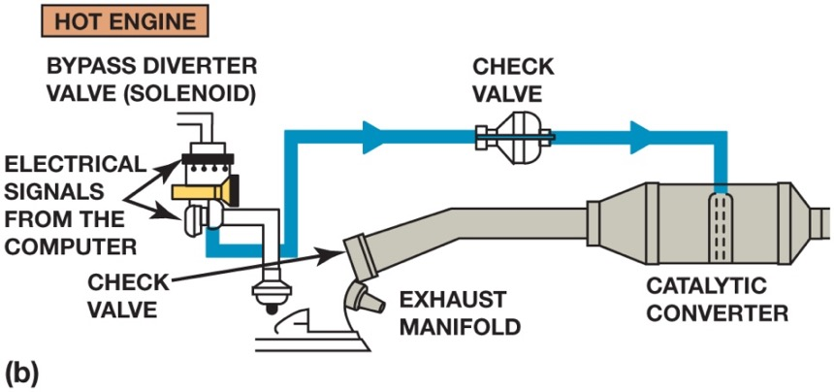
Figure 27.20 (b) When the engine achieves closed loop, the air is directed to the catalytic converter

Slide 26
Animation: Secondary Air-Injection ((Animation will automatically start in a few seconds)he animation will automatically start in a few seconds)

Slide 27
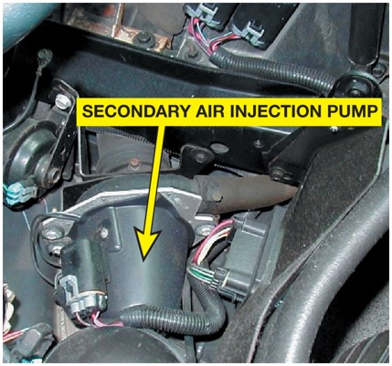
Figure 27.21 A typical electric motor-driven S A I pump. This unit is on a Chevrolet Corvette and only works when the engine is cold

Slide 28
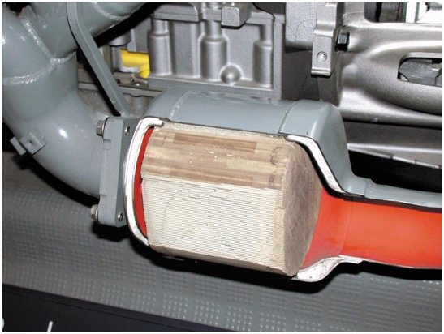
Figure 27.22 Most catalytic converters are located as close to the exhaust manifold as possible, as seen in this display of a Chevrolet Corvette

Slide 29
Animation: Catalytic Converter Operation ((Animation will automatically start in a few seconds)he animation will automatically start in a few seconds)

Slide 30
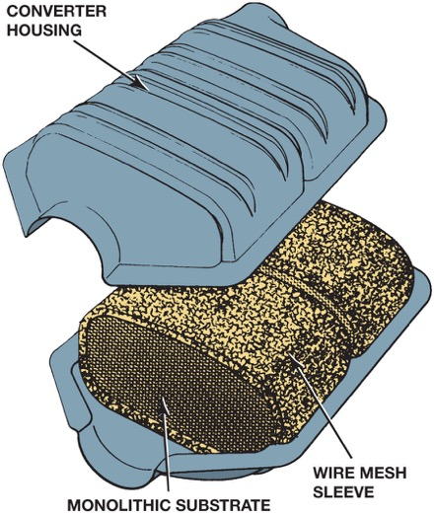
Figure 27.23 A typical catalytic converter with a monolithic substrate

Slide 31
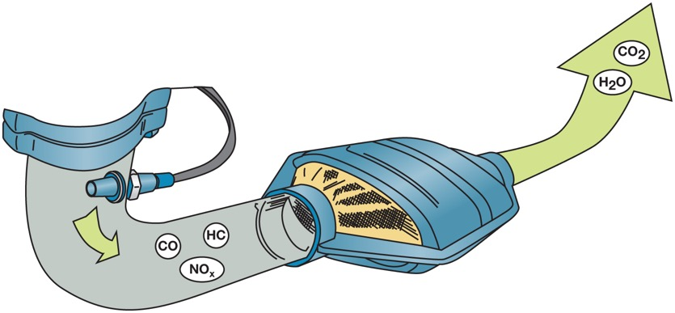
Figure 27.24 The three-way catalytic converter first separates the N O_{x} into nitrogen and oxygen and then converts the H C and C O into harmless water (H₂O) and carbon dioxide (C O₂)

Slide 32
Animation: Catalytic Converter (2004+) ((Animation will automatically start in a few seconds)he animation will automatically start in a few seconds)

Slide 33
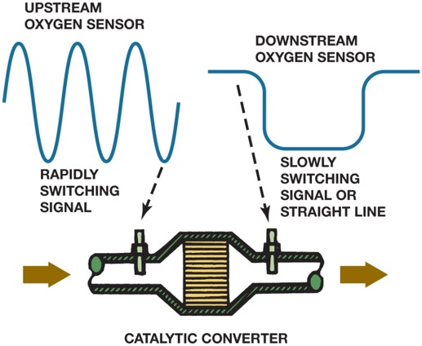
Figure 27.25 The O B D-I I catalytic converter monitor compares the signals of the upstream and downstream H O2S to determine converter efficiency

Slide 34
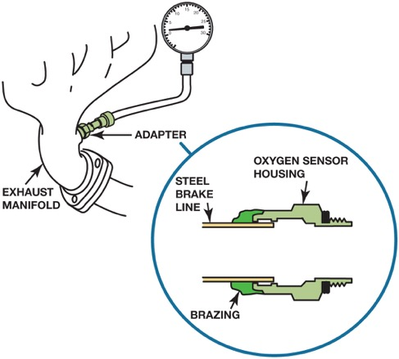
Figure 27.26 A back pressure tool can be made by using an oxygen sensor housing and epoxy or braze to hold the tube to the housing

Slide 35
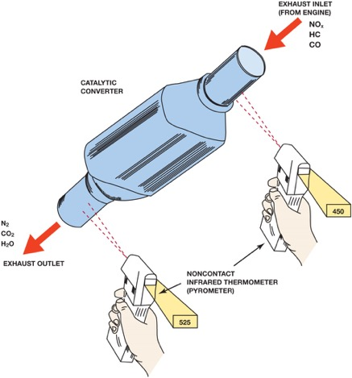
Figure 27.27 The temperature of the outlet should be at least 10% hotter than the temperature of the inlet. If a converter is not working, the inlet temperature will be hotter than the outlet temperature

Slide 36
Figure 27.28 Whenever replacing a catalytic converter with a universal unit, first measure the distance between the rear brick and the center of the rear oxygen sensor. Be sure that the replacement unit is installed to the same dimension

Slide 37
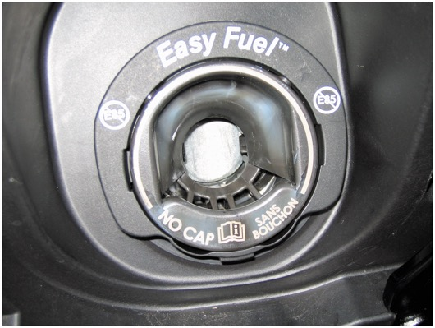
Figure 27.29 A capless system from a Ford does not use a replaceable cap; instead, it has a spring-loaded closure

Slide 38
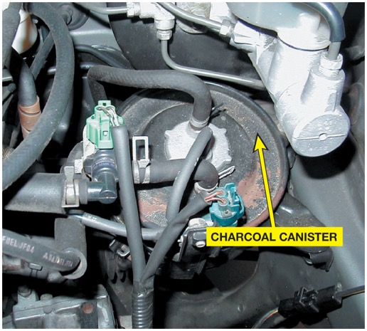
Figure 27.30 A charcoal canister can be located under the hood or underneath the vehicle

Slide 39
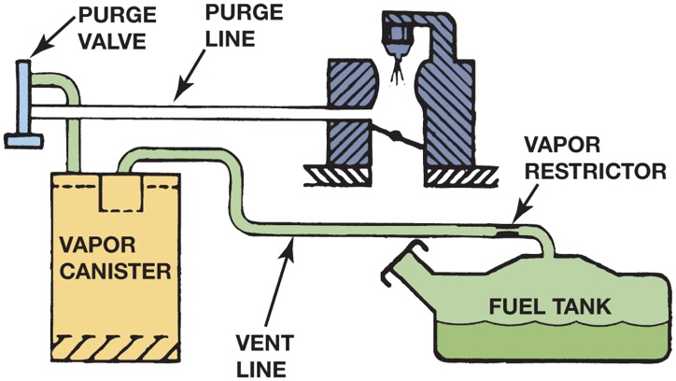
Figure 27.31 The evaporative emission control system includes all of the lines, hoses, and valves, plus the charcoal canister

Slide 40
Animation: Evaporative Emission Control System ((Animation will automatically start in a few seconds)he animation will automatically start in a few seconds)

Slide 41
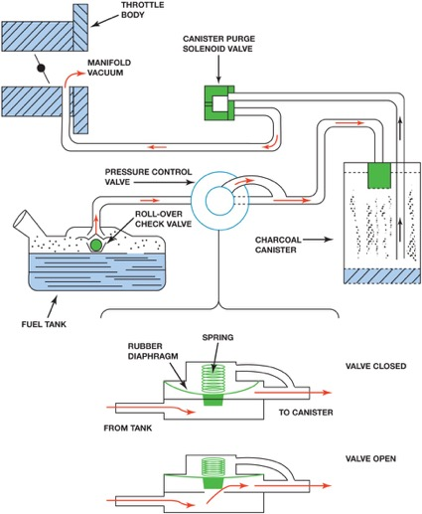
Figure 27.32 A typical evaporative emission control system. Note that when the computer turns on the canister purge solenoid valve, manifold vacuum draws any stored vapors from the canister into the engine. Manifold vacuum also is applied to the pressure control valve. When this valve opens, fumes from the fuel tank are drawn into the charcoal canister and eventually into the engine. When the solenoid valve is turned off (or the engine stops and there is no manifold vacuum), the pressure control valve is spring-loaded shut to keep vapors inside the fuel tank from escaping to the atmosphere

Slide 42
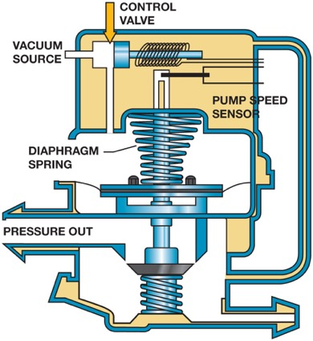
Figure 27.33 A leak detection pump (L D P) used on some Chrysler vehicles to pressurize (slightly) the fuel system to check for leaks

Slide 43
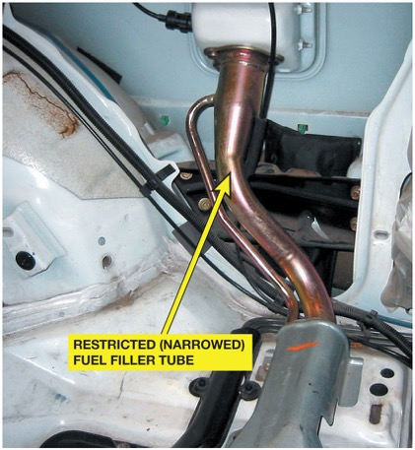
Figure 27.34 A restricted fuel fill pipe shown on a vehicle with the interior removed

Slide 44
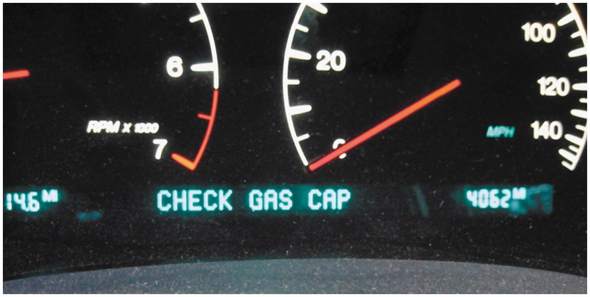
Figure 27.35 Some vehicles will display a message if an evaporative control system leak is detected that could be the result of a loose gas cap

Slide 45
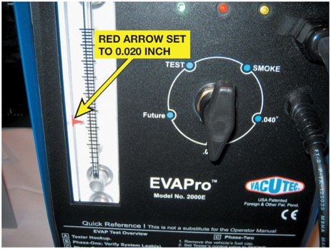
Figure 27.36 To test for a leak, this tester was set to the 0.020 inch hole and turned on. The ball rose in the scale on the left and the red arrow was moved to that location. When testing the system for leaks, if the ball rises higher than the arrow, the leak is larger than 0.020 inch. If the ball does not rise to the level of the arrow, the leak is smaller than 0.020 inch

Slide 46
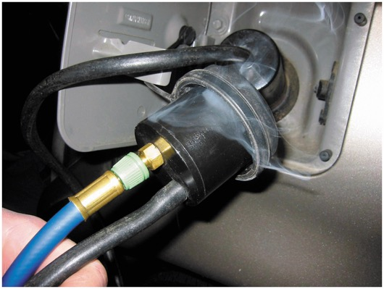
Figure 27.37 This unit is applying smoke to the fuel tank through an adapter and the leak was easily found to be the gas cap seal

Slide 47
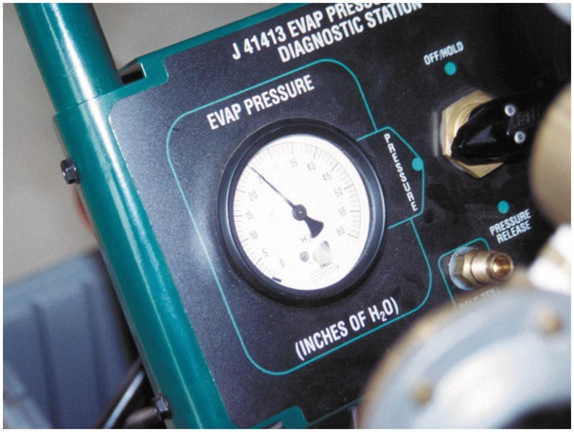
Figure 27.38 An emission tester that uses nitrogen to pressurize the fuel system

Slide 48
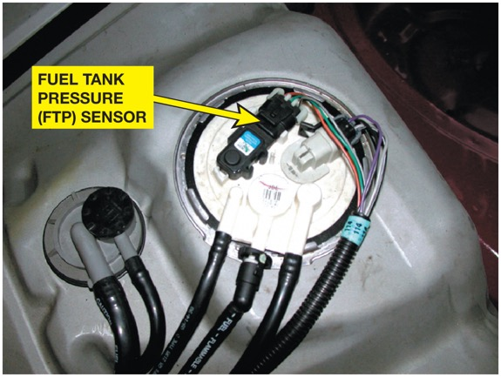
Figure 27.39 The fuel tank pressure sensor (black unit with three wires) looks like a M A P sensor and is usually located on top of the fuel pump module (white unit)

Slide 49
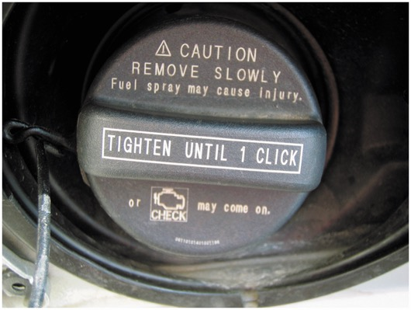
Figure 27.40 This Toyota cap has a warning. The check engine light will come on if not tightened until one click

Slide 50
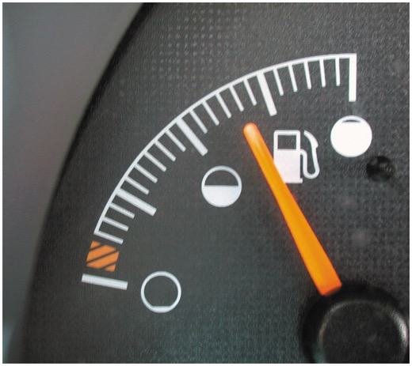
Figure 27.41 The fuel level must be between 15% and 85% before the E V A P monitor will run on most vehicles

Slide 51
Video Links (Internet Access Required)
EGR (time 17:12)
EGR temperature sensor (time 0:50)
Vent solenoid (time 2:53)
Scanning EGR (time 2:18)
Scanning catalytic converters (time 1:50)
EGR position sensor (time 1:43)
EGR pintle position sensor (time 1:57)
Ford DPFE sensor (time 4:31)
LDP EVAP system (time 5:43)
Fuel vapor control valve (time 0:46)

Slide 52
Video Links (Internet Access Required)
EGR Valve (time 0:45)
EGR solenoid (time 0:45)
VSV diagnostics (time 4:44)
EGR diagnostics (time 4:30)
Bad catalytic converter (time 0:50)
Evap diagnostics (time 12:53)
EGR port cleaning (time 5:13)
EGR system (time 2:08)
Catalytic converters (time 3:04)
Understanding catalytic converters (time 4:39)

Slide 53
Video Links (Internet Access Required)
EVAP (time 6:06)
EVAP part 2 (time 9:34)
Purge control solenoid (time 1:28)
Charcoal canister (time 1:11)
Secondary air injection (time 4:23)
PCV valve (time 1:45)
VW EVAP system (time 32:15)
PCV valve (time 2:37)
P1494 leak detection pump (time 2:45)
P0442 (time 6:11)

Slide 54
Video Links (Internet Access Required)
GM EVAP vent solenoid testing (time 33:00)
Secondary Air Injection system (time 1:11)
PCV Oil Leak (time 1:04)
Testing Electric Air Pump (time 18:44)
EGR temp sensor (time 0:50)
Fuel tank pressure sensor (time 3:32)
Fuel tank pressure sensor circuit (time 1:16)
Vapor canister (time 0:46)
Vacuum leak (time 12:09)
EVAP leak test (time 7:59)
Replacing A Bad Catalytic Converter Yourself (time 3:14)

Slide 55
Copyright

