Slide 1
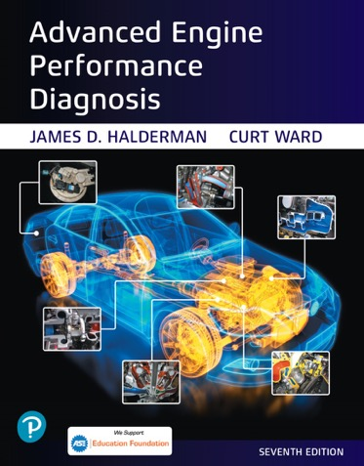
Advanced Engine Performance Diagnosis
Seventh Edition
Chapter 25
Electronic Transmission Controls
Copyright © 2020 Pearson Education, Inc. All Rights Reserved

Slide 2
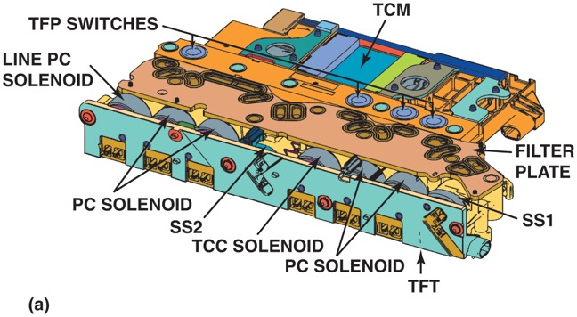
Figure 25.1 (a) This control solenoid assembly contains four transmission fluid pressure (T F P) switches, a line pressure control (P C) solenoid, four pressure control (P C) solenoids, two shift solenoids (S S), a torque converter clutch (T C C) solenoid, a transmission fluid temperature (T F T) sensor, and the transmission control module (T C M). It also has a vehicle harness connector and connectors to the shift position switch and the input and output speed sensors

Slide 3
Animation: Electronic Controlled Shifts ((Animation will automatically start in a few seconds)he animation will automatically start in a few seconds)

Slide 4
Animation: Electronic Clutch Control ((Animation will automatically start in a few seconds)he animation will automatically start in a few seconds)

Slide 5
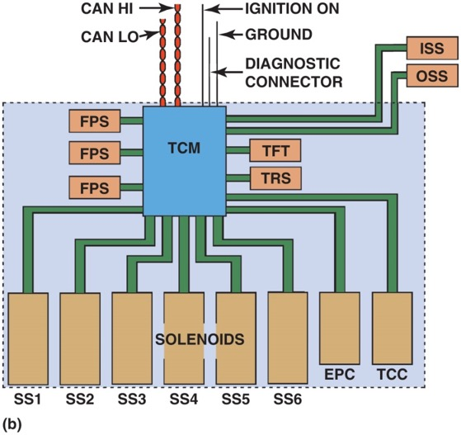
Figure 25.1 (b) A simplified view is also shown

Slide 6
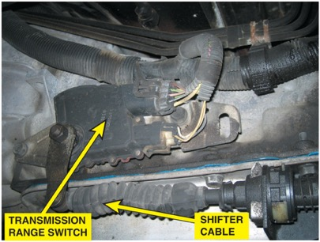
Figure 25.2 The transmission range switch is usually located on the case where the shifter cable attaches to the manual valve lever. The switch also includes the switch for the backup lights and the park/neutral switch, which is used to prevent the start being engaged unless the shifter is in park or neutral

Slide 7
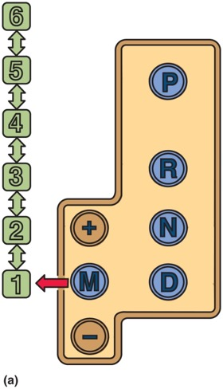
Figure 25.3 Moving the shift lever to the M (manual) position (a) activates the up/down, +/− switches that will cause an upshift or downshift

Slide 8
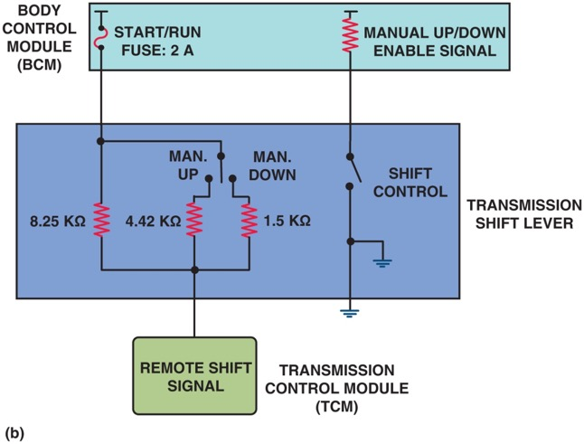
Figure 25.3 Moving the shift lever to the M (manual) position (b) The schematic of a typical circuit involving the transmission shift lever

Slide 9
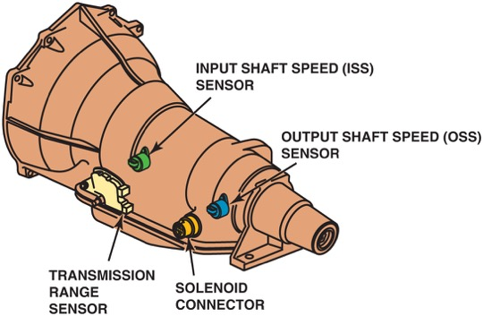
Figure 25.4 Speed sensors are used by the powertrain control module (P C M) or the transmission control module (T C M) to control shifts and detect faults such as slippage when the two speeds do not match the predetermined ratio for each gear commanded

Slide 10
Animation: Electronic Transmission Control ((Animation will automatically start in a few seconds)he animation will automatically start in a few seconds)

Slide 11
Figure 25.5 (a) The speed sensor switch will close as the magnet moves past it

Slide 12
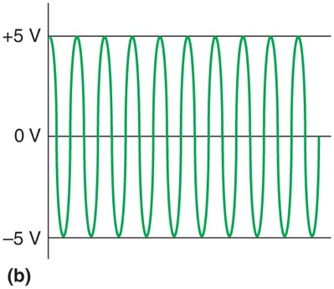
Figure 25.5 (b) It will generate a sine wave signal, which is converted inside the P C M/T C M to a digital signal. The frequency of the signal is used to measure the speed

Slide 13
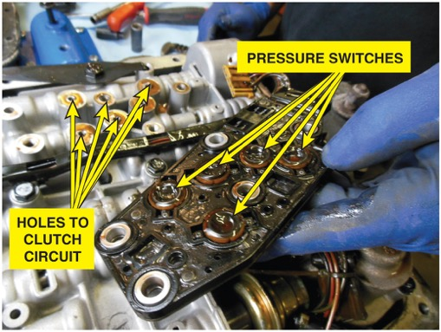
Figure 25.6 The pressure switch manifold (P S M) used in a G M 4L60-E consists of diaphragm switches with seals around each one that are bolted to the valve body over holes for each clutch circuit

Slide 14
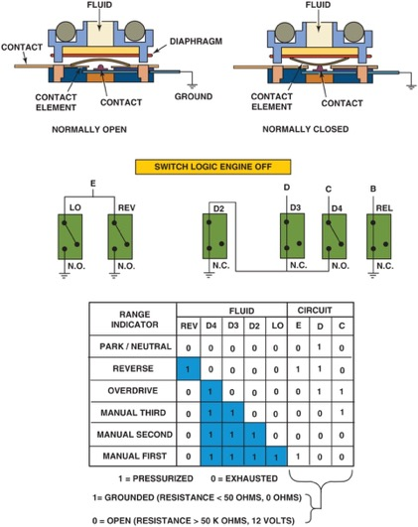
Figure 25.7 Some switches are electrically normally open (N.O.) and others are normally closed (N.C.) and are used to provide gear selection information to the P C M/T C M

Slide 15
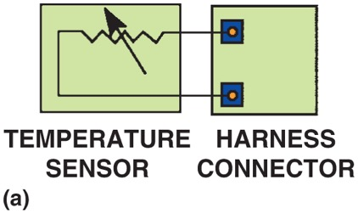
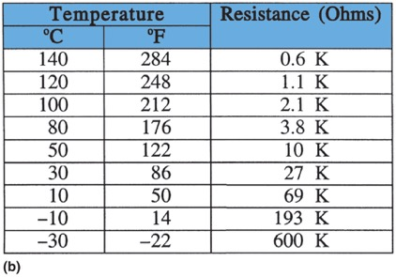
Figure 25.8 (a) A transmission fluid temperature sensor can be checked by connecting an ohmmeter to the harness connector terminals. (b) The resistance should change as the temperature changes

Slide 16
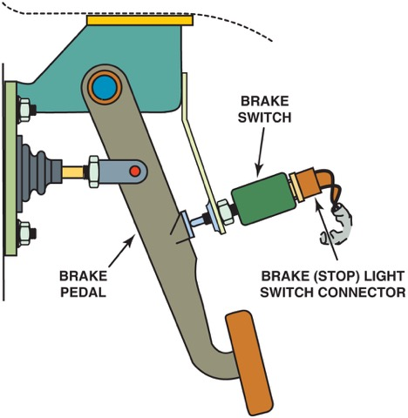
Figure 25.9 The brake (stop light) switch is mounted at the brake pedal. It provides a brake-apply signal to the T C M

Slide 17
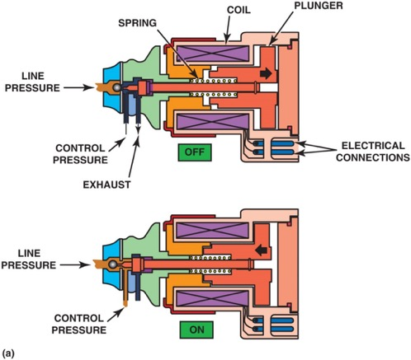
Figure 25.10 (a) The normally closed solenoid blocks fluid flow when it is off while opening the exhaust; and when it is on, it opens the valve

Slide 18
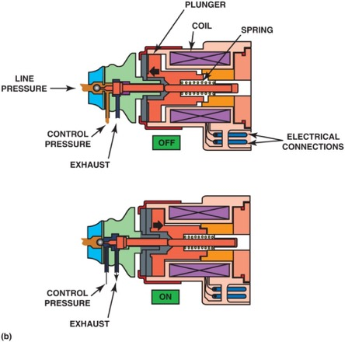
Figure 25.10 (b) The normally open solenoid allows fluid flow when it is off; and when it is on, it closes the valve while opening the exhaust

Slide 19
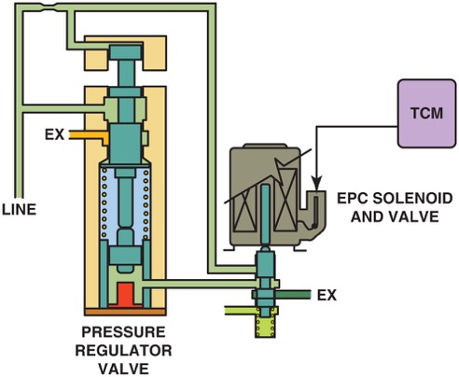
Figure 25.11 The signal from the T C M can cause the E P C solenoid to change the pressure regulator valve to adjust line pressure

Slide 20
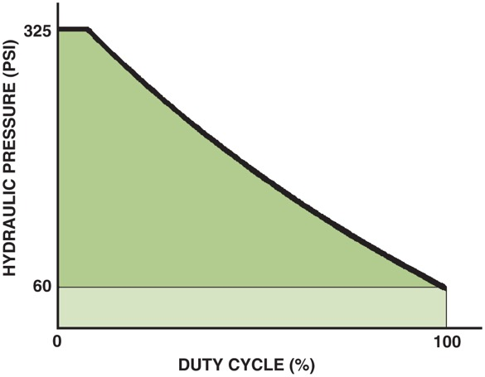
Figure 25.12 Line pressure increases as the duty cycle of the E P C solenoid decreases

Slide 21
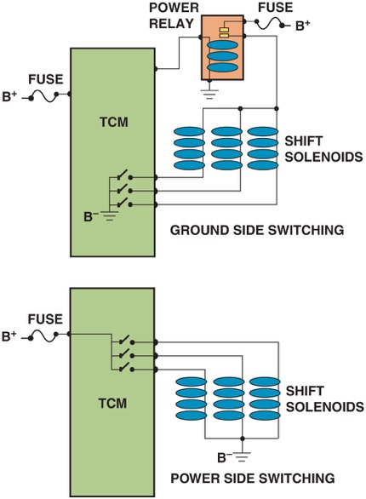
Figure 25.13 Top image shows that the T C M completes the ground side (B−) of the shift solenoids whereas the lower figure shows that the T C M completes the power side (B+) side of the shift solenoids

Slide 22
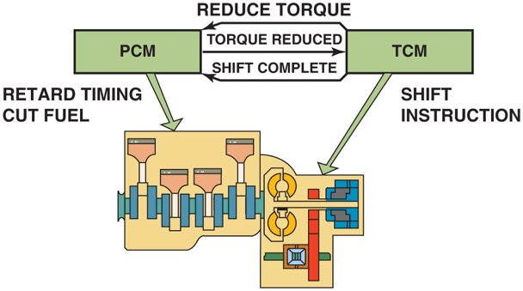
Figure 25.14 When the transmission control module (T C M) is ready to begin an upshift, it signals the powertrain control module (P C M) to reduce engine torque. This produces a smoother shift with less wear in the transmission

Slide 23
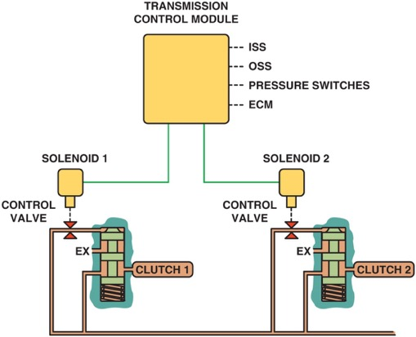
Figure 25.15 Using data from the various sensors, the T C M can apply or release the clutches. During an upshift, solenoid 1 can control how fast clutch 1 releases as solenoid 2 controls how fast clutch 2 applies to keep the shift time at the proper speed

Slide 24
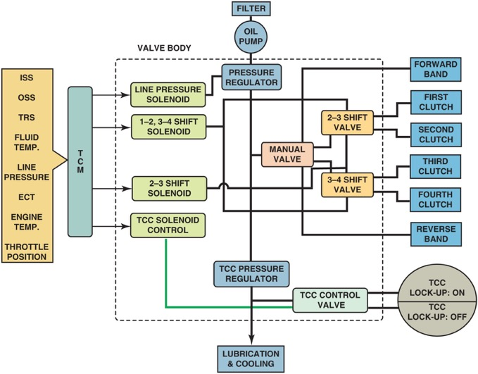
Figure 25.16 A diagram showing the relationship between the electronic and hydraulic controls

Slide 25
Animation: Electronic/Hydraulic Shift Control ((Animation will automatically start in a few seconds)he animation will automatically start in a few seconds)

Slide 26
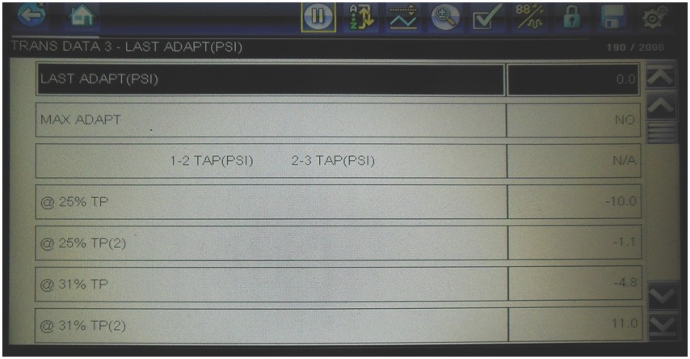
Figure 25.17 A scan tool display showing the adaptive (T A P) pressure changes at various throttle positions

Slide 27
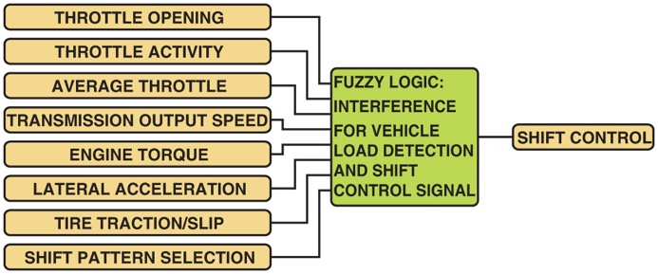
Figure 25.18 The fuzzy logic part of the T M C receives input signals, compares what the driver is doing with the throttle and what the vehicle is doing with normal operation, and adapts shift timing

Slide 28
Video Links (Internet Access Required)
Hyundai 8 speed automatic (time 3:03)
Pressure feedback switches (time 1:36)
Shift solenoid circuit diagnosis (time 1:08)
Pressure control solenoid circuit (time 1:21)
Shift solenoid (time 3:46)
Transmission range switch (time 2:47)

Slide 29
Copyright

