Slide 1
Advanced Engine Performance Diagnosis
Seventh Edition
Chapter 24
Fuel-injection System Diagnosis and Service
Copyright © 2020 Pearson Education, Inc. All Rights Reserved

Slide 2
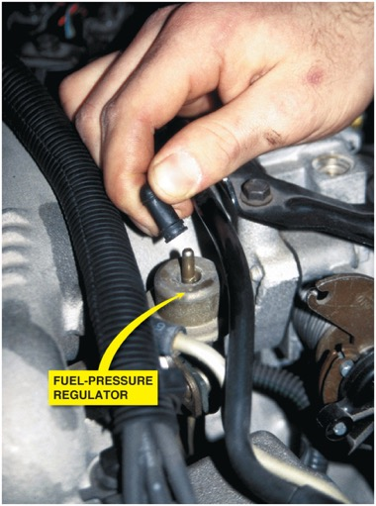
Figure 24.1 If the vacuum hose is removed from the fuel-pressure regulator when the engine is running, the fuel pressure should increase. If it does not increase, then the fuel pump is not capable of supplying adequate pressure or the fuel-pressure regulator is defective. If gasoline is visible in the vacuum hose, the regulator is leaking and should be replaced

Slide 3
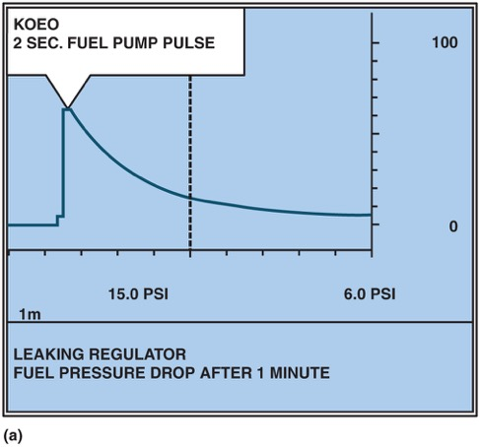
Figure 24.2 (a) A fuel-pressure graph after key on, engine off (K O E O) on a T B I system

Slide 4
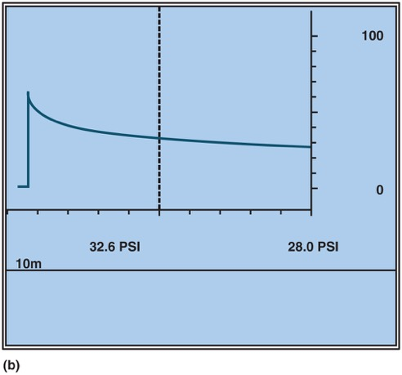
Figure 24.2 (b) Pressure drop after 10 minutes on a normal port fuel-injection system

Slide 5
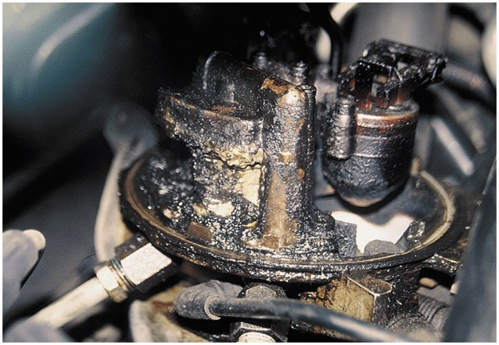
Figure 24.3 A clogged P C V system caused the engine oil fumes to be drawn into the air cleaner assembly. This is what the technician discovered during a visual inspection

Slide 6
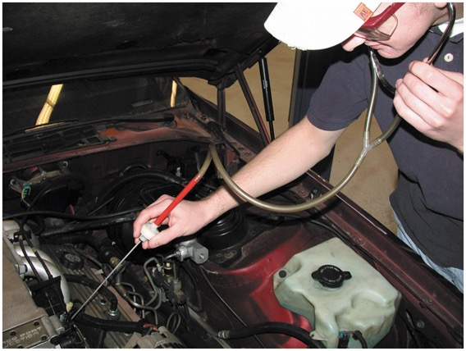
Figure 24.4 All fuel injectors should make the same sound with the engine running at idle speed. A lack of sound indicates a possible electrically open injector or a break in the wiring. A defective computer could also be the cause of a lack of clicking (pulsing) of the injectors

Slide 7
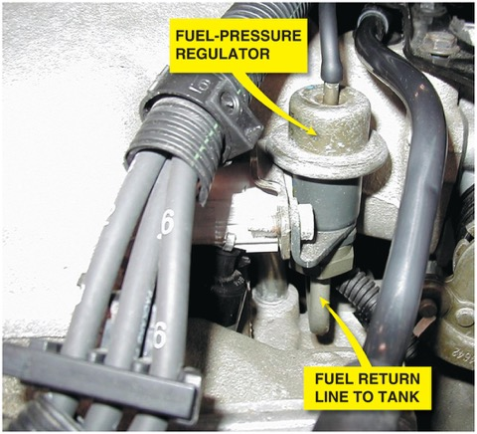
Figure 24.5 Fuel should be heard returning to the fuel tank at the fuel return line if the fuel-pump and fuel-pressure regulator are functioning correctly

Slide 8
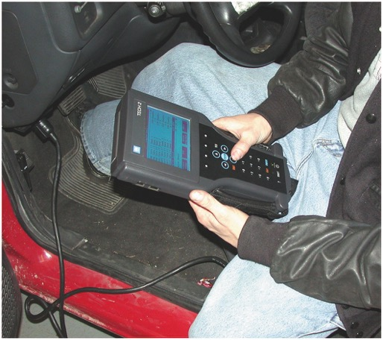
Figure 24.6 Using a scan tool to check for I A C counts or percentage as part of a diagnostic routine

Slide 9
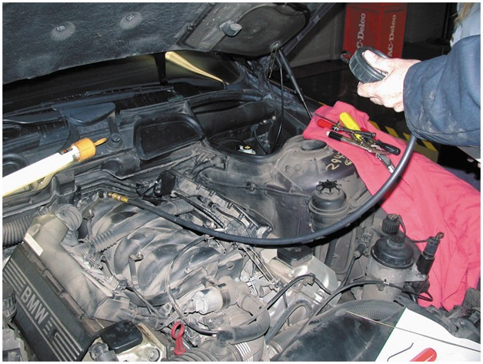
Figure 24.7 Checking the fuel pressure using a fuel-pressure gauge connected to the Schrader valve

Slide 10
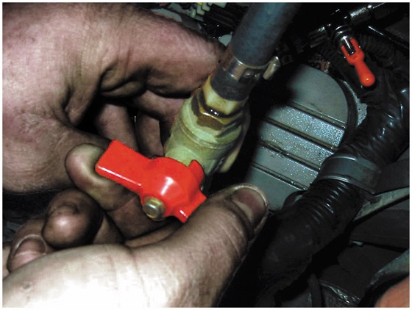
Figure 24.8 Shutoff valves must be used on vehicles equipped with plastic fuel lines to isolate the cause of a pressure drop in the fuel system

Slide 11
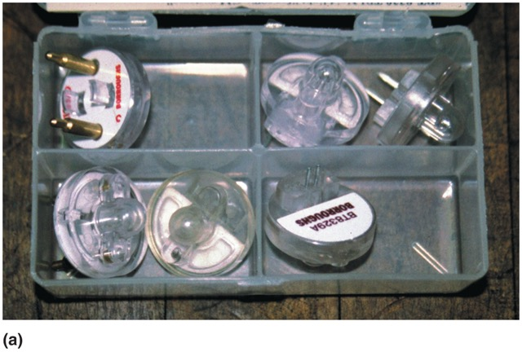
Figure 24.9 (a) Noid lights are usually purchased as an assortment so that one is available for any type or size of injector wiring connector

Slide 12
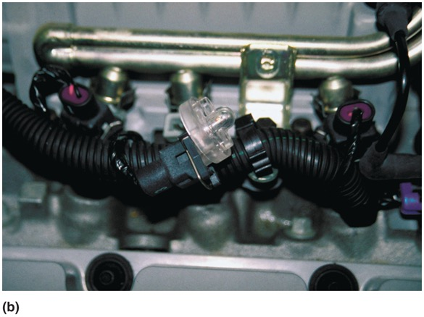
Figure 24.9 (b) The connector is unplugged from the injector and a noid light is plugged into the injector connector. The noid light should flash when the engine is being cranked if the power circuit and the pulsing to ground by the computer are functioning okay

Slide 13
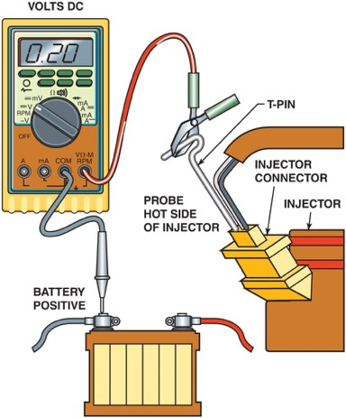
Figure 24.10 Use a D M M set to read D C volts to check the voltage drop of the positive circuit to the fuel injector. A reading of 0.5 volt or less is generally considered to be acceptable

Slide 14
Animation: Quick Check Injector Volts ((Animation will automatically start in a few seconds)he animation will automatically start in a few seconds)

Slide 15
Animation: Quick Check Injector Pulse ((Animation will automatically start in a few seconds)he animation will automatically start in a few seconds)

Slide 16
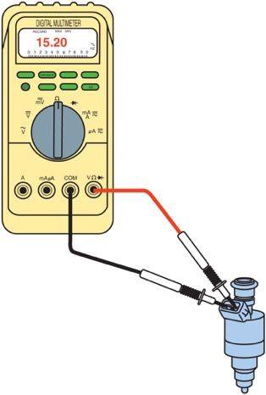
Figure 24.11 Connections and settings necessary to measure fuel-injector resistance

Slide 17
Animation: Test Injector Resistance ((Animation will automatically start in a few seconds)he animation will automatically start in a few seconds)

Slide 18
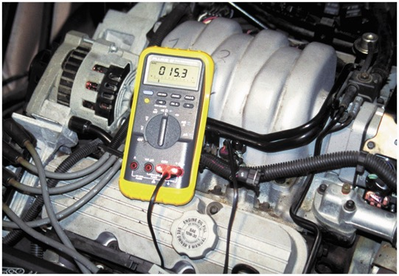
Figure 24.12 To measure fuel-injector resistance, a technician constructed a short wiring harness with a double banana plug that fits into the V and C O M terminals of the meter and an injector connector at the other end. This setup makes checking resistance of fuel injectors quick and easy

Slide 19
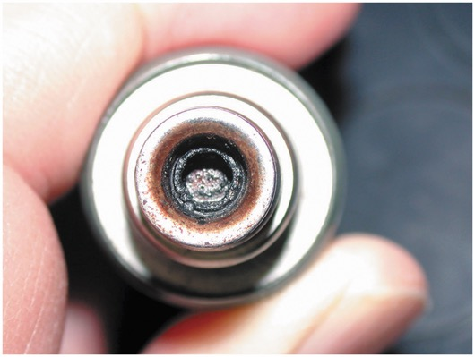
Figure 24.13 If an injector has the specified resistance, this does not mean that it is okay. This injector had the specified resistance yet it did not deliver the correct amount of fuel because it was clogged

Slide 20
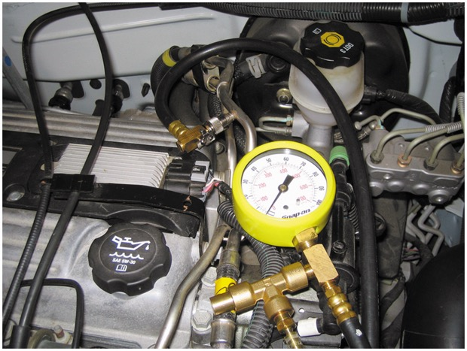
Figure 24.14 Connect a fuel-pressure gauge to the fuel rail at the Schrader valve

Slide 21
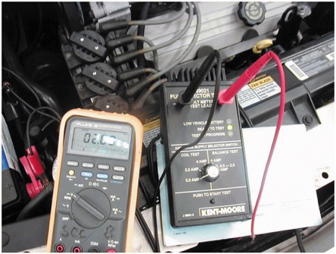
Figure 24.15 An injector tester being used to check the voltage drop through the injector while the tester is sending current through the injectors. This test is used to check the coil inside the injector. This same tester can be used to check for equal pressure drop of each injector by pulsing the injector on for 500 ms

Slide 22
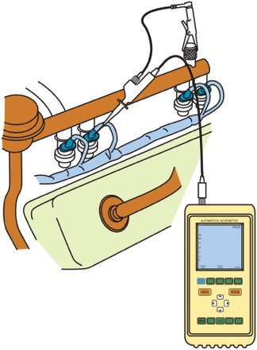
Figure 24.16 A digital storage oscilloscope can be easily connected to an injector by carefully back-probing the electrical connector

Slide 23
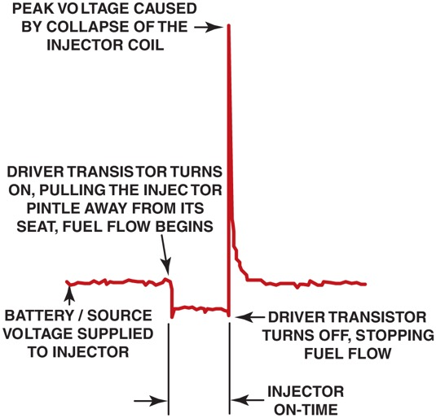
Figure 24.17 The injector on-time is called the pulse width

Slide 24
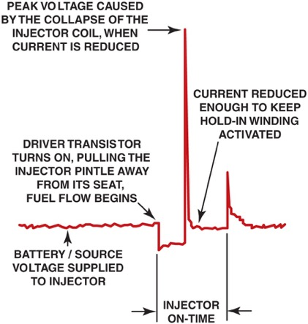
Figure 24.18 A typical peak-and-hold fuel-injector waveform. Most fuel injectors that measure less than 6 ohms will usually display a similar waveform

Slide 25
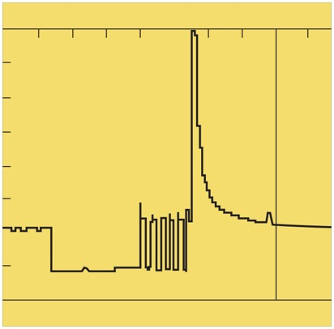
Figure 24.19 A waveform of a pulse-width-modulated fuel injector. At the end, when the voltage is removed, there is an inductive spike created similar to the spike created by other types of injectors

Slide 26
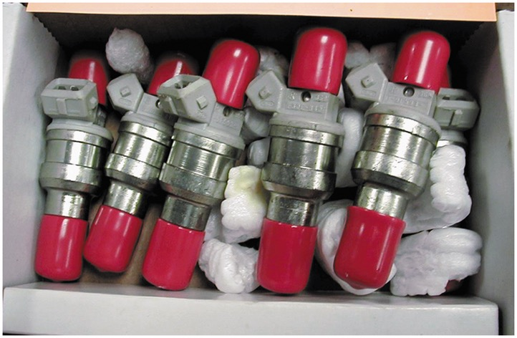
Figure 24.20 A set of six reconditioned injectors. The sixth injector is barely visible at the far right

Slide 27
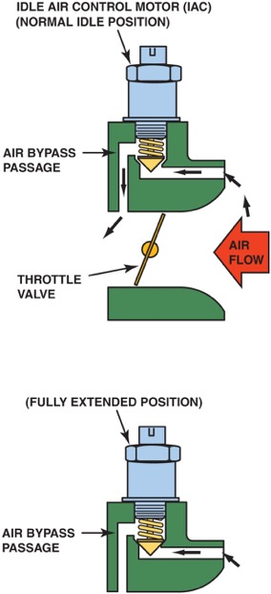
Figure 24.21 An I A C controls idle speed by controlling the amount of air that passes around the throttle plate. More airflow results in a higher idle speed

Slide 28
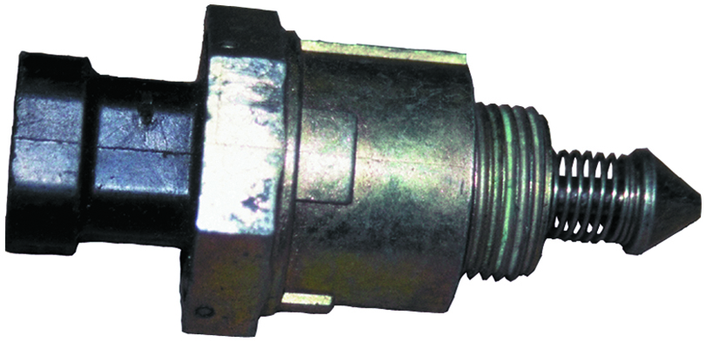
Figure 24.22 A typical I A C

Slide 29
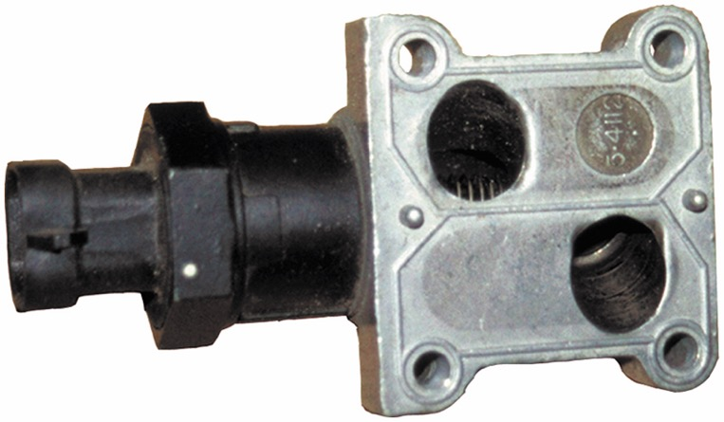
Figure 24.23 Some I A C units are purchased with the housing as shown. Carbon build-up in these passages can cause a rough or unstable idling or stalling

Slide 30
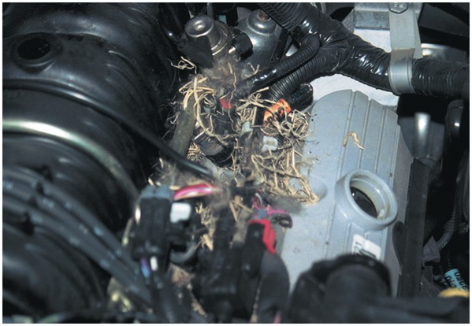
Figure 24.24 When the cover is removed from the top of the engine, a mouse or some other animal nest is visible. The animal had already eaten through a couple of injector wires. At least the cause of the intermittent misfire was discovered

Slide 31
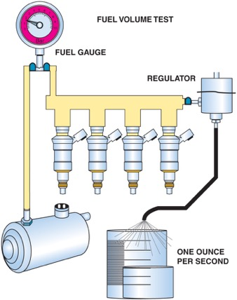
Figure 24.25 Checking fuel-pump volume using a hose from the outlet of the fuel-pressure regulator into a calibrated container

Slide 32
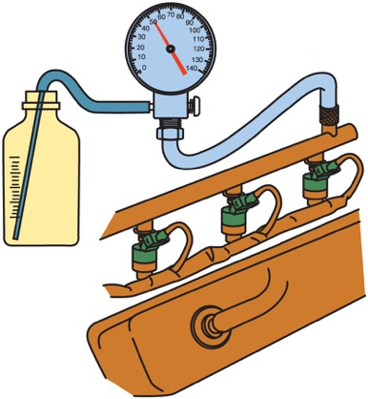
Figure 24.26 Testing fuel-pump volume using a fuel-pressure gauge with a bleed hose inserted into a suitable container. The engine is running during this test

Slide 33
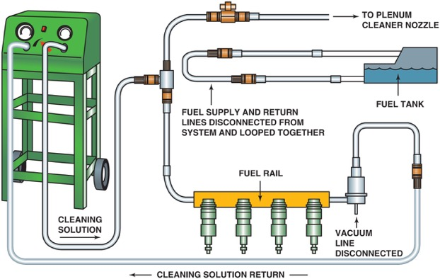
Figure 24.27 A typical two-line cleaning machine hook-up, showing an extension hose that can be used to squirt a cleaning solution into the throttle body while the engine is running on the cleaning solution and gasoline mixture

Slide 34
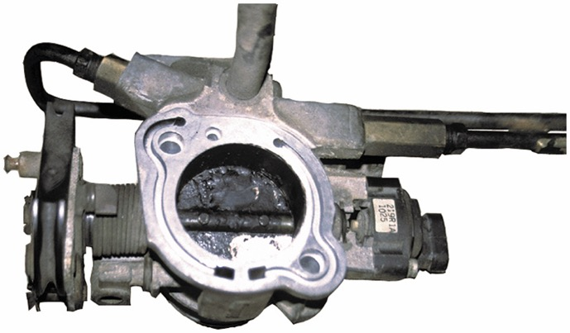
Figure 24.28 To thoroughly clean a throttle body, it is sometimes best to remove it from the vehicle. Dirty throttle plate(s) can cause a rough, unstable idle or stalling especially when the engine is warm

Slide 35
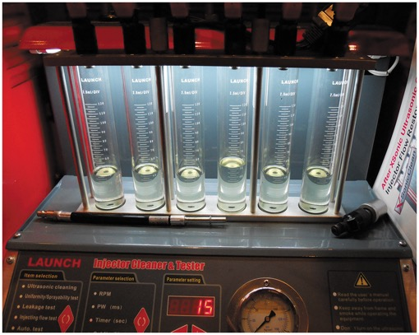
Figure 24.29 The amount each injector is able to flow is displayed in glass cylinders are each injector for a quick visual check

Slide 36
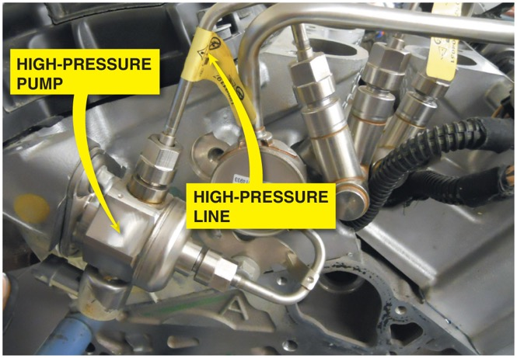
Figure 24.30 The line that has the yellow tag is a high-pressure line and this linßpart

Slide 37
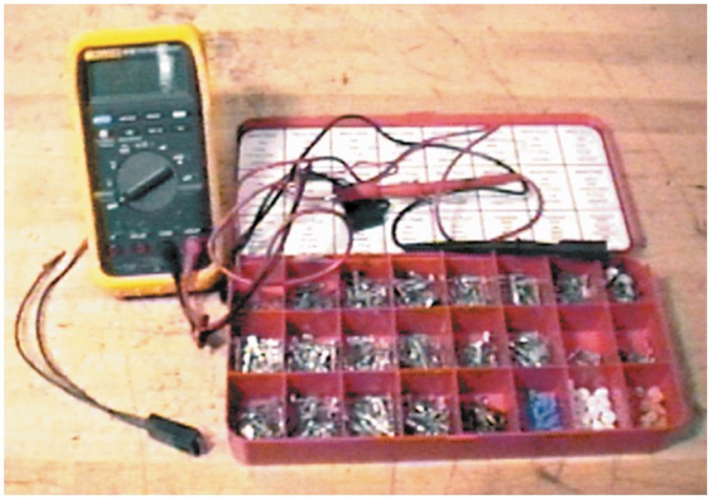
FUEL-PUMP RELAY CIRCUIT DIAGNOSIS 1

Slide 38
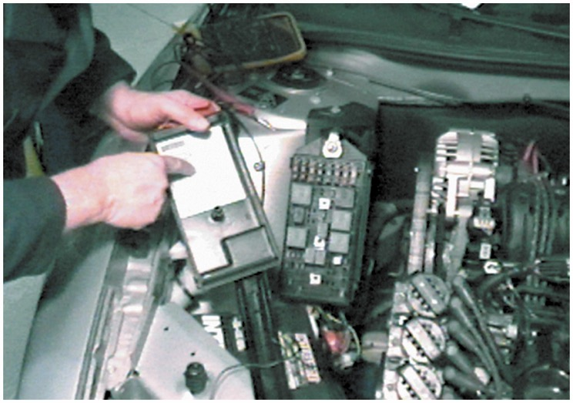
FUEL-PUMP RELAY CIRCUIT DIAGNOSIS 2

Slide 39
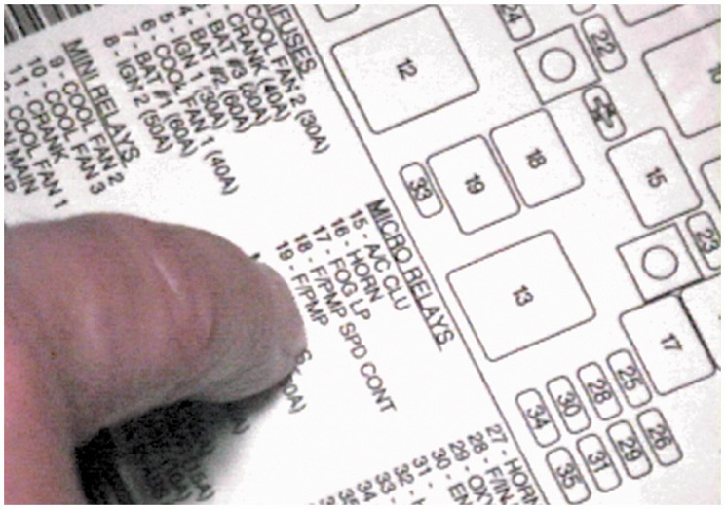
FUEL-PUMP RELAY CIRCUIT DIAGNOSIS 3

Slide 40
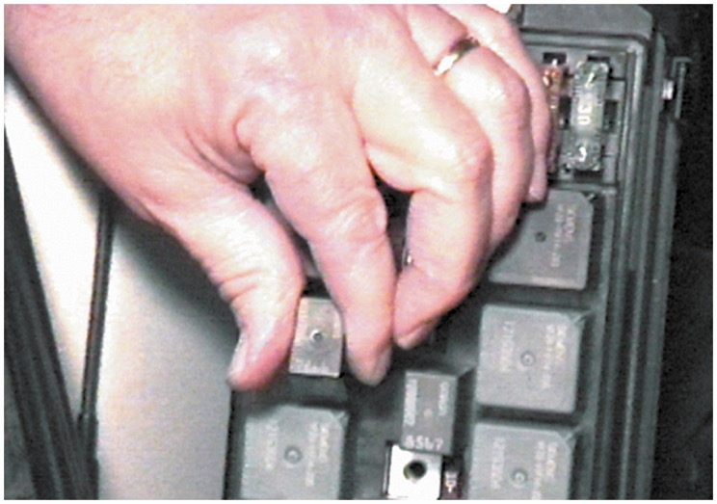
FUEL-PUMP RELAY CIRCUIT DIAGNOSIS 4

Slide 41
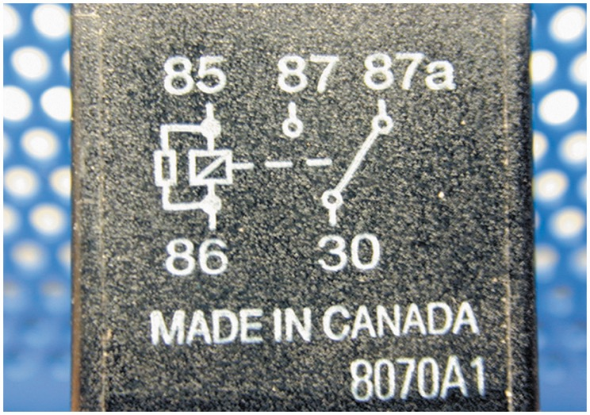
FUEL-PUMP RELAY CIRCUIT DIAGNOSIS 5

Slide 42
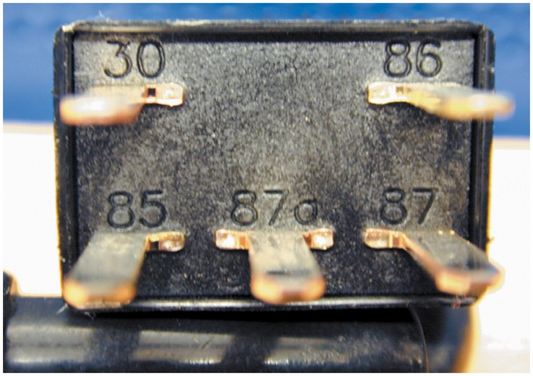
FUEL-PUMP RELAY CIRCUIT DIAGNOSIS 6

Slide 43
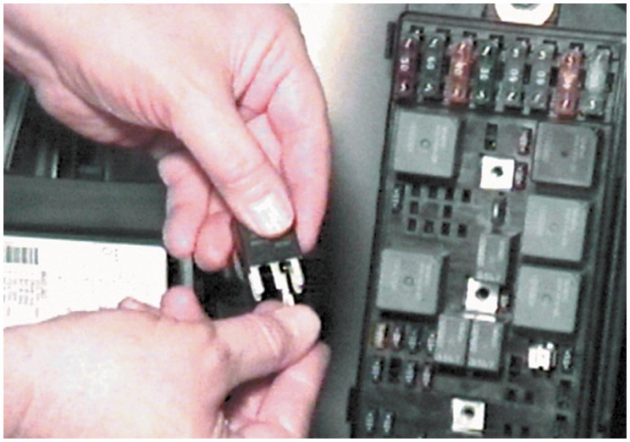
FUEL-PUMP RELAY CIRCUIT DIAGNOSIS 7

Slide 44
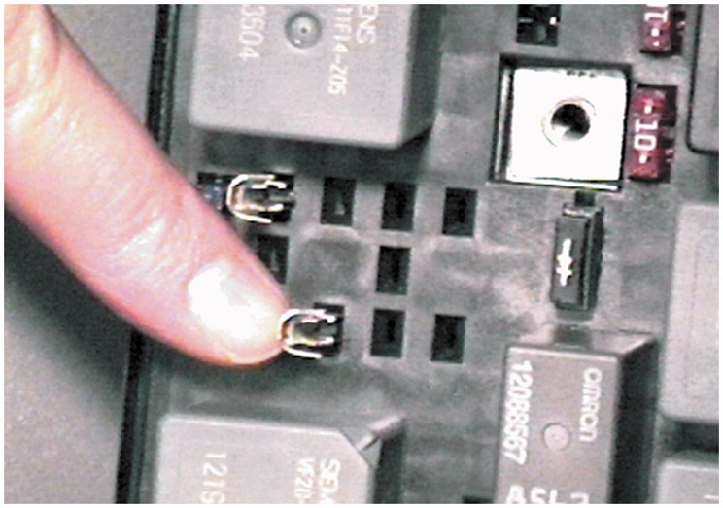
FUEL-PUMP RELAY CIRCUIT DIAGNOSIS 8

Slide 45
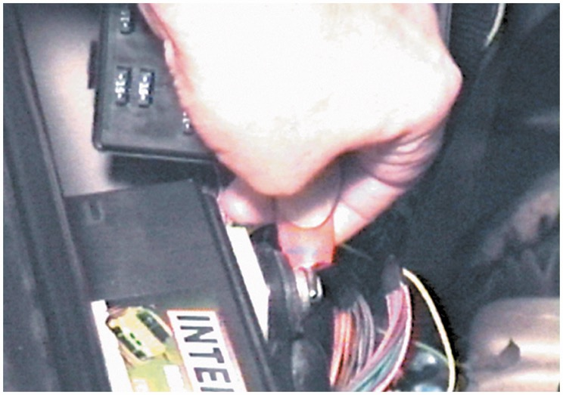
FUEL-PUMP RELAY CIRCUIT DIAGNOSIS 9

Slide 46
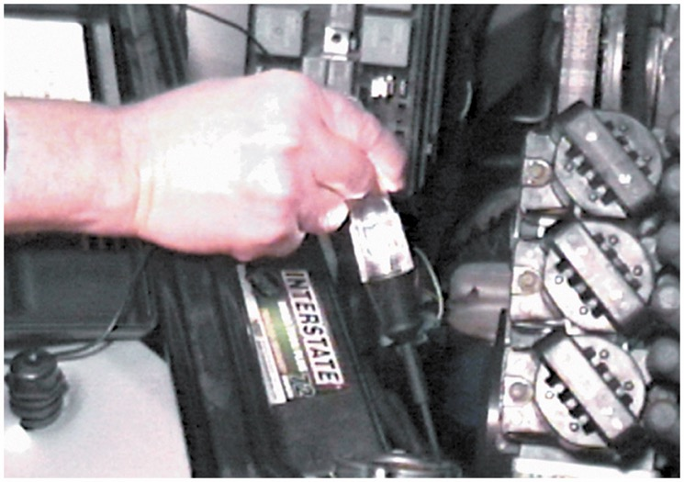
FUEL-PUMP RELAY CIRCUIT DIAGNOSIS 10

Slide 47
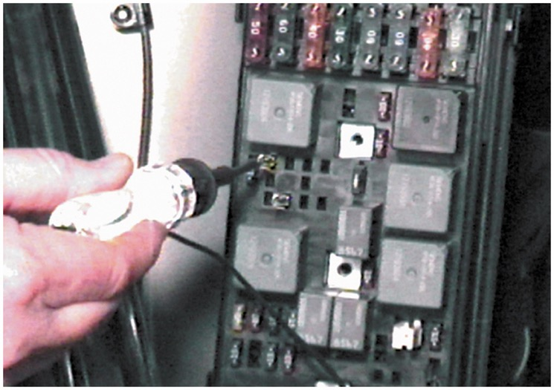
FUEL-PUMP RELAY CIRCUIT DIAGNOSIS 11

Slide 48
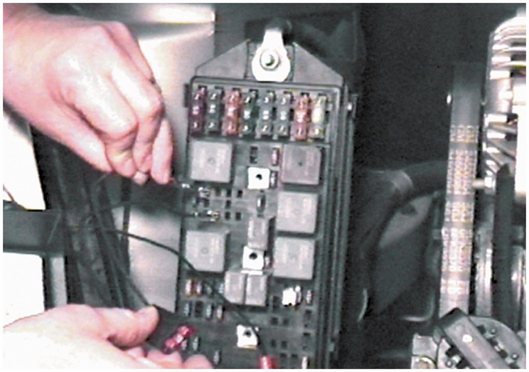
FUEL-PUMP RELAY CIRCUIT DIAGNOSIS 12

Slide 49
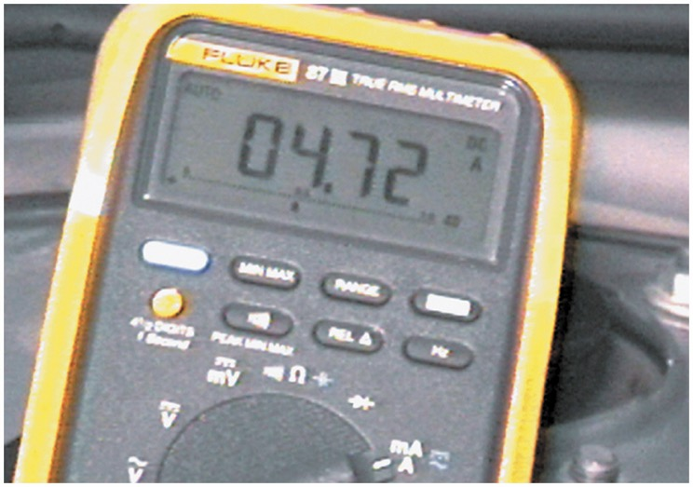
FUEL-PUMP RELAY CIRCUIT DIAGNOSIS 13

Slide 50
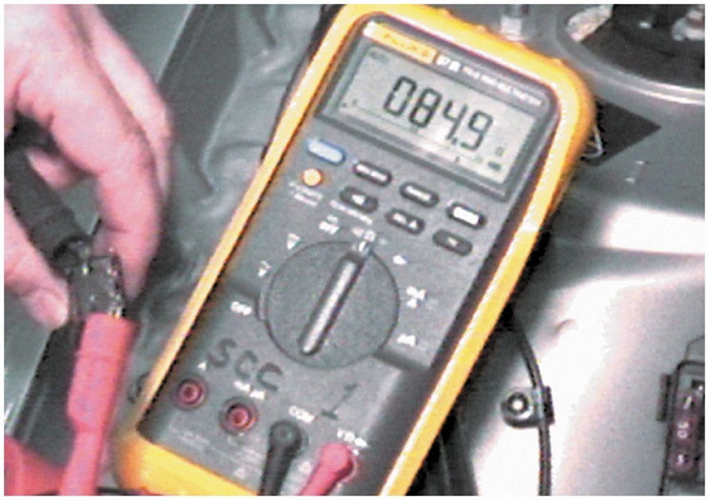
FUEL-PUMP RELAY CIRCUIT DIAGNOSIS 14

Slide 51
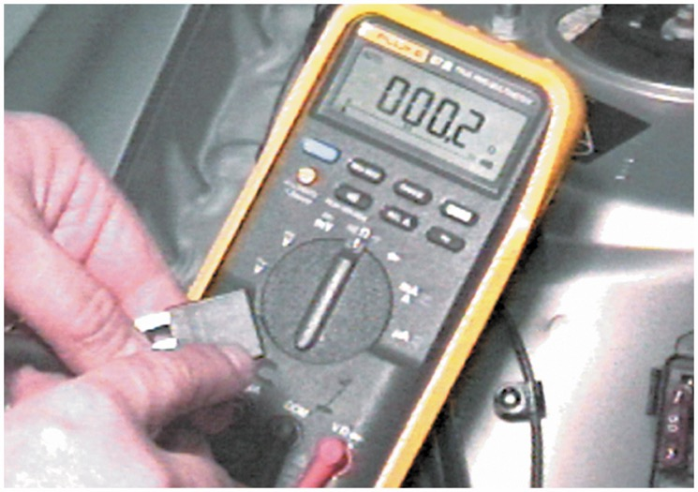
FUEL-PUMP RELAY CIRCUIT DIAGNOSIS 15

Slide 52
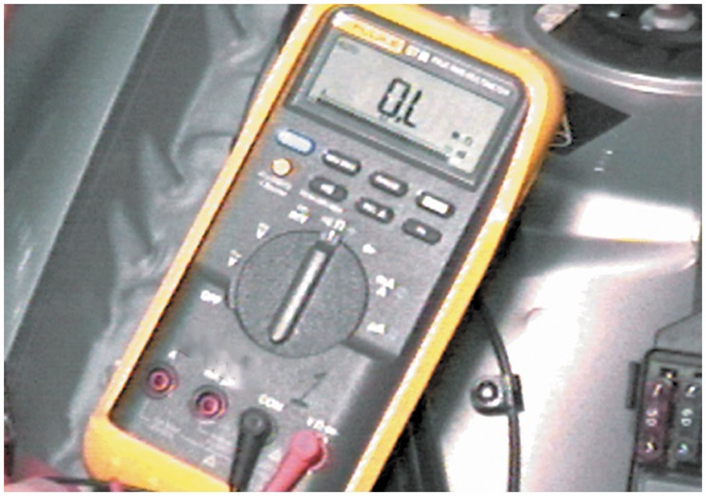
FUEL-PUMP RELAY CIRCUIT DIAGNOSIS 16

Slide 53
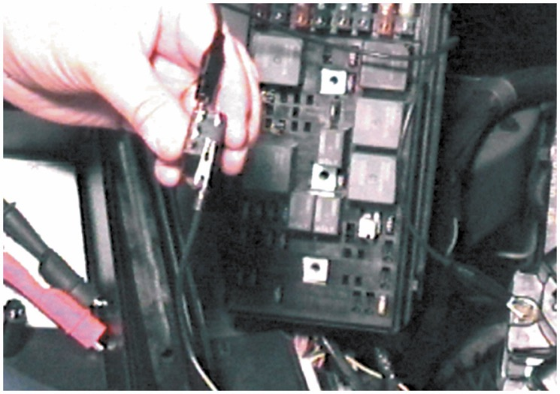
FUEL-PUMP RELAY CIRCUIT DIAGNOSIS 17

Slide 54
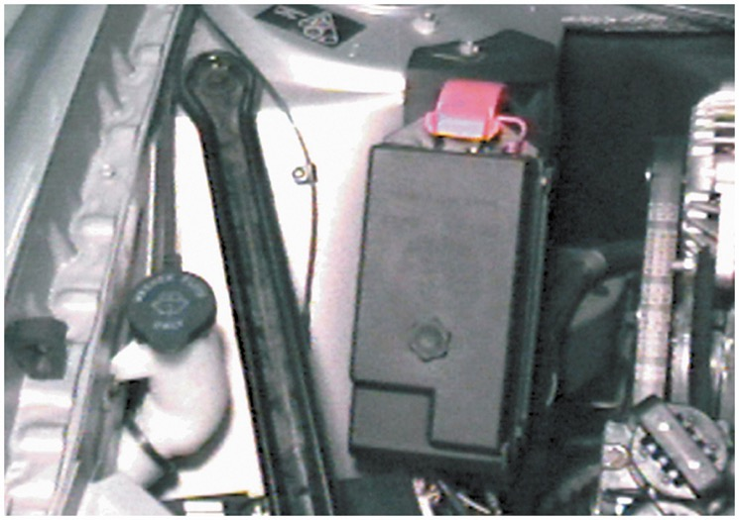
FUEL-PUMP RELAY CIRCUIT DIAGNOSIS 18

Slide 55
FUEL INJECTOR CLEANING 1

Slide 56
FUEL INJECTOR CLEANING 2

Slide 57
FUEL INJECTOR CLEANING 3

Slide 58
FUEL INJECTOR CLEANING 4

Slide 59
FUEL INJECTOR CLEANING 5

Slide 60
FUEL INJECTOR CLEANING 6

Slide 61
FUEL INJECTOR CLEANING 7

Slide 62
FUEL INJECTOR CLEANING 8

Slide 63
FUEL INJECTOR CLEANING 9

Slide 64
FUEL INJECTOR CLEANING 10

Slide 65
FUEL INJECTOR CLEANING 11

Slide 66
FUEL INJECTOR CLEANING 12

Slide 67
Video Links (Internet Access Required)
Injector balance (time 13:29)
Returnless fuel system part 1 (time 22:35)
Returnless fuel system part 2 (time 47:18)
Fuel injection (time 30:49)
Spider injectors (time 10:39)
Fuel rail (time 7:15)
Fuel injector replacement (time 3:21)
Fuel pump circuit access (time 5:58)
2005 Neon injector problem (time 10:41)
Fuel system cleaning (time 8:16)

Slide 68
Video Links (Internet Access Required)
Fuel system diagnosis (time 7:28)
Fuel system diagnostic tips (time 9:36)
Fuel pressure test (time 4:12)
GM fuel pressure sensor test (time 25:20)
Crank no start (time 6:15)
Drivability (time 21:31)
Noid light testing (time 30:44)
Fuel injector drivers (time 44:07)
PCM driver testing part 1 (time 3:11)
PCM driver testing part 2 (time 3:10)

Slide 69
Video Links (Internet Access Required)
Stuck closed fuel injector (time 11:34)
GM shorted injector (time 14:42)
Scoping out drivability (time 12:05)
Injector Waveform analysis (time 6:53)
Throttle body cleaning (time 3:38)
Throttle body cleaning (time 6:55)
Fuel leak at regulator (time 6:42)
Clean an IAC valve (time 2:39)

Slide 70
Copyright

