Slide 1
Advanced Engine Performance Diagnosis
Seventh Edition
Chapter 22
Fuel-injection Components and Operation
Copyright © 2020 Pearson Education, Inc. All Rights Reserved

Slide 2
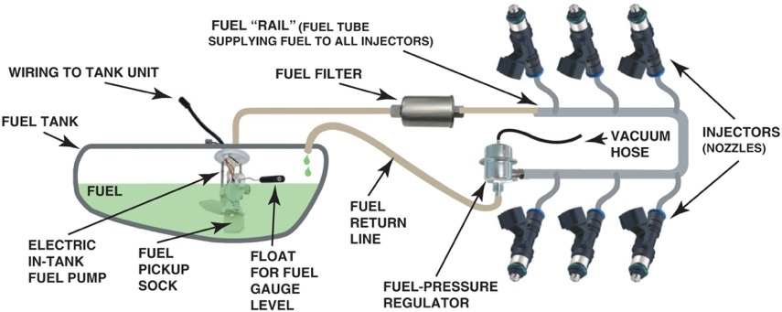
Figure 22.1 Typical port fuel-injection system, indicating the location of various components. Notice that the fuel-pressure regulator is located on the fuel return side of the system. The computer does not control fuel pressure, but does control the operation of the electric fuel pump (on most systems) and the pulsing on and off of the injectors

Slide 3
Animation: Electronic Fuel Injection, EFI ((Animation will automatically start in a few seconds)he animation will automatically start in a few seconds)

Slide 4
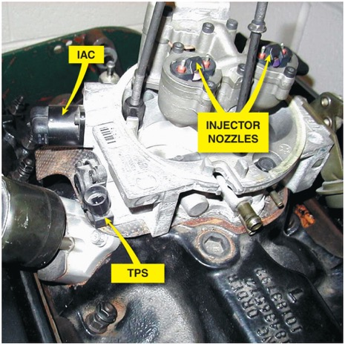
Figure 22.2 A dual-nozzle T B I unit on a Chevrolet 5.0 L V-8 engine. The fuel is squirted above the throttle plate where the fuel mixes with air before entering the intake manifold

Slide 5
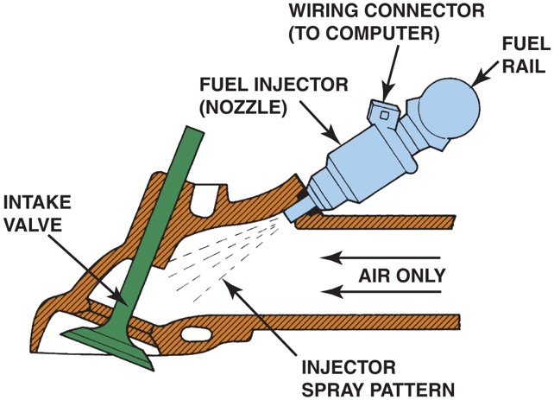
Figure 22.3 A typical port fuel-injection system squirts fuel into the low pressure (vacuum) of the intake manifold, about 3 inch (70 to 100 mm) from the intake valve

Slide 6
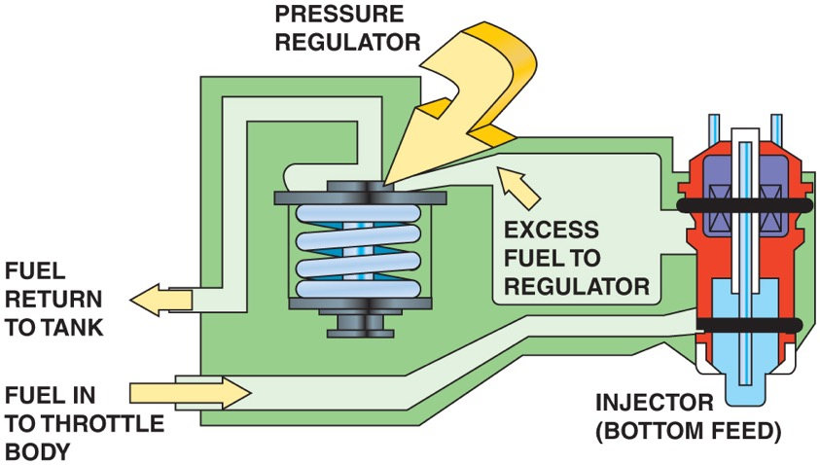
Figure 22.4 The tension of the spring in the fuel-pressure regulator determines the operating pressure on a throttle-body fuel-injection unit

Slide 7
Animation: Electronic Fuel Injection, EFI ((Animation will automatically start in a few seconds)he animation will automatically start in a few seconds)

Slide 8
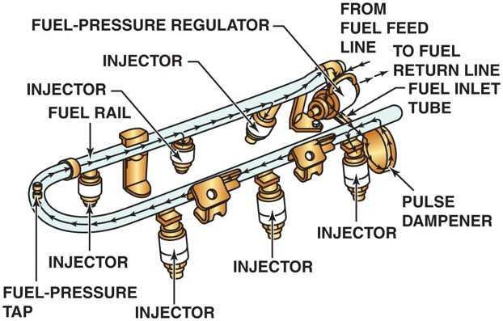
Figure 22.5 The injectors receive fuel and are supported by the fuel rail. A pulse damper is used to help reduce noise caused by the pressure changes in the fuel rail during injector pulsing operation

Slide 9
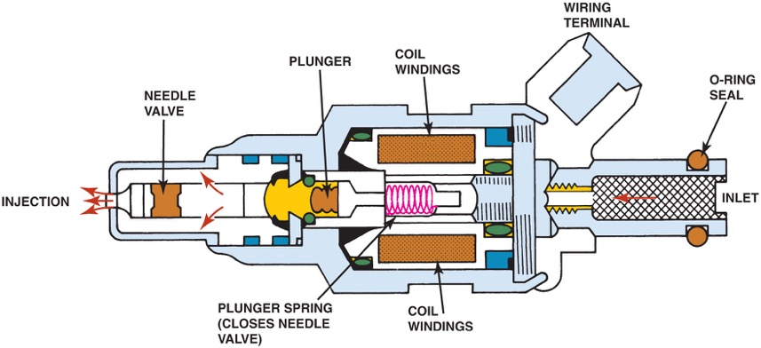
Figure 22.6 Cross section of a typical port fuel-injection nozzle assembly. These injectors are serviced as an assembly only; no part replacement or service is possible except for replacement of external O-ring seals

Slide 10
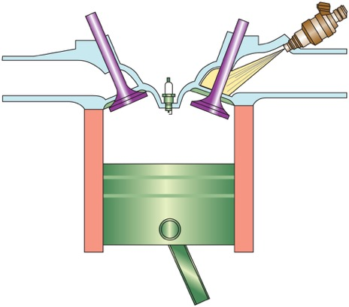
Figure 22.7 Port fuel injectors spray atomized fuel into the intake manifold about 3 inches (75 mm) from the intake valve

Slide 11
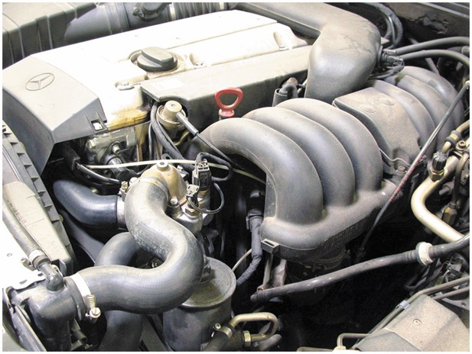
Figure 22.8 A port fuel-injected engine that is equipped with long, tuned intake-manifold runners

Slide 12
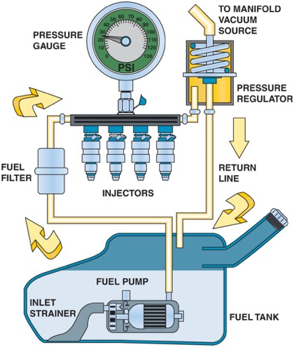
Figure 22.9 A typical port fuel-injected system showing a vacuum-controlled fuel-pressure regulator

Slide 13
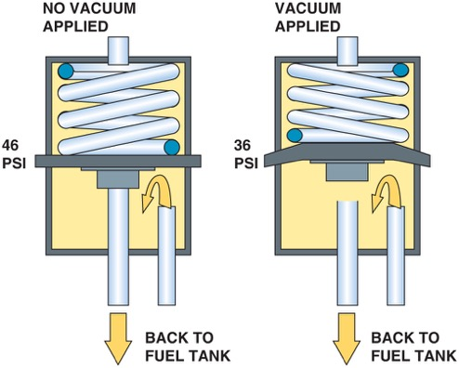
Figure 22.10 A typical fuel-pressure regulator that has a spring that exerts 46 pounds of force against the fuel. If 20 inches of vacuum are applied above the spring, the vacuum reduces the force exerted by the spring on the fuel, allowing the fuel to return to the tank at a lower pressure

Slide 14
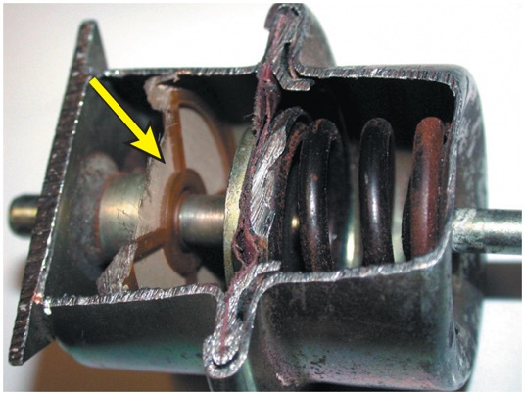
Figure 22.11 A lack of fuel flow could be due to a restricted fuel-pressure regulator. Notice the fine screen filter. If this filter were to become clogged, higher than normal fuel pressure would occur

Slide 15
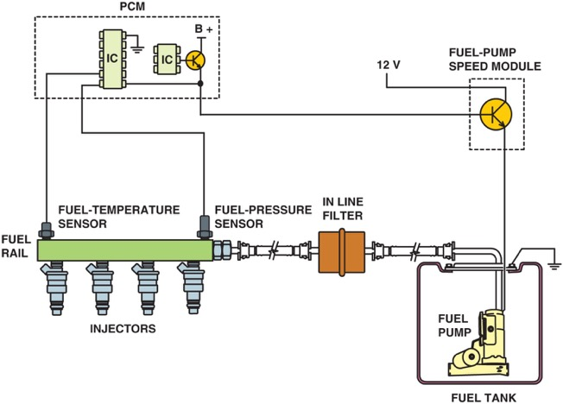
Figure 22.12 The fuel-pressure sensor and fuel-temperature sensor are often constructed together in one assembly to help give the P C M the needed data to control the fuel-pump speed

Slide 16
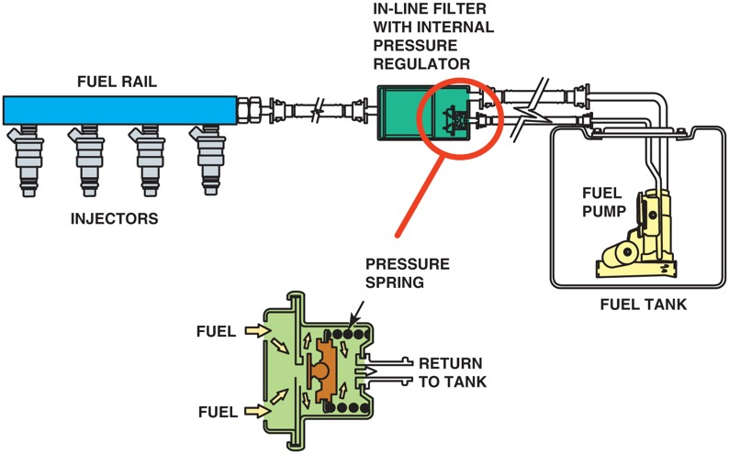
Figure 22.13 A mechanical returnless fuel system. The bypass regulator in the fuel tank controls fuel line pressure

Slide 17
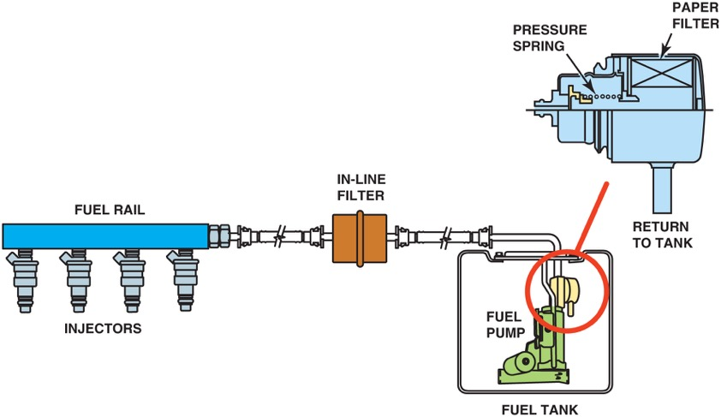
Figure 22.14 A demand delivery system uses a fuel-pressure regulator attached to the fuel pump assembly inside the fuel tank

Slide 18
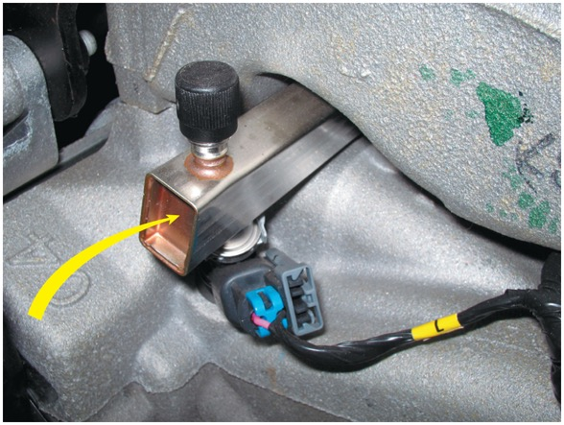
Figure 22.15 A rectangular-shaped fuel rail is used to help dampen fuel system pulsations and noise caused by the injectors opening and closing

Slide 19
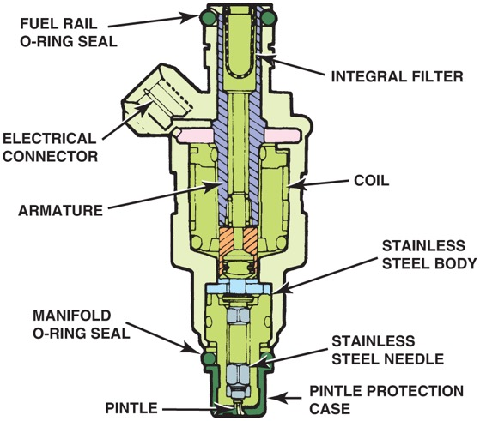
Figure 22.16 A multiport fuel injector. Notice that the fuel flows straight through and does not come in contact with the coil windings

Slide 20
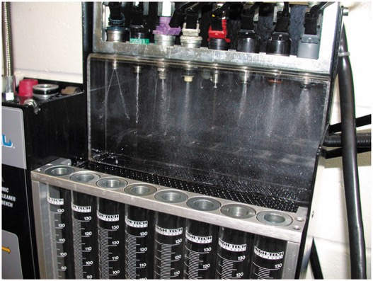
Figure 22.17 Each of the eight injectors shown are producing a correct spray pattern for the applications. While all throttle-body injectors spray a conical pattern, most port fuel injections do not

Slide 21
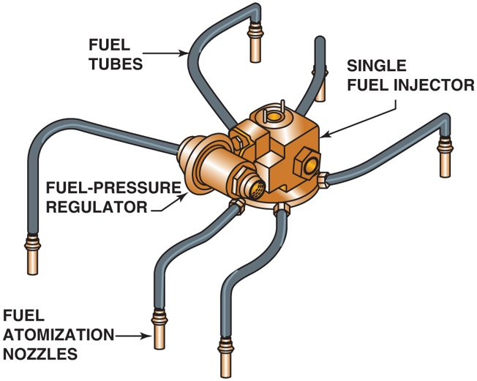
Figure 22.18 A central port fuel-injection system

Slide 22
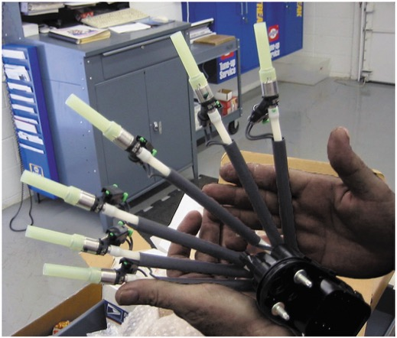
Figure 22.19 A factory replacement unit for a C S F I unit that has individual injectors at the ends that go into the intake manifold instead of poppet valves

Slide 23
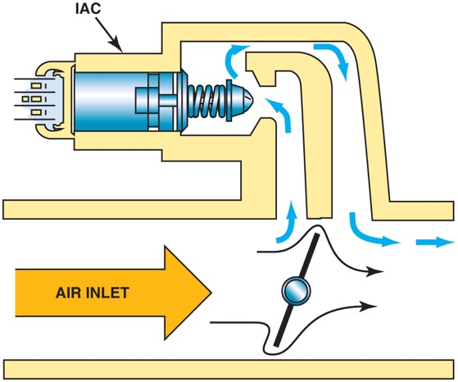
Figure 22.20 The small arrows indicate the air bypassing the throttle plate in the closed throttle position. This air is called minimum air. The air flowing through the I A C is the airflow that determines the idle speed

Slide 24
Animation: Idle Air Control, IAC ((Animation will automatically start in a few seconds)he animation will automatically start in a few seconds)

Slide 25
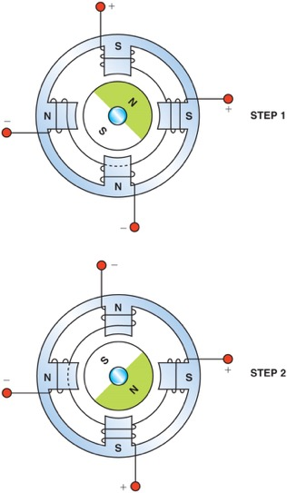
Figure 22.21 Most stepper motors use four wires, which are pulsed by the P C M to rotate the armature in steps

Slide 26
Video Links (Internet Access Required)
Fuel injector drivers (time 44:07)
Cold start valve (time 0:42)
Fuel injector (time 0:37)
Fuel pump troubleshooting (time 5:09)
Injector circuits (time 4:49)
Fuel pressure regulator (time 0:34)
Throttle body injection (time 6:56)
Returnless fuel system part 1 (time 22:35)
Returnless fuel system part 2 (time 47:18)
Fuel injection (time 30:49)

Slide 27
Video Links (Internet Access Required)
Fuel injection (time 4:23)
Spider injectors (time 10:39)
Fuel rail (time 7:15)
Intake manifold runner control (time 12:04)
Fuel injector operation (time 2:48)
Fuel injector (time 0:37)
Idle air control valve (time 0:46)
Fuel injection (time 3:09)
ECM circuit and wiring diagram (time 3:26)
Injector circuits (time 4:49)

Slide 28
Copyright

