Slide 1
Advanced Engine Performance Diagnosis
Seventh Edition
Chapter 21
Fuel Pumps, Lines, and Filters
Copyright © 2020 Pearson Education, Inc. All Rights Reserved

Slide 2
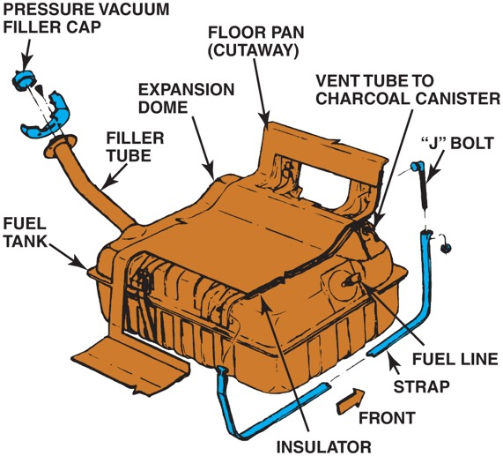
Figure 21.1 A typical fuel tank installation

Slide 3
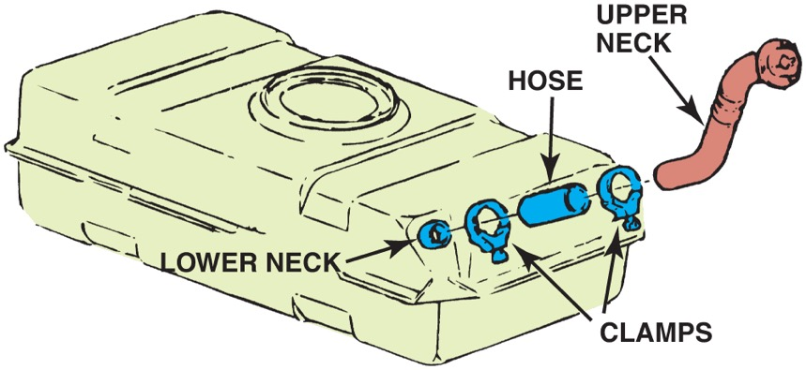
Figure 21.2 A three-piece filler tube assembly

Slide 4
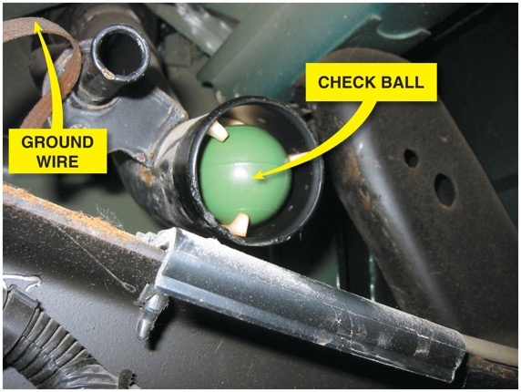
Figure 21.3 A view of a typical filler tube with the fuel tank removed. Notice the ground strap used to help prevent the buildup of static electricity as the fuel flows into the plastic tank. The check ball looks exactly like a ping-pong ball

Slide 5
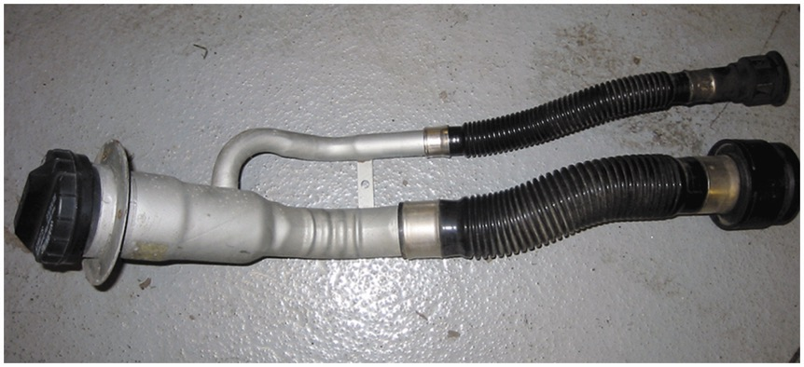
Figure 21.4 Vehicles equipped with onboard refueling vapor recovery usually have a reduced-size fill tube

Slide 6
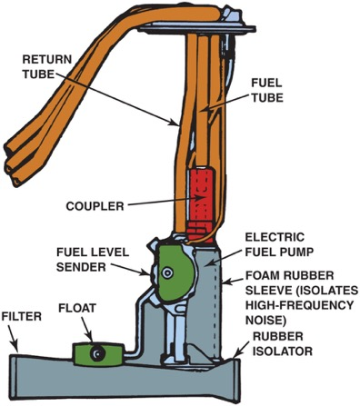
Figure 21.5 The fuel pickup tube is part of the fuel sender and pump assembly

Slide 7
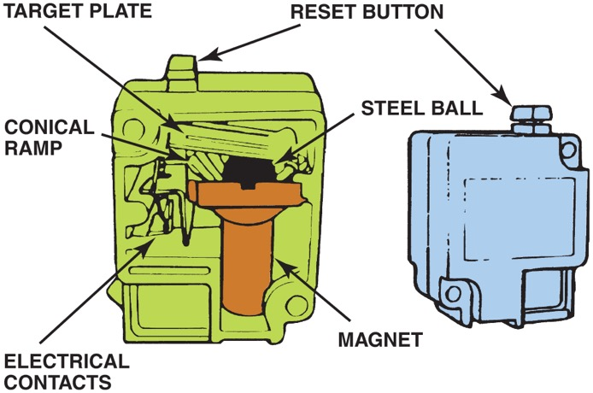
Figure 21.6 Ford uses an inertia switch to turn off the electric fuel pump in case of an accident

Slide 8
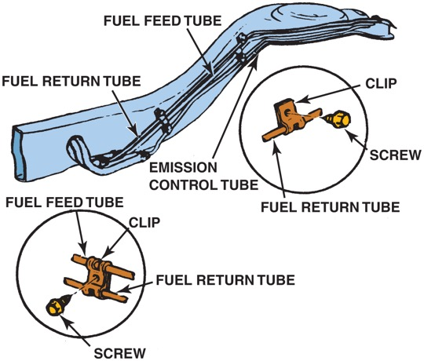
Figure 21.7 Fuel lines are routed along the frame or body and secured with clips

Slide 9
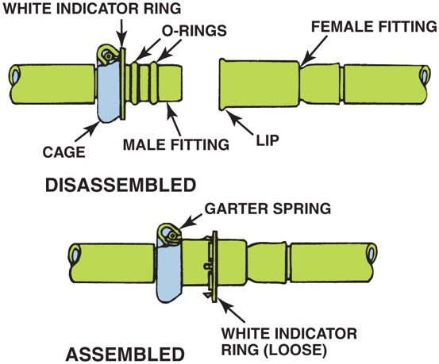
Figure 21.8 Some Ford metal line connections use spring-locks and O-rings

Slide 10
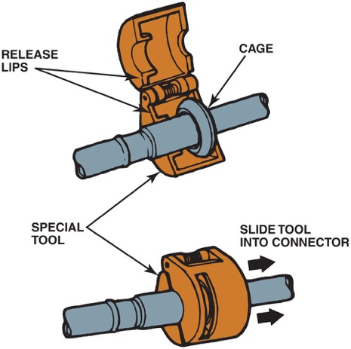
Figure 21.9 Ford spring-lock connectors require a special tool for disassembly

Slide 11
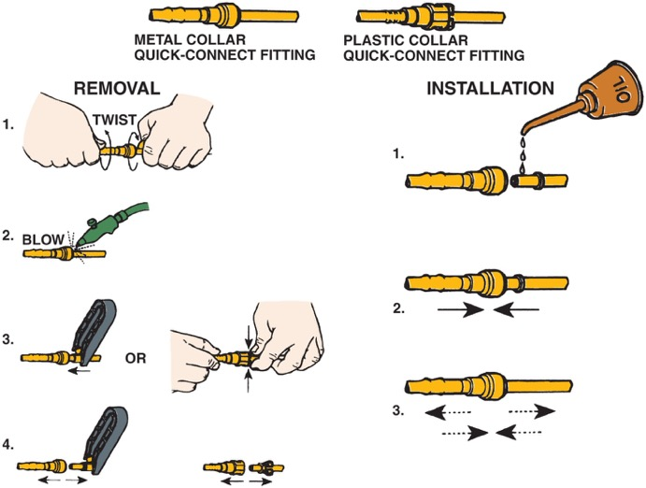
Figure 21.10 Typical quick-connect steps

Slide 12
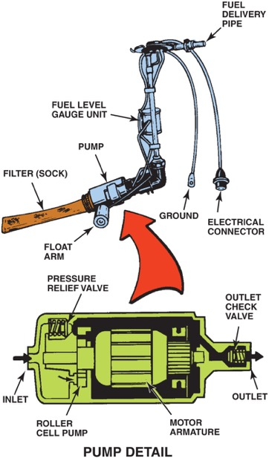
Figure 21.11 A roller cell-type electric fuel pump

Slide 13
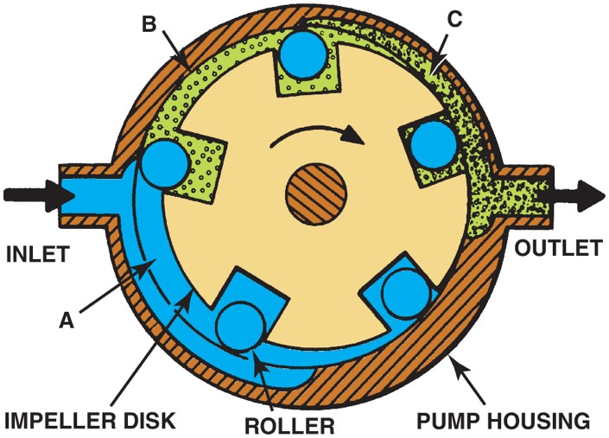
Figure 21.12 The pumping action of an impeller or rotary vane pump

Slide 14
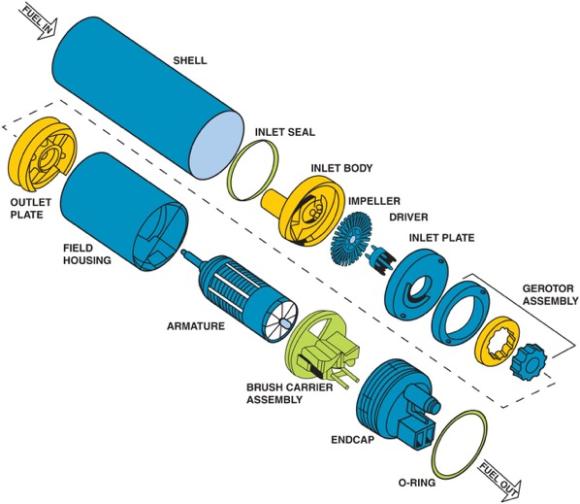
Figure 21.13 An exploded view of a gerotor electric fuel pump

Slide 15
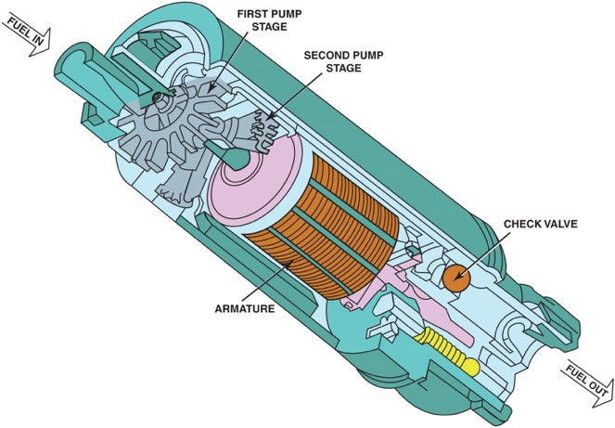
Figure 21.14 A cutaway view of a typical two-stage turbine electric fuel pump

Slide 16
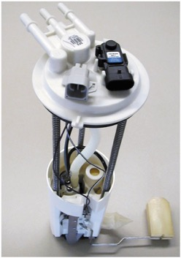
Figure 21.15 A typical fuel-pump module assembly, which includes the pickup strainer and fuel pump, as well as the fuel-pressure sensor and fuel level sensing unit

Slide 17
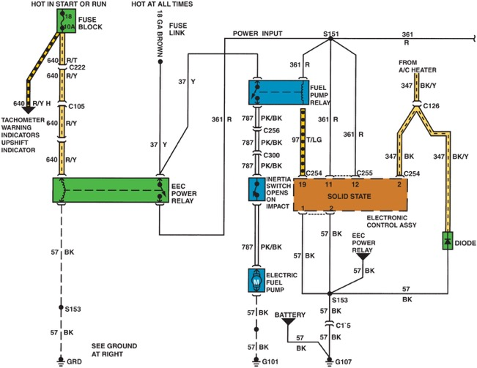
Figure 21.16 A schematic showing that an inertia switch is connected in series between the fuel-pump relay and the fuel pump

Slide 18
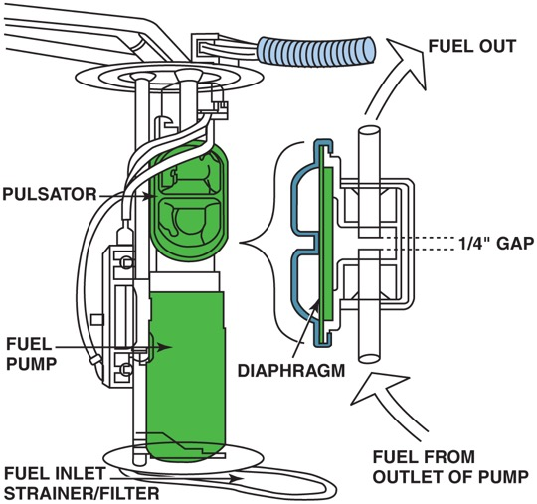
Figure 21.17 A typical fuel pulsator used mostly with roller vane-type pumps to help even out the pulsation in pressure that can cause noise

Slide 19
Animation: Low-Side Driver, Fuel Pump Control ((Animation will automatically start in a few seconds)he animation will automatically start in a few seconds)

Slide 20
Animation: Output Driver, Fuel Pump Control ((Animation will automatically start in a few seconds)he animation will automatically start in a few seconds)

Slide 21
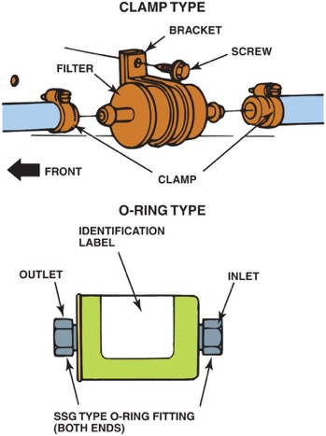
Figure 21.18 Inline fuel filters are usually attached to the fuel line with screw clamps or threaded connections. The fuel filter must be installed in the proper direction or a restricted fuel flow can result

Slide 22
Animation: Fuel Filters ((Animation will automatically start in a few seconds)he animation will automatically start in a few seconds)

Slide 23
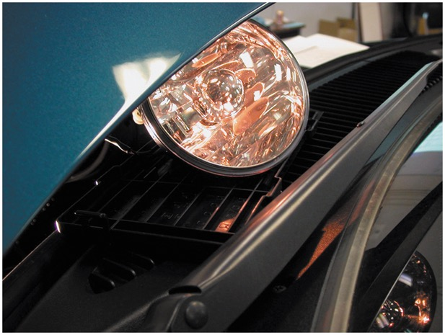
Figure 21.19 A dim headlight indicates excessive resistance in fuel pump circuit

Slide 24
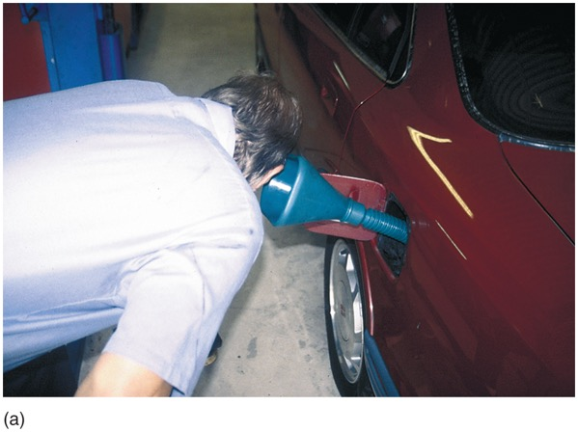
Figure 21.20 (a) A funnel helps in hearing if the electric fuel pump inside the gas tank is working

Slide 25
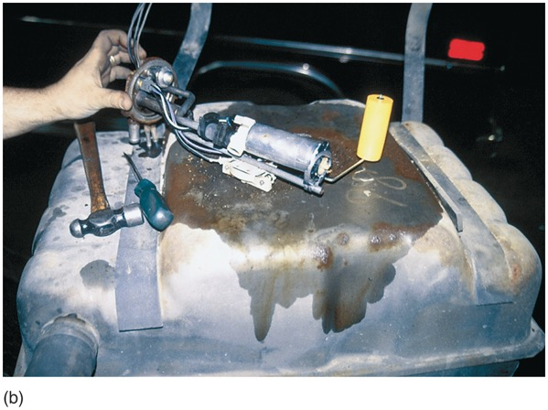
Figure 21.20 (b) If the pump is not running, check the wiring and current flow before going through the process of dropping the fuel tank to remove the pump

Slide 26
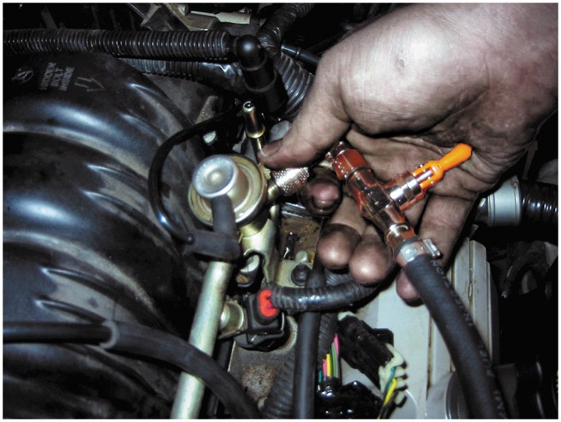
Figure 21.21 The Schrader valve on this General Motors 3800 V-6 is located next to the fuel-pressure regulator

Slide 27
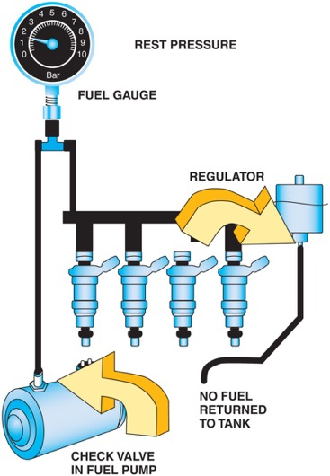
Figure 21.22 The fuel system should hold pressure if the system is leak free

Slide 28
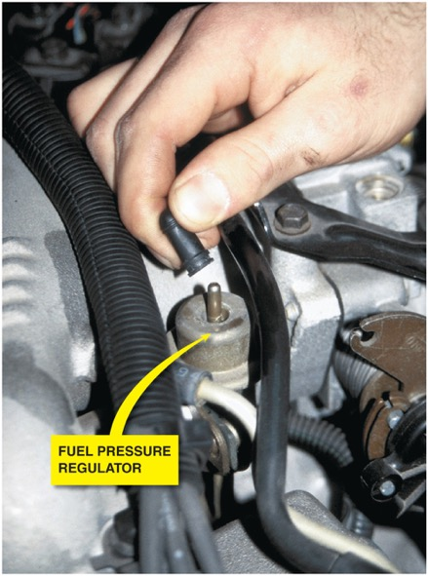
Figure 21.23 If the vacuum hose is removed from the fuel-pressure regulator when the engine is running, the fuel pressure should increase. If it does not increase, then the fuel pump is not capable of supplying adequate pressure or the fuel-pressure regulator is defective. If gasoline is visible in the vacuum hose, the regulator is leaking and should be replaced

Slide 29
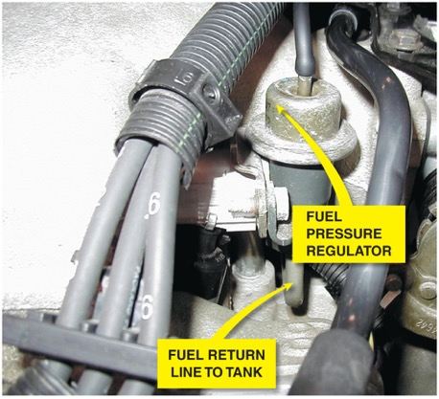
Figure 21.24 Fuel should be heard returning to the fuel tank at the fuel return line if the fuel pump and fuel-pressure regulator are functioning correctly

Slide 30
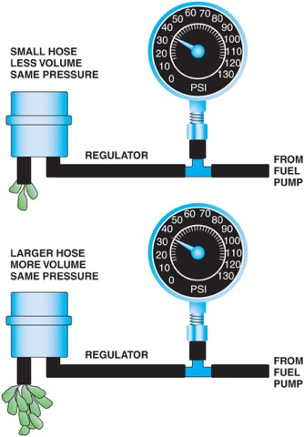
Figure 21.25 A fuel-pressure reading does not confirm that there is enough fuel volume for the engine to operate correctly

Slide 31
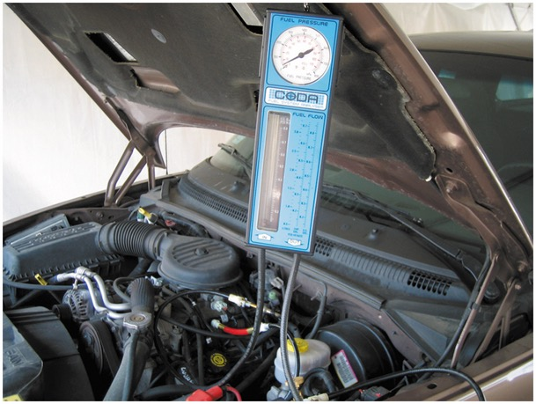
Figure 21.26 A fuel system tester connected in series in the fuel system so all of the fuel used flows through the meter, which displays the rate of flow and the fuel pressure

Slide 32
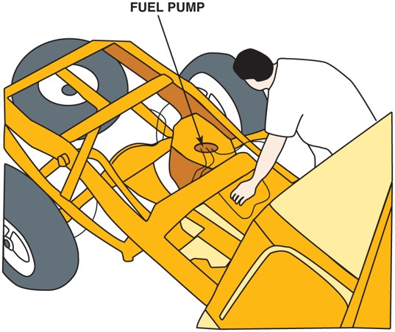
Figure 21.27 Removing the bed from a pickup truck makes gaining access to the fuel pump a lot easier

Slide 33
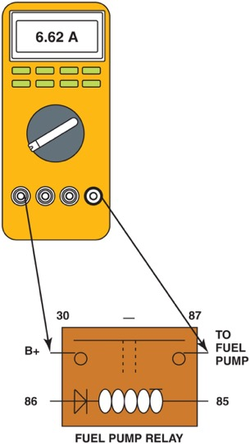
Figure 21.28 Hookup for testing fuel-pump current draw on any vehicle equipped with a fuel-pump relay

Slide 34
Video Links (Internet Access Required)
Fuel pump (time 0:31)
Fuel pump strainer (time 0:34)
Fuel pump relay (time 22:32)
Fuel tank pressure sensor (time 3:32)
Fuel pump replacement (time 1:16)
Fuel pump removal (time 6:17)
Fuel pump connections (time 6:16)
Fuel tank removal (time 7:11)
Fuel pump and fuel systems (time 5:04)
Fuel tank pressure sensor circuit (time 1:16)

Slide 35
Video Links (Internet Access Required)
Fuel level circuit (time 1:29)
Fuel volume (time 3:09)
Fuel volume test (time 4:29)
Fuel pump replacement (time 11:26)
Fuel filter replacement (time 6:55)
Fuel filter replacement (time 5:17)
Fuel pump testing (time 3:41)
Fuel filter (time 3:18)
Fuel pump circuit (time 44:03)
Fuel filter Toyota (time 2:10)

Slide 36
Video Links (Internet Access Required)
What’s inside a fuel pump (time 9:02)
Fuel pump relay testing (time 27:40)
Fuel system diagnosis (time 9:36)
Fuel pump circuit access (time 5:58)
Fuel pump troubleshooting (time 5:09)
Fuel system cleaning (time 8:16)
Fuel system diagnosis (time 7:28)
Fuel pressure test (time 4:12)
Fuel pressure regulator (time 7:32)
GM fuel pressure sensor test (time 25:20)

Slide 37
Copyright

