Slide 1
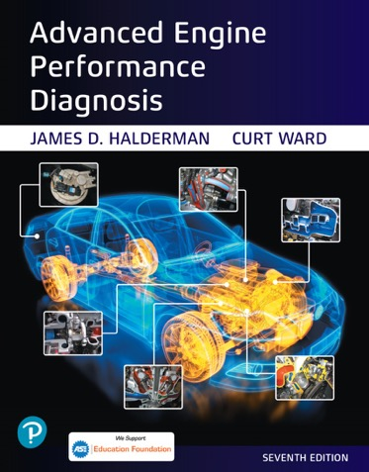
Advanced Engine Performance Diagnosis
Seventh Edition
Chapter 14
Ignition System Operation and Diagnosis
Copyright © 2020 Pearson Education, Inc. All Rights Reserved

Slide 2
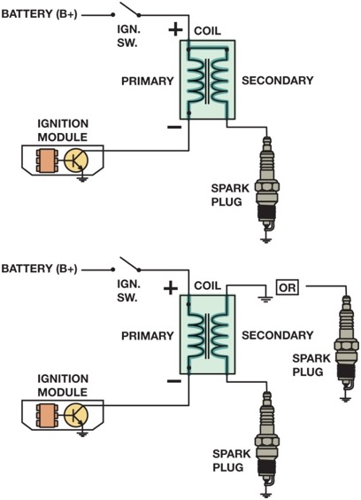
Figure 14.1 Some ignition coils are electrically connected, called married (top figure), whereas others use separate primary and secondary windings, called divorced (lower figure). The polarity (positive or negative) of a coil is determined by the direction in which the coil is wound

Slide 3
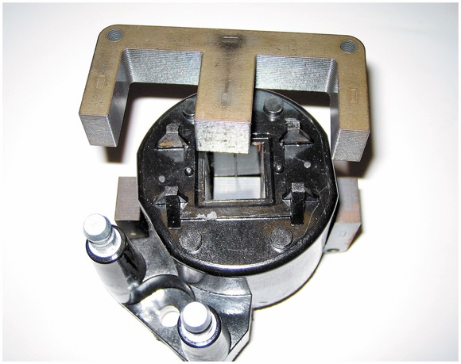
Figure 14.2 The steel lamination used in an E coil helps increase the magnetic field strength, which helps the coil produce higher energy output for a more complete combustion in the cylinders

Slide 4
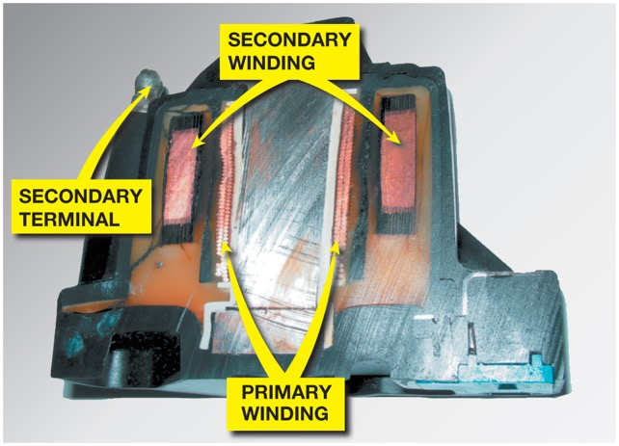
Figure 14.3 The primary windings are inside the secondary windings on this General Motors coil

Slide 5
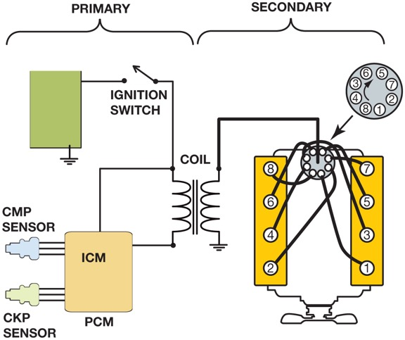
Figure 14.4 The primary ignition system is used to trigger and therefore create the secondary (high-voltage) spark from the ignition coil

Slide 6
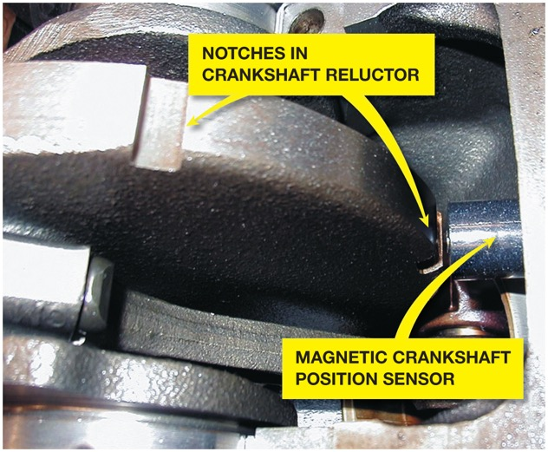
Figure 14.5 A typical magnetic crankshaft position sensor

Slide 7
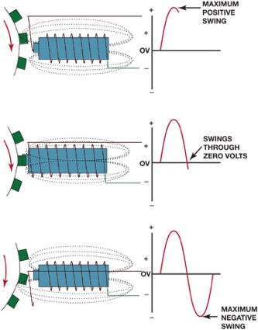
Figure 14.6 A magnetic sensor uses a permanent magnet surrounded by a coil of wire. The notches of the crankshaft (or camshaft) create a variable magnetic field strength around the coil. When a metallic section is close to the sensor, the magnetic field is stronger because metal is a better conductor of magnetic lines of force than air

Slide 8
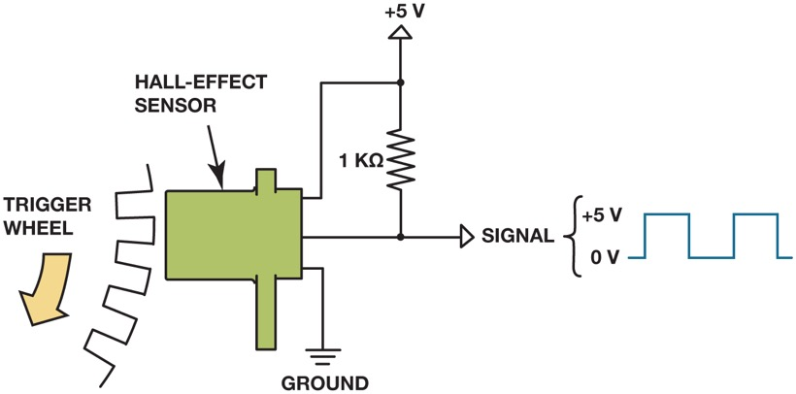
Figure 14.7 A Hall-effect sensor produces an on-off voltage signal whether it is used with a blade or a notched wheel

Slide 9
Animation: Hall-effect Sensor ((Animation will automatically start in a few seconds)he animation will automatically start in a few seconds)

Slide 10
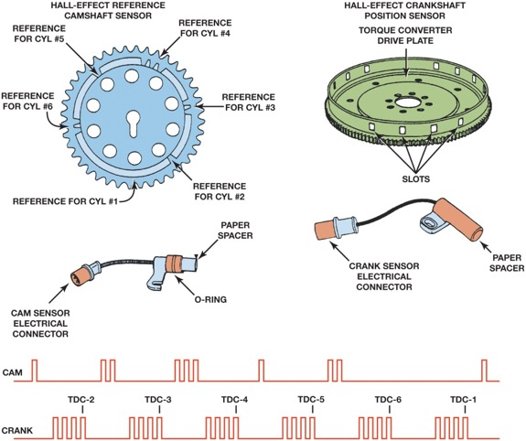
Figure 14.8 Some Hall-effect sensors look like magnetic sensors. This Hall-effect camshaft reference sensor and crankshaft position sensor have an electronic circuit built in that creates a 0 to 5 volt signal as shown at the bottom. These Hall-effect sensors have three wires: a power supply from the computer (controller), a signal (0 to 5 volts), and a signal ground

Slide 11
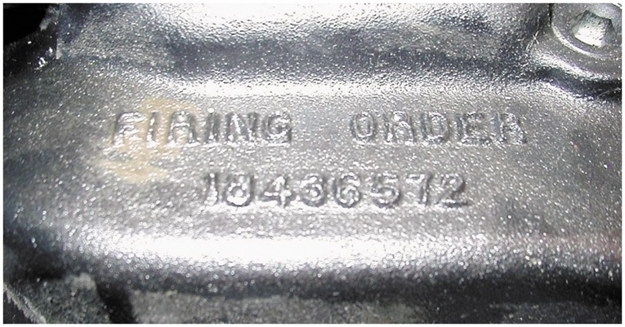
Figure 14.9 The firing order is cast or stamped on the intake manifold on most engines that have a distributor ignition

Slide 12
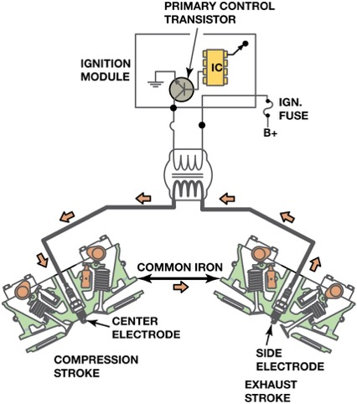
Figure 14.10 A waste-spark system fires one cylinder while its piston is on the compression stroke and into paired or companion cylinders while it is on the exhaust stroke. In a typical engine, it requires only about 2 to 3 kV to fire the cylinder on the exhaust stroke. The remaining coil energy is available to fire the spark plug under compression (typically about 8 to 12 kV)

Slide 13
Animation: Waste Spark Ignition System ((Animation will automatically start in a few seconds)he animation will automatically start in a few seconds)

Slide 14
Animation: Waste Spark Ignition System ((Animation will automatically start in a few seconds)he animation will automatically start in a few seconds)

Slide 15
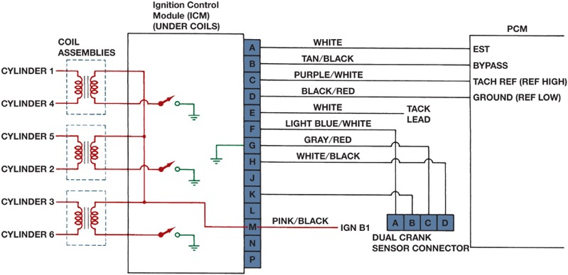
Figure 14.11 Typical wiring diagram of a V-6 waste-spark ignition system. The P C M uses input data from all of the engine sensors and determines the optimum ignition timing, then triggers the primary ignition circuit to fire the spark plug or sends the trigger signal to the I C M , if equipped

Slide 16
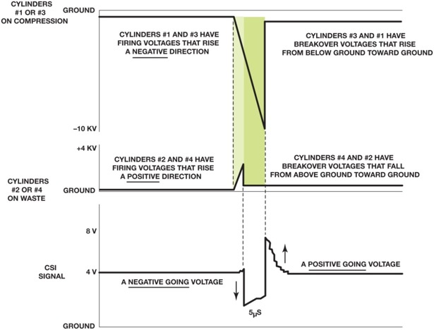
Figure 14.12 The slight (5 microseconds) difference in the firing of the companion cylinders is enough time to allow the P C M to determine which cylinder is firing on the compression stroke

Slide 17
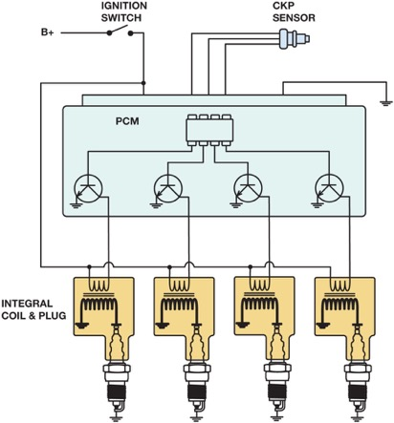
Figure 14.13 A typical coil-on-plug ignition system showing the triggering and the switching being performed by the pcm from input from the crankshaft position sensor

Slide 18
Animation: Coil-On-Plug Ignition System ((Animation will automatically start in a few seconds)he animation will automatically start in a few seconds)

Slide 19
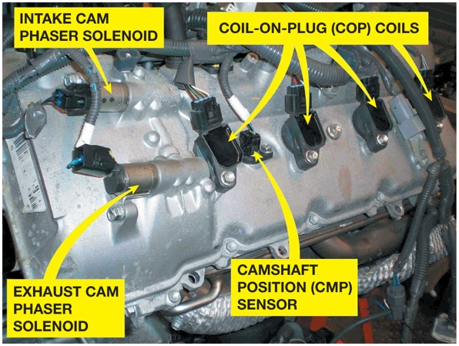
Figure 14.14 An overhead camshaft engine equipped with variable valve timing on both the intake and exhaust camshafts and coil-on-plug ignition

Slide 20
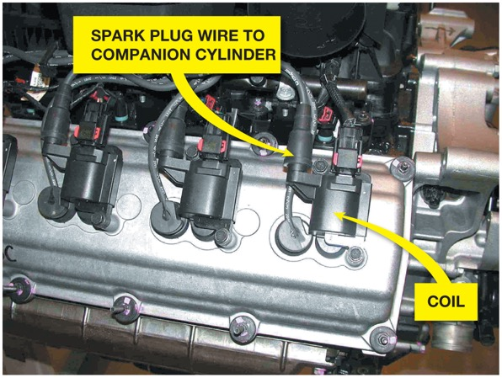
Figure 14.15 A Chrysler Hemi V-8 that has two spark plugs per cylinder. The coil on top of one spark fires that plug plus, through a spark plug wire, fires a plug in the companion cylinder

Slide 21
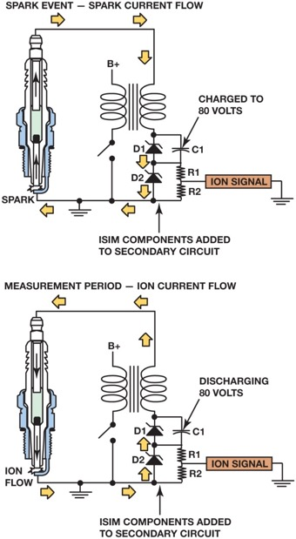
Figure 14.16 A D C voltage is applied across the spark plug gap after the plug fires and the circuit can determine if the correct air–fuel ratio was present in the cylinder and if knock occurred. The applied voltage for ion-sensing does not jump the spark plug gap, but determines the conductivity of the ionized gases left over from the combustion process

Slide 22
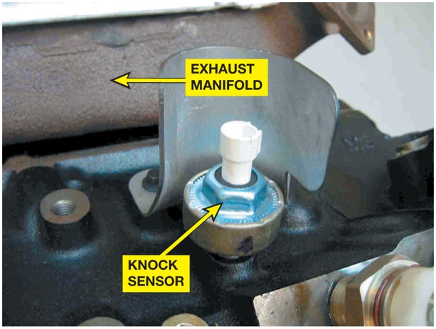
Figure 14.17 A typical knock sensor on the side of the block. Some are located in the “V” of a V-type engine and are not noticeable until the intake manifold has been removed

Slide 23
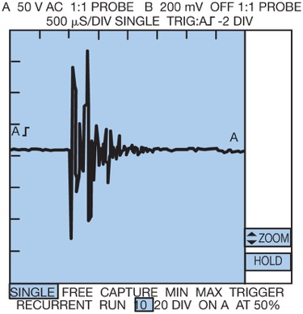
Figure 14.18 A typical waveform from a knock sensor during a spark knock event. This signal is sent to the computer which in turn retards the ignition timing. This timing retard is accomplished by an output command from the computer to either a spark advance control unit or directly to the ignition module

Slide 24
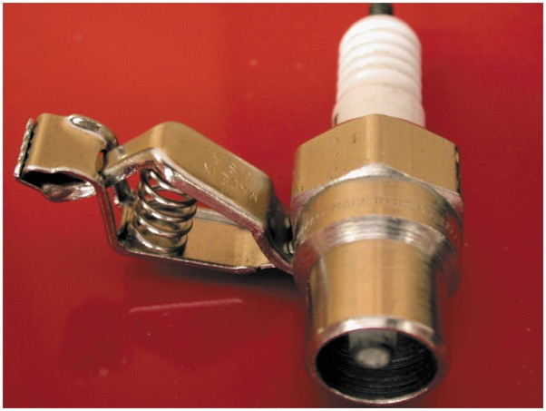
Figure 14.19 A spark tester looks like a regular spark plug with an alligator clip attached to the shell. This tester has a specified gap that requires at least 25,000 volts (25 kV) to fire

Slide 25
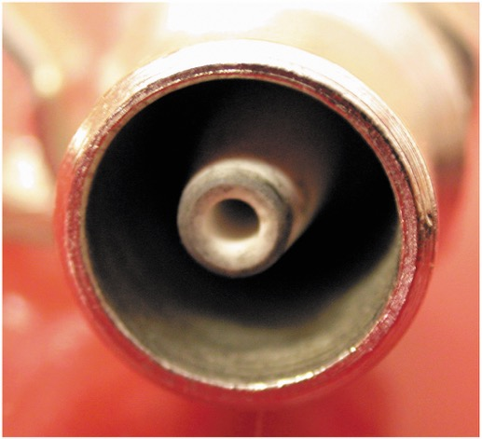
Figure 14.20 A close-up showing the recessed center electrode on a spark tester. It is recessed 3/8 inch into the shell and the spark must then jump another 3/8 inch to the shell for a total gap of 3/4 inch

Slide 26
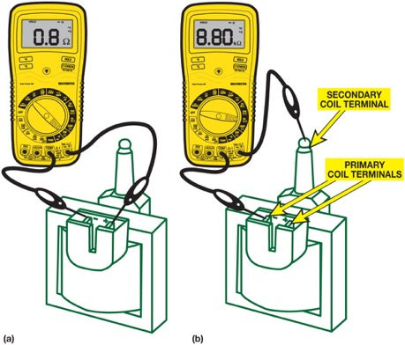
Figure 14.21 (a) Set the digital meter to read Ohms and measure between the two the primary terminal of the coil. Most coils are less than one Ohm. (b) To measure the secondary winding. Connect one meter lead to one of the primary terminals and the other to the secondary terminal

Slide 27
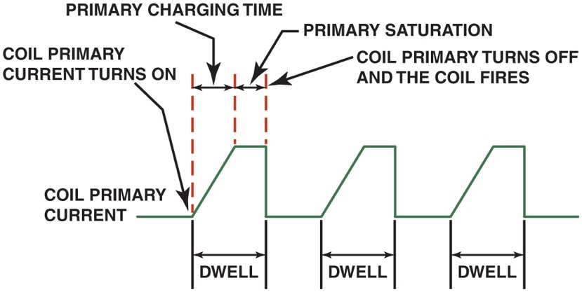
Figure 14.22 A waveform showing the primary current flow through the primary windings of an ignition coil

Slide 28
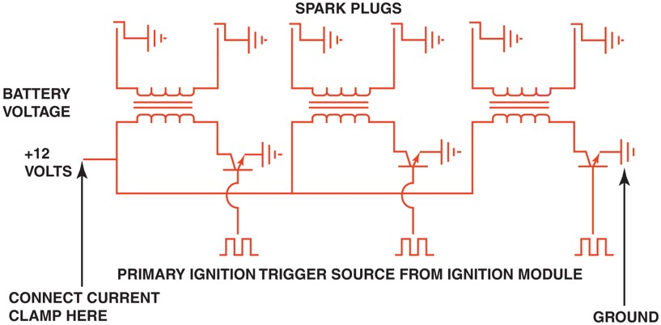
Figure 14.23 Schematic of a typical waste-spark ignition system showing the location for the power feed and grounds

Slide 29
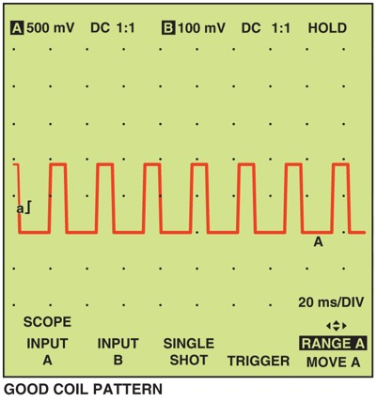
Figure 14.24 An example of a good coil current flow waveform pattern. Note the regular shape of the rise time and slope. Duration of the waveform may change as the module adjusts the dwell. The dwell is usually increased as the engine speed is increased

Slide 30
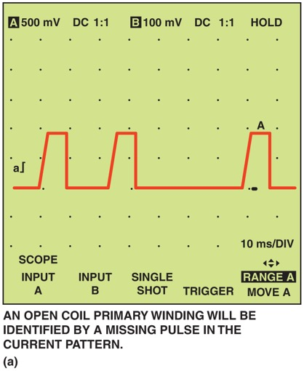
Figure 14.25 (a) A waveform pattern showing an open in the coil primary

Slide 31
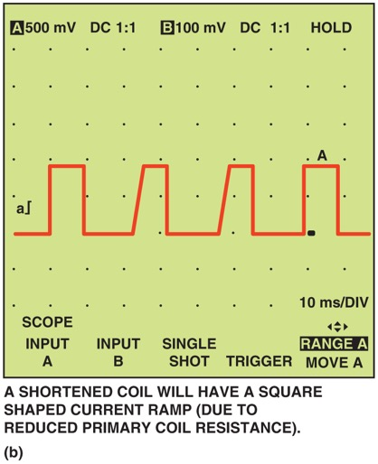
Figure 14.25 (b) A shorted coil pattern waveform

Slide 32
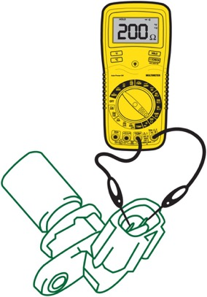
Figure 14.26 Measuring the resistance of an magnetic crankshaft position (C K P) sensor using an ohmmeter

Slide 33
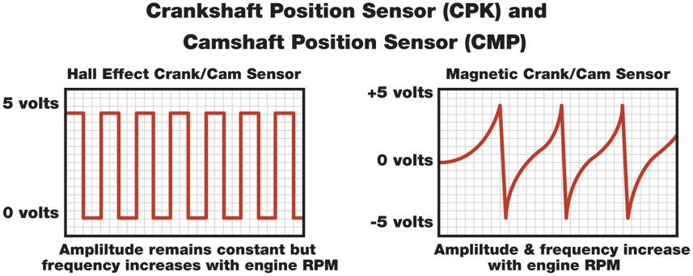
Figure 14.27 A Hall Effect sensor produces an square waveform whereas a magnetic sensor produces an analog waveform when viewed on scope

Slide 34
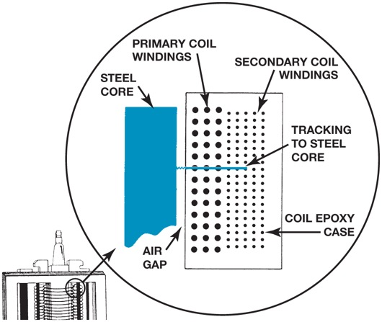
Figure 14.28 A track inside an ignition coil is not a short, but a low resistance path or hole that has been burned through from the secondary wiring to the steel core

Slide 35
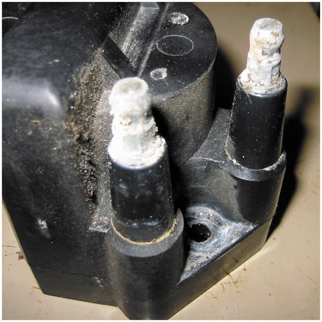
Figure 14.29 Corroded terminals on a waste spark coil can cause misfire diagnostic trouble codes to be set

Slide 36
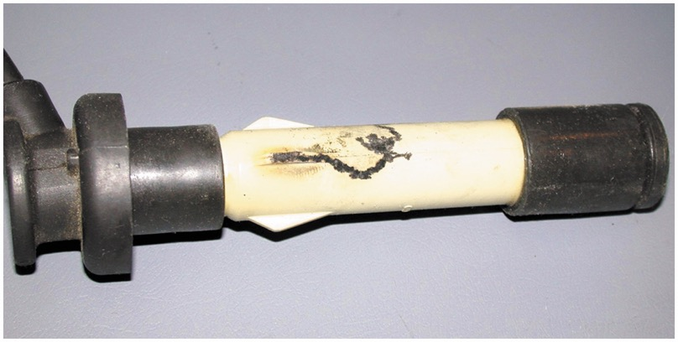
Figure 14.30 This spark plug boot on an overhead camshaft engine has been arcing to the valve cover causing a misfire to occur

Slide 37
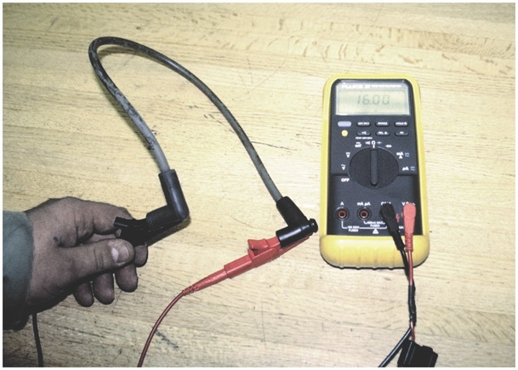
Figure 14.31 Measuring the resistance of a spark plug wire with a multimeter set to the ohms position. The reading of 16.03 kΩ (16,030 ohms) is okay because the wire is about 2 ft long. Maximum allowable resistance for a spark plug wire this long would be 20 kΩ (20,000 ohms)

Slide 38
Animation: Test Spark Plug Wire ((Animation will automatically start in a few seconds)he animation will automatically start in a few seconds)

Slide 39
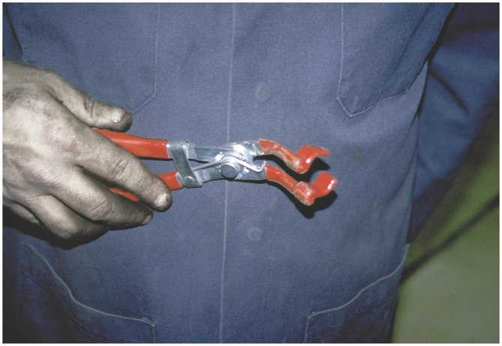
Figure 14.32 This spark plug wire boot pliers is a handy addition to any tool box

Slide 40
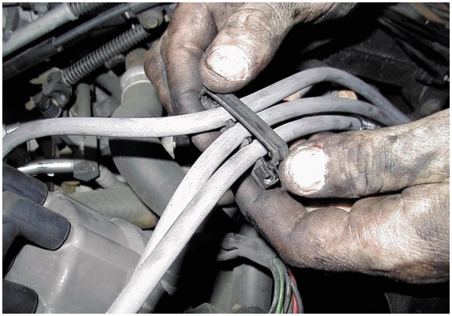
Figure 14.33 Always take the time to install spark plug wires back into the original holding brackets (wiring combs)

Slide 41
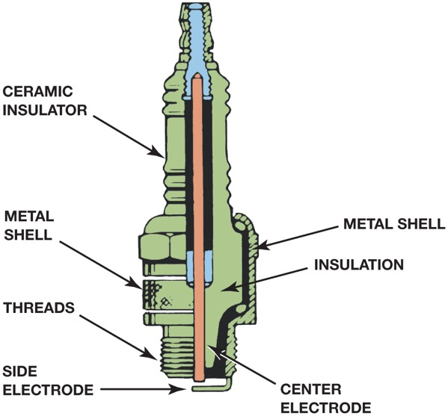
Figure 14.34 Parts of a spark plug

Slide 42
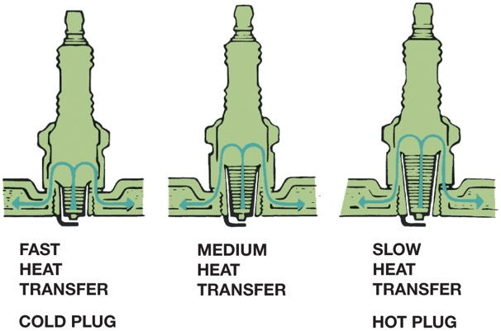
Figure 14.35 The heat range of a spark plug is determined by distance the heat flows from the tip to the cylinder head

Slide 43
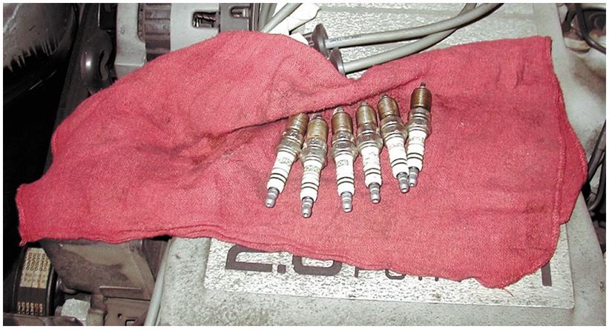
Figure 14.36 When removing spark plugs, it is wise to arrange them so that they can be compared and any problem can be identified with a particular cylinder

Slide 44
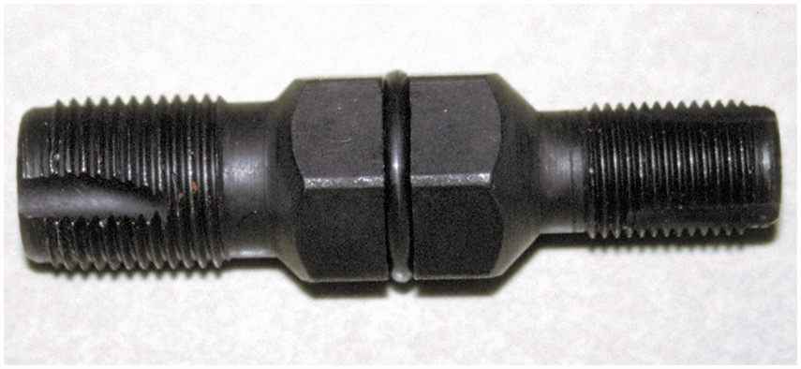
Figure 14.37 A spark plug thread chaser is a low-cost tool that hopefully will not be used often, but is necessary to use to clean the threads before new spark plugs are installed

Slide 45
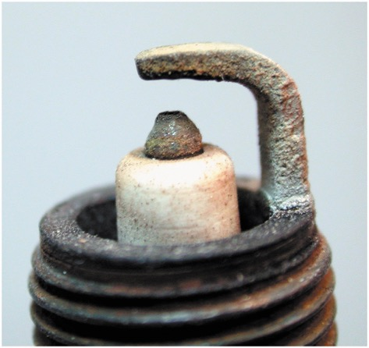
Figure 14.38 A normally worn spark plug that uses a tapered platinum-tipped center electrode

Slide 46
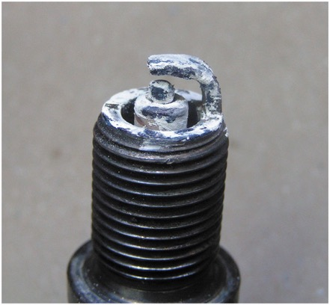
Figure 14.39 A spark plug from an engine that had a blown head gasket. The white deposits could be from the additives in the coolant

Slide 47
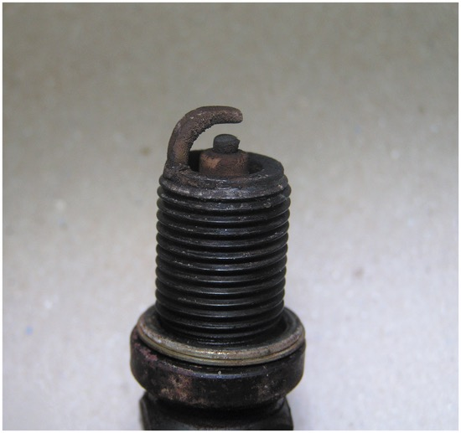
Figure 14.40 A worn spark plug showing fuel and/or oil deposits

Slide 48
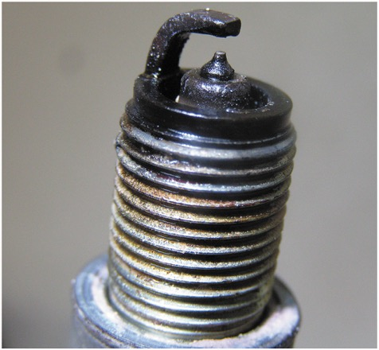
Figure 14.41 A platinum tipped spark plug that is fuel soaked indicating a fault with the fuel system or the ignition system causing the spark plug to not fire

Slide 49
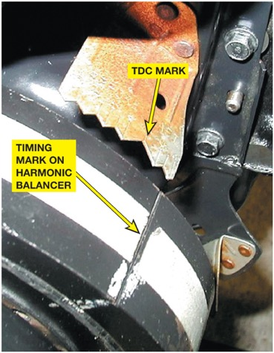
Figure 14.42 Ignition timing marks are found on the harmonic balancers on engines equipped with distributors that can be adjusted for timing

Slide 50
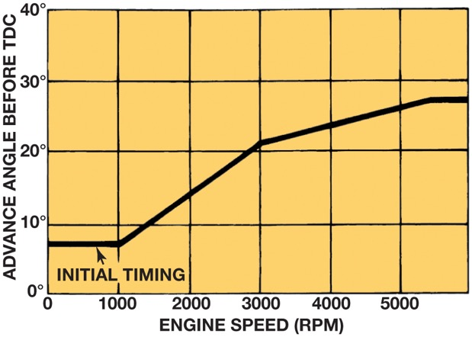
Figure 14.43 The initial (base) timing is where the spark plug fires at idle speed. The P C M then advances the timing based primarily on engine speed

Slide 51
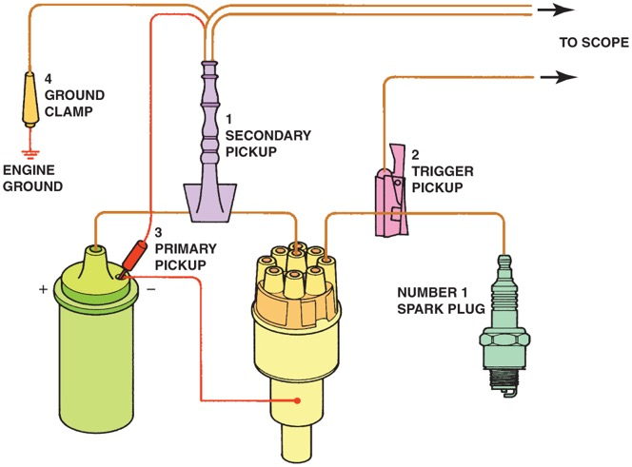
Figure 14.44 Typical engine analyzer hookup that includes a scope display. (1) Coil wire on top of the distributor cap if integral type of coil; (2) number 1 spark plug connection; (3) negative side of the ignition coil; (4) ground (negative) connection of the battery

Slide 52
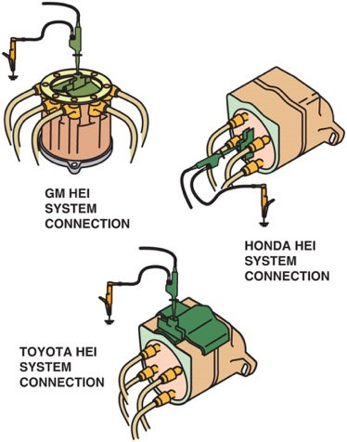
Figure 14.45 Clip-on adapters are used with an ignition system that uses an integral ignition coil

Slide 53
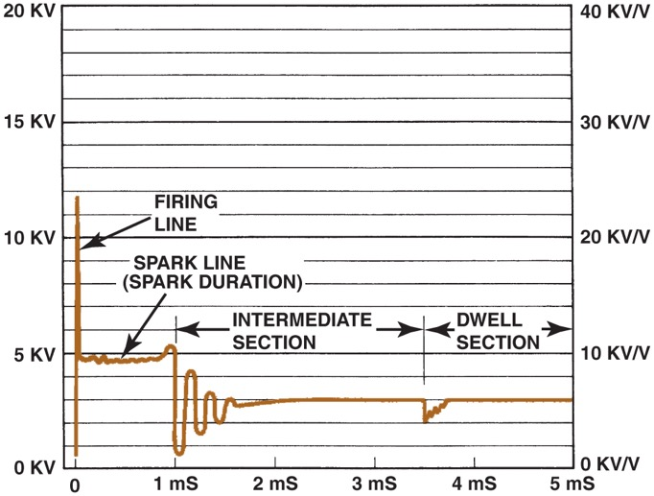
Figure 14.46 Typical secondary ignition oscilloscope pattern

Slide 54
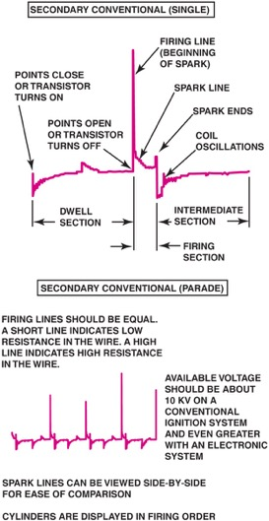
Figure 14.47 A single cylinder is shown at the top and a 4-cylinder engine at the bottom

Slide 55
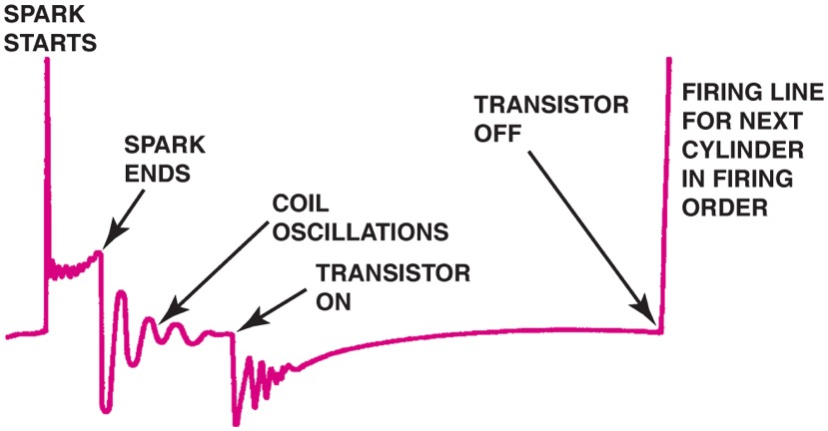
Figure 14.48 Drawing shows what is occurring electrically at each part of the scope pattern

Slide 56
Figure 14.49 Typical secondary ignition pattern. Note the lack of firing lines on the superimposed pattern

Slide 57
Figure 14.50 Raster is the best scope position to view the spark lines of all the cylinders to check for differences. Most scopes display cylinder 1 at the bottom. The other cylinders are positioned by firing order above cylinder 1

Slide 58
Figure 14.51 Display is the only position to view the firing lines of all cylinders. Cylinder 1 is displayed on the left (except for its firing line, which is shown on the right). The cylinders are displayed from left to right by firing order

Slide 59
Figure 14.52 A downward-sloping spark line usually indicates high secondary ignition system resistance or an excessively rich air–fuel mixture

Slide 60
Figure 14.53 An upward-sloping spark line usually indicates a mechanical engine problem or a lean air–fuel mixture

Slide 61
Figure 14.54 The relationship between the height of the firing line and length of the spark line can be illustrated using a rope. Because energy cannot be destroyed, the stored energy in an ignition coil must dissipate totally, regardless of engine operating conditions

Slide 62
Figure 14.55 A dual trace scope pattern showing both the power and the waste spark from the same coil (cylinders 1 and 6). Note that the firing line is higher on the cylinder that is under compression (power); otherwise, both patterns are almost identical

Slide 63
Figure 14.56 A secondary waveform of a Ford 4.6 liter V-8, showing three sparks occurring at idle speed

Slide 64
Figure 14.57 An inductive paddle being used on engine equipped with a coil-on-plug ignition to get a scope pattern on the laptop computer using a Pico scope

Slide 65
Figure 14.58 The inductive paddle used with a Pico scope created the pattern showing normal ignition and engine operation

Slide 66
Video Links (Internet Access Required)
Cylinder deactivation (time 2:35)
Ignition system (time 5:26)
Basic ignition (time 1:07:57)
COP ignition system (time 3:00)
Electronic ignition distributor (time 2:21)
Ignition coil signal circuit (time 2:38)
Spark plug wires (time 1:20)
Ignition triggers (time 1:03)
Ignition control module (time 1:02)
Transformers (time 0:49)

Slide 67
Video Links (Internet Access Required)
Knock sensor signal circuit (time 1:29)
Hall effect sensor signal circuit (time 1:36)
Hall effect crank sensor reference voltage circuit (time 1:25)
Hall effect crank sensor (time 1:46)
Phototransistor crank sensor circuit (time 1:22)
Magnetic crankshaft sensor signal circuit (time 1:14)
Magnetic crankshaft sensor reference circuit (time 1:32)
Cam and Crank sensor circuits (time 1:39)
Knock sensor (time 0:41)
CMP sensor (time 0:59)

Slide 68
Video Links (Internet Access Required)
CKP sensor (time 3:33)
Crankshaft position sensor (time 0:42)
Camshaft position sensor (time 0:42)
Knock sensor (time 0:46)
Cam and crank sensors and wiring diagrams (time 5:16)
Knock sensor testing (time 16:09)
NGC ignition codes (time 4:21)
Crankshaft position sensor (time 3:55)
Crankshaft position sensor (time 4:07)
Crankshaft position sensor (time 3:32)

Slide 69
Video Links (Internet Access Required)
Crankshaft sensor (time 9:57)
IAC test with a scope (time 7:17)
Crankshaft sensor (time 5:12)
Scope testing a crankshaft sensor (time 6:47)
Chrysler hall effect sensor testing part (time 14:55)
Chrysler hall effect sensor testing part 2 (time 6:10)
Testing crankshaft sensors (time 4:39)
Testing crankshaft sensors (time 5:00)
Distributor cap and rotor (time 2:57)
Spark plugs (time 3:25)

Slide 70
Video Links (Internet Access Required)
Ignition coil (time 3:40)
Spark plugs (time 6:56)
Spark plugs and oxygen sensors (time 8:30)
Ignition coil (time 0:53)
How Ignition System Works (time 4:06)

Slide 71
Copyright

