Slide 1
Advanced Engine Performance Diagnosis
Seventh Edition
Chapter 13
Starting and Charging System Diagnosis
Copyright © 2020 Pearson Education, Inc. All Rights Reserved

Slide 2
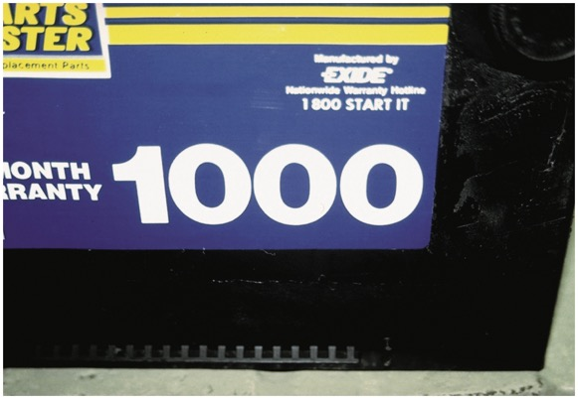
Figure 13.1 This battery has a cranking amperes (C A ) rating of 1,000. This means that this battery is capable of cranking an engine for 30 seconds at a temperature of 32°F (0°C) at a minimum of 1.2 volts per cell (7.2 volts for a 12-volt battery)

Slide 3
Animation: Battery Action ((Animation will automatically start in a few seconds)he animation will automatically start in a few seconds)

Slide 4
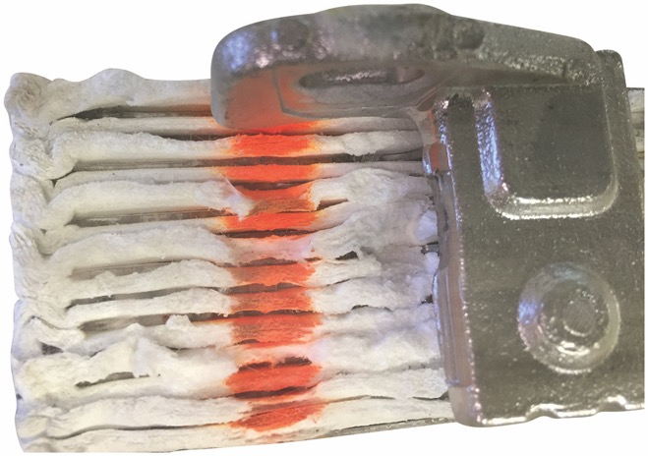
Figure 13.2 A close-up of an A G M cell showing the mat totally encasing the plates

Slide 5
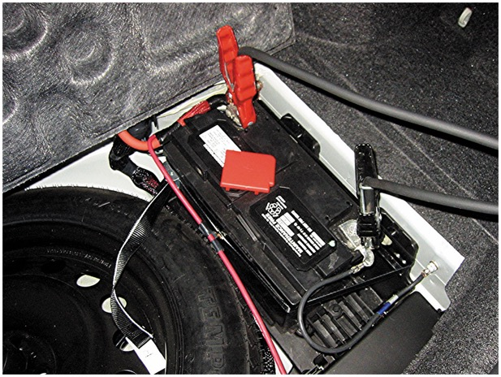
Figure 13.3 An A G M battery under the floor next to the spare tire on a Lexus N X300h hybrid electric vehicle

Slide 6
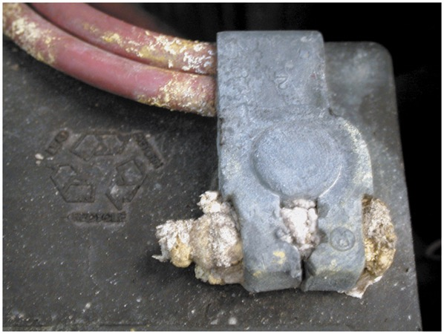
Figure 13.4 Corrosion on a battery cable could be an indication that the battery itself is either being overcharged or is sulfated, creating a lot of gassing of the electrolyte

Slide 7
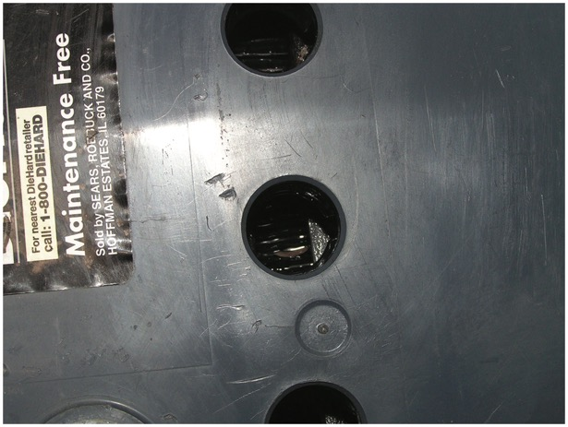
Figure 13.5 A visual inspection on this battery shows the electrolyte level is below the plates in all cells

Slide 8
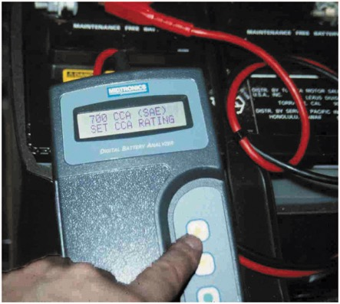
Figure 13.6 A conductance tester is very easy to use and has proved to accurately determine battery condition if the connections are properly made. Follow the instructions on the display exactly for best results

Slide 9
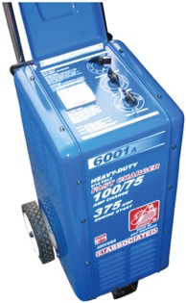
Figure 13.7 A typical industrial battery charger. Be sure that the ignition switch is in the off position before connecting any battery charger. Connect the cables of the charger to the battery before plugging the charger into the outlet. This helps prevent a voltage spike and spark that could occur if the charger happened to be accidentally left on. Always follow the battery charger manufacturer’s instructions

Slide 10
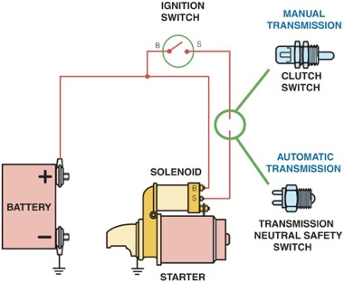
Figure 13.8 To prevent the engine from cranking, an electrical switch is usually installed to open the circuit between the ignition switch and the starter solenoid. The control circuit includes the small wiring and components needed to control the solenoid. The starter solenoid controls the electrical current flow through the large battery cables of the power circuit which operates the starter motor

Slide 11
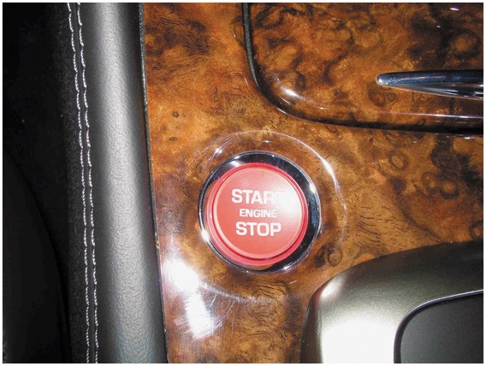
Figure 13.9 Instead of using an ignition key to start the engine, some vehicles are using a start button which is also used to stop the engine, as shown on this Jaguar

Slide 12
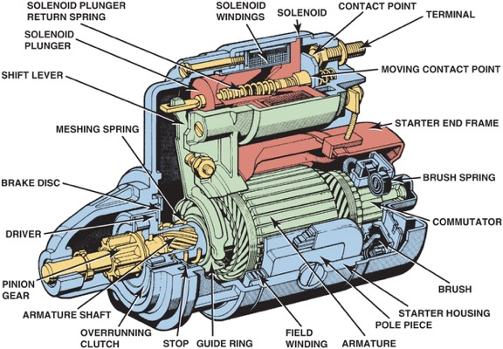
Figure 13.10 A cutaway of a typical starter motor showing the commutator, brushes, and brush spring

Slide 13
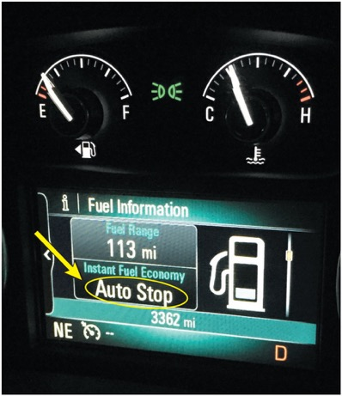
Figure 13.11 A Buick Auto Stop system lets the driver know when the engine is stopped

Slide 14
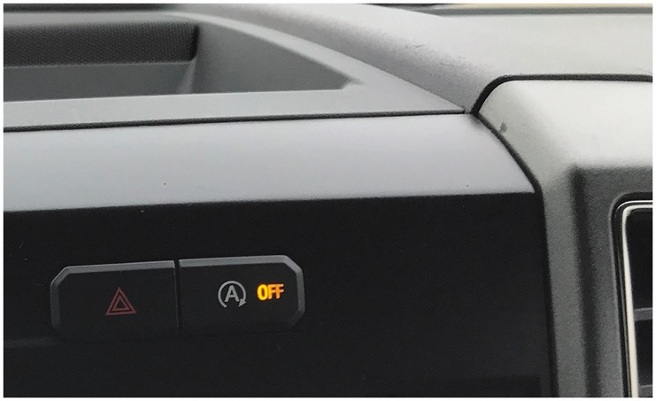
Figure 13.12 The stop-start system on this Ford F-150 pickup truck can be turned off using a switch on the dash

Slide 15
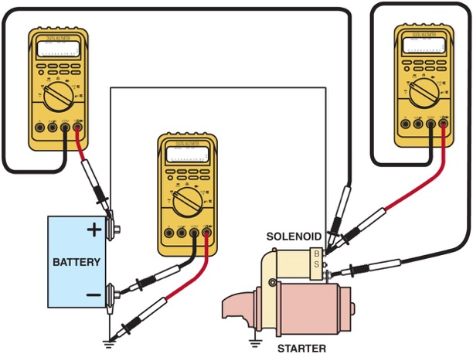
Figure 13.13 Voltmeter hookups for voltage drop testing of a solenoid-type cranking circuit

Slide 16
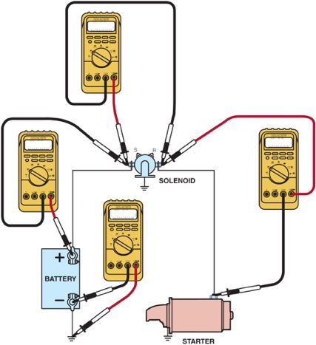
Figure 13.14 Voltmeter hookups for voltage drop testing of a Ford cranking circuit

Slide 17
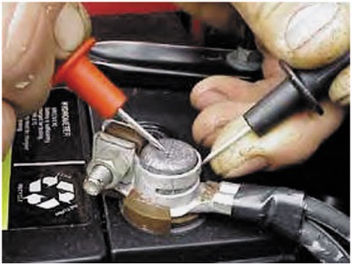
Figure 13.15 To test the voltage drop of the battery cable connection, place one voltmeter lead on the battery terminal and the other voltmeter lead on the cable end and crank the engine. The voltmeter will read the difference in voltage between the two leads, which should not exceed 0.20 volt (200 mV )

Slide 18
Animation: Measure Battery Voltage Drop ((Animation will automatically start in a few seconds)he animation will automatically start in a few seconds)

Slide 19
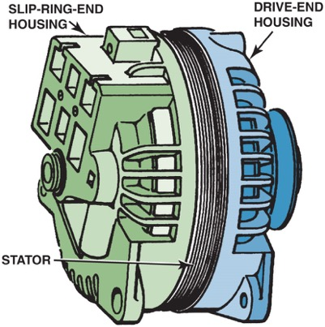
Figure 13.16 The end frame toward the drive belt is called the drive-end housing and the rear section is called the slipring-end housing

Slide 20
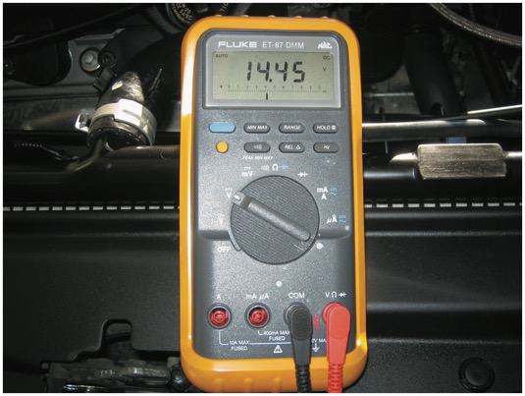
Figure 13.17 The digital multimeter should be set to read D C volts, with the red lead connected to the positive (+) battery terminal and the black meter lead connected to the negative (−) battery terminal

Slide 21
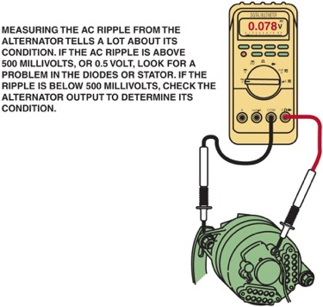
Figure 13.18 Testing A C ripple at the output terminal of the alternator is more accurate than testing at the battery due to the resistance of the wiring between the alternator and the battery. The reading shown on the meter, set to A C volts, is only 78 millivolts (0.078 V), far below what the reading would be if a diode were defective

Slide 22
Animation: Measure AC Ripple ((Animation will automatically start in a few seconds)he animation will automatically start in a few seconds)

Slide 23
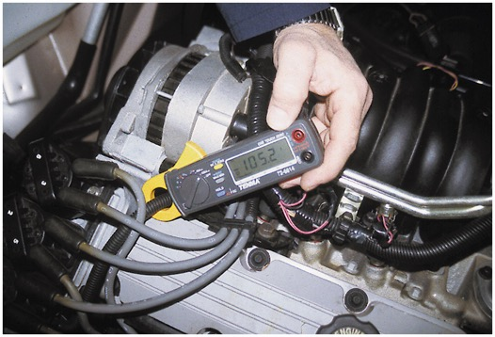
Figure 13.19 A mini clamp-on meter can be used to measure alternator output as shown here (105.2 A). Then the meter can be used to check A C current ripple by selecting A C amps on the rotary dial. A C ripple current should be less than 10% of the D C current output

Slide 24
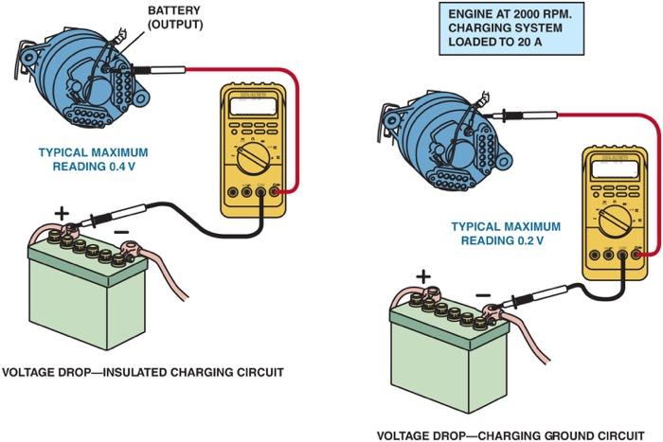
Figure 13.20 Voltmeter hookup to test the voltage drop of the charging circuit

Slide 25
Animation: Starter Circuit, Voltage Drop Tests ((Animation will automatically start in a few seconds)he animation will automatically start in a few seconds)

Slide 26
Figure 13.21 Normal alternator scope pattern. This A C ripple is on top of a D C voltage line. The ripple should be less than 0.50 volt high

Slide 27
Figure 13.22 Alternator pattern indicating a shorted diode

Slide 28
Figure 13.23 Alternator pattern indicating an open diode

Slide 29
Video Links (Internet Access Required)
Charging system problem – voltage drops (time 34:23)
How to test an alternator – Diagnose charging issues (time 11:32)
How to check a charging system (time 4:48)
Voltage drop testing the charging system (time 9:48)
Battery, starter, and alternator testing (time 4:48)
BMW Charging System Alternator Diagnosis (time 22:31)
Tech Garage No Crank/Battery Starting and Charging System (time 22:16)
The Trainer – Testing Battery/Starting/Charging Systems (time 9:50)
Engine Starting and Charging System (time 1:51)

Slide 30
Copyright

