Slide 1
Advanced Engine Performance Diagnosis
Seventh Edition
Chapter 12
Immobilizer Systems
Copyright © 2020 Pearson Education, Inc. All Rights Reserved

Slide 2
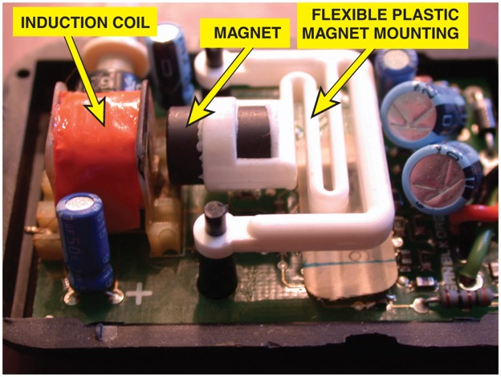
Figure 12.1 A shock sensor used in alarm and antitheft systems. If the vehicle is moved, the magnet will move relative to the coil, inducing a small voltage that will trigger the alarm

Slide 3
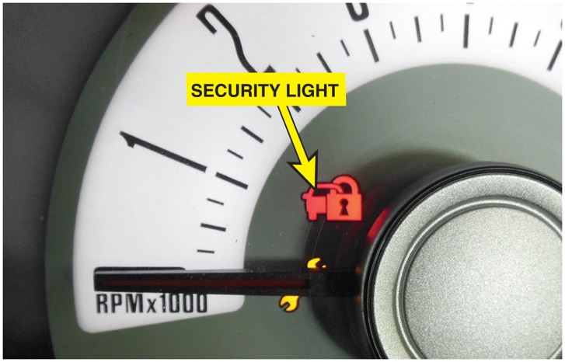
Figure 12.2 The security system symbol used on a Ford. The symbol varies by make model and year so check service information to determine what symbol is used on the vehicle being diagnosed

Slide 4
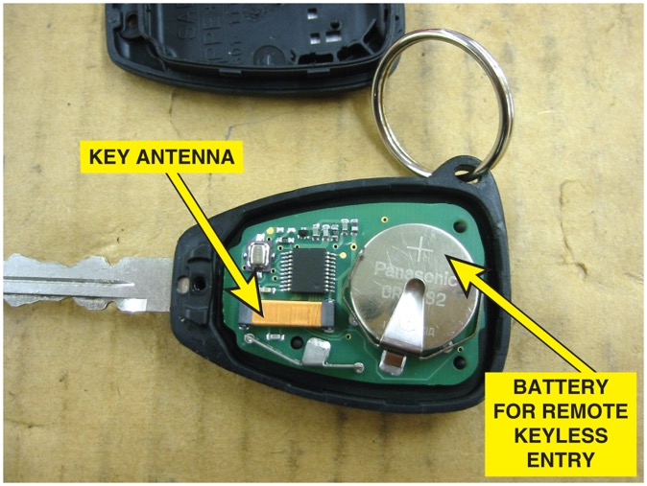
Figure 12.3 A typical key with the cover removed showing the battery used to power the door lock and the antenna used for the immobilizer system

Slide 5
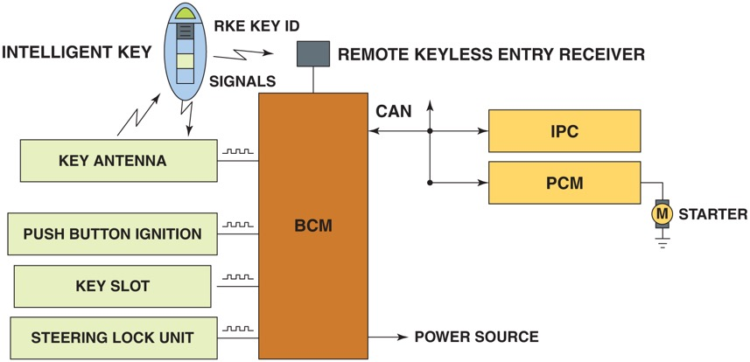
Figure 12.4 The remote keyless entry is used to unlock the doors as well as create the signals to the powertrain control module (P C M) used to control the starter motor and/or the fuel system and the warning lamp on the instrument panel cluster (I P C)

Slide 6
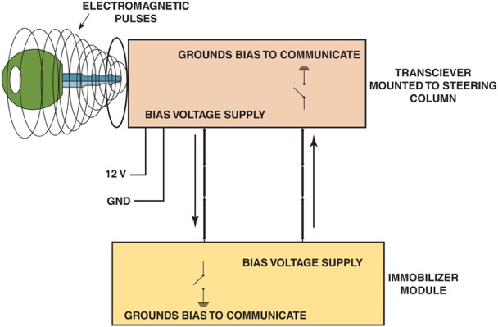
Figure 12.5 A typical immobilizer circuit showing the communication between the key and the transceiver. The transceiver then communicates with the immobilizer module over data lines

Slide 7
Animation: Immobilizer System ((Animation will automatically start in a few seconds)he animation will automatically start in a few seconds)

Slide 8
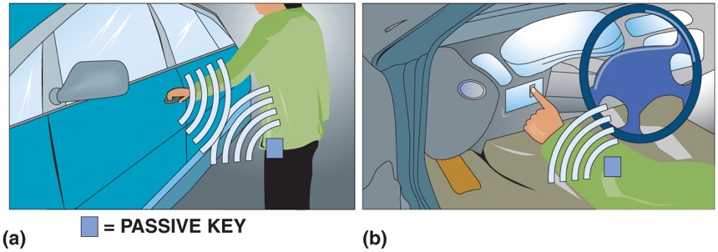
Figure 12.6 (a) If the passive key is within about 15 feet (5 m) of the vehicle when the door handle is touched, the door will unlock allowing access to the interior. (b) The engine will start if the smart key is detected being inside the vehicle

Slide 9
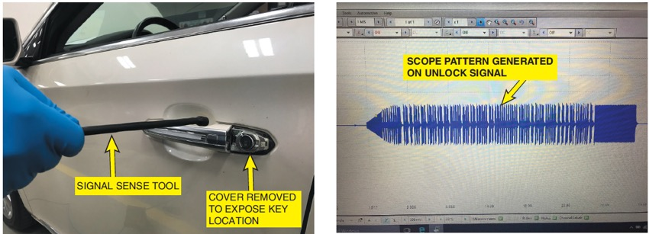
Figure 12.7 (a) The keyless entry signal detector is used on the driver’s door handle to verify its functionality. (b) The scope pattern that was generated by the vehicle on the unlock command verified the functionality of the circuit.

Slide 10
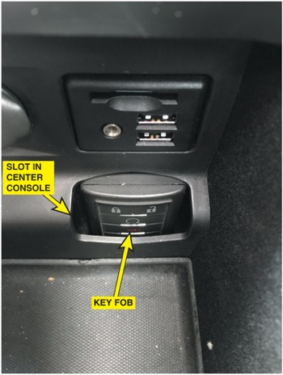
Figure 12.8 The placement of the passive key fob in the slot in the center console is an example of how an immobilizer system is able to recognize the fob even when the key is dead and allow the vehicle to start

Slide 11
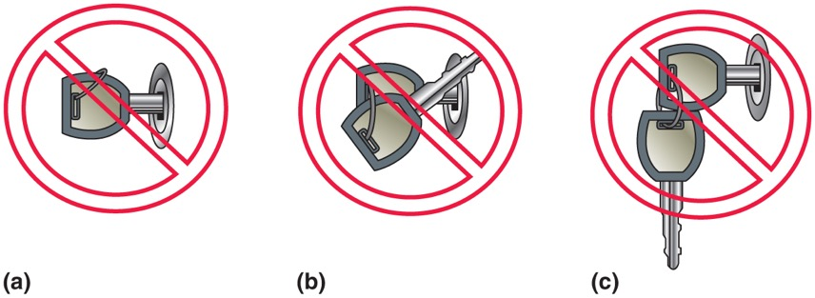
Figure 12.9 (a) Avoid using a key where the key ring is over the top of the key, which can interfere with the operation of the immobilizer system. (b) Do not angle another key upward from the key being used to help prevent interference with the magnetic field used to energize the key. (c) Do not have the keys from another vehicle near the key being used

Slide 12
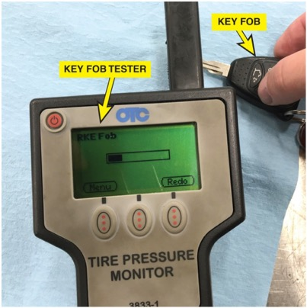
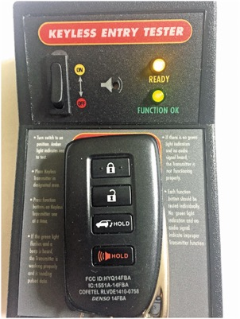
Figure 12.10 The R K E test equipment indicates a signal from the key fob when the unlock button was pushed indicating that portion of the fob is functional and the battery strength was sufficient

Slide 13
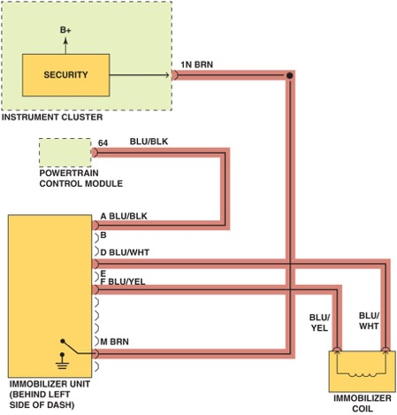
Figure 12.11 Check service information for the exact wiring diagram (schematic) for the vehicle being tested. Highlighting the wires and noting their color will help when following the specified testing procedures

Slide 14
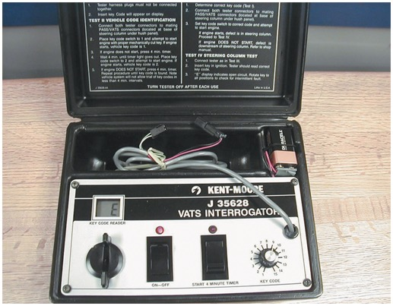
Figure 12.12 A special tool is needed to diagnose a General Motors V A T S security system and special keys that contain a resistor pellet

Slide 15
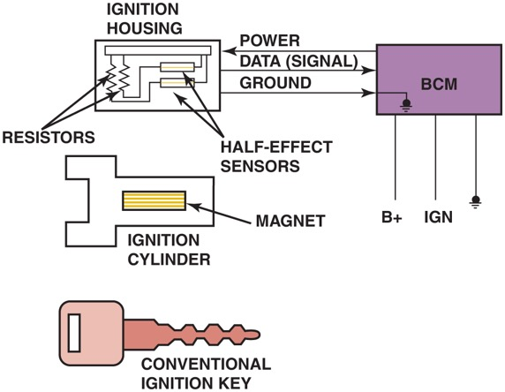
Figure 12.13 The Passlock series of General Motors security systems uses a conventional key. The magnet is located in the ignition lock cylinder and triggers the Hall-effect sensors

Slide 16
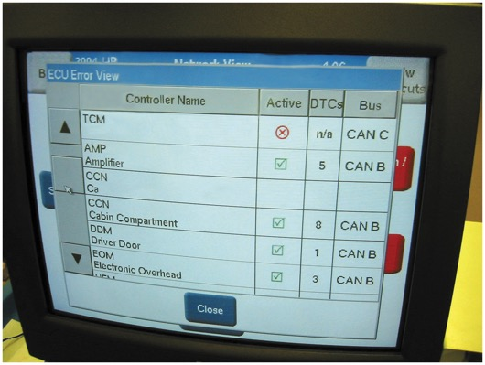
Figure 12.14 Scan tools, such as this factory tool being used on a Chrysler, are capable of many diagnostic functions that can help the technician zero in on the root cause of a problem

Slide 17
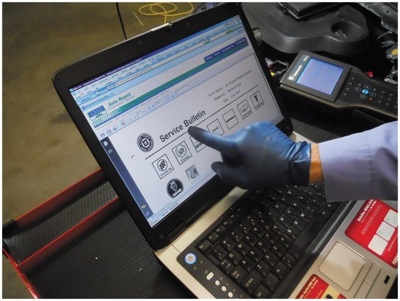
Figure 12.15 After checking for stored diagnostic trouble codes (D T C s), the wise technician checks service information for any technical service bulletins (T S B s) that may relate to the vehicle being serviced

Slide 18
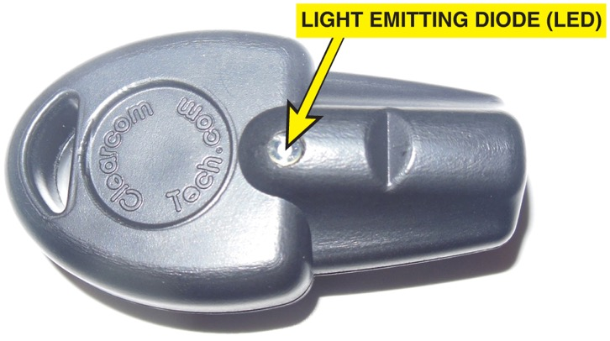
Figure 12.16 Immobilizer coil detectors can be found online by searching for immobilizer transponder coil detector

Slide 19
Video Links (Internet Access Required)
Electronic Immobilizer (time 1:07)
Toyota Engine Immobilizer System (time 1:16)
How the Immobilizer Works (time 0:55)
Honda Antitheft System Immobilizer (time 1:01)
Immobilizer Testing (time 3:09)
Anti-theft (time 4:28)
Ignition key transponders (time 3:19)

Slide 20
Copyright

