Slide 1
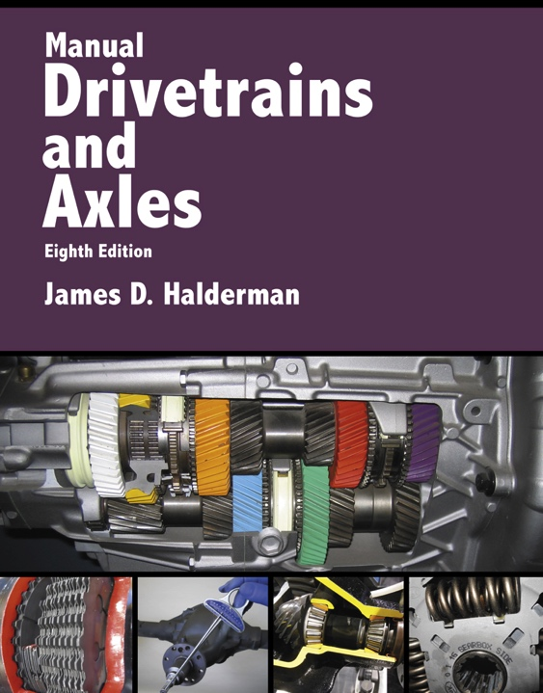
Manual Drivetrains and Axles
8th Edition
Chapter 4
Clutch Parts and Operation

Slide 2
Learning Objectives (1 of 2)
1.1 Prepare for ASE Manual Drive Train and Axles (A3) certification test content area “A” (Clutch Diagnosis and Repair).
1.2 List the major parts that are included in the clutch system and describe how the clutch works.
1.3 Discuss the purpose and function of clutch discs.

Slide 3
Learning Objectives (2 of 2)
1.4 Discuss the purpose and function of pressure plates.
1.5 State the characteristics of a flywheel and explain how a dual-mass flywheel works.
1.6 Describe how a clutch pedal linkage and a clutch pedal switch works.
1.7 Describe the operation of the release bearing and state the types of release bearings.

Slide 4
Clutches
The clutch assembly includes the flywheel, clutch disc, release (throwout) bearing, and pressure plate.
Force is exerted on the pressure plate by release bearings…
  Released from clutch disc between flywheel and pressure plate.

Slide 5
Figure 4–2 (a) When the clutch is in the released position (clutch pedal depressed), the clutch fork is applying a force to the throwout (release) bearing, which pushes on the diaphragm spring, releasing the pressure on the friction disc. (b) When the clutch is in the engaged position (clutch pedal up), the diaphragm spring exerts force on the clutch disc, holding it between the flywheel and the pressure plate

Slide 6
Clutch Discs
The clutch discs transfer engine torque from the flywheel to the input shaft of the transmission/transaxle.
It connects the flywheel and pressure plate when the clutch is engaged…
  And the pressure plate spring exerts spring pressure against the disc and forces it against the flywheel.
How do you assemble the hub and dampener?

Slide 7
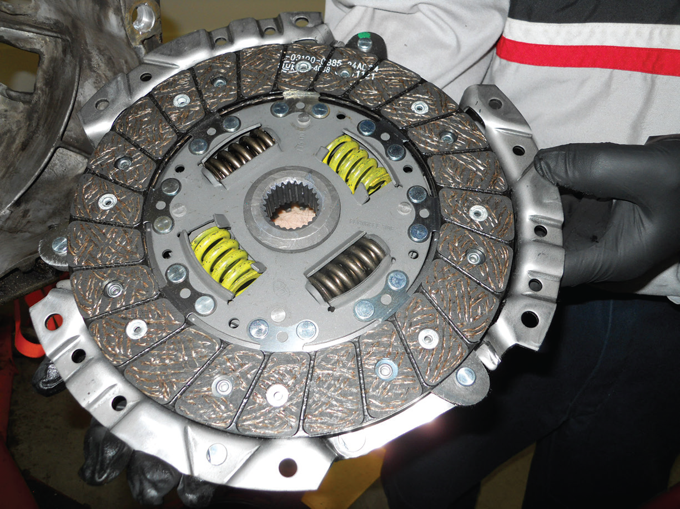
FIGURE 4–3 A replacement clutch is designed to meet the same friction specifications of the original so the new clutch will operate like new.

Slide 8
Pressure Plates
The pressure plate exerts force on the clutch disc so engine torque can be transmitted from engine to transmission/ transaxle. The required strong clamping force is provided by the pressure plate spring(s).
What are the different styles of pressure plates?
What are the advantages of a diaphragm-type clutch?
What is a: pressure plate ring? Cover (hat)? Release lever? Double disc clutch?

Slide 9
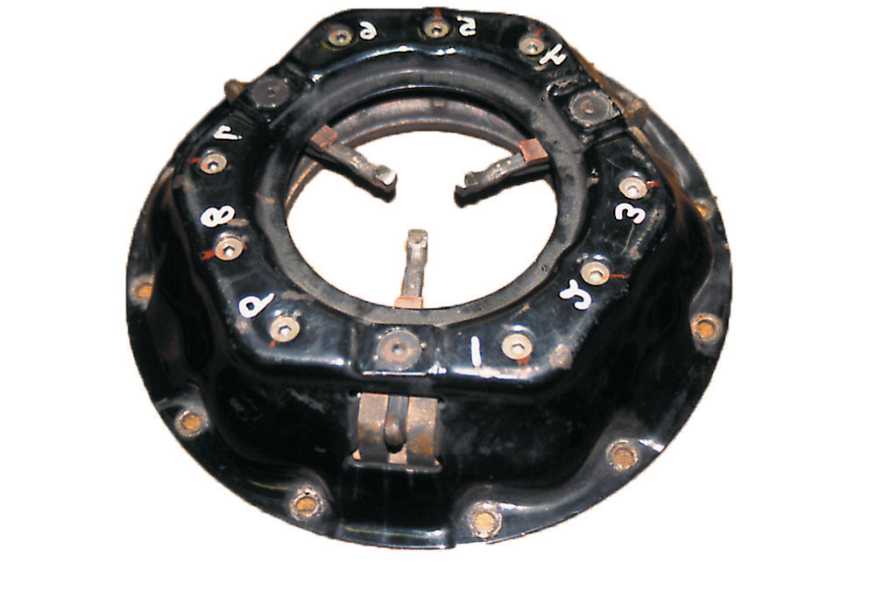
FIGURE 4–7 A coil spring (lever style) clutch pressure plate.

Slide 10
Flywheels
Characteristics
  Smooth out or dampens engine power pulses.
  Absorbs some of the heat created by clutch operation.
  Provides the connection point for the starter motor to rotate the engine.
  Provides the friction surface for the clutch friction disc.
What is inertia? What are stepped flywheels?

Slide 11
Figure 4–11 The ring gear, which is attached to the outer rim of the flywheel, provides the teeth needed to mesh with the starter pinion gear

Slide 12
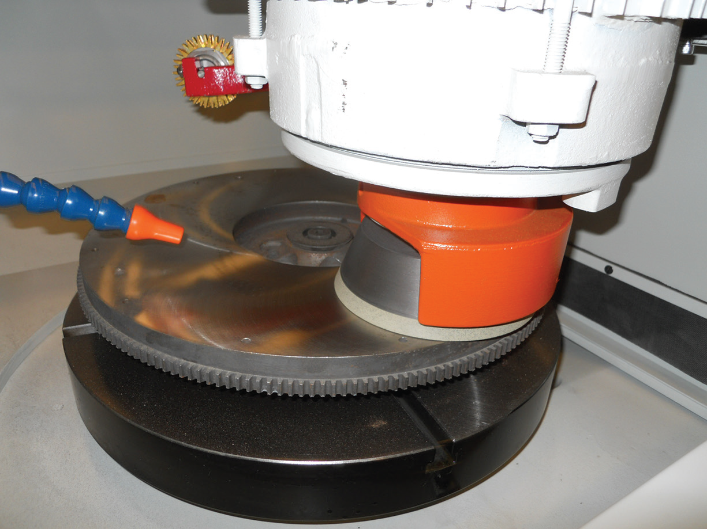
FIGURE 4–12 A flywheel being machined (ground) to provide the correct surface finish for the replacement clutch disc.

Slide 13
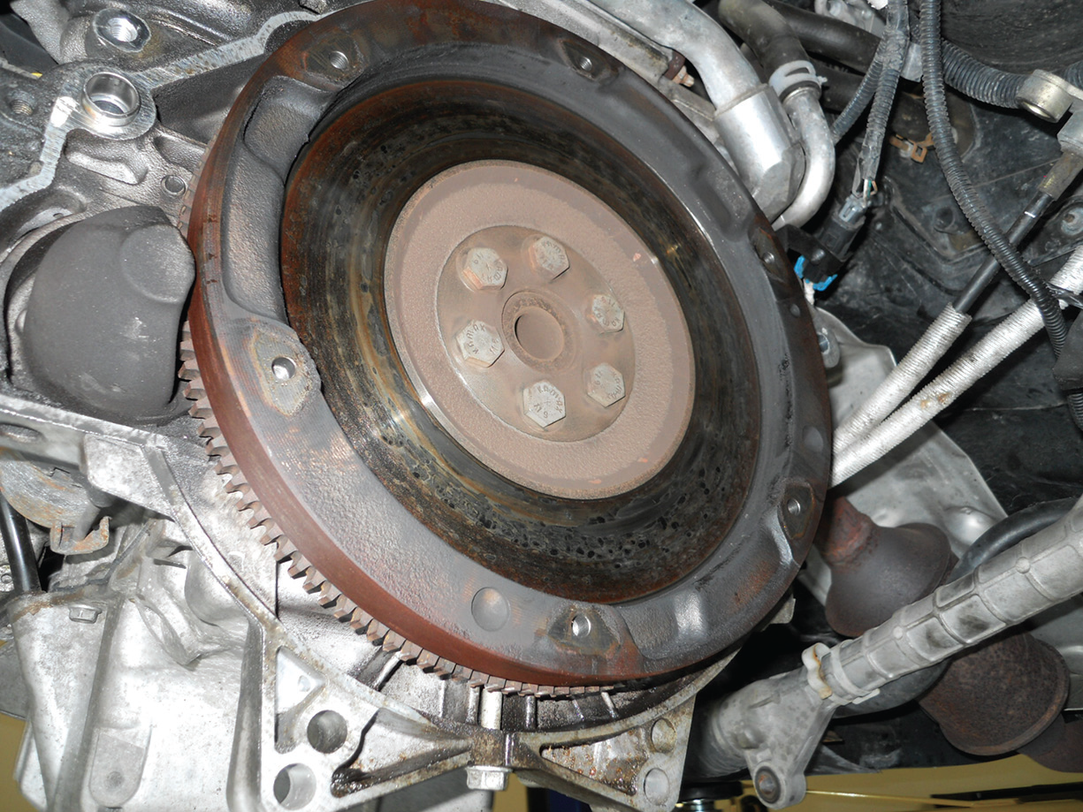
Figure 4–13 A stepped flywheel has more mass on the outer edge which helps smooth out the impulses from a four-cylinder engine especially at idle speed

Slide 14
Dual-mass flywheel
The starter ring gear mounts on the primary flywheel.
Power from the starter motor does not have to flow through the damper assembly to reach the engine crankshaft.
The pilot bearing is also attached to the primary flywheel.
The clutch friction surface is usually on the secondary flywheel.

Slide 15
Figure 4–14 A dual-mass wheel consists of two flywheels connected between with a spring to help absorb engine pulsations

Slide 16
Pilot Bearings
The engine end of a transmission input (clutch) shaft is supported by a pilot bearing that is pressed into the end of the crankshaft.
Need for a pilot bearing
Construction: How can pilot bearings be constructed?
How do pilot bearings operate?

Slide 17
FIGURE 4–16 Pilot bearings (bushings) are made in several different designs depending on the application.

Slide 18
Clutch Pedal Linkage
The clutch pedal linkage…
  Transfers the force the driver exerts on the clutch pedal to the release bearing.
What are the types of clutch linkage?

Slide 19
FIGURE 4–19 The actuator cylinder of some systems is concentric to the transmission input bearing retainer. When the clutch pedal is depressed, pressurized fluid is forced from the clutch master cylinder to the actuator cylinder to release the clutch.
Actuator Cylinder

Slide 20
Release (Throwout) Bearings
Operation of the release bearing:
  Presses against the diaphragm spring fingers or coil spring levers
  Takes spring force off the pressure plate so that it no longer clamps the friction disc against the flywheel
Constant-running:
  The release bearing outer race constantly turns at engine crankshaft speed
What are the types of release bearings?

Slide 21
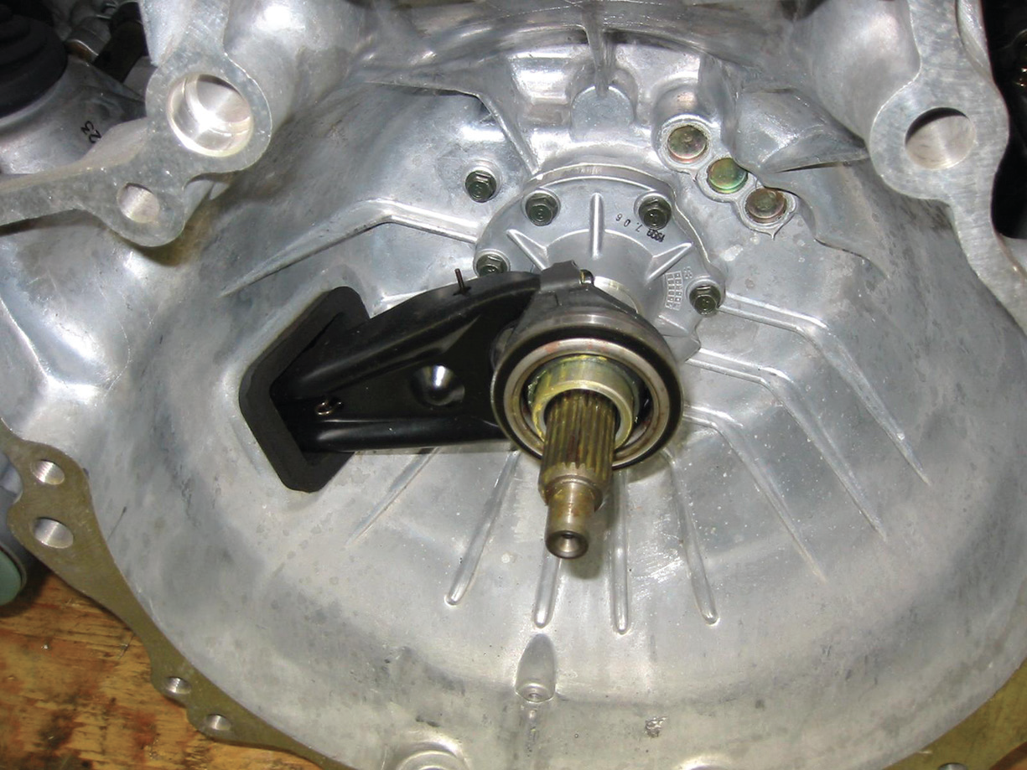
Figure 4–20 (a) A release (throwout) bearing on a transmission that uses a clutch fork and a mechanical or cable operated linkage.

Slide 22
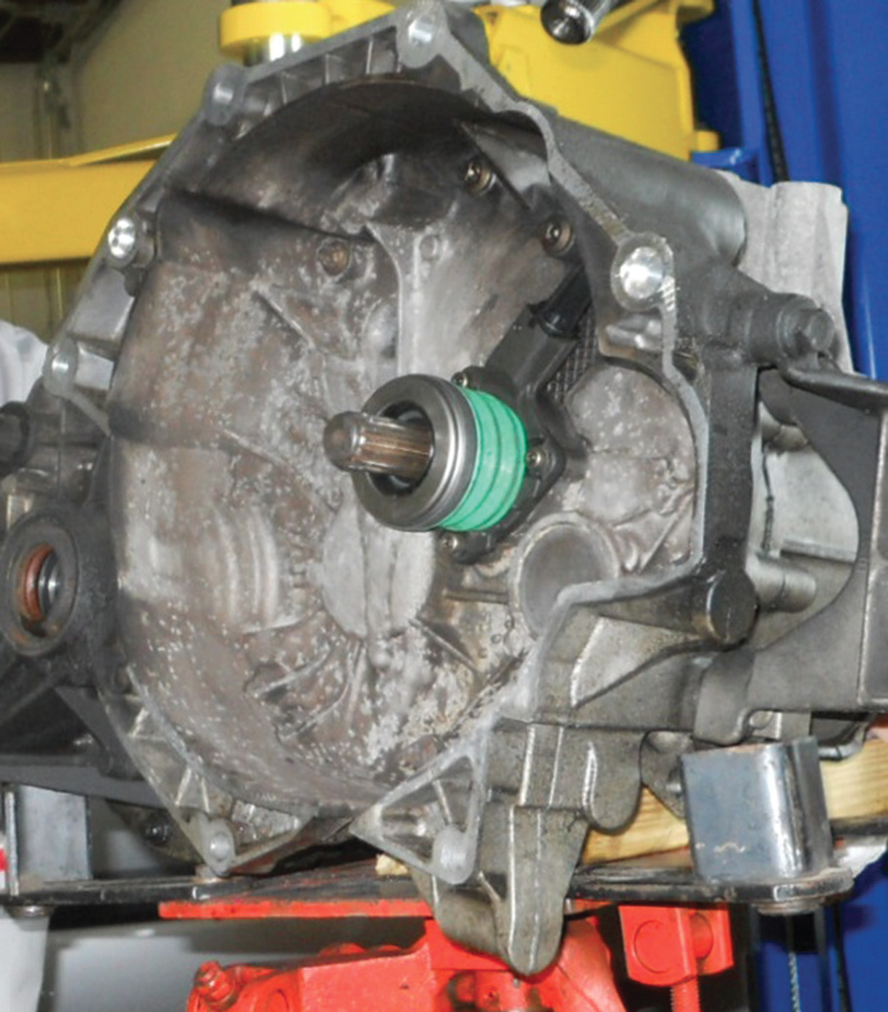
Figure 4–20 (b) A style of release bearing that includes the actuator cylinder, sometimes called a concentric actuator cylinder.

Slide 23
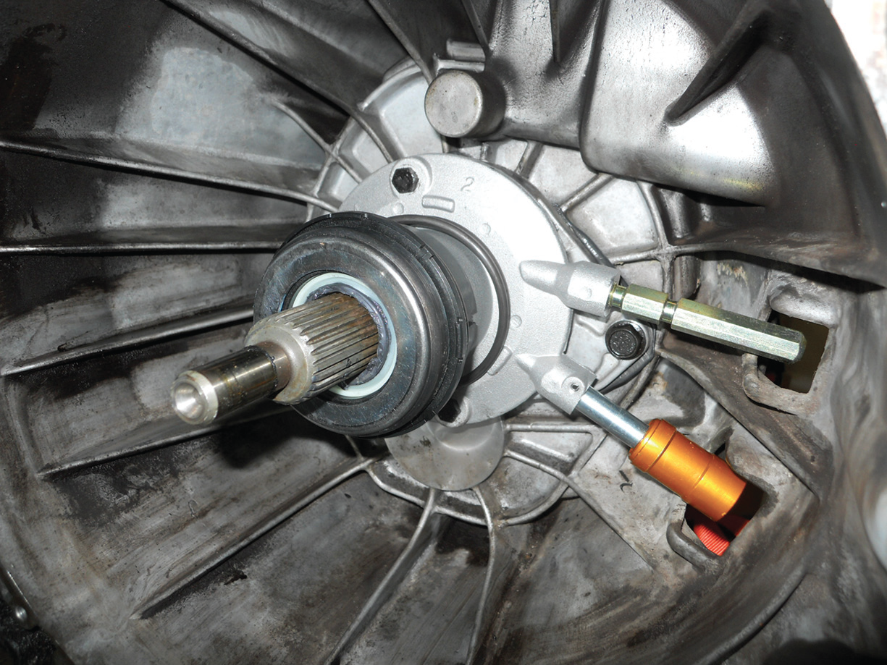
Figure 4–20 (c) A combination release bearing and actuator cylinder showing the two hydraulic lines. The lower line is from the master clutch cylinder and the upper line is used to bleed air from the hydraulic system

Slide 24
Clutch Pedal Switch
A clutch pedal switch…
  Signals the starter circuit that the clutch is released which prevents starter operation unless the clutch pedal is depressed.
Notes:
FIGURE 4–21 To prevent the engine from cranking, an
electrical switch is usually installed to open the circuit
between the ignition switch and the starter solenoid. When the
clutch pedal is depressed, the switch closes and completes
the circuit to the starter.

Slide 25
Summary (1 of 2)
The purpose and function of a clutch and clutch disc.
The clutch assembly includes the flywheel, clutch disc, release (throwout) bearing, and pressure plate.
The four basic purposes of the engine flywheel services.

Slide 26
Summary (2 of 2)
The clutch pedal linkage transfers the force the driver exerts on the clutch pedal to the release bearing.

