Slide 1

Automotive Technology Principles, Diagnosis, and Service
Sixth Edition
Chapter 93
Electric and Plug-In Hybrid Electric Vehicles
Copyright © 2018, 2015, 2011 Pearson Education, Inc. All Rights Reserved

Slide 2
LEARNING OBJECTIVES
93.1 Identify a plug-in hybrid electric vehicle (PHEV) and explain how the high-voltage battery is recharged.
93.2 Discuss the battery capacity and range correlation of an EV.
93.3 Describe the levels of chargers used to charge a PHEV or an EV.

Slide 3
PLUG-IN HYBRID ELECTRIC VEHICLES (1 OF 3)
Principles
  A plug-in hybrid electric vehicle (PHEV) is a vehicle that is designed to be plugged into an electrical outlet at night to charge the batteries.
Identifying a PHEV
  different badges (usually stating that it is a PHEV)
  an electrical connection door and a door for fuel for the ICE

Slide 4
PLUG-IN HYBRID ELECTRIC VEHICLES (2 OF 3)
PHEV Battery Capacity
  Battery capacity is measured in kilowatt-hours, abbreviated kWh.
  The higher the kWh rating of the battery, the more electrical energy it can store and the greater the distance it can travel before recharging.
PHEV Examples
  Toyota Prius has a 1.3 kWh battery pack
  A Plug-In Prius has a 4.4 kWh battery

Slide 5
PLUG-IN HYBRID ELECTRIC VEHICLES (3 OF 3)
Charging a PHEV
  The ICE is used to keep the battery charged enough to propel the vehicle, but it does not fully recharge the battery pack.
  To fully charge the high-voltage battery pack in a PHEV requires that it be plugged into either a 120-volt or a 240-volt outlet.

Slide 6
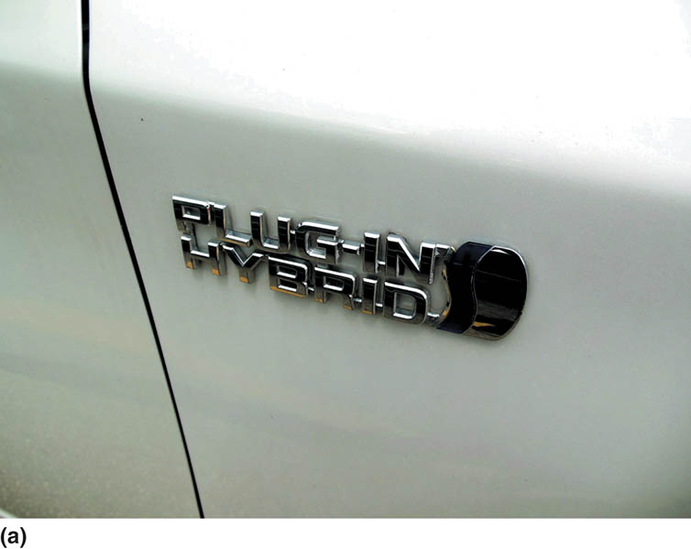
Figure 93.1 (a) About the only way to tell a plug-in Prius from a regular Prius is from the badge on the sides

Slide 7

Figure 93.1 (b) by the charge port door on the passenger side at the rear

Slide 8
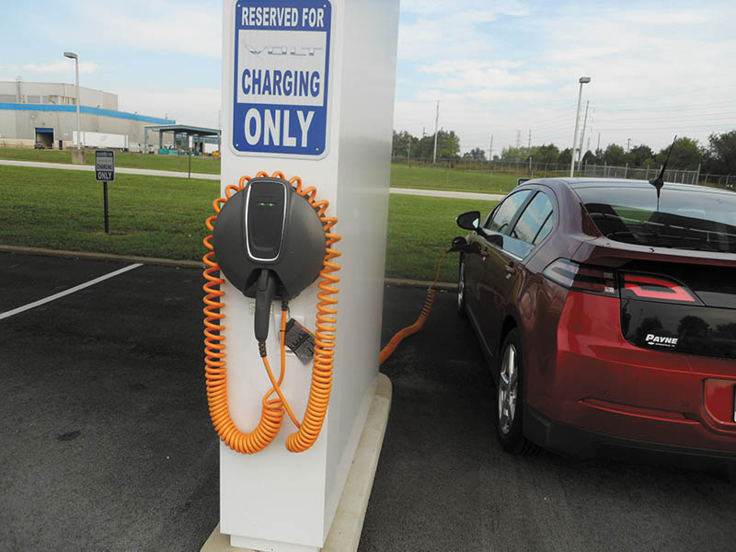
Figure 93.2 A Chevrolet Volt extended-range electric vehicle (EREV), also called a plug-in hybrid electric vehicle (PHEV), being charged at a row of charging stations at the Corvette assembly plant in Bowling Green, KY

Slide 9
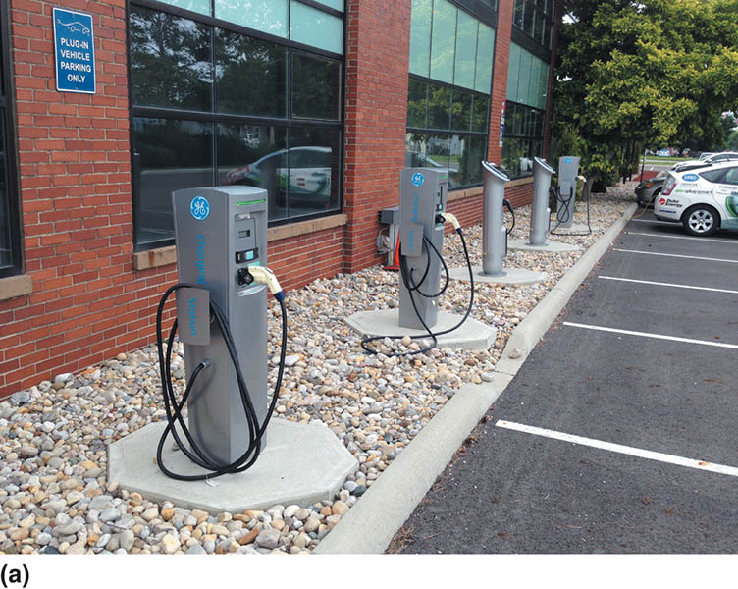
Figure 93.3 (a) Charging stations that are equipped with SAE standard J1772 chargers are often found at large companies, colleges, universities, and shopping malls in many parts of the country

Slide 10
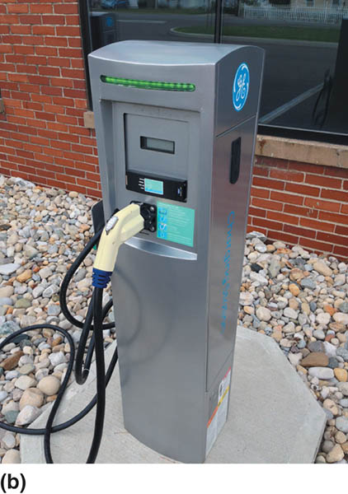
Figure 93.3 (b) A typical SAE J1772 charging station that is in a designated electric vehicle parking location, which is often in a premiere location to encourage use of electric and plug-in electric vehicles

Slide 11
QUESTION 1: ?
What is the difference between a HEV and a PHEV?

Slide 12
ANSWER 1:
The PHEV is plugged into the grid to charge the battery.

Slide 13
ELECTRIC VEHICLES (1 OF 3)
Principles
  An electric vehicle (EV) uses a high-voltage battery pack to supply electrical energy to an electric motor(s) to propel the vehicle under all driving conditions.
Cold Weather Concerns
  Cold weather is a major disadvantage to the use of EVs because it reduces the battery efficiency. Power is also consumed to heat the passenger compartment and the battery.

Slide 14
ELECTRIC VEHICLES (2 OF 3)
Hot Weather Concerns
  Batteries do not function well at high temperatures, and, therefore, some type of battery cooling must be added to the vehicle to allow for maximum battery performance.
Range
  The range of an EV depends on many factors, including:
  Vehicle weight, battery energy storage capacity, outside temperature, terrain, and use of electrical devices.

Slide 15
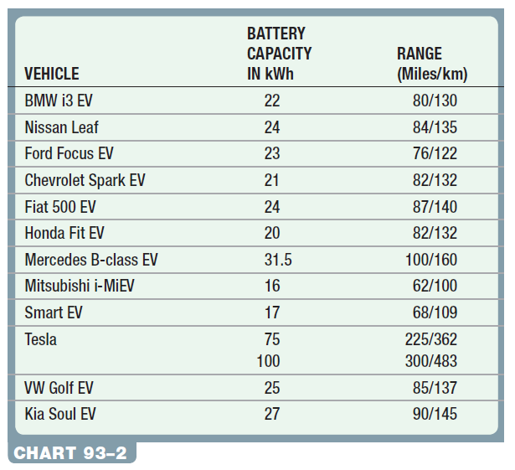
ELECTRIC VEHICLES (3 OF 3)
Battery Capacity and Range Examples

Slide 16
QUESTION 2: ?
What factors effect the range of an electric vehicle?

Slide 17
ANSWER 2:
  Vehicle weight, battery energy storage capacity, outside temperature, terrain, and use of electrical devices.

Slide 18
ELECTRIC VEHICLE CHARGING
SAE Standard Charger Plug
  Most EVs and PHEVs, such as the Chevrolet Volt and Toyota Prius, use a standard charger plug. The standard charger plug meets the specification as designated by SAE standard J1772 (updated in 2009)
Charging Levels
  Level 1—Level 1 uses 110- to 120-volt standard electric outlet (20-amp circuit).
  Level 2—Level 2 chargers use 220 to 240 volts to charge the vehicle.
  Level 3—Level 3 charging stations use 440 volts and can charge most electric vehicles to 80% charge in less than 30 minutes.

Slide 19
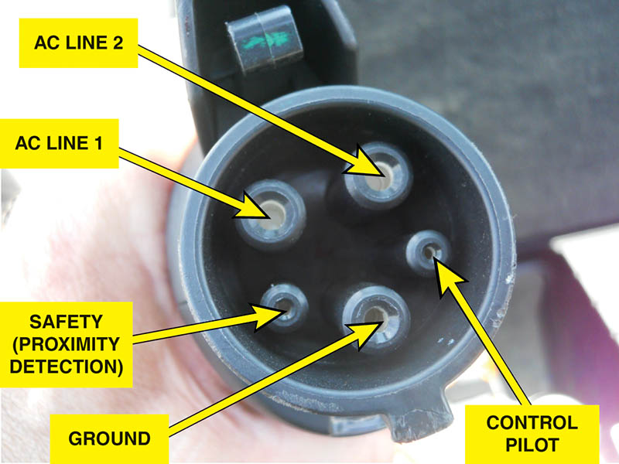
Figure 93.4 The SAE J1772 plug is used on most electric and plug-in hybrid electric vehicles and is designed to work with Level 1 (110–120 volt) and Level 2 (220–240 volt) charging

Slide 20
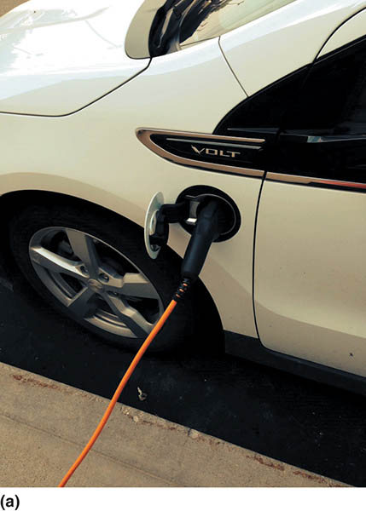
Figure 93.5 (a) A Chevrolet Volt being charged using the supplied 110-volt charger

Slide 21
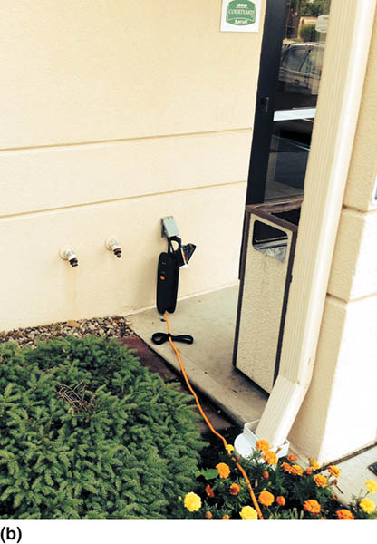
Figure 93.5 (b) Always lay out the entire length of the charging cord before plugging the vehicle into the outlet. e cord is not kept straight, the current flow can not only create a coil, but the flow of current can overheat the wires and, in some cases, can actually cause the insulation to melt

Slide 22
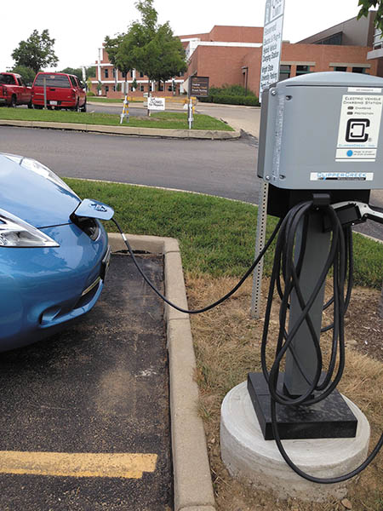
Figure 93.6 A Nissan Leaf plugged into a charging station at a college

Slide 23
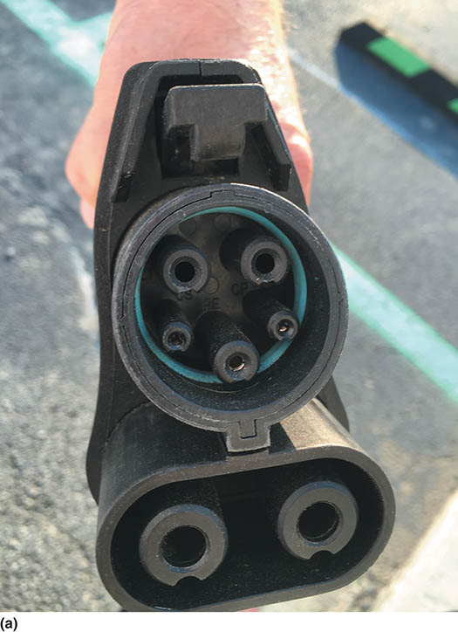
Figure 93.7 (a) An SAE combo plug that includes the J-1776 design at the top for level 1 and level 2 charging, with the added two large terminals that are used to charge using high-voltage DC

Slide 24
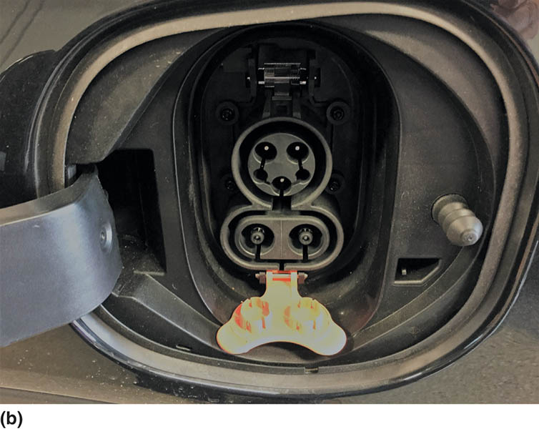
Figure 93.7 (b) A Chevrolet Bolt electrical charging terminal. The orange plastic tab can be pivoted to cover the level 3 terminals if a level 1 or 2 is being used

Slide 25
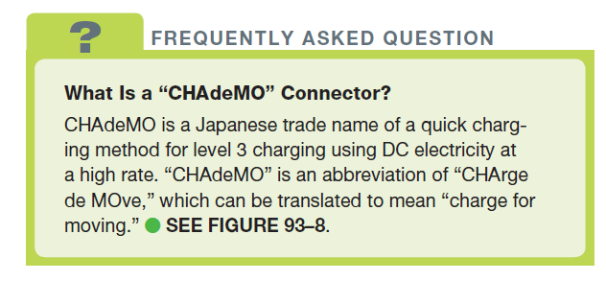
FREQUENTLY ASKED QUESTION

Slide 26
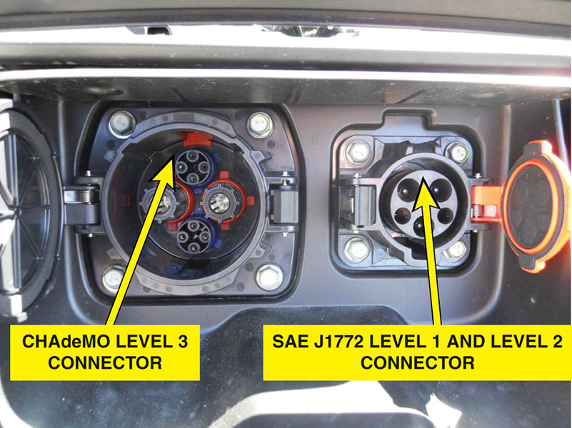
Figure 93.8 A Nissan Leaf electric vehicle charging ports located at the front of the vehicle under a hinged door for easy access

Slide 27
QUESTION 3: ?
What are the differences between the level 1,2, and three chargers?

Slide 28
ANSWER 3:
The voltage level and the amount of time it takes to charge the battery.

Slide 29
Video Links (Internet Access Required)
Outlander PHEV bigger battery 19.5 kWh (time 2:51)
Outlander PHEV Battery Disassembly (time 15:35)
Mitsubishi Outlander PHEV – Technology (time 4:10)

Slide 30

Copyright

